Slide 1


What is ATLAB?
ATLAB (ATLAS Technology Lab) is a centralized platform or interface to facilitate technology exchange with external (industrial) partners outside the Collaboration, across different ATLAS Upgrades and R&D projects, by obtaining complementary funding, e.g. from the EU
ATLAB offers external partners an integrated test environment for new technology products and ideas
ATLAB has methods to scan the market potential for new concepts and ideas, in close collaboration with CERN
ATLAB is a technology-market meeting point (show-case)
ATLAB is seeking for new partners related to its Upgrade R&D efforts

Slide 2
Exec Summary
Wanting to know what industry thinks of PP and technology transfer.
An active network of 22 Nodes
  Active events programme
  Interacts with other academic disciplines & industry
Delivering Society Impact
Sharing best practice around the network

Slide 3
Bipolar Roadmap
next generation (SBC18H4) is in final development stage ,Fmax=350Ghz , improved noise figure.
SiGe NPN on thick film SOI under development.

Slide 4
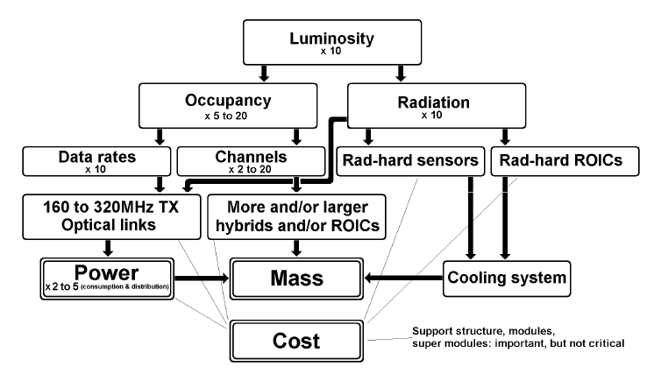
Summary - ID Challenges at HL-LHC
DCS
Services
Tracking Performance
Layout
Trigger
For Phase 2 HL-LHC (after 2022) we still have some time to make R&D effort for improving the detector design and performance – Clear development program is essential
4

Slide 5
Direct DUV Silicon Based Camera
Durability
High Power
Dynamic Range
Ultra High Speed
DUV / EUV
High QE
High QE & Low Noise
10nm (Design Rule)

Slide 6
Topics of interest
High-resolution systems
Optical fields
Simulations
Light sources
Detectors & sensors
Nanometer-scale structures

Slide 7

Conclusion
Pixel sensors in several technologies proved to high doses (planar/3D/diamond shown to 2×10¹⁶n_{eq}/cm²)
Pixel sizes need to shrink to cope with high occupancy and can do so with 65 nm CMOS
Test structures in 65nm have been studied after irradiation
Larger area sensors produced on 150mm diameter wafers with several foundries
Application space for these technologies growing rapidly
THANK YOU

Slide 8
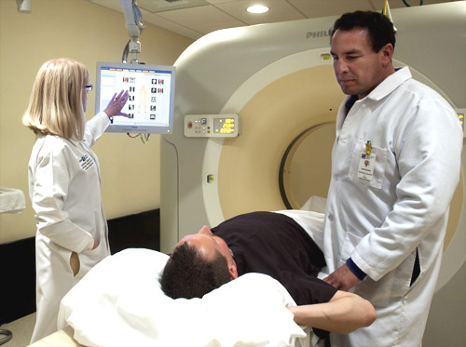
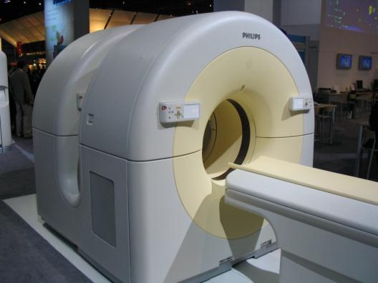
Detector-Based Innovations in Medical Imaging (CT and PET)
INGENUITY CT
TOF PET CT
Ami Altman, PhD, Philips Science Fellow & Scientific Director
Oren Zarchin, PhD, Director Spectral CT and Detectors Lab
Global Research & Advanced Development
CT Business Unit, PHILIPS Healthcare

Slide 9
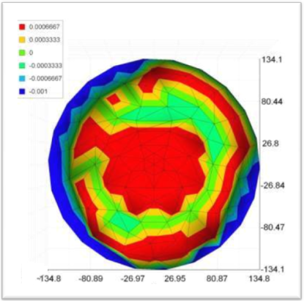
Extreme Tolerances & Geometrical Shapes
  Tolerances: ±1µm
  Surface Finish: 0.05µm N2
  Flatness: ±1µm/Ø300mm
  Parallelism: ±1µm
  Polish: Optical Polish λ/4

Slide 10
Summary
Low mass, fine pitch PCB for tracker
  Flex and rigid
  Aluminum
“Standard” PCB for high speed application
  Controlled impedances
  Low loss material welcome
Large size PCB and flex for the MPGC

Slide 11
Summary
We will have to develop two main types of converters
  Relatively high power to be used in the outer parts of the detector with moderate radiation and magnetic fields
  POL low power to be used also in places with very high radiation and magnetic fields
The first type could be fully industrial
  We could/would help for the radiation hardness qualification
The second type is to be based on a custom radiation hard ASIC and an air-core inductor
  Production of 10,000’s modules needed

Slide 12
Agenda
About Orbotech
PCB Automated Optical Inspection
PCB Automated Optical Repair
PCB Additive Manufacturing

