Slide 1

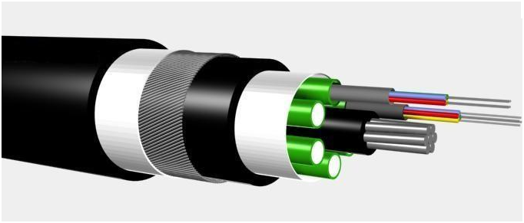
Steve McMahon
STFC- RAL - UK
Developments for Optical Transmission at CERN
Common Technological Projects between CERN and Israel
Meeting in Weizmann Institute
Sunday March 3rd to Tuesday March 5th 2013

Slide 2
Contents
Introduction and a single slide overview of the problem
What makes this particular problem special/interesting
The Versatile Link collaboration (Versatile link = Baseline Solution)
Link architecture
The GBTX (including status in 2013)
Front End Transceivers
Properties of transmitters under irradiation
Choice of p-i-n diodes and radiation
Transmission test results and BER measured in PSI test beam
Passive components
OFF detector considerations and solutions
Conclusions
BACK—UP
  Power budget
  Radiation damage to fibres

Slide 3
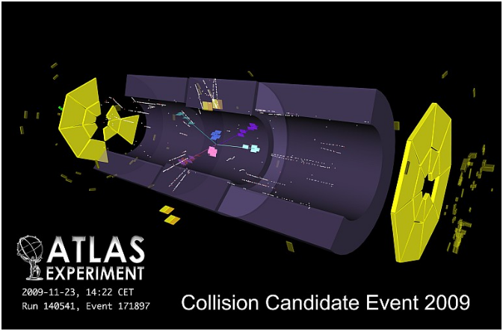
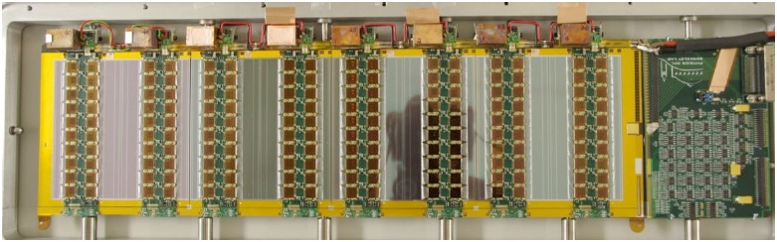
A schematic overview of the problem
Illustrated here with one particular application of Tracking for the ATLAS Phase II upgrade
Recording physics events in p-p and HI collisions
Parameters
LHC bunch crossings 40Mhz
Write to disk at ~1kHz
Level 1 event rate 200 kHz
Problem is to get interesting data off the
detector for downstream processing,
filtering and eventual mass storage.
ATLAS Phase II Pixel
Area of silicon 8.2m²
# channel = 638 x 10⁶
Data rate 4.8 GBit/link/sec
# GigaBitLinks = 1100
ATLAS Phase II Strip Detector
Area of silicon 193m²
# channel = 74 x 10⁶
Data rate 4.8 GBit/link/sec
# GigaBitLinks = 2096
Cost of tracker ~ 130 M CHF
Installation in year 2022 / Build ~2016
Optical links transmit the “hit” information (DATA)
Optical links for Trigger Timing and Control (TTC)

Slide 4
ON detector: Key requirements
Data transmission rates of 4.8Gb/s
Requirements from multiple customers
  4 experiments with similar but subtly different requirements (even differences within 1 expt)
Minimal power consumption
  Reduce cooling requirements
Low mass
  Reduce multiple scattering of tracks from inactive material in tracker volumes (low Z)
Radiation tolerance
  Integrated luminosities up to 3,000 fb⁻¹
  Neutrons (bulk damage) 1.5 x 10¹⁵ 1 MeV neutron equivalent/cm²
  Ionizing radiation 500 kGy Si (includes a 1.5 safety factor)
Magnetic field
  Up to 4 Tesla. Non magnetic components
  Remove “cages” supplied by vendors
Operating temperature
  -20ºC to +40ºC, good properties under thermal cycle after irradiation.
Tolerant of
  Single event upset. SEU
Humidity
  operate in a dry nitrogen environment
Backward compatibility
  Existing systems
    1310nm EEL - SM fibres.
    850nm VCSEL - MM fibres
Space
  Very limited space on detector
Accessibility
  No possibility of maintenance, replacement or repair after a few years of operation
reliability, reliability, reliability
  Move away from custom and in house packaging

Slide 5




The Versatile Link Project
Common approach across the LHC experiments
  Reduce development cost
  Minimal modifications to existing commercial solutions
    Benefit from extensive reliability testing in industry
  4 Work-packages
    Point to Point architecture and system engineering
    Front end components (Versatile Transceiver)
    Back End Components (COTs, off detector components)
    Passive components
https://espace.cern.ch/project-versatile-link/public/default.aspx
Disclaimer : I am not a member of the VL project

Slide 6
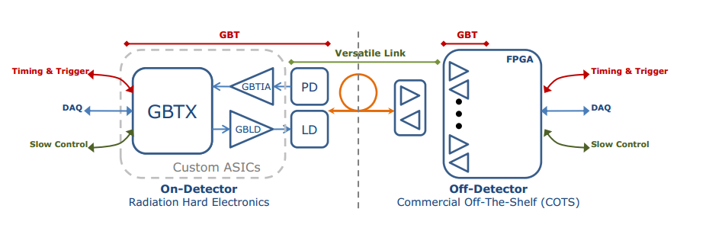
Radiation Hard Optical Link Architecture
Bi-directional : GBTX=SERDES
GBT : GigaBit Transceiver
GBT family includes : GBTX, GBTIA, GBLD
Implemented in commercial 130nm technology

Slide 7
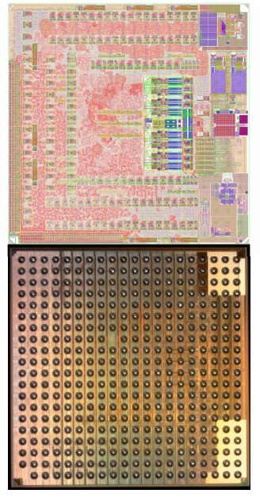
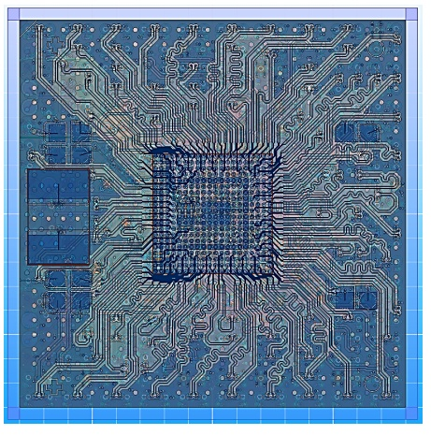
GBT Status in 2013
GBTX
Designed at CERN, submitted last year
0.5M gates all in TMR program registers (SEU)
160 x ASICs available since Dec 2012
Option to buy 240 more in 2013
Verification stage
Packaging
20 x 20 BGA (0.8mm pitch)
designed and packed by ASE
Package design complete
About to start
Tooling development
Substrate manufacture
Availability
available to test in May 2013
testing for 6 months

Slide 8
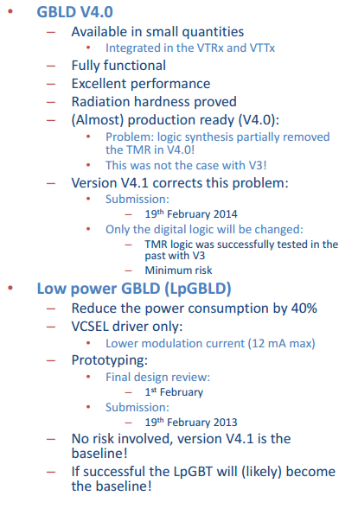
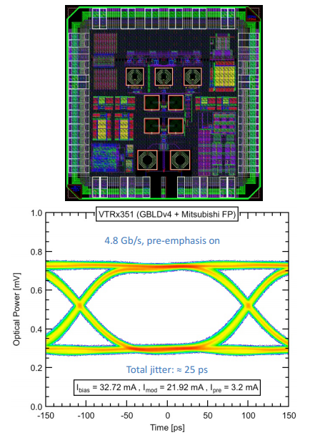
GBLD Architecture & Status

Slide 9
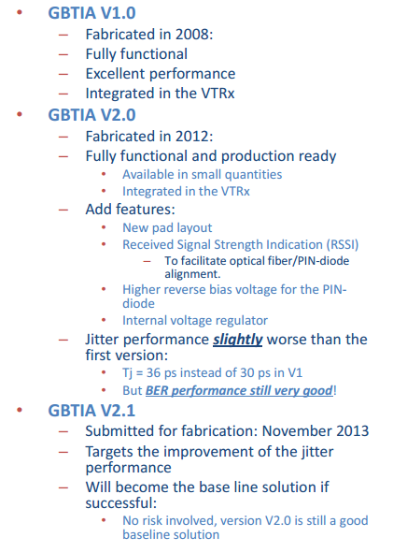
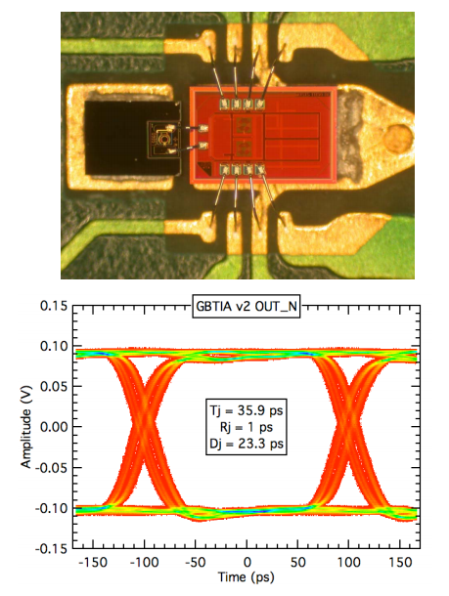
GBTIA Architecture & Status

Slide 10
Front-end Transceiver: VTRx (CERN)
Adapt commercial SFP+ Transceiver, produced.
  Low mass, small & non-magnetic
  Radiation-tolerant
Two versions
  850nm MM, & 1310nm SM
Tested
  -30C to +60C.
Bitrate 5 to 10 Gbps
  Depends on ASICs
Radiation-tolerant ASICs
  Laser Driver: GBLD
  p-i-n receiver: TIA/LA
EMI testing
  No indication of excess emissions
  Need to specify allowed levels & test with modules.
Prototype showing plastic housing for OSAs (2012)
And LC fibre connector and PCB with laser driver
The TIA is integrated into the ROSA.
Versions available for VCSEL and EEL
Picture of commercial package.
Concentrate on changes from commercial package (keep TOSA and ROSA)

Slide 11
GBLD Laser Driver
Eye Diagram for VCSEL
Laser driver for EEL & VCSELs
  Works at 4.8 Gb/s
  Meets all specs including
    Low jitter (~ 30 ps)
    Rise & fall times
    Eye opening
    Low noise
Power in mW vs Current in mA VCSELs or EEL
Eye Diagram for EEL

Slide 12
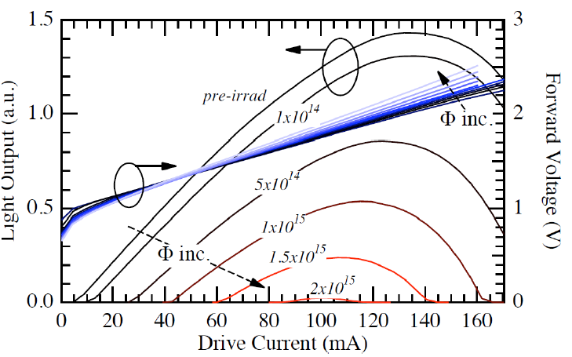
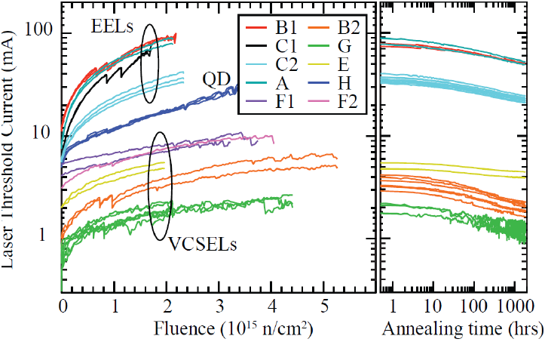
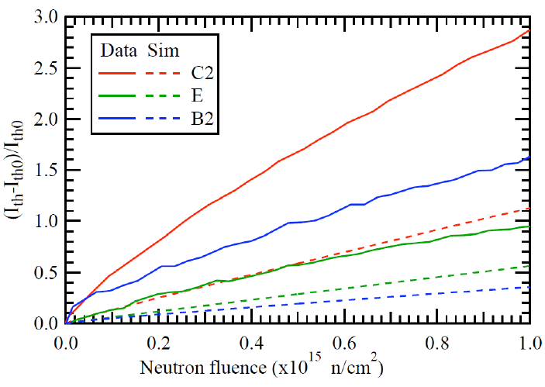
Laser Radiation Hardness
EEL
TL: change in VCSEL parameters for different dose
- in this case we are using 20MeV pions.
TR: change in threshold current (inset annealing)
BL: Fractional change in threshold current. Data
Taken at high dose scaled to operational value.
Taken at 1.5-3 x 10¹⁰ n/cm² scaled to 10⁷ n/cm^{2/sec}
C2 = EEL, E & B2 = VCSEL
Fractional change in threshold current

Slide 13
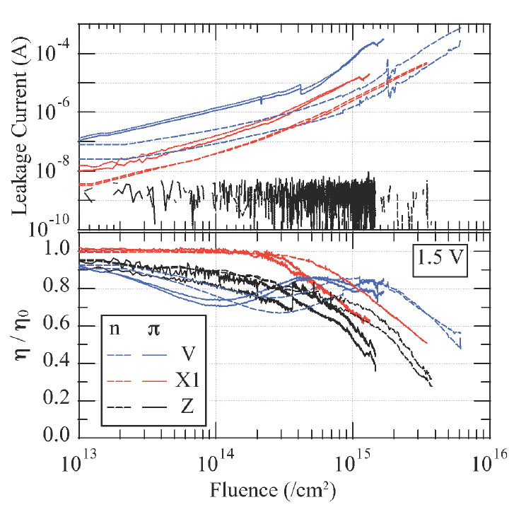
p-i-n Diode Radiation Hardness
Two effects of rad in p-i-n diodes
Increase in leakage current
Decrease in responsivety
Study GaAs and InGaAs
InGaAs shows better performance
for responsivity.
Device Z is GaAs
Devices V and X1 are InGaAs
These p-i-n dioes will be used for
both 850nm and 1310nm
Losses accounted for in power
budget covered below.

Slide 14
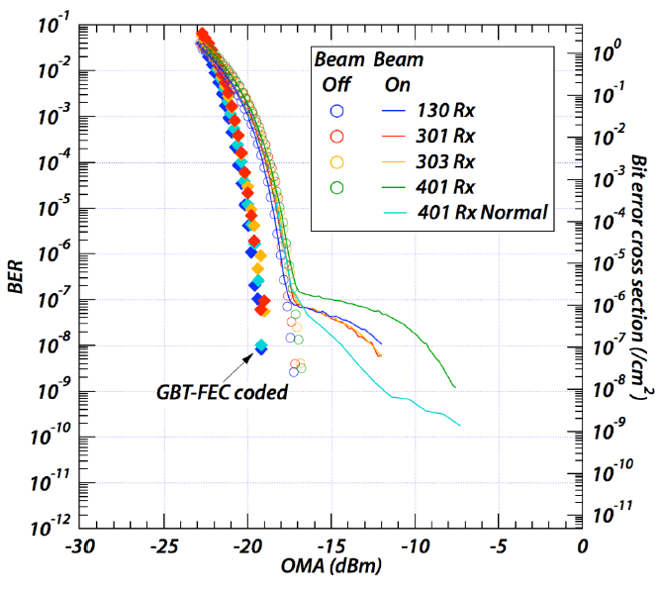
The effect of SEU as a function of OMA
Bit error rates measured at PSI
Beam On and Beam OFF
With and without error
Correction.
Bursts of errors up to 16
Bits long can be corrected.

Slide 15
Passive component issues
Passive Components
  Consists of Fibres, optical connectors, fibre cable & jackets
  For PON solution would also require qualification of optical couplers
  Qualification needs to be done for LHC environment (radiation and cooling)
  Here a strange thing!
  Cooling is bad. The radiation effects of cooled fibres is worse than at room temp
  Cooling suppresses the thermal annealing that takes place.
  Role of phosphor in fabrication is important
See 2 Pages
  Top Right plot
    radiation field (1/4 section) around end of detector
Radiation Induced Absorption measured at T ~ -25C:
  MM &(SM) fibres from 2 (3) vendors qualified
  eg Corning SMF28e+
  Losses for expected doses allowing for ATLAS routing computed and are small.

Slide 16
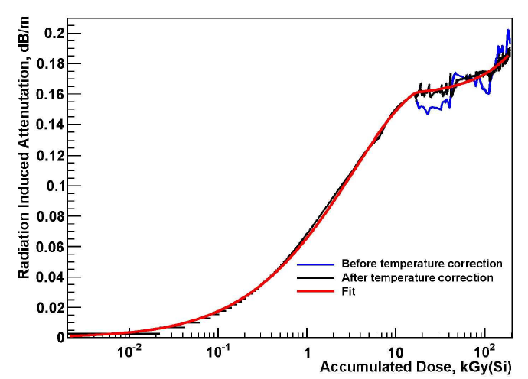
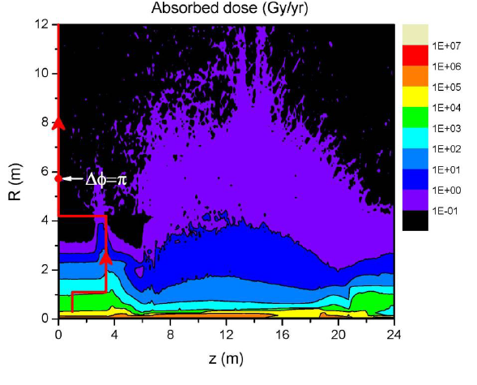
Passive components Radiation Hardness
Passive components include : fibres, connectors ...
RIA for Corning SMF-28e, T=-25ºC
Use ATLAS radiation maps to
calculate the full effect of radiation
along routing of fibre

Slide 17
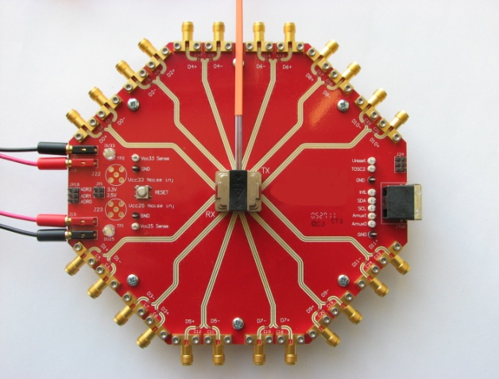
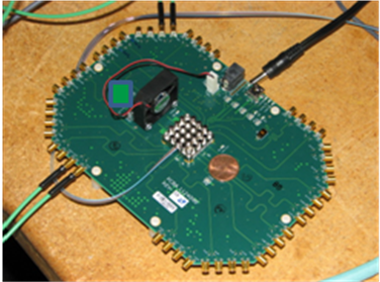
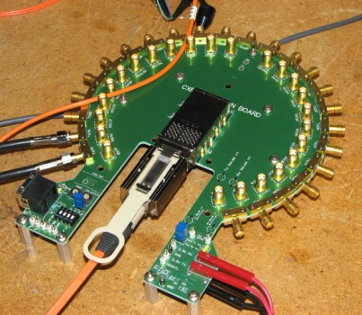
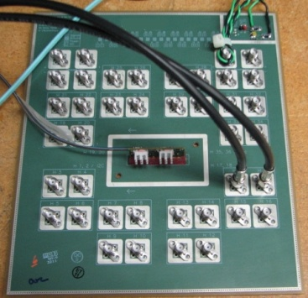
Parallel Optics Back End Component Testing
Requirements for off detector components are more relaxed
COTS is the solution
Products from 3 vendors have been tested
Packages vary for different device types
Card Edge Mountable
Mid Board Mountable
Five different products have been tested.
Different device types tested:
12 channel transceivers (4 samples tested)
12 channel transmitters (3 samples tested)
12 channel receivers (3 samples tested)
4 channel transceivers (2 samples tested)

Slide 18
Back End components
Where ever possible use off the shelf components and standards
First studies done on standard SFP+ transceivers, to define specifications (high density is a requirement)
Performance of devices shown in radar plot (each axis is a key requirements)
Do not have the same constraints as on detector components
2
Parallel Optics Transmitter Radar Plot
8
2
Measurement Norm
OMA -3.6 dBm*
Ext. Ratio 3.0 dB
Tx. Eye Opening 60% of OMA
Tx Rise Time 70 ps
Tx Fall Time 70 ps
Tx Total Jitter 0.25 of UI
Tx Deterministic Jitter 0.12 of UI
*Tracker Grade Spec
2
1.6
4
4.3
Move to back up

Slide 19
Summary & Outlook
Optical Transmission in the HL-LHC will be a challenging problem
The feasibility of the VL project has been demonstrated and is the baseline solution for many of the HL-LHC requirements.
Initial R&D is well advanced and a plan is mapped out for Phase II
  ON detector VTRx demonstrated, plastic parts need to be optimized & mass production developed.
  For the passive components reliability of fibre and cables after HL-LHC needs to be demonstrated. Candidate fibres have been selected based on the considerations shown including the ATLAS routing.
  For the backend work will continue to make sure that the TXs can satisfy the OMA specs

Slide 20
BACK UP SLIDES

Slide 21
Link Budget
Parameter | Multi Mode |  | Single Mode
 | VTx_Rx | Tx-VRx | VTx_Rx | Tx-VRx
 | DATA | TTC | DATA | TTC
Min TX OMA/ dBm | -5.2 | -1.6 | -5.2 | -3.6
Max RX Sensitivity/ dBm | -11.1 | -13.1 | -12.6 | -15.4
Power Budget /dB | 5.9 | 11.5 | 7.4 | 11.8
Fibre attenuation /dB | 0.6 | 0.6 | 0.1 | 0.1
Insertion loss / dB | 1.5 | 1.5 | 2.0 | 2.0
Link Penalties / dB | 1.0 | 1.0 | 1.5 | 1.5
TX radiation penalty /dB | 0 | - | 0 | -
RX radiation penalty / dB | - | 5.4 | - | 5.4
Fibre Radiation Penalty / dB | 1.0 | 1.0 | 1.0 | 1.0
Margin | 1.8 dB | 2.0 dB | 2.8 dB | 1.8 dB
TTC links are “down” links DATA links are “up” links, Optical power in dBm (relative to 1mW)
Stress down link pin damage.
Sufficient head room

Slide 22
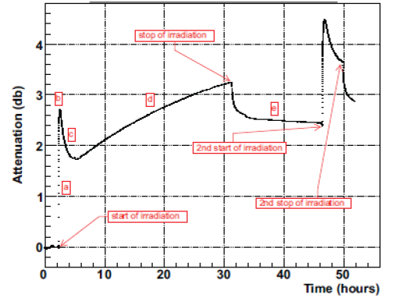
Attenuation history of a test fibre
Stop of irradiation
Start of 2nd irradiation
Stop of 2nd irradiation
Start of irradiation

