Slide 1
Common Technological Projects - CERN & Israel
Workshop at the Weizmann Institute March 3, 2013
Joel Seligson, KLA-Tencor (Israel) Corp.

Slide 2
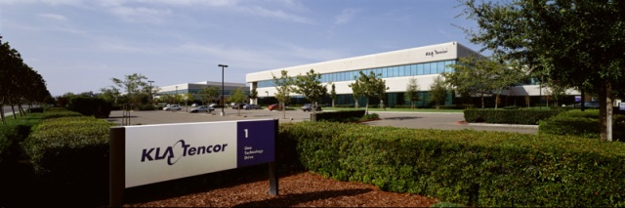
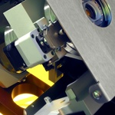
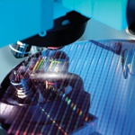
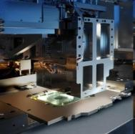
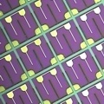
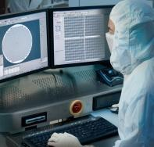
KLA-Tencor Overview
Global leader in yield acceleration since 1976
Installed base ~22,700 tools
> 5,800 employees
~ 3,870 technical personnel in 17
countries
>$1.5B R&D investments over last
4 years
FY 2012 Revenue $3.2 billion
KLA-Tencor Markets
Wafer
Metrology
Reticle
LED
Service/Apps
Notes:
Updated 10/2012

Slide 3
KLA-Tencor (Israel) Corporation
Founded in 1986
>450 employees in Migdal HaEmek & other sites
Develops and manufactures overlay metrology tools
A global manufacturing center for KLA-Tencor Corporation

Slide 4
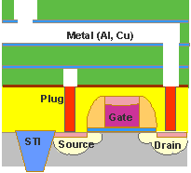
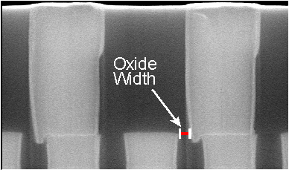
Overlay metrology - technological challenge
Measure lateral shifts to an accuracy of <1nm.
Optical measurements:
  Imaging-based
  Diffraction-based
Shrinking dimensions → Technology development

Slide 5
Topics of interest
High-resolution systems
Optical fields
Simulations
Light sources
Detectors & sensors
Nanometer-scale structures

Slide 6
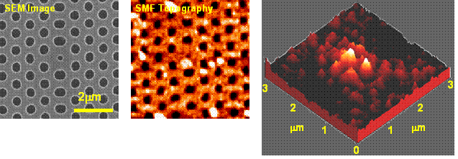
High-resolution systems
Standard methods:
  Increase numerical aperture
  Decrease wavelength
Non-standard methods
  Biological applications, e.g. STED
  Near-field imaging

Slide 7
Optical fields
Interference
Singular fields
Near-field interactions
Manipulation of complex amplitude, coherence

Slide 8
Simulations
Calculation of optical fields in complex geometries
Effects of sub-resolution features
Inverse problems
Efficiency of simulation algorithms (speed, memory)

Slide 9
Light sources
Thermal vs. coherent sources
  Luminance (brightness)
  Coherence
  Bandwidth
Short-wavelength sources
Pulsed sources

Slide 10
Detectors & sensors
Detector characteristics:
Spatial ↑ Mpixels <2Mp = standard
Spectral ↓ λ visible = standard
Temporal ↑ frame rate <100Hz = standard
Well depth (1/Noise) ↑ 20…30ke⁻ = standard
Cost - Fix $1k…3k = standard
Above have tradeoffs
We want no tradeoffs (“…and I want it now!”)

Slide 11
Nanometer-scale structures
Creating novel optical properties using nanometer-scale structures
Simulating nano-structure/optics interactions

