Slide 1
TowerJazz High Performance SiGe BiCMOS processes

Slide 2


Slide 3
Comprehensive Technology Portfolio
0.50
µm
0.35
µm
0.25
µm
0.18/0.16/0.152
µm
0.13
µm
0.13µm
BiCMOS, SiGe
SiGe
SiGe
SiGe
Power/BCD
BCD
BCD
Power/BCD
Image Sensor
(X-Ray & Visible)
Image Sensor
(X-Ray & Visible)
Image Sensor
(X-Ray & Visible)
eNVM
eNVM
RFCMOS
RFCMOS and SOI CMOS
RFCMOS and SOI CMOS
RFCMOS and SOI CMOS
Mixed-Signal
Digital CMOS
Mixed-Signal
Digital CMOS
Mixed-Signal
Digital CMOS
Mixed-Signal
Digital CMOS
Mixed-Signal
Digital CMOS
Notes:
3

Slide 4


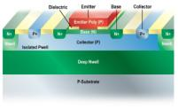
RF and HPA Applications and Technology
RF and Tuners
Front-End Modules
RF CMOS and SiGe BiCMOS
Cell Phone, WiFi TxRx
Basestation, Specialty Wireless
TV, Satellite, STB Tuners
SOI Switch and SiGe Power Amplifiers
Power Amplifiers
Antenna Switch
PA Controllers
mmWave
High Performance Analog
High Performance SiGe
Optical Fiber Networks
Automotive Radar
60 GHz WiFi, 24GHz Backhaul
Light Peak and Thunderbolt
GPS LNA
Complementary BiCMOS
Line Drivers DSL, HomePlug, ATE
HDD PreAmp
DAC, ADC
Best-in-class SiGe, RF CMOS, RF models and Design Enablement
4

Slide 5
Front-End Module Technology
Controller
SOI Switch
RF CMOS Controller Platform
5V, 0.18um optimized CMOS
Up to 50% die size shrink vs. 0.25um
1.8V Logic, Bipolar, LDMOS options
Platform for integration of FEM
Thin-Film SOI (best in class Ron-Coff)
Thick-Film SOI for ease of integration
5V control, LNA, PA/Driver options
Power Amplifier
Design Services and IP
SiGe PA, through-silicon-via (TSV), IPD
SiGe PA cells for WiFi and Cellular
TSV for low-inductance ground
1.8/3.3/5V CMOS, high res options
IPD (5um dual-Cu in development)
Models, design tools and IP
Example: PA Design Library (PADL)
Example: 4T, 6T, 9T SOI Switch IP
Analog / RF Design Services
Best-in-class SiGe, RF CMOS, RF models and Design Enablement
5

Slide 6
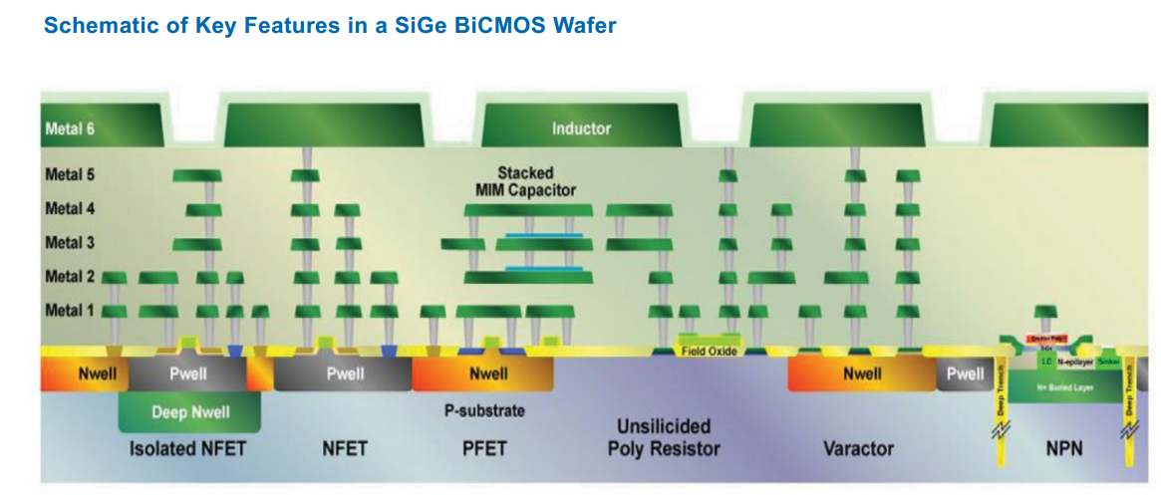
Schematic of Key Features in SiGe BiCMOS platform
The SiGe HBJTs are embedded into complimentary BiCMOS platforms offering high performance RF , analog and digital performances.

Slide 7
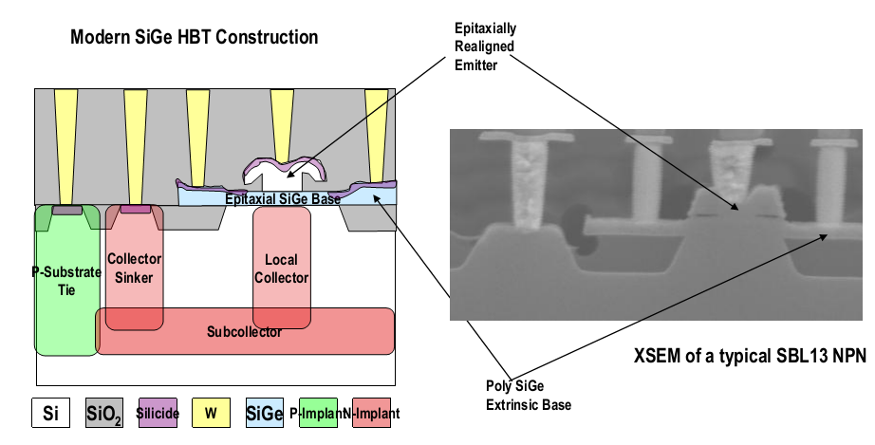
SiGe HBJT device structure
The high-performance bipolar transistors are built “vertically” meaning that the n-p-n structure is created perpendicularly from the top of the wafer down.

Slide 8
TowerJazz High Speed SiGe Processes
 |  | SBC18HA | SBC18H2 | SBC18H3 | SBC13HA | SBC13H3
Status |  | Prod. | Prod. | Proto. | Proto. | Devel.
CMOS | Voltages | 1.8/3.3V | 1.8/3.3V | 1.8/3.3V | 1.2/3.3V | 1.2/3.3V
HS Bipolar | F_{T} (GHz) | 150 | 200 | 240 | 200 | 240
 | F_{MAX} (GHz) | 190 | 200 | 270 | 200 | 270
 | BV_{CEO} (V) | 2.2 | 1.9 | 1.6 | 1.9 | 1.6
Capacitor | fF/µm² | 2.8/5.6 | 2/4 | 2.8/5.6 | 2.8/5.6 | 2.8/5.6
Varactor | Q at 20 GHz | 10 | NA | 15 | NA | 15
LPNP | Beta | 32 | 7 | 30 | 7 | 30
There are numerous other SBC18 flavors in production with variations in back end configuration, selection of available devices etc.
Presented data mainly from the SBC18H2/H3 flavors.

Slide 9
SiGe HBJT’s current and power gain
240 GHz Ft / 270 GHz Fmax devices in mass production.
High frequency performances sustained for wide collector current range.

Slide 10
SiGe HBJT’s gain vs DC power density
TowerJazz Devices are optimized for low power consumption.

Slide 11
SiGe HBJT’s Noise
SBC18H4 minimum noise figure at 20Ghz is measured less than 1dB and at 40GHz at only 2dB.
NFMIN is flat across various frequency ranges.

Slide 12
Circuit examples at ~100GHz: LNAs
SBC18H2
SBC18H3
SBC18H2
SBC18H3
Broad band mm-wave LNAs fabricated in SBC18H2 and SBC18H3
4 identical LNAs built for a 4-channel W-band phased-array receiver
Nearly 30dB of gain above noise floor at 85GHz
Almost perfect matching between LNAs

Slide 13
RF Grounding:
Deep Silicon Vias vs. Through Silicon Vias
Deep Silicon Vias
Through-Silicon Vias
Metal 1
Metal 1
emitter
collector
p- Epi
~10um
~150um
p++ handle wafer
~100um
Backside Metallization
Backside Metallization
Deep Silicon Vias and Through Silicon Vias are available for enhanced RF grounding.

Slide 14
Bipolar Roadmap
next generation (SBC18H4) is in final development stage ,Fmax=350Ghz , improved noise figure.
SiGe NPN on thick film SOI under development.

Slide 15
Summary
TowerJazz offer SiGe HBJT devices on 0.35µm, 0.18µm and 0.13µm technology nodes.
TowerJazz SiGe HBJT offers Best in class SiGe Speed / Power and Best in class Noise.
The SiGe HBJTs are embedded into complimentary BiCMOS platforms offering high performance RF, analog and digital performances.

Slide 17
Complete SBC18H3 Device Roster
Family | Device | Characteristics
CMOS | 1.8V CMOS | Model-exact copy of all other TJ 0.18um CMOS
 | 3.3V CMOS
Bipolar | HS NPN | 240 GHz F_{T} / 280 GHz F_{MAX}
 | STD NPN | 55GHz F_{T} / 3.2V BV_{CEO}
 | LPNP | β=35
Resistors | Poly | 235 Ω/sq and 1000 Ω/sq
 | Metal | 25 Ω/sq TiN on M3
Capacitors | Single MIM | 2 or 2.8 fF/µm²
 | Stacked MIM | 4 or 5.6 fF/µm²
Varactors | 1.8V MOS | Q @ 20GHz = 20
 | Hyper-abrupt junction | Q @ 20GHz =15, Tuning Ratio = 21%
RF Diodes | p-i-n | Isolation <-15dB, Insertion loss > -3.5dB at 50GHz
 | Schottky | F_{C} > 800 GHz

Slide 18
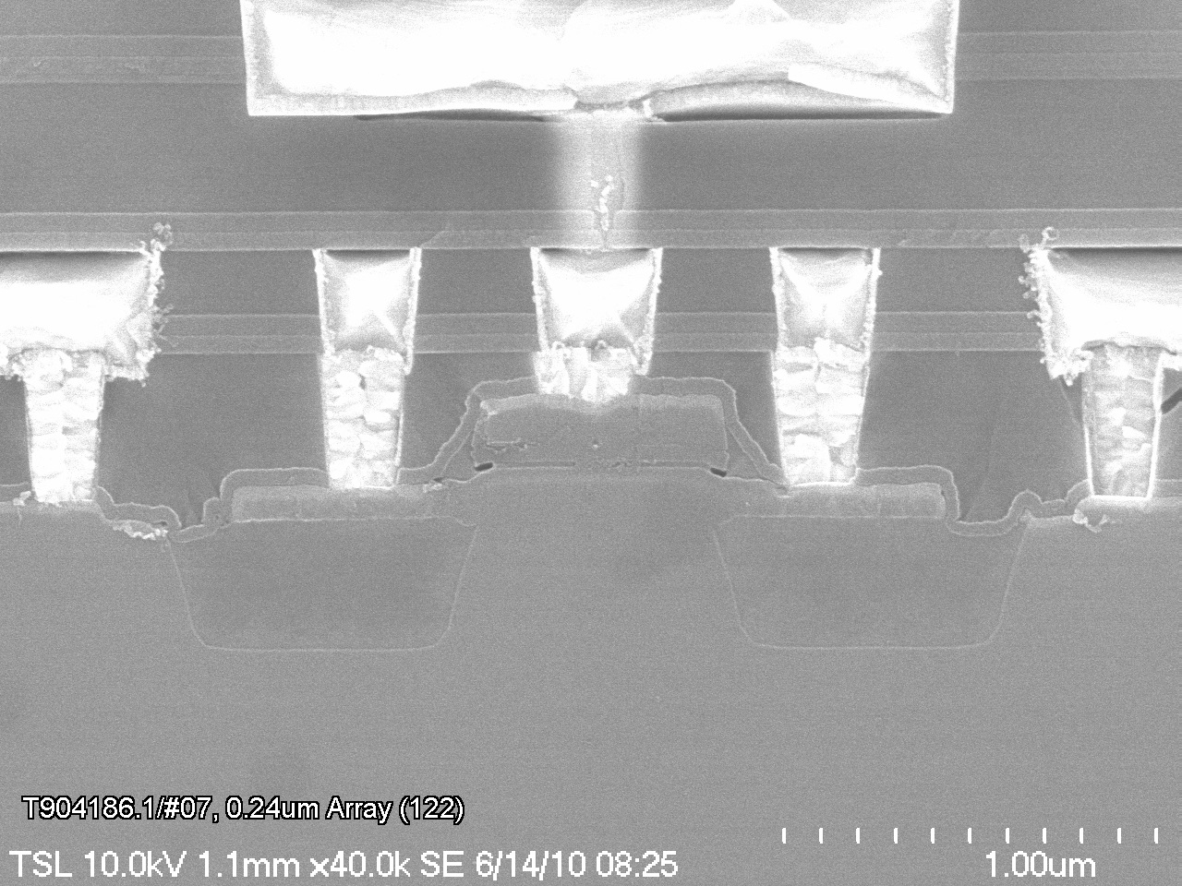
SiGe HBJT basic layout-122 configuration
SC
AREA2
BP
WN
XN
AA
AA, EP
EW
Collector
Base
Emitter
Base
Collector
Collector
Emitter Poly
Collector
Base
Emitter
Base
EW
N+ for Nsub
SiGe-Based layer
N+ for Nsub
STI
Emitter Poly
STI
SC Implant
WN
EW
WN
Native P-sub
N+ for Nsub
SiGe-Based layer
N+ for Nsub
STI
SC Implant
STI
WN
Native P-sub
WN

