Slide 1




Development and Needs for Silicon Tracker
D. Ferrère, University of Geneva
Workshop CERN-Israel
Common Technological Projects
March 3rd – 5th , 2013

Slide 2

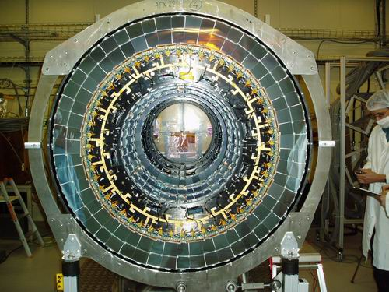
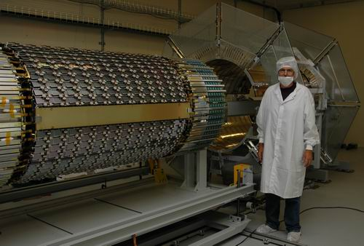
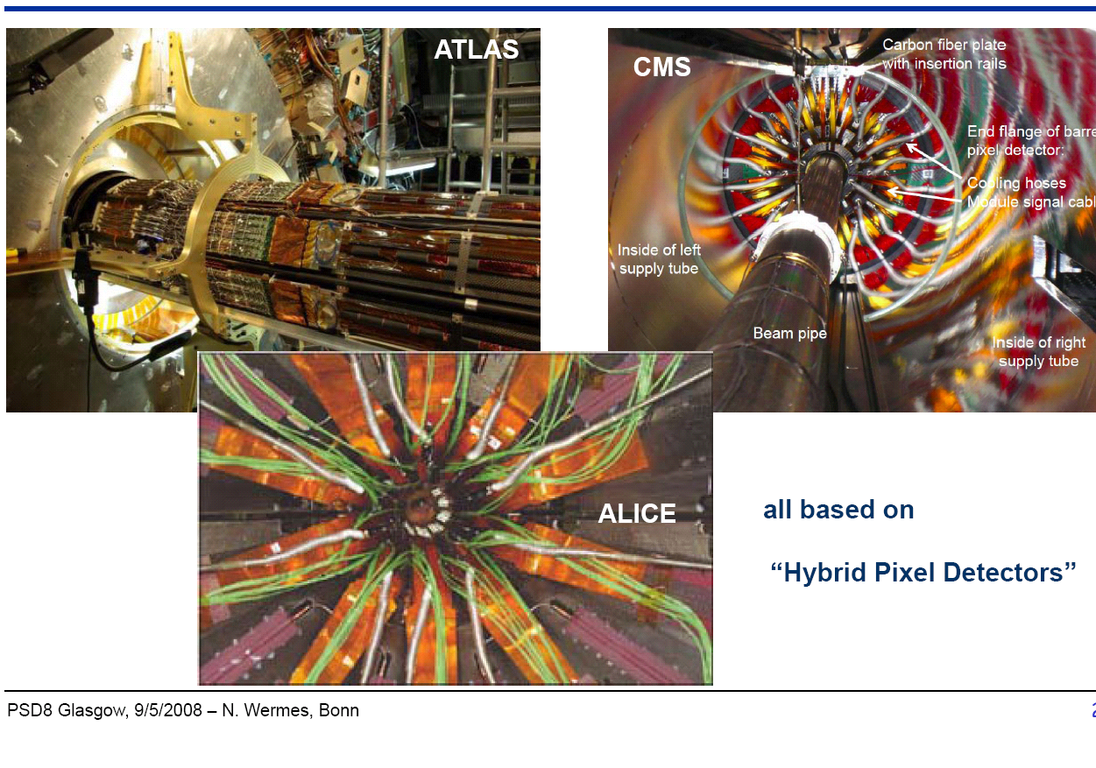
ATLAS – Silicon Inner Tracker
SCT EC at SR1
63 m2 of silicon installed today
→ more than 10 years of R&D, production, integration and installation
SCT barrel integration
4th “Trento” Workshop, D. Ferrère
Pixel Installation
2
2

Slide 3
Challenges for the Tracker and the Upgrades
Requirements for the physics performances:
Layout is essential for the tracking and the momentum resolution for |η| < 2.5
Trigger and RoI (Region of Interest) to be optimized
Granularity versus the detector occupancy to be optimized
Material budget to be light targeting 1.5 to 2% of X/X0 per track layer
Detector efficiency up to the targeted total luminosity (after significant radiation damages)
Detector stability (few microns within a day of operation)
Inputs for R&D and construction phases
Technical challenges:
Detector technology – Planar Si is well known but 3D, diamond, monolithic sensors are at various phases
Front-end electronics – Always trying to follow the sub-micron technology evolutions (250nm → 130nm → 65nm …)
Powering – Individual powering is highly consuming material therefore serial powering or DC-DC are investigated (experiencing it with R&D)
Module design and assembly on local support construction:
  Thermal management – Cooling and thermal runaway of the silicon to contain
  Sensor location accuracy and stability
  Stiffness, material budget, service integration and interconnection
Data transmission: electrical at high speed up to 320 Mbps and optical at more than 5Gbps
Global engineering: mechanical structures, cooling and services design and integration
Last but not least the construction cost!
3

Slide 4
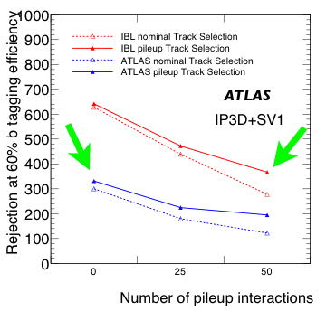
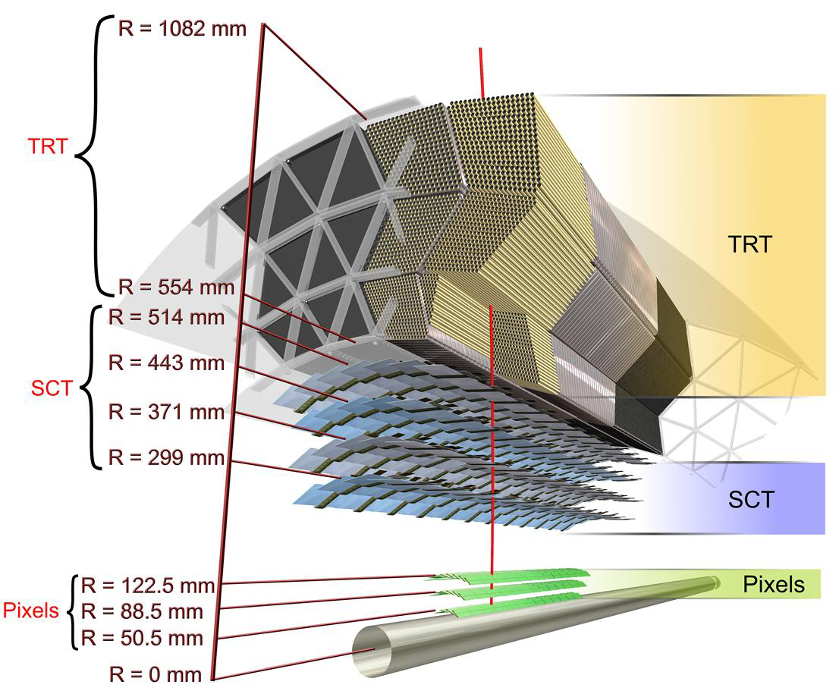
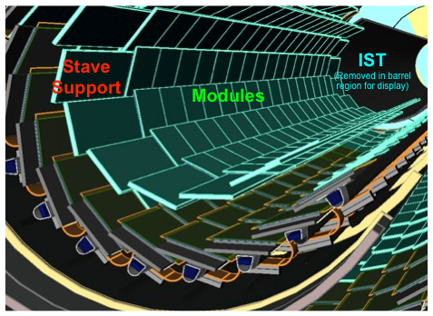
Insertable B-Layer (IBL) – Phase0 Upgrade
Features:
4th Pixel layer (instead of b-layer replacement)
Closer interaction point (5.05 → 3.27cm)
Smaller pixels (50 x 250 μm2)
Better sensors, better R/O chip
More robust tracking
Better performance
Under construction
Reduce beam pipe diameter (47 mm) in Beryllium already delivered
ATLAS Inner Detector sector
IBL
4

Slide 5
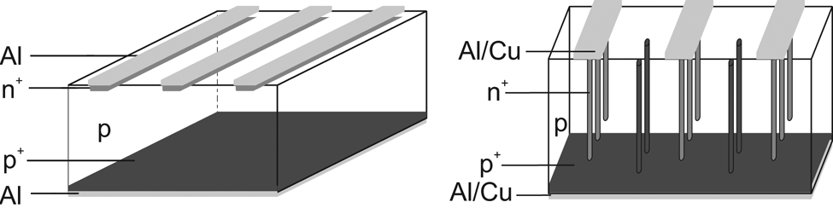
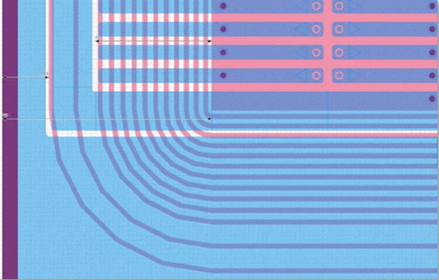
Silicon Technology
Planar sensor – n-in-n
Charges are collected at the strip surface
3D sensor
Charges are collected at the bulk implanted electrodes
n
Well known and used in all LHC trackers
Production now made for IBL and for the first time
Structure for IBL | Planar | 3D
Thickness (nominal) [μm] | 200 | 230
Depletion voltage [V] | ~35 | 10 - 25
Working voltage after LHC fluence (5x10¹⁵ 1MeV n_{eq}/cm²) [V] | ~1000 | ~160
Module width [μm] | 41325 | 20450
Active size WxL [mm²] | 16.8 x 40.9 | 16.8 x 20.0
5

Slide 6
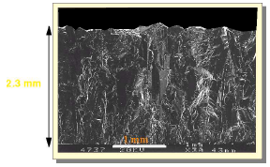
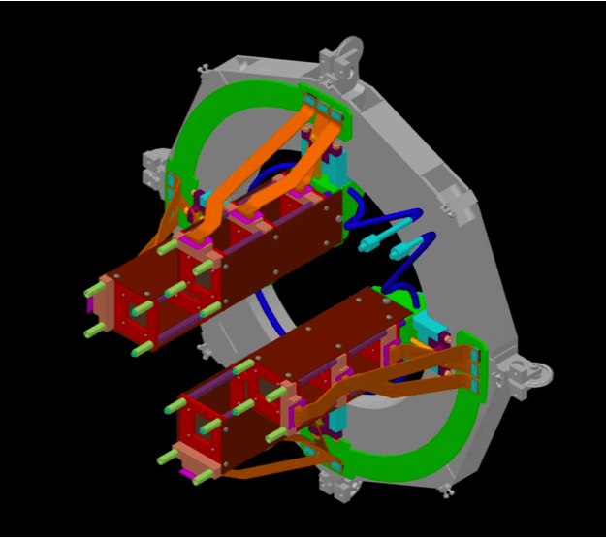
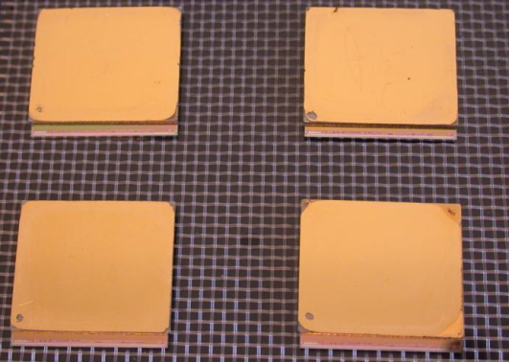
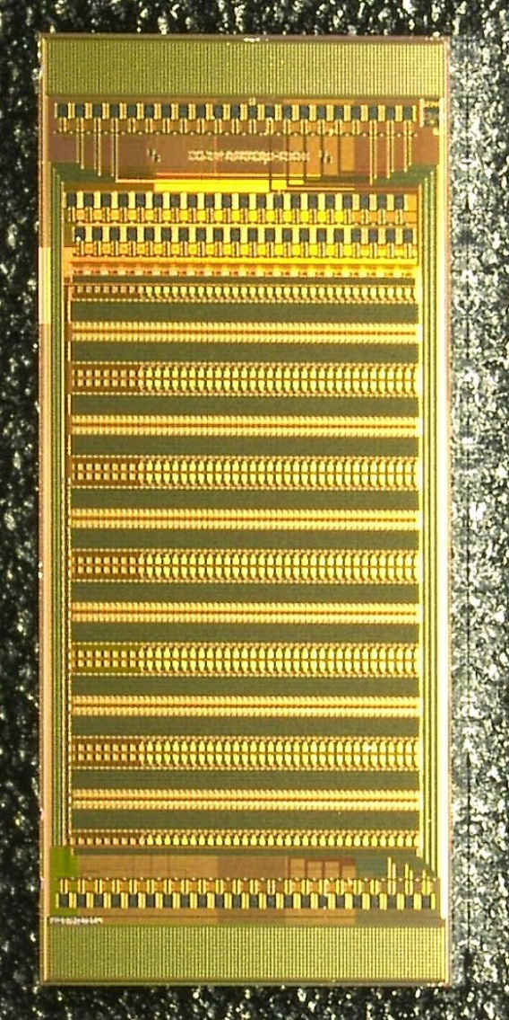
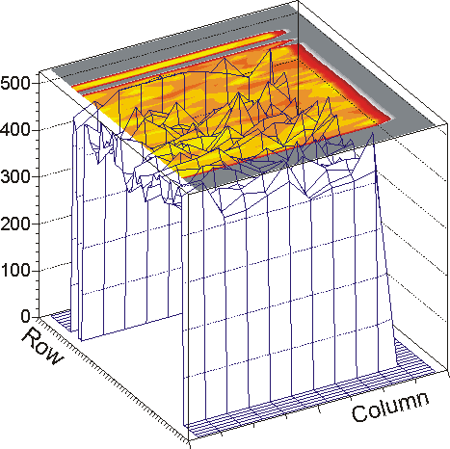
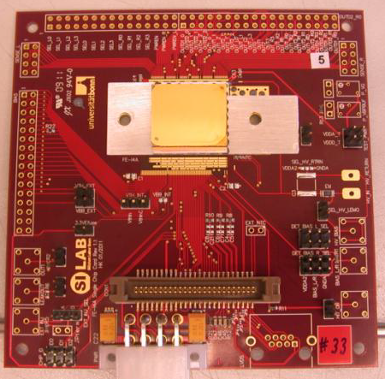
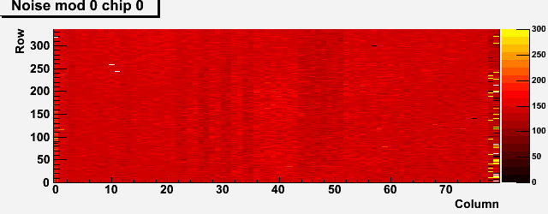
Other Technologies
Diamond
HV-CMOS
Features: Low noise, small I leak, no runaway
Features: Tunable charge amplification, Collection in
very limited depth (~15 μm)
pCVD
PMOS
NMOS
deep n-well
Depletion zone
Drift
Potential energy (e-)
~15µm
p-substrate
Application: DBM – Diamond Beam Monitor
Application: Very promising for Pixel and Strip Upgrade
DBM module group on nSQP
It can be implemented in any CMOS technology that has a deep-n-well surrounding low voltage p-wells
1st DBM modules with FEI4
HV22 FEI4 test chip for Pixel and strip
Module on test board
Results with CCPD FEI4 readout
Noise map of a DBM module
Challenge: Cost, industrialization to large scale
Challenge: New tech, thinning to 20-30μm
6

Slide 7
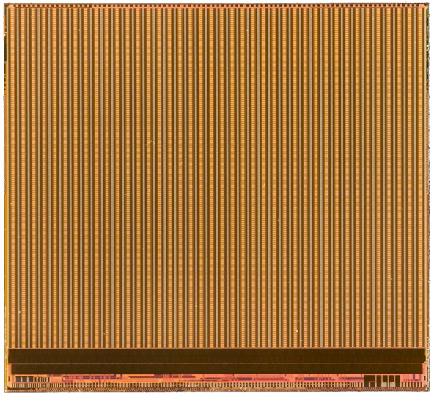
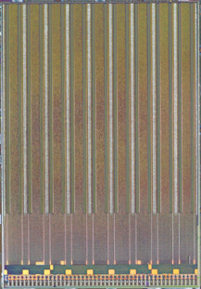
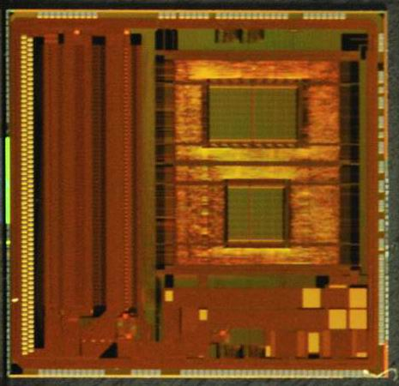
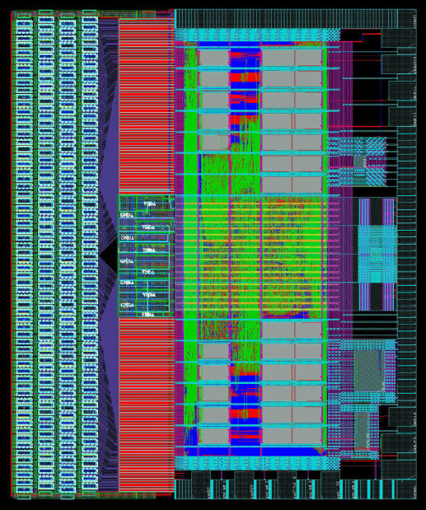
Front-end Electronics
20.2 mm
FEI4 main features:
IBM in 130 nm while FEI3 in 250nm
70 Million transistors
26880 pixels (50 x 250 μm2)
Lower noise than FE-I3 (~150e- with sensor)
Lower threshold operation
Higher rate compatibility
Radiation hard to >250Mrad
In use for pixel R&D and towards IBL and Upgrade phase 2
FEI4
7.6 mm
Pixel
FEI3
18.8 mm
11.1 mm
ABCN main features:
1st version in 250nm made for prototype investigation reusing r/o features of ABCD used on SCT
2nd version in 130nm is under design and submission expected at the beginning of 2013 together with a hybrid controller chip
Future features:
  256 r/o channels per FE distributing two strip rows
  2nd level trigger (R3 or L1) specifies LOID buffer memory index
  Fixed length readout block
  Powering compatibility for serial powering and high efficiency DC-DC
ABCN250
Strip
ABCN130
4 rows of 64 FE pads
7

Slide 8
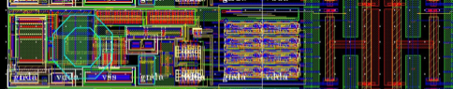
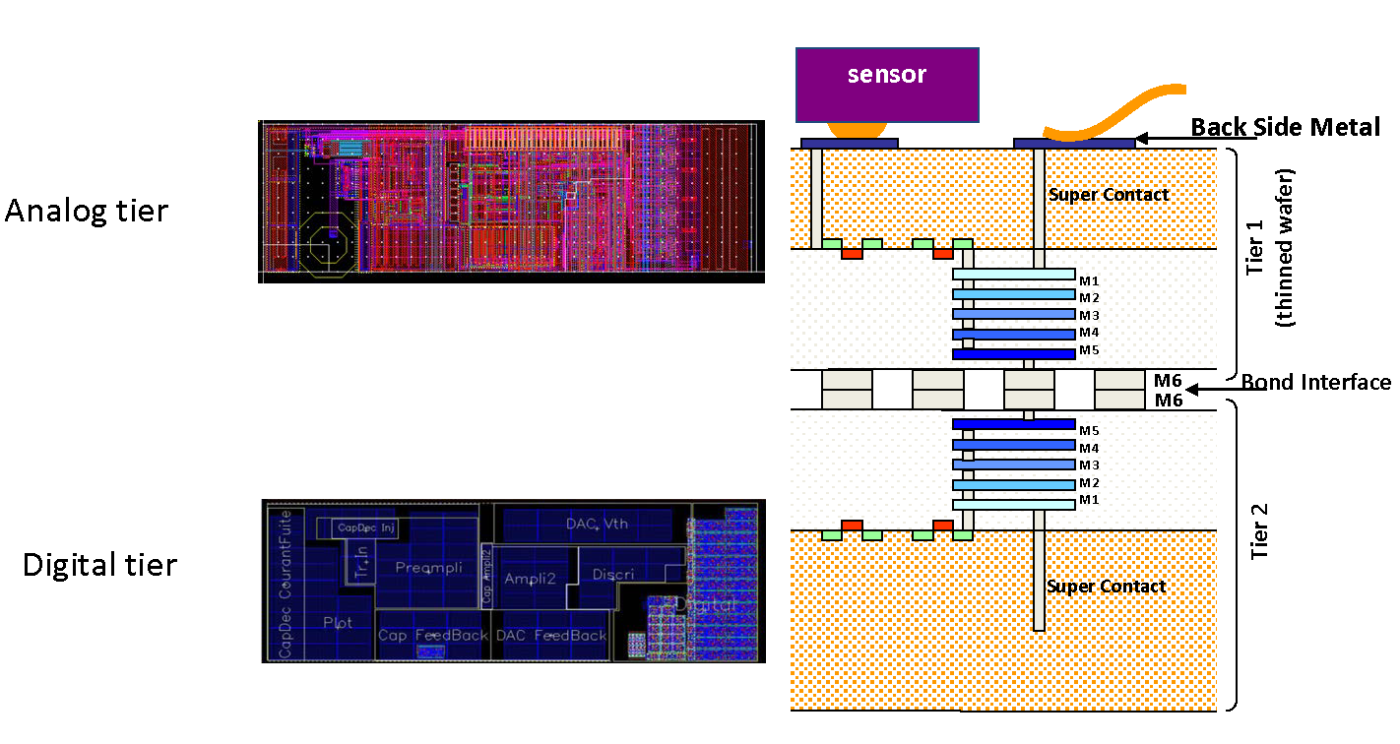
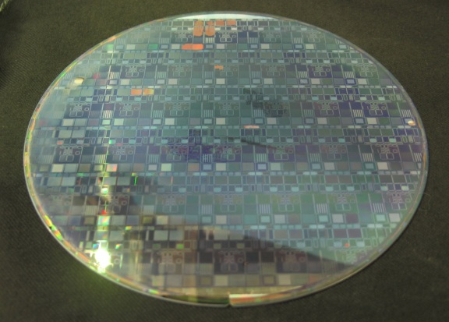
Front-end Electronics - Future
New R&D are investigated allowing to consider higher Pixel granularity
FE-X5 65nm CMOS technology (ATLAS Pixel Upgrade)
400 μm
50 μm
FE-I3 CMOS 250 nm
250 μm
Prototypes have been design and made to study radiation hardness and SEU tolerance
50 μm
FE-I4 CMOS 130 nm
125 μm
Triplication significantly improves the SEU tolerance
OK up to 250Mrad for chip functionality
New design is under work
25 μm
FE-I5 CMOS 65 nm
3D electronics – Vertical integration technique
FE-electronics: 3D 130nm pixel 50x125 µm
Analog tier is performing well after thinning Si to 10 μm
Communication between analog and digital tiers were established
Ultimate goal to include CMOS sensors in the analog tier
8

Slide 9
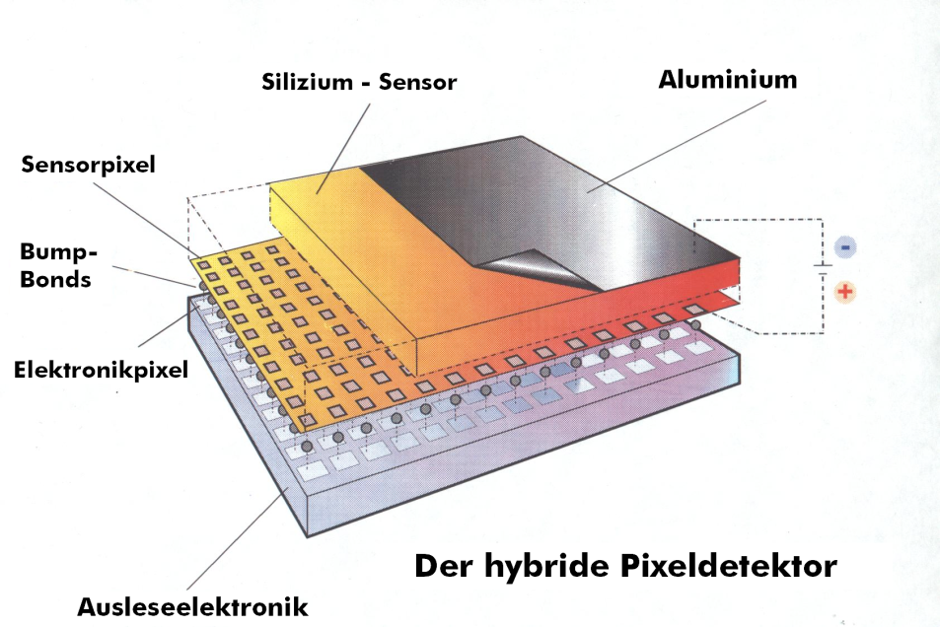
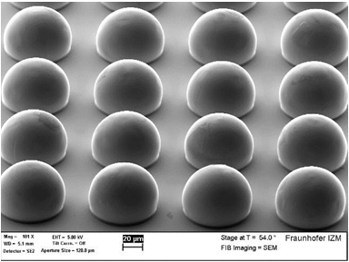
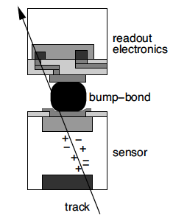
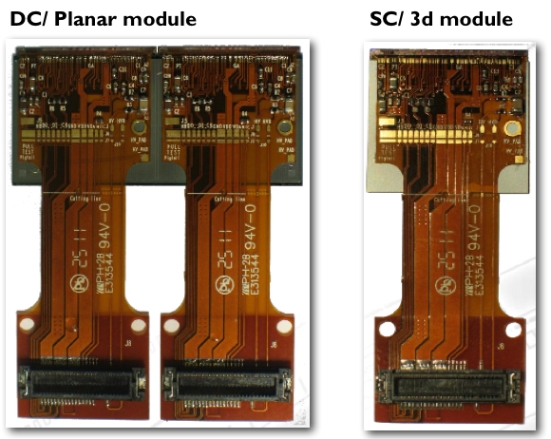
Pixel Modules Assembly
Hybrid Pixel Detector
Hybridization process very delicate and done by few companies:
UBM deposition (electroplating, evaporation,…)
IC mounted first on with a glass substrate to stiffen the assembled part (specially for thinned FE) + thinning down
Solder material deposition (SnPb, SnAg, In, AuSn, CuSn, …)
Chip and sensor dicing
Solder reflow
Removal of the glass substrate
Module to flex assembly usually done by Institutes or/and University:
Module flex production and SMD component population
Sensor to flex gluing
Wire bonding between the FE and the module flex
QA of the module including burn-in and thermal cycling
IBL modules
9

Slide 10
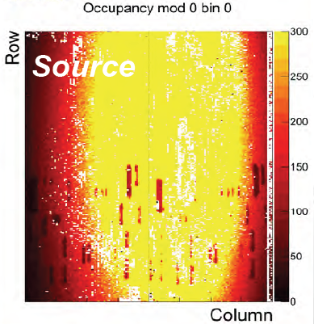
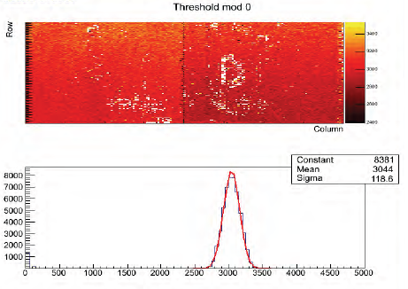
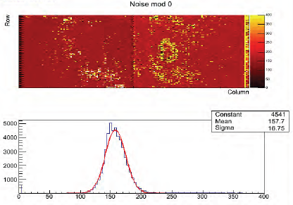
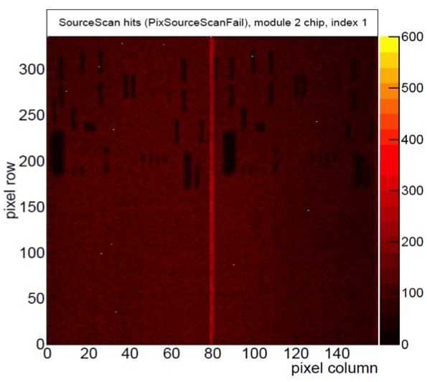
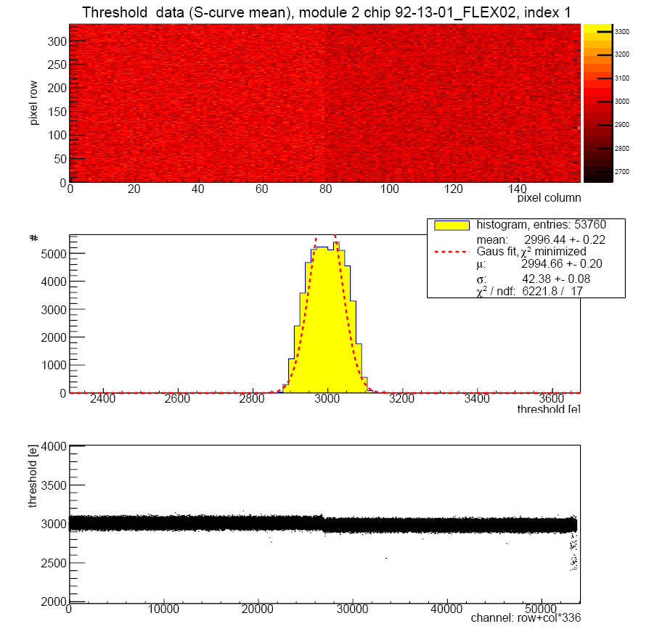
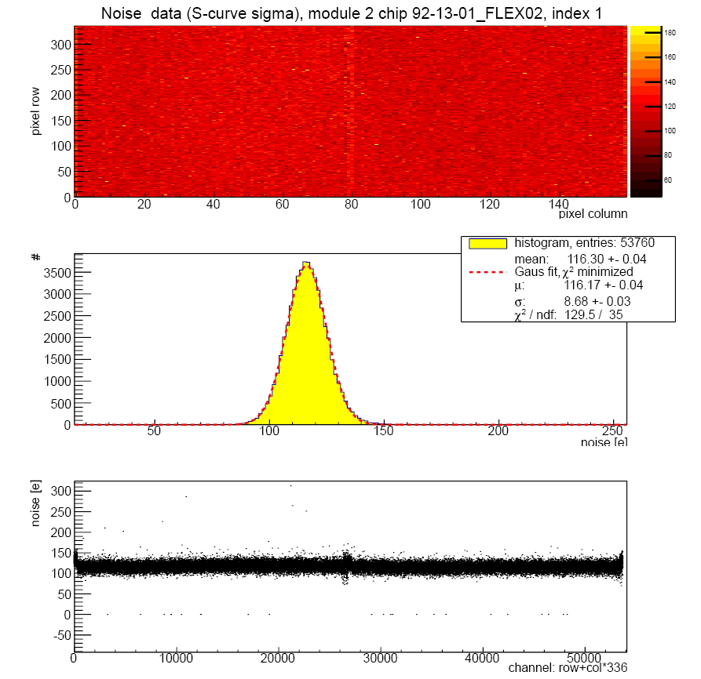
Pixel Modules Assembly – Con’t
QA is essential to trace the flip-chipping problems like merge or disconnected bumps
Unacceptable defects
Essential to survey the flip-chipping production and trace process quality
New batch after correction
10

Slide 11
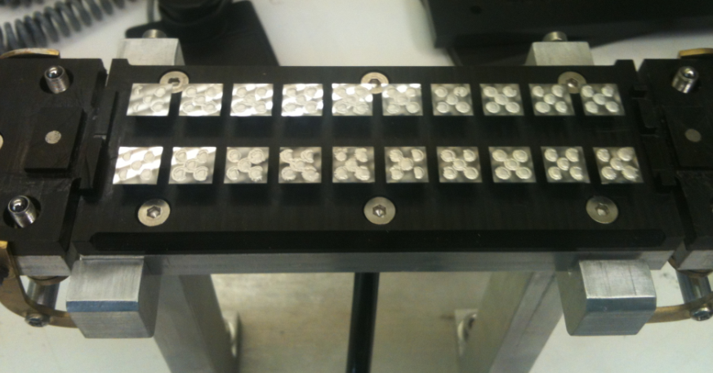
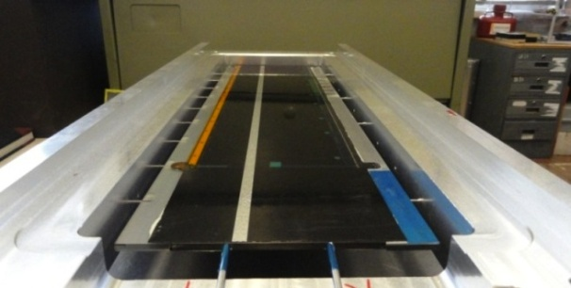
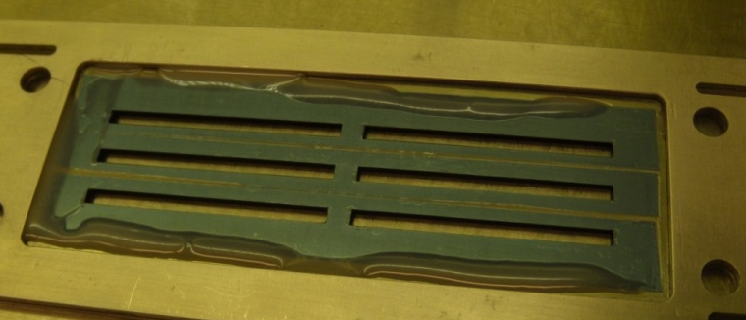
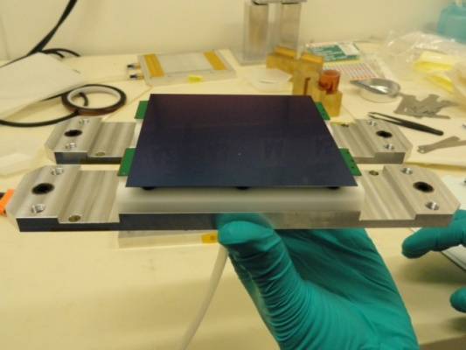
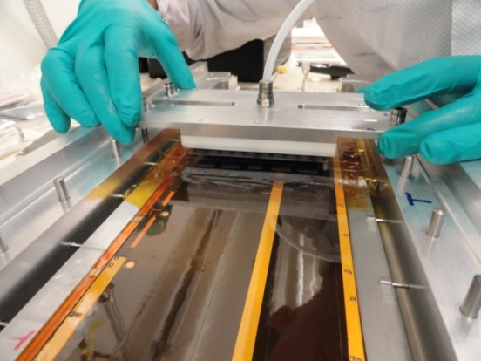
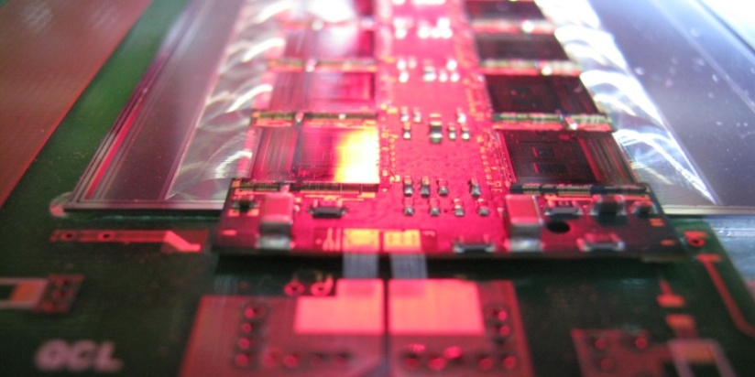
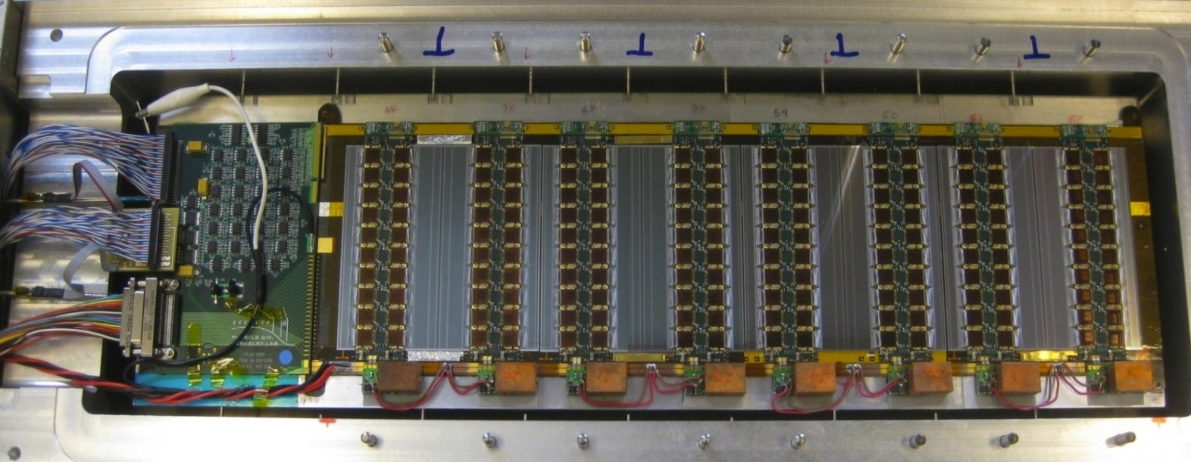
Strip Modules Assembly
Single-sided short strip module with glued hybrids (Upgrade R&D)
FE chip assembly
Hybrid mask for glue spreading
Module to stave assembly
40 modules made so far at:
LBL, SCIPP, Cambridge, Freiburg, Glasgow, Liverpool
Other institutes are on the way to produced module within barrel and EC community
LBL-06
LBL-03
LBL-02
LBL-01
11

Slide 12
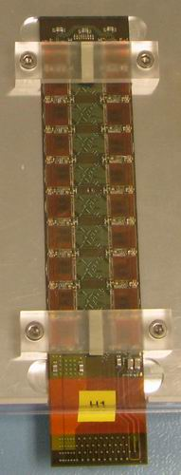
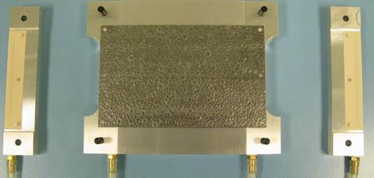
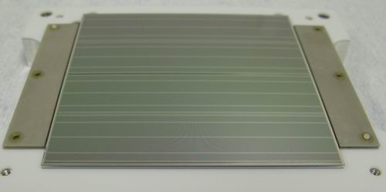
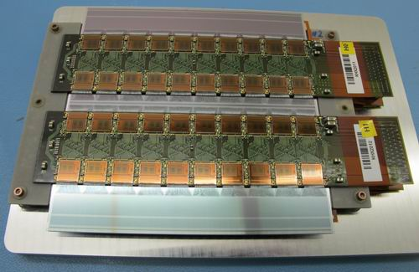
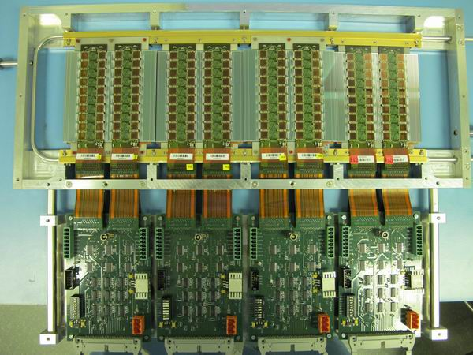
Strip Modules Assembly - Con’t
Double-sided short strip module with bridged hybrids (Upgrade R&D)
TPG and Ceramic facings
Sensor to baseboard assembly
Requires conventional assembly with jigs - Sensor placement accuracy can be as low as 1μm (obtained with SCT production)
More than 10000 wire bonds per module
4 modules mounted together in a test box
More than 10 modules produced at 2 sites
KEK and University of Geneva with high yield
12

Slide 13
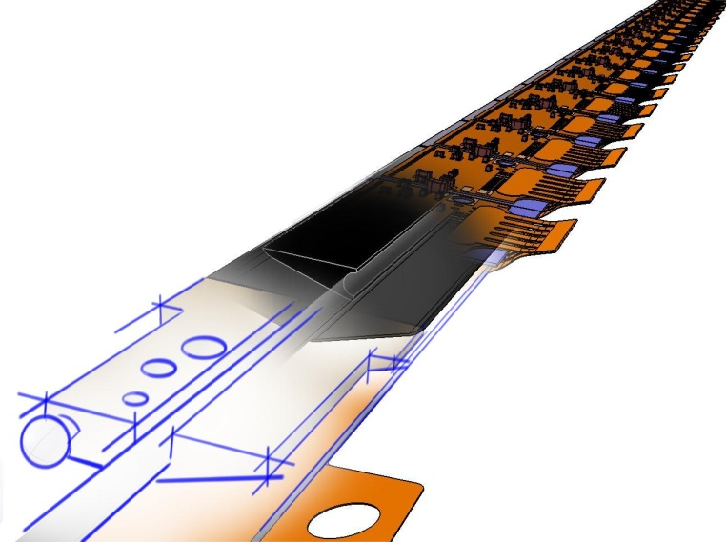
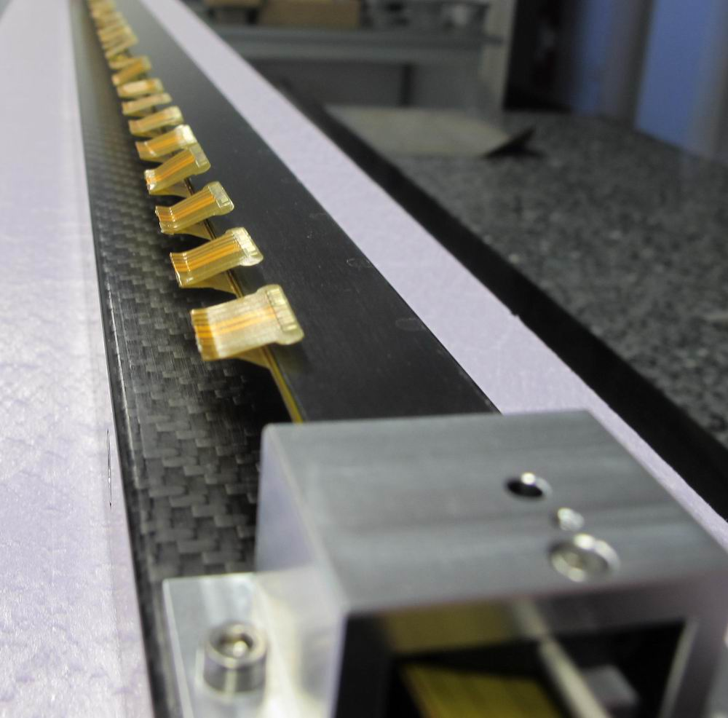
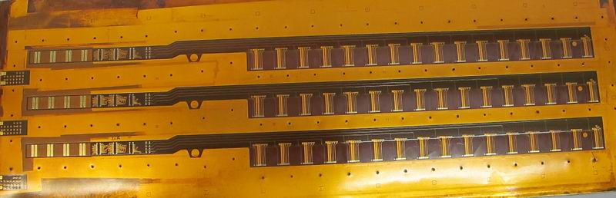
Local support – IBL stave and Flex
Stave features:
Made of light material (K9 carbon foam + CFRP skins for stiffness)
Ti pipe of 1.5mm ID and 0.1mm wall thickness
Face plate (module side) is coated with Parylen for safer electrical break to detector HV
Tight planarity and envelope tolerance: +/- 0.1mm
Stave fixations on 3 points: 2 end-blocks + central support
Stave & flex pre-production started and OK
K9 Foam block
K13C /RS3 parylen coated face plate
Peek end blocks
Flex features:
- Mix of 4 Cu-layers and 2 Al-layers for the LV lines. Total thickness ~450μm
The 2 Al-layers needs to be processed with CVD for Chrome and Copper (vias)
The wings supply through 1 layer the connectivity for every FE. Wing thickness 70μm
Wings are folded and glued at 180° for very precise envelope required for the integration
K13C/RS3 Omega
Stiffener
ID 1.5mm Ti boiling pipe
Flex Bus
1st AlCu flex ever made for tracker in fabrication for IBL
13

Slide 14
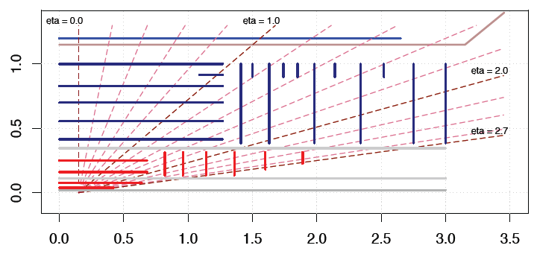
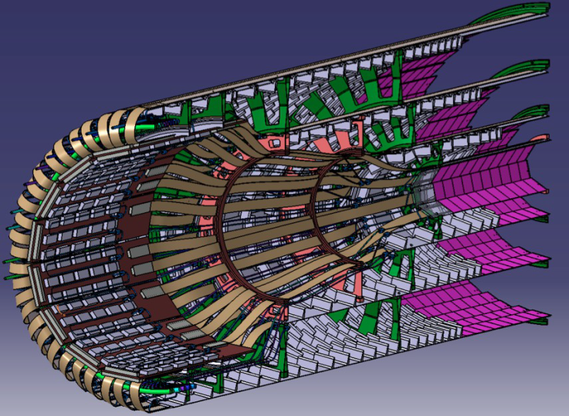
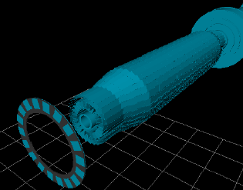

Local support – Pixel Upgrade
R [m]
Classical layout – Barrel & Disk
• 2 innermost pixel layers should be replaceable (IST R=11cm)
• Full pixel package should be replaceable
• Pixel services should be axial
I-beam stave concept for Innermost 2 layers
Z [m]
Possible options for outer layers
Goal is to reduce or suppress disc → material budget saving
Alpine stave concept
Conical layout
Bended staves in conical layout
Real prototype for feasibility
14

Slide 15





Local support – Strip Stave Upgrade
Low density carbon foam K-foam , and CFRP honeycomb and plane
Double edge mount with end-insertion
Petal et program is underway…
Petal layout
Thermo-mechanical stave
15

Slide 16






Local support – Strip Super-Module Upgrade
Concept validated with end-insertion and interfacing a dummy barrel locking system
Light CFRP local support structure made at UniGe
Module + Cooling plate and loop independent from LS
Easy handling…
Super-module prototype fully functional with 8 modules
12 module concept
16

Slide 17



Powering
ID Upgrade has a lot of more channels to power than current ID.
Higher granularity due to the occupancy
More Si layers than the current ID (9 instead of 7)
2 options are considered: - Serial Powering (SP)
- DC-DC conversion
IP
ABC-Next 250 nm : Vcc = 2.2 V, Icc = 0.036 A
Vdd = 2.5 V, Idd = 0.12 A
0.38W/FE → 30.4W/module → 365W/stave
SP
ABC-Next 130 nm : 1mW/ch expected
0.13W/FE → 10.2W/module → 123W/stave
24i
i
DC-DC
IP → ~2 order of magnitude higher of line width than SP or DC-DC
DC-DC plug-in board
Main issues: System integration (SP) and EMI produced close to sensors (DC-DC)
- Both proved to work so far on multi-module readout systems with up to 4 modules.
- Not enough to qualify it on large detector scale.
SPI board
serial power
interface chip (SPI)
Current tests with Strip and Pixel…
17

Slide 18



Engineering Integration/Installation
IBL is certainly one of the most challenging integration:
14 staves of 7 m long to be integrated with small clearance such as < 1mm
All staved and services are packed inside 15mm
Along 7m long structure
The beam pipe is integrated inside IBL package
and free to be extracted
Pixel package mechanics without stave and services
IPT
Service rings
Inner part of the
sealing ring
2 half shells
(IPT connection to BP)
IBL Service end
Beam pipe extender
(service wrapping)
Staves
Stave integration
Beam pipe
18

Slide 19



IBL cooling pipe extension
Brazing stand of 7m long for pipe extension
Brazing mobile set-up with vacuum chamber
No fitting inside the detector volume
To be installed in SR1 during the integration work
Brazing work made by EN-MME (S. Mathot, G. Favre)
Status:
As opposed to OW no measured EMI emitted that could damage the FE electronics
40 samples brazed and tested so far: He leak tests, visual inspection, thermal shock, metallographic, tensile tests
  All samples OK
Brazing stand is complete now for stave extension tests at CERN in October
Tensile breaking stress is as expected for titanium Grade 2
19

Slide 20



Services
Service module of a strip barrel end is under study
Movable service patch-panel sealing the ID volume with fast and reliable connector
nSQP features (for Pixel Upgrade Phase0):
No optical transceiver inside the ID region (VCSEL problems on ID triggered the project)
On-detector optoboards replaced by new accessible optoboards located at ID End-Plate
Reproduces the Pixel services with design improvements
Add long-term reliability to the operation of the detector
nSQP for Pixel Upgrade
All panels fully produced and tested
Service arrangement requires a detail engineering work to have reliable and modular arrangement for electrical, optical and cooling interconnections
20

Slide 21

Summary - ID Challenges at HL-LHC
DCS
Services
Tracking Performance
Layout
Trigger
For Phase 2 HL-LHC (after 2022) we still have some time to make R&D effort for improving the detector design and performance – Clear development program is essential
21

