Slide 1




Recent operation and outlook for the ISOLDE
Resonance Ionization Laser Ion Source (RILIS)
Bruce Marsh - EN-STI-LP
LA³NET Topical Workshop: Laser based particle sources
20-22nd February 2013

Slide 2
Outline of Talk
Introduction to ISOLDE and the RILIS installation
  The original CVL pumped dye laser system
  The new Dual TiSa and Dye laser RILIS
Operation of the RILIS in 2012
  Total operating time
  Specifics of Dual RILIS operation
  Highlights and new developments
Outlook and development work for 2013 and CERN LS1
  Practical changes to the RILIS installation
  Scheme development
  Laser system upgrades / changes
  Improved laser beam transport system

Slide 3
Part 1
Introduction to ISOLDE and the RILIS installation
  The original CVL pumped dye laser system
  The new Dual TiSa and Dye laser RILIS
Operation of the RILIS in 2012
  Total operating time
  Specifics of Dual RILIS operation
  Highlights and new developments
Outlook and development work for 2013 and CERN LS1
  Practical changes to the RILIS installation
  Scheme development
  Laser system upgrades / changes
  Improved laser beam transport system

Slide 4
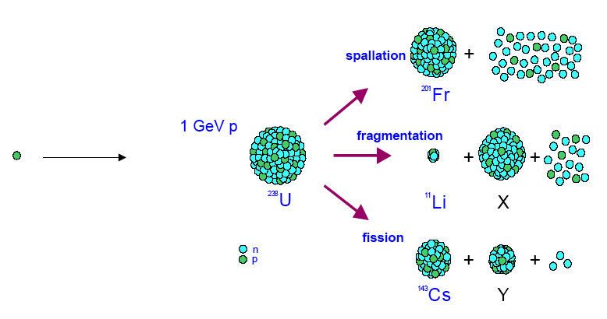
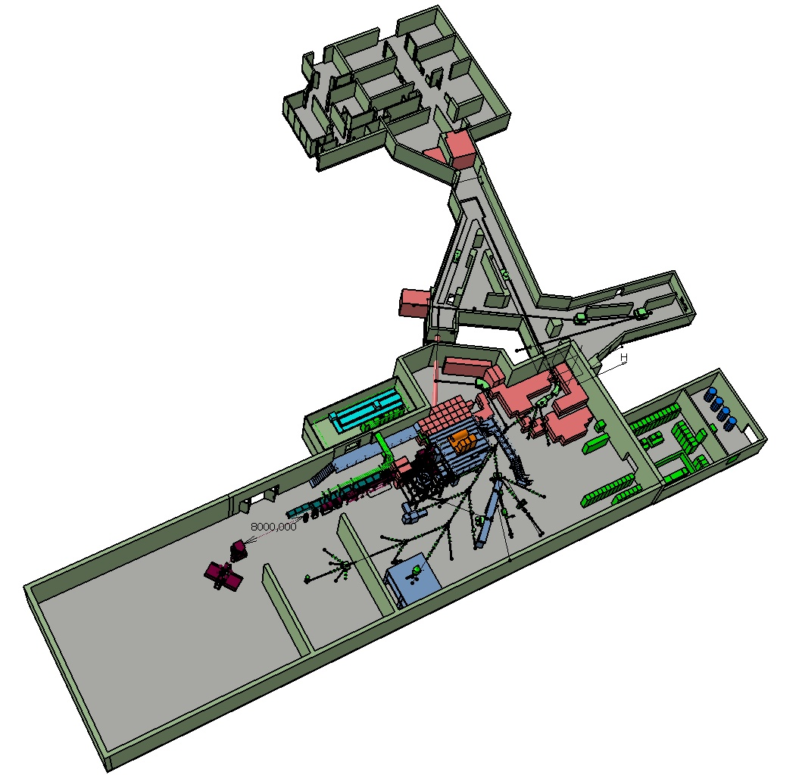
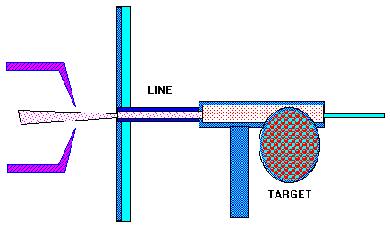
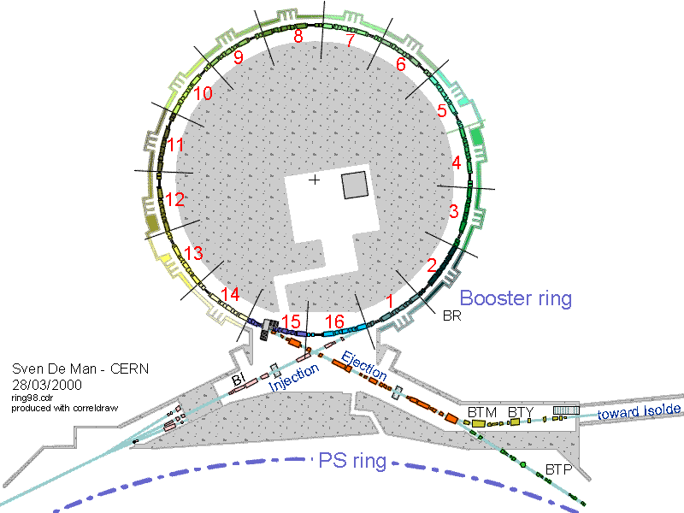
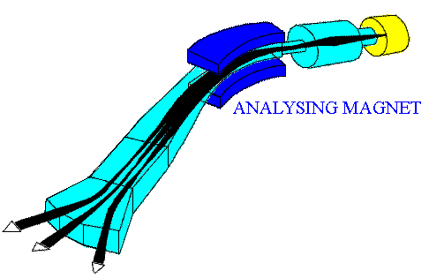
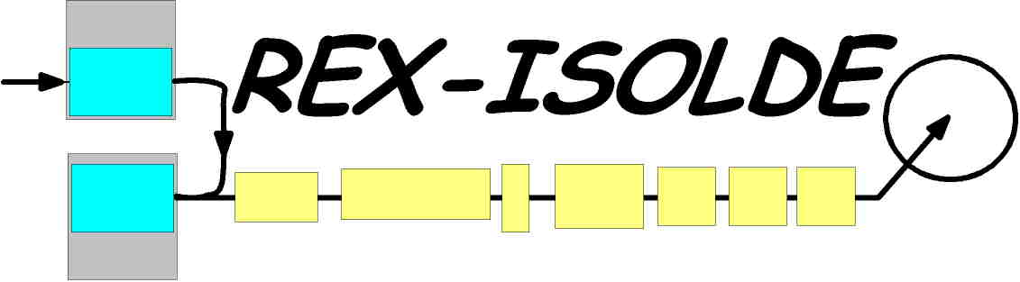
ISOLDE isotope separator on-line
1-1.4 GeV p
Ionization
2 μA
Single charge:
Surface
Plasma
RILIS
ECR
Production
Delivers yearly 3200 h of radioactive ion-beams to 30 experiments by means of two target stations
Mass
separation
Post acceleration
Jonson, B., & Richter, A. (2000). More than three decades of ISOLDE physics. Hyperfine Interactions, 129, 1–22. doi:10.1023/A:1012689128103
http://isolde.web.cern.ch/ISOLDE/

Slide 5
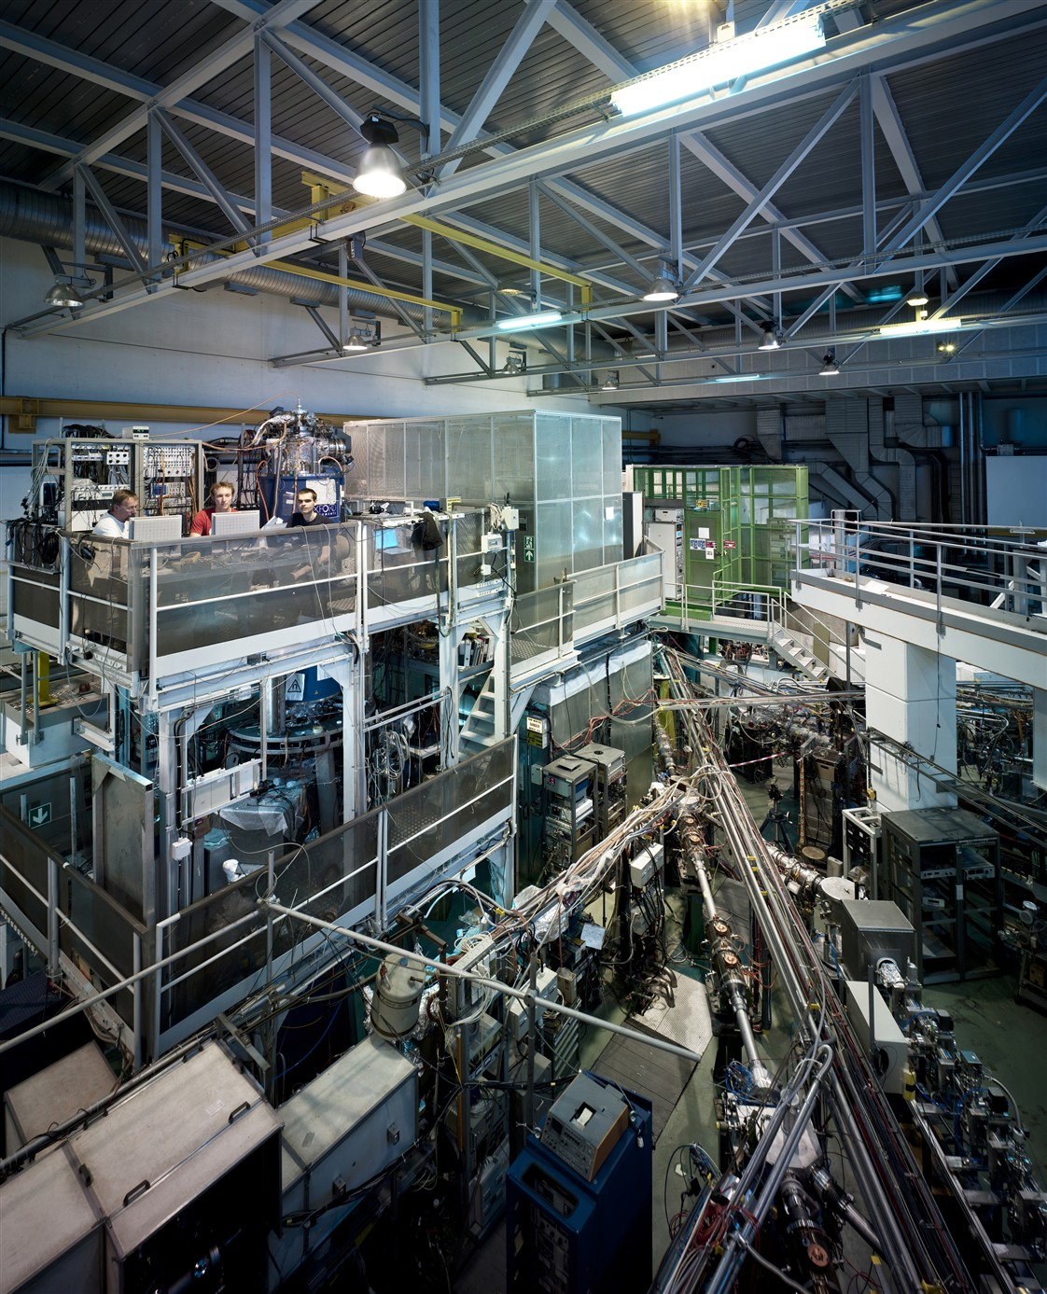
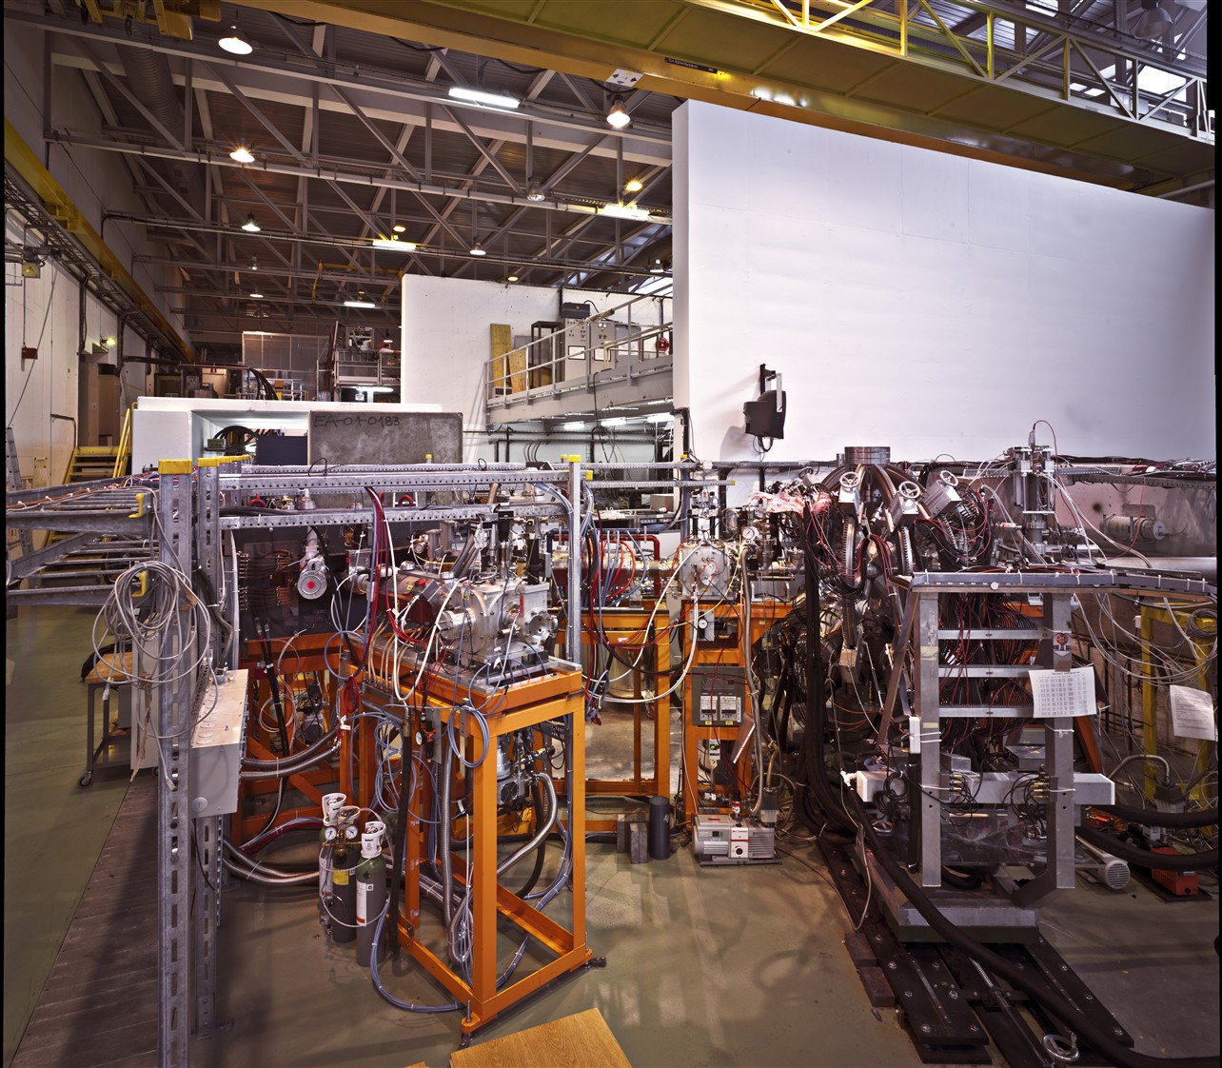
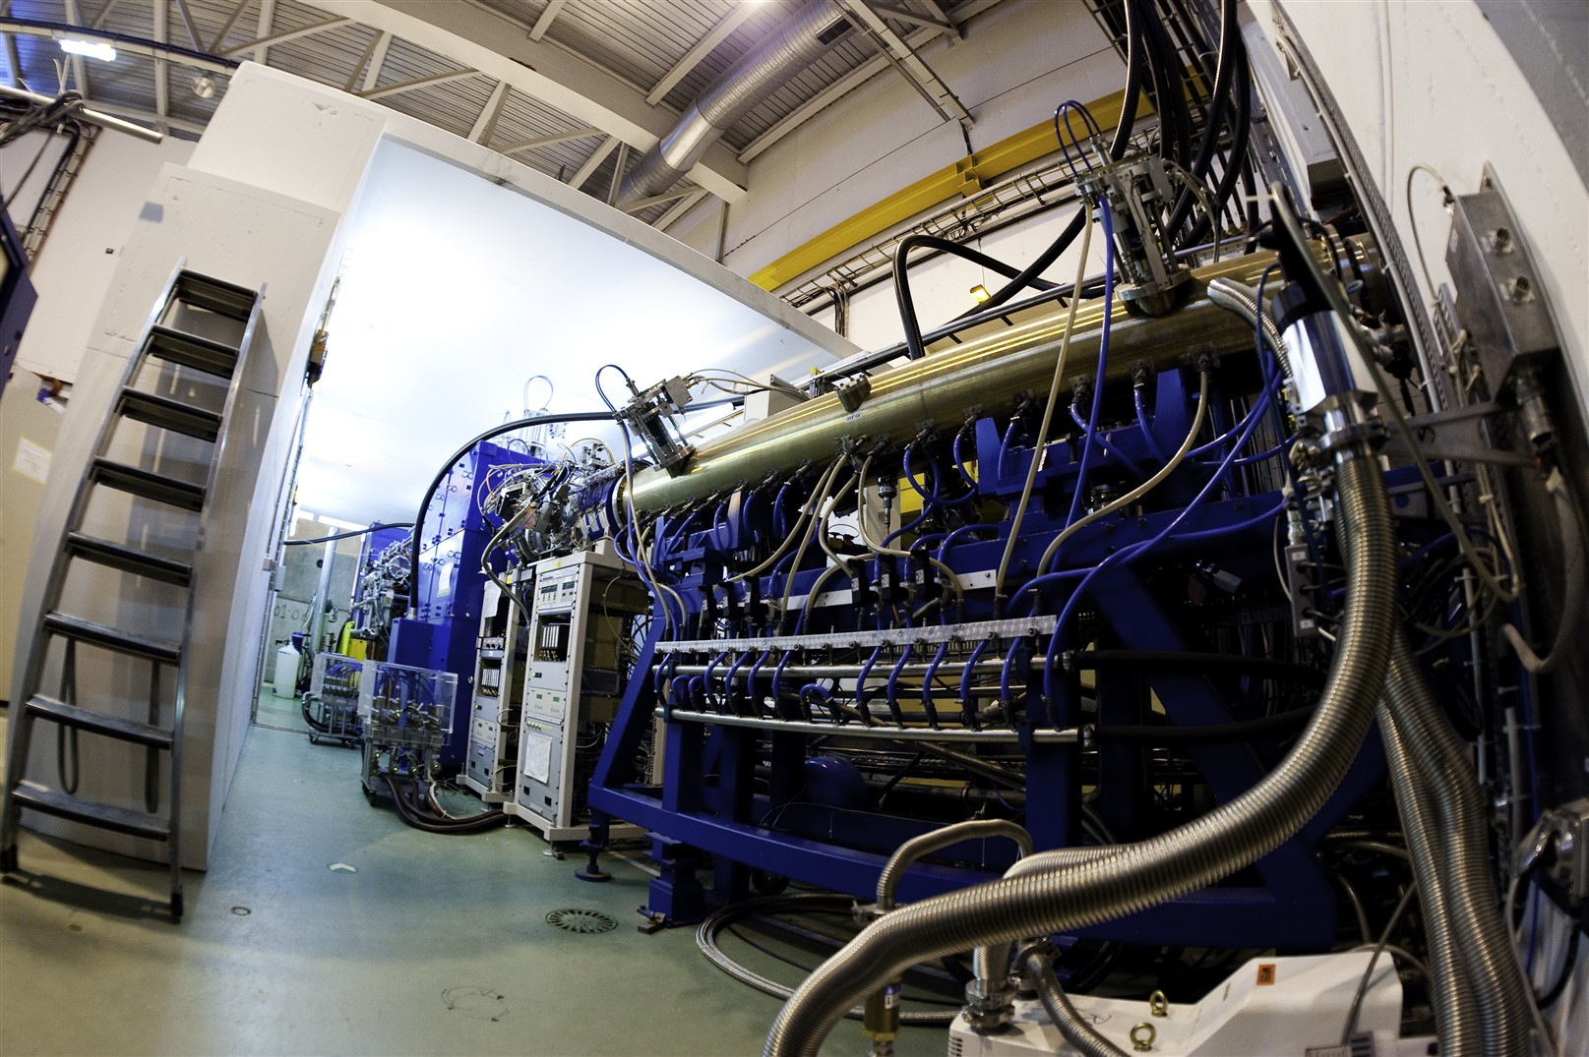

Slide 6
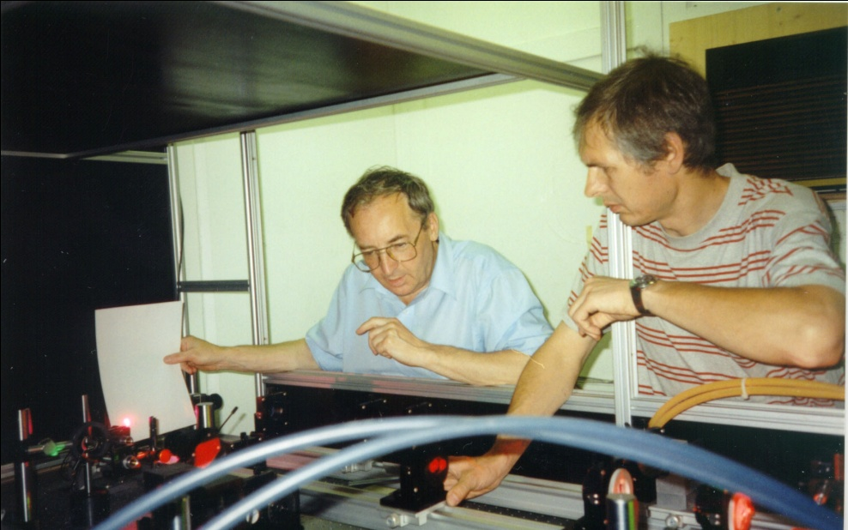
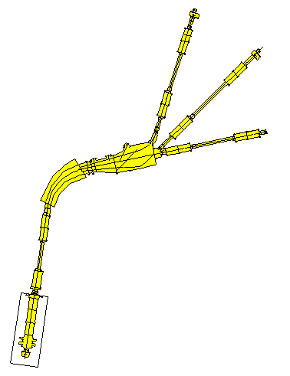
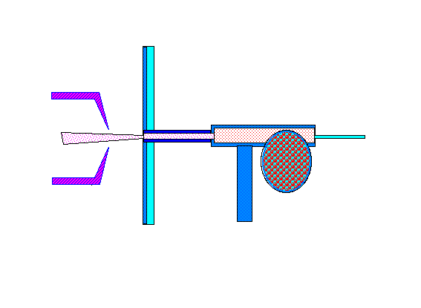
RILIS at ISOLDE-PSB
RILIS at ISOLDE-PSB
Slava Mishin
(Talk on Friday)
Installed in 1993
+
Ion beam lines
+
+
Mass separator
Laser system
Valentin
Fedosseev
CVL lasers: ν_{rep}=11.000 Hz
Oscillator + 2 amplifiers
2-3 dye lasers with amplifiers,
nonlinear crystals BBO:
Proton beam
60 kV
Extraction
Electrode
Laser
beams
+
+
Ionizer
Target
Target
DC
Target - Ion Source Unit
Mishin, V., Fedoseyev, V. , Kluge, H., Letokhov, V., Ravn, H., Scheerer, F., Shirakabe, Y. et al. (1993).
Chemically selective laser ion-source for the CERN-ISOLDE on-line mass separator facility. NIM B: 73(4), 550–560.

Slide 7
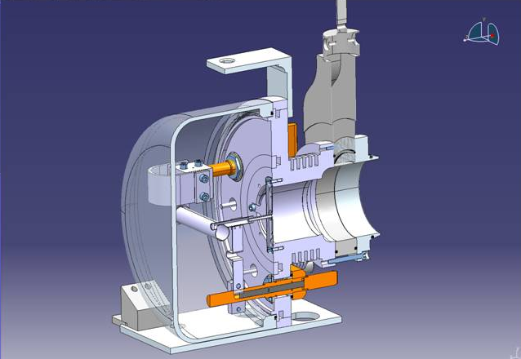
RILIS LASERS
> 20 m optical path
3 mm diameter ion source
Proton beam
from PSB
~10 cm

Slide 8
RILIS operation: 1994-2010
Laser ON time
in 2010:
2096 h – total
2000 h - on-line
Laser time per beam for the 2010
Sm | Mg | Cu | Ga | Tl | Be | Pb | Mn | Au | Be | Zn | Ag | At
52 | 154 | 183 | 52 | 184 | 54 | 123 | 228 | 114 | 344 | 299 | 140 | 74

Slide 9
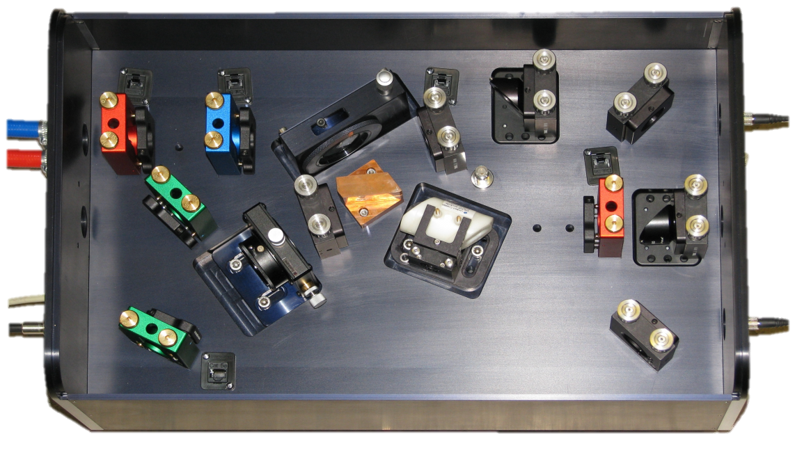
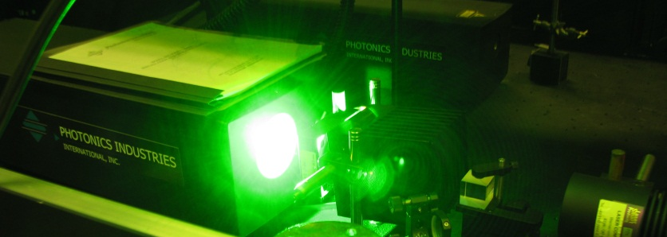
The RILIS Ti:Sa lasers
Pump laser: Nd:YAG (532 nm), Photonics Industries Ltd. DM60
Repetition rate: 10 kHz
Pulse length: 180 ns
Power: 60 W
100 mm
Ti:Sa lasers:
Line width: 5 GHz
Pulse length: 30-50 ns
Wavelength tuning range (6 mirror sets):
Fundamental (ω) 690 - 940 nm (5 W)
2nd harmonic (2ω) 345 - 470 nm (1 W)
3rd harmonic (3ω) 230 - 310 nm (150 mW)
4th harmonic (4ω) 205 - 235 nm (50 mW)
Featured in the next talk by Sebastian Rothe
“A complementary laser system for ISOLDE RILIS” S Rothe et al: Journal of Physics: Conference Series 312 (2011) 052020

Slide 10
Dual RILIS tuning range
Fedosseev, V. N., Fedorov, D. V, Fink, D., Losito, R., Marsh, B. A., S.Rothe et al. (2012).
Upgrade of the RILIS at ISOLDE; Rev. Sci. Inst 83(2), 02A903. doi:10.1063/1.3662206

Slide 11
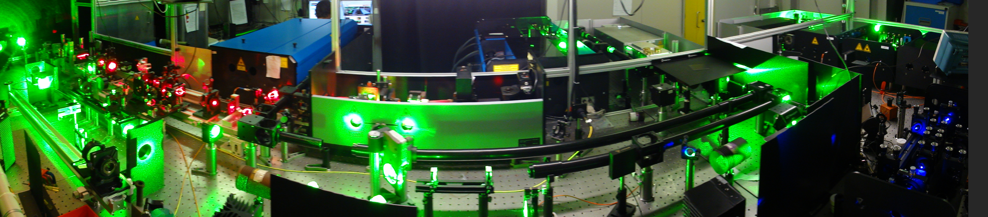
The RILIS Dye + Ti:Sa system
Improved HRS laser beam launch system with a 4th laser beam path for laser transport to ISCOOL
Narrow band dye laser with computer controlled grating and etalon for high resolution spectroscopy or isomer selectivity
Edgewave Nd:YAG laser for dye pumping or non resonant ionization
Sirah dye lasers with 2nd harmonic generation and UV pumping option
3 Ti:Sa lasers
Photonics Industries Nd:YAG pump laser for the Ti:Sa lasers
Harmonic generation unit for Ti:Sa system
Dye laser 3rd harmonic generator
RILIS cabin layout has been redesigned to accommodate the new lasers
Dye and Ti:Sa synchronization → mixed ionization schemes are possible
The laboratory is now at maximum capacity – extension is planned.
Fedosseev, V. N., Fedorov, D. V, Fink, D., Losito, R., Marsh, B. A., S.Rothe et al. (2012).
Upgrade of the RILIS at ISOLDE; Rev. Sci. Inst 83(2), 02A903. doi:10.1063/1.3662206

Slide 12
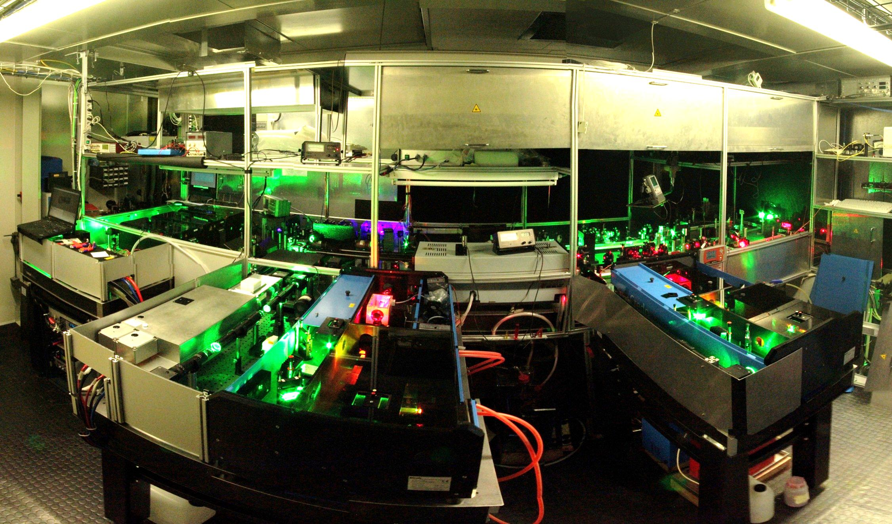
RILIS in action

Slide 13
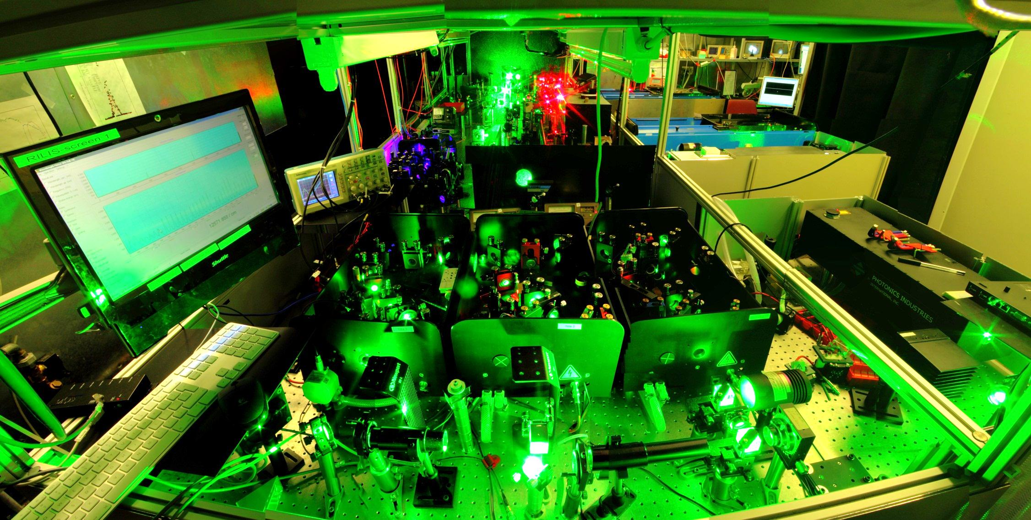
RILIS in action

Slide 14
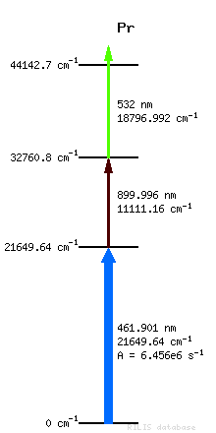
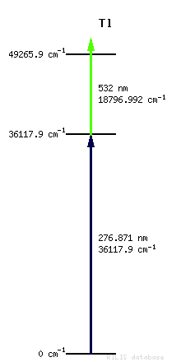
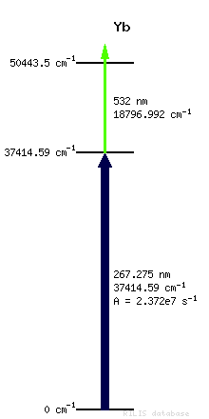
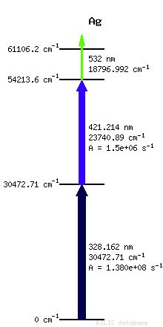
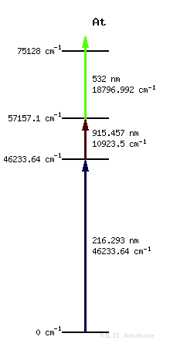
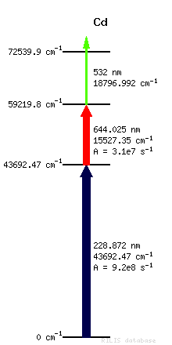
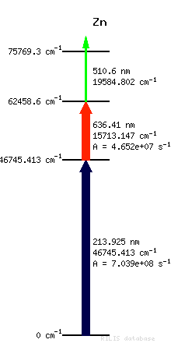
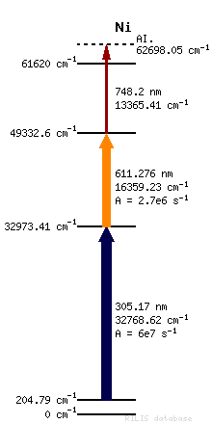
New modes of operation
New modes of operation – The Dual RILIS
Prerequisite for dual operation: Temporal synchronization pulses of the two laser systems
100W Nd:YAG laser is available for non-resonant ionization in Ti:Sa only schemes
Mixed schemes
Dye and Ti:Sa are exchangeable
Backup solution
Increased efficiencies
New elements
Keep one dye set up for future, use Ti:Sa instead
The Dual-RILIS is unique amongst laser ion sources
Reduction in down time
http://isolde-project-rilis.web.cern.ch/isolde-project-rilis/

Slide 15
Part 2
Introduction to ISOLDE and the RILIS installation
  The original CVL pumped dye laser system
  The new Dual TiSa and Dye laser RILIS
Operation of the RILIS in 2012
  Total operating time
  Specifics of Dual RILIS operation
  Highlights and new developments
Outlook and development work for 2013 and CERN LS1
  Practical changes to the RILIS installation
  Scheme development
  Laser system upgrades / changes
  Improved laser beam transport system

Slide 16
RILIS operation: 1994-2012
Ion beams of 13 elements were produced with RILIS in 2012
Laser ON time in 2012:
3000 h in 2012
24 separate runs
344 RILIS operator shifts
Availability of two complementary laser systems (Dye and Ti:Sapphire) has ensured the increase of RILIS beam time in 2011-2012
Beam | Sm 2 runs | Ca 2 runs | Cd | At 2 runs | Au 2 runs | Be 3 runs | Dy | Mg 4 runs | Po 2 runs | Ag 2 runs | Zn | Cu | Mn
Planned | 208 | 272 | 192 | 300 | 172 | 446 | 88 | 296 | 206 | 96 | 198 | 112 | 148
Real | 212 | 359 | 253 | 345 | 262 | 278 | 111 | 378 | 206 | 113 | 124 | 69 | 208

Slide 17
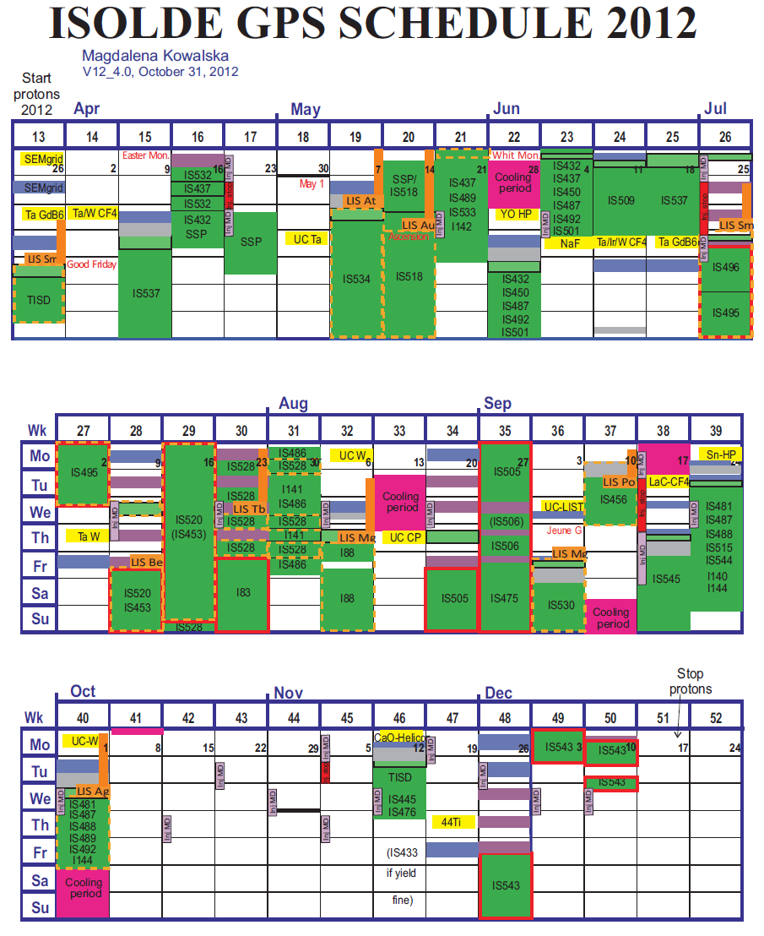
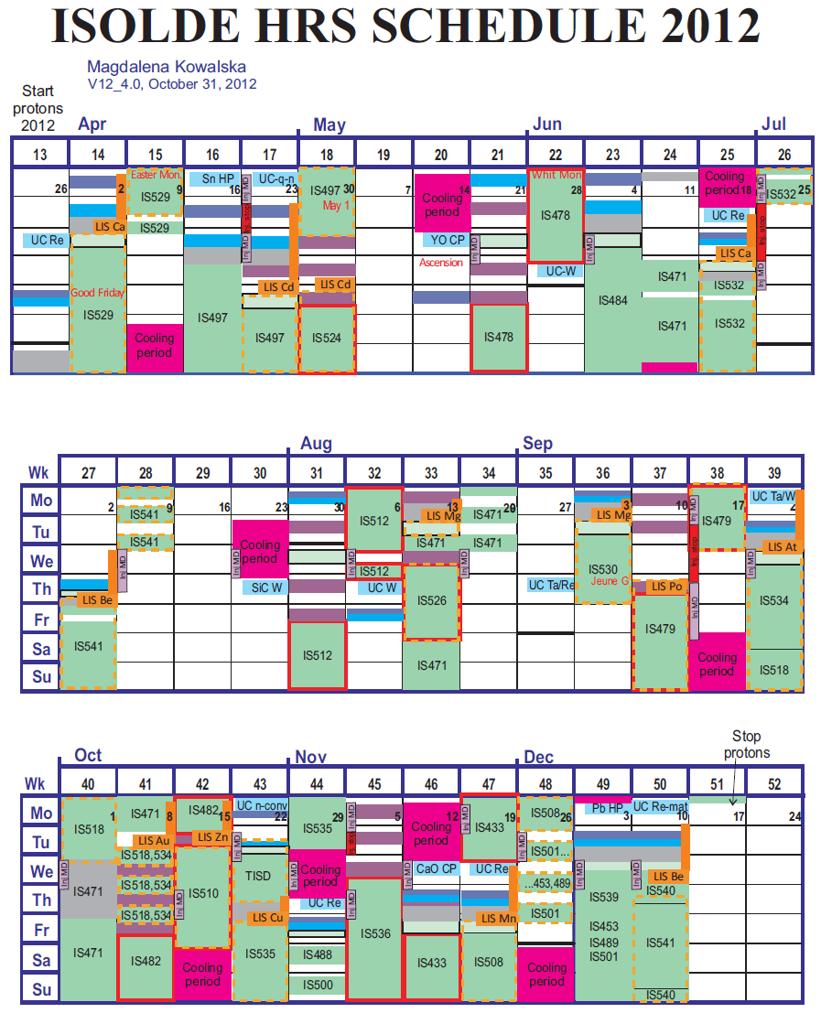
RILIS runs in 2012
RILIS runs in 2012
ISOLDE RILIS SCHEDULE 2012
Ca
Cd
Ca
Cd
Ca
Ca
At
Au
Ca
At
Au
Ca
Sm
Ca
Sm
Ca
Sm
Sm
Cd
Cd
Cd
Cd
Sm
Be
Dy
Sm
Be
Be
Dy
Be
Po
Po
Po
Mg
Mg
Po
Mg
Mg
Dy
Dy
At
At
Mg
Be
Mg
Mg
Be
Mg
Po
Po
Be
Be
At
At
Mn
Mn
Au
Zn
Zn
Au
Zn
Zn
Ag
Ag
Be
Be
Cu
Mn
Cu
Mn
http://isolde.web.cern.ch/ISOLDE/

Slide 18
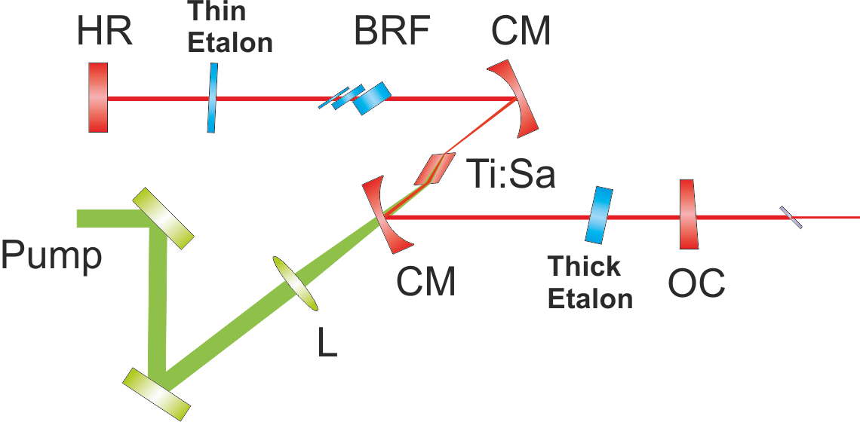
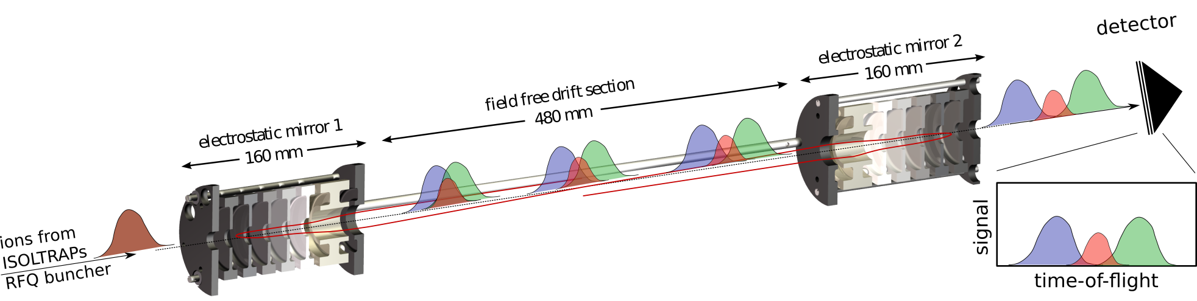
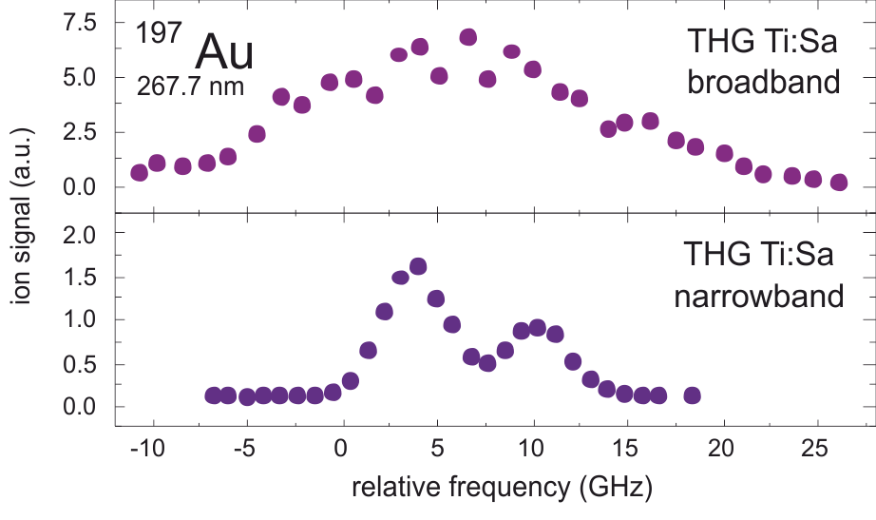
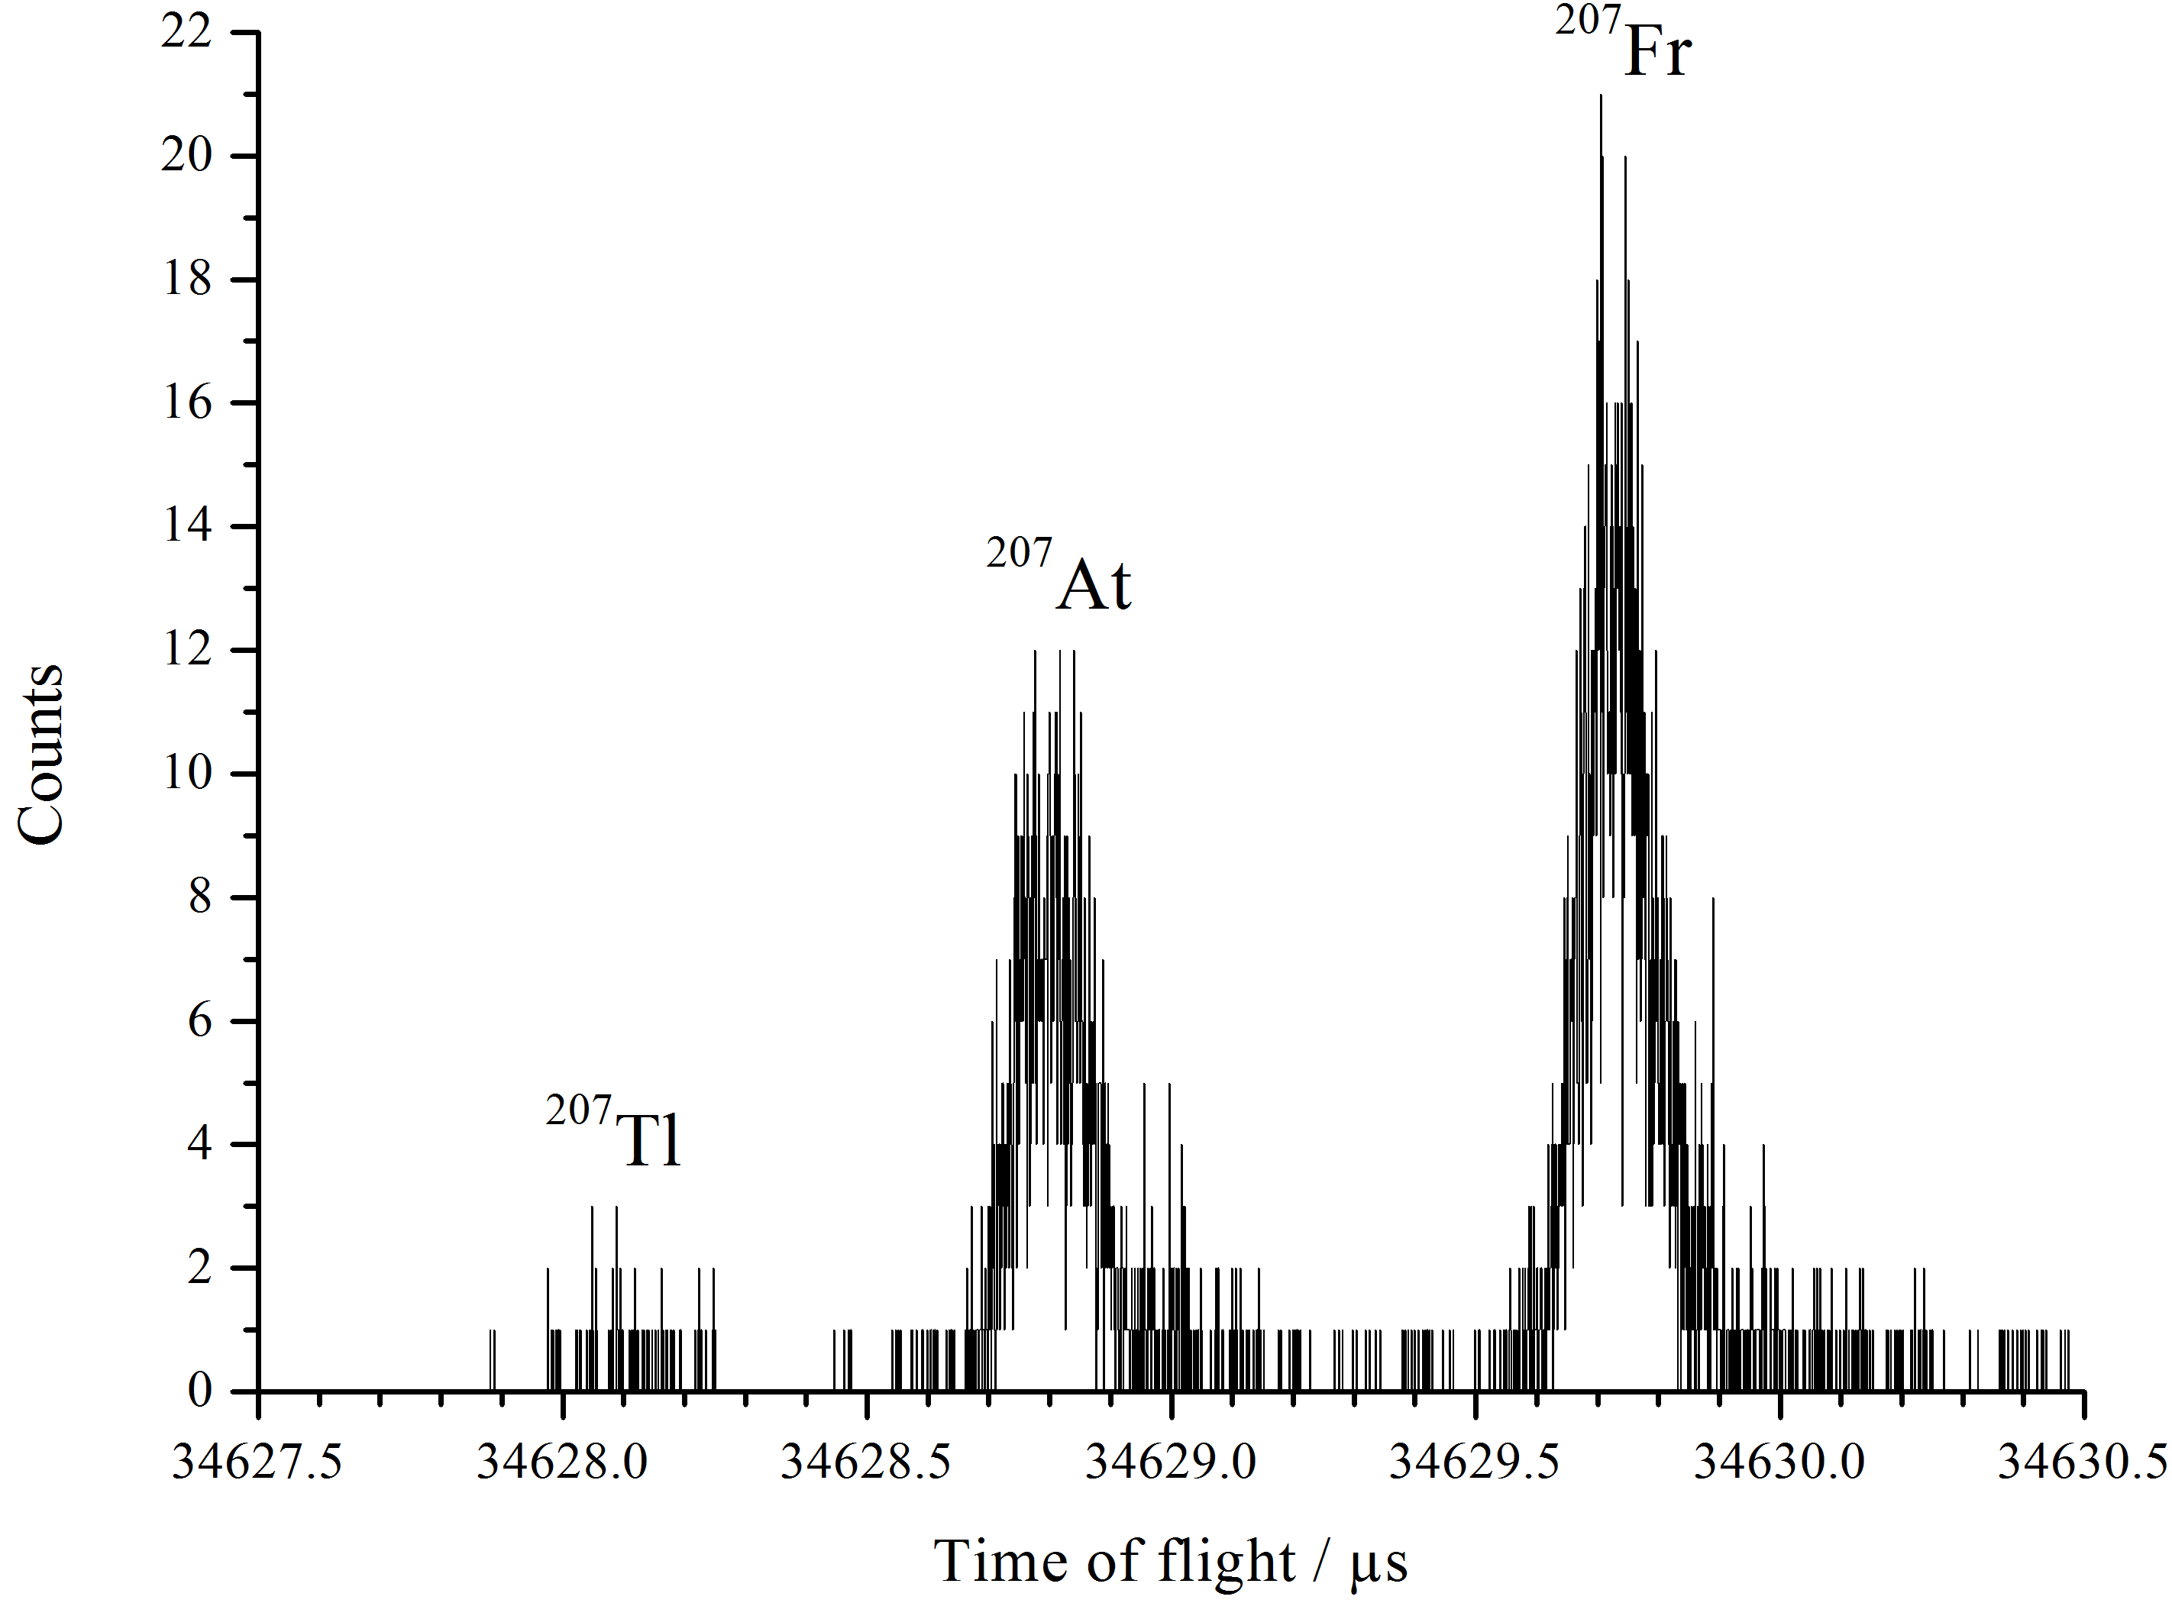
Highlights 1 - In-source RIS
Dual etalon, narrow line-width Ti:Sa
ISOLTRAP MR-TOF isobar separated
ion detection
Mass resolution in the range of M/ΔM = 10⁶
MCP is used for direct ion detection with ~1% efficiency: No activity required for detection.
Direct communication with RILIS for cycle triggering and shared data acquisition is established.
Addition of a thick etalon to the TiSa cavity
Reduction of linewidth from >5 GHz → <1GHz
Remote dual etalon control, automatic optimization routine and feedback based frequency stabilization
See talks of Anatoly Barzakh and Maxim Seliversov on Friday
R. N. Wolf et al., Nucl. Instr. and Meth. A 686, 82-90 (2012), (MR-TOF)
B.Marsh, V Fedosseev,, R. Rossel, S Rothe, D.Fink, M. Seliverstov, N. Imai et al, EMIS 2012 Proceedings, in preparation (RILIS)

Slide 19
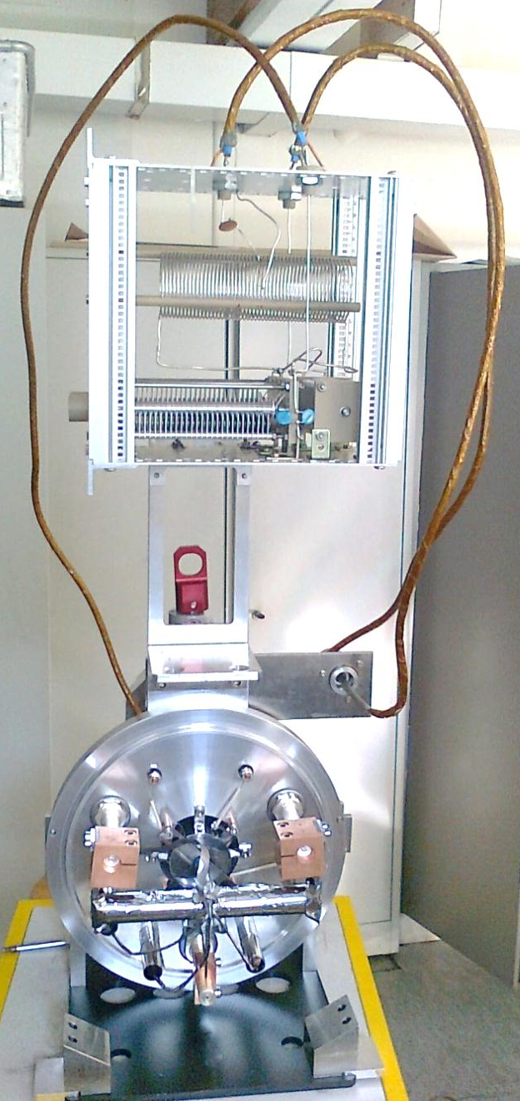
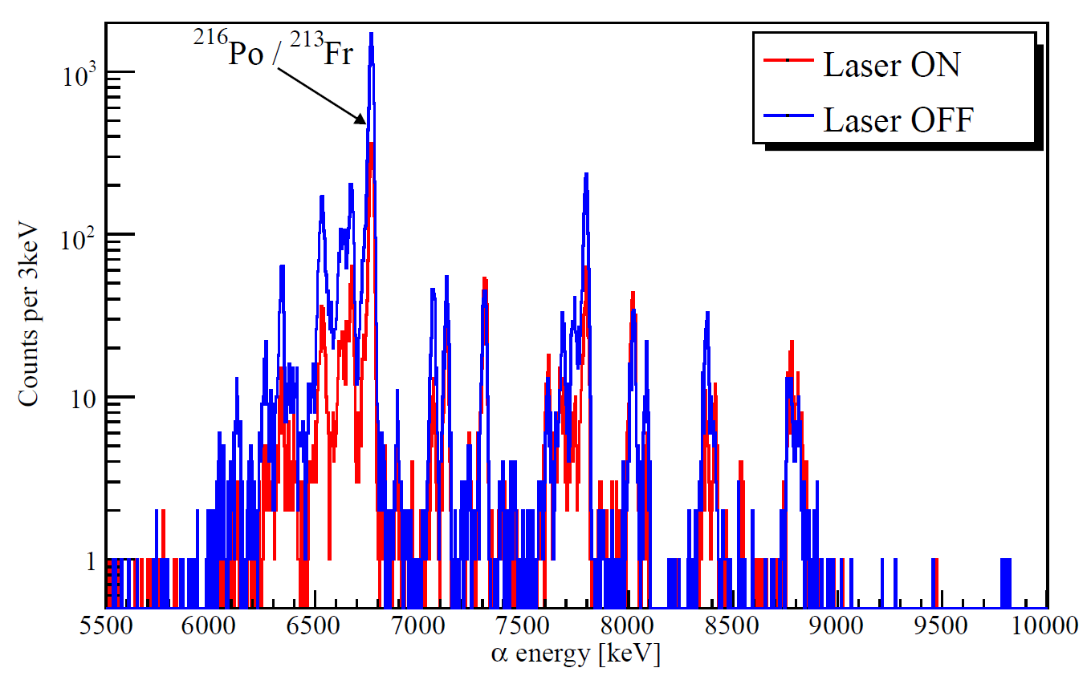
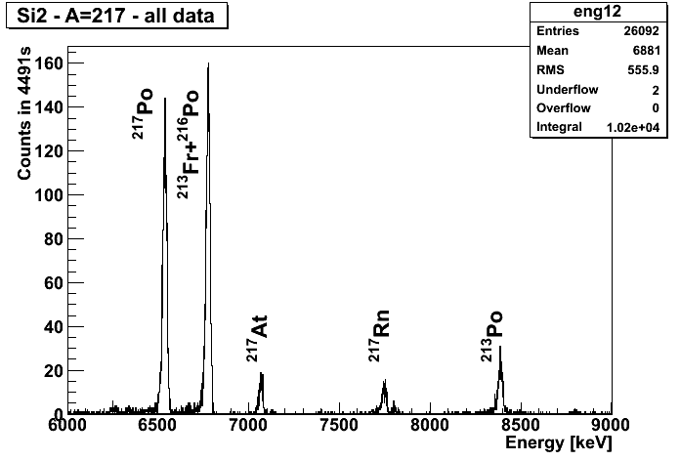
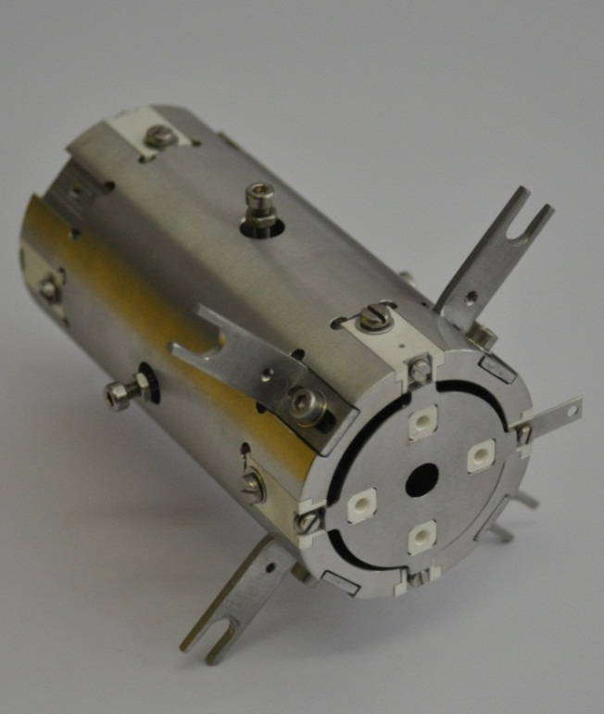
Highlights 2 – LIST operation
LIST + UCx run for Fr suppression for laser spectroscopy of Po
  Suppression of >1000 for most surface ions
  Ionization efficiency reduction by ≈20x (Mg,Po)
1 cm
Talk by Sven Richter on Friday morning!
Daniel Fink (CERN, Univ. Heidelberg) and Sven Richter (Univ. Mainz): PhD work

Slide 20
Part 3
Introduction to ISOLDE and the RILIS installation
  The original CVL pumped dye laser system
  The new Dual TiSa and Dye laser RILIS
Operation of the RILIS in 2012
  Total operating time
  Specifics of Dual RILIS operation
  Highlights and new developments
Outlook and development work for 2013 and CERN LS1
  Practical changes to the RILIS installation
  Scheme development
  Laser system upgrades / changes
  Improved laser beam transport system

Slide 21
Future developments
Extension of RILIS cabin
  Enlarged entrance/storage and work area to maximize the useable laser laboratory space
GENERAL RILIS DEVELOPMENTS
Implement a dedicated, high power Nd:YVO₄ laser for non resonant ionization
  High beam quality industrial laser could significantly improve efficiency for many schemes.
  Would simplify RILIS setup, increase reliability and reduce setup time.
On-call operation
  Installation of a machine protection and monitoring system to reduce reliance on shift-based operation
  To be implemented during LS1
IONIZATION SCHEMES
Investigate RILIS for refractory metals at ISOLDE
Improved RILIS schemes for the Dual RILIS system
See talk of Tom Day Goodacre
Installation of a reference cell at RILIS
Pulsed amplification of CW seeded Dye laser or TiSa
Improved motorization of Narrow-band TiSa
IN-SOURCE SPECTROSCOPY
See talk of Anatoly Barzakh
SELECTIVITY IMPROVEMENTS
Further optimization of LIST
Improving the laser ion time structure or using a time focus for effective beam gating
See talk of Sven Richter

Slide 22
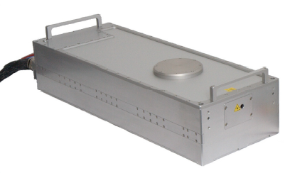
RILIS room extension
Required for:
Safety
Reference cell installation
Dye handling
Upgrade of beam observation system
Installation of extra YAG laser
Improved ventilation system
Comfort/ergonomics
RILIS
Existing laser room + SAS
28 m²
REF
REX EBIS
254 cm
DESK
320 cm
Extended part (SAS)
IS COOLER
HV cage
6 m²
100 cm

Slide 23
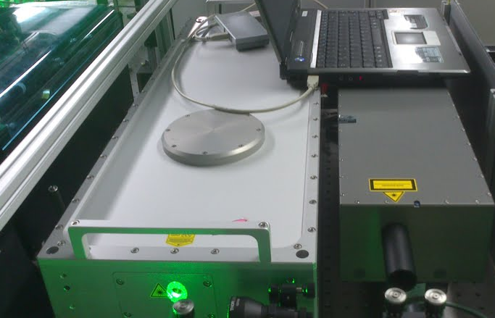

Independent laser for non resonant ionization
40W at 10 kHz
17ns Pulse
Low Jitter
Gaussian beam
Much better transmission
efficiency to ion source
Blaze laser installed for a short test at RILIS in Dec 2012
Laser | Laser Power (on table) | Reference beam power in 3 mm aperture | Transport efficiency
Edgewave | 43 W | 370 mW | 33 %
Blaze | 15 W | 350 mW | > 80%
Blaze | 40 W | 800 mW | ~80 %
A similar efficiency improvement should be expected for the 18 RILIS elements that use non-resonant ionization for the final step!
Power dependent thermal lensing in the beam transport optics is to be eliminated
Can be used for Dye and Ti:Sa pumping as a back-up laser
B. Marsh et al., Suitability test of a high quality Nd:YVO industrial laser for the ISOLDE RILIS installation.
CERN-ATS-Note-2013-007 TECH

Slide 24
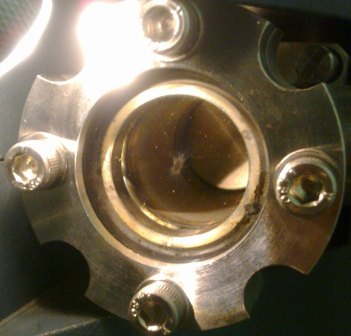
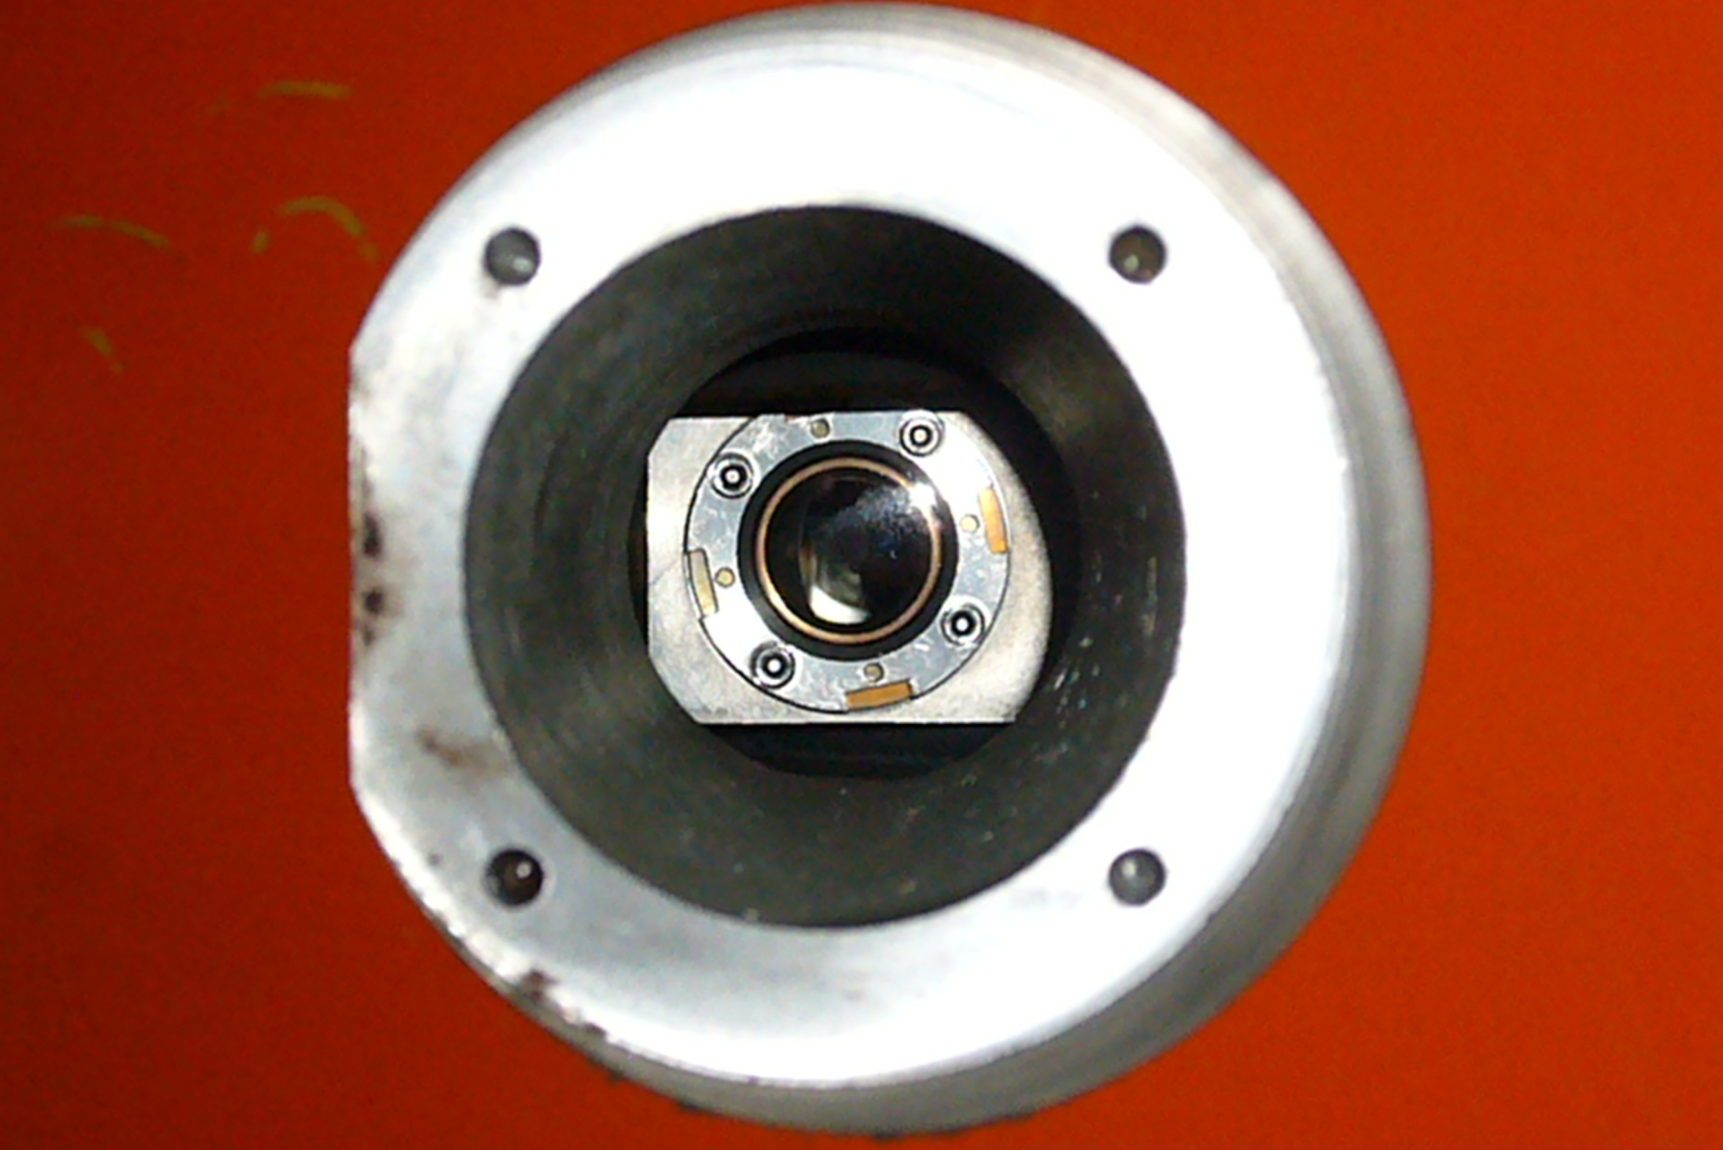
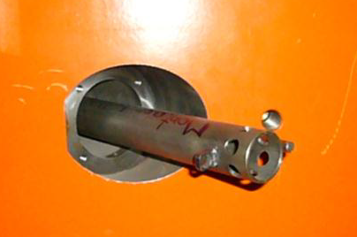
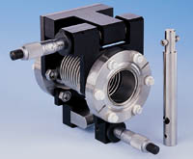
  Upgrade of HRS window
Problem with existing window
1) Window contamination:
Annual window change is required
Difficult to access for change or inspection
2) Thermal lensing:
Defocussing issue for high power beams must be measured and resolved
Solution
Extend the vacuum chamber and mount an adjustable window outside the magnet shielding
Use the internal and external reflections from the window for thermal lens and contamination diagnostics

Slide 25
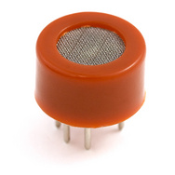
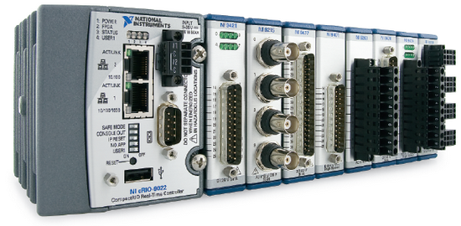
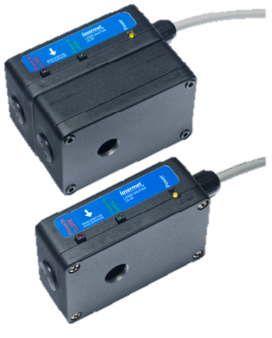
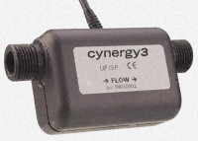
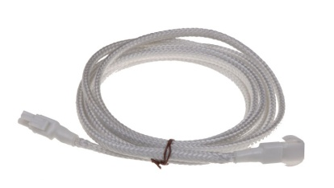
Machine protection
Dye Leak: Fire hazard; laser damage risk
Up to 6 dye circulators each containing up to 3 L of ethanol flowing at 7 L/min.
Action required: Stop dye circulator, Stop or block pump laser, alert the laser operator.
NI CompactRIO
MPS
Laser beam shutter
or pump laser switch OFF
using interlock system
RELAY for circulator interlock
Organic solvent
detector
(breathalyzer)
+
+
Dye flow interruption: Fire hazard; laser damage risk
Up to 40 W pump beam focused on dye cell. Almost immediate dye cell damage if dye flow stops.
Action required: Block pump beam to dye laser, alert the laser operator.
NI CompactRIO
MPS
Solution to be tested:
Remote controlled
Laser beam
shutter
Non invasive
dye flow sensor
(ULTRASONIC)
+
+
Water leak: Equipment damage risk; electrical safety hazard
Water cooling for Ti:Sa crystals. Water cooling network for each dye circulator. Water cooled pump lasers
Action required: Stop pump lasers, alert the laser operator.
Install water leak sensor cables on laser table and RILIS cabin floor
Include sensor data logger in RILIS monitoring system

Slide 26
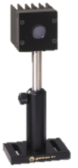
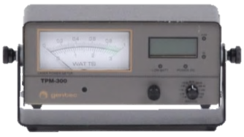
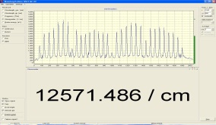




On-call operation
3 requirements for On-Call operation:
1) Machine protection / safety
2) Performance monitoring
3) Automation
This must be a ROBUST system
(PC independent).
+ Alert system to request
operator intervention.
To maintain RILIS performance
therefore reducing the frequency
of operator interventions.
ESSENTIAL
NON ESSENTIAL
Diagram made by Ralf Rossel; the project is being realized in collaboration with EN-STI-ECE

Slide 27






Acknowledgements
Valentine FEDOSSEEV¹, Bruce MARSH¹, Sebastian ROTHE¹, Daniel FINK^{1,8}, Maxim SELIVERSTOV², Nobuaki IMAI⁴, Ralf Erik ROSSEL³, Dmitri FEDOROV², Anatoly BARZAKH², Pavel MOLKANOV², Marica Anna SJOEDIN⁵, Daniele SCARPA⁶, Sven RICHTER⁷, Klaus WENDT⁷
EN-STI-ECE: Alessandro MASI¹, Sergio BATUCA¹
¹CERN ²Petersburg Nuclear Physics Institute (PNPI)
³Hochschule RheinMain, Wiesbaden
⁴KEK, Japan
⁵GANIL/CNRS, France
⁶LNL – INFN, Italy
⁷Johannes-Gutenberg-Universitaet Mainz
⁸University of Heidelberg
⁹University of Manchester
Spectroscopy with RILIS
IS511
Shape coexistence in the lightest Tl isotopes studied by laser spectroscopy
http://greybook.cern.ch/programmes/experiments/IS511.html
Fellow
Thomas DAY GOODACRE^{1,9}
IS534
Beta-delayed fission, laser spectroscopy and shape-coexistence studies with radioactive At beams
http://greybook.cern.ch/programmes/experiments/IS534.html
IS456
Study of polonium isotopes ground state properties by simultaneous atomic- and nuclear-spectroscopy
http://greybook.cern.ch/programmes/experiments/IS456.html
Knut and Alice Wallenberg Foundation

Slide 28
Spare slides

Slide 29
RILIS scheme setup requirements
 |  | Dye laser schemes |  |  |  |  |  |  |  | Ti:Sa schemes
Element | Setting time* | Step 1 |  | Step 2 |  | Step 3 |  | Efficiency |  | Step 1 |  | Step 2 |  | Step 3
 | days | λ₁, nm | Dye | λ₂, nm | Dye/YAG | λ₃, nm | Dye/YAG | off-line |  | λ₁, nm | Fundamental | λ₂, nm | Fundamental | λ₃, nm | TiSa/YAG
₄Be | 3 | 234.9 | Pyridin 1 | 297.3 | Rhod B | – |  | >7% |  | 234.9 | 939.444
₁₂Mg | 2 | 285.2 | Rhod 6G | 552.8 | Fluorescein 27 | 532.1 | YAG | 10% |  | 285.2 | 855.639 | 552.8 |  | 532.1 | YAG
₁₃Al | 2 | 309.3 | Rhod B | 532.1 | YAG | – |  | 20% |  | 309.3 |  | 532.1 |  | –
 |  | 308.2 | Rhod B |  |  |  |  |  |  | 308.2
₂₀Ca | 2 | 272.2 | ? | 532.1 | YAG | – |  | 0.50% |  | 422.7 | 845.346 |  | Rhod B |  | DCM
₂₁Sc | 2 | 327.4 | Phenox 9 | 719.8 | Pyridin 2 ? | 532.1 | YAG | 15% |  | 327.4 |  | 719.8 |  | 532.1 | YAG
₂₅Mn | 3 | 279.8 | Rhod 6G | 628.3 | DCM | 635.8 | DCM | 19% |  | 279.8 |  | 628.3 |  | 635.8
₂₇Co | 2 | 304.4 | Rhod B | 544.5 | Fluorescein 27 | 532.1 | YAG | >3.8% |  | 304.4 |  | 544.5 |  | 532.1 | YAG
₂₈Ni | 3 | 305.1 | Rhod B | 611.1 | Rhod B | 748.2 | Styr 8 | >6% |  |  | Dye |  | Dye | 748.2 | TiSA
₂₉Cu | 2 | 327.4 | Phenox 9 | 287.9 | Rhod 6G | – |  | >7% |  | 327.4 |  | 287.9 |  | –
₃₀Zn | 3 | 213.9 | DCM | 636.2 | DCM | 532.1 | YAG | 4.90% |  | 213.9 | 855.428 | 636.2 | Dye | 532.1 | YAG
₃₁Ga | 2 | 287.4 | Rhod 6G | 532.1 | YAG | – |  | 21% |  | 287.4 |  | 532.1 |  | –
 |  | 294.4 | Pyrr 597 |  |  |  |  |  |  | 294.4
₃₉Y | 2 | 414.3 | Styr 9 | 662.4 | Phenox 9 | 510.6 | YAG |  |  | 414.3 |  | 662.4 |  | 510.6 | YAG
₄₇Ag | 2 | 328.1 | Phenox 9 | 546.6 | Fluorescein 27 | 532.1 | YAG | 14% |  | 328.1 |  | 546.6 |  | 532.1 | YAG
₄₈Cd | 3 | 228.8 | Pyridin 1 | 643.8 | DCM | 532.1 | YAG | 10.40% |  | 228.8 | 915.208 | 643.8 | Dye | 532.1 | YAG
₄₉In | 2 | 303.9 | Rhod B | 532.1 | YAG | – |  |  |  | 303.9 |  | 532.1 |  | –
 |  | 325.6 | Phenox 9 |  |  |  |  |  |  | 325.6
₅₀Sn | 4 | 286.3 | Rhod 6G | 811.4 | Styr 9 | 823.5 | Styr 9 | 9% |  | 286.3 | 858.9 | 811.4 | TiSA | 823.5 | TiSA
₅₁Sb | 3 | 217.6 | Phenox 9 | 560.2 | Rhod 6G | 532.1 | YAG | 2.70% |  | 217.6 |  | 560.2 |  | 532.1 | YAG
₆₀Nd | 2 | 588.8 | Rhod B or Pyrr 597 | 596.9 | Rhod B | 596.9 |  |  |  | 588.8 |  | 596.9 |  | 596.9
₆₂Sm | 3 | 600.4 | Rhod B | 675.2 | Phenox 9 | 676.18 | Phenox 9 |  |  | 600.4 |  | 675.2 |  | 676.18
₆₅Tb | 3 | 579.6 | Pyrr 597 | 551.7 | Fluorescein 27 | 618.3 | Rhod B |  |  | 579.6 |  | 551.7 |  | 618.3
₆₆Dy | 2 | 625.9 | DCM | 607.5 | Rhod B | 532.1 | YAG | 20% |  | 625.9 |  | 607.5 |  | 532.1 | YAG
₇₀Yb | 2 | 555.6 | Pyrr 567 | 581.0 | Rhod 6G | 581.0 | Rhod 6G | 15% |  | 555.6 |  | 581.0 |  | 581.0
₇₁Lu |  | 573.7 | Rhod 6G | 642.5 | DCM | 643.5 | DCM |  |  | 451.9 | 903.8 | 460.7 | 921.4
₇₉Au | 5 | 267.6 | Coum 540A | 306.5 | DCM | 673.9 | Phenox 9 | >3% |  | 267.6 |  | 306.5 |  | 673.9
₈₀Hg | 3 | 253.7 | Styr 8 | 313.2 | DCM | 626 | DCM |  |  | 253.7 |  | 313.2 |  | 626
₈₁Tl | 2 | 276.8 | Rhod 110 | 532.1 | YAG | – |  | 27% |  | 276.8 |  | 532.1 |  | –
₈₂Pb | 2 | 283.3 | Rhod 6G | 600.2 | Rhod B | 532.1 | YAG | >3% |  | 283.3 |  | 600.2 |  | 532.1 | YAG
₈₃Bi | 2 | 306.8 | Rhod B | 555.2 | Fluorescein 27 | 532.1 | YAG | 6% |  | 306.8 |  | 555.2 |  | 532.1 | YAG
₈₄Po | 4 | 255.8 | Styr 8 | 843.4 | Styr 9 | 532.1 | YAG |  |  | 255.8 | 767.403 | 843.4 | TiSA | 532.1 | YAG
₈₅At | 4 | 216.9 | Phenox 9 | 795.4 | Styr 9 | 532.1 | YAG |  |  | 216.9 | 867.6 | 795.4 | TiSA | 532.1 | YAG
 |  | 224.4 | Phenox 9 | 793.2 ? | Styr 9 | 532.1 | YAG |  |  | 224.4 | 897.6 | 793.2 ? | TiSA | 532.1 | YAG

Slide 30
Ni: Dye-Dye-TiSa
Higher power from TiSa for AIS transition
Step 2
Step 3
Step 1
305 nm
Dye SHG
Ni
611 nm
Dye fund
748 nm
TiSa fund

Slide 31
Ca: TiSa-dye-dye
Higher power from TiSa for Step 1
~50W @ 532 nm to pump dye laser for AIS search for step 3 – new scheme found
Step 2
Step 3
Step 1
423 nm
TiSa SHG
Ca
586 nm
Dye fund
654 nm
Dye fund

Slide 32
Mg: Dye-Dye-YAG
Dye only: TiSa is available for preparation for the next RILIS element
Step 1
Step 2
285 nm
Dye SHG
Mg
532 nm
Nd:YAG SHG
553 nm
Dye fund

Slide 33
Po: Dye-TiSa-YAG
Higher power from TiSa for Step 2, narrow line-width TiSa for spectroscopy
256 nm
Dye THG
Po
532 nm
Nd:YAG SHG
843 nm
TiSa fund

Slide 34
At: Dye(TiSa)-TiSa-YAG
Dye and TiSa exchangeable for Step 1
~50W @ 532 nm for Step 3
Higher power from TiSa for Step 2
Step 3
Step 2
Step 1
216 nm
Dye THG
At
532 nm
Nd:YAG SHG
795 nm
TiSa fund

Slide 35
Au: TiSa-Dye-Dye
Higher power from TiSa for Step 1
~50W @ 532 nm to pump dye laser for Step 3
Step 3
Step 2
Step 1
268 nm
TiSa THG
306 nm
Dye SHG
Au
674 nm
Dye fund

