Slide 1


ALTO Laser Ion Source
Ruohong Li, Serge Franchoo, Christophe Lau
LA³NET Feb 22, 2013

Slide 2
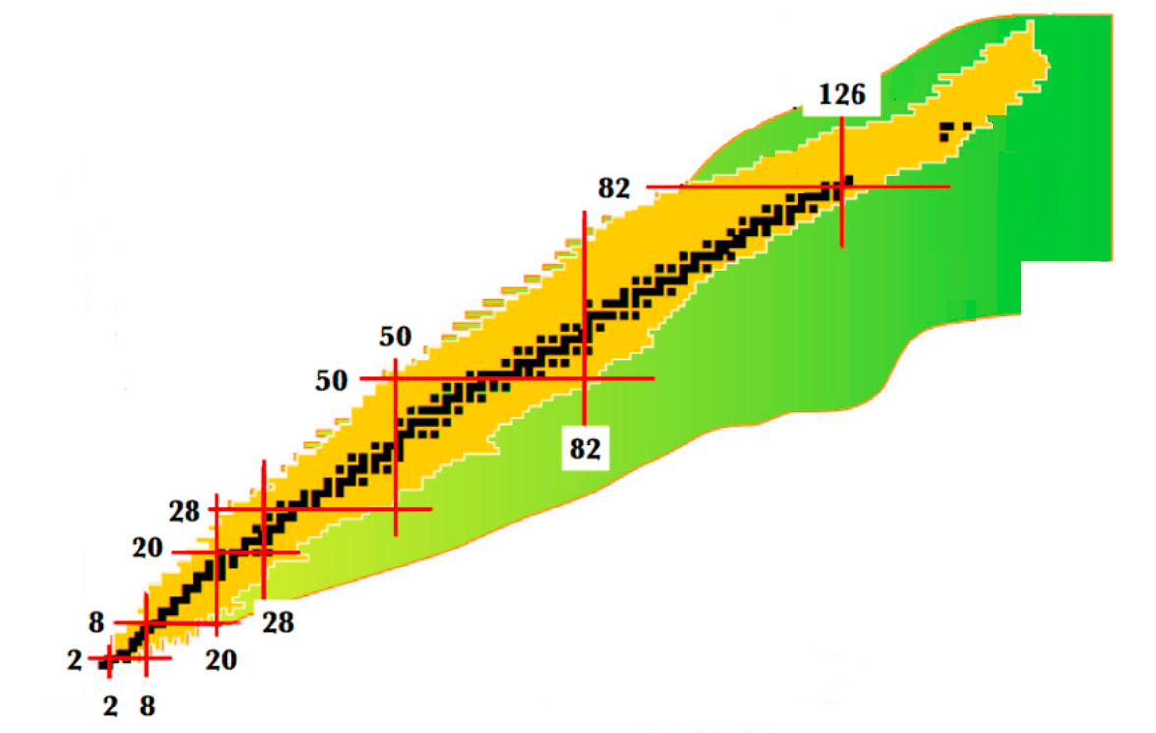
Resonance laser ion source
Auto-ionizing state
Thermal photos/
electric field
Ionization Potential
Rydberg states
Good ionization efficiency
Z selectivity
Ground State
High resolution mass separators
Proton number
Laser ionization
Neutron number

Slide 3

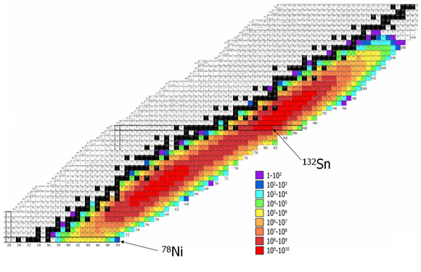
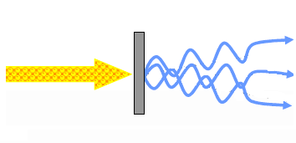
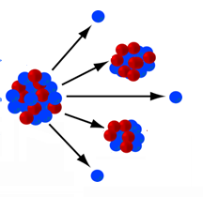
Neutron rich nuclei productions
e⁻ induced photofission
10¹¹ fissions/second
ALTO LINAC
10uA, 50 MeV electron beam
No contamination from the isobars of neutron deficient nuclei
High productivity around two closed shells N=50 and N=82
β decay of neutron rich nuclei around N=50 and N=82 at ALTO

Slide 4
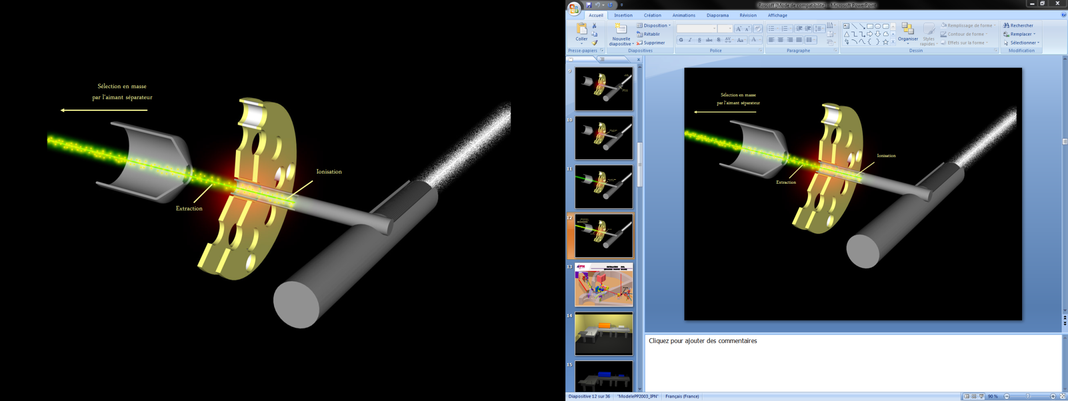
ISOLDE -type ion source
extracted ion beam
electron beam
ionisation
photofission
uranium carbide target

Slide 5
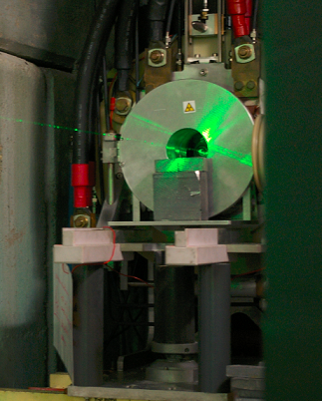
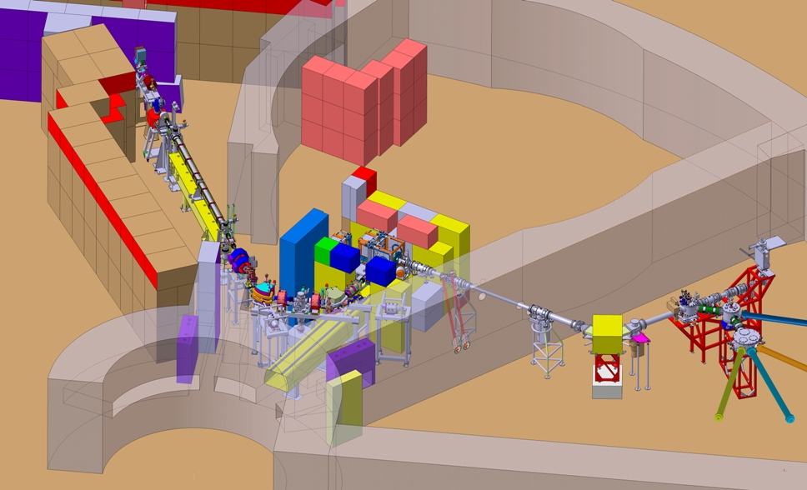
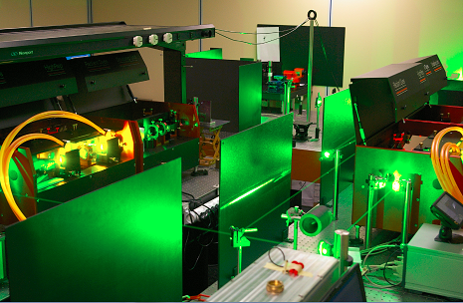
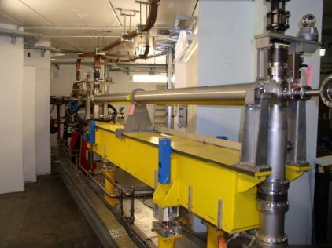
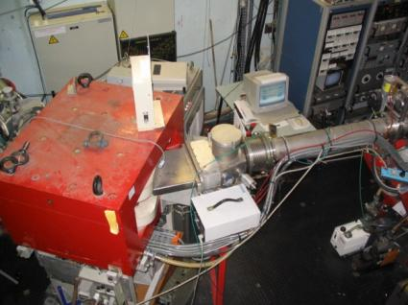
Laser lab
Target and ion source
e-LINAC
mass separator

Slide 6
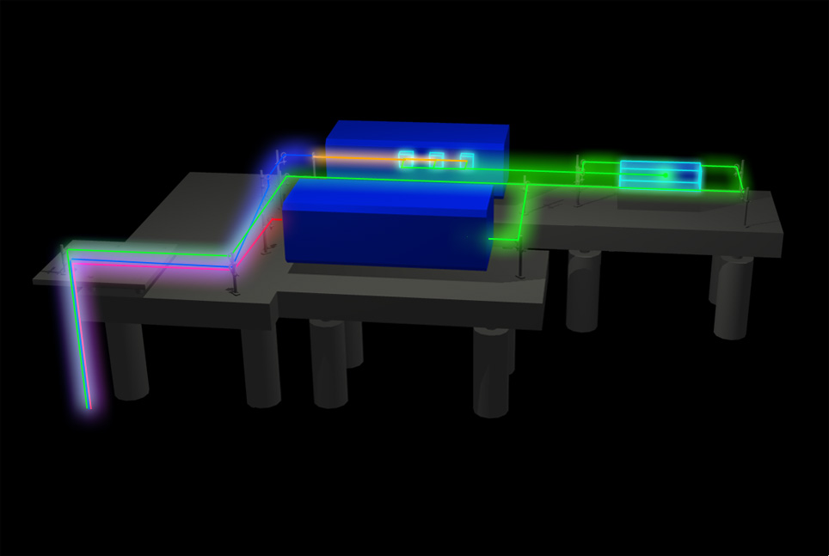
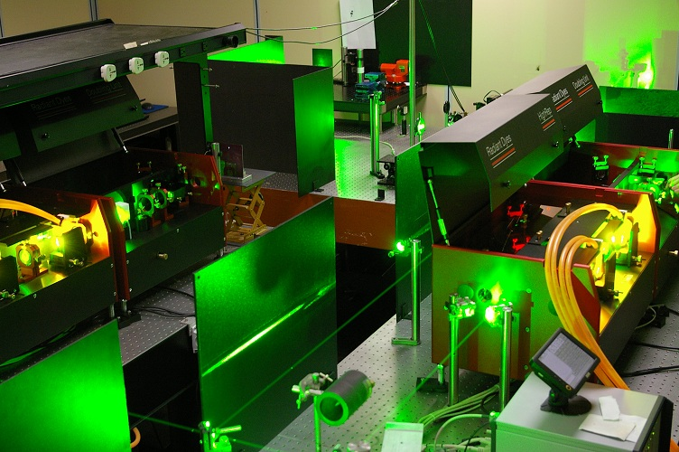
Laser system
Pump laser: Nd:YAG laser ( 532nm, 100W )
Two new Radiant Dyes lasers (540-850nm, typically ~8W @ 30W pump laser, ~10ns pulse width and ~3GHz linewidth )
BBO doubling units (270-425nm, typically hundreds mW )

Slide 7
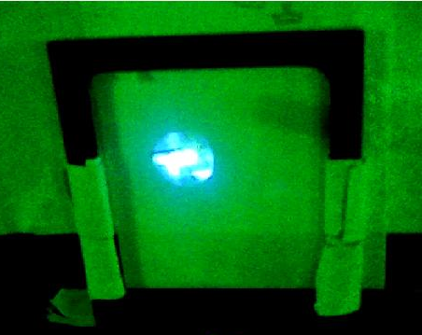
2 X
Dye laser
Pump laser
2 X
Dye laser
Up stairs
Down stairs
Mass separator
ionizer

Slide 8
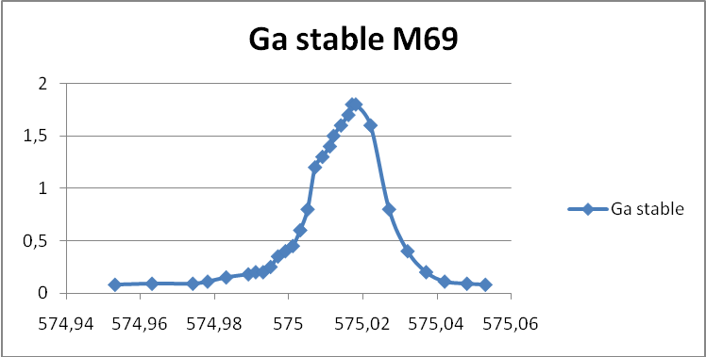
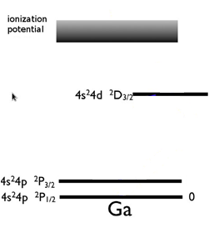
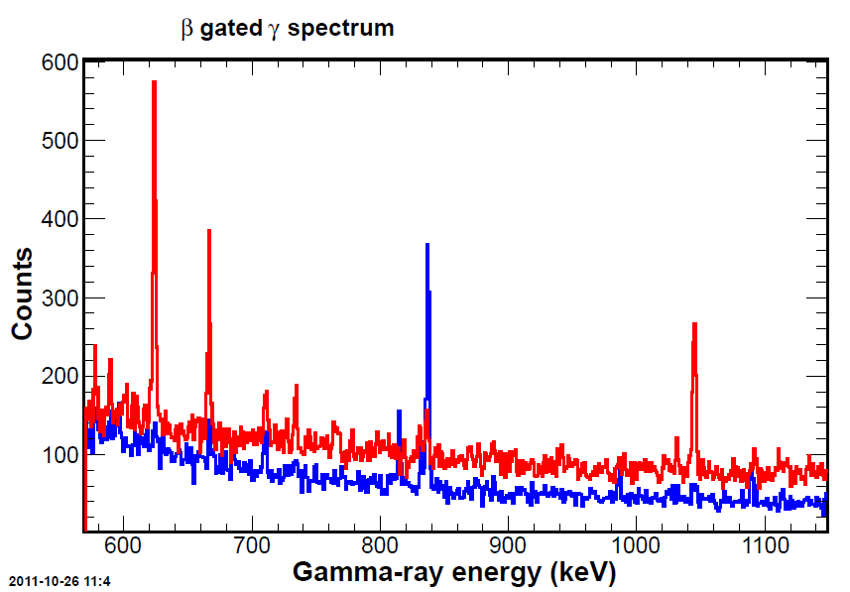
Ga isotopes on-line delivery in 2011
48387.6 cm⁻¹
18 W at source (transmission = 67%)
532 nm
x 10
34 781.6 cm⁻¹
287nm
120 mW at source (transmission = 24%)
826.2 cm⁻¹
cm⁻¹
X10 enhancement in ionization
efficiency compared to surface ionization
laser ionization ε~10% & 10 µA
& Z selectivity
blue: surface ionization ε~1%& 1 µA
⁸⁴Ga->⁸⁴Ge

Slide 9
Stable Ga (mass=69) in 2012
Two new dye lasers (Radiant Dye)
Collaborated with ISOLDE (Bruce March & Kieran Flanagan)
48387.6 cm⁻¹
532 nm
287nm (300mW) | 532nm (~10W) | Ions (nA)
off | off | 1.3
√ | off | 1.3
off | √ | 1.3
√ | √ | 22
34 781.6 cm⁻¹
287nm
55.3 %
44.7 %
826.2 cm⁻¹
cm⁻¹
x 17

Slide 10
Radioactive Ga (mass=82) in 2012
ionized both from the ground state (0 cm⁻¹) and metastable state (826.2 cm⁻¹)
48387.6 cm⁻¹
287nm (250mW) | 294nm (130mW) | 532nm (~10W) | Ions (pA)
off | off | off | 50
√ | off | √ | 150
off | √ | √ | 220
√ | √ | √ | 305
532 nm
34 781.6 cm⁻¹
294 nm
287nm
55.3 %
44.7 %
826.2 cm⁻¹
cm⁻¹
laser enhancement dropped from X18 to X3 with the 287nm+532nm scheme
efforts were made: optimize the alignments of lasers, check the synchronization of the laser pulses, check the wavelength by taking the resonance curve, check the saturation of the atomic transition by the saturation curve.
more beam diagnostics—installing MCP in the beam line to check the pulse temporal profile.

Slide 11
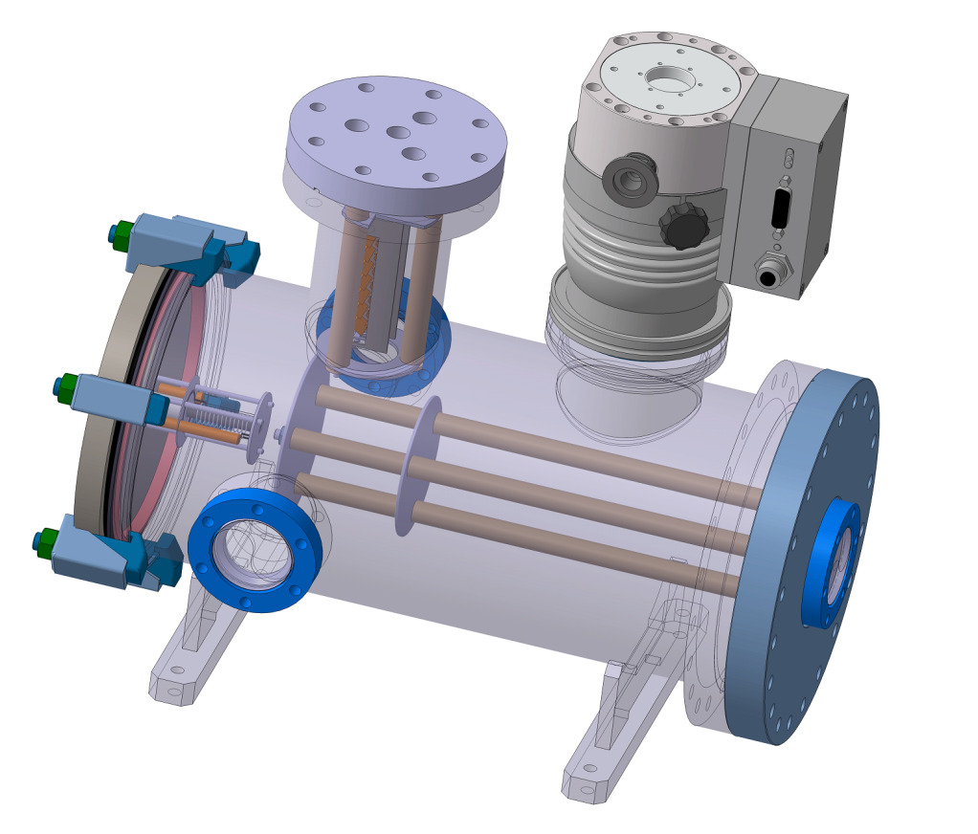
Off-line reference cell
Develop unknown laser ionization schemes
Test the ionization schemes before on-line runs
Electron multiplier
Pump
oven
laser
laser
Collaborate with : Mainz University Tobias Kron, Klaus Wendt
IPN design office: Fabien Leseigneur , Denis Reynet

Slide 12
Example: Tellurium(Te) scheme development
3rd laser
Nonresonance
AI resonant ionization
Nonresonance
AI
IP 72667.8(8) cm⁻¹
532 nm
AI/ Rydberg
63556.7 cm⁻¹
-- 68603.6 cm⁻¹ ^{b}
Scan from 384.404nm(1st step 214nm) / 351.929nm (1st step 225nm) to lower wavelength
< 384 nm
540nm-591 nm ^{b}
46652.738 cm⁻¹
5p³(⁴Sº)6s ³Sº J=1
44253.000 cm⁻¹
5p³(⁴Sº)6s ⁵Sº J=2
214.281 nm (air) ª
225.903 nm (air) ª
Tripling unit
A=3.12 X10⁸
A=1.28 X10⁷
Collaborate with ISOLDE
0 cm⁻¹
5p⁴ ³P J=2

Slide 13
Plan in 2013
Build and test the reference cell (collaborate with Mainz University)
Instrument and optics upgrading: new wavemeter, transport mirrors and focusing lens for broader wavelength range.
Develop and test Zn and Te ionization schemes (tripling unit: collaborate with ISOLDE)
Develop the function of Second harmonic scanning of the dye lasers.
2013 On-line beam delivery of Zn

Slide 14
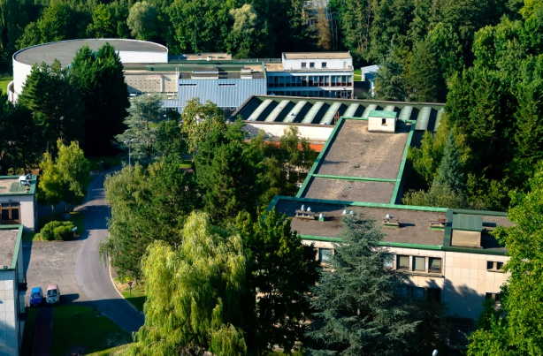
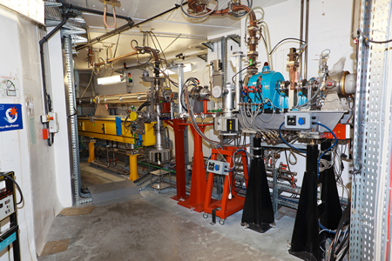


Merci beaucoup!
Thank you!

