Slide 1
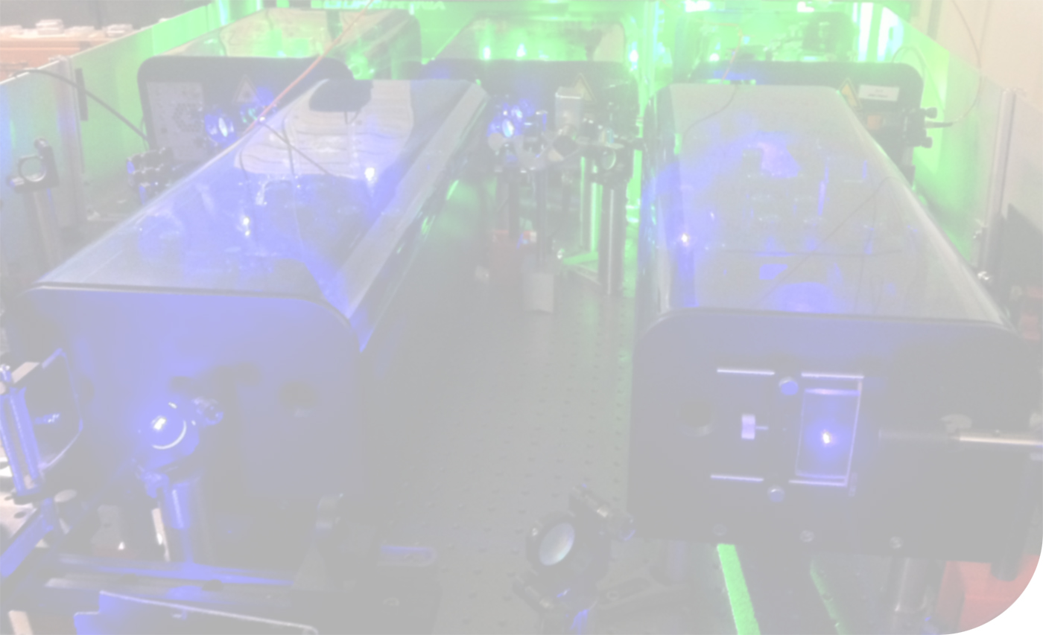
Radioactive Ion Beam (RIB) Production at ISOLDE by the Laser Ion Source and Trap (LIST)
Sven Richter for the LIST-, RILIS- and ISOLDE IS456 Collaborations

Slide 2
Content
Motivation:
Experimental Setup:
Results:
Summary
Upgrade of the ISOLDE RILIS towards
full suppression of isobaric contaminations
Standard operation of the ISOLDE RILIS
Principle of the Laser Ion Source and Trap
LIST offline & LIST online run 2011
LIST online run 2012

Slide 3
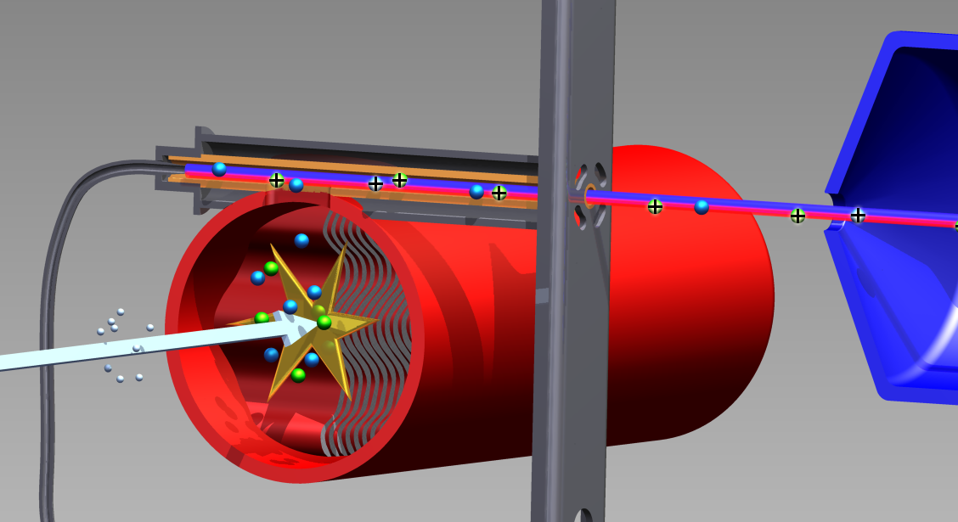
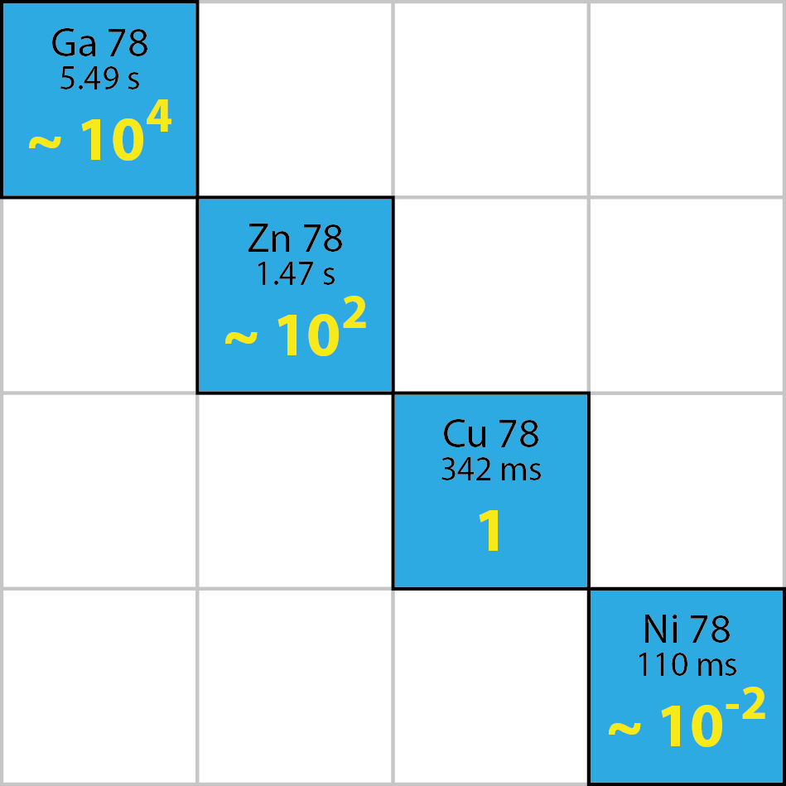
Motivation: Reduction of Isobaric Contamination
Mass-marker
Hot cavity atomizer
Laser beams
Protons
1,4 GeV
Nuclear
Reaction
Target
Extraction
Nickel-78 ion beam: Example of isobaric contamination
Cross-section production of different isotopes in a UCx target with 1.4 GeV protons

Slide 4
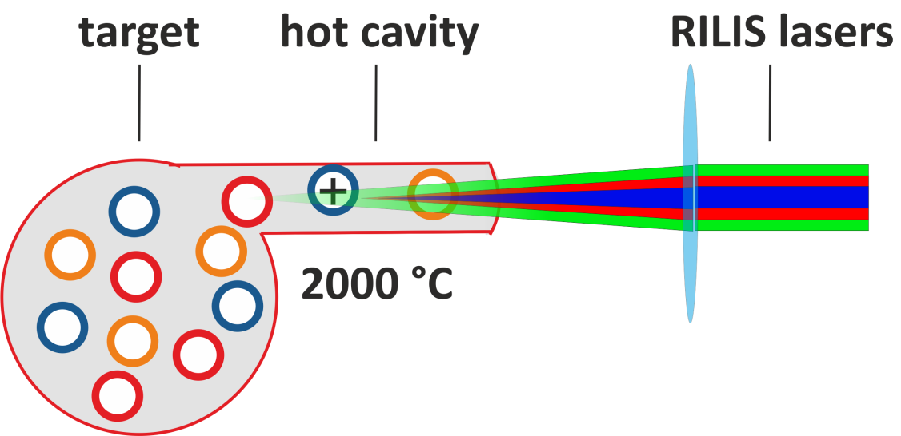
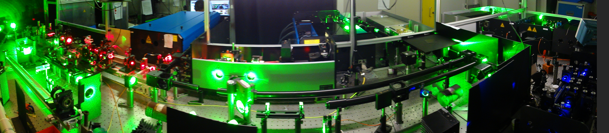
Scheme of RILIS at ISOLDE
Element unique RILIS schemes
Principle of RILIS
AIS
Ion
IP
Rydberg
state
RILIS lasers
E₂
E₁
Atom
E₀
Very efficient and element selective ionization!
Panoramic view of the RILIS laser setup:
Slide: D. Fink

Slide 5
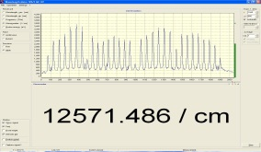
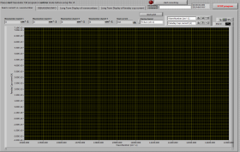
Dual RILIS Laser Setup
Nd:YAG
Dye 2
λ – meter
SHG
Dye 1
THG
10 kHz Master clock
Narrowband Dye
RILIS Dye Laser System
GPS/HRS
Delay generator
RILIS Ti:Sa Laser System
Target &
Ion Source
Nd:YAG
Ti:Sa 1
SHG/THG/FHG
Ti:Sa 2
Faraday cup…
Ti:Sa 3
λ – meter
LabVIEW based DAQ
pA – meter
Slide: S. Rothe

Slide 6
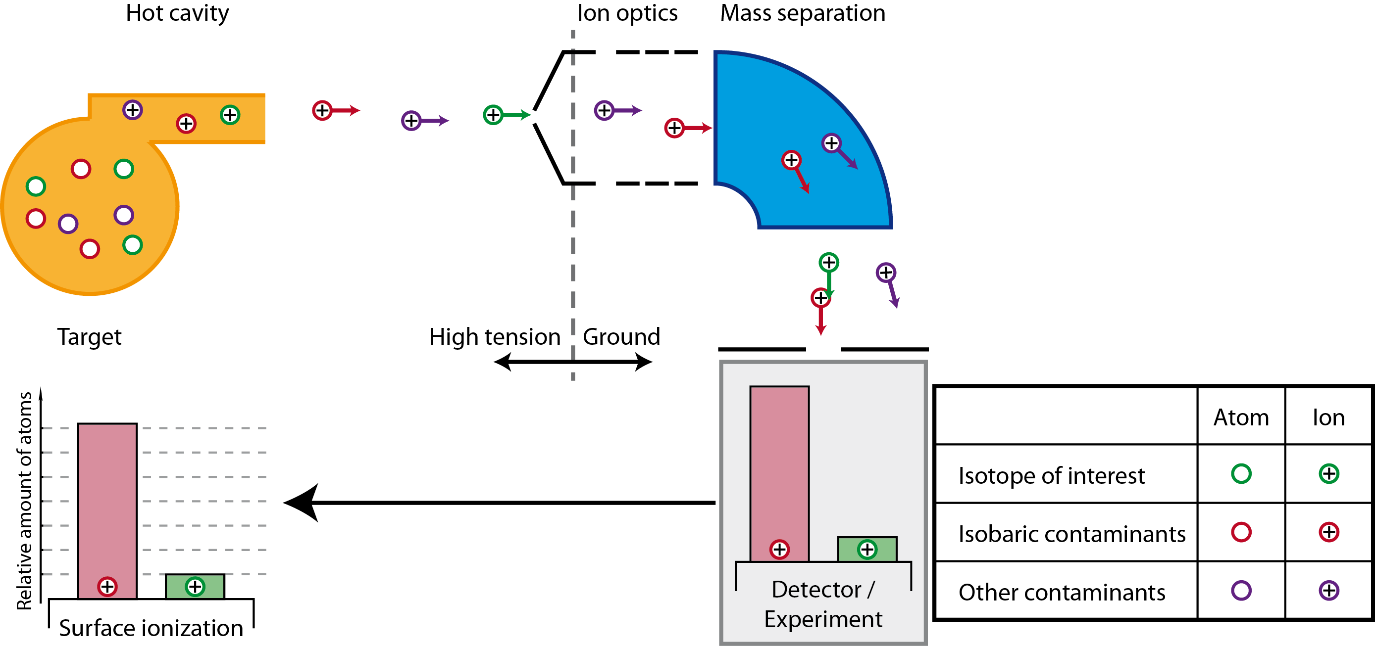
Ion Source & Beam Purity
Surface Ionization
Nonselective surface inonization in hot cavity
Strong interference in experiments by isobaric contamination

Slide 7
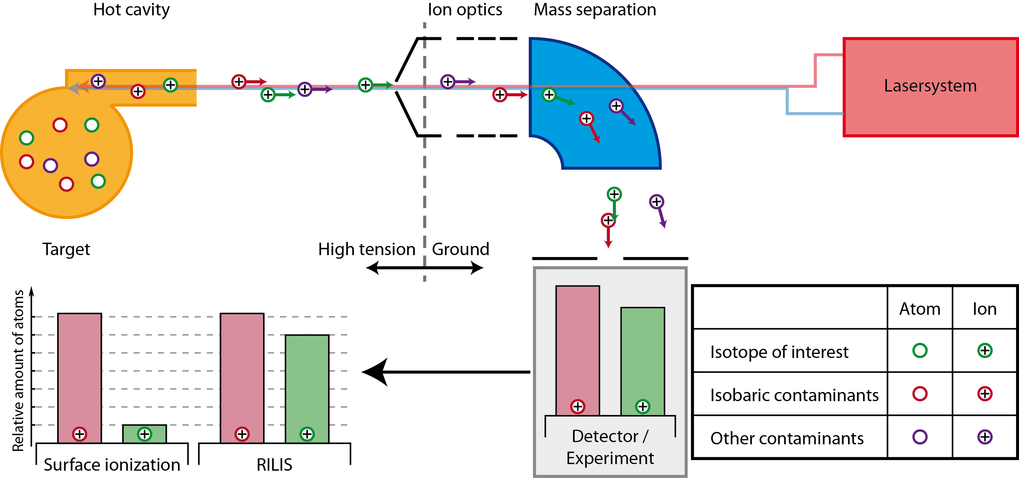
Ion Source & Beam Purity
RILIS
Increase of ionization efficiency for the element of interest
Better selectivity but no suppression of isobaric contaminants

Slide 8
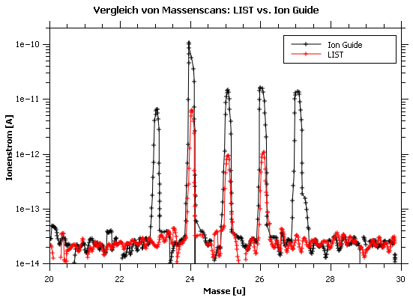
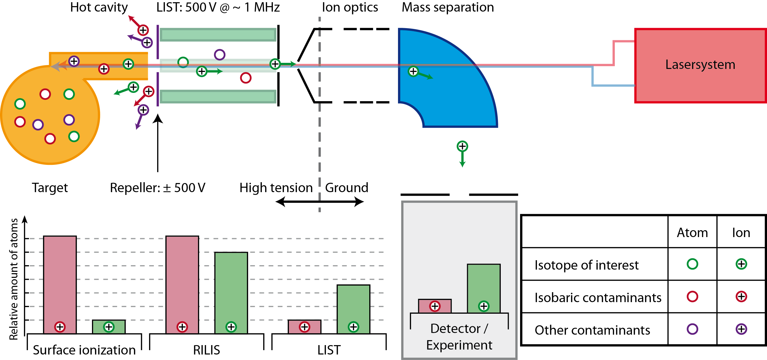
Ion Source & Beam Purity
Laser Ion Source & Trap
Mg²⁴
Mg²⁵
Mg²⁶
Al²⁷
Na²³
ion current [A]
mass [u]
Suppression of surface ions by electrostatic repeller
High selective laser ionization inside the LIST
Ion guide towards extraction by transverse rf-trapping field

Slide 9



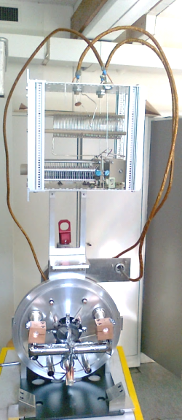
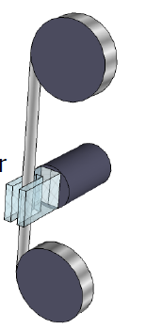
Principle of using the LIST at ISOLDE
RILIS cabin
High voltage cage
1. 285 nm (UV)
Glass fiber
Nd:YAG
Dye 1
SHG
Repeller voltage
2. 552 nm
Dye 2
Remote control
Rf-generator
3. 532 nm
Mg RILIS setup
̴ 20m
ISOLDE hall
Target area
GPS
+
+
+
Separator magnet
+
+
60 keV
Detectors: tape station, Faraday cup, MCP, WINDMILL
Slide: D. Fink

Slide 10
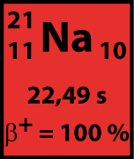
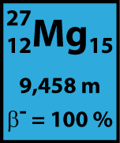
LIST run in 2011: results
First on-line test of the LIST in May 2011
Physics case: Mg
Realistic on-line conditions over 48 hours
Suppression limited by background
of Faraday cup
No significant changes of LIST performance during online run
Effective suppression of surface ions but with lower laser ionization efficiency.

Slide 11
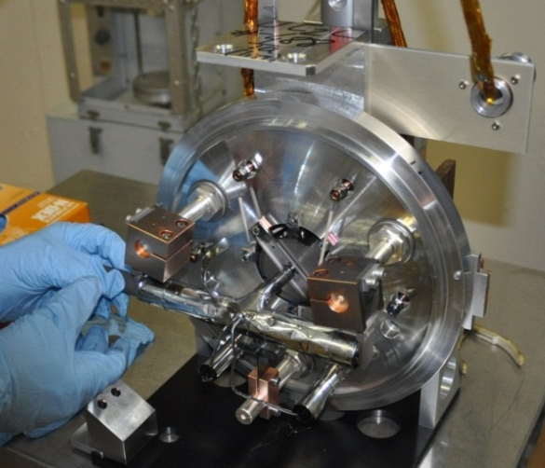
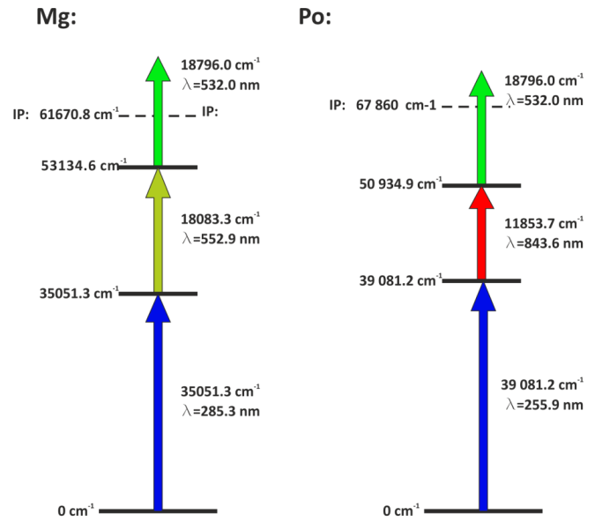
LIST run in 2012: overview
UCx target
Goals of 2nd LIST online run:
First real online application of LIST at ISOLDE
Provide highly purified beams of Mg and Po
Proof of principle with strongly outgassing UCx target
Test of improved LIST design for higher efficiency
RILIS schemes for Po
α detector (Windmill, Leuven)
Annular Si
Si
216Po
beam
C-foils
20 mg/cm²

Slide 12
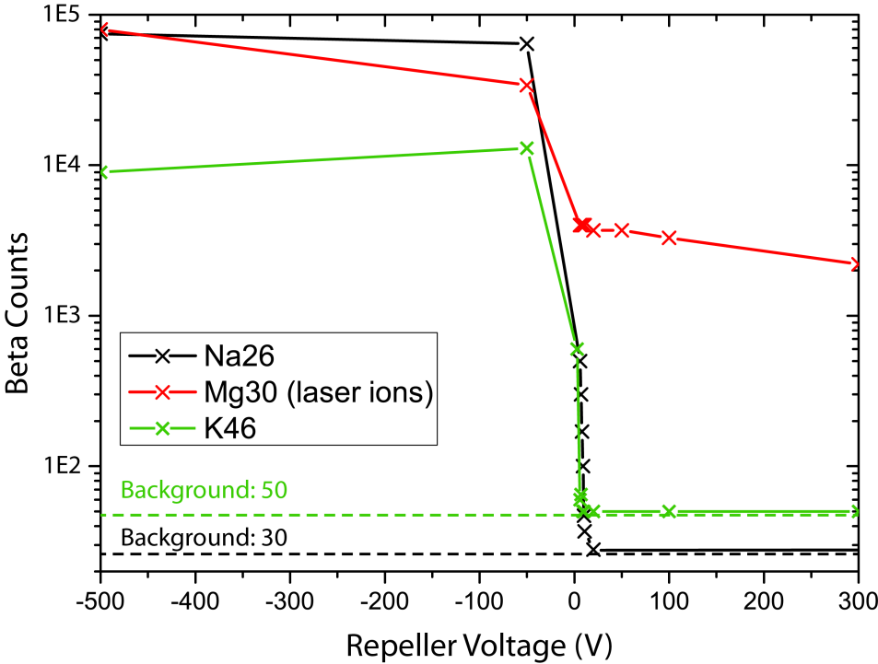
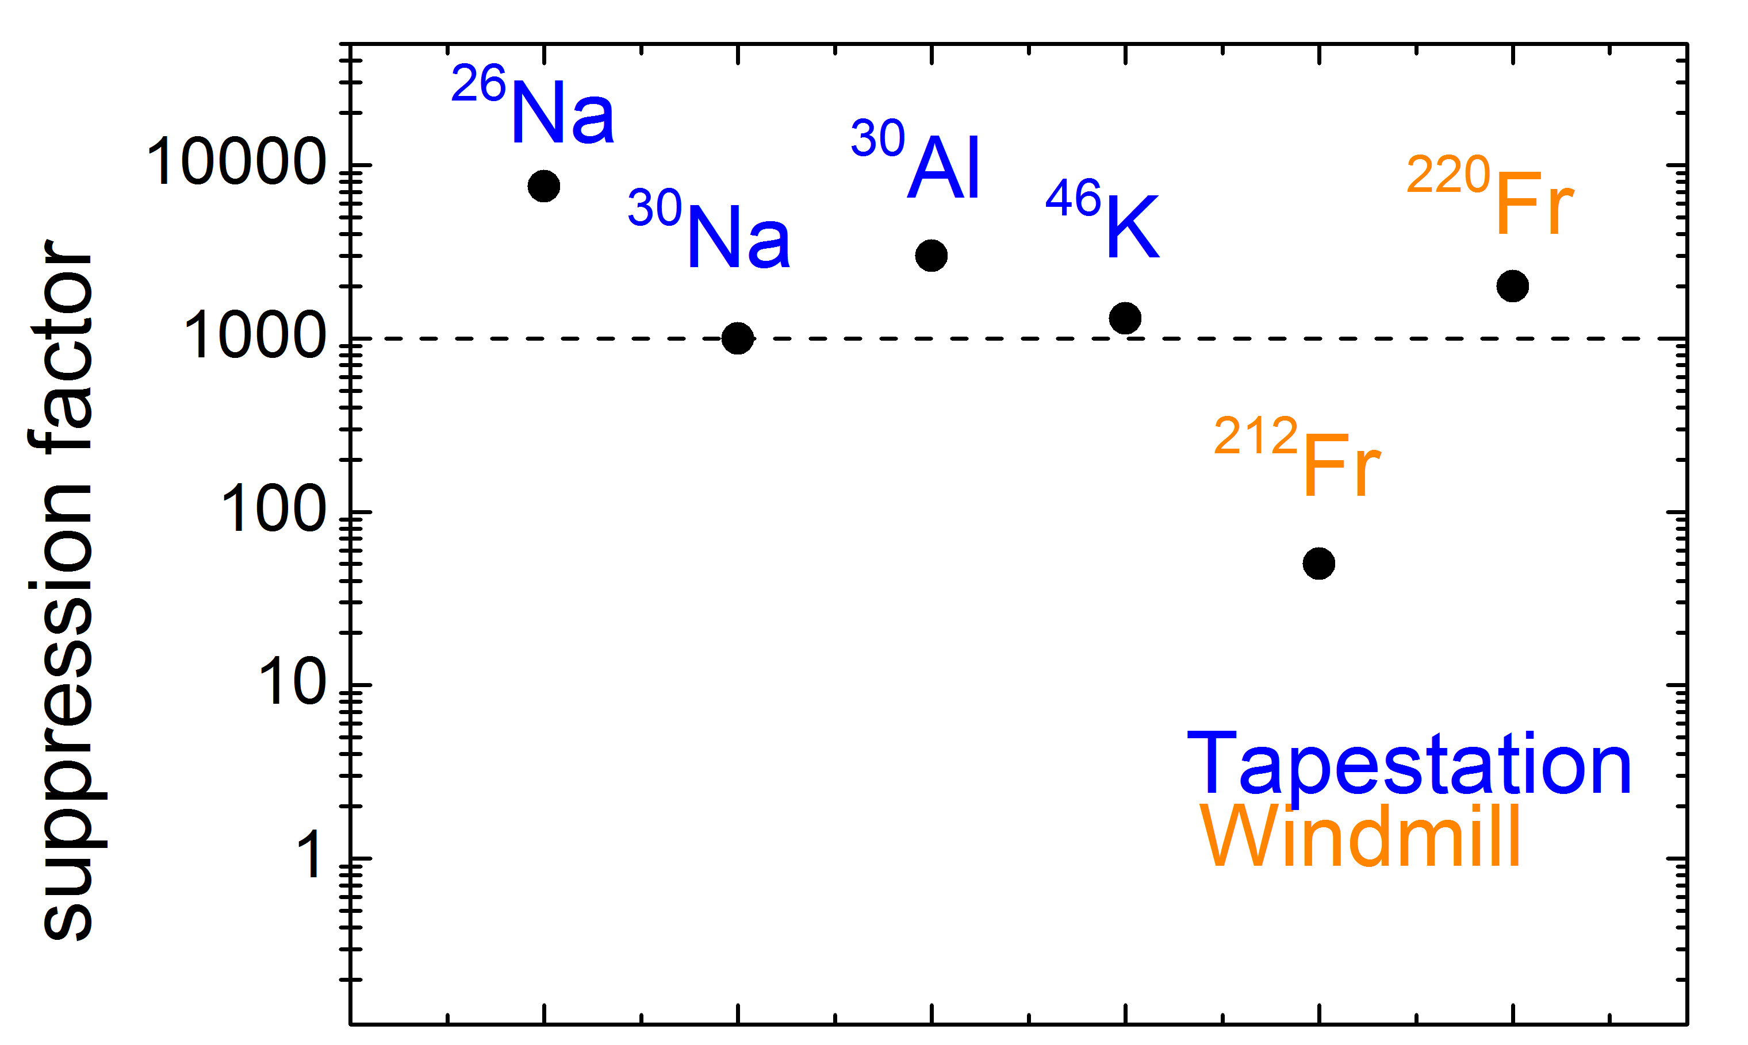
LIST run in 2012: suppression
Analysis of suppression factors for different isotopes
Suppression factor
RILIS vs. LIST mode
Suppression
(2011) ²⁷Mg:
³⁰Mg:
²⁰⁸Po:
Usually > 3 orders of magnitude
Exceptions observed for some isotopes
➔ Limits by LIST electrode structure
(2012)

Slide 13
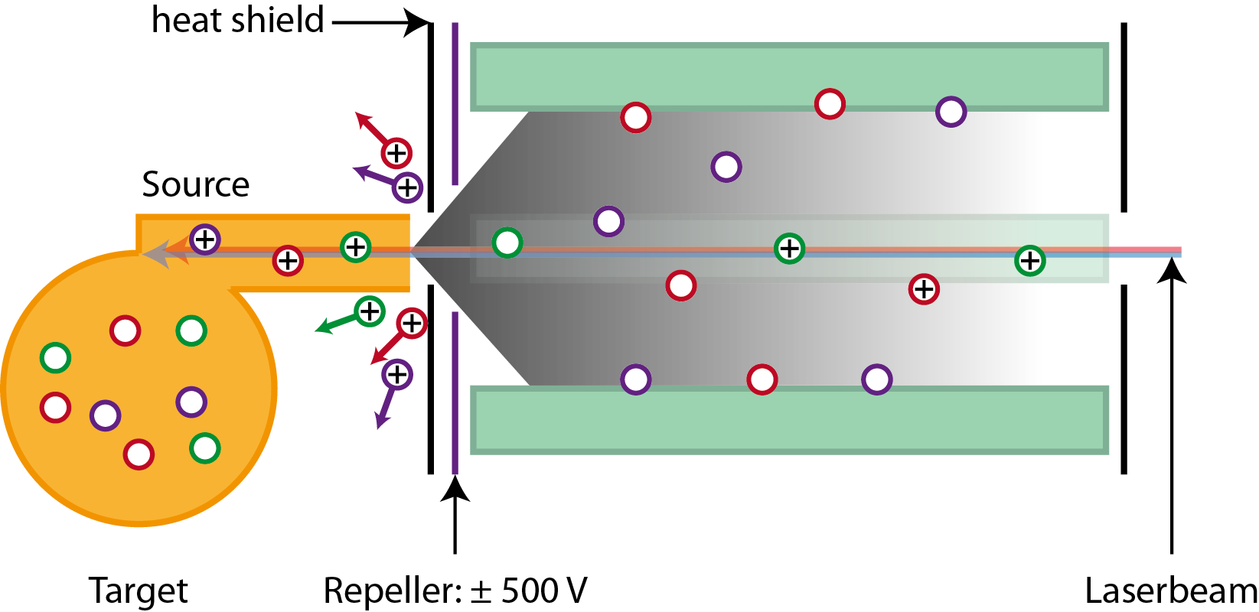
LIST run in 2012: suppression limits
Suppression Limits
Deposit of neutral atoms on quadrupole rods
Decay inside the LIST
Other ionization mechanisms
➔ Secondary isobaric contamination

Slide 14
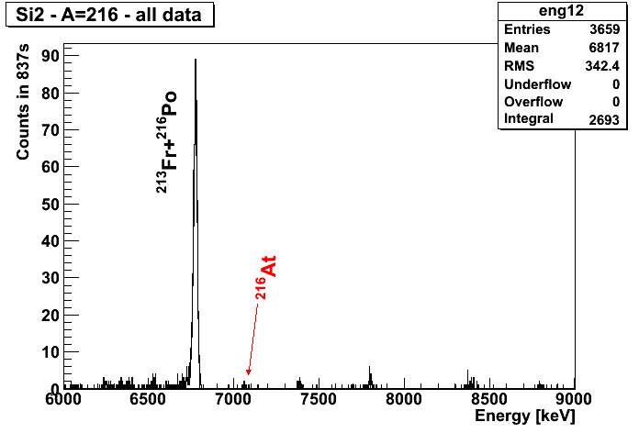
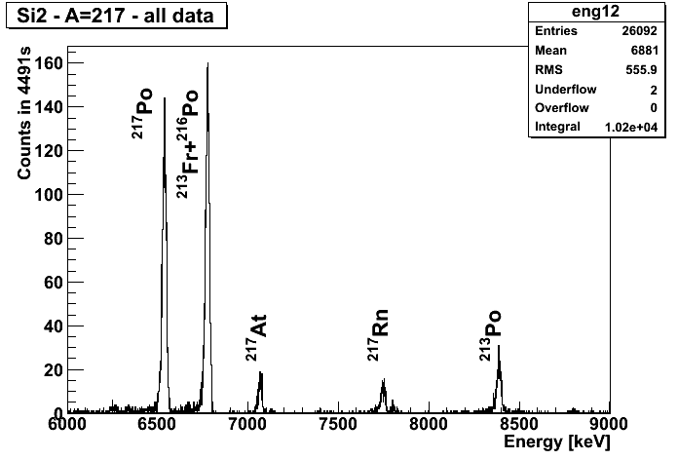
Unexpected production of short-lived isotopes
α-spectrum at mass 216u:
α-spectrum at mass 217u:
²¹⁶At: T_{1/2} = 300µs,
α-decay of ²²⁰Fr
²¹⁷Rn: T_{1/2} = 540µs,
α-decay of ²²¹Ra
²¹⁷Rn
Deposit of mother nuclei (e.g. ²²⁰Fr, ²²¹Ra) on quadrupole rods
Decay inside the LIST
Other ionization mechanisms and extraction towards ISOLDE beam line
0.2 counts/sec of short-lived isotopes (²¹⁶At, ²¹⁷Rn)
general half life of produced isotopes at ISOLDE: > 1 ms
Notes:
Ra = Radium

Slide 15
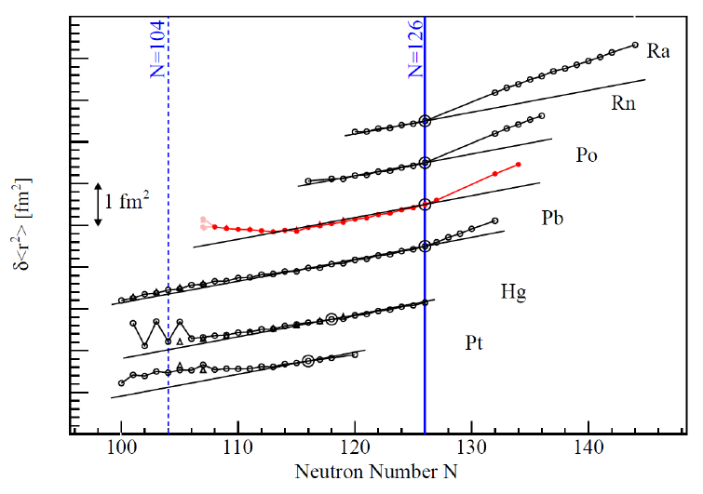
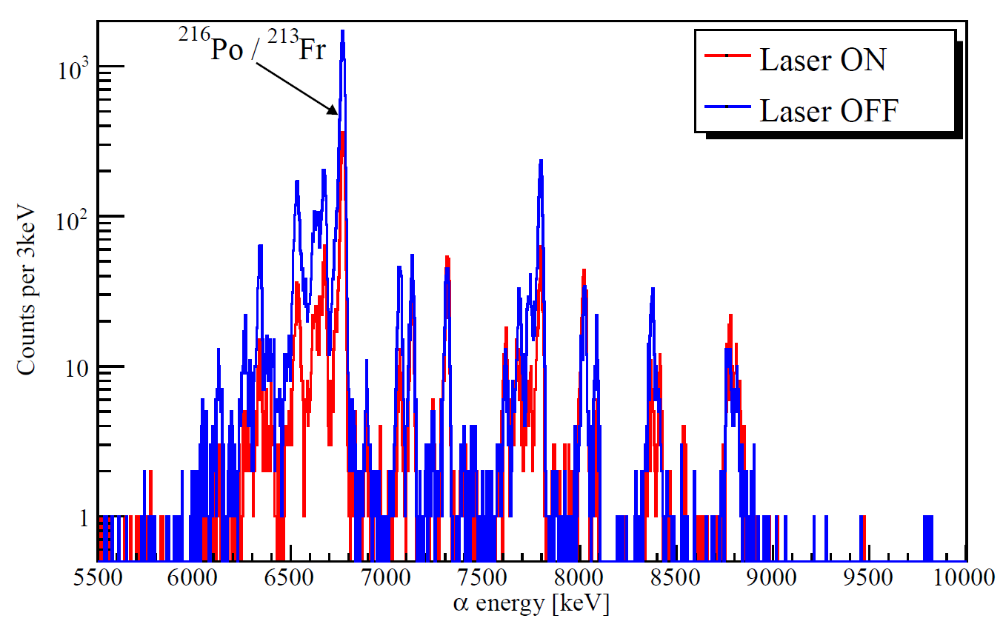
LIST run in 2012: Laser Spectroscopy on Po
Two measurement campaigns in 2007 and 2009 at ISOLDE/CERN
Mean square radii of Po-isotopes among other elements:
Several Po-isotopes remained unstudied due to strong Fr-contamination
Using LIST to suppress Fr contamination in 2012
Work of T. E. Cocolios, M. Seliverstov et al.

Slide 16
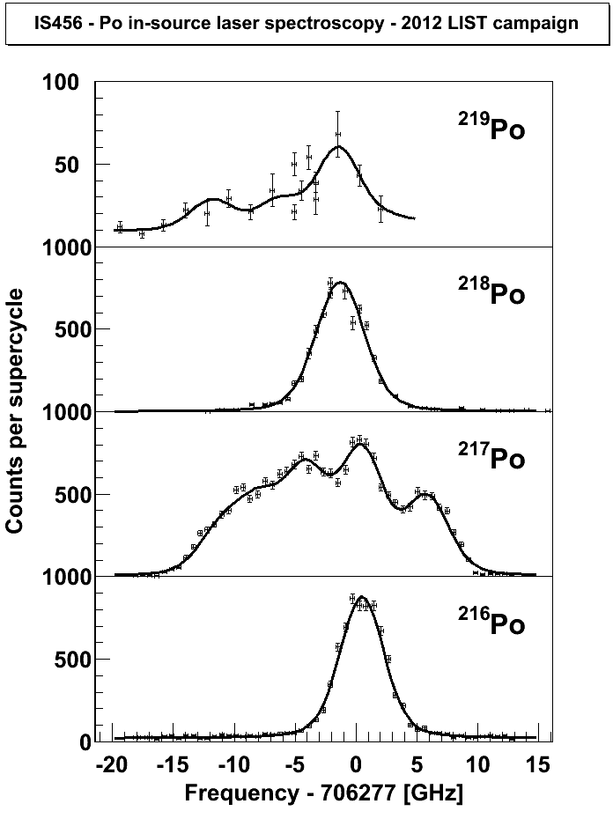
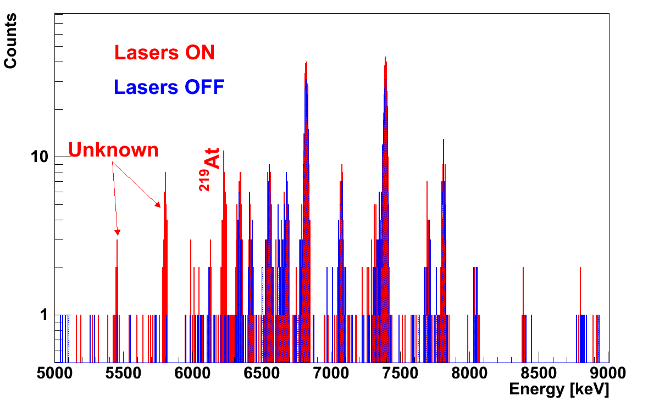
Polonium Spectroscopy: HFS and IS
New Po-decay data on mass 219
Preliminary
²¹⁶Po and ²¹⁷Po in one measurement
  Direct measurement of IS of ²¹⁶Po and ²¹⁷Po
Laser frequency offset, GHz
Slide: D. Fink

Slide 17
Summary
Suppression of isobaric contamination and selectivity improvement of RILIS by LIST
Proof of principle by 2011 on-line run:
  Suppression of > 1000
  Ionization efficiency reduction of ≈50 (Mg)
First real physics application in 2012:
  Laser spectroscopy of ²¹⁶⁻²¹⁷Po possible due to suppression of Fr by LIST
  Suppression factor > 1000
  (limited by depositon and decay inside the LIST for few isotopes)
  Ionization efficiency reduction of ≈20 (Mg,Po)
  Production of ion beams of short-lived ions by in-trap decay
LIST demonstrated its ability – a new option for ISOLDE users

Slide 18



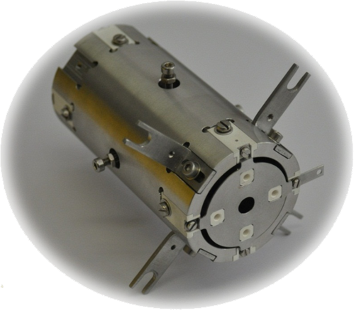





Thank you for LISTening
… and special thanks to all the collaborators:

Slide 19
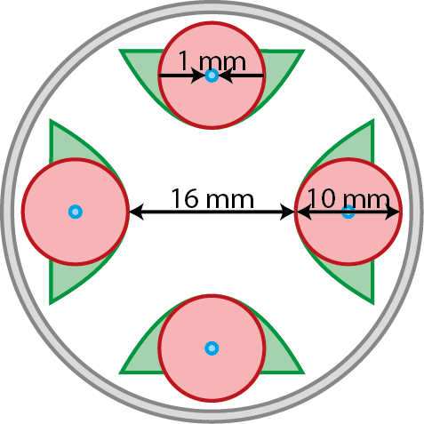
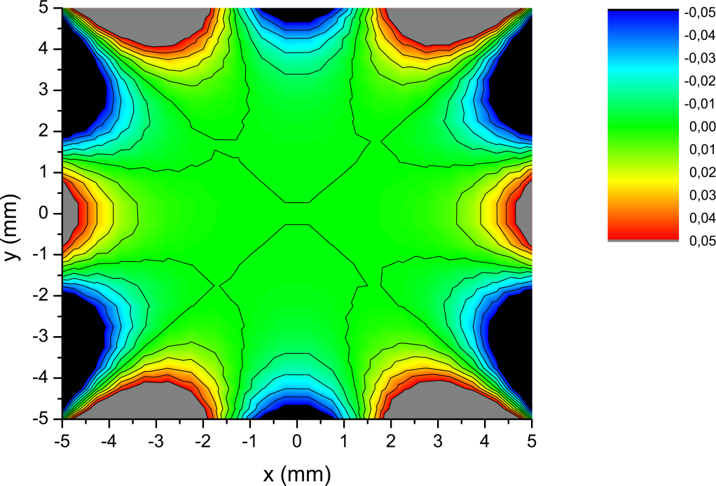
Outlook
Improvements for the next LIST version
  Ensuring suppression for all isotopes
  Avoid deposit of neutral atoms on quadrupole structure
  ➔Surface reduction of quadrupole rods
Analyzing rf-field of the LIST by simulations
Almost the same rf-field in center
as with large rod diameter
5 times higher rf-voltage necessary
➔next step: planning a prototype

Slide 20
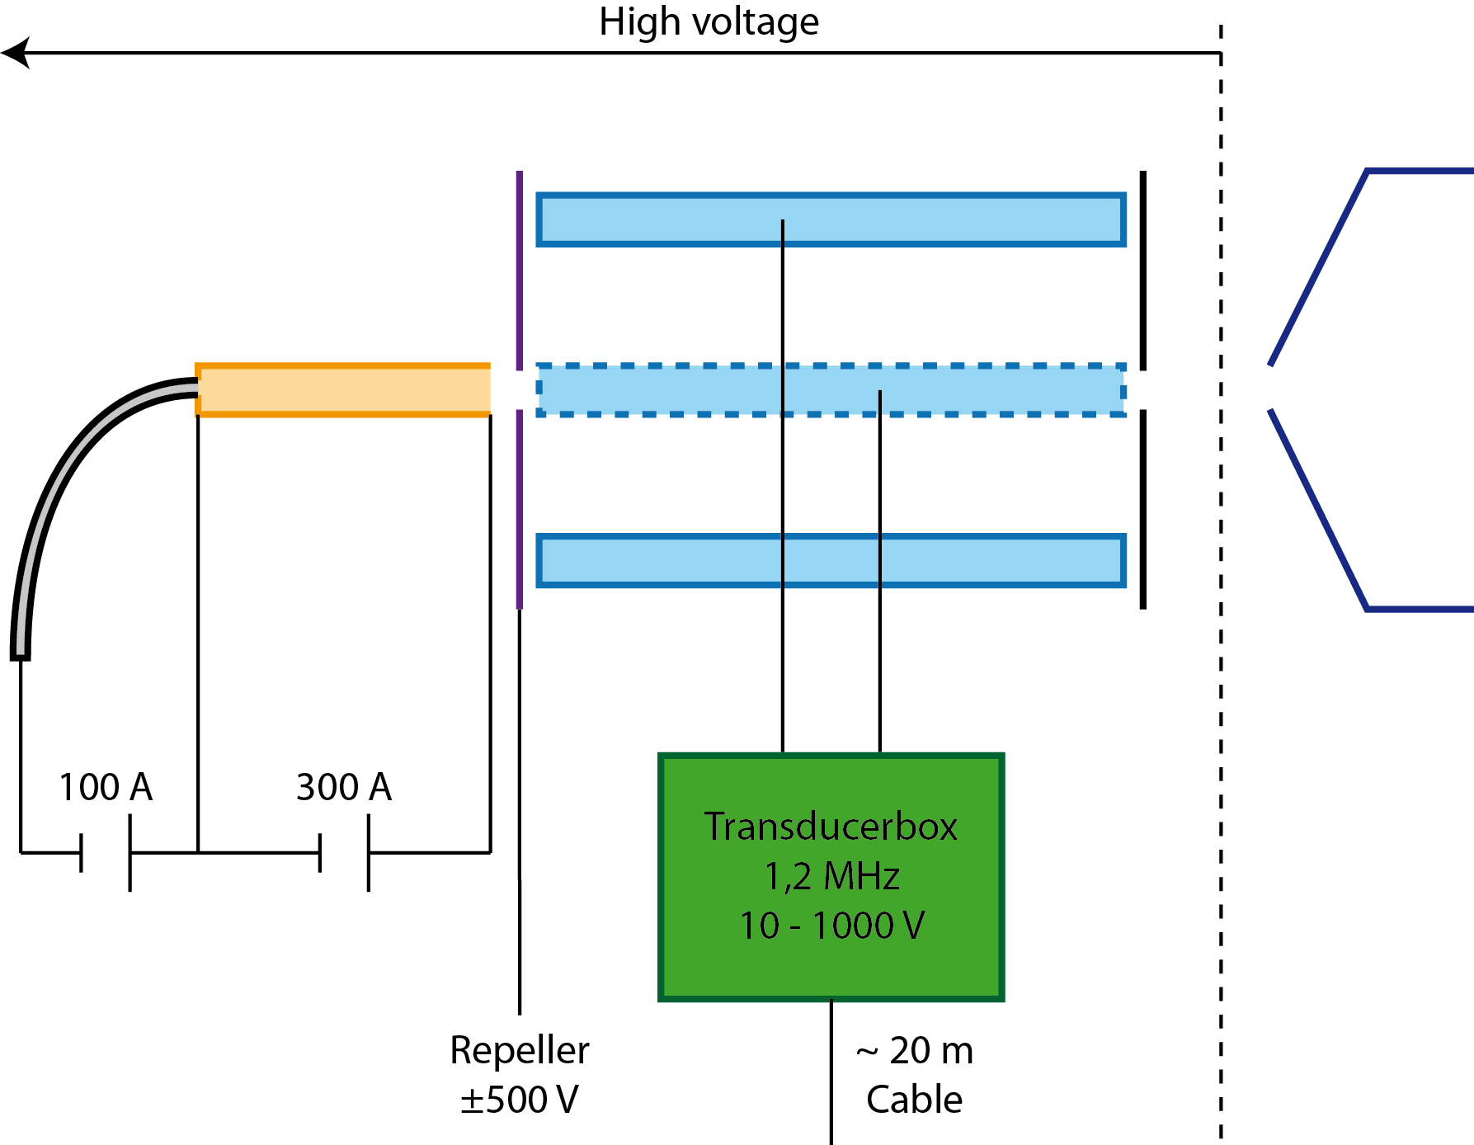
LIST Parameters
Two operational modes of LIST:
  RILIS (ion guide) mode
  LIST (repelling) mode
Electrode potential (Repeller):
  -50 V (ion guide)
  10 V (repelling)
LIST RF field ( 1 MHz)
  Amplitude 10 – 1000 V_{pp}
~
~
~

