Slide 1



Feasibility of Stripping Test along L4Z line Beam Dynamics
Veliko Dimov
BE-ABP-HSL
18.10.2012

Slide 2
Outline
Layout of L4Z line
Option 1 : Installing Only Stripping Foil Unit
Possible location for installation
Beam dynamics simulations
Option 2: Installing Stripping Foil Unit with Chicane Magnets
Possible location for installation
Beam dynamics simulations
Conclusion

Slide 3
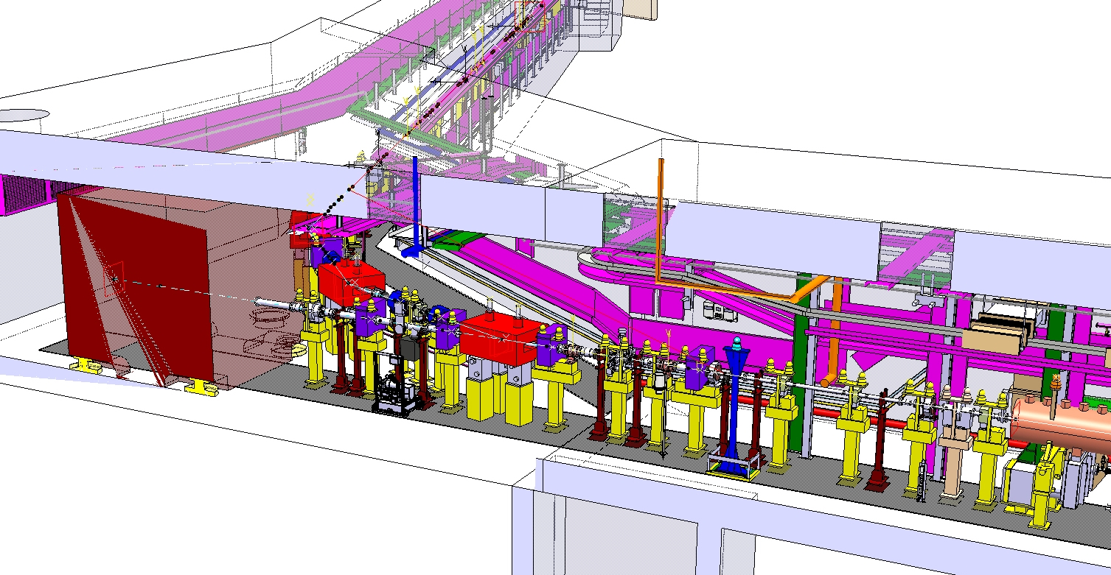
Layout of L4Z Line
BCTs
Profile Monitors
Main Dump
Steerers
Quadruples
Bending Magnet
End of PIMS

Slide 4
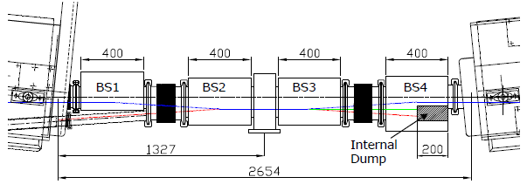
Option 1 : Installing Only Stripping Foil Unit
Requires about 20 cm of free space along the beam line

Slide 5
Option 1 : Installing Only Stripping Foil Unit
̴1m

Slide 6
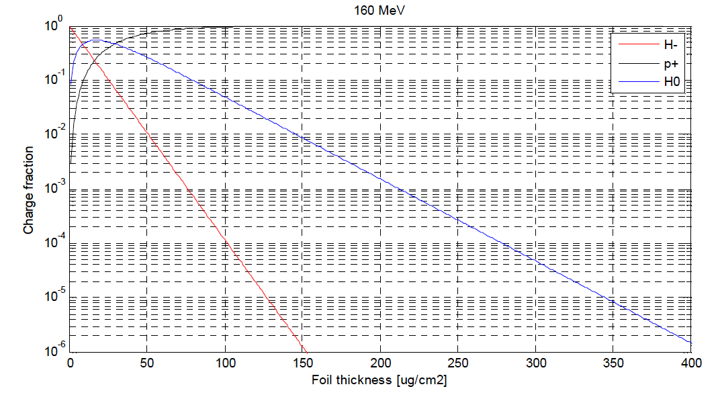
Beam Dynamics Simulations for Option 1
The H- yield is several orders of magnitude below the H0.
In case of a damaged area on the foil, H- ratio will be increased after the foil.
We need optics to transfer H-, H0 and protons to the main dump without loss.
H0: 2 %
H-: negligible
H-, H0 and p+ yield as a function of stripping foil thickness.
Ref: sLHC Project Note 0005

Slide 7
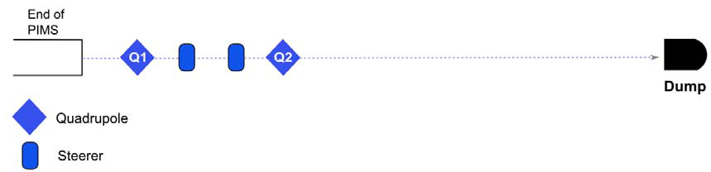
Q1: L4T.MQD.0110, Q2: L4T.MQF.0210
By switching off Q2, a beam composed of protons, H0 and H- can be transported to the dump without any loss.
Q1 can be varied between 2.5 T/m and 9 T/m without beam losses to vary the beam size on the stripping foil.

Slide 8
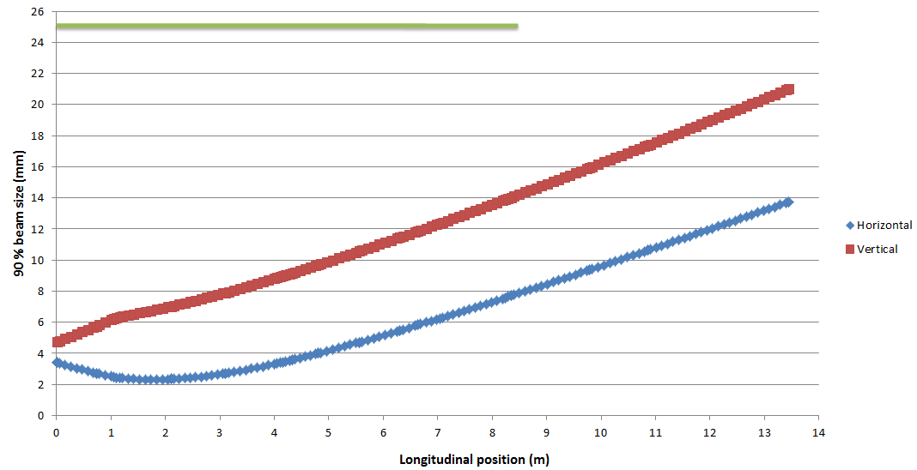
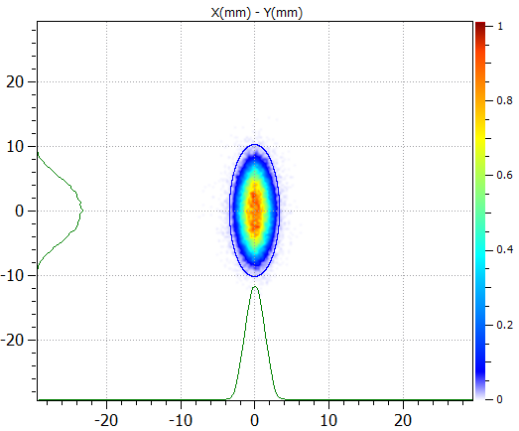
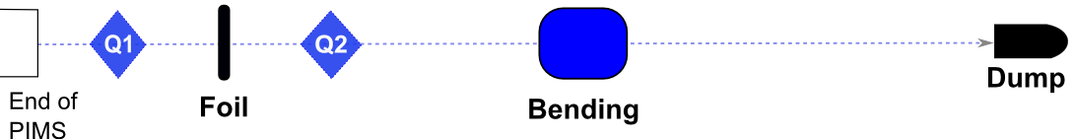
Q1=2.5T/m, Q2=0 T/m
Beam size (x-y) on stripping foil. Blue line shows the 99 per cent emittance ellipse.
99 % beam size
x= ± 3.4 mm
y = ± 10.2 mm

Slide 9
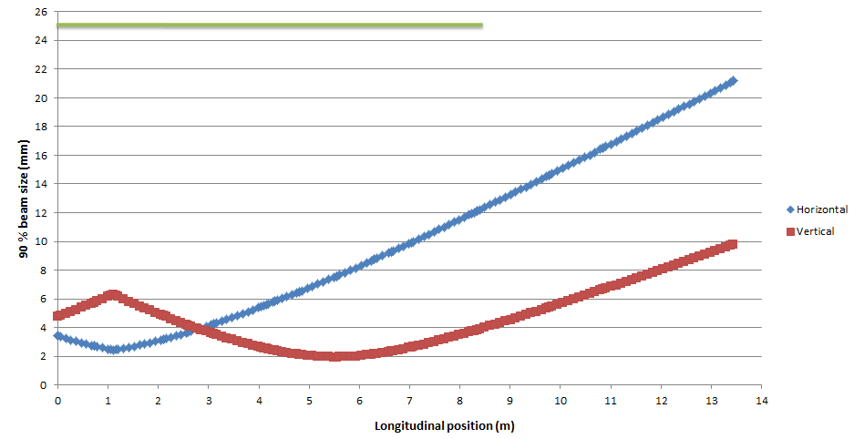
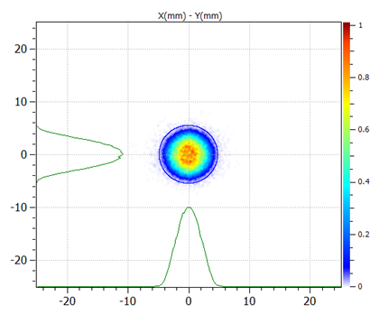
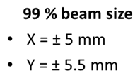
Q1=9 T/m, Q2=0 T/m
Beam size (x-y) on stripping foil. Blue line shows the 99 per cent emittance ellipse.

Slide 10
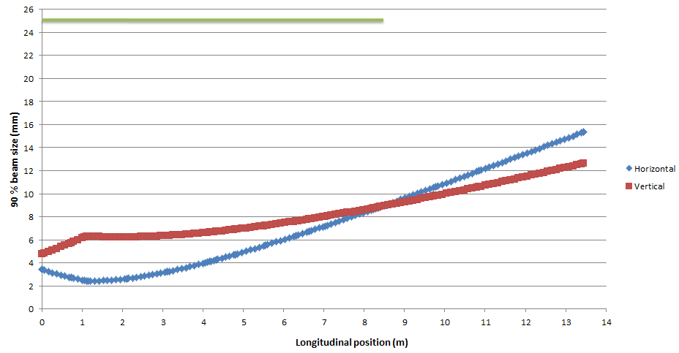
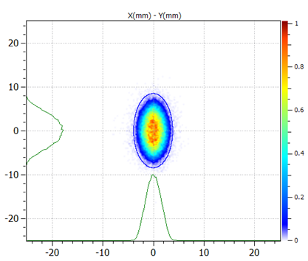
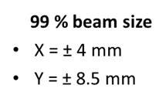
Q1=4.8T/m, Q2=0 T/m
Beam size (x-y) on stripping foil. Blue line shows the 99 per cent emittance ellipse.

Slide 11
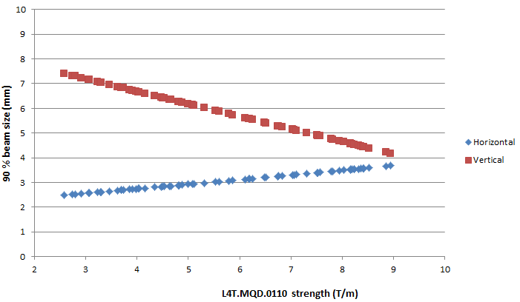
Varying beam size on the foil
PSB injection
H- beam spot size (4rms) is between
3 – 5 mm
90% beam size on stripping foil with different strengths of Q1 (L4T.MQD.0110)

Slide 12
Option 2: Installing Stripping Foil Unit with two Chicane Magnets
Requires about 1.3m of space along the beam line.
Ref: L4-T-EP-0002 rev 1.0

Slide 13
Option 2: Installing Stripping Foil Unit with two Chicane Magnets
Beam pipe size!!!

Slide 14
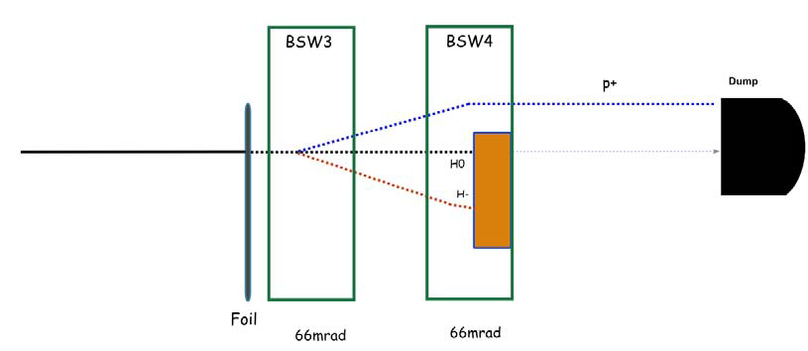
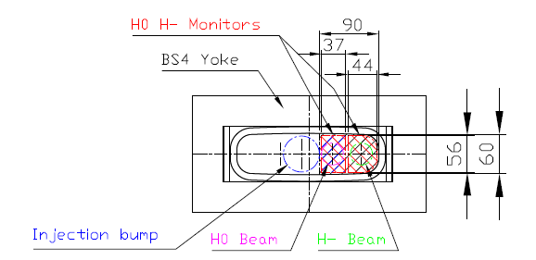
Beam Dynamics Simulations for Option 2
Proton beam will be off axis after stripping.
Bending angle at PSB injection: 66mrad gives around 45 mm offset of the proton beam.
Beam pipe radius is 50mm.
Possibility of hitting the beam pipe and missing the dump!!!
We need to make sure that proton beam is transferred to main dump safely.
H0 and H- beams must fall on the area covered by the H0 and H- monitors in front of the internal dump.
Cross-section of internal beam dump and areas to be covered by the H0/H- monitors (Ref: L4-T-EP-0003 rev 1.0).

Slide 15
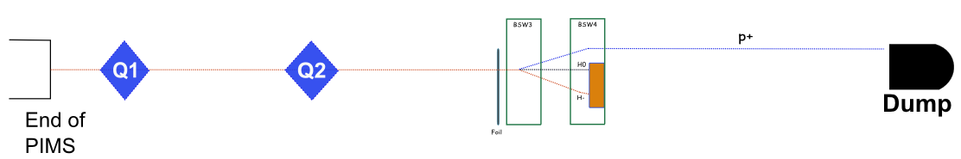
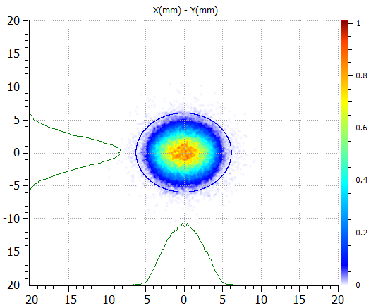
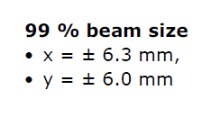
Q1=9 T/m
Q2=-6.5 T/m
Small horizontal size
Small horizontal divergence

Slide 16
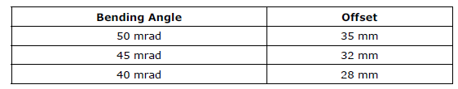
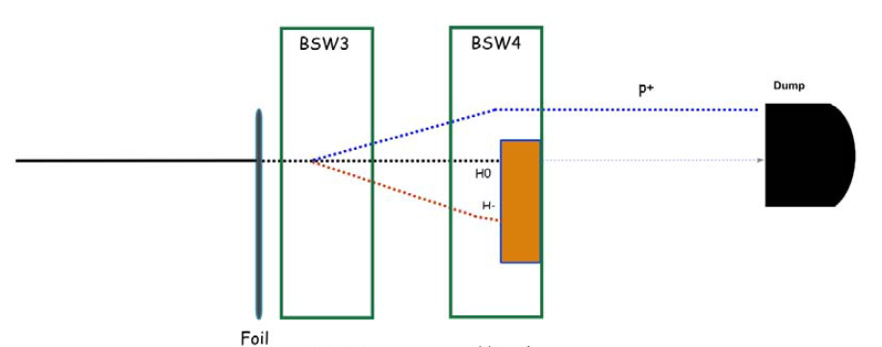
Reducing bending angles of Chicane Magnets
Bending angles of chicane magnets and offset of proton beam.
A bending angle of 50 mrad is the highest safest angle that could be applied in this setup!!!

Slide 17
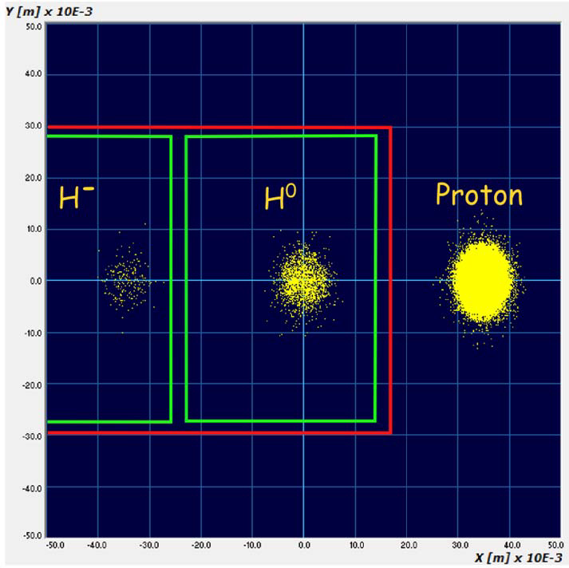
Bending Angle: 50mrad
The H0 and H- monitors could be made to overlap transversely by having a small longitudinal displacement and staggering the two foils. (ref: L4-T-EP-0003 rev 1.0 )

Slide 18
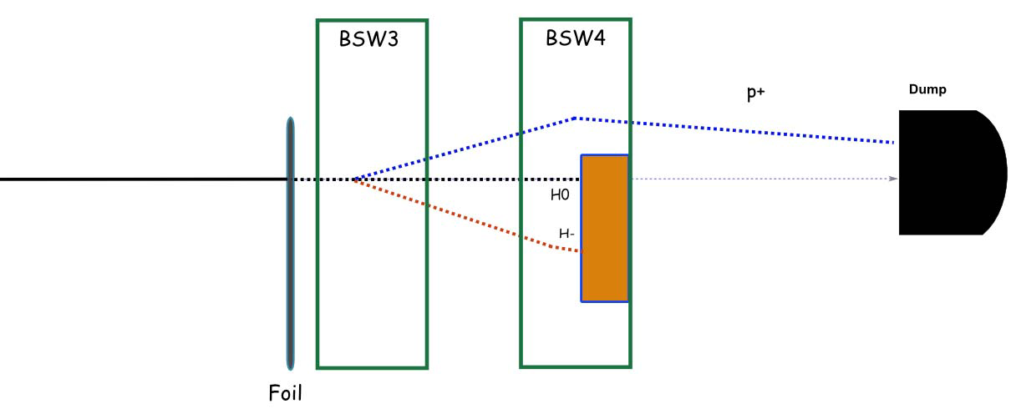
Alternatives for safer operation
If BSW3 and BSW4 can be powered independently, it would be safer to set BSW4 to a slightly higher value so that the proton beam would approach the center of the beam pipe after BSW4.

Slide 19
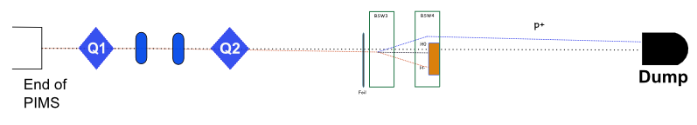
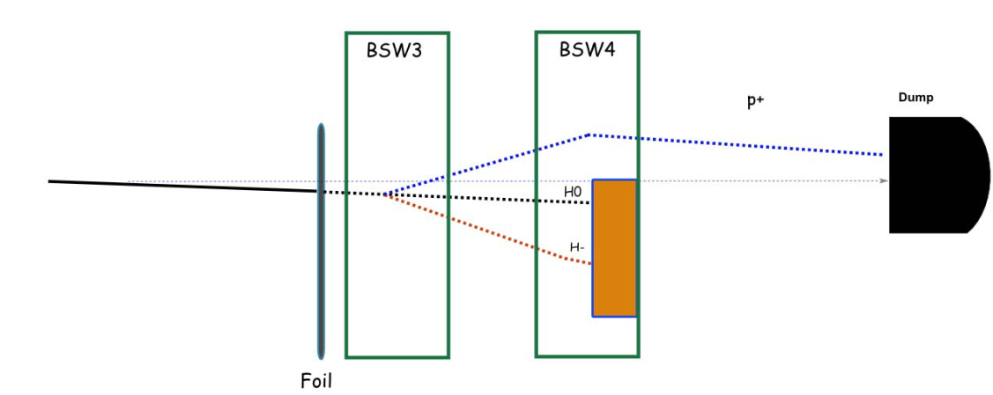
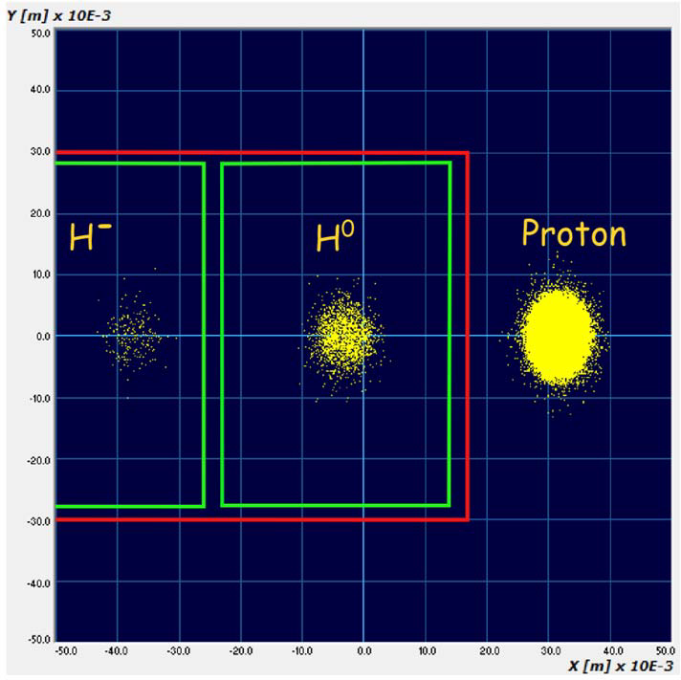
1 mrad kick
0.65 mrad
More complicated!
Not recommended
unless really needed!!!
L4T.MCHV.0115
This results in 3mm offset of the H- beam center on the stripping foil.

Slide 20
Conclusion
Option 1
Feasible in beam dynamics point of view.
Linac4 beam commissioning can be performed with foil unit installed on L4Z line (without foil interfering with the H- beam).
Option 2
Feasible in beam dynamics point of view.
Linac4 beam commissioning can’t be performed with foil unit and two chicane magnets installed on L4Z line.

Slide 21
Thank you!

