Slide 1
Recent validations results for msc
V.Ivanchenko
25 October 2012

Slide 2
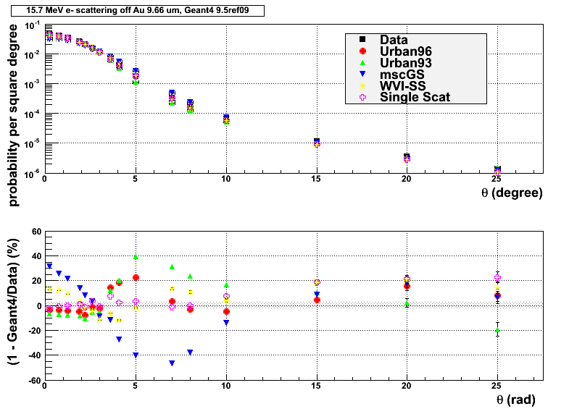
Hanson data

Slide 3
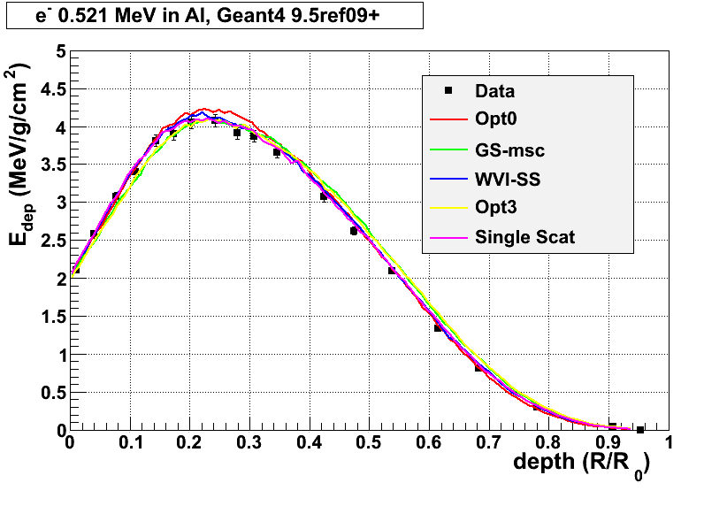
Sandia data msc96 is used

Slide 4
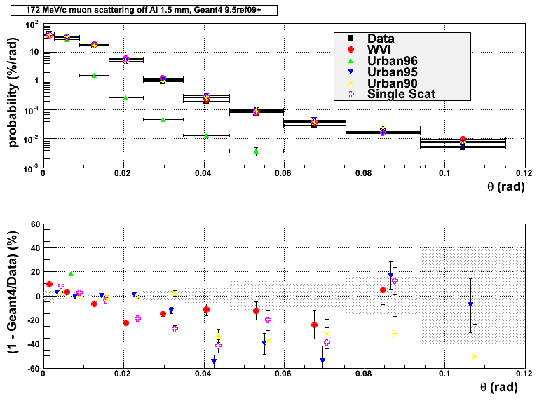
MuScat data

Slide 5
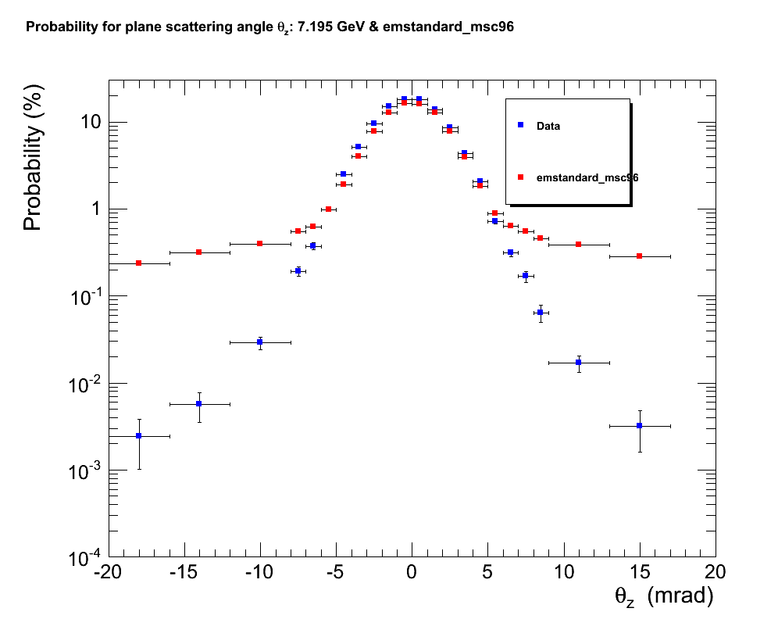
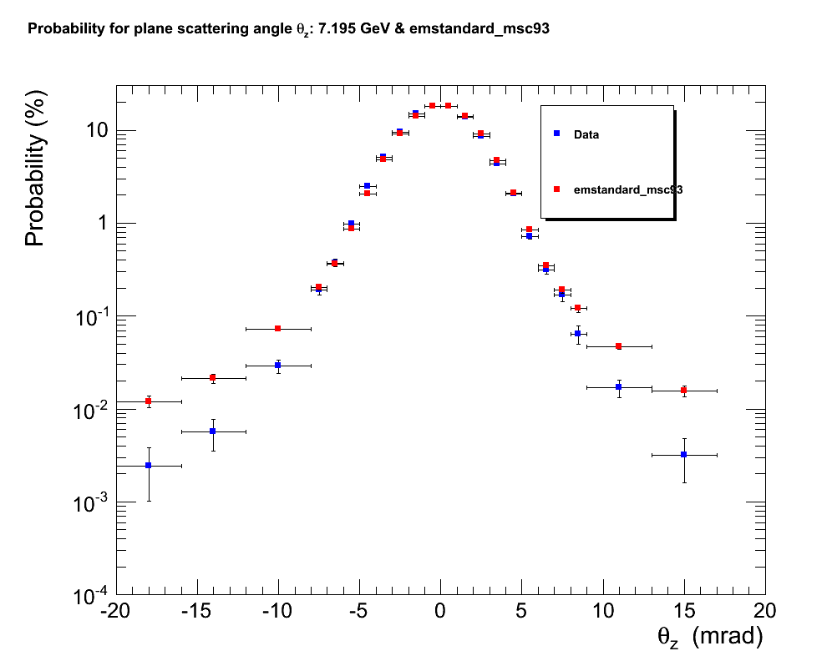
Muon scattering data

Slide 6
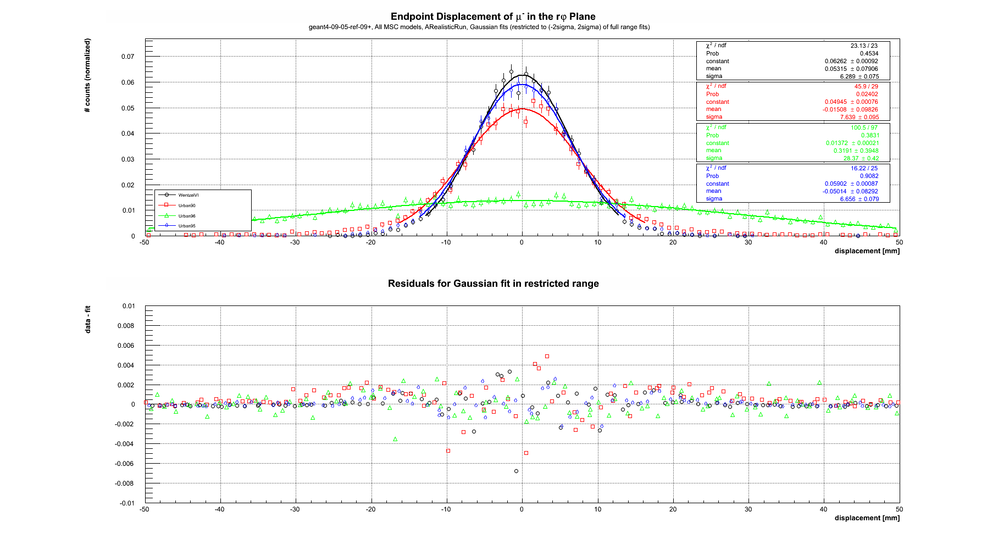
L3 muon scattering

Slide 7
Summary
Move of multiple scattering from PostStep to AlongStep is completed – no change of results
UrbanMscModel96 is working normally for electron benchmarks but show problems when applied for muons
  Results obtained only last nightr and will reported to Laszlo after the meeting
  We need dose kernel plots to evaluate msc at low energies
UrbanMscModel95 has no problems for any particles
  It can be default for all particle types in 9.6
    More correct tails for muons/hadrons than msc90
  Urban models 90 and 92 can be marked as obsolete?
  CMS and LHCb are using msc93 we need to check calorimeter responses before making msc93 obsolete
In 9.6 WentzelVI + SingleScattering will be default above 100 MeV for Opt0, Opt1, Opt2, Opt4 builders
  Needed for LHC and other HEP applications because no parameterisations are involved which may provide bad results for energies outside area of parameterisation

