Slide 1
WLCG
Ian Bird
WLCG Referees’ meeting
CERN, 3rd December 2013

Slide 2
C-RRB (29th Oct)
C-RSG recommendations to RRB – see RSG report attached to RRB agenda
  Rebus to be updated to reflect this
The resource requirements for 2014-17 were shown to the RRB
  General agreement that working assumption of flat budgets is a reasonable approach

Slide 3
CRSG comments/ recommendations
Run 2 requests have become more definite since Spring – assumed flat budgets;
ALICE and LHCb scrutinised requests have not always been met at T1. RRB requested to help find a way to resolve this;
CRSG strongly supports on going efforts to improve software efficiency, notes that resulting gains are already assumed in the requests for Run 2;
Effectiveness of disk use only partly reflected in occupancy. Welcome efforts (popularity, etc.) but would like a metric to take account of access frequency;
Networks have been exploited to reduce disk use and move processing between tiers. Concern that poorly networked sites will be underused and cost implications of providing network capacity.

Slide 4
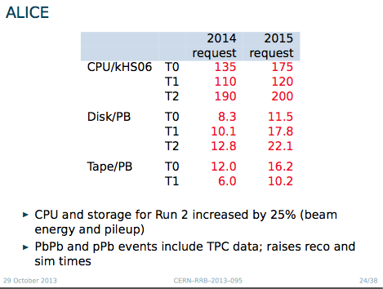

Slide 5
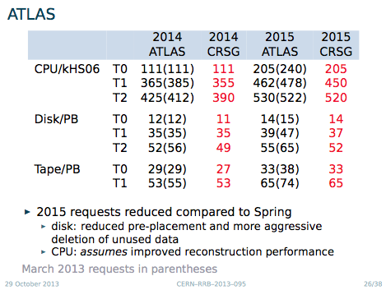

Slide 6
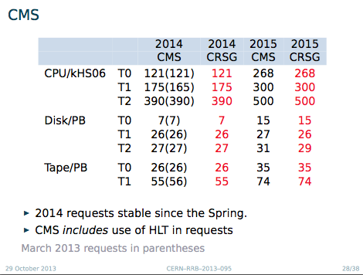

Slide 7
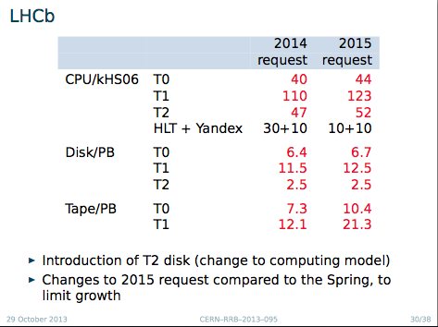

Slide 8
Updated scrutiny schedule
Spring of year n
  Final scrutiny of requests for year n+1 and look beyond
  Review use of resources in previous calendar year, n-1
Autumn of year n
  Look forward to requests for year n+2 and beyond
  If necessary, consider year n+1 requests
    For individual experiments if they want significant changes
    Or for all experiments if, say, LHC running parameters change significantly
CRSG asks experiments to submit documentation on 1 February and 1 August

Slide 9
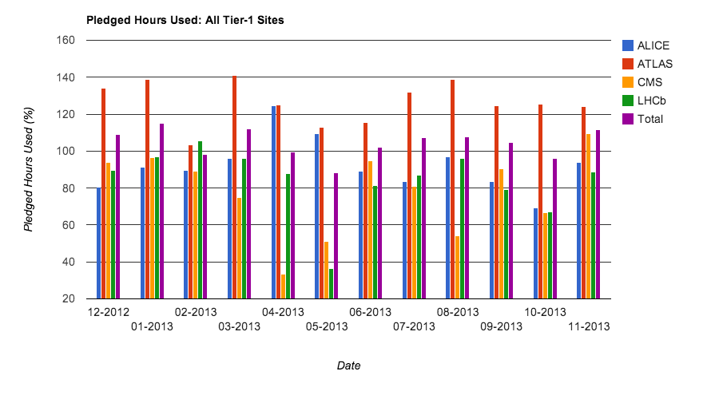
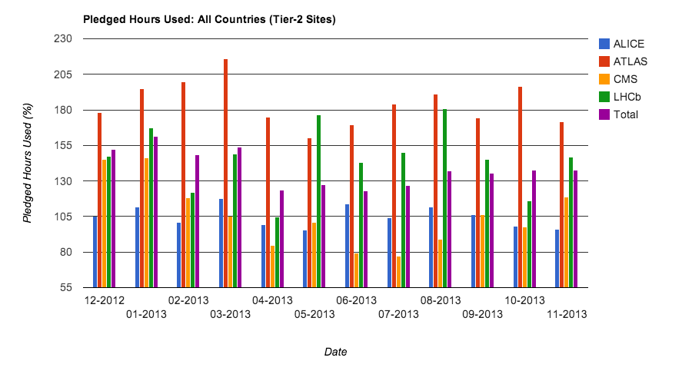
Resource occupancy
Tier 1
Tier 2

Slide 10
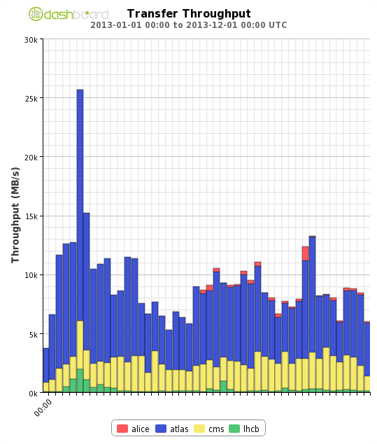
Transfers: Jan – Nov 2013
Worldwide

Slide 11
Preparations for Run 2
WLCG workshop agreed that
  Operations coordination team will manage the scheduling of experiment challenges during 2014
  Anticipated to being Spring 2014
  No reason for dedicated challenge with all 4 experiments
    System is still operating and will not be stopped

