Slide 1


Search for long-lived massive particles with the ATLAS detector
Nick Barlow
(University of Cambridge)
on behalf of the ATLAS collaboration

Slide 2
Contents
Motivation for searching for long-lived particles.
Very quick look at a couple of signal models.
The ATLAS detector and the 2011 dataset.
SUSY-based searches:
  Stable charged sleptons and R-hadrons.
  Disappearing tracks.
  Displaced vertices in inner tracking detector.
Other models:
  Higgs to 2 long-lived pseudoscalars.
  Displaced muonic lepton jets.
  Magnetic monopoles.

Slide 3
Motivation for searches for Long-lived particles (LLPs)
Several New Physics models could give rise to new, massive particles, with (relatively) long lifetimes.
Will give a very brief summary of a couple of examples, but there are also (infinitely) many possibilities that no-one has ever thought of!
We should look for signatures of New Physics any way we can!

Slide 4
The Physics

Slide 5
The Physics
(An extremely sketchy overview of a few possible examples of)

Slide 6
Why might we get LLPs?
Long-lived particles can arise in a model if any of the following conditions are present:
  Very small coupling in decay chain.
  Strong virtuality due to decay to heavy particles.
  Very small mass differences in decay chain (i.e. not much phase space for decay).
  Pair production of particles with conserved quantum number.
One or more of these cases are reasonably likely to come up when model-building.
  ➔Searches for LLPs are an important part of the LHC physics program!

Slide 7
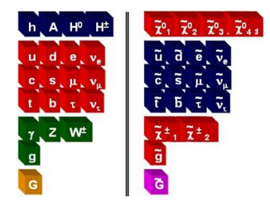
Supersymmetry
Supersymmetry (SUSY) solves the Hierarchy Problem (sensible Higgs mass without fine-tuning) by introducing superpartners for SM particles.

Slide 8
Supersymmetry
Supersymmetry (SUSY) solves the Hierarchy Problem (sensible Higgs mass without fine-tuning) by introducing superpartners for SM particles.
  BUT, no SUSY particles (sparticles) have ever been seen..
  ➔Supersymmetry is not a perfect symmetry – must be broken by some mechanism.

Slide 9
Some SUSY breaking mechanisms
Gravity-mediated (e.g. mSUGRA).
Gauge-mediated SUSY breaking (GMSB).
  SUSY breaking communicated via SM gauge interactions.
  Gravitino acquires mass (LSP).
  ➔Depending on SUSY-breaking scale, NLSP can be long-lived.
Anomaly-mediated SUSY breaking (AMSB).
  SUSY breaking is caused by loop effects, gives constrained mass spectrum:
  Ratios of gaugino masses are approximately:
    M_{bino}: M_{wino}: M_{gluino} ≈ 3 : 1 : 7
  Masses of lightest chargino and lightest neutralino are nearly degenerate.
  ➔lightest chargino has long lifetime!
Split SUSY.
  New bosons are at very high mass scale, while new fermions at TeV-scale.
  ➔gluino has long lifetime!
  (will combine with SM quarks and gluons to form “R-hadrons”).

Slide 10
R-Parity Violating (RPV) SUSY
Many SUSY models assume R-Parity conservation, i.e. Lightest Supersymmetric Particle (LSP) is stable.
  (Excellent Dark Matter candidate!)
BUT no reason to assume this a priori..
  If we introduce R-Parity Violating terms into superpotential, LSP can decay to SM particles.

Slide 11
R-Parity Violating (RPV) SUSY
Many SUSY models assume R-Parity conservation, i.e. Lightest Supersymmetric Particle (LSP) is stable.
  (Excellent Dark Matter candidate!)
BUT no reason to assume this a priori..
  If we introduce R-Parity Violating terms into superpotential, LSP can decay to SM particles.
Lepton number violating

Slide 12
R-Parity Violating (RPV) SUSY
Many SUSY models assume R-Parity conservation, i.e. Lightest Supersymmetric Particle (LSP) is stable.
  (Excellent Dark Matter candidate!)
BUT no reason to assume this a priori..
  If we introduce R-Parity Violating terms into superpotential, LSP can decay to SM particles.
Baryon number violating

Slide 13
R-Parity Violating (RPV) SUSY
Many SUSY models assume R-Parity conservation, i.e. Lightest Supersymmetric Particle (LSP) is stable.
  (Excellent Dark Matter candidate!)
BUT no reason to assume this a priori..
  If we introduce R-Parity Violating terms into superpotential, LSP can decay to SM particles.
  If these couplings are weak, LSP can have a long lifetime.

Slide 14
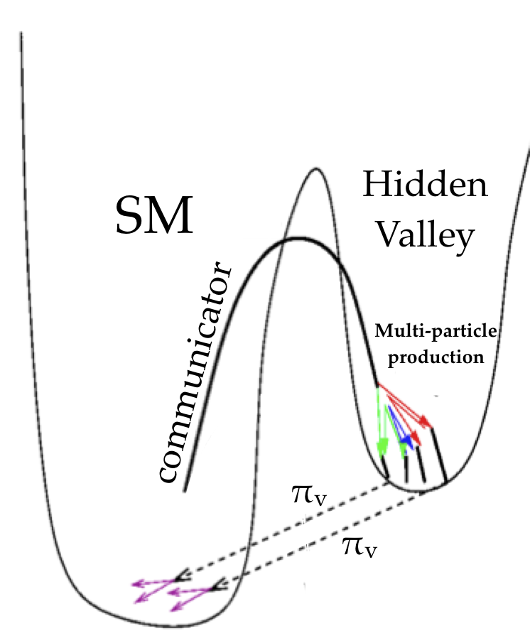
Hidden valley
Hidden sector interacts with SM via (heavy) Communicator particle(s).
  Could be new Z’, Higgs boson or bosons, heavy sterile neutrinos, or something else..
Weak coupling between SM and hidden sectors can lead to particles in hidden sector having long lifetimes.

Slide 15
The Detector

Slide 16
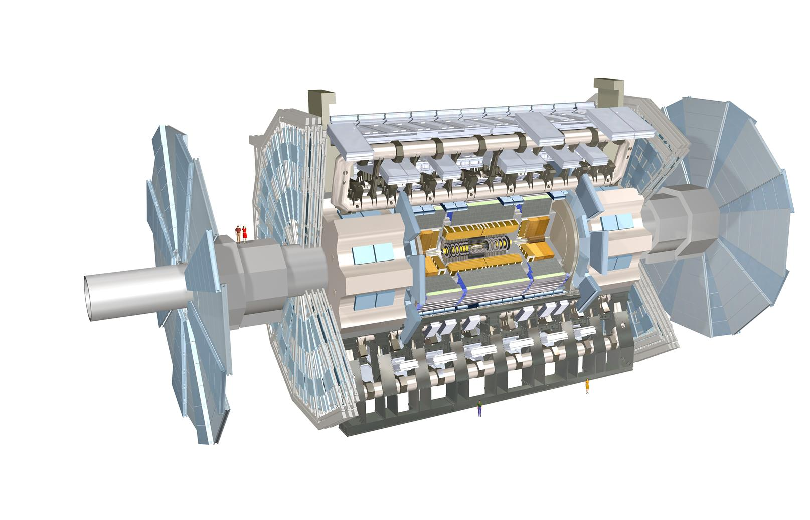
The ATLAS detector
ATLAS is a great General Purpose Detector for all the usual reasons..
  Hermetic coverage.
  Precise tracking.
  Good calorimeter energy resolution.
  Efficient muon reconstruction.
  ….

Slide 17
The ATLAS detector
ATLAS is a great General Purpose Detector for all the usual reasons..
  But also…..

Slide 18
The ATLAS detector
ATLAS is a great General Purpose Detector for all the usual reasons..
  But also…..
  It is BIG!!
25m

Slide 19
The ATLAS detector
ATLAS is a great General Purpose Detector for all the usual reasons..
  But also…..
  It is BIG!!
  And has several subdetectors with excellent time resolution!
25m

Slide 20
The ATLAS detector
ATLAS has several subdetectors with excellent time resolution, including (but not only):
25m

Slide 21
The ATLAS detector
ATLAS has several subdetectors with excellent time resolution, including (but not only):
Liquid Argon (LAr) calorimeter
25m

Slide 22
The ATLAS detector
ATLAS has several subdetectors with excellent time resolution, including (but not only):
Liquid Argon (LAr) calorimeter
Tile calorimeter
25m

Slide 23
The ATLAS detector
ATLAS has several subdetectors with excellent time resolution, including (but not only):
Liquid Argon (LAr) calorimeter
Tile calorimeter
Monitored Drift Tubes (MDTs)
25m

Slide 24
The ATLAS detector
ATLAS has several subdetectors with excellent time resolution, including (but not only):
Liquid Argon (LAr) calorimeter
Tile calorimeter
Monitored Drift Tubes (MDTs)
Resistive Plate Chambers (RPCs)
25m

Slide 25
The ATLAS detector
ATLAS has several subdetectors with excellent time resolution, including (but not only):
Liquid Argon (LAr) calorimeter
Tile calorimeter
Monitored Drift Tubes (MDTs)
Resistive Plate Chambers (RPCs)
25m
Can measure time-of-flight!

Slide 26
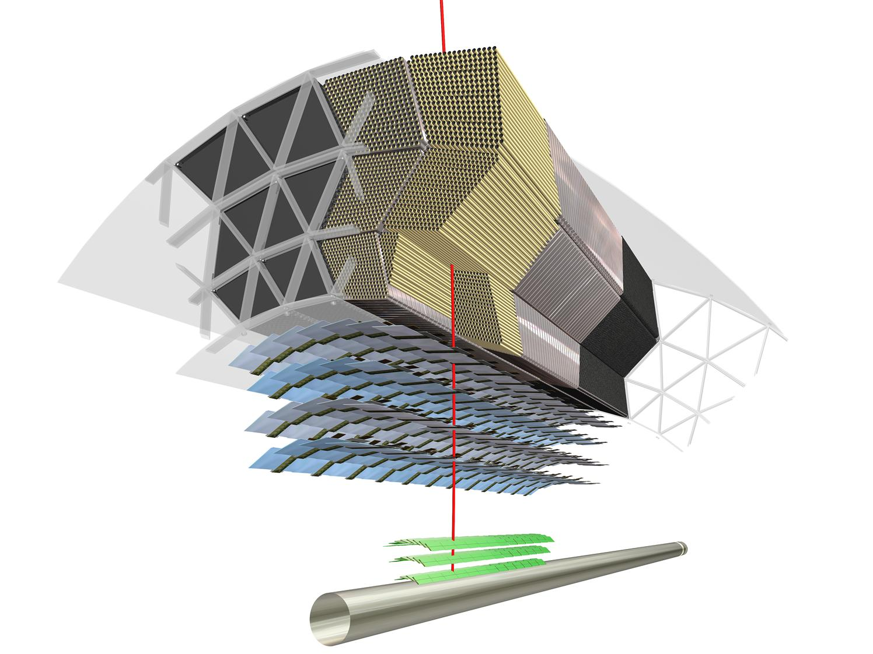
The ATLAS Inner Detector (ID)
ATLAS inner tracking system consists of:

Slide 27
The ATLAS Inner Detector (ID)
ATLAS inner tracking system consists of:
Pixel detector

Slide 28
The ATLAS Inner Detector (ID)
ATLAS inner tracking system consists of:
Pixel detector
Semiconductor Tracker (SCT)

Slide 29
The ATLAS Inner Detector (ID)
ATLAS inner tracking system consists of:
Pixel detector
Semiconductor Tracker (SCT)
Transition Radiation Tracker (TRT)

Slide 30
The ATLAS Inner Detector (ID)
ATLAS inner tracking system consists of:
Pixel detector
Semiconductor Tracker (SCT)
Transition Radiation Tracker (TRT)
All within a 2T solenoidal B-field

Slide 31
The ATLAS Inner Detector (ID)
i.e. it has:
Precise Silicon detectors
  Good for finding vertices!

Slide 32
The ATLAS Inner Detector (ID)
i.e. it has:
Precise Silicon detectors
  Good for finding vertices!
and

Slide 33
The ATLAS Inner Detector (ID)
i.e. it has:
Precise Silicon detectors
  Good for finding vertices!
and
a continuous tracker
  Can detect kinked or disappearing tracks!

Slide 34
The ATLAS Inner Detector (ID)
And there’s more!!

Slide 35
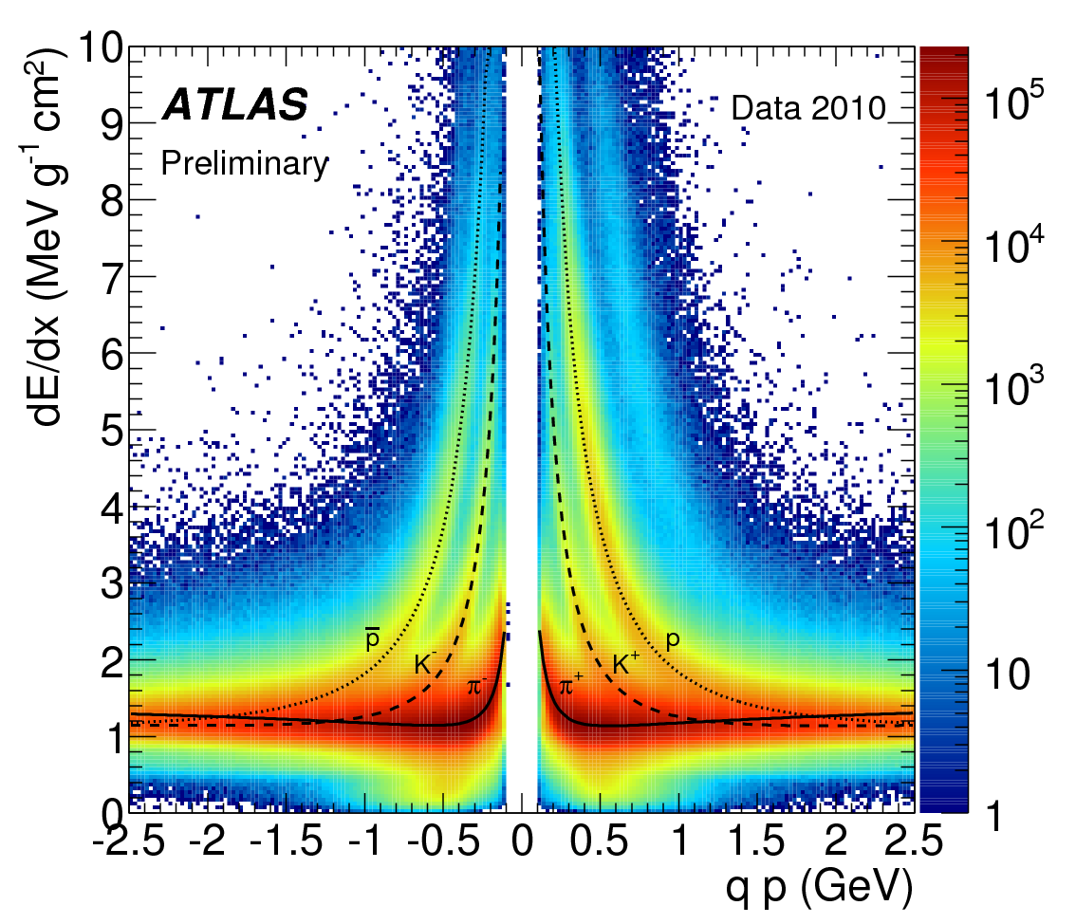
The ATLAS Inner Detector (ID)
And there’s more!!
Pixel detector can measure ionization energy loss dE/dx via charge deposited (calculated from Time-over-Threshold)

Slide 36
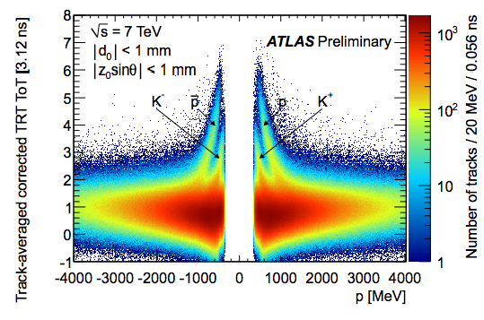
The ATLAS Inner Detector (ID)
And there’s more!!
TRT can also measure dE/dx via Time-over-Threshold

Slide 37
The ATLAS Inner Detector (ID)
And there’s more!!
TRT can also measure dE/dx via Time-over-Threshold
and
“High Threshold” hit fraction (primarily intended for identifying electrons emitting transition radiation) is also a useful variable for identifying highly-ionizing particles.

Slide 38
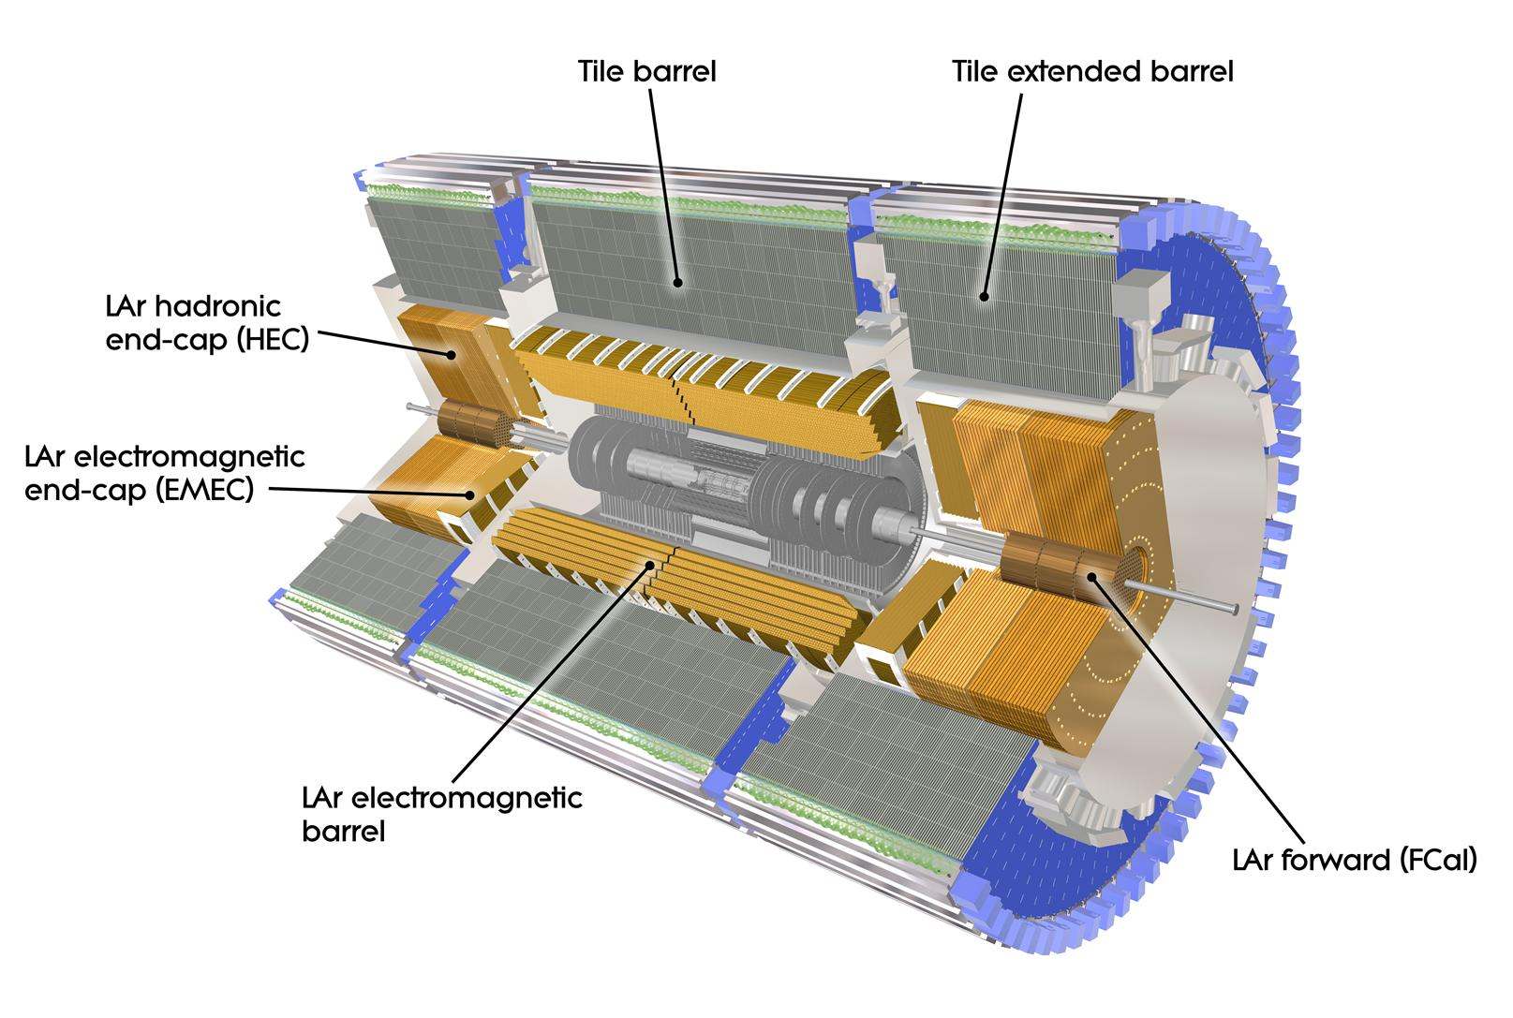
The ATLAS Calorimeters
Liquid Argon (LAr) electromagnetic calorimeter has longitudinal as well as transverse segmentation

Slide 39
The ATLAS Calorimeters
Liquid Argon (LAr) electromagnetic calorimeter has longitudinal as well as transverse segmentation
Both LAr and Tile calorimeters can also measure dE/dx by summing energy deposits over path length.

Slide 40
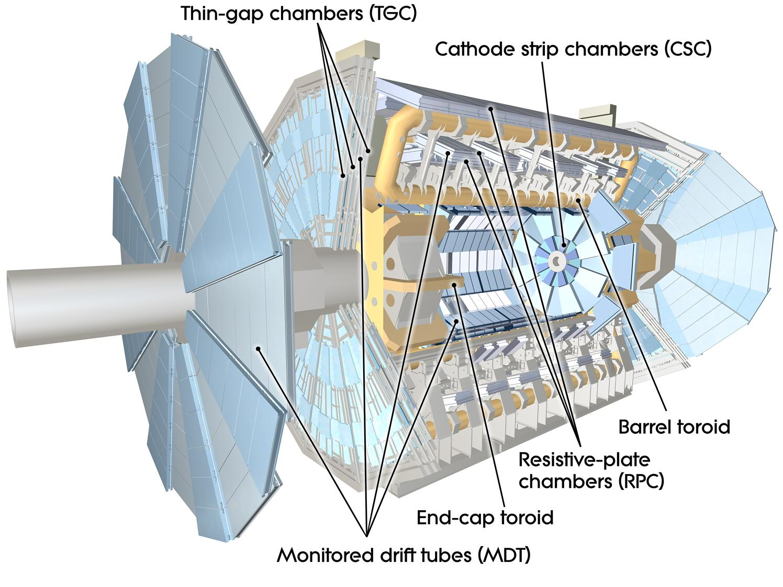
The ATLAS Muon Spectrometer (MS)
Precision muon chambers can reconstruct “standalone” tracks

Slide 41
The ATLAS Muon Spectrometer (MS)
Precision muon chambers can reconstruct “standalone” tracks
i.e. can find particles that did not leave tracks in Inner Detector (e.g. decay products of LLPs)

Slide 42
The ATLAS Muon Spectrometer (MS)
Precision muon chambers can reconstruct “standalone” tracks
i.e. can find particles that did not leave tracks in Inner Detector (e.g. decay products of LLPs)
MDTs can also measure dE/dx (similar principle to TRT).

Slide 43
The Data

Slide 44
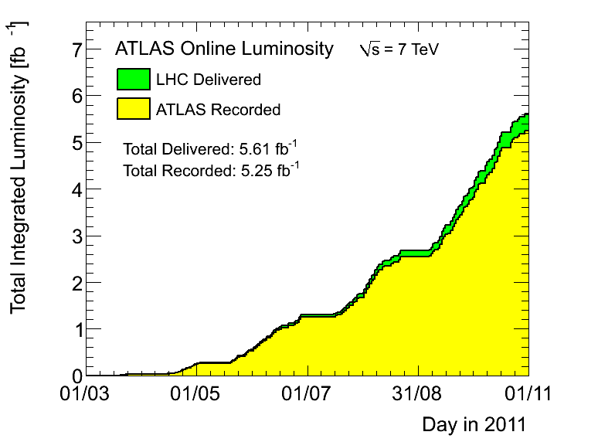
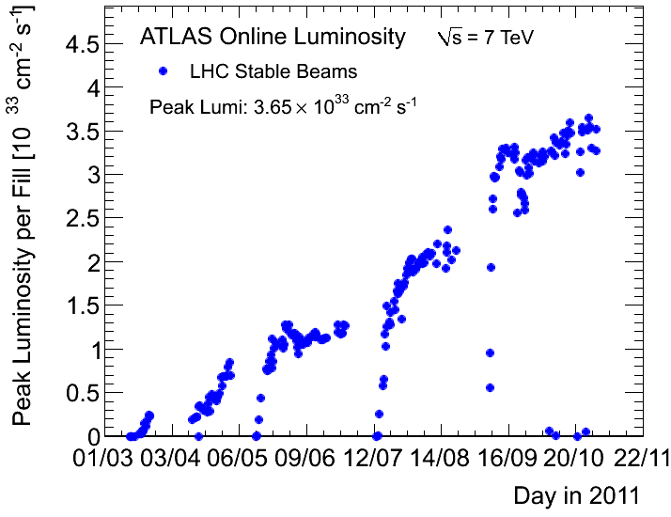
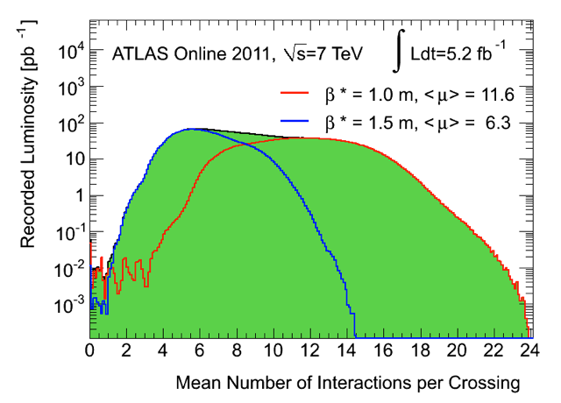
ATLAS data-taking in 2011
ATLAS recorded 5.3 fb⁻¹ data in 2011.
After “all good” data quality requirements, most analyses used about 4.7 fb⁻¹.
First ~2 fb⁻¹ data have less pile-up.

Slide 45
The Analyses

Slide 46
Stable Massive Particles (SMPs)
ATLAS-CONF-2012-075
Particles with lifetimes of order nanoseconds or greater are likely to traverse the whole detector.
  If they are neutral, and weakly interacting, they will show up as missing E_{T}.
  If they are charged (at any point!) or strongly interacting, we have a chance to detect them directly!
Several candidate particles, including:
  Long-lived sleptons in GMSB models.
  R-hadrons.

Slide 47
Stable Massive Particles (SMPs)
ATLAS-CONF-2012-075
Particles with lifetimes of order nanoseconds or greater are likely to traverse the whole detector.
  If they are neutral, and weakly interacting, they will show up as missing E_{T}.
  If they are charged (at any point!) or strongly interacting, we have a chance to detect them directly!
Several candidate particles, including:
  Long-lived sleptons in GMSB models.
  R-hadrons.
Common feature: if they are massive, they will be produced with low velocities: β < 1.

Slide 48
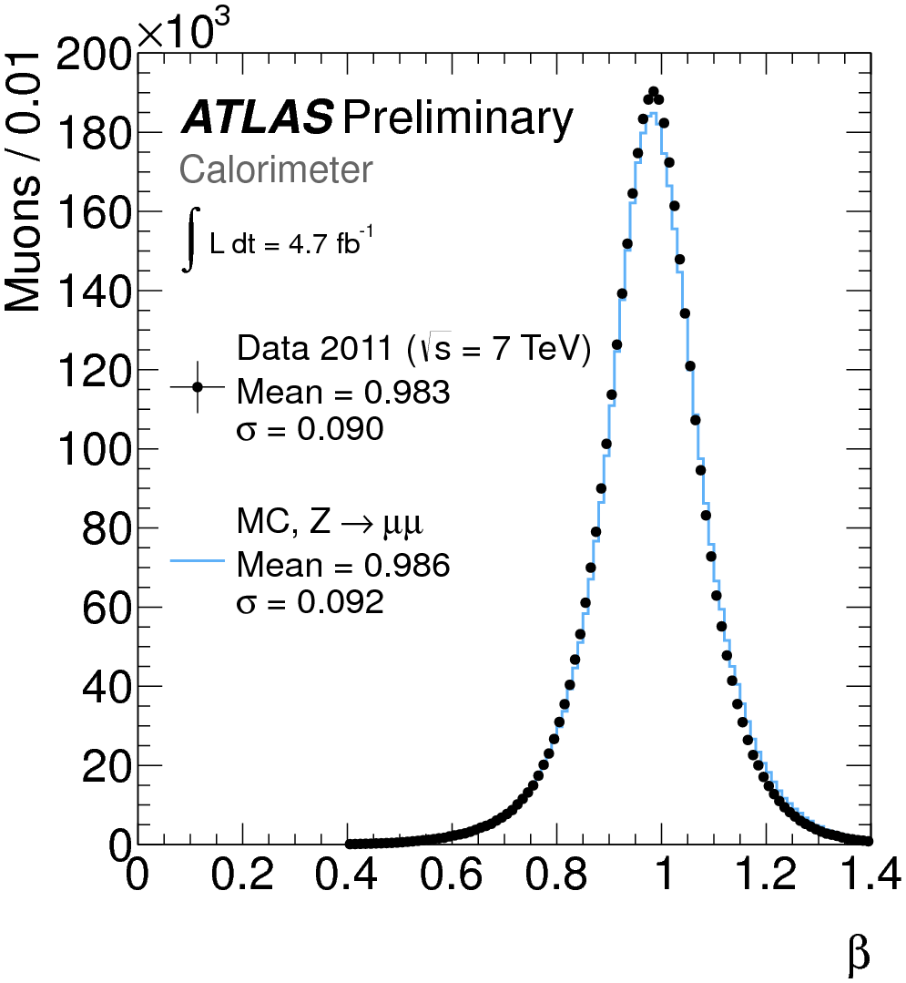
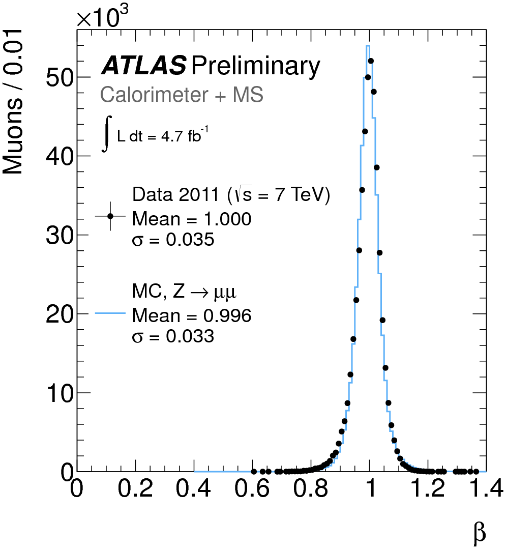
SMPs - Combining β measurements
Use Z to μμ events to calibrate β measurements.
If β measurements from different systems are > 0.2 and internally consistent, they are combined in a weighted average.

Slide 49
Measuring the mass of SMPs
Can measure time-of-flight in several subdetectors.
  For these analyses, use Tile+LAr Calorimeters, RPC, MDT.
  Can therefore measure velocity β.
Can measure charged particle momentum p in Inner Detector and Muon Spectrometer.
Can measure energy loss dE/dx in several subdetectors.
  For these analyses, use Pixel detector.
  dE/dX is related to relativistic boost factor βγ

Slide 50
Measuring the mass of SMPs
Can measure time-of-flight in several subdetectors.
  For these analyses, use Tile+LAr Calorimeters, RPC, MDT.
  Can therefore measure velocity β.
Can measure charged particle momentum p in Inner Detector and Muon Spectrometer.
Can measure energy loss dE/dx in several subdetectors.
  For these analyses, use Pixel detector.
  dE/dX is related to relativistic boost factor βγ
p=βγm

Slide 51
Stable Massive Particles - backgrounds
Main background for both slepton and R-hadron searches is high-p_{T} muons with mis-measured β.
  Exploit fact that mis-measurements of β or βγ in different subdetectors are uncorrelated.
Use data-driven method, based on randomly sampling β or βγ values from control sample distributions and combining with measured p for each candidate.
  Sample many times for each p measurement to reduce statistical uncertainty.

Slide 52
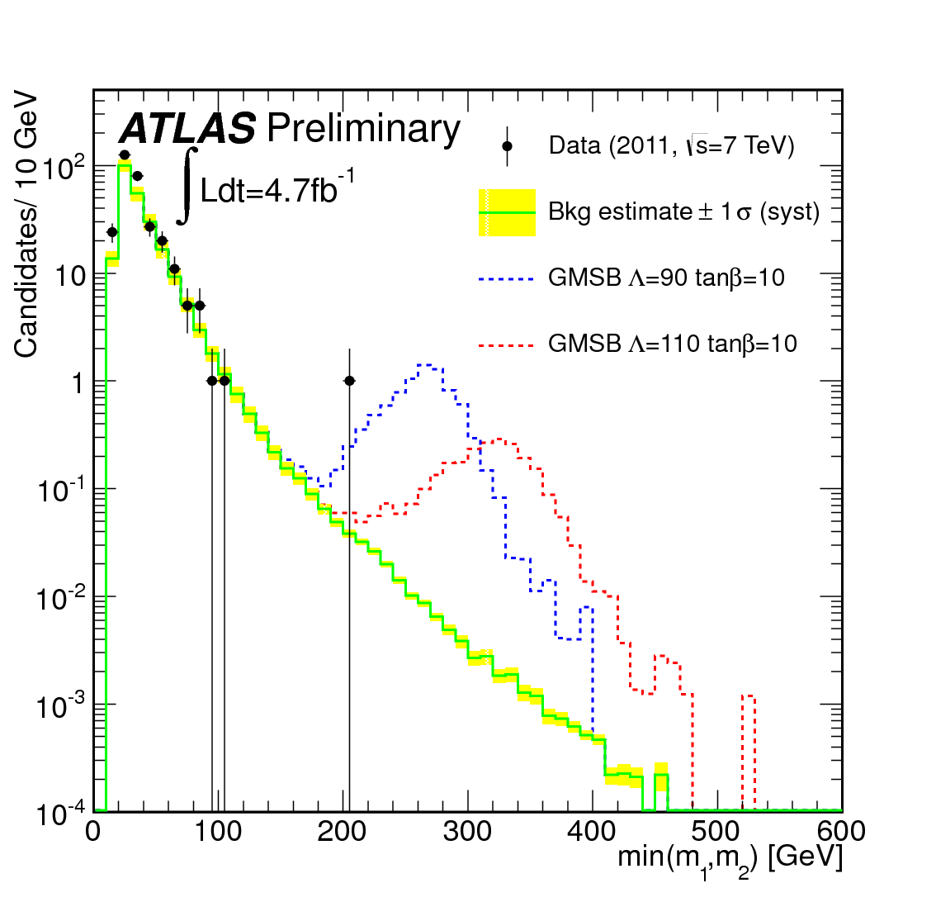
Long-lived sleptons - selection
Would behave like “heavy muons”, releasing energy throughout detector.
Likely to be 2 produced per event.
Use single muon trigger.
In offline selection, require 2 muon candidates per event.
Define “loose” and “tight” SMP selections, based on p_{T} and β measurements.
“2 candidate signal region”:
  both candidates must pass loose selection.
“1 candidate signal region”:
  one candidate passes tight selection.

Slide 53
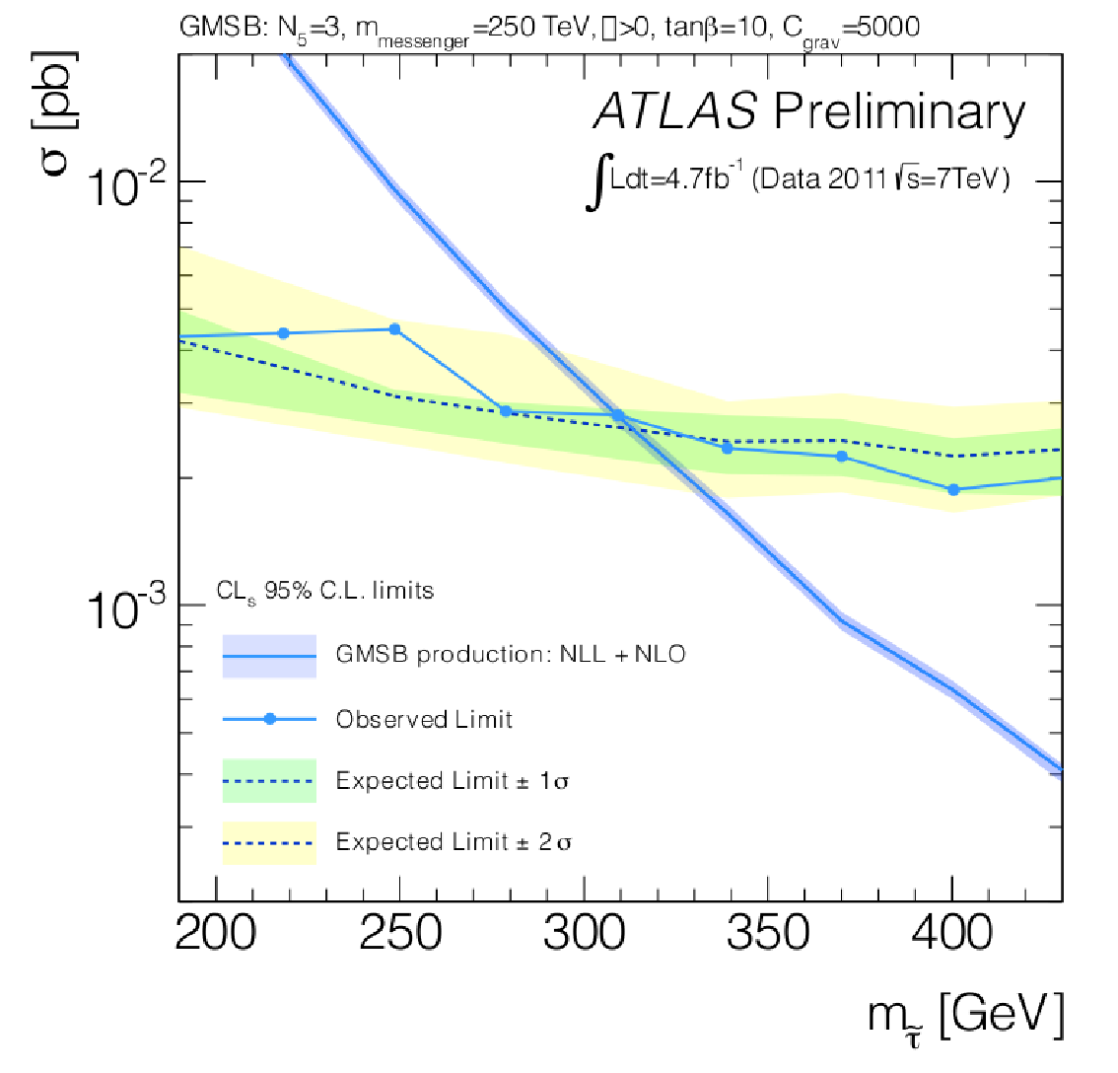
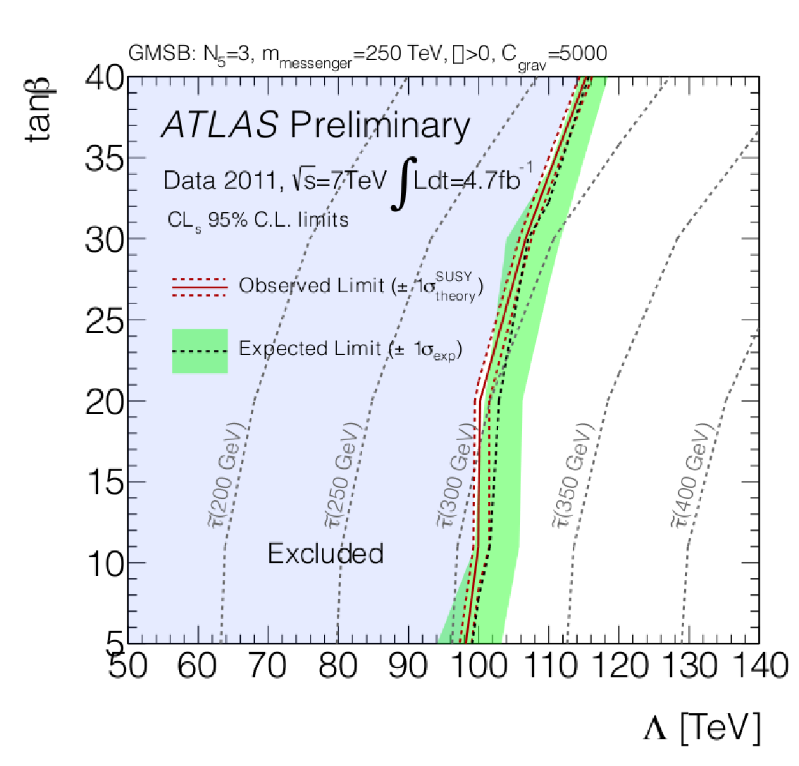
Slepton search - results
No excess above background expectation is seen.
Set limits on tanβ vs Λ in GMSB scenario.
Set limits on stau mass in GMSB scenario.

Slide 54
R-hadrons - selection
Can undergo interactions with detector material.
  ➔can even change charge as it moves through detector!
If β is too low, particle might be associated with following bunch crossing by the time it gets to MS.
Due to both these effects, efficiency for single muon trigger can be quite low.
  ➔also use missing E_{T} trigger (due to strong production, events often contain high p_{T} jets, while R-hadron itself will only deposit a small amount of energy in calorimeters).
Three different analyses:
  “Full Detector”,
  “MS agnostic”,
  “ID only”.

Slide 55
R-hadrons - selection
Can undergo interactions with detector material.
  ➔can even change charge as it moves through detector!
If β is too low, particle might be associated with following bunch crossing by the time it gets to MS.
Due to both these effects, efficiency for single muon trigger can be quite low.
  ➔also use missing E_{T} trigger (due to strong production, events often contain high p_{T} jets, while R-hadron itself will only deposit small amount of energy in calorimeters).
Three different analyses:
  “Full Detector”,
  “MS agnostic”,
  “ID only”.
Uses the most information – best sensitivity for SMPs that are charged all the way through.

Slide 56
R-hadrons - selection
Can undergo interactions with detector material.
  ➔can even change charge as it moves through detector!
If β is too low, particle might be associated with following bunch crossing by the time it gets to MS.
Due to both these effects, efficiency for single muon trigger can be quite low.
  ➔also use missing E_{T} trigger (due to strong production, events often contain high p_{T} jets, while R-hadron itself will only deposit small amount of energy in calorimeters).
Three different analyses:
  “Full Detector”,
  “MS agnostic”,
  “ID only”.
Can detect R-hadrons even if they become neutral before traversing Muon Spectrometer.

Slide 57
R-hadrons - selection
Can undergo interactions with detector material.
  ➔can even change charge as it moves through detector!
If β is too low, particle might be associated with following bunch crossing by the time it gets to MS.
Due to both these effects, efficiency for single muon trigger can be quite low.
  ➔also use missing E_{T} trigger (due to strong production, events often contain high p_{T} jets, while R-hadron itself will only deposit small amount of energy in calorimeters).
Three different analyses:
  “Full Detector”,
  “MS agnostic”,
  “ID only”.
Can also detect R-hadrons that decay with few ns average lifetime.

Slide 58
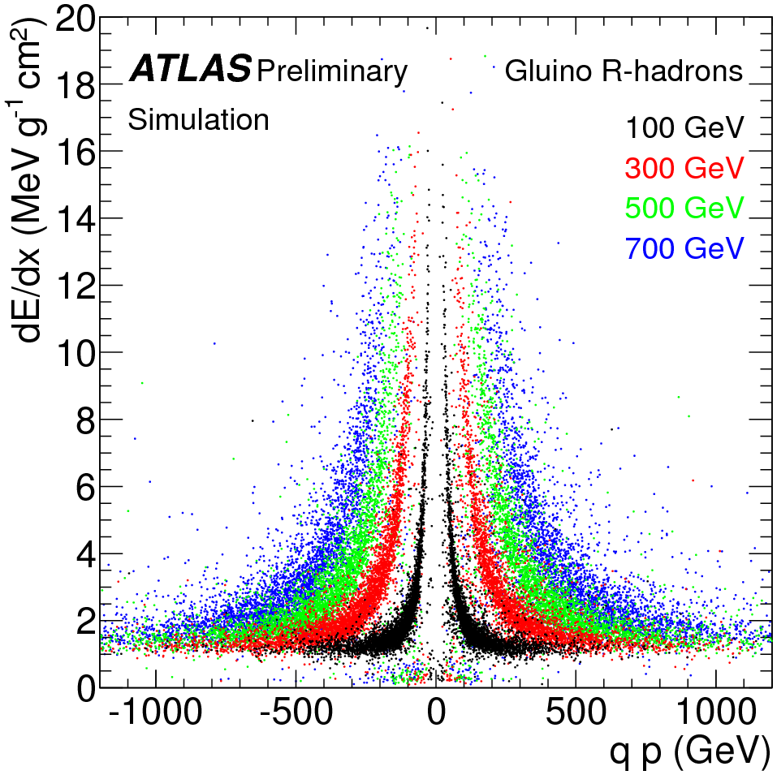
R-hadrons - selection
All three analyses require good quality, isolated, high-momentum ID track.
“MS agnostic” uses missing E_{T} triggers, and calorimeter-only timing measurement.
“ID only” analysis has tighter selection:
  Offline missing E_{T} cut.
  Tighter cuts on isolation and number of silicon hits.

Slide 59
R-hadrons - selection
All three analyses require good quality, isolated, high-momentum ID track.
“MS agnostic” uses missing E_{T} triggers, and calorimeter-only timing measurement.
“ID only” analysis has tighter selection:
  Offline missing E_{T} cut.
  Tighter cuts on isolation and number of silicon hits.

Slide 60
R-hadrons - selection
All three analyses require good quality, isolated, high-momentum ID track.
“MS agnostic” uses missing E_{T} triggers, and calorimeter-only timing measurement.
“ID only” analysis has tighter selection:
  Offline missing E_{T} cut.
  Tighter cuts on isolation and number of silicon hits.

Slide 61
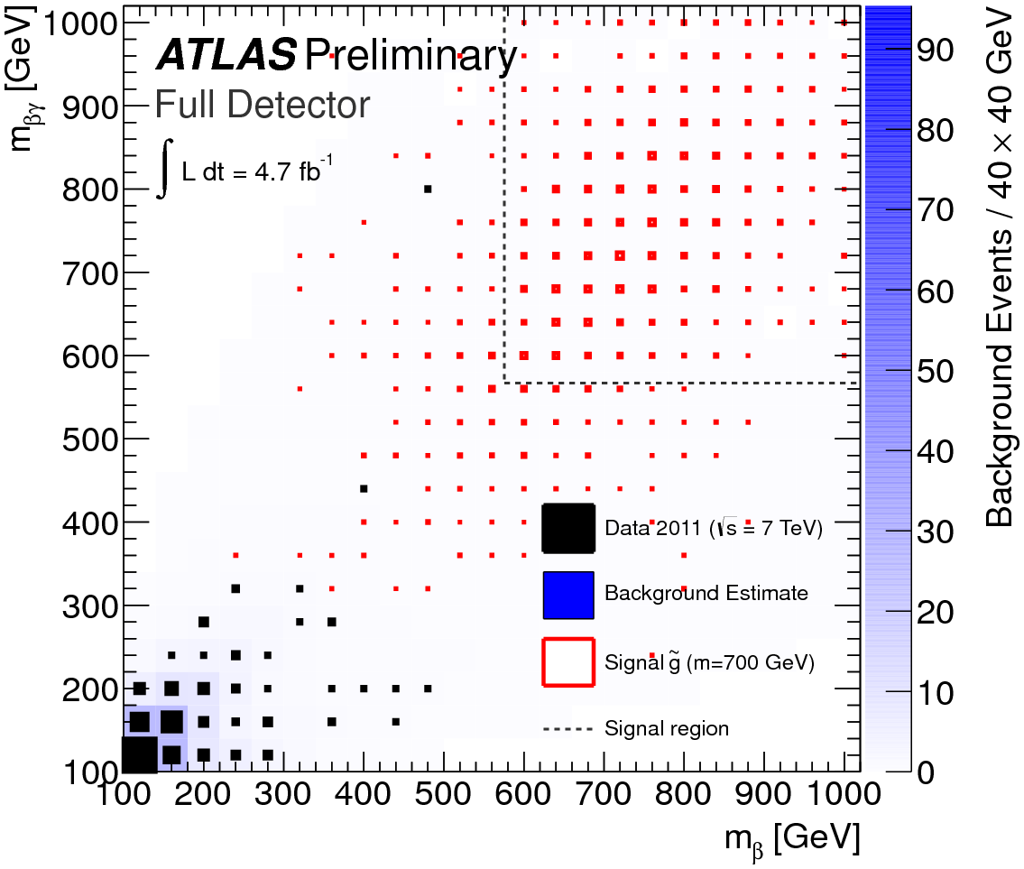
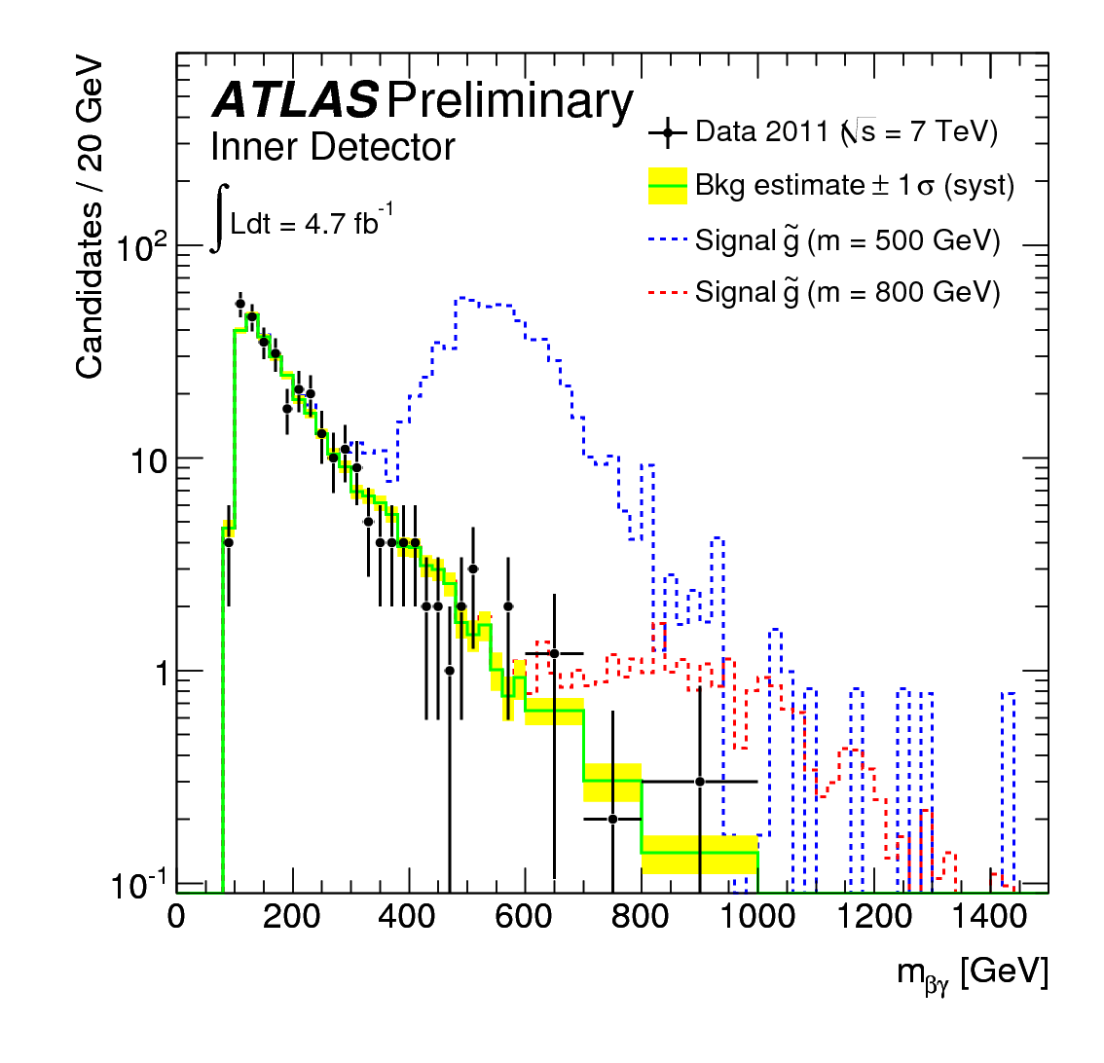
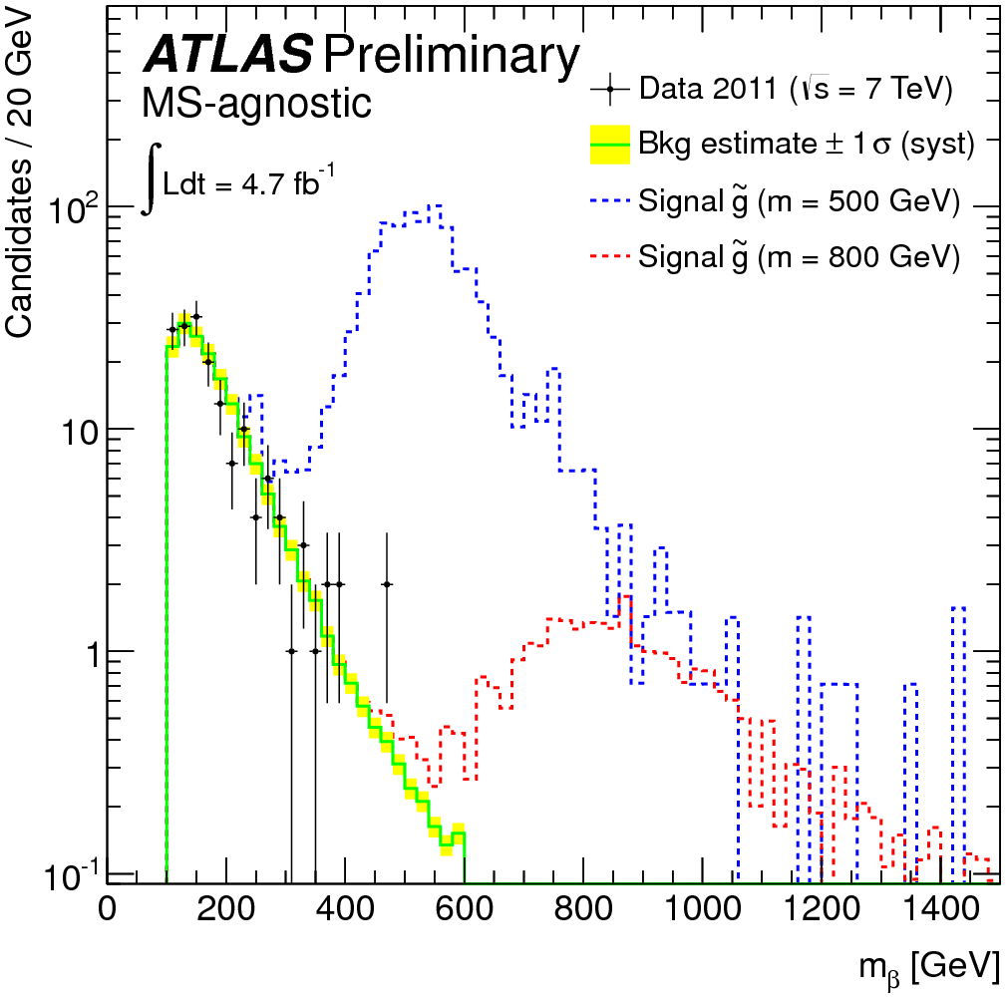
R-hadron searches - results
No excess above background expectation seen in any of the three analyses.

Slide 62
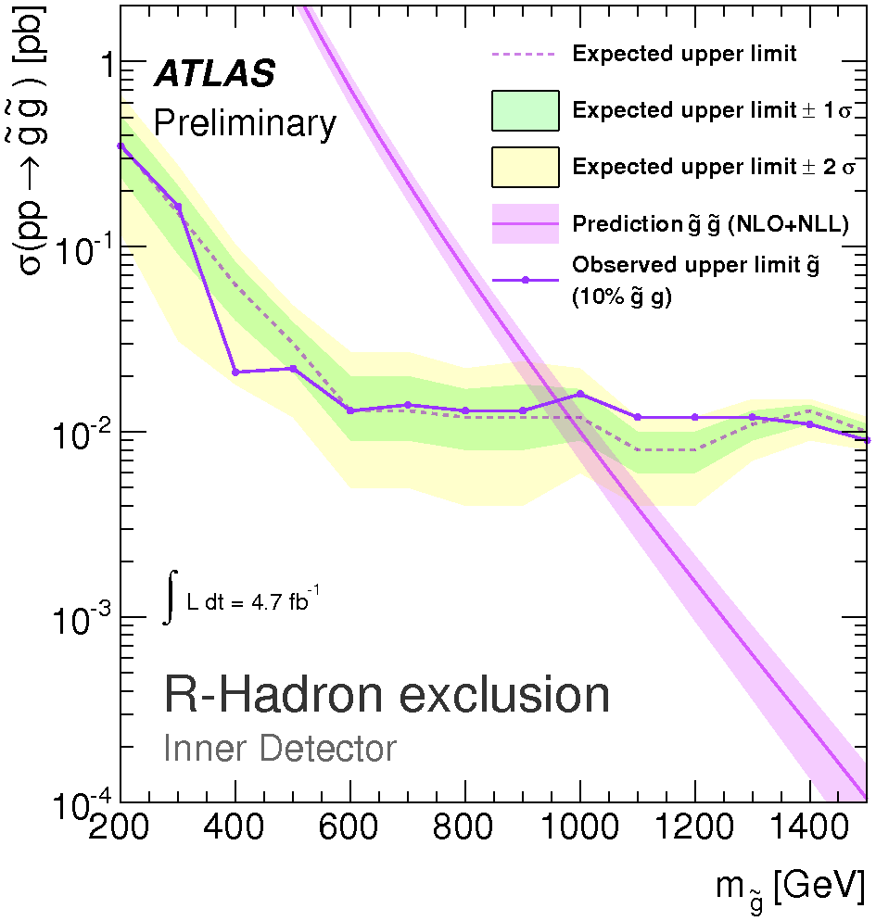
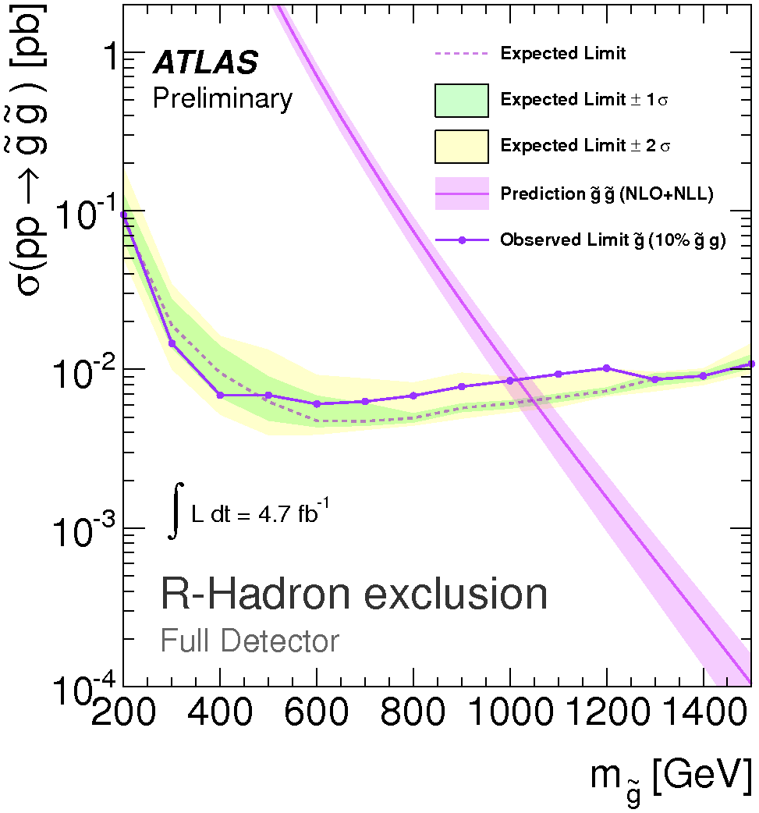
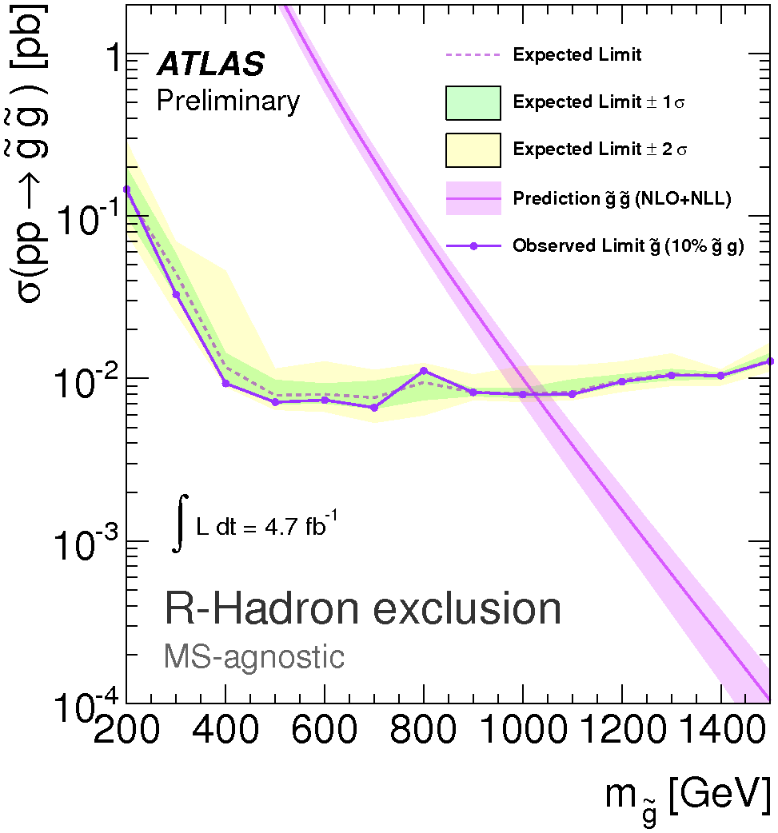
R-hadron searches - results
No excess above background expectation seen in any of the three analyses.
Set limits on gluino R-hadrons:

Slide 63
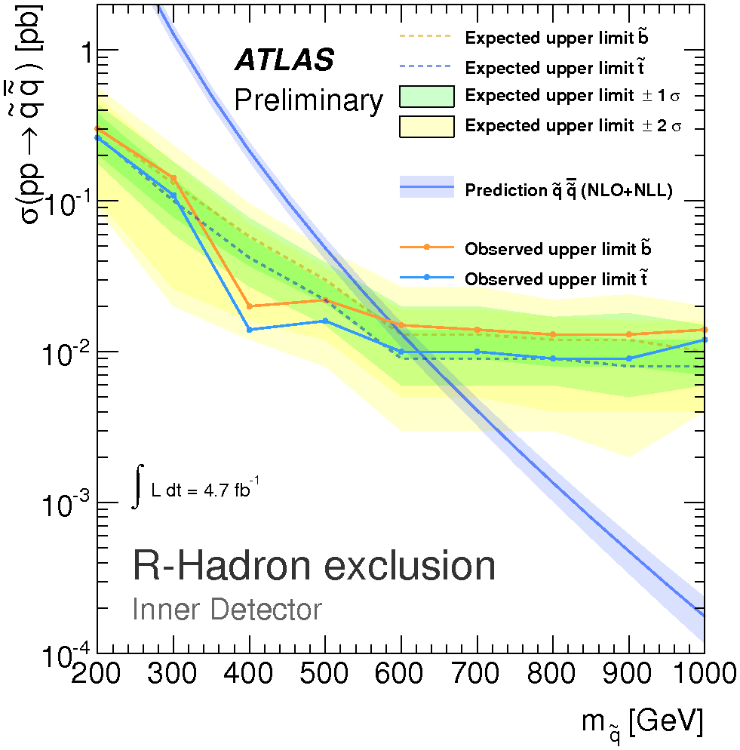
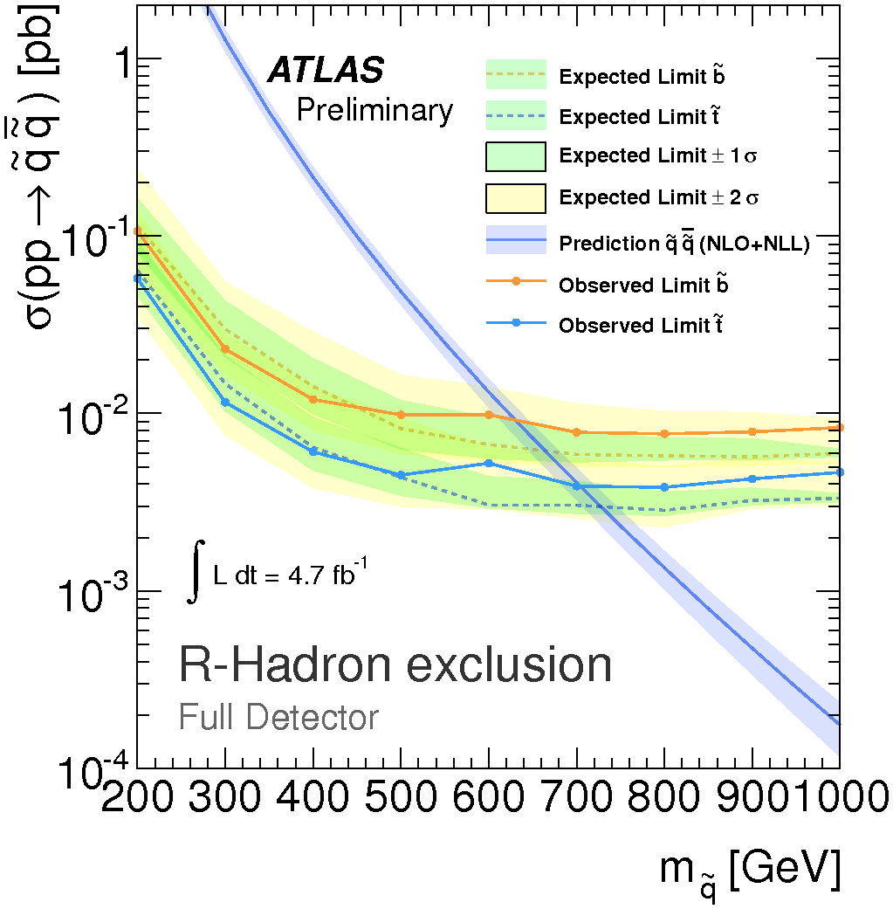
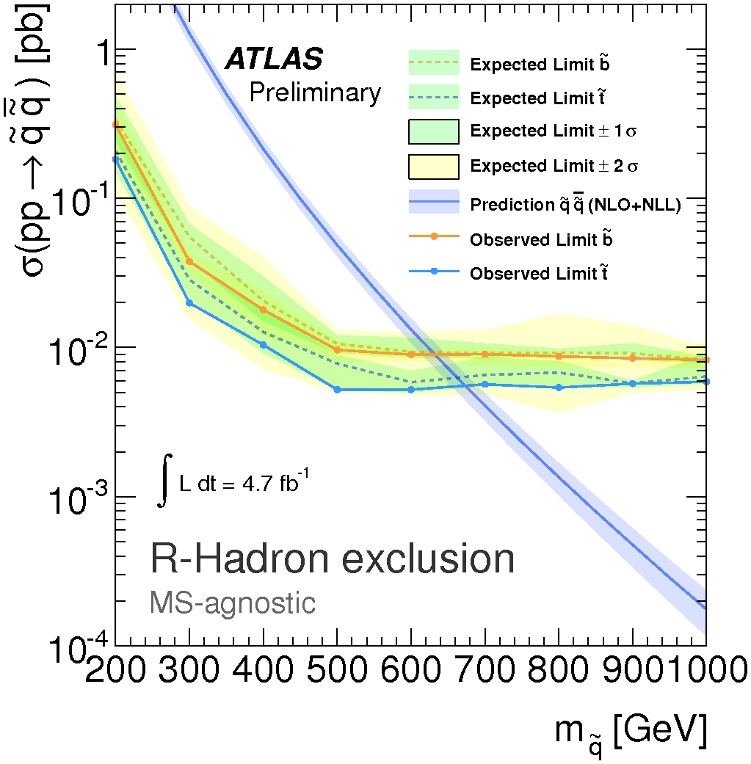
R-hadron searches - results
No excess above background expectation seen in any of the three analyses.
Set limits on squark R-hadrons (using triple-Regge model):

Slide 64

Disappearing tracks - introduction
arXiv:1210.2852 [hep-ex]
SUSY breaking could also leave the lowest gauginos approximately mass-degenerate (predicted, eg, by AMSB), giving rise to LL chargino decaying to neutralino and soft pion.
Look for production processes:
(jet from ISR, needed to trigger on event).
Resulting final state will include:
  High p_{T} jet
  Large missing transverse momentum.
  High-p_{T} disappearing track (or “kinked” track, but reconstruction efficiency for soft pion is not so good..)

Slide 65
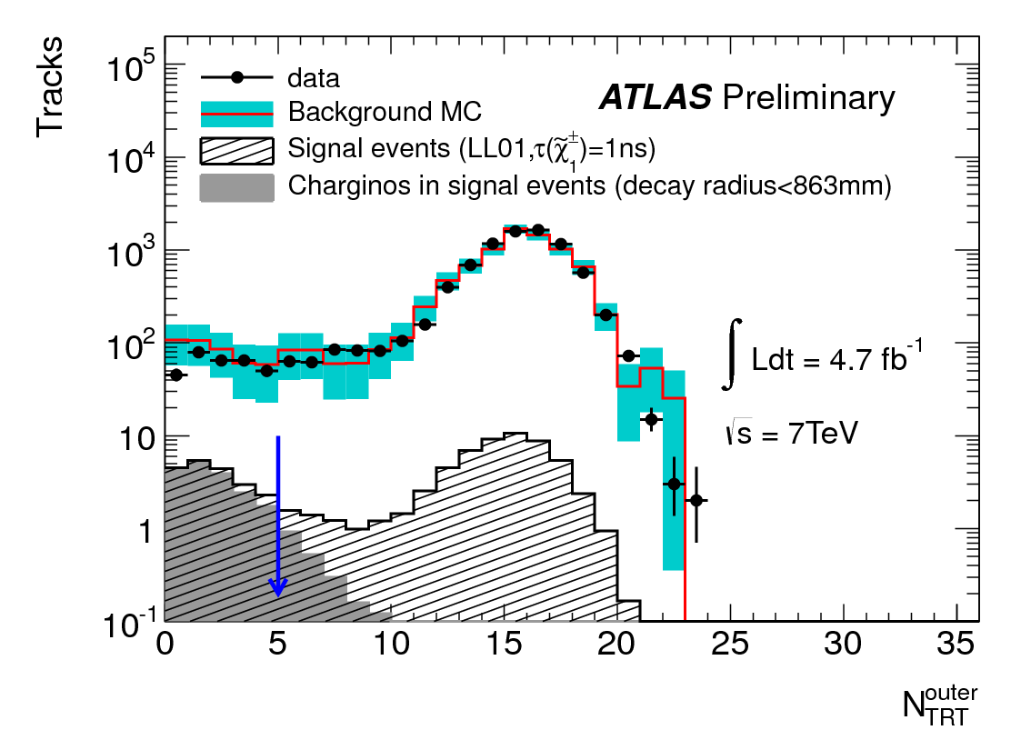
Disappearing tracks - selection
Event selection:
  Trigger on jet + missing E_{T}
  In offline selection, require missing E_{T} > 90GeV and at least one jet with p_{T} > 90GeV, well separated from missing E_{T} direction in φ.
  Lepton veto – no reconstructed electron or muon candidates.
Disappearing track candidate selection:
  Track must be isolated,
  have p_{T} > 10GeV,
  at least 1 Pixel hit and 6 SCT hits,
  originate from primary vertex,
  and point to TRT barrel (but not region
  around |η|=0).
  Fewer than 5 hits in TRT outer module.

Slide 66
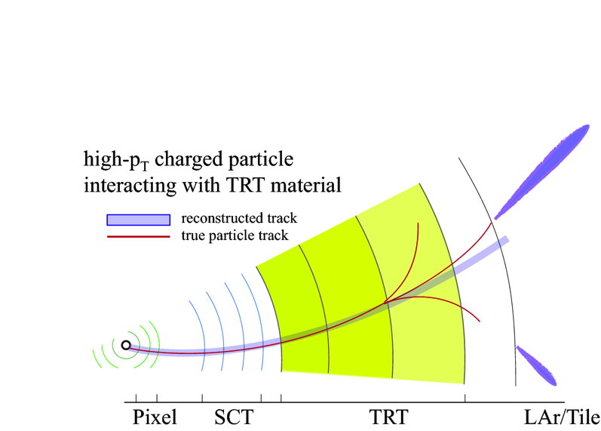
Disappearing tracks - backgrounds
Potential background sources are:
Charged hadrons interacting with detector material.

Slide 67
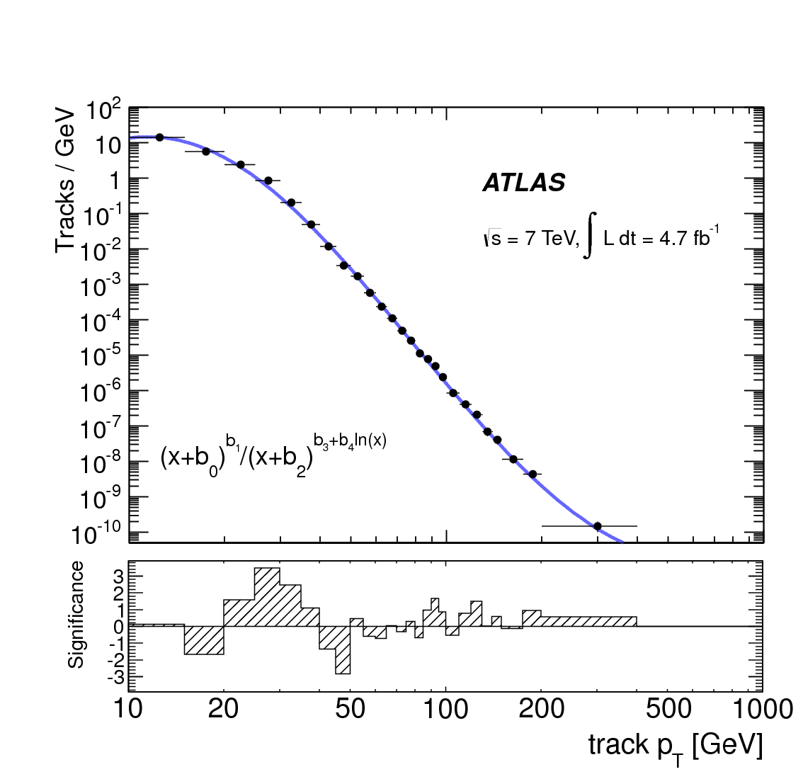
Disappearing tracks - backgrounds
Potential background sources are:
Charged hadrons interacting with detector material.
Electrons surviving lepton veto, undergoing bremsstrahlung.

Slide 68
Disappearing tracks - backgrounds
Potential background sources are:
Charged hadrons interacting with detector material.
Electrons surviving lepton veto, undergoing bremsstrahlung.
Obtain p_{T} spectrum for both sources of background using data control samples.

Slide 69
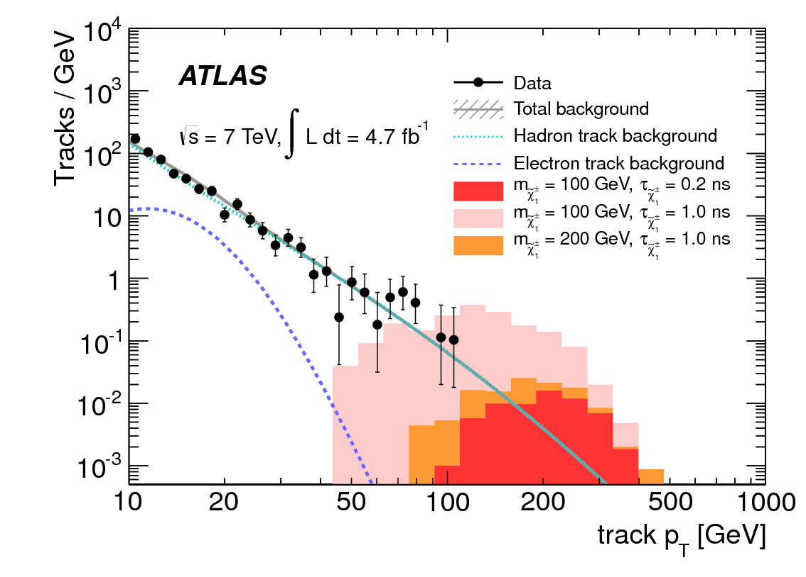
Disappearing tracks - results
Use signal+background likelihood fit to track p_{T} spectrum, to test different signal hypotheses.

Slide 70
Disappearing tracks - results
Use signal+background likelihood fit to track p_{T} spectrum, to test different signal hypotheses.
No significant excess found.

Slide 71
Disappearing tracks - results
Use signal+background likelihood fit to track p_{T} spectrum, to test different signal hypotheses.
No significant excess found.
Set limits on chargino mass and lifetime:

Slide 72
Disappearing tracks - results
Use signal+background likelihood fit to track p_{T} spectrum, to test different signal hypotheses.
No significant excess found.
Set limits on chargino mass and lifetime:
And on chargino – neutralino mass difference:

Slide 73
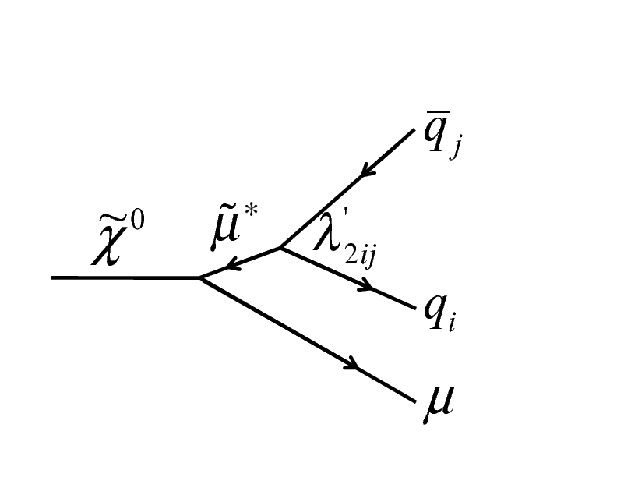
Displaced vertices with tracks+muons, in the Inner Detector
ATLAS-CONF-2012-113
Particles with average lifetimes up to a few nanoseconds could decay within the ID, giving rise to displaced vertices.
One of the easiest models to look for is RPV SUSY with a non-zero (but small) λ’₂₁₁ coupling.
Neutralino decays to muon plus jets.

Slide 74
Displaced vertices with tracks+muons, in the Inner Detector
ATLAS-CONF-2012-113
Particles with average lifetimes up to a few nanoseconds could decay within the ID, giving rise to displaced vertices.
One of the easiest models to look for is RPV SUSY with a non-zero (but small) λ’₂₁₁ coupling.
Neutralino decays to muon plus jets.
  Muon is useful for triggering and background rejection.

Slide 75
Displaced vertices with tracks+muons, in the Inner Detector
ATLAS-CONF-2012-113
Particles with average lifetimes up to a few nanoseconds could decay within the ID, giving rise to displaced vertices.
One of the easiest models to look for is RPV SUSY with a non-zero (but small) λ’₂₁₁ coupling.
Neutralino decays to muon plus jets.
  Muon is useful for triggering and background rejection.
  High track multiplicity helps vertex reconstruction.

Slide 76
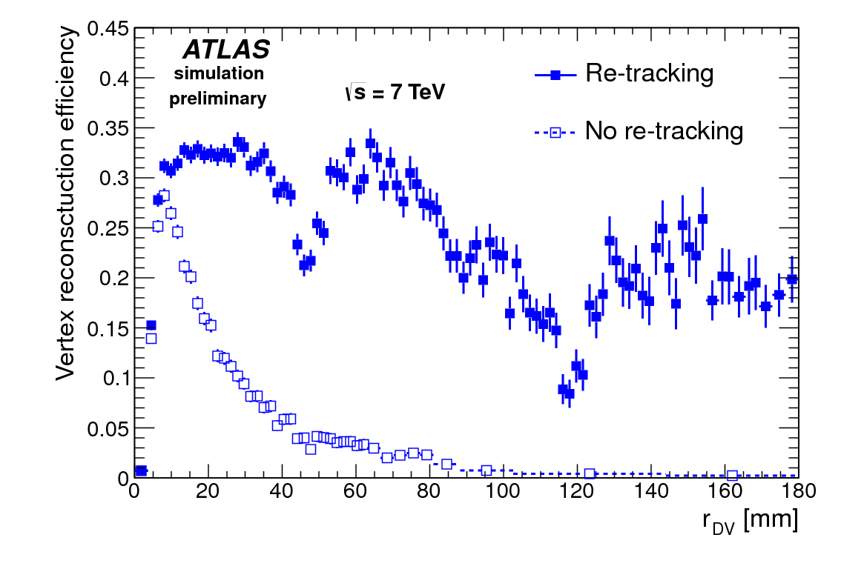
Displaced vertices – track and vertex reconstruction
Standard ATLAS tracking is highly optimized for tracks coming from the primary interaction point (IP).
To increase efficiency for secondary tracks, we re-run Silicon-seeded tracking algorithm, with looser cuts on transverse impact parameter, using “left-over” hits from Standard tracking.
Vertex-finding algorithm based on incompatibility graph method.
Iterative disambiguation process then splits/merges/refits vertices until no tracks are shared between vertices.

Slide 77
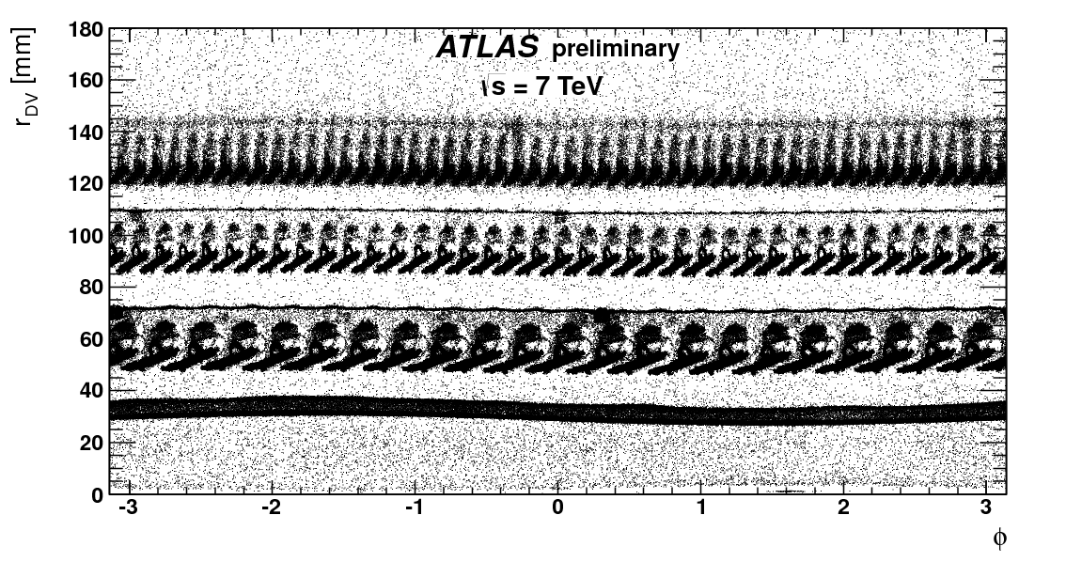
Displaced vertices – selection
Events triggered by high-p_{T} muon trigger, with no ID track requirement.
Use tracks with |d₀|>2mm, p_{T}>1 GeV as input to vertexing.
Look in fiducial volume roughly corresponding to Pix barrel.
Require at least 5 tracks in vertex, and mass > 10 GeV.
Require high-p_{T} muon passing within 0.5mm of reco vertex.
Veto vertices reconstructed in regions with high material density.

Slide 78
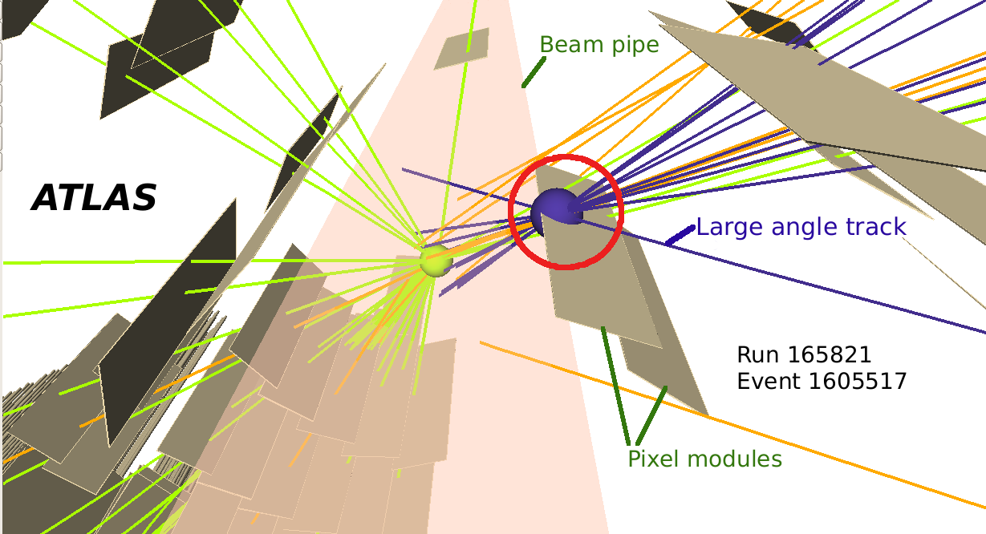
Displaced vertices – backgrounds
Two sources of background vertices considered:
  Purely random combinations of tracks inside the beampipe (where vacuum is good, but track density is high).
  High-mass tail of distribution of real vertices from hadronic interactions with gas molecules.
    Particularly if vertex is crossed by random (real or fake) track at large angle.
Use a different data-driven method for each background source: total estimate is
(4 ± 60)*10⁻³
vertices in signal region.

Slide 79
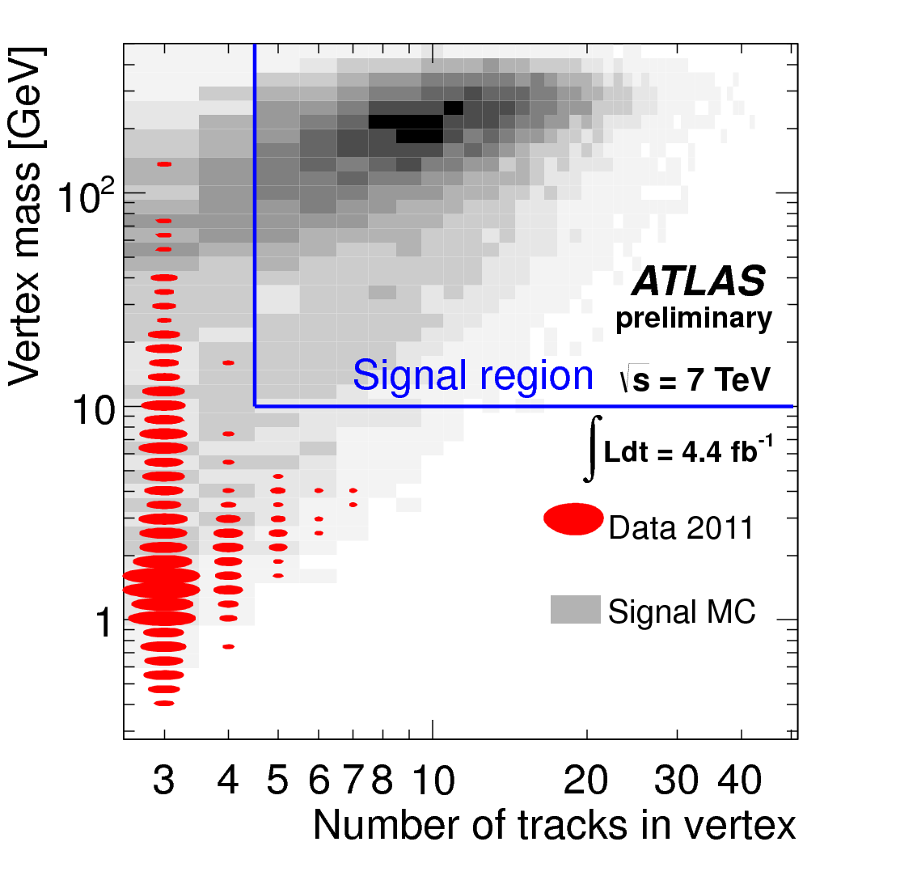
Displaced vertices – results
Zero vertices passing selection requirements observed in 4.5 fb⁻¹ data sample.

Slide 80
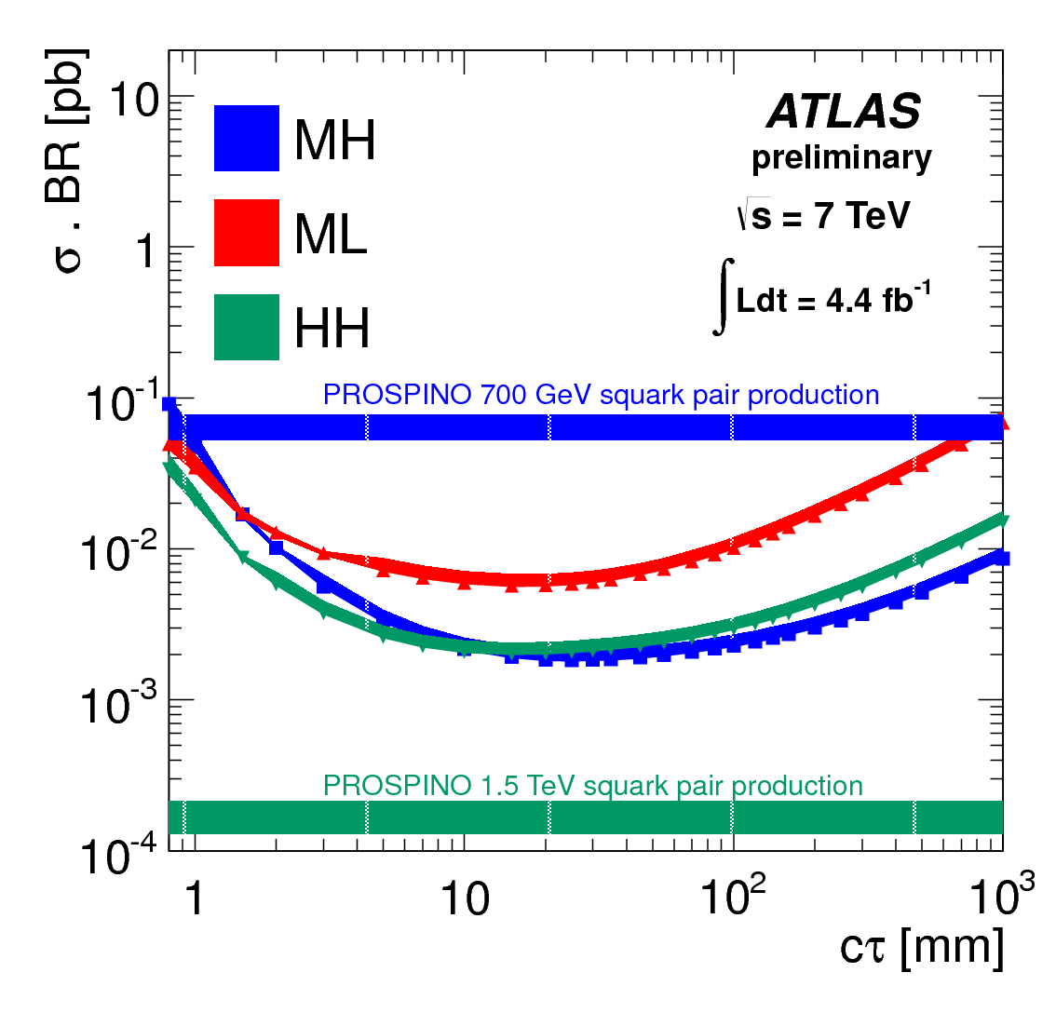
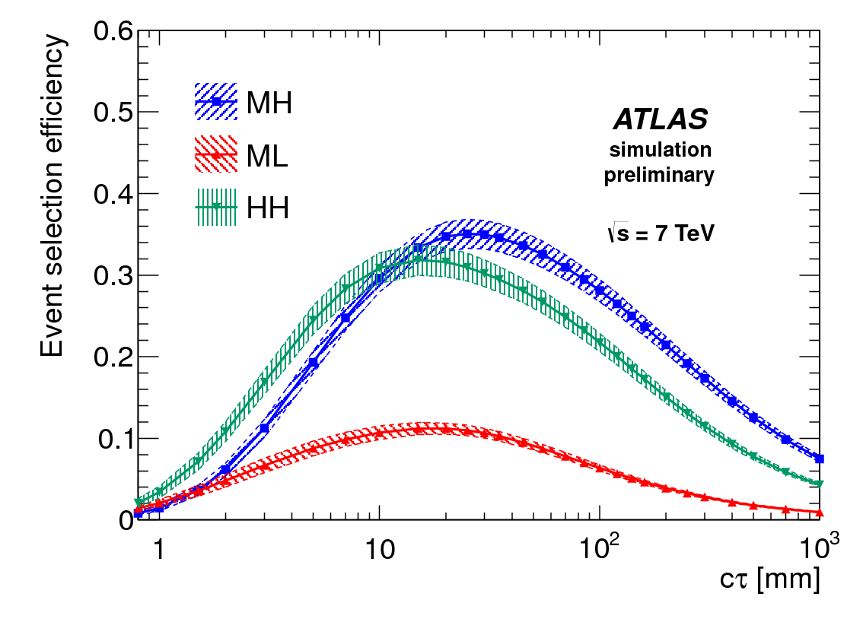
Displaced vertices – interpretation
Use simplified RPV SUSY signal model to set limits.
Squark pair production, squark decays directly to long-lived neutralino, which decays to muon plus jets.
Three combinations of squark and neutralino mass, to get idea of effect of LLP mass and boost on reconstruction efficiency.

Slide 81
Hidden Valley: light Higgs-to-LLP search
Phys.Rev.Lett. 108 (2012) 251801
We can also look for displaced vertices at larger radii, near outer radius of hadronic calorimeter, or in the MS.
As benchmark, take a Hidden Valley model, where hidden sector includes pseudoscalar π_{v}.
Higgs could decay to pair of π_{v}.
  Due to weak coupling with SM, π_{v} is long-lived.
  Will decay to fermion-antifermion pair, predominantly bb,cc,τ⁺τ⁻ (due to helicity suppression).
Signature will be two back-to-back (η,Φ) clusters of charged and neutral hadrons in the MS, (one for each π_{v} decay).
  Use specially developed trigger algorithm, and specialized tracking and vertexing, to reconstruct vertices in MS.

Slide 82
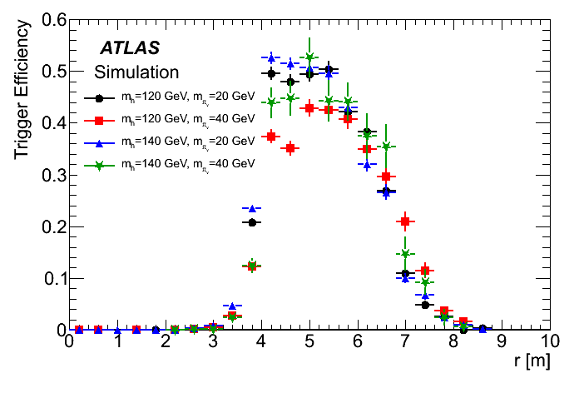
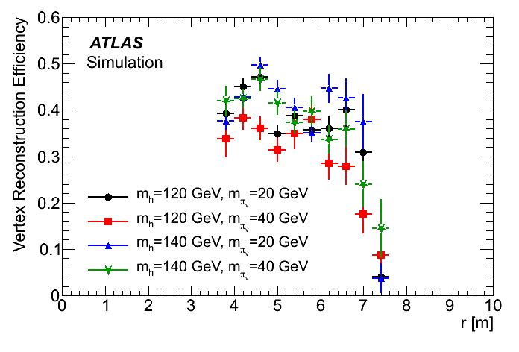
Hidden Valley: light Higgs-to-LLP search
Level 1 muon trigger creates “Regions Of Interest” (RoIs) based on hits in the MS trigger chambers.
“Muon RoI cluster trigger” then selects events with cluster of 3 or more RoIs in ΔR=0.4 cone in MS barrel.
Reconstruct “tracklets” from MDT hits.
Extrapolate back through B-field, and reconstruct vertex position as point in (r,z) that uses highest number of tracklets to make vertex with χ² probability > 5%.

Slide 83
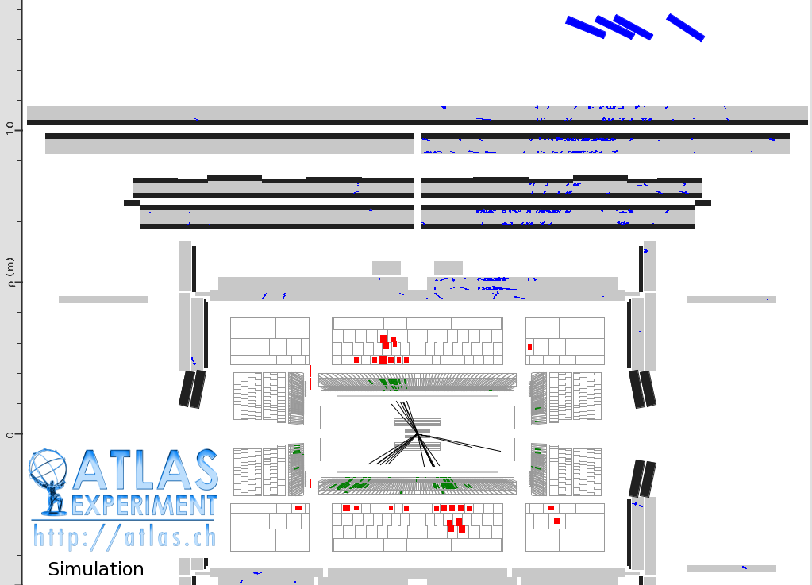
Hidden Valley: light Higgs-to-LLP search
RoI clusters
MDT hits

Slide 84
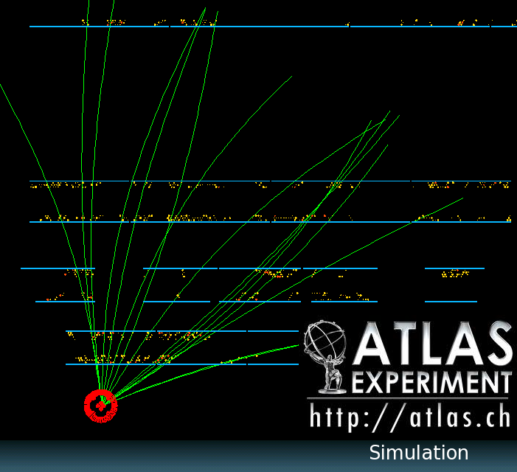
Hidden Valley: light Higgs-to-LLP search
Truth tracks

Slide 85
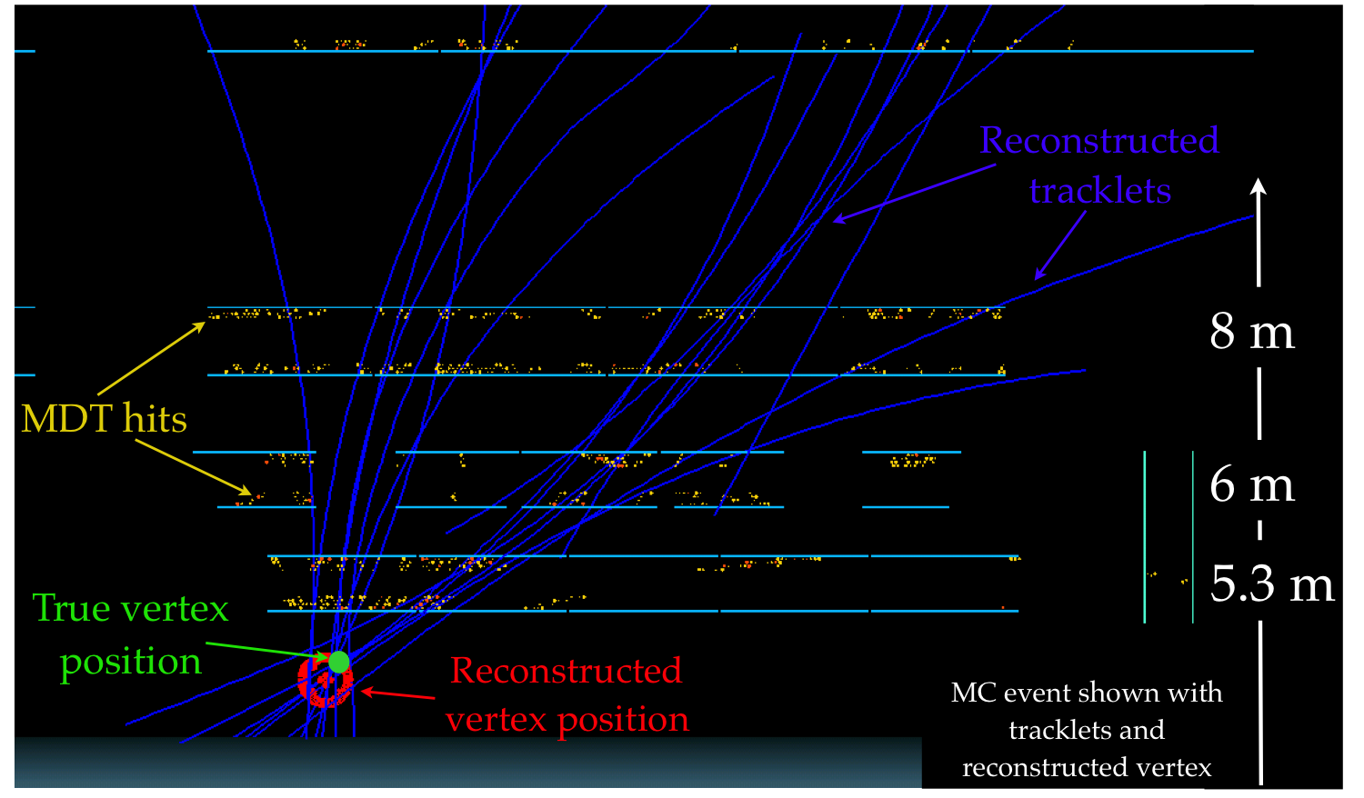
Hidden Valley: light Higgs-to-LLP search
Reconstructed tracks

Slide 86
Hidden Valley: light Higgs-to-LLP search
Reconstructed vertices are required to:
  have at least three “tracklets”,
  point back to IP,
  be in range |η|<2.2,
  be separated from high-p_{T} tracks and jets.
2 vertices per event are required, separated by ΔR>2.
Calculate background using data-driven method, exploiting the fact that the two vertices can be triggered on and reconstructed independently.
  Estimate:
0.03±0.02 events

Slide 87
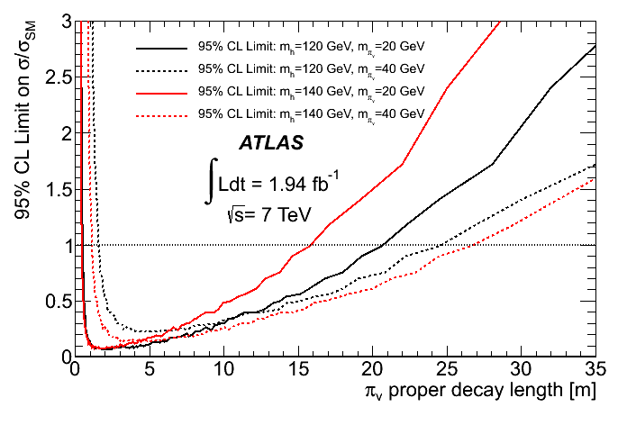
Hidden Valley: light Higgs-to-LLP search results
No events seen passing all selection requirements, in 1.9 fb⁻¹ data
Set limits on h⁰ to π_{v} π_{v} cross-section as a function of π_{v} proper decay length, in multiples of SM Higgs production cross-section (assume 100% branching ratio):

Slide 88
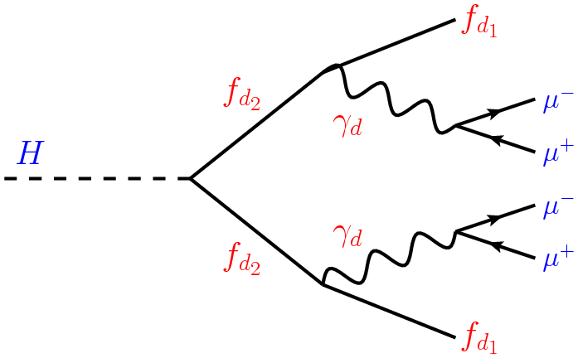
Displaced muonic lepton jets
arXiv:1210.0435 [hep-ex]
At the LHC, hidden sector particles could be produced with large boosts, such that their decay products form jet-like structures.
If the Higgs can decay to hidden-sector fermions, these could in turn decay to a (potentially long-lived) neutral hidden-sector particle γ_{d} and a stable hidden sector fermion that escapes detection.
Decay of γ_{d} could give rise to collimated pairs of leptons.

Slide 89
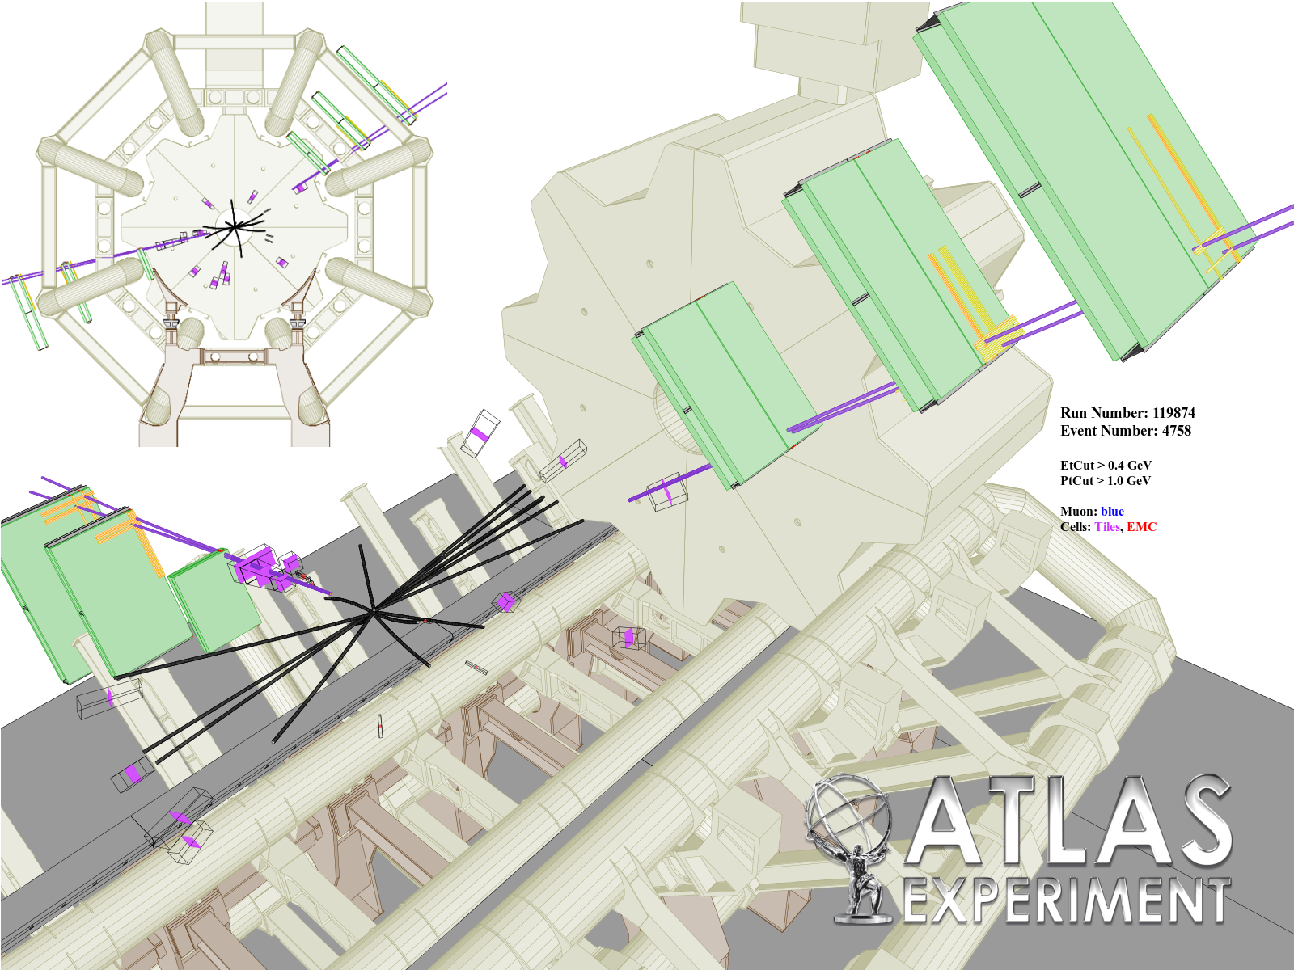
Displaced muonic lepton jets

Slide 90
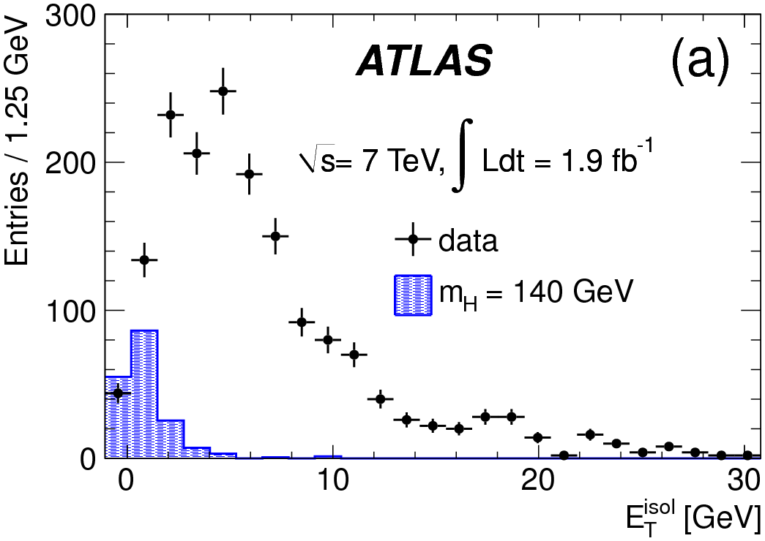
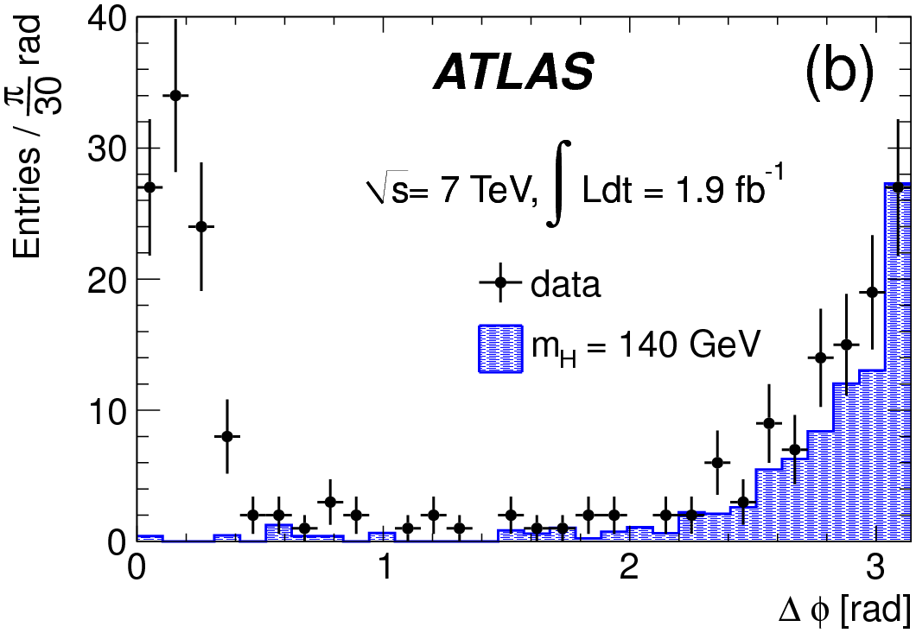
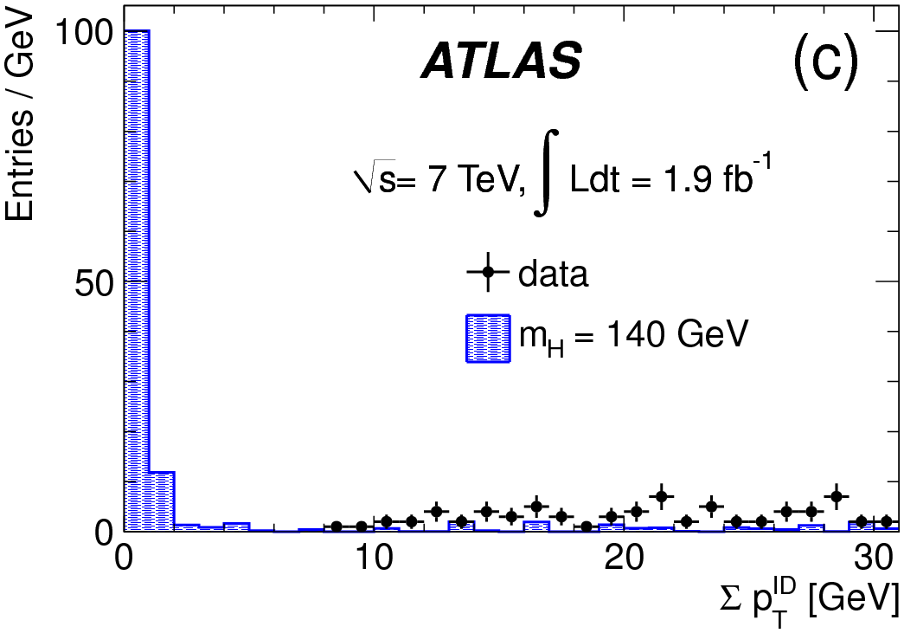
Displaced muonic lepton jets – reconstruction and selection
Muon jets (MJs) from displaced γ_{d} decays will have pair of muons in narrow cone.
Use low-p_{T} multi-muon trigger without any ID track requirement.
Reconstruct tracks in MS, and use clustering algorithm to gather muons within a cone.
Require MJs to have 2 oppositely charged muons, and 2 MJs per event.
Reject background using cuts on track and calorimeter isolation, ΔΦ between MJs.
Use data collected in empty bunch crossings to estimate potential background from cosmic ray showers – estimate fewer than 2 events.

Slide 91
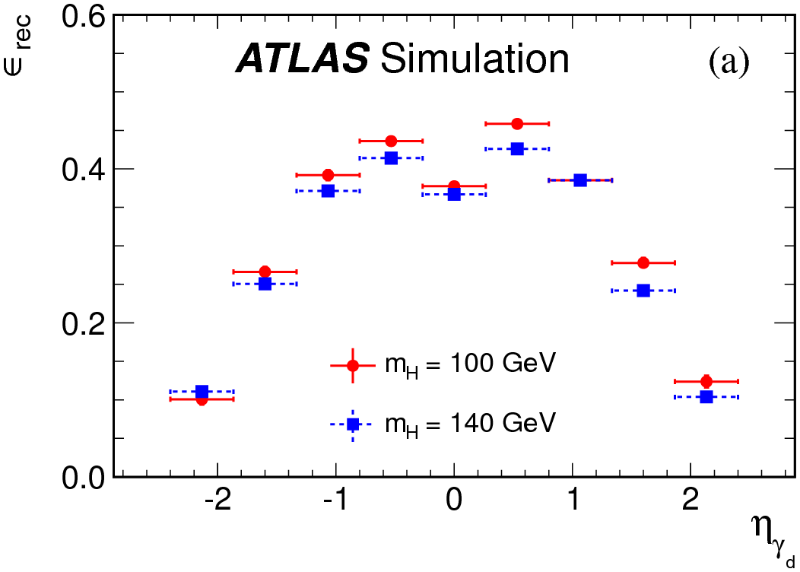
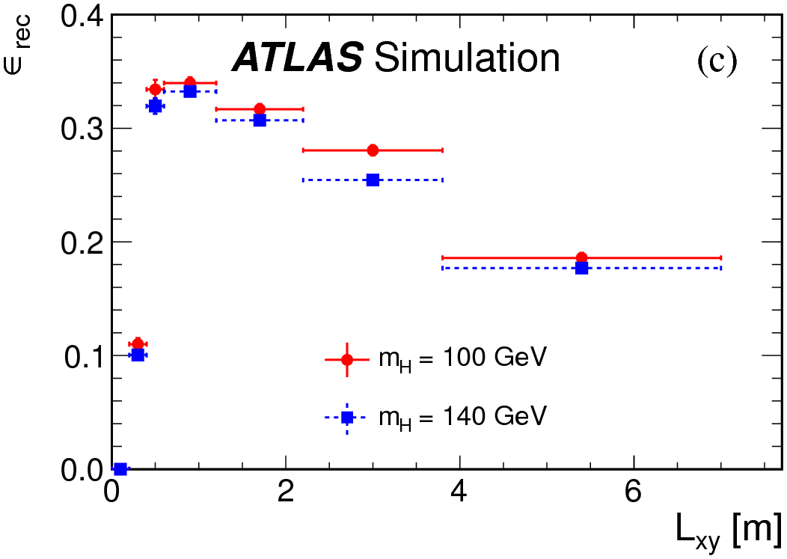
Displaced muonic lepton jets – signal efficiency
Use signal Monte Carlo samples with Higgs masses of 100 GeV and 140 GeV, γ_{d} mass of 0.4 GeV, and proper decay length cτ of a few cm.
Can then reweight these samples to get efficiencies for different values of cτ.

Slide 92


Displaced muonic lepton jets – results
No candidate events survive all selection requirements in 1.9 fb⁻¹ data sample.
Set limits on σ.BR(H to γ_{d} γ_{d} +X) vs cτ.
  Assuming BR(γ_{d} to μμ)=45% and mass(γ_{d})=0.4 GeV.

Slide 93

Magnetic monopoles
arXiv:1207.6411 [hep-ex]
Magnetic monopoles appear in many Grand Unified Theories.
Their existence would explain quantisation of electric charge.
Dirac quantization condition:
i.e. would interact with matter like an ion with electric charge 68.5e… very highly ionizing!!
  Even more so due to “knock-on” δ-rays.
Electrically neutral magnetic monopole traversing ID would be straight in (r,Φ) plane and curved in (r,z).

Slide 94



Magnetic monopoles
Experimental signature would be large, localized energy deposit in EM calorimeter, associated with region of high ionization in TRT.
Use high-p_{T} single electron trigger to select events.
Use Φ position of EM cluster to define “roads” from beamline, and count TRT High Threshold hits.

Slide 95

Magnetic monopoles
Final Discriminating variables are
  Fraction f_{HT} of High Threshold TRT hits in narrow road from beamline to cluster.
  Energy-weighted η-Φ cluster dispersion σ_{R} in second layer of EM calorimeter.
Main backgrounds are high-p_{T} electrons, photons, jets, which have no correlation in these variables.
  Expected background in signal region is 0.011±0.007 events.
In 2 fb⁻¹ dataset, no events observed in signal region.

Slide 96



Magnetic monopoles - limits
From MC signal, reconstruction efficiency is high and uniform for large range in E_{T}^{Kin}.
Set upper limits on production cross-section for both single monopoles in fiducial region, and Drell-Yan production.

Slide 97
Conclusions
Wide range of analyses, looking for many different signatures, and often using the detector in interesting and “non-standard” ways.
  Provide a fun challenge for ambitious experimentalists!
No sign of New Physics so far….
BUT:
  All these analyses are being updated (and improved) with 2012 data.
  Plus more to come!
We are doing our best to cover as much parameter space as we can..
  And also to get maximum possible value out of our fantastic detector!

Slide 98
References:
SUSY Stable Massive Particles: ATLAS-CONF-2012-075
  (will be submitted to PLB any day now!!)
Disappearing tracks: arXiv:1210.2852 [hep-ex], submitted to JHEP
Displaced vertices with muon: ATLAS-CONF-2012-113
  (will be submitted to PLB any day now!)
Search for light Higgs decay to LLPs:
Phys.Rev.Lett. 108 (2012) 251801.
Displaced muonic lepton jets: arXiv:1210.0435 [hep-ex], submitted to PLB
Magnetic monopoles: arXiv:1207.6411 [hep-ex], submitted to PLB

Slide 99
Backup

Slide 100

How to get βγ from dE/dx
Get most probable value of dE/dx from 5-parameter simplified version of Bethe-Bloch:
Most probable value for MIPS is about 1.2MeVg⁻¹cm²

Slide 101
Long-lived sleptons - selection
Use single muon trigger.
In offline selection, require 2 muon candidates per event.
Loose SMP selection:
  p_{T} > 50 GeV (and consistent between MS and ID measurements)
  Z-veto
  Consistent β and βγ measurements in different systems, with combined β <0.95
If one of the muon candidates in an event fails this loose SMP selection, the other one is then required to pass tight selection:
  p_{T} > 70 GeV
  Tighter requirements on consistency between β measurements
Final requirements on beta and betagamma optimized for each hypothesis.

Slide 102
R-hadrons – selection
Full detector and MS-agnostic:
  ID track with p>140 GeV and |eta|<2.5
  No jet with p_{T} > 40 GeV within 0.3 cone, no track with p_{T} > 10 GeV within 0.25 cone.
  Good dE/dx measurement
  Uncertainty on beta less than 10% for calo only, or 4% for combination.
ID only:
  PV must have more than 4 tracks
  Offline missing E_{T} cut of 85 GeV
  2 pixel and 6 SCT hits, p_{T} > 50 GeV and p > 100 GeV
  No tracks with p_{T} > 1 GeV within 0.25 cone.
Final requirements on beta and betagamma optimized for each hypothesis.

Slide 103

SMPs - systematics

Slide 104

Disappearing tracks
Cross-section for direct chargino production.

Slide 105

Disappearing tracks – background and systematics
Main background after high-pT isolated track selection is from W->tau nu events
Data-driven method uses control samples to get pT distribution
  Non interacting hadron tracks by requiring >10 hits in TRT outer barrel.
  Electrons, by requiring normal selection apart from lepton veto, and applying “medium” electron ID.
Systematics:

Slide 106

Disappearing tracks - cutflow

Slide 107



Incompatibility graph
S. R. Das, “On a new approach for finding all the modified cut-sets in an incompatibility graph”, IEEE Transactions on Computers v22(2) (1973) 187.

Slide 108

Displaced vertices – interpretation
Use CL_{s} method to set 95%C.L. upper limit on σ-vs-cτ for each mass combination
Limit shown here is for two neutralinos per event, but efficiency factorizes, so limit for single vertex can be easily calculated: (eff_{evt}=2*eff_{vtx}-eff_{vtx}²)

Slide 109


Higgs to LLPs – systematics
Look at data/MC difference in numbers of RoIs and in vertex reconstruction efficiency for punch-through jets.
Total systematic uncertainty on efficiency for reconstructing a vertex is 16%

Slide 110

Higgs to LLP – ctau vs mass

Slide 111


Higgs to LLP – RoI positions in data

Slide 112
Higgs to LLP – Background estimate
Number of events with single muon RoI trigger object, and isolated MS vertex
Probability for random event to contain an MS vertex
N_{fake}(2 MS vertex) = N(MS vertex, 1trig)*P_{vertex} + N(MS vertex,2trig)*P_{reco}
Number of events with isolated vertex and 2 trigger muon RoI cluster objects
Probability to reconstruct a vertex given that there was an RoI cluster

Slide 113



Displaced muonic lepton jets
Challenge is getting separate RoIs from two very collimated muons, separated by DeltaR

Slide 114
Displaced muonic lepton jets - selection
Exactly 2 MJs, each of which have exactly 2 oppositely charged muons.
Difference E_{t}^{isol} between calorimeter energy in R=0.4 cone around highest pT muon and in 0.2 cone must be < 5 GeV for both MJs.
Sum of pT of all ID tracks in 0.4 cone around MJ must be < 4 GeV.
abs(Delta phi) between two MJs must be >2.

Slide 115

Displaced lepton jets - cutflow

Slide 116
Displaced lepton jets - systematics
Luminosity: 3.7%.
Muon momentum resolution: negligible.
Trigger (evaluated using T&P on Jpsi->mumu): 17%.
Reco efficieny (evaluated using T&P on Jpsi->mumu): 13%.
Pile-up: negligible.

Slide 117

H1 monopole search
H1 removed beampipe, used magnetometer to look for stable monopoles.
  Eur.Phys.J. C41 (2005) 133-141

