Slide 1
LHCONE Point-to-Point Service Workshop - CERN Geneva
Eric Boyd, Internet2
Slides borrowed liberally from Artur, Inder, Richard, and other workshop presenters

Slide 2
Who was there?
Network Operators
LHCONE Application Developers
https://indico.cern.ch/conferenceDisplay.py?confId=215393

Slide 3
First Part: Bandwidth on Demand
Introduction to BoD Concepts – Inder Monga
NSI – Jerry Sobieski
Circuit Service Deployments
  North America et al – Eric Boyd
  GEANT – Tangui Coulouarn
Example of what Data Intensive Science can do with BoD: JIVE – Paul Boven

Slide 4
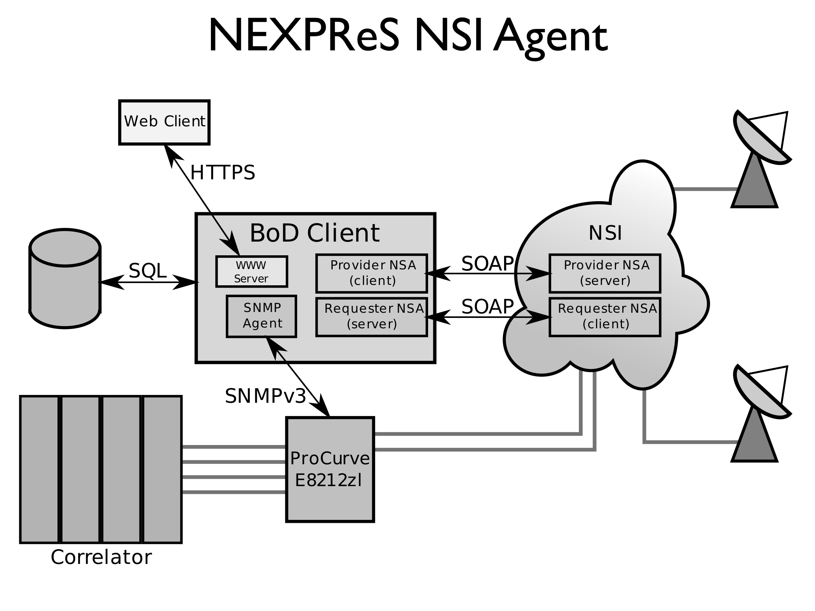

Slide 6
Second Part: LHC Computation Middleware and Workflow
Networking and Workload Management – Kaushik De
ATLAS and CMS Data Management Tools and Federated Data Store Implementations – Daniele Bonacorsi
ALICE Data Access Model – Costin Grigoras
ANSE Project Overview – Artur Barczyk

Slide 7
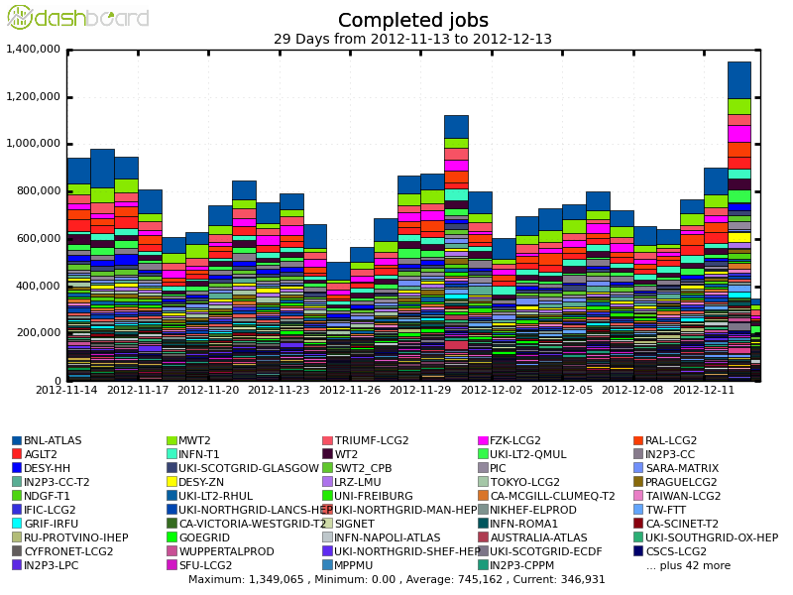
PanDA Scale
Number of Analysis Users: (unique)
Users in the last 3 days : 458; 7: 623; 30: 941; 90: 1240; 180: 1547;

Slide 8
PanDA Philosophy
PanDA WMS design goals:
  Achieve high level of automation to reduce operational effort
  Flexibility in adapting to evolving hardware and network capabilities
  Support diverse and changing middleware
  Insulate user from hardware, network, middleware, and all other complexities of the underlying system
  Unified system for organized production and user analysis
  Incremental and adaptive software development
PanDA and DDM
  PanDA uses a independent and asynchronous Distributed Data Management system (DDM) called DQ2 in ATLAS
  DDM is tightly coupled to networking – will not address here

Slide 9
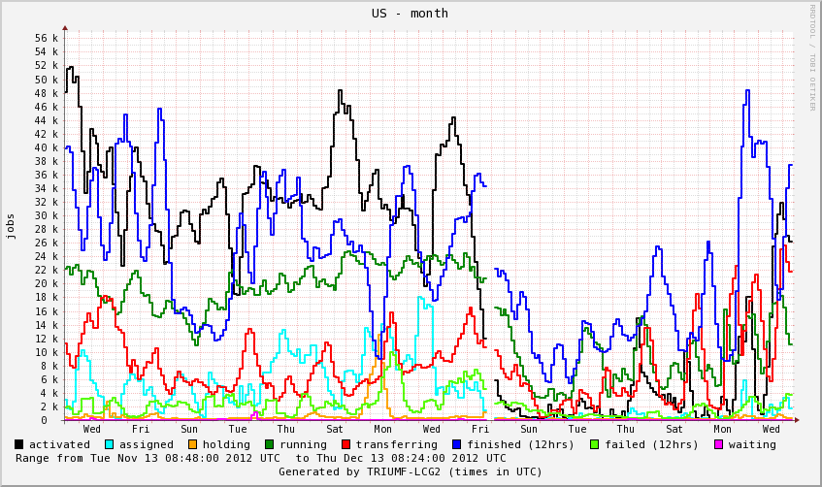
Job States
Panda jobs go through a succession of steps tracked in DB
  Defined
  Assigned
  Activated
  Running
  Holding
  Transferring
  Finished/failed

Slide 10
Assigned Jobs
Assigned -> Activated workflow
  Group of jobs are assigned to a site by PanDA brokerage
  For missing input files, data transfer is requested asynchronously
  PanDA waits for “transfer completed” callback from DDM system to activate jobs for execution
  Network data transfer plays crucial role in this workflow
Can network technology help assigned->activated transition?
  Can we use network provisioning in this step?
  Jobs are reassigned if transfer times out (fixed duration) – can knowledge of network status help reduce the timeout?
  Can modification of network path help?

Slide 11
Transferring Jobs
Transferring state
  After job execution is completed, asynchronous data transfer is requested from DDM
  Callback is required for successful job completion
How can network technology help?
  Similar questions as assigned state
  Very long timeout delays completion – can network status info help
  Can we balance CPU resource vs Network resource
  At what point can we give up on transfer and rerun the job?

Slide 12
Summary
In the past WMS assumed:
  Network is available and ubiquitous
  As long as we implement timeouts, workflow will progress smoothly
  Computing models can tell us how to design workflows
What we learned from the LHC:
  Flexibility in WMS design is more important than computing model
  Network evolution drives WMS evolution
  We should start thinking about Network as resource
  WMS should use network information actively to optimize workflow
  Resource provisioning could be important for the future
The future:
  Advanced Network Services for Experiments (ANSE), NSF funded (Caltech, Michigan, Vanderbilt and U Texas Arlington)
  Next Generation Workload Management and Analysis System for Big Data, PANDA integration with networking, DOE funded (BNL, U Texas Arlington)

Slide 13
Second Part: LHC Computation Middleware and Workflow
Networking and Workload Management – Kaushik De
ATLAS and CMS Data Management Tools and Federated Data Store Implementations – Daniele Bonacorsi
ALICE Data Access Model – Costin Grigoras
ANSE Project Overview – Artur Barczyk

Slide 16
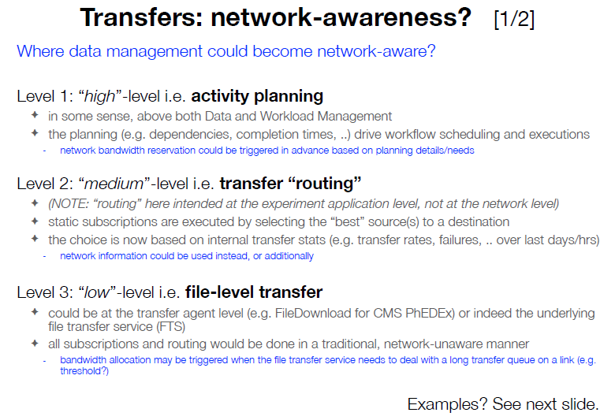
Where to Attach?
To be further investigated in ANSE later stage
ANSE initial main thrust axis
Can do “now” with DYNES/FDT and PhEDEx (CMS) – first step in ANSE
D. Bonacorsi, CMS, at LHCONE P2P Service Workshop, Dec. 2012

Slide 18
Second Part: LHC Computation Middleware and Workflow
Networking and Workload Management – Kaushik De
ATLAS and CMS Data Management Tools and Federated Data Store Implementations – Daniele Bonacorsi
ALICE Data Access Model – Costin Grigoras
ANSE Project Overview – Artur Barczyk

Slide 19
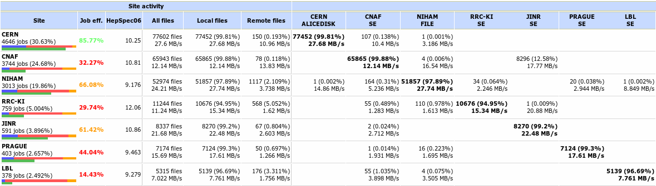
A particular analysis task …
IO-intensive analysis train run
Small fraction of files accessed remotely
  With the expected penalty
However the external connection is the lesser issue …

Slide 20
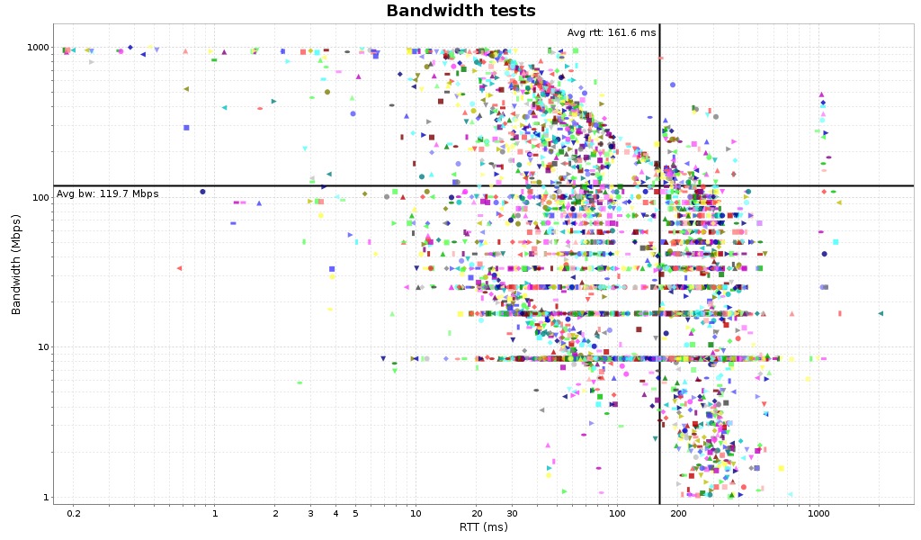
Available bandwidth per stream
Suggested larger-than-default buffers (8MB)
Funny ICMP throttling
Discreet effect of the congestion control algorithm on links with packet loss (x 8.39Mbps)
Default buffers

Slide 21
Second Part: LHC Computation Middleware and Workflow
Networking and Workload Management – Kaushik De
ATLAS and CMS Data Management Tools and Federated Data Store Implementations – Daniele Bonacorsi
ALICE Data Access Model – Costin Grigoras
ANSE Project Overview – Artur Barczyk

Slide 24
Inder’s Summary of the discussion
Application
Network Information
Availability
Performance
Capabilities
Statistics
Topology?
…
PanDA
PhEDeX
P2P Network Services
Resource reservation
Pt-MP
Priority
Modify
…
Network

Slide 25
Inder: Discussion from P2P workshop:
Questions → Opportunities
Applications need information from the network to help determine
  What can it provide that will help choose the best Data Transfer Replica?
  Where should I run my next job (A, A’ or A’’) – co-scheduling requirement
    Is it better to move storage to compute or compute to storage?
  Federated Storage Redirection
    Choice of the source of traffic is just-in-time
    Throughput monitoring, can tell the network when something is not working as expected
  Application based routing of flows
    If A → C is busy or blocked, can I move it from A → B → C
  Middleware like Workflow Managers
    Can we provide an aggregated view to the network

Slide 26
Inder: Network Services Questions
Point to Multi-point data replication (or Multi-point to single point)
Granularity of the Network Service request
  Service limitations of the network
  Can that be discovered end-to-end?
Circuit-blocking response
  What happens when network cannot provide the circuit?
  Alternate suggestions from the network rather than yes/no answer
Prioritization of various circuit requests
  Bump one vs the other?
Should the applications be multi-domain aware or agnostic
  Network as a single black box or more visible?
Ability to modify network paths – more duration or bandwidth
How should applications model the network: Network as a resource or Network as a service

Slide 27
Takeaways – Richard’s Thoughts
Experiments need to be able to manage the network & its resources and to interact with Panda and FedX.
Users need the authority to allocate net resources
need authi & authz mechanisms
BOD usage
  May need strict policing or floor with excess marked as LBE
  Concern re integration time/duty cycle for policing; need for shaping of flows and effect of buffer over runs
  May wish to lower the bandwidth of a BoD link
  Need to have tools to know what possible BW/path can be requested both now and at a future time, then user will determine if reservation is useful (FedX).
  Network needs to return this information on request.

Slide 28
Takeaways – Richard’s Thoughts
Users (and networkers) want to know WHY a reservation failed
or had poor performance
  Also what to do about it
  Need enough info to tell the net people what was wrong so can look at it.
Is the network a black box?
Need a global view of the network to be able to organise storage and access to data – not just moving 1 file but eg which replica to use?
Topology info and “normal routes” important
eg decide to move data lon-chi, not gen-chi but actually it flows lon-gen-chi.
Chain or tree for NSI BoD?
  Problems in the past with trees failing – need for info about each step
  App could decide on the path
  Will Client APIs talk only to local NREN?

