Slide 1
LHCb Grid Operations
Stefan Roiser
IT/ES

Slide 2
2012 Reprocessing
Current main activity in distributed computing
  Will last until end of this year for 2012 data
  Q1/2013 will start processing of 2011 data
Progressing very well, ahead of schedule
  Few site specific issues concerns mainly in data management

Slide 3

Data Processing Workflow
Replication
4a
5a
FULL.DST
FULL.DST
6a
FULL.DST
6
RAW
1
RAW
UNM.DST
9
7
Tape
Buffer
Tape
Disk
Buffer
4
Merging
Data Processing
2
Data Managemt
8
Destroy
D1T0
10
PHY.DST
D0T1
Disk
Storage
Stripping
5
3
LHCb File
Reconstruction
FULL.DST = reconstructed physics quantities
UNM.DST = temporary output for physics stream, PHY.DST = file ready for physics user analysis

Slide 4
Data access by jobs
FULL.DST
UNM.DST
RAW
Tape
Buffer
Disk
Buffer
Merging
SRM access problems
  Jobs downloading their
  input data to the WNs
    Including reconstruction
    on “remote T2s”
  Bursts appearing and disappearing
Stripping
Reconstruction

Slide 5
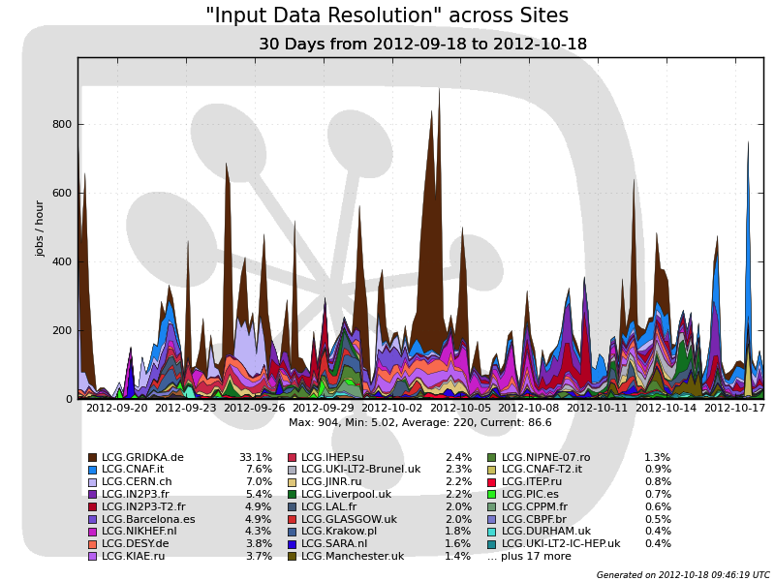
Data access by jobs (ctd)
SRM problems at Gridka
Network outage
at CNAF
“Remote”
Tier2s not finding input data , network congestion, …

Slide 6
Data Migration Disk -> Tape
Replication
FULL.DST
FULL.DST
FULL.DST
Tape
Buffer
Tape
Disk
Buffer
FULL.DSTs are not only produced by Tier1s but also “attached Tier2s”
  Consequently stress on disk buffer
  Essential to migrate data efficiently onto Tape in order to let FULL.DSTs be deleted afterwards
BUFFER is on the same SE than production data
  Filling up the BUFFER can jeopardize the storage
Destroy

Slide 7
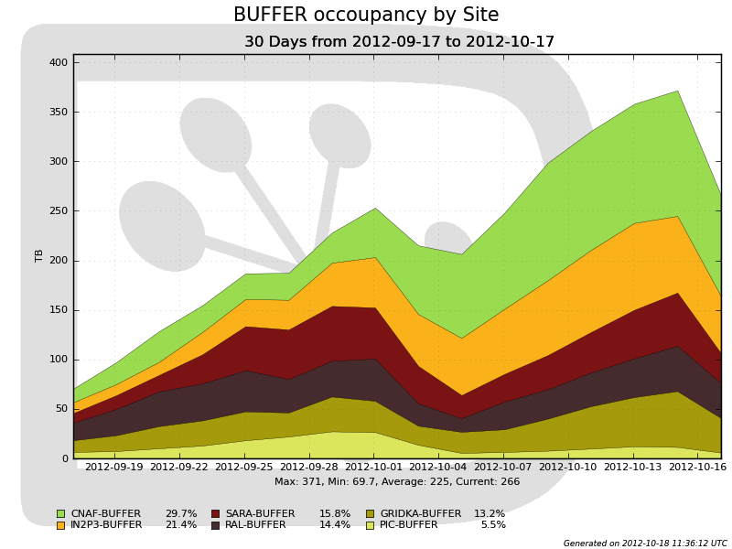
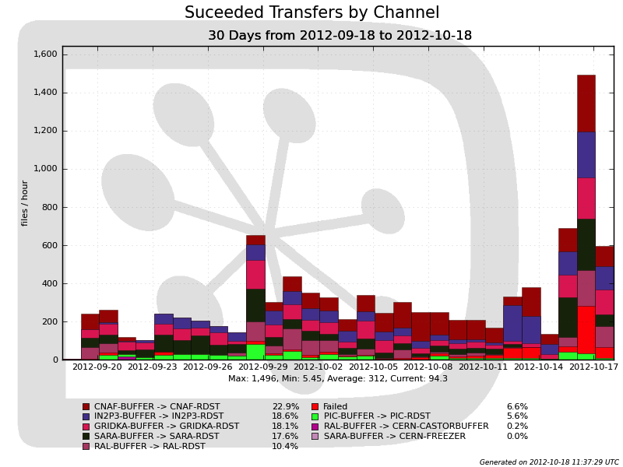
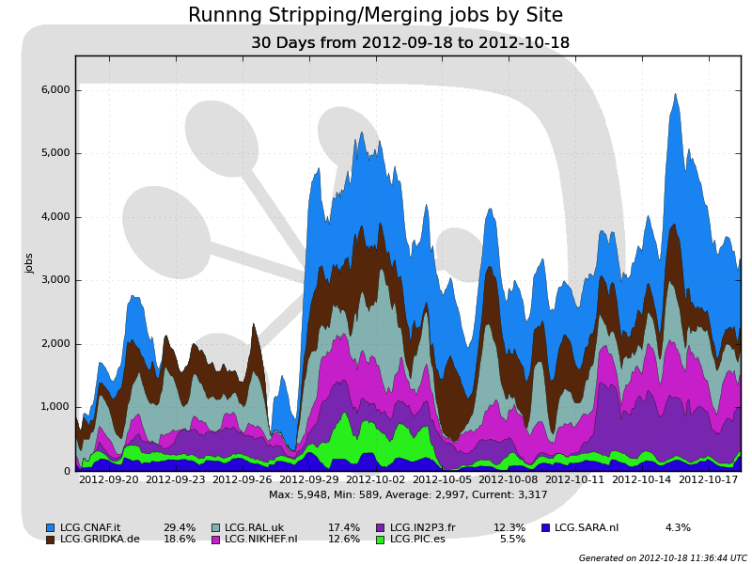
Data Migration Disk -> Tape (ctd)
Increase in
Disk BUFFER
occupancy
Mitigation by increased
transfers BUFFER->Tape
High number of Stripping Merging jobs allow
freeing of
BUFFER
Situation under control
  After increasing of transfer rates
  Buffer occupancy decreasing

Slide 8
Data Staging
During reprocessing all RAW
data of a year is being staged
  Much more staging than
  during “prompt reconstruction”
  RAW data serves also as input to “attached sites”
Stager shall provide enough resources to feed all sites
RAW
RAW
Tape
Buffer
Tape

Slide 9
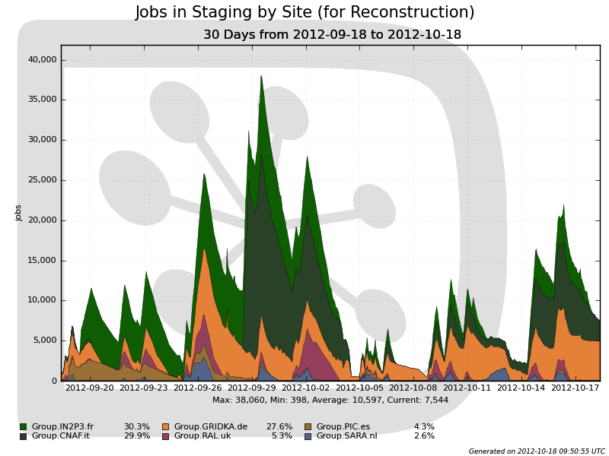
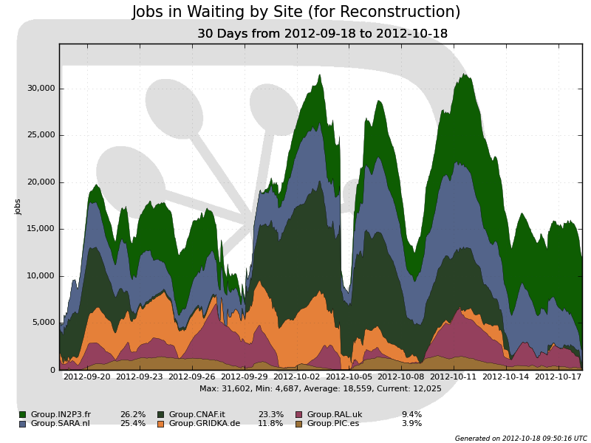
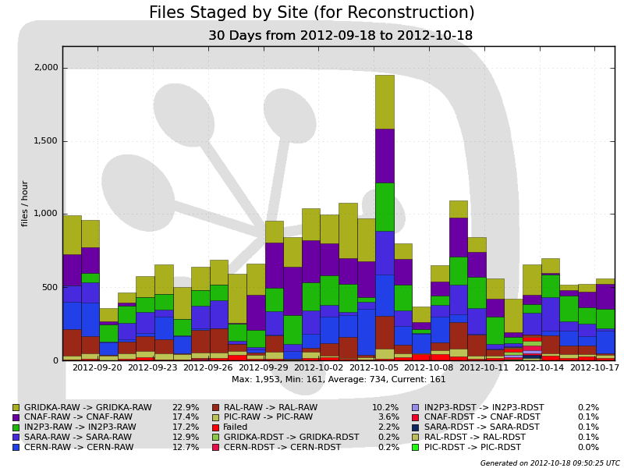
Data Staging (ctd)
To be staged data usually well absorbed by sites
Waiting jobs
for reco
Amount of staged data / site
Concern about Gridka staging efficiency
  Resolution of the problem foreseen for end of 2012
Other sites with occasional errors

