Slide 1
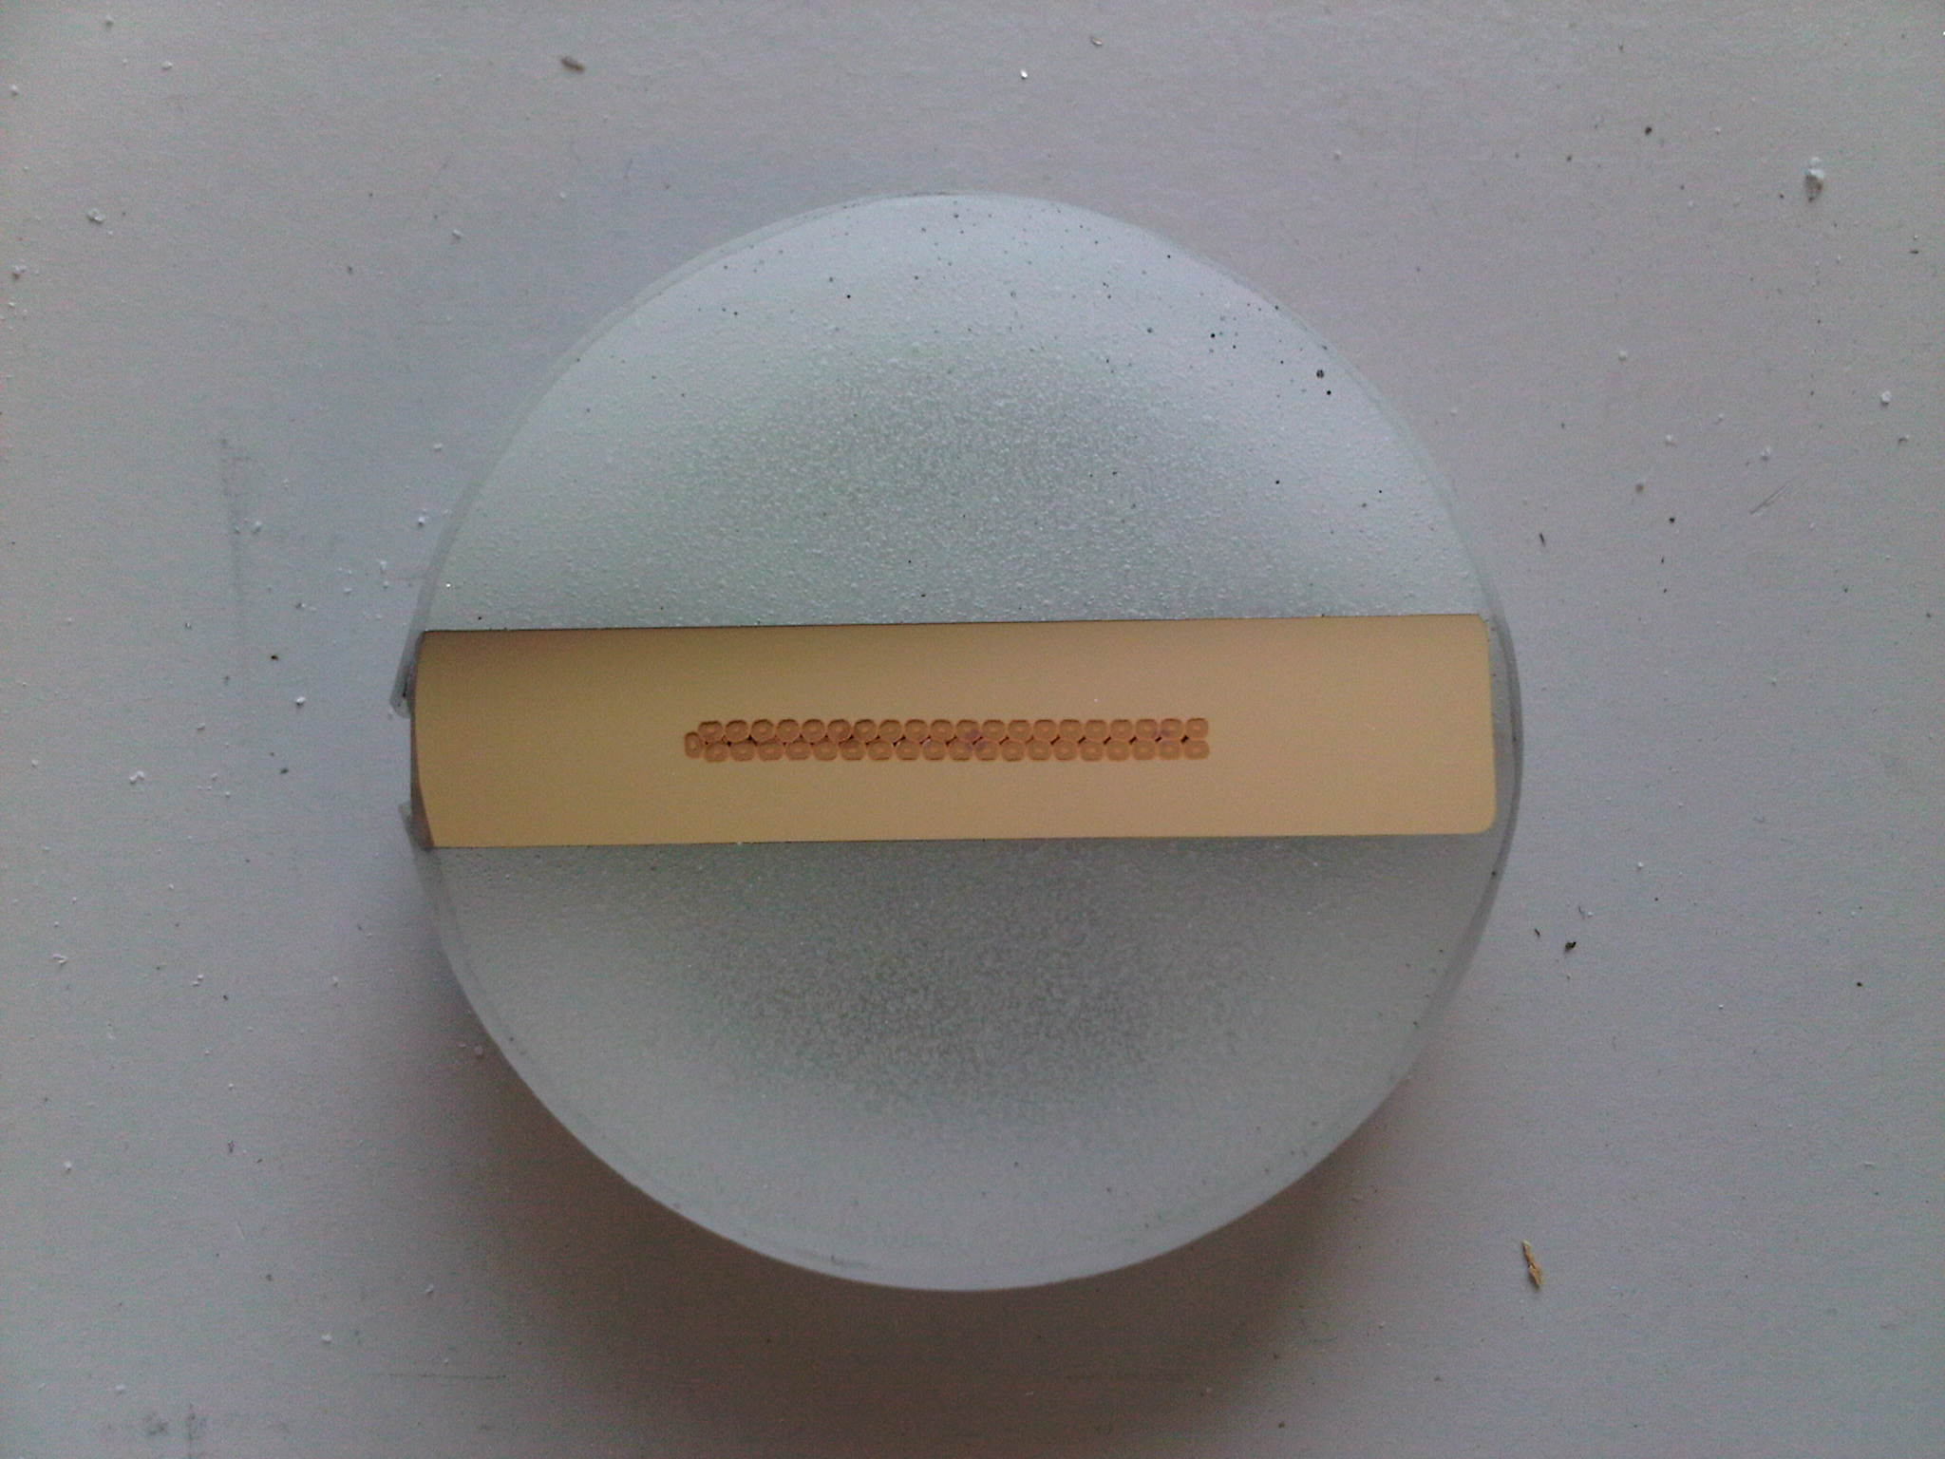
LCD solenoid al-stabilized superconductor Extruded Al-0.1wt.%Ni measurement status
Stefanie Langeslag
LCD Magnet Meeting
October 19th, 2012

Slide 2
Section determination Al-0.1wt%Ni including sc-cable
Work Hardening
Microstructure Analysis
Mechanical Measurements
Resistivity Measurements
Measurement Continuation
Discussion

Slide 3
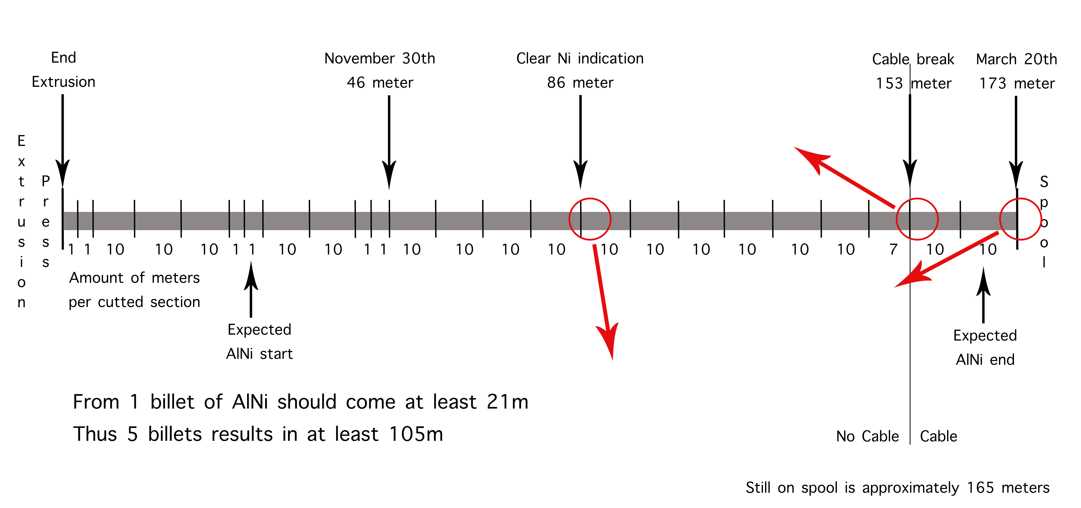




Slide 4
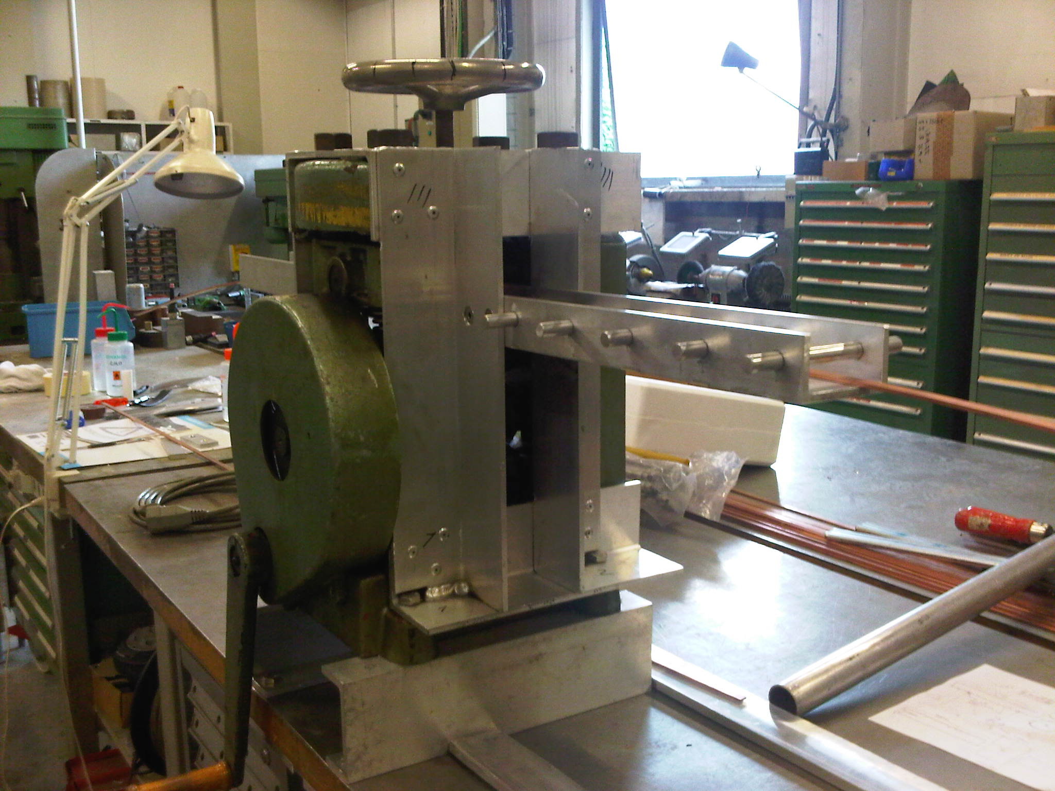
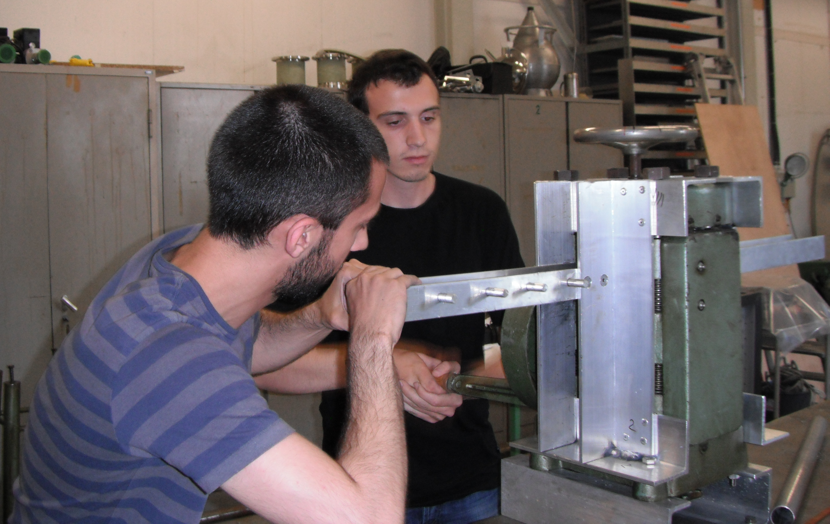
Work Hardening

Slide 5
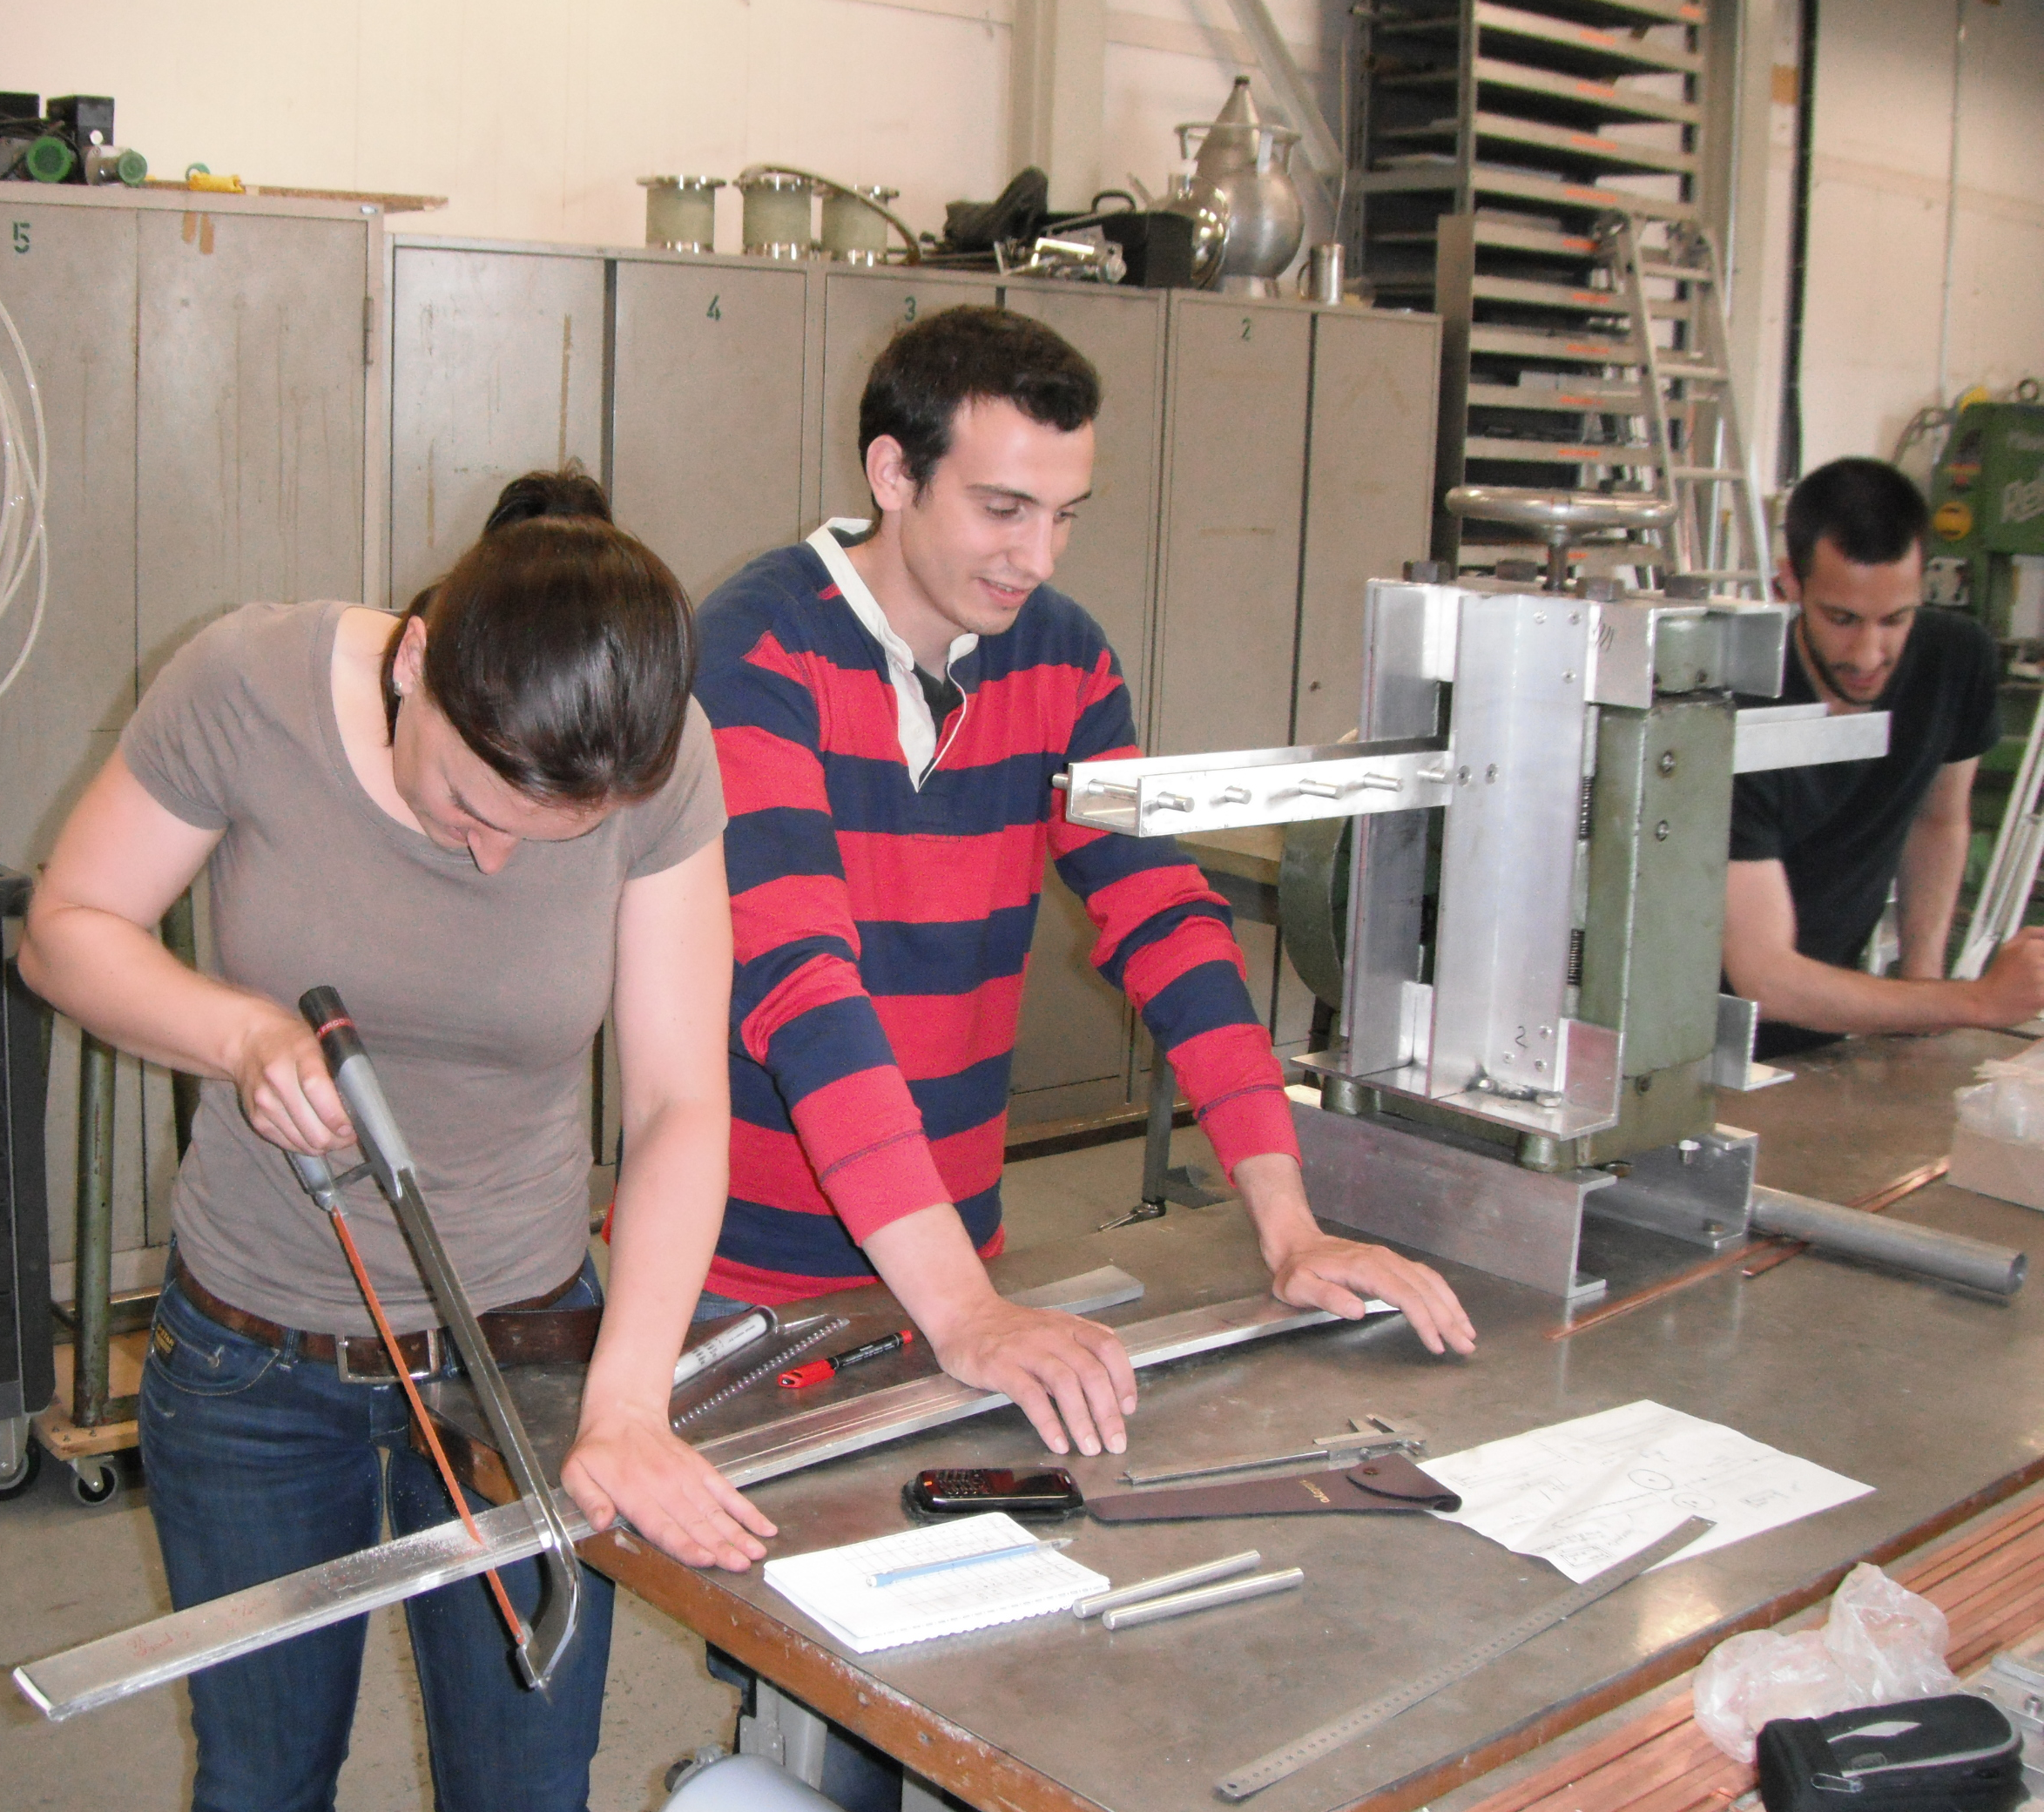
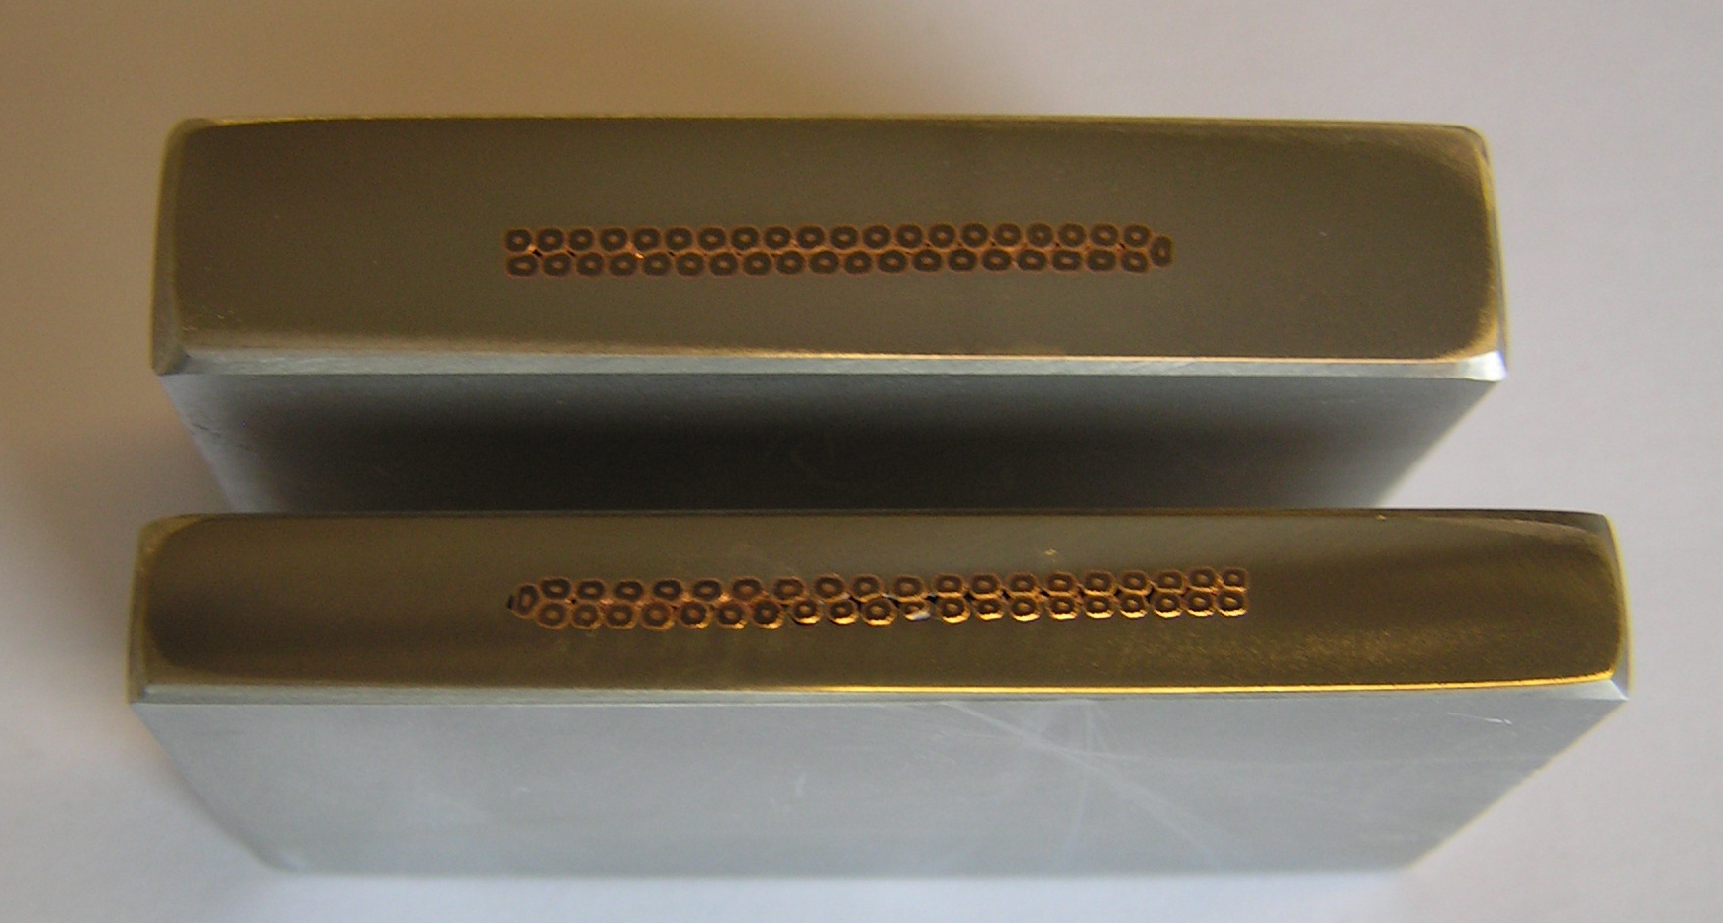
Work Hardening
Specimen Extraction at:
0%, 15%, 20%, 25% & 30%
Al-Ni^{c} 0% cold-worked and Al-Ni^{c} 30% cold-worked
Specimen Extraction

Slide 6


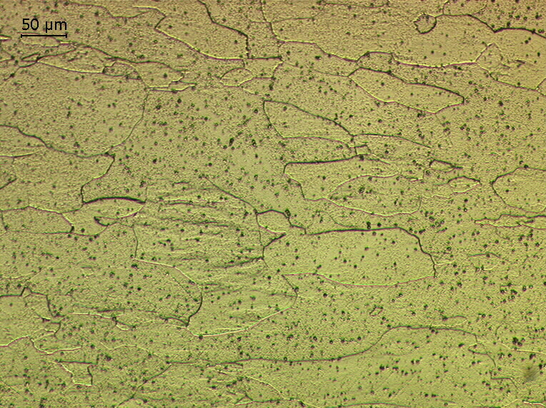
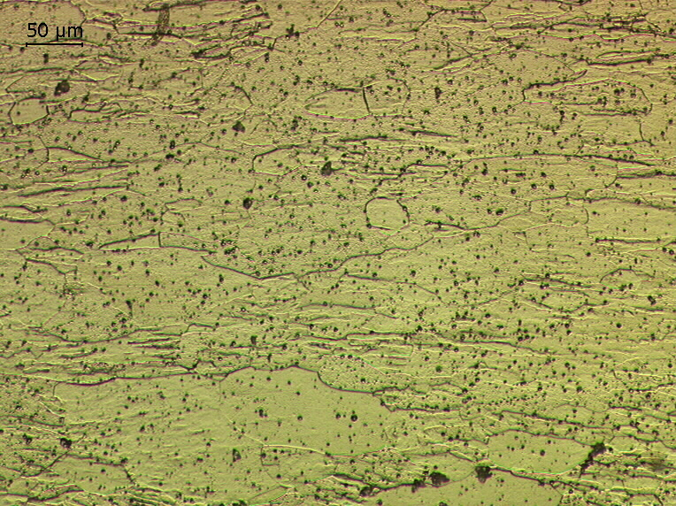
Microscope pictures of HF/H₂O solution etched Al-Ni^{c} sample

Slide 7
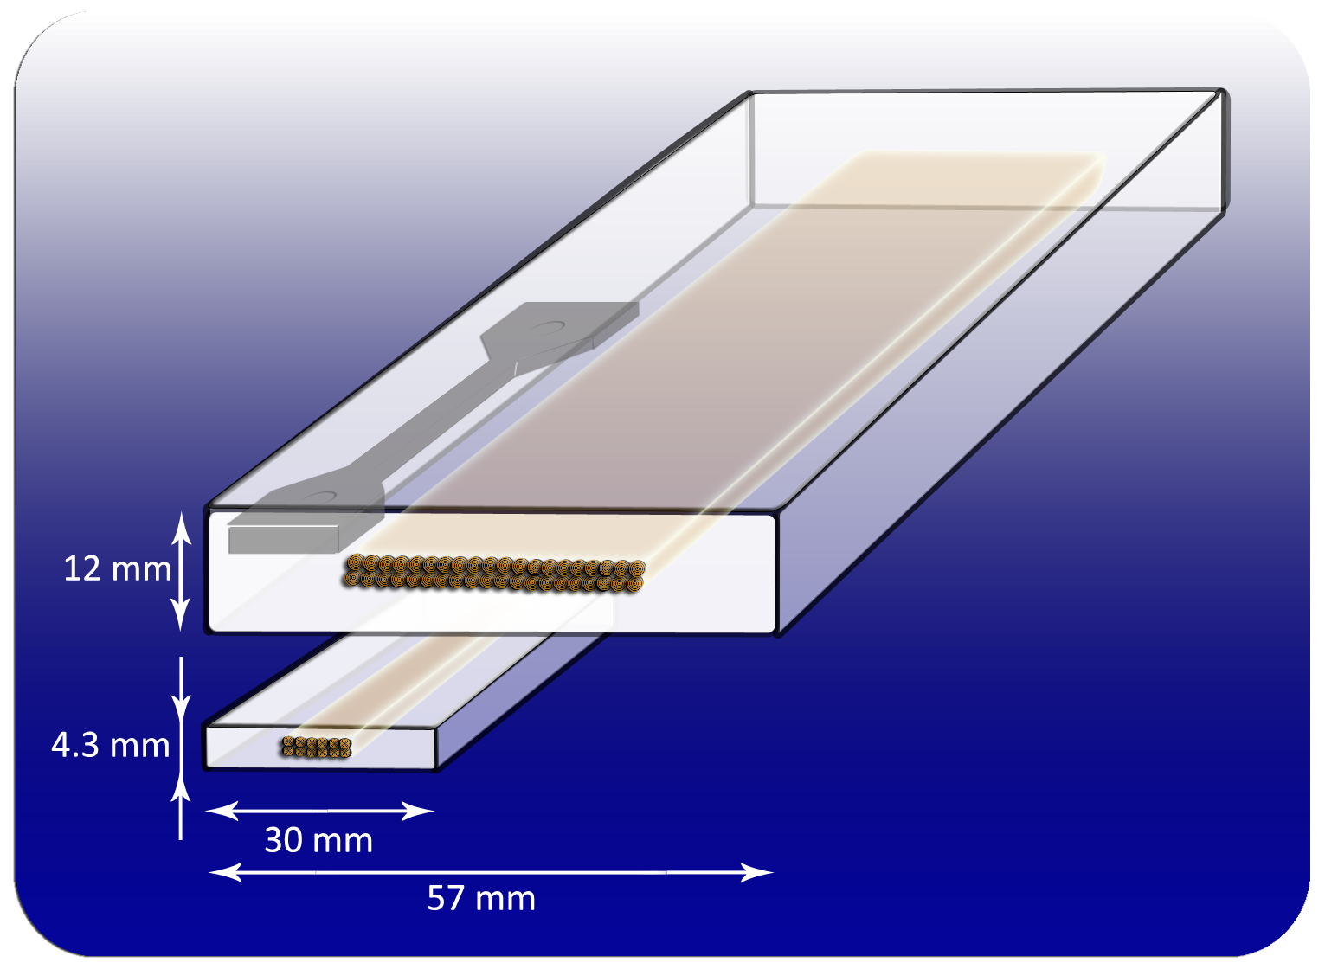
Schematic image of the sample extraction position

Slide 8
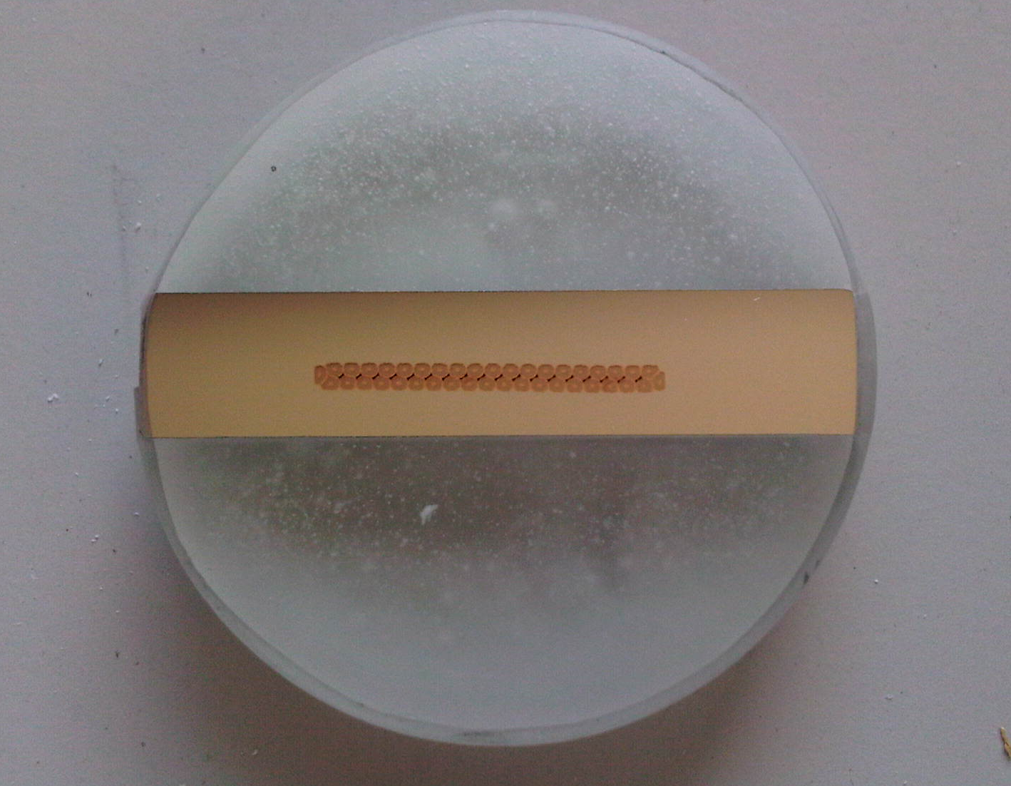
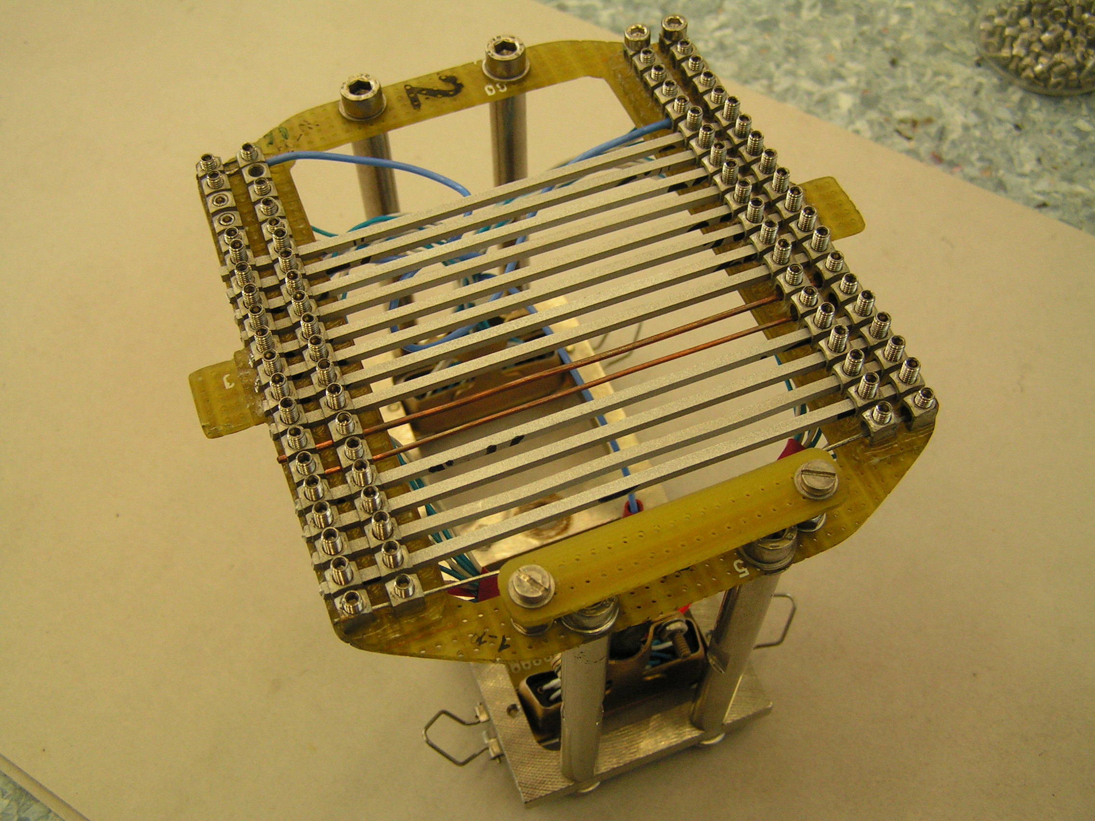
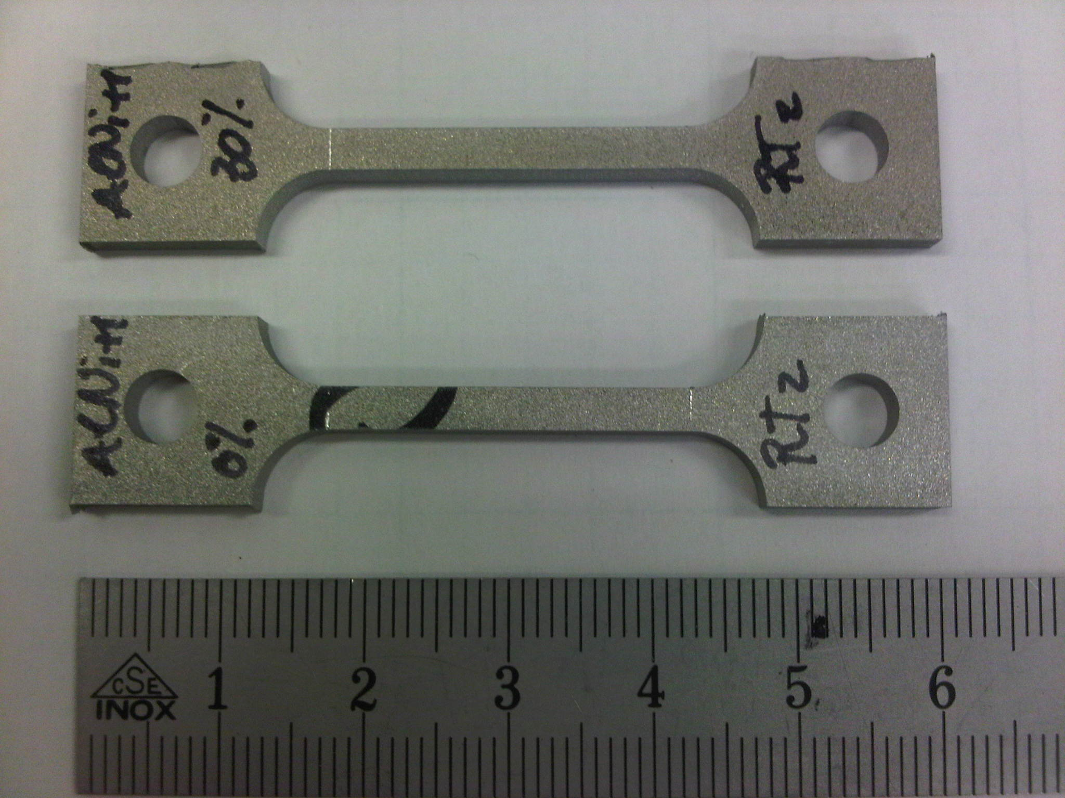
Sample Dimensions
Microstructure analysis
  Transverse plane, full cross-section
RRR measurement
  2 x 2 x 110 mm³, voltage taps at 80 mm
Tensile measurement
  3 x 3 mm² cross-section, 25 mm calibrated length
Optical sample RRR sample Tensile sample

Slide 9
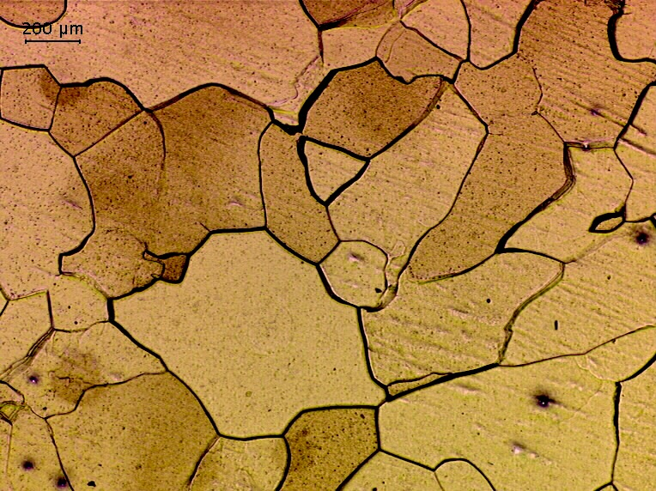
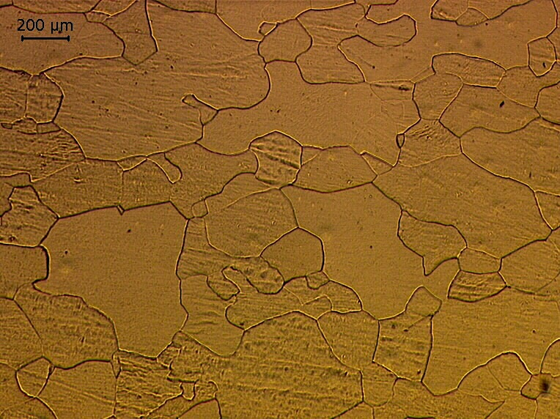
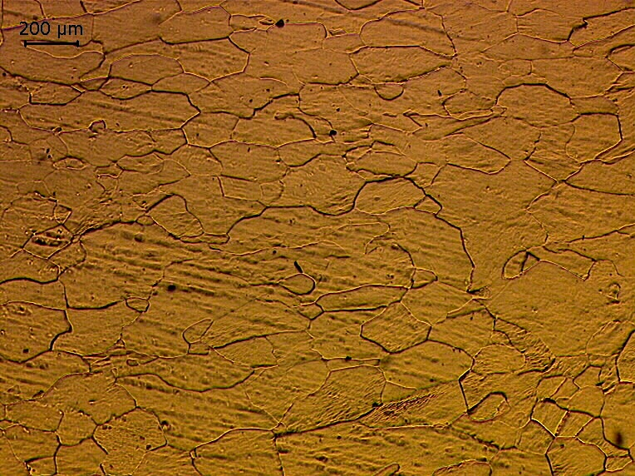
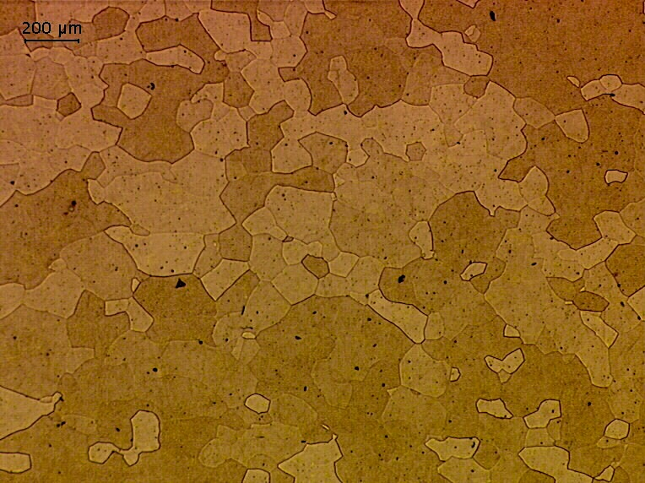
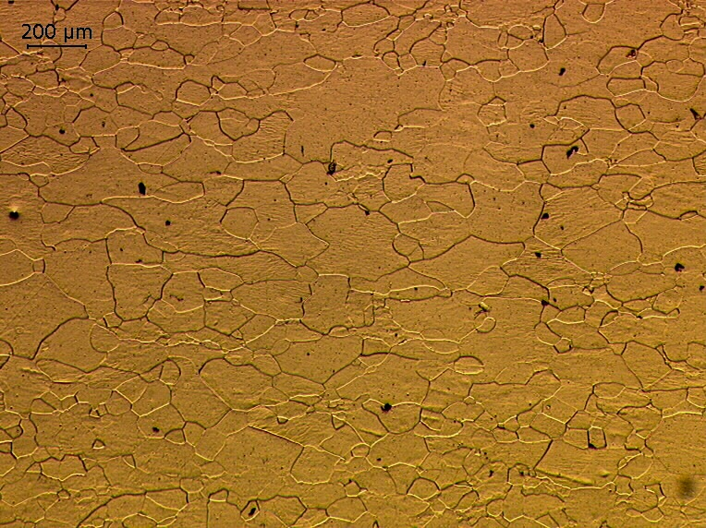
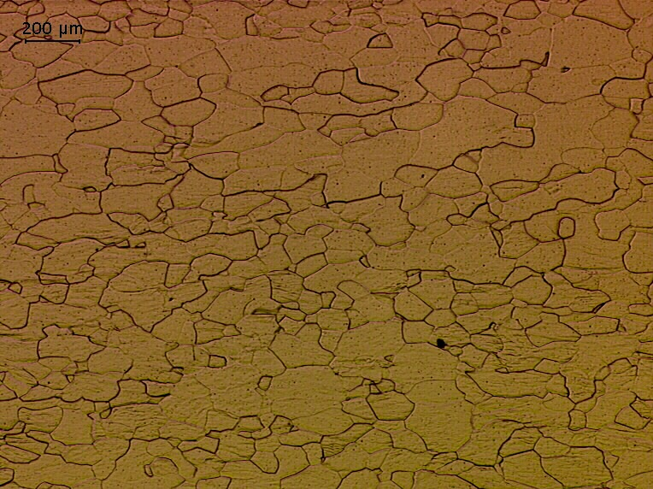
Changes in Microstructure
0% CW 20% CW 30% CW
Al
Al
Al
Al-Ni
Al-Ni
Al-Ni

Slide 10
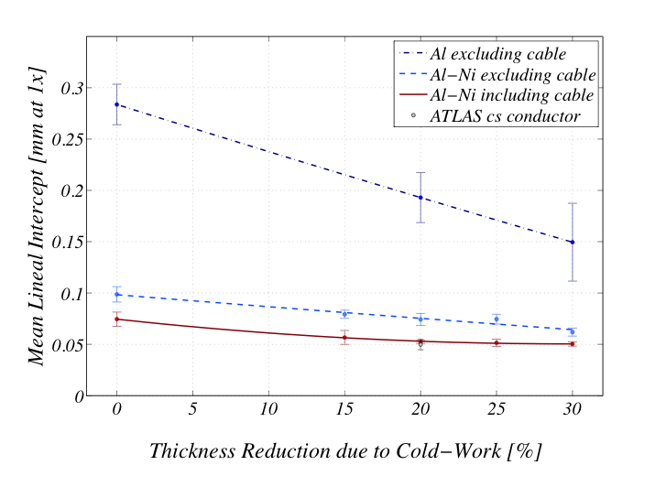
Changes in Microstructure
Grain sizes show to decrease with work hardening extent.
Slightly compressed grains with thickness reduction.
Grain size as function of the work hardened state for the Al conductor, the Al-Ni conductor, and the Al-Ni^{c} conductor.

Slide 11
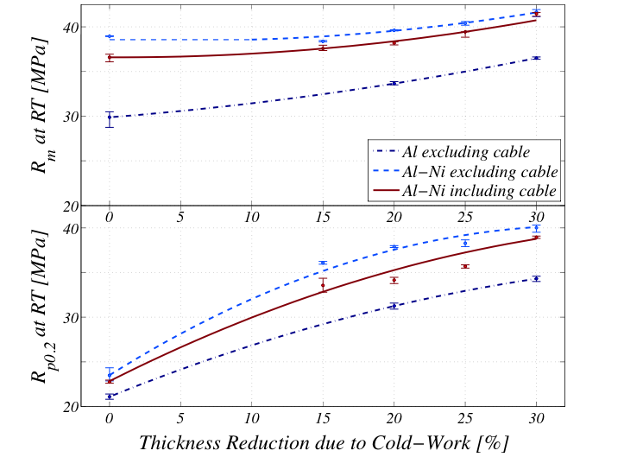
Mechanical Characteristics
R_{p0.2} increases in an almost linear manner.
Decreased mechanical properties of the Al-Ni^{c} alloy for higher cold-worked states.
May indicate an effect of the Rutherford cable on the work hardening process.
Tensile properties of the Al conductor, the Al-Ni conductor, and the Al-Ni^{c} conductor for five different cold worked states.

Slide 12
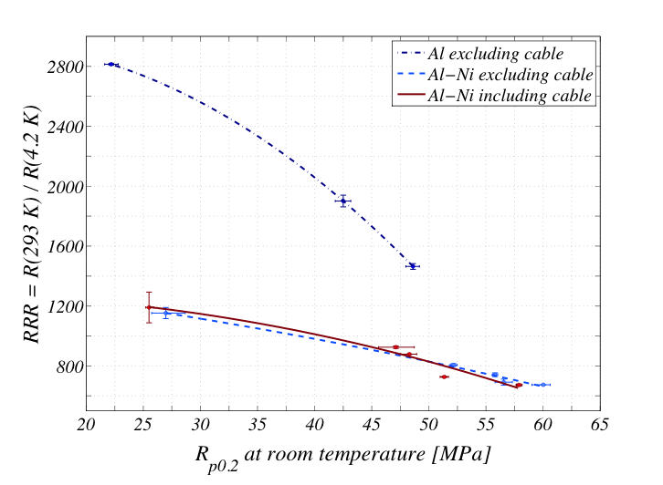
R_{p0.2} – RRR Relationship
Increasing the R_{p0.2} with use of work hardening has a less detrimental effect on the RRR of the Al-Ni alloy as it does on the 5N-Al material.
RRR in relation R_{p0.2} for the various different extruded material variants at the various cold worked states.

Slide 13
Conclusion of the results
The Al-Ni alloy extruded with Rutherford cable exhibited in the highest cold worked state of 30% an R_{p0.2} of 58 and RRR of 673, which will result in an R_{p0.2} of 87 MPa at 4.2 K [1].
The obtained values are slightly lower than the gross of measurements conducted on Al-0.1wt%Ni extruded in smaller cross-sections in the development of the ATLAS and CMS solenoid conductor [1-4].
A cautious conclusion to be further verified is that increased cross-section extrusions result in decreased work hardening effects.
[1] S. Sgobba, D. Campi, B. Cure, P. El-Kallassi, P. Riboni, and A. Yamamoto, “Toward an improved high strength, high RRR CMS conductor,” in IEEE Transactions on Applied Superconductivity, pp. 521–524, ETH, CH-8092 Zurich, Switzerland, 2006.
[2] K. Wada, S. Meguro, H. Sakamoto, T. Shimada, Y. Nagasu, I. Inoue, K. Tsunoda, S. Endo, A. Yamamoto, Y. Makida, K. Tanaka, Y. Doi, and T. Kondo, “Development of high-strength and high-RRR aluminum- stabilized superconductor for the ATLAS thin solenoid,” IEEE Transactions on Applied Superconductivity, vol. 10, no. 1, pp. 373–376, 2000.
[3] K. Wada, S. Meguro, H. Sakamoto, A. Yamamoto, and Y. Makida, “High-strength and high-RRR Al-Ni alloy for aluminum-stabilized superconductor,” in IEEE Transactions on Applied Superconductivity, pp. 1012–1015, Furukawa Elect Co Ltd, Nikko, Japan, 2000.
[4] A.Yamamoto, Y.Makida, K.Tanaka,and Y.Doi, “Development towards ultra-thin superconducting solenoid magnets for high energy particle detectors,” Nuclear Physics B, vol. 78, pp. 565–570, 1999.

Slide 14
Conclusion of the measurements
For an initial determination of work hardening on the properties of the material the current work-hardening method proved to be sufficient.
  However, for a determination of bonding characteristics and critical current degradation with cold work, a more industrial scale work-hardening method should be found.
For a more satisfying specification of properties of the entire conductor, microstructure and hardness measurements along the entire cross-section should be made.
  Grain sizes should be determined in at least two planes in a highly cold-worked state.

Slide 15
Measurement Continuation
Hardness measurements in entire cross-sectional plane
Microstructure evaluation in planar plane
Tensile measurements at cryogenic temperature
Work hardening on industrial scale
  Bonding quality analysis
  Shear stress measurements
  Critical current degradation measurement
Material characterization after annealing (ATLAS & CMS coil curing cycle)
  Tensile measurements
  RRR measurements
  Microstructure analysis

Slide 16
Discussion
Industrial scale work-hardening method
  Flat rolling vs. Turk head rolling
Critical current degradation measurements
  Strand extraction
Shear stress measurement
  Clamp design

