Slide 1
Current situation with LHC transverse & longitudinal profile and bunch charge measurements
F. Roncarolo with input from
E.Bravin, B.Dehning, J.Emery, J-J. Gras, M.Sapinski, R.Steinhagen
Beam Gas Imaging Kick-off meeting
30-Oct-2012

Slide 2
Contents
Transverse distribution monitors
  Wire Scanners
  Synchrotron Light monitor
  Beam-Gas monitor
Longitudinal Distribution and bunch charge
  Longitudinal Density Monitor
  Abort Gap Monitor
  Wall Current Monitor
  Fast Beam Current Transformer

Slide 3
Wire Scanners – Introduction
Wire scanners are the LHC reference monitors for transverse profile measurements
  30um carbon wires flying at 1 m/s through the beam
  At each proton beam revolution: downstream Scintillator+Photo-Multiplier measures secondary shower of particles to be correlated to wire position → profile
Scan on demand
Dynamic range controlled by PM gain and optical filters
Can be used up to a maximum intensity that depends on beam energy
  Above such maximum intensity: wire damage and/or quench downstream magnets (→ BLM thresholds to dump before reaching quench limit)
Expected lifetime under normal operation (below intensity limits)
  ~ 100.000 scans? (bellow, wire)

Slide 4
Wire Scanners – Operational Specifications
Integration
  40 MHz sampling of PM integrator allows bunch per bunch measurements
    50 ns ok
    25 ns cross-talk being studied
Repetition Rate
  Ideally ~0.2 Hz, at cost of system lifetime (wire, bellows)
Dynamic range
  From pilot bunch to ultimate intensity per bunch, but:
    Limits on total beam intensity
Future: faster WS (20 m/s?)
  can allow higher intensities at the cost of
    multi-scans on a single bunch (go faster → few points/sigma) → need to overlap multi-scans with sampling position offsets
    single scan, combine NN bunches to have enough points/sigma
Energy | Limit | Reason
450 GeV | 2.7e13p | Wire damage
4 TeV | 3.6e12 p | BLM threshold
6.5 TeV | ~1e12 p | BLM threshold

Slide 5
Wire Scanners – Resolution/Accuracy
Resolution
  limited by minimum wire speed vs protons revolution frequency
    1 m/s → 89 um between two consecutive wire position acq. (→ profile points)
  Can be improved overlapping multi-scans (or single scan combining NN bunches) with sampling position offset (as being tested now @ SPS)
  Anyhow
    Present wire position resolution limited by noise potentiometer noise (some 20um)
    New WS: aiming for 2um resolution (independent of speed)
Accuracy
  With proper PM and filter settings, absolute accuracy proved to be 1% for the SPS linear WS
  Accuracy of LHC WS under study
    theoretically equal to SPS linear WS
    At the moment: evidence of dependence on working point (PM gain + filter settings)
  Plan for different secondary shower detector (diamond)
    Improve dynamic range
    Get rid of filters → avoid dependence on working point

Slide 6
BSRT - Layout
Gated camera
(BSRTS)
Proton/Ion
beam
Optical delay line
DC Camera
60 %
Abort Gap Monitor
(AGM)
40 %
10 %
Neutral filters
90 %
Color filters
Long. Density Monitor
(LDM)
60 %
40 %

Slide 7
BSRT -- Introduction
Imaging of synchrotron radiation from SC undulator (for E<1.5TeV) and D3 dipole (for E>1.5TeV)
Extraction mirror 30m downstream light source sends light to optical imaging system
Continuous measurement
  Far from being able to use images during the ramp (superimposition of undulator and D3 light)
Dynamic range controlled by intensified camera gain + optical filters
2012 problems with high intensity beams, due to strong RF coupling → heating → extraction mirror distortion / mirror holding failure

Slide 8
BSRT – Operational Specifications
Gating
  Intensified camera gating down to 25ns with a 12.5ns gating resolution
Repetition rate
  Max 200 Hz (limited by intensifier trigger rate)
  Present image digitalization (BTV) 50 Hz
  Present control + acquisition SW ~12 Hz
  Can do bunch per bunch @ ~12Hz
  Can do single bunch single turn but not on consecutive turns
Dynamic Range
  Protons: From pilot at injection (single turn, every 220 turns) to average over all bunches at flat top
  Ions: From ~30 bunches at injection to average over all bunches at flat top

Slide 9
BSRT – Resolution/Accuracy
Resolution
  Present optics 0.1 mm/pix, next: 0.05 mm/pix
Relative bunch per bunch accuracy <= 5%
  5% on single shot, dominated by reproducibility affected by noise (airflow, optical elements vibration, fit accuracy, etc …)
  1% averaging on multi-shots
Absolute accuracy:
  Optics magnification validated to <= 5%
    Calibration target
    Beam orbit local bumps
  Ultimate accuracy dominated by aberration / diffraction
    Need cross calibration w.r.t. WS
    → calibration factors → accuracy <=10% after calibration
  Calibration factors not stable
    Possible drifts due to mirror coating aging (heating)

Slide 10
BSRT – LS1 Upgrades
Rethink mechanical design + mirror type to cope with RF heating with high intensity beams
Change optics from focusing mirrors to focusing lenses
  Simpler optics, less elements
    Smaller effect of vibrations on reproducibility/noise
  Decouple AGM and BSRT/LDM
  Prototype optics installed on B1 during TS#3, will do the same on B2 during TS#4

Slide 11
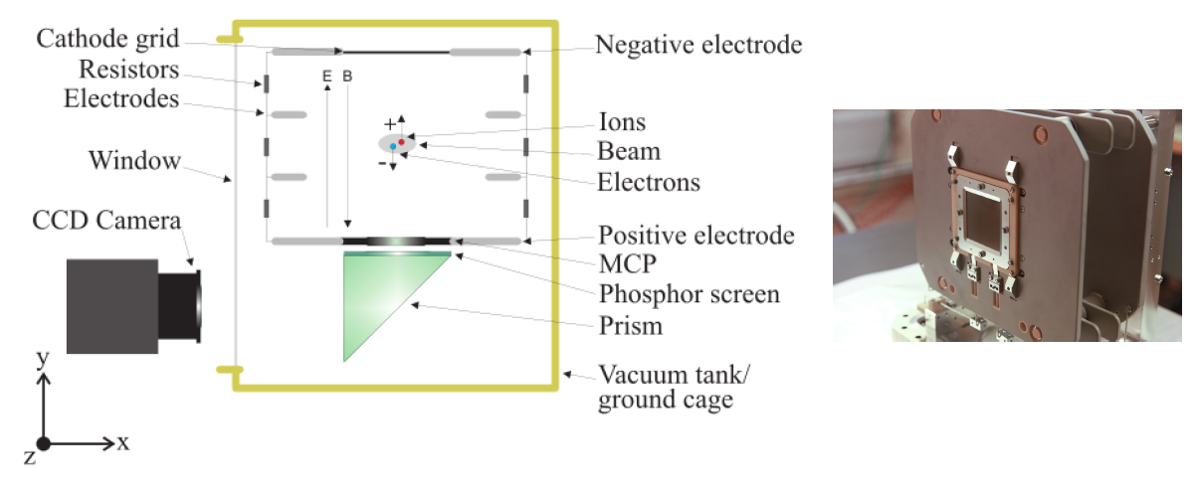
BGI - Introduction
Collect electrons form beam-gas ionization
  Dipole B field to avoid drift from ionization location to MCP
  MCP electron multiplication
  Phosphor coupled to MCP output for electron→photon conversion
  Imaging of phosphor output
Designed for heavy ions
Enough signal from protons by injecting local pressure bumps or high intensity
Can monitor average relative beam size variation during the ramp
M.Patecki, M.Sapinski

Slide 12
BGI – Operational Specifications
Gating/Integration
  Gated camera
  Need to gate over multi-bunches to have enough signal (see dynamic range)
Repetition Rate
  50Hz, limited by image digitalization (BTV)
Dynamic range
  With a “fresh” MCP:
    10 proton bunches with gas injection 10-8mbar
    Single Pb ion bunch with gas injection 10-8mbar
    A bit better at 4TeV due to denser beam
  MCP aging rather quick

Slide 13
BGI – Resolution/Accuracy
Resolution
  Present optics gives 0.115 mm/pixel
Accuracy
  Optics magnification validated to 1% by
    Beam orbit local bumps
    Reference wire-grid calibration
  Needs cross calibration w.r.t WS and BSRT
  For the moment not better than 20%, degrading with MCP aging
  Many studies on going to understand ultimate resolution/accuracy
LS1:
    Replace MCPs
    Second camera with better performances

Slide 14
Transverse Profile Monitors Summary
Monitor | Max Acq. rate | Minimum Gating/Sampling | Dynamic Range |  | Spatial Resolution | Accuracy | Remarks
 |  |  | Prot. | Pb Ions
WS | ~ 0.2 Hz * | 25 ns | >5e9 <2.7e13 (450 GeV) <3.6e12 (4TeV) <1e12 (6.5TeV) | Under study | 89 um @ 1 m/s | On paper ~1 % absolute and relative | Dependence on operational point (PM+filters)
BSRT | 12 Hz (SW overheads) 50 Hz (BTV) | 25 ns | >5e9 | >30 Pb ions bunches @ inj | 0.1mm/pixel | 1 % relative ~ 10 % absolute | Need frequent calibration w.r.t. WS RF heating
BGI | 50 Hz (BTV) (but needs 100ms to see signal) | 20 ns (but not enough signal) Operational :100ms | >1e12 (with 1e-8mbar) | 1 Pb bunch (with 1e-8mbar) | 0.1mm pixel | ~20% after calibration w.r.t. WS/BSRT. | MCP aging
* Would imply continuous scanning→ low wire, bellow lifetime + blow-up due (interceptive device)

Slide 15
Abort Gap Monitor
Photo Multiplier detecting synchrotron light
10 Hz acquisition
~1e6 dynamic range (without considering optical filters)
100ns resolution
Better than 5 % accuracy after cross-calibration vs FBCT
  Need calibration curve vs energy to cope with sync. light sources

Slide 16
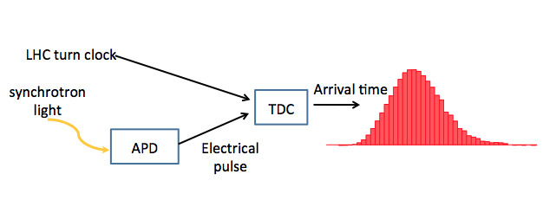
Longitudinal Density Monitor (LDM)
Geiger mode Avalanche Photo-Diode, single photon counting
50ps resolution
10e5 dynamic range
Need long integration time (10-15 minutes to achieve 10e5 dynamic range)
Lots of data logged in 2012
Ultimate accuracy/reliability affected by
  BSRT system reliability
  internal reflections
Some ideas to improve system in LS1, resources manpower to be established

Slide 17
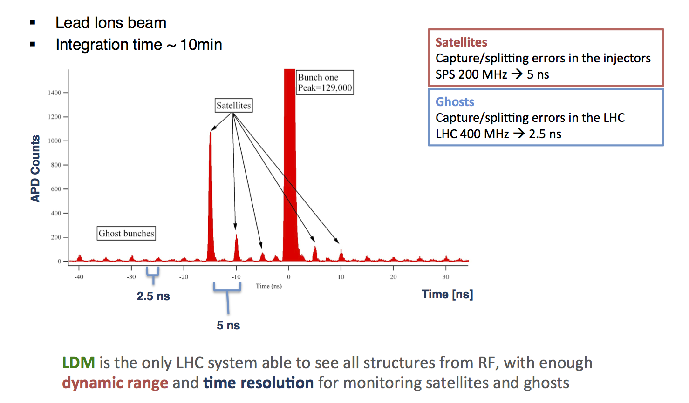
LDM meas. example

Slide 18
FBCT
Fast Beam current transformer able to meas. bunch per bunch
Needs cross calibration with DC BCT
Dependence on bunch length reduced after modified electronics
Dependence on beam position depends on detector itself
Future: development of new detector that should be much less sensible to beam position
Relative bunch per bunch charge 1%
Absolute accuracy ~1% after calibration w.r.t. DC BCT
Integration limited to 25ns (maybe better after LS1)

Slide 19
Wall Current Monitor
8 ports RF pickup capable of estimating bunch charges and bunch shape
Bunch intensity:
  Absolute accuracy: cross-calibration w.r.t. DC BCT
  Relative bunch per bunch accuracy, 0.1% limited by ADC linearity, stable over weeks after calibration w.r.t. DC BCT
Bunch length
  Different fit functions (Gaus,Cos2,parabolic) + fit errors for identifying bunch shape variations
  Compensated for cable length/dispersion up to 3 GHz → << 1% in defining bunch length/shape variations
For both intensity and longitudinal distribution meas.
  Ultimate accuracy is limited by systematics (reflection of main bunch)
  Need Integration @ 0.1Hz
  B1 operational, B2 need to sort out SW/HW issues
After LS1:
  Aim for 10-6 satellites/main bunch.

Slide 20
WCM example (R.Steinhagen)

Slide 21
Summary
Transverse Profile Monitors
  WS are the most accurate system (dependence on working point under study), but
    Can’t be used at all beam intensities
    Can’t be used continuously
  BGI and BSRT
    provide a continuous and a higher repetition rate measurement, but ultimate relative and absolute accuracy is not established yet
  WS, BGI, BSRT: Resolution for smaller beams at 6.5-7TeV (can go down to 100um or less with present beam optics) not necessarily achievable with present systems
Bunch Charge and Longitudinal distribution monitors
  FBCT relative bunch per bunch charge @ 1% after calibration w.r.t. DC BCT
  LDM and WCM potentially very useful for longitudinal distribution, but still some work to achieve desired accuracy and reliability to consider them operaitonal

Slide 22
SPARE

Slide 23
WCM example (R.Steinhagen)

