Slide 1
The LHC accelerator complex
Lucio Rossi – CERN
HiLumi LHC Project Coordinator
The biggest accelerators in space and on earth
Organised by COAST, CERN-TH and CERN-LPCC
CERN, 18 March 2013

Slide 2
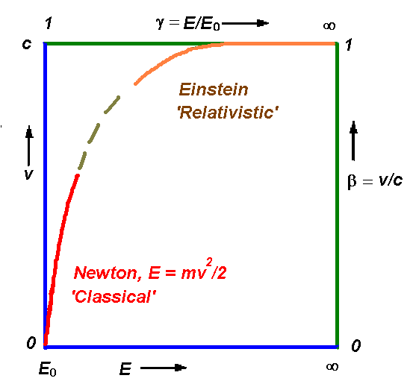
Accelerators?
Name accelerator applies only for the first part
«Ponderator» was proposed to replace «accelerator» in 1948
But of course not likeable so accelerator remains.

Slide 3
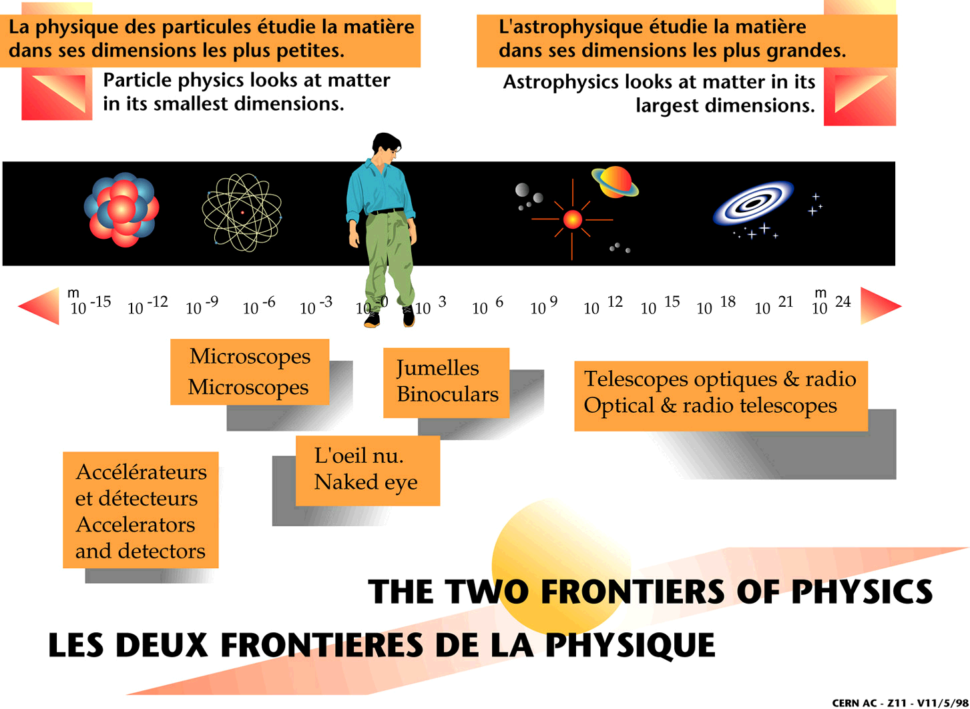
Accelerators gain us one frontier of the physics spectrum
Why accelerators? To investigate Particle Physics
Accelerators
Microscopes
Binoculars
Optical, radio télescopes
Particle physics looks at matter in its smallest dimensions and accelerators are very fine microscope or, better, atto-scope!
λ = h/p ; @LHC: T = 1 TeV ⇒ λ ≅ 10⁻¹⁸ m

Slide 4
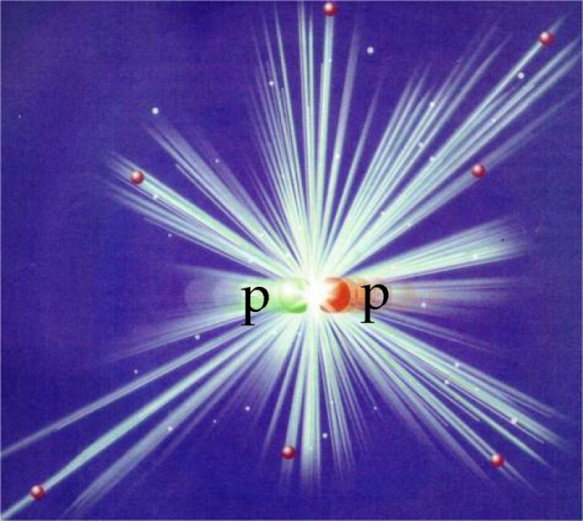
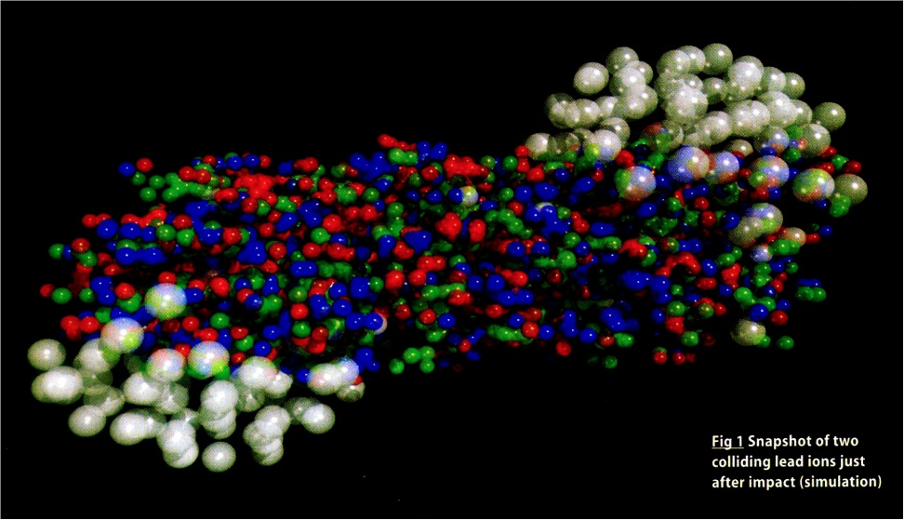
…back to Big Bang
Trip back toward the Big Bang: t_{μs}≅1/E²_{Gev}
T ≅ 1 ps for single particle creation
T ≅ 1 μs for collective phenomena QGS (Quark-Gluon Soup)
But we are left with the task of explaining how the rich complexity that developed in the ensuing 13.7 billion years came about…
Which is a much more complex task!

Slide 5
Accelerators: the two frontiers
2 routes to new knowledge about the
fundamental structure of the matter
High Energy Frontier
New phenomena
(new particles)
created when the
“usable” energy > mc² [×2]
High Precision Frontier
Known phenomena studied
with high precision may show
inconsistencies with theory

Slide 6
What do we need to make progress?
To reach higher energy, i.e., go beyond the LEP/Tevatron energy scale ~100-300GeV
The Large Hadron Collider:
using composite particles (p-p) at high energy 7+7 TeV:
0.1-1.5 TeV (and more)
The Linear Electron-Positron Collider will use of e+ e- annichilation 0.25+0.25 TeV: 0.5 TeV with more accuracy
pp “Floodlight”
e⁺e⁻

Slide 7
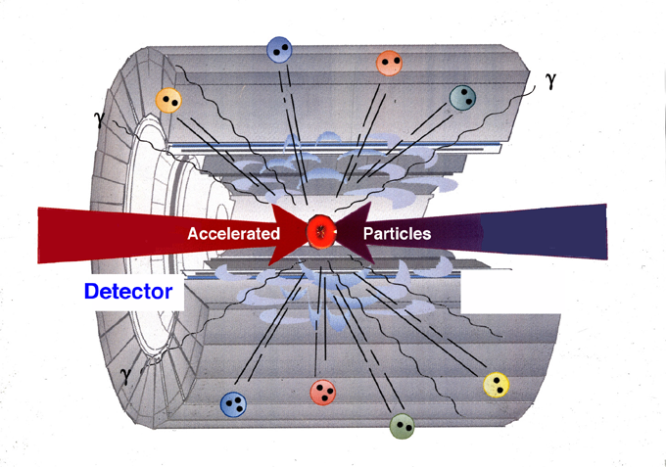
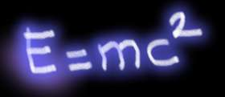
The method of HEP colliders
Methods of Particle Physics
1) Concentrate energy on particles (accelerator)
2) Collide particles (recreate conditions after Big Bang)
3) Identify created particles in
Detector (search for new clues)
And both of them need high technology like superconductivityy

Slide 8
Use of e.m. and magentic fields
RF fields bunch the beam

Slide 9
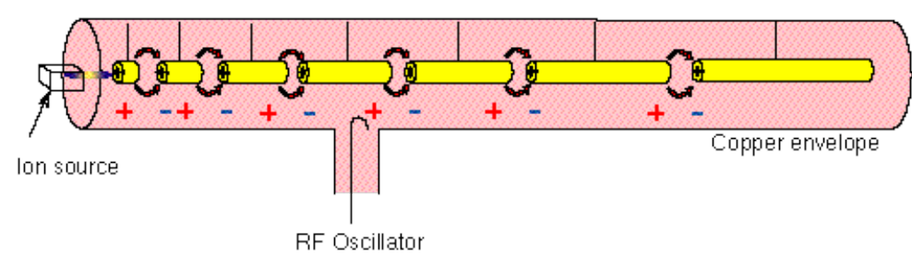
Linear accelerator: Linac
E = G x L (GeV; MV/m; km)
Alvarez linac – the first practical linac 32 MeV at Berkeley 1946:
Particle gains energy at each gap.
Drift tube lengths follow increasing velocity.
The periodicity becomes regular as v apporaches c.
His choice of 200 MHz became a de facto standard for many decades.

Slide 10
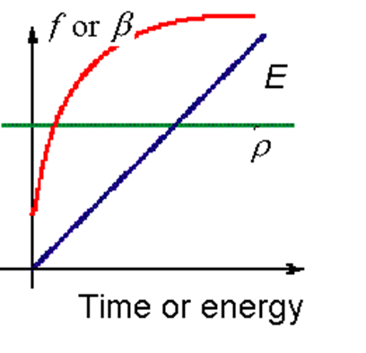
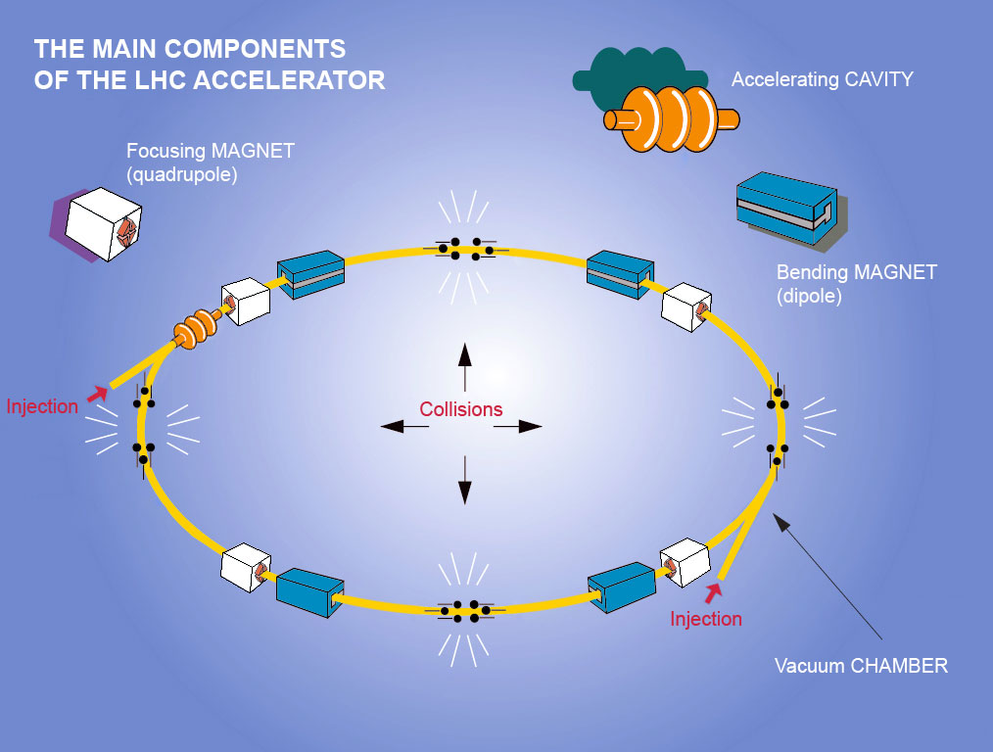
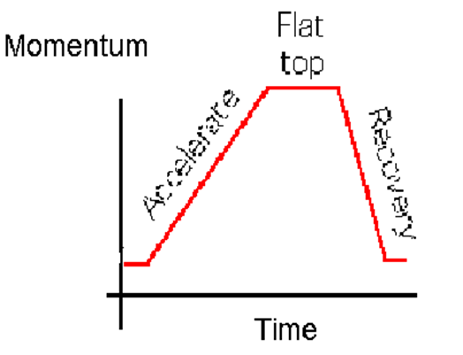
Circular accelerators: synchrotrons
E ≅ 0.3 B R (TeV; T; km)

Slide 11
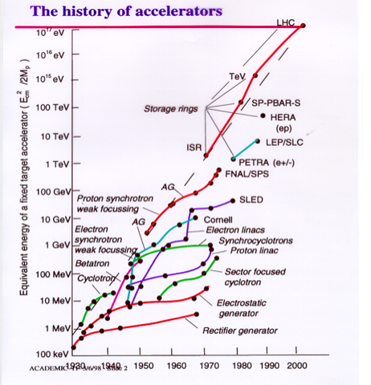
Livingstone plot (equivalent fixed target energy)
In this scale we have been able to sustain an exponential growth
However when translated, in useful energy (c.o.m.) the progress is less glorious…

Slide 12
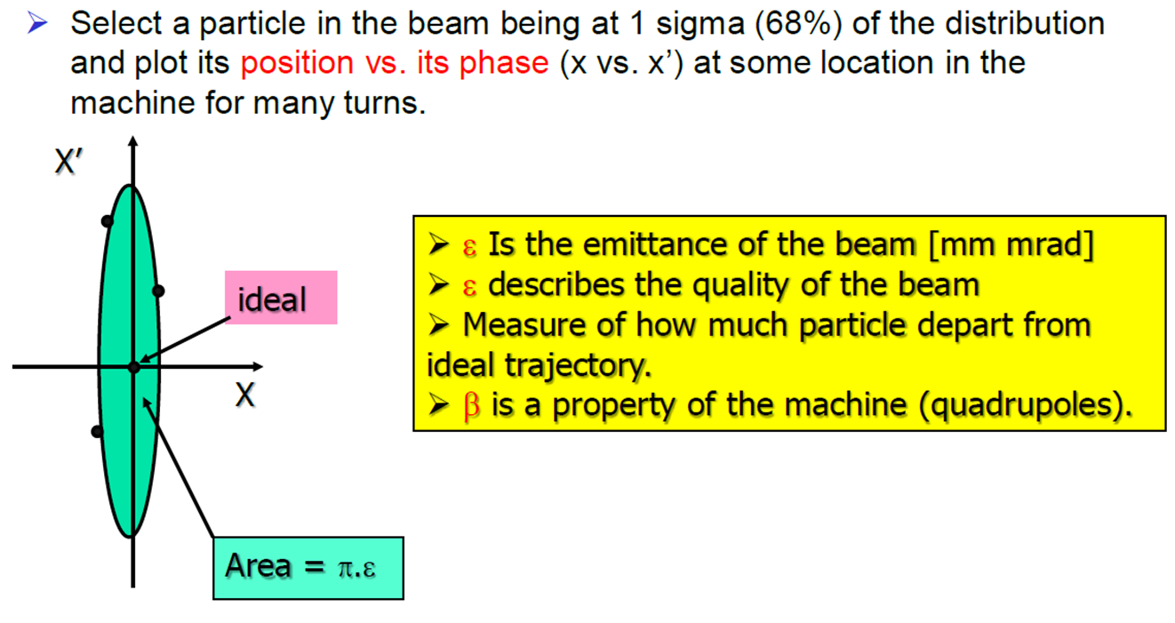
Energy is not all for a particle beam : emittance

Slide 13
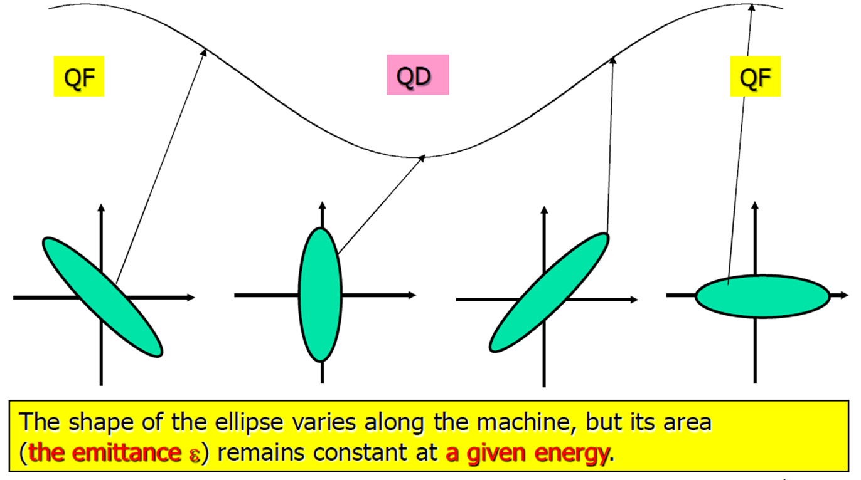
Emittance is constant (unless friction and instabilities):

Slide 14
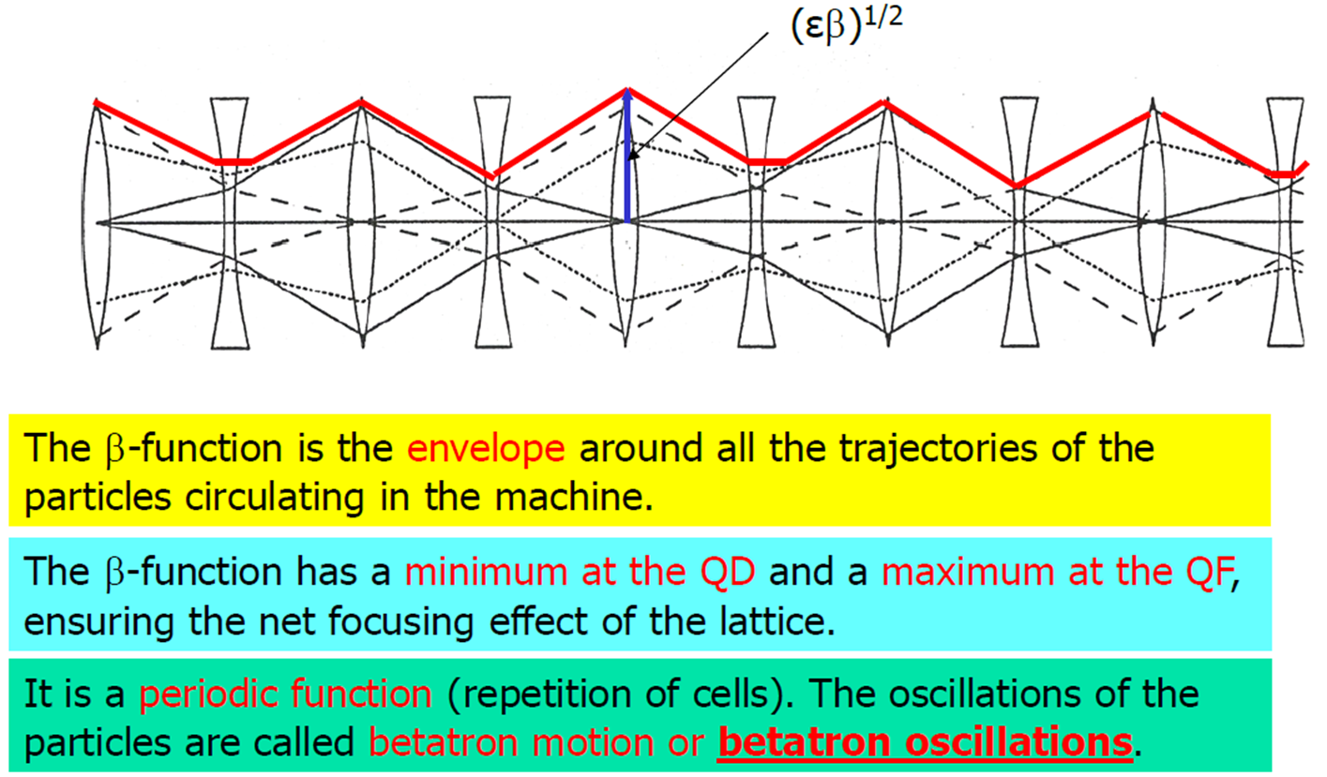
β-function and beam size

Slide 15
Recap of main properties
Energy
Intensity of beam: number of particle circulating or bunch population N_{p}
Emittance ε: decrease with energy so we define a normalized one: ε_{n} = γ ε that is constant (unless instabilities and heatings)
β : focalization length (β* at IP of colliders)
σ_{xy} (transverse cross section) = εβ
Brightness: density of partic¨le in the phase space (N_{p}/ε)

Slide 16
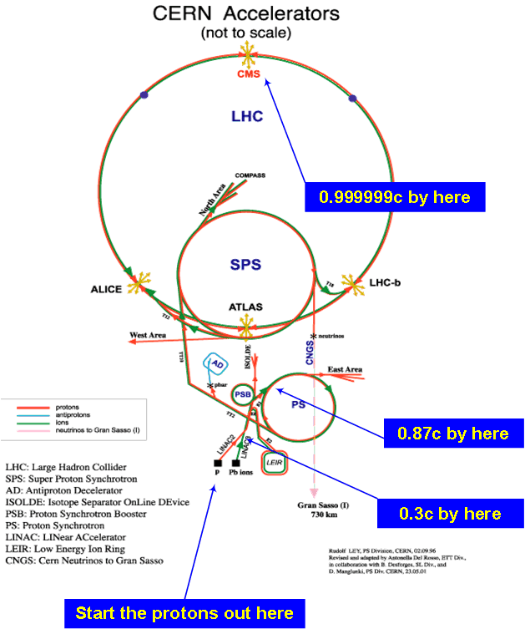
CERN proton accelerator chain
LHC : 2x(0.45 – 7) TeV
SPS : 26 – 450 GeV
PS : 1.4 - 26 GeV
PSB : 0.05 -1.4 GeV
Linac: 0-50 MeV

Slide 17
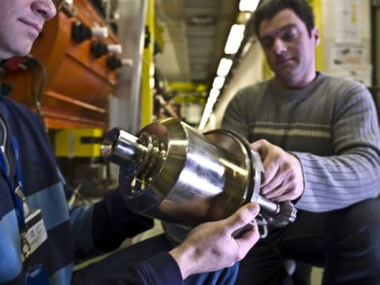
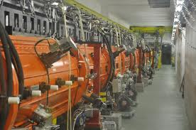
SOURCE and LINAC2
Duoplasmatron source
Linac2 : in evidence the accelerating RF structure

Slide 18
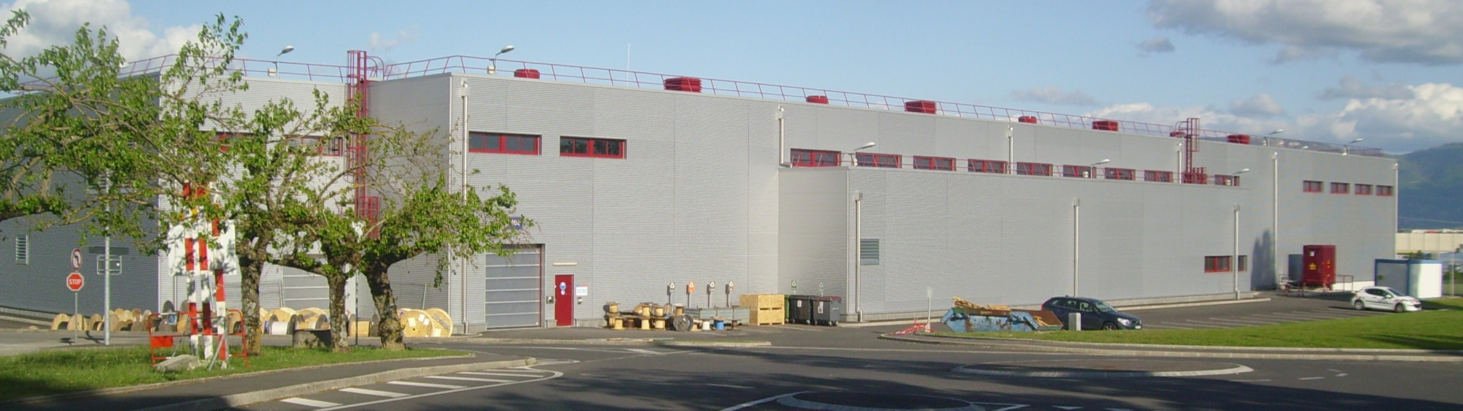
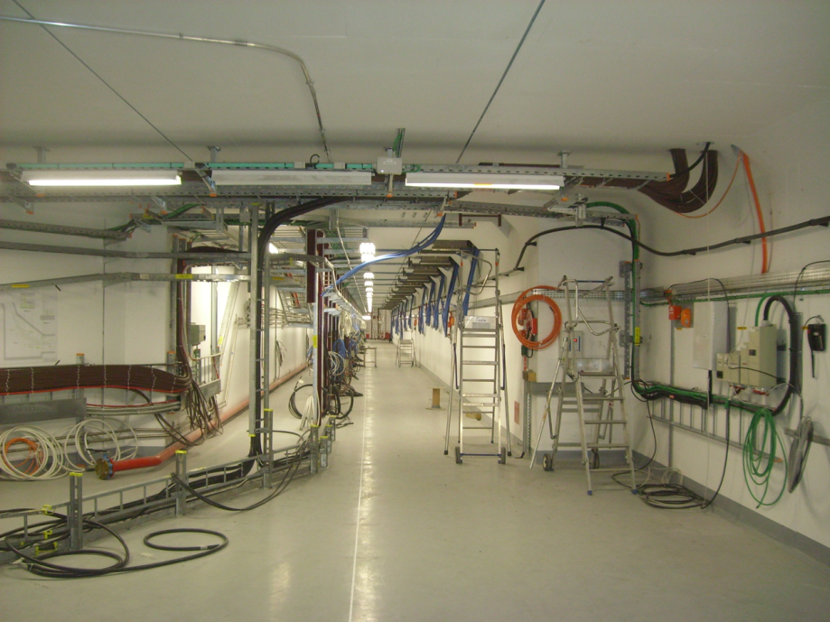
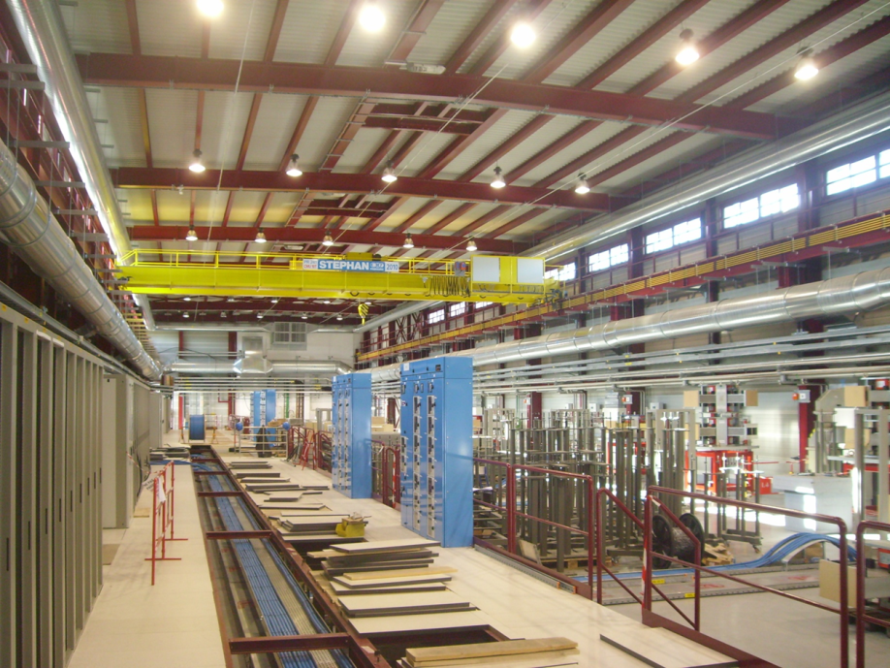
Upgrade : LINAC4 (2015-16 ?)
H⁻ and 160 MeV
Surface building
Accelerator tunnel
Equipment hall

Slide 19
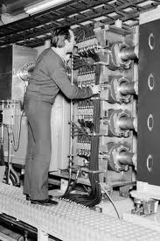
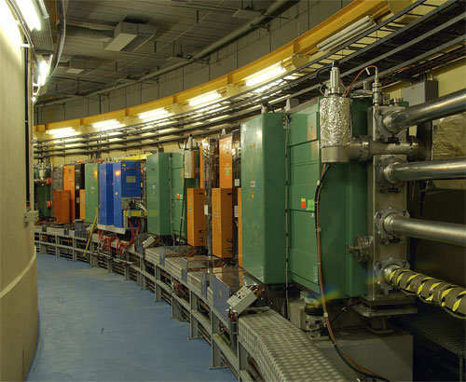
PSB (Booster): 1.4 GeV
Magnetic structure of PSB
Length : 150 m
Actually are four rings. Each beam is injected in the PS

Slide 20
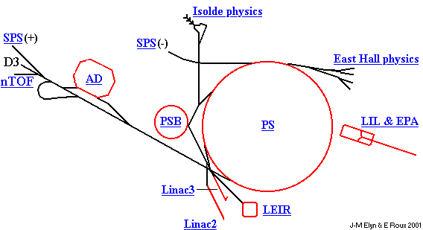
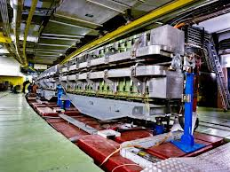
The PS complex: injector for LHC and much more…

Slide 21
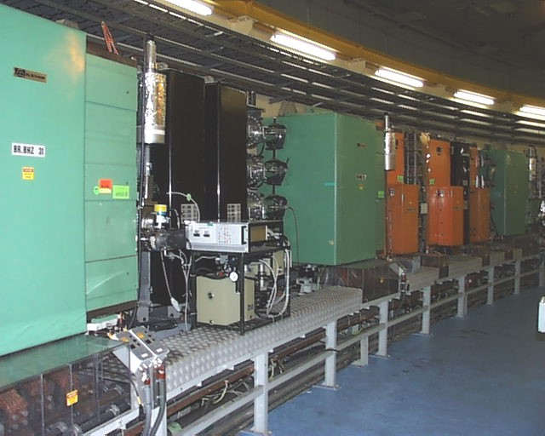
PSB upgrade to 2 GeV: brightness ↑
Increased intensity
Doubling of density in transverse phase planes
160 MeV H⁻ injection
2 GeV upgrade
Courtesy R. Garoby

Slide 22
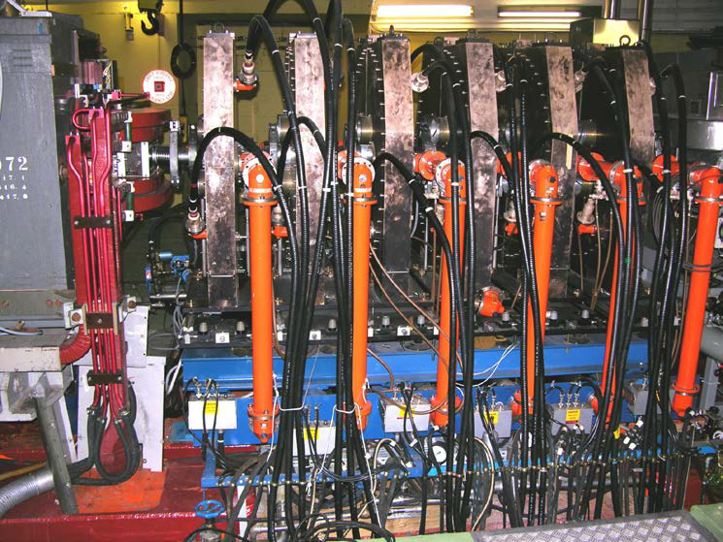
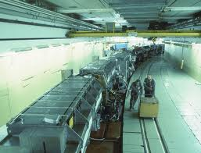
PS: 28 GeV
PS ring (magnetic structure)
PS 200 MHz system and 10 MHz system (1/10)

Slide 23
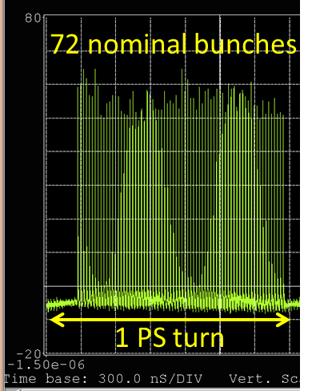
PS: generation of LHC beam
Each bunch from the PSB is divided by 12 → 6 x 3 x 2 x 2

Slide 24
PS upgrade (minor)
J.B. Adams – 25 Nov. 1959 – Design intensity: 3 10¹¹ p/p
Increased intensity / bunch
2 GeV injection
Increased transverse brightness
Radioprotection
Courtesy R. Garoby

Slide 25
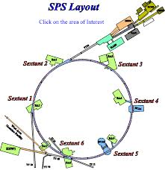
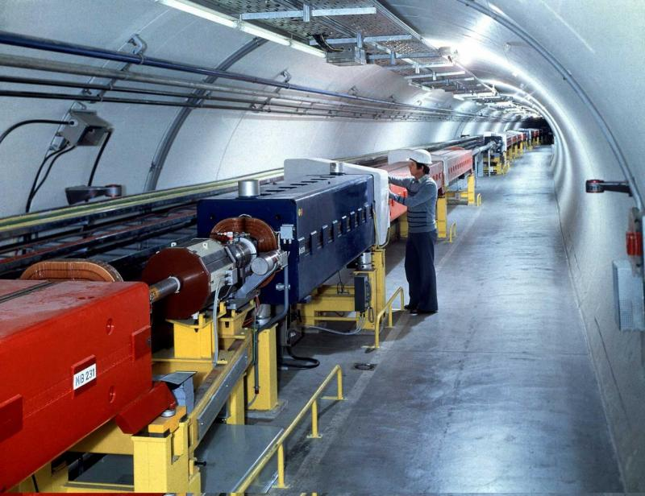
SPS: 450 GeV proton beam
(in the 1980’s worked as p-pbar)
SPS tunnel (almost 7 km)
SPS complex with experimental area

Slide 26
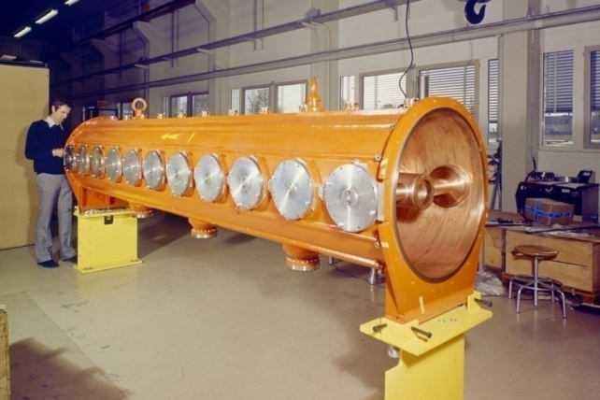
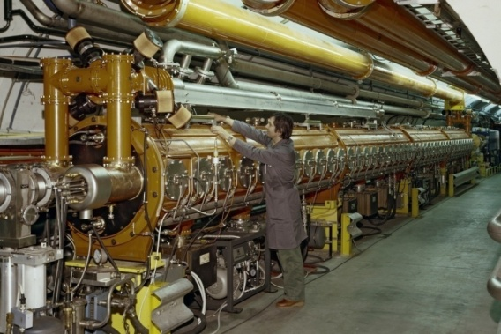
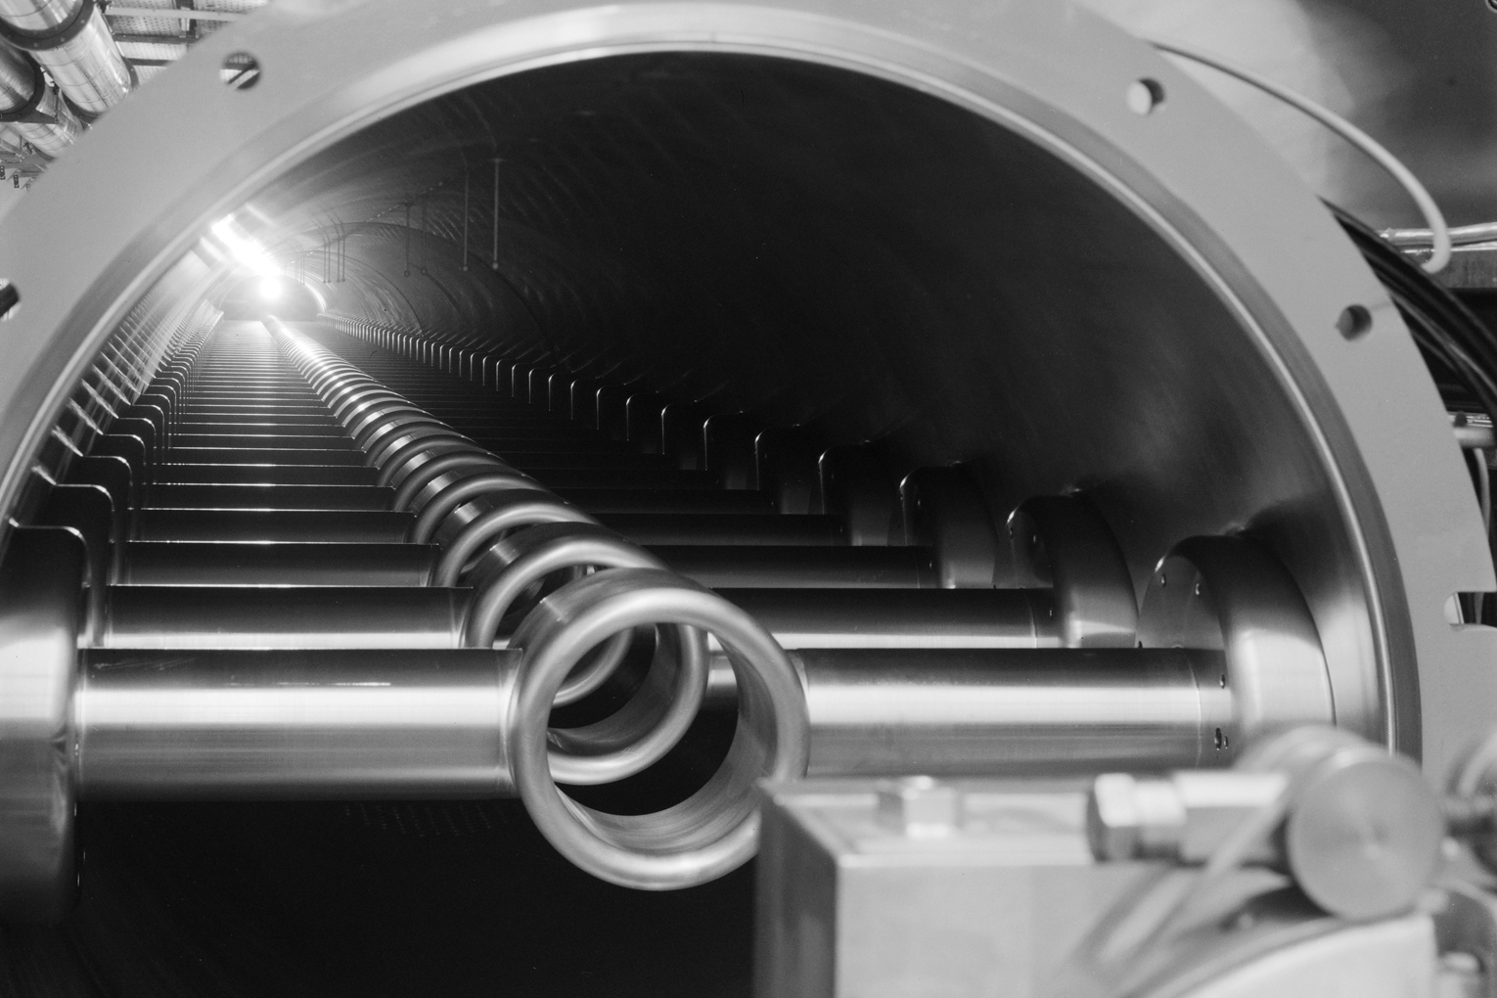
SPS upgrade
200 MHz Travelling Wave Accelerating Structures
One four sections cavity
(four power couplers and two terminating power loads)
Increased transverse brightness
Increased intensity
One section = 11 drift tubes
Courtesy R. Garoby

Slide 27
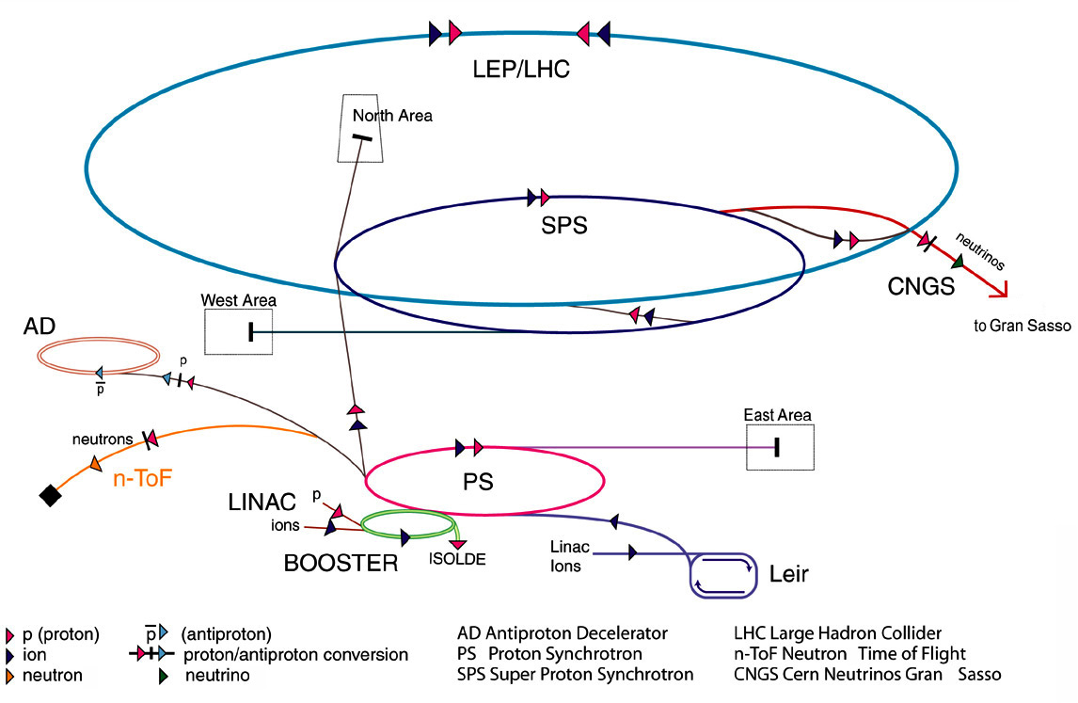
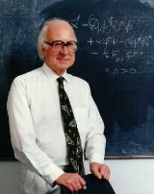
CERN’s particle accelerator chain: 40 km of tunnels (rings and transfer lines)
From LINAC to LHC…
?
?
?
?
H
2004: The 20 member states

Slide 28
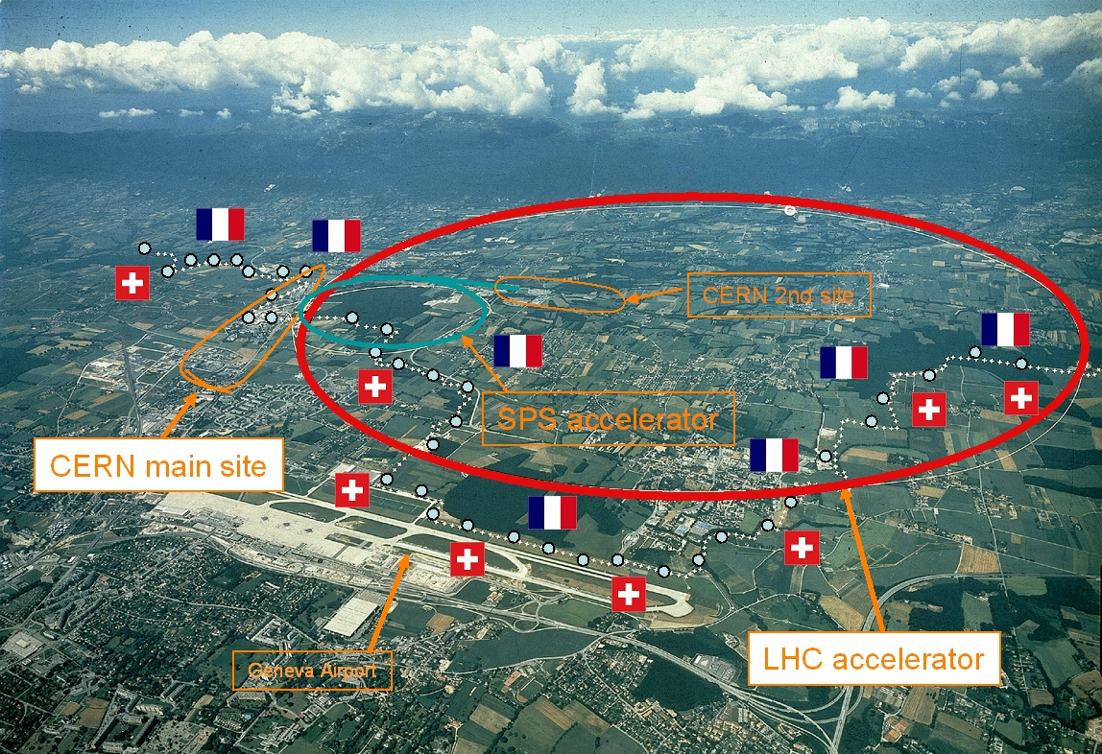
CERN
European Organization for Nuclear Research
2004: The 20 member states

Slide 29
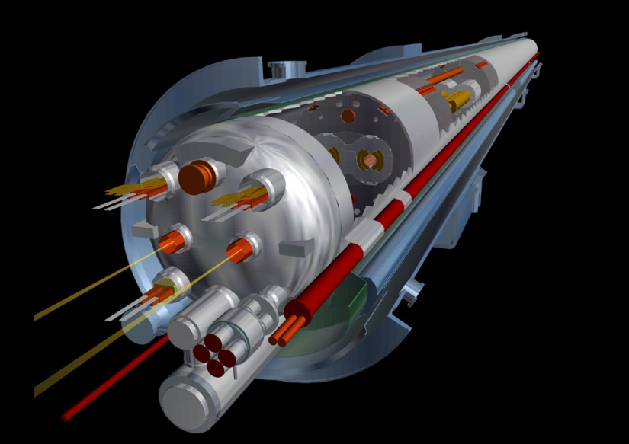
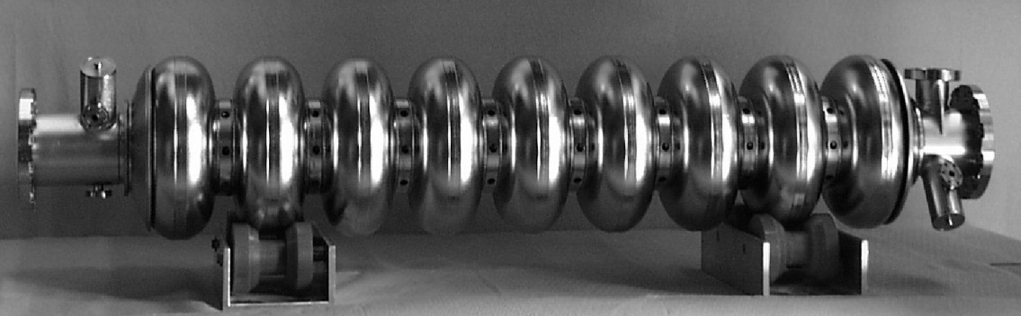
Superconducting accelerators
Rationale for
superconductivity in accelerators
Circular Accelerators
  E_{beam} = 0.3 B r [GeV] [T] [m]
  → superconducting bending and focussing magnets
    high-energy hadron synchrotrons
Linear Accelerators
  E_{beam} = E L [MeV] [MV/m] [m]
  → superconducting acceleration cavities
    high-energy e⁺-e⁻linacs

Slide 30
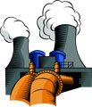
SC: an enabling technology
Rationale for
superconductivity in accelerators
The LHC has a circumference of 26.7 km, out of which some 20 km of main superconducting magnets operating at 8.3 T. Cryogenics will consume about 40 MW electrical power from the grid.
If the LHC were not superconducting:
If it used resistive magnets operating at 1.8 T (limited by iron saturation), the circumference would have to be about 100 km, and the electrical consumption 900 MW (a good-size nuclear power plant), leading to prohibitive capital and operation costs.

Slide 31
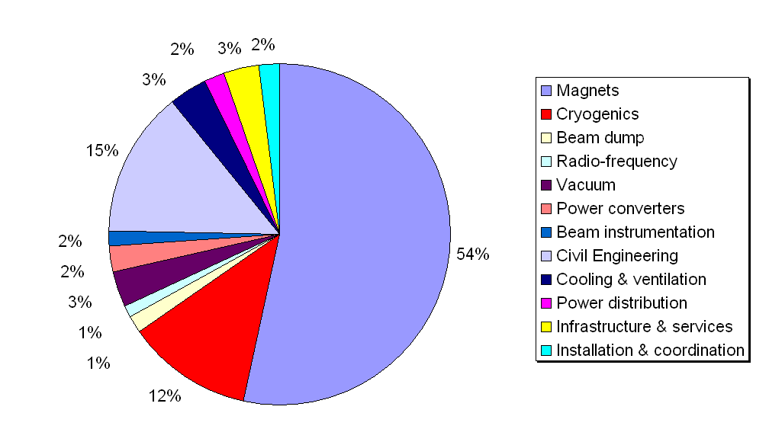

Cost structure of the LHC
Total material cost: about 2.5 G€
Magnet+cryogenics = 66%

Slide 32
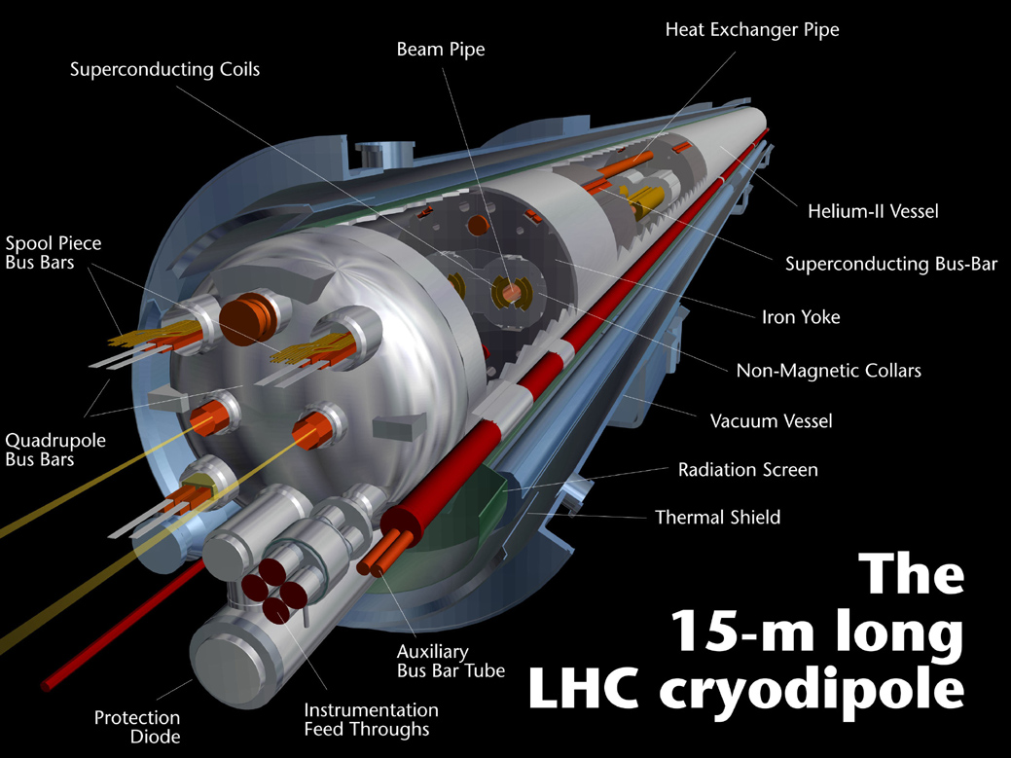

LHC dipole magnet
1232 dipole magnets, 15 m long
B field 8.3 T (11.8 kA) @ 1.9 K (super-fluid Helium) – after incident operated up to ~4.7 T ➔ interconnect consolidation during Long Shut-down 2013-2014
2 magnets-in-one design : two beam tubes with an opening of 56 mm.
Operating challenges:
  Dynamic field changes at injection.
  Very low quench levels (~ mJ/cm³)

Slide 33
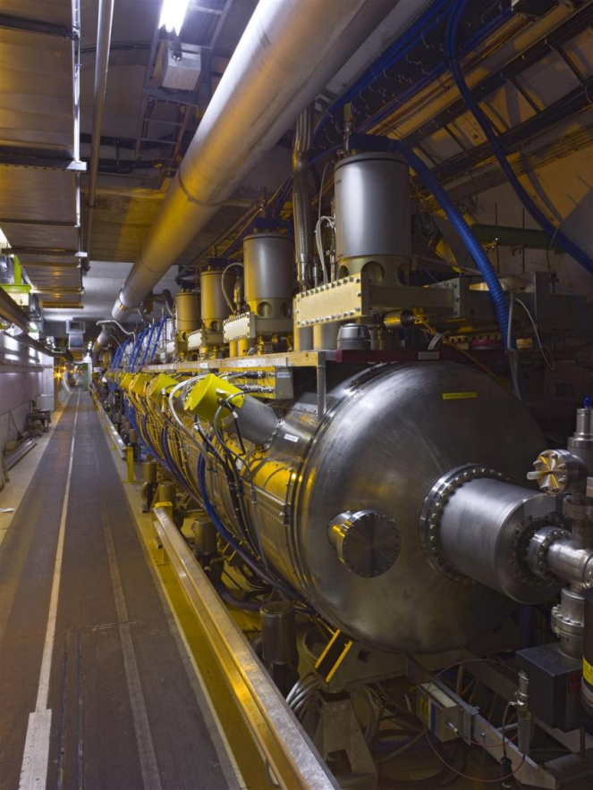
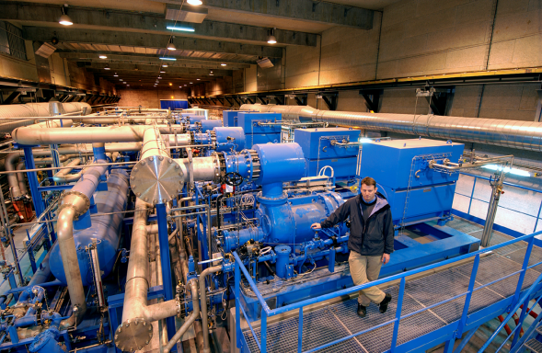
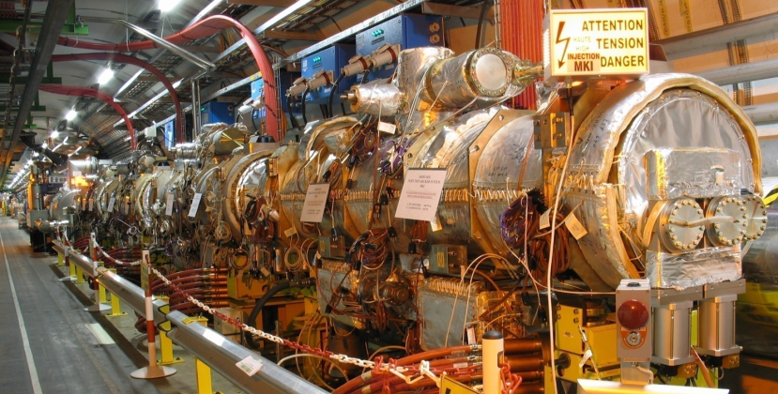
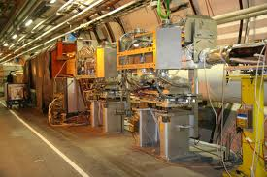

LHC: 24 km of 10,000 SC magnets … but much more than magnets
Cryogenics
Kickers for injection
CERN Control Center
400 MHz SCRF cavities (2x 15 m)
Collimators to clean > 99.9% of the losses

Slide 34
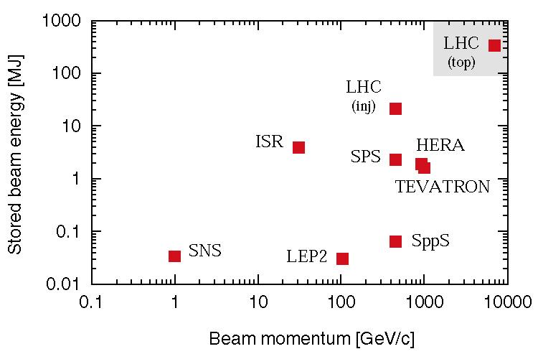
The power of the LHC beams
The LHC beam energy is 350 MJ. Already at injection the beam can damage a magnet.

Slide 35
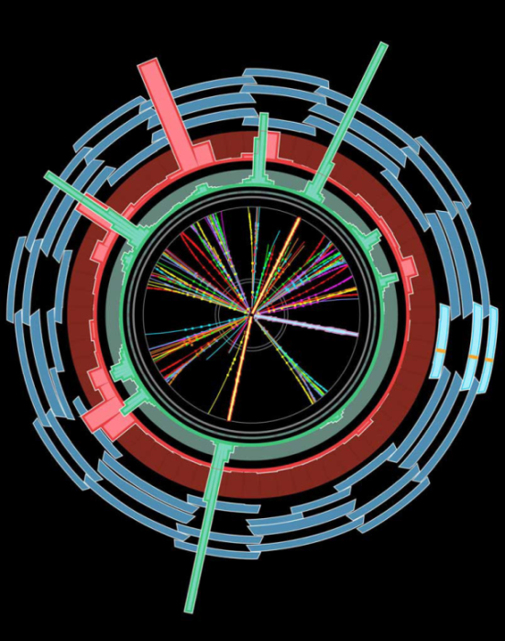
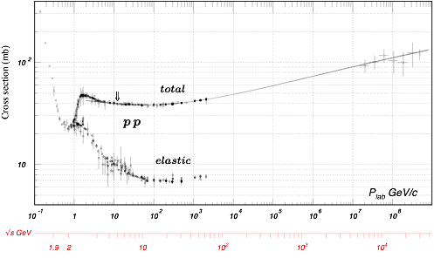
After energy, luminosity is the most important parameter of a collider
pp cross section
LHC - 14 TeV

Slide 36

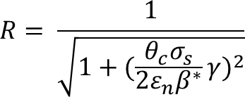
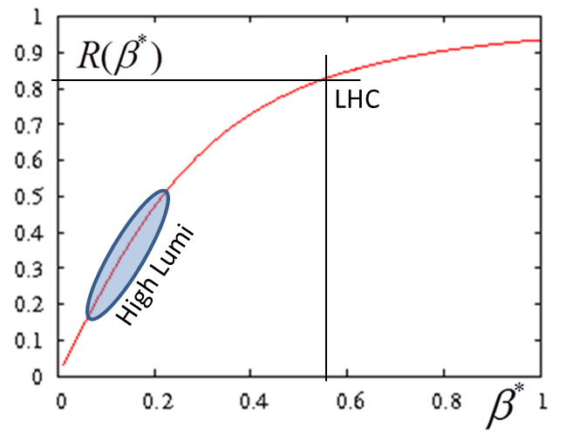

Luminosity: main ingredients
Beam current
energy
Beam size
Beam current and emittance: involve Inj chain and whole ring
β∗ involve «only» 2 IRs, 600 m.

Slide 37


Beam envelope scales as 1/√β∗ at IPs
Low-β quadrupole triplet

Slide 38


Integrated Luminosity in LHC (fb⁻¹)
In 2011: at 7 TeV accumulated 5.6 fb⁻¹
In 2012: at 8 TeV accumulated almost 25 fb⁻¹

Slide 39





Possible evolution of luminosity
Full Upgrade: High Luminosity LHC
Full upgrade
Shut down to fix interconnects and overcome energy limitation (LHC incident of Sept 2008) and R2E
Shut down to overcome beam intensity limitation (Injectors, collimation and more…)

Slide 40

Magnets: 11 T dipoles, 12-13 Quads
Crab Cavities : femtosecond accuracy
SC links: 150-200 kA, 5 kV, 300-700 long
New cryogenic plants and other equipment

Slide 41

HL-LHC: Change > 1.2 km of LHC…
Works all around the ring
LHCb and Alice not considered for the moment

Slide 42




Some of the hardware to change…

Slide 43



27 km tunnel, 4 x12 kW refrigerators

Slide 44



8 x18 kW 4.2 K refrigerators
8 2.5 kW 1.9 K refrigerators
12 x 13 kA Testing bench
Large SC test facility
2000x7-15 m SC magnets

Slide 45




2x18 kW 4.2 K + 2 2.5 kW 1.9K
20x 11 T twin dipoles
20 large 13 T quadrupoles & dipoles
Sc test faciltiy at 30 kA -13 T
SC cable for 1 GW d.c. power transmission
First unit of 3 kA in MgB2 and YBCO sucessfully tested

Slide 46


Slide 47

Main technology is dipole magnets: is it possible ?
Looking at performance offered by practical SC, considering tunnel size and basic engineering (forces, stresses, energy) the practical limits is around 20 T.
Nb-Ti operating dip;
Nb3Sn cosϑ test dip
Nb3Sn block test dip

Slide 48
The superconductor space
Nb-Ti
Nb₃Sn
HTS

Slide 49


The « new » materials
1 – Nb3Sn
Recent 23.4 T (1 GHz) NMR Magnet for spectroscopy in Nb₃Sn (and Nb-Ti). 15-20 tons/year for NMR and HF solenoids. Experimental MRI is taking off
ITER: 500 t in 2010-2015! It is comparable to LHC!
HEP ITD (Internal Tin Diffusion):
  High Jc., 3xJc ITER
  Large filament (50 µm), large coupling current...
  Cost is 5 times LHC Nb-Ti
0.7 mm, 108/127 stack RRP from Oxford OST
1 mm, 192 tubes PIT from Bruker EAS

Slide 50


The successful cable as result of 5 –y R&D (FP6-CARE-NED)
Jc is the only Sc current density at 12 T (reference point)
1.25 mm PIT strand, 14 strands @ CERN 2011
Courtesy L. Bottura
Thermo-magnetic instability and FQ issues will continue to play a major role.
However the route is traced and we can expect that in the next 5-6 years , also thanks to HiLumi R&D and industrialization, Nb₃Sn for HEP will be consolidated.

Slide 51



The « new » materials: HTS
Bi-2212
Round wire, isotropous and suitable to cabling!
HEP only users (good < 20K and for compact cable)
Big issue: very low strain resistance, brittle
Production ~ 0,
cost ~ 2-5 times Nb3Sn
(Ag stabilized)
DOE program 2009-11 in USA let to a factor 2 gain. We need another 50% and more uniformity, eliminating porosity and leakage

Slide 52


The « new » materials: HTS
YBCO
Tape of 0.1-0.2 mm x 4-10 mm : difficult for compact (>85%) cables
Current is EXCELENT but serious issue is the anisotropy;
>90% of world effort on HTS are on YBCO! Great synergy with all community
Cost : today is 10 times Nb₃Sn, target is same price: components not expensive, process difficult to be industrialize at low cost
FP7 Eucard is developing EU Ybco

Slide 53


New (old) approach to cabling suitable for tapes
An old type of cabling (Roebel) suitable for tapes has been recently rivisited (Karlsruhe, New Research Industry NZ)
Here a first 2 m long test cable done at CERN

Slide 54


First consistent cross section, 2010 WG and Malta (fits our tunnel)
L. Rossi and E. Todesco
Magnet design: 40 mm bore (depends on injection energy: > 1 Tev)
Very challenging but feasable: 300 mm inter-beam; anticoils to reduce flux
Approximately 2.5 times more SC than LHC: 3000 tonnes!

Slide 55






LHC→HE-LHC/VHE-LHC (F. Zimmerman)
LHC is the 1st Higgs factory!
E_{CoM}=8-14 TeV,$\hat{ L}\sim$10³⁴cm⁻²s⁻¹
total cross section at 8 TeV: 22 pb
1 M Higgs produced so far – more to come
15 H bosons / min – and more to come
HL-LHC (~2022-2030)
will deliver ~9x more H bosons!
E_{CoM}=14 TeV,$\hat{ L}\sim$5x10³⁴cm⁻²s⁻¹
with luminosity leveling
8 → 14 TeV: ggH x1.5
- pushes magnet technology!
F. Cerutti, P. Janot
HE-LHC: in LHC tunnel (2035-)
E_{CoM}=33 TeV,$\hat{ L}=5$x10³⁴cm⁻²s⁻¹
VHE-LHC: new 80 km tunnel (2040?)
E_{CoM}=84-104 TeV,$\hat{ L}=5$x10³⁴cm⁻²s⁻¹
E. Todesco, L. Rossi, P.. McIntyre
20-T dipole magnet
16-T or 20-T magnets
80 km tunnel
14 → 33 TeV: HH x6
J. Osborne, C. Waaijer, S. Myers
HH x42
Notes:
HELHC

Slide 56

80-km tunnel in Geneva area – “best” option
«Pre-Feasibility Study for an 80-km tunnel at CERN»
John Osborne and Caroline Waaijer,
CERN, ARUP & GADZ, submitted to ESPG
F. Zimmermann
even better
100 km?

Slide 57

Is there a limit? Think bigger!
Thanks for your attention !

