Slide 1



High energy emission of transient black hole binaries
Fiamma Capitanio
INAF-IAPS Rome Italy
The biggest accelerators in space and on earth, COST Conference 18-22 March 2013 Geneva

Slide 2
OUTLINE
What is a Black Hole X-ray binary?
Structure of an BH X-ray binary
Principal X-ray Emission processes
Spectral emission and timing variability
Disk instability two curious examples: IGR J17091-3624 and 4U1630-472
BHXRB and AGN connection
Conclusion and open questions

Slide 3
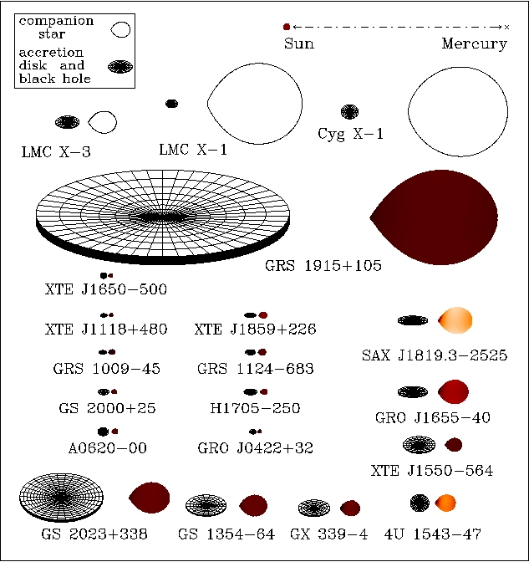
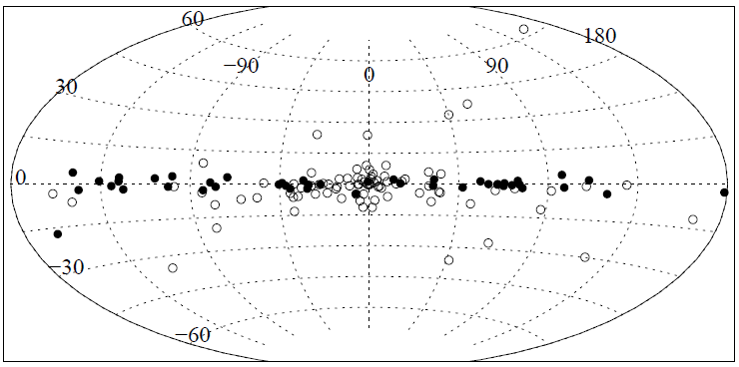
Black Hole X-ray binary
A BHXRB is a binary stars system formed by either a main sequence low mass star and a BH accreting matter from the companion via Roche lobe overflow.
Most of the BHXRBs are transient sources. They spend most of the time in quiescence (L~ 10³²⁻ 10³⁴ erg/s).
The outburst duration can spans from some days until years.
During an outburst the X-ray flux increases by several orders of magnitude in few days (L_{max}~10³⁸-10³⁹ erg/s.)
Persistent
systems
(Remillard & McClintock 2006)
Transient systems
The intervals between the outbursts vary from less than 1 month to tens of years or more
The BHXRB are old systems and lie in the galactic centre region
Grimm et al 2002

Slide 4
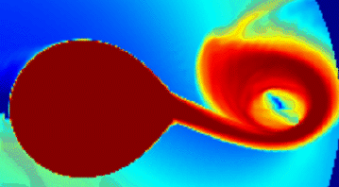
Accretion disk formation
The material, transferred through the Lagrangian point L1, has high specific angular momentum and because it is conserved, the material cannot accrete directly onto the compact star and starts to orbit around the BH.
The dissipative processes, present in each ring of the disk, will convert some of the kinetic energy into heat that is radiated away.
So the angular momentum is transferred outwards the disk
The original ring of matter is speared to both smaller and larger radii
The outburst origin
The XRB outbursts are probably due to a mass transfer instability. This could result from either an instability of the disk itself or a mass transfer event from the companion
The viscosity should change suddenly when it is close enough for hydrogen to become partially ionized and for opacities to depend strongly on temperature.

Slide 5
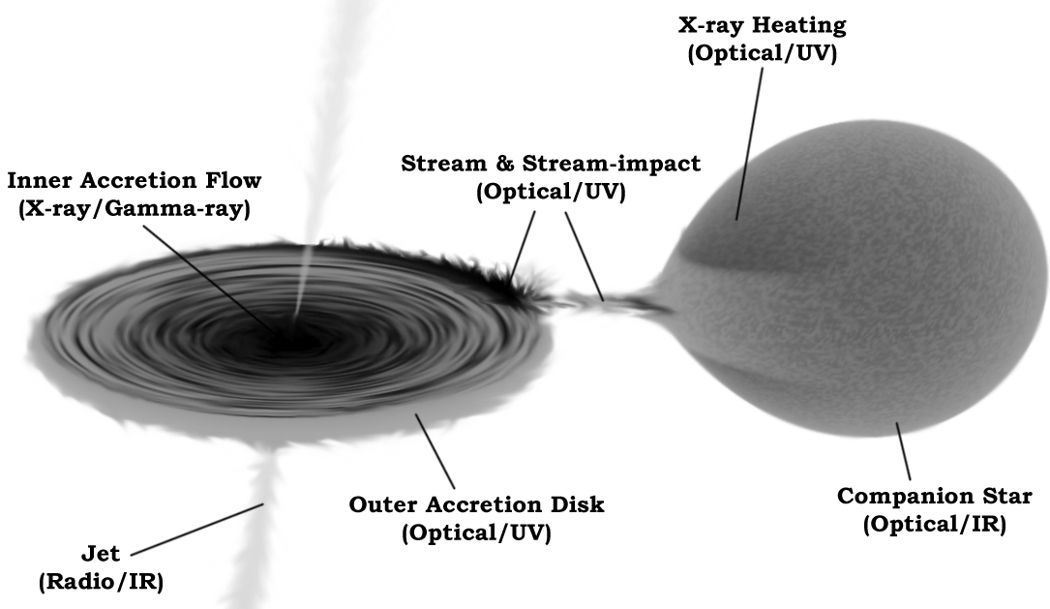
High Energy Emission processes
Disk seed photons up scattered by an hot electrons corona (Inverse Compton scattering
(X-ray/Gamma-ray)
Hynes 2010 astroph: 1010.5770v1

Slide 6
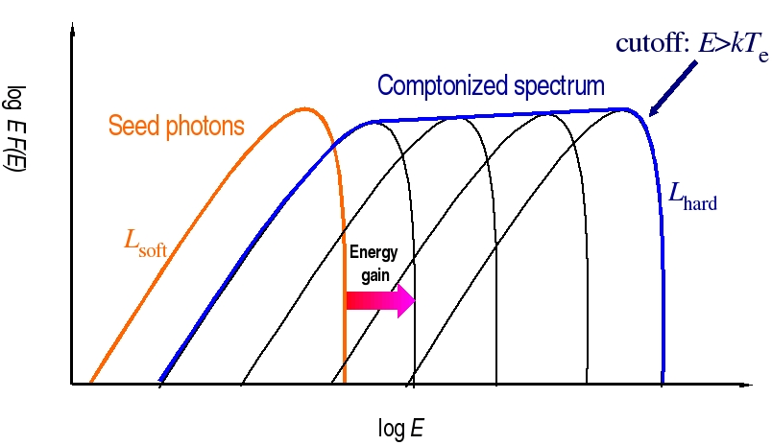
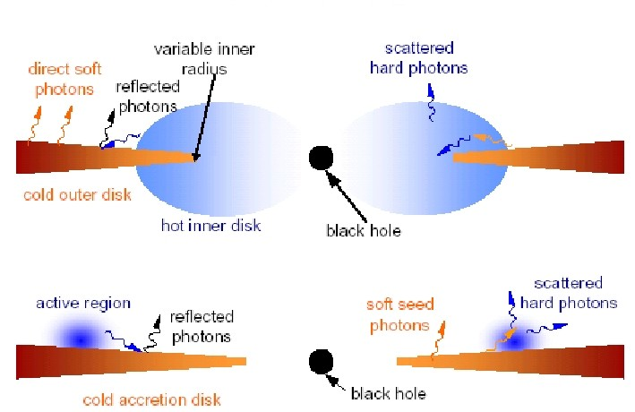
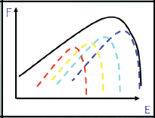
The standard scenario: Hard and Soft state
Inverse compton scattering of the disk seed photons by a thermal relativistic electrons populations
Principal parameters of the Comptonization model: T_{o,}seed photons temp. KT_{e}, e⁻ temp.; τ_{e}, optical depth.
Non thermal or hybrid comptonization??
Luminosity
Thin disk approx.
(Shakura & Sunyaev 1973):
multi-color blackbody spectrum

Slide 7
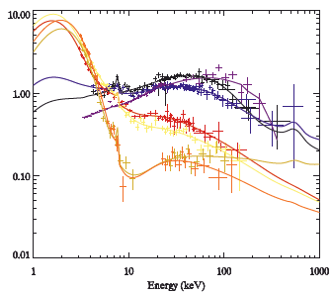
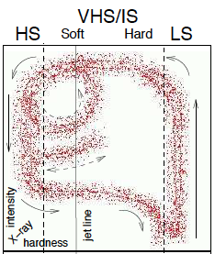
High Soft State
Low Hard State
EF(E)
Fender Belloni Gallo 2005
Intermediate States
A
B
GX 339-4
A+B
Del Santo et al. 2008
B/A

Slide 8
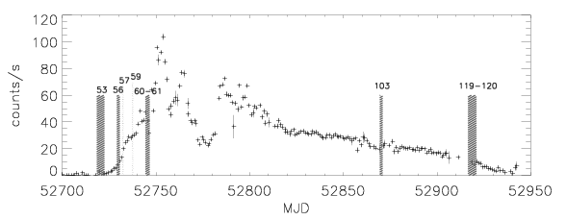
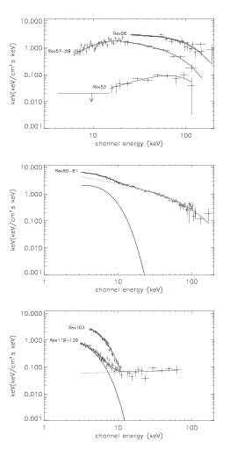
H1743-322 spectral evolution during 2003 outburst
Fender Belloni Gallo 2005
A+B
A/B
Capitanio et al. 2005
Notes:
Fifare lo spettro HSS!!!

Slide 9
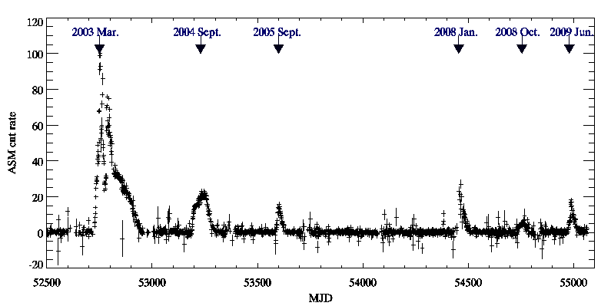
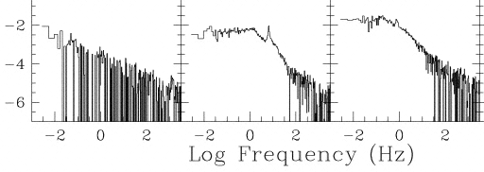
X-ray Emission Variability tackers : QPO
Variability is a characteristic of the accretion
The X-ray Luminosity varies in a non-periodic fashion on different time scales
Thus the Power spectrum is good tracker of variability.
Power spectrum often presents transient QPO (see Orhan Donmez talk)
QPOs can be explained as intensity fluctuations with a preferred frequency
~7 years
0.5 hour
100 days
5 days
Remillard & Morgan ¹⁹⁹⁹
H1743-322 2002-2009 light curve between 1-12 keV
This complex fast time variability shows a marked dependence on the energy spectrum of the source, with transitions which can be as fast as a few seconds.

Slide 10
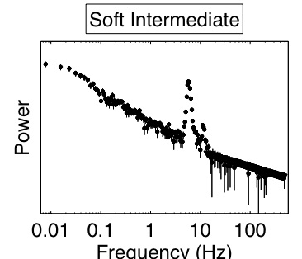
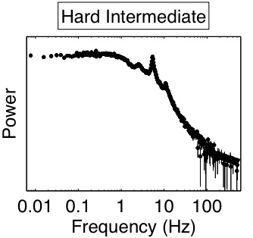
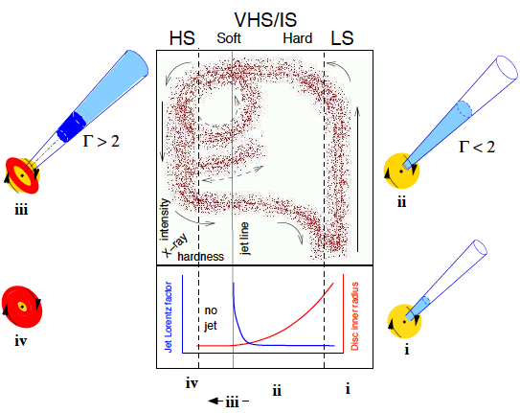
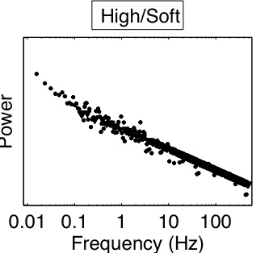
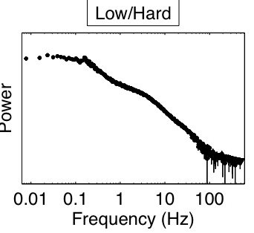
The different spectral states of a BHXRB does not involve only a spectral variation. All the system properties are thought to change
Which is the role of the corona in the jet lunching?
Fender et al. ‘05; Homan & Belloni ’05

Slide 11
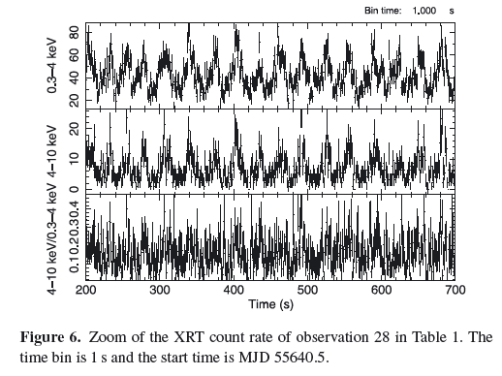
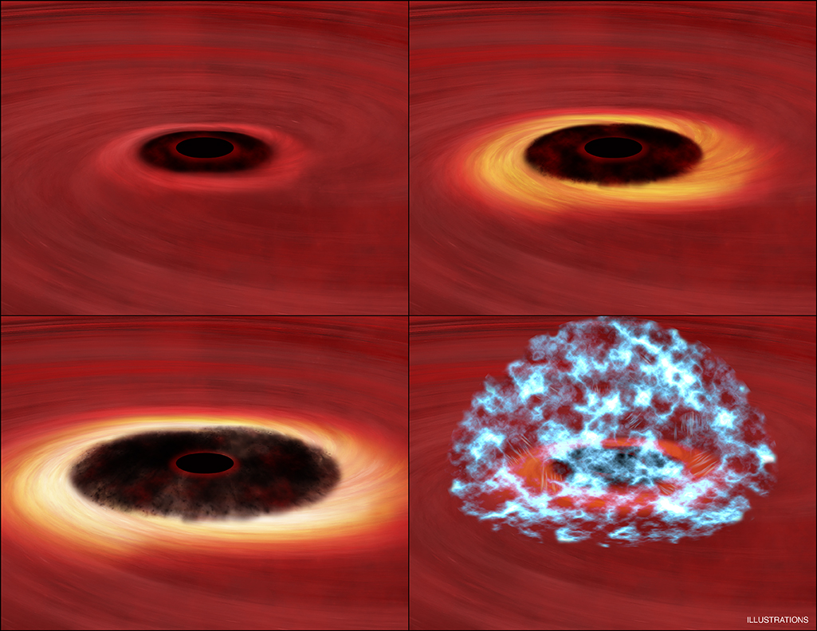
An extreme example of disk instability:
IGR J17091-3624
This features are probably due to a limit cycle in the accretion disc instability dominated by the radiation pressure (Lightman–Eardley )
The inner part of the disc empties and refills with a time-scale of seconds.
Reported for the first time by Altamirano et al. 2011 Atel 3230
Capitanio et al. 2012
Hardness variation
IGR J17091-3624 avg. flux 4.6 mCrab; (HSS flux 2011 outburst ~100 mCrab )
(Lightman&Eardley 1974; Szuszkiewicz&Miller 1998; Nayakshin&Rappaport 2000, Belloni et al. 1997)

Slide 12
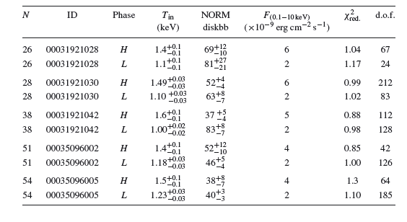
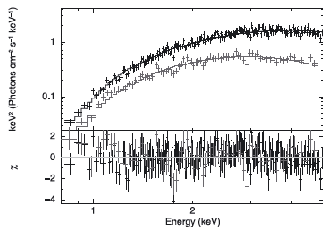
Spectra FROM the ‘heartbeat’
Rate-resolved analysis←→ Phase-resolved analysis:
Adding time intervals corresponding to the peaks (ct/s> 60) and to the minima of the flare (ct/s<30)
highest count rates indicated a higher inner disc temperature and a hint for a smaller inner disc radius than what measured at the minima of the flares.
This is similar to the case of GRS 1915+105 (Neilsen, Remillard & Lee 2011).
absorbed DISKBB
Notes:
Unfortunately, only in observations where the flux variation during the flares was more pronounced, was it possible to constrain the MDBB normalization constant with enough confidence.

Slide 13
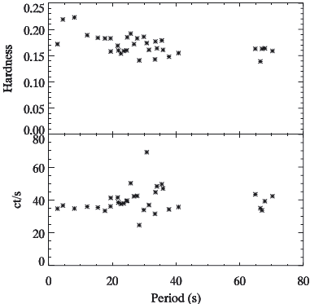
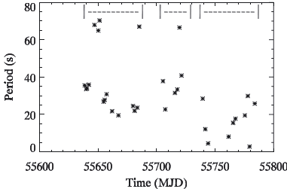
No evident correlation between the periods of the flare-like events with the count rate or the HR has been found. The only peculiarity is the presence of a sort of ‘forbidden zone’ in the possible period values (from ∼40 to ∼65 s).
the flare-like events lose coherence and change their period with time with a decreasing trend.

Slide 14
Another example of disk instability?: 4U1630-472, recurrent outbursts
The peculiarity 4U1630-47is the presence of regular outbursts since its discovery in 1969 with a period of about 600/700 days
Even during the 2003 outburst, the brightest and longest ever seen from this source, that covered a time period for which we expect two outbursts, the two secondary peaks lie exactly at the expected.
After the 2003 outburst the recurrence time seems to become a bit longer and equal to 730 days with only few days of error.
The reason why the instability is able to maintain phase over so many cycles is still unknown. Even if the recurrence could be due to geometrical reasons (a third body, or an eccentric orbit)
Capitanio et al. in prep.

Slide 15
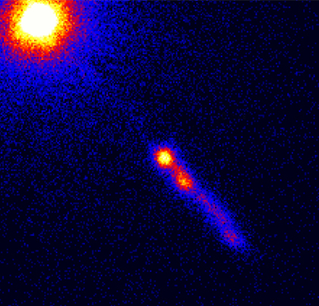
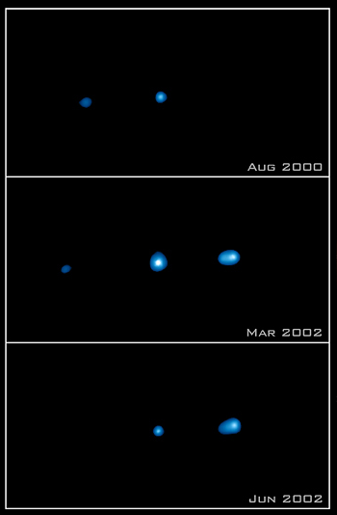
AGN
XRAY BINARY/ AGN connection
BHXRB
Same physical processes
Different masses and dimensions
Different time scales
~ 10¹⁸ Km
~10⁸M☉
~10³ Km
10 M☉
Million of years
3C273
Months
Mpc÷Gpc
Different distances
~10kpc
Thus the approach to X/soft gamma-ray data analysis is different.
XTE J1550-564
AGN
Slight X-ray flux variations →Low flux sources → longer integration times → averaged spectra
BHXRB
High X-ray flux variations → bright sources → shorter integration times → Spectral and time variability studies

Slide 16
Conclusions
The variability of an X-ray binary is due to a change in the “state of the source”: accretion geometry, physical processes.
We know that variability and instability are strictly connected but far to be understood.
There must be a connection between the spectral “state” of a BHXRB, the Jets lunch and disk instability (which is the role of the relativistic electrons of the corona?)
Even if a phenomenological classification have been developed in the last years, there are still sources that have peculiar and unpredicted behaviour.
Connection with AGN: observing a BHXRB we see the same phenomenon at different time scales

Slide 17
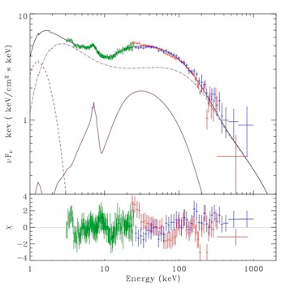
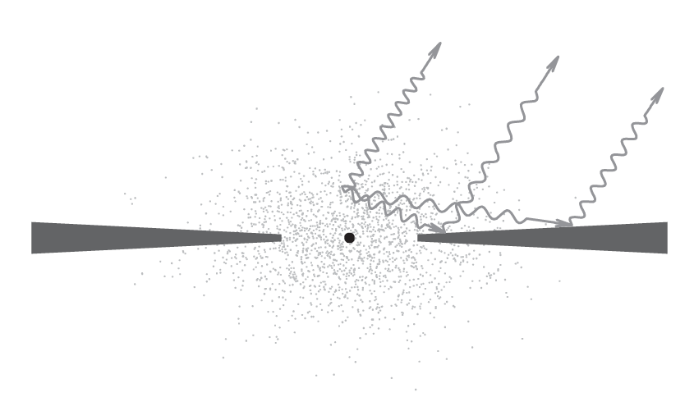
Reflection component
A Fraction of the Comptonized photons is intercepted by the disk. Part of it can be reflected via combined effects off photo-absorption, fluorescence, and Compton scattering.
The spectrum of the reflected emission, consisting of a number of fluorescent lines and K-edges of cosmically abundant elements superimposed on the broad Compton reflection hump
Comptonised spectrum
Disk Black Body
Reflection component
Malzac et al. 2006
The disk albedo depends on the photon wavelength and on the chemical composition and ionization state of the disk

Slide 18

Disk instability
The XRB outbursts are probably due to a mass transfer instability. This could result from either an instability of the disk itself or a mass transfer event from the companion
The viscosity should change suddenly when the is close to 104 K, enough for hydrogen to become partially ionized and for opacities to depend strongly on temperature.
However, several features of outburst light curves remain unexplained: generally different time scales variability of the standard disk model are explained with different definition of the viscosity.
Istability Variability
van Paradijs (1996)
Notes:
In some cases, the accretion disc undergoes sporadic outbursts which are thought to be triggered by a thermal–viscous instability, resulting in an increased mass accretion rate on to the primary and a rapid X-ray brightening.
This instability is thought to arise when the disc effective temperature is close to 104 K, enough for hydrogen to become partially ionized and for opacities to depend strongly on temperature. However, several features of outburst light curves remain unexplained. Hence, it is difficult to use outburst light curves to provide definitive tests of the DIM. In contrast, one of the core predictions of the DIM, which depends little on the details
of angular momentum transport, is the existence of a critical mass-transfer rate that depends on disc size, separating stable and unstable discs.

Slide 19
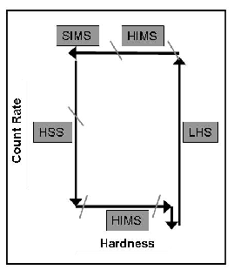
Transient BHC states (Fender, Belloni Gallo 2004; Homan):
Hard Intermediate State: The energy spectrum becomes softer and a soft thermal disk component becomes detectable. The radio spectrum becomes steeper and the velocity of the jet outflow increases. The power density spectrum features have higher characteristic frequencies than LS and usually there is a rather strong 0.1-15 Hz type-C QPO.
Low Hard State, The outburst start: The energy spectrum is hard and strong band limited noise (30-40%) is observed in the power density spectrum. The flux increases with harder spectral shape. These emissions are probably associated to compact jet ejection
Soft Intermediate State: before the transition to the SIMS state, the jet velocity increases rapidly, giving origin to a fast relativistic jet and strong radio flares. Also significant changes appears in the power density spectrum features. This happened when the source approaches the "jet line“ in the HID.
Past the line, there are non more radio detections. The source remains for a long time in this state drawing several loops in the HID . The spectrum is dominated by the disk component. No band-limited noise is observed but the power density spectrum shows complex and variable features.
Low Hard State II: The source continues to harden and moves to the right side of the HID reaching the same value as when it started its outburst.
Hard Intermediate State II: The flux stats to increase and the spectrum hardens again. The source enters again in HIMS state with the same characteristic of previous transition but with a weaker flux.
High Soft State: The energy spectrum is soft and strongly dominated by a thermal disk component, a weak power law hard component is present without any detectable cutoff up to 300 keV. The flux decreases with time and only weak power-law noise is observed. No core radio emission is detected. In this configuration the source is in a regime that is probably the closest one to Sakura Suniayev theory of the accretion disks.
Notes:
19

