Slide 1


Hardware implications of IR upgrade:
TAN, TAS & forward detectors
Anne Laure Perrot
on behalf of EN/MEF
Special thanks to
F. Butin, I. Efthymiopoulos, S. Evrard, F. Galleazi, D. Lacarrere
EN/MEF in charge of these elements
HiLumi-LHC, Workshop collider-experiments interface, 30th Nov. 2012, CERN

Slide 2
Contents
Locations of TAS, TAN & forward detectors
at the end of LS1
TAS
TAN
LHC forward detectors

Slide 3
Locations of TAS, TAN and forward detectors
LSS1 – end of LS1
ATLAS
IP8
IP2
IP1
TAN
TAS
TAS
TAN
ALFA
LHCf
BRAN
ATLAS ZDC
LHCf
BRAN
ATLAS ZDC
ALFA
AFP
AFP
Forward detectors - installed
Forward detectors under study – installation foreseen during Xmas break 2015-2016
HiLumi, WP8, 30th Nov. 2012
A. L. Perrot, EN-MEF/LE
3

Slide 4
Locations of TAS, TAN and forward detectors
LSS2 – end of LS1
IP1
ALICE
IP3
IP2
ALICE ZDC
ALICE ZDC
Forward detectors - installed

Slide 5
Locations of TAS, TAN and forward detectors
LSS5 – end of LS1
IP4
CMS
IP6
IP5
CMS FSC
CMS FSC
HPS
TOTEM
TAN
TAS
TAS
TAN
TOTEM
HPS
&
new detectors
BRAN
CMS ZDC
&
new detectors
BRAN
CMS ZDC
Forward detectors - installed
Forward detectors under study

Slide 6
TAS (Target Absorbers Secondaries)
Purpose
Front quadrupoles absorbers around IPs 1/5
Protect Q1,2,3 from debris (prevent them from quenching)
Protect the inner tracking elements of ATLAS and CMS detectors from loss of beam particles in the IRs
Forward shielding around TAS to protect ATLAS & CMS detectors from particles leaving the TAS (backscattering /activation)
TAS designed to be an integral part of the forward shielding of ATLAS and CMS

Slide 7
TAS (Target Absorbers Secondaries)
Technical specificities
Copper absorbers, 3.2 tons, internal beam tube, adjustable supports and alignment rods;
In situ vacuum bake-out (strip heaters/ internal thermocouples)
Cooling system (water) to ensure internal max beam tube temperature below 75 C
Technical requirements: see edms 101559

Slide 8
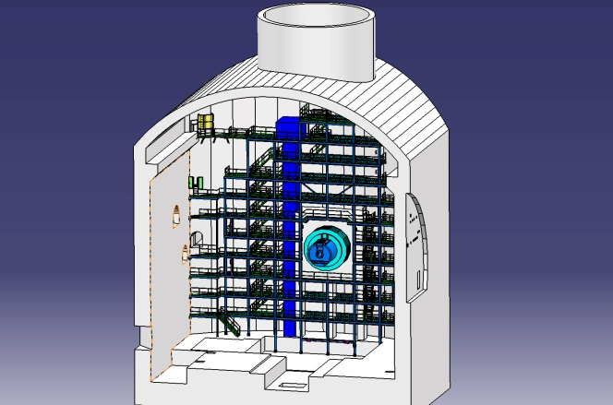
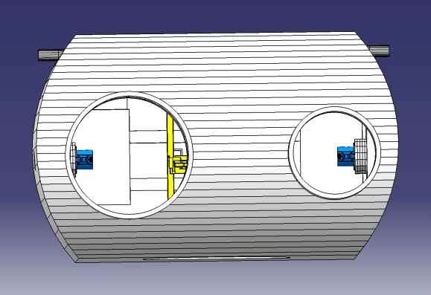
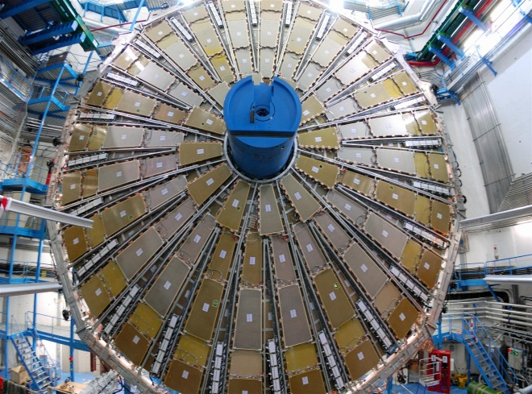
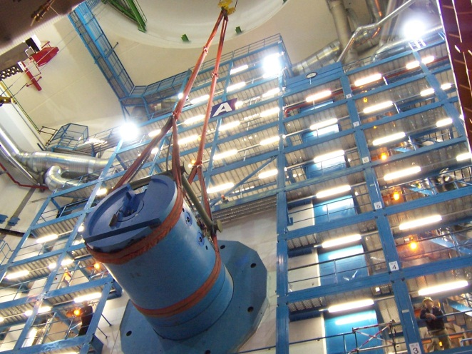
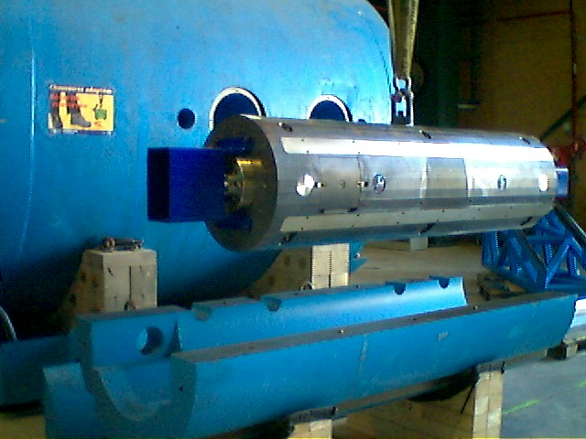
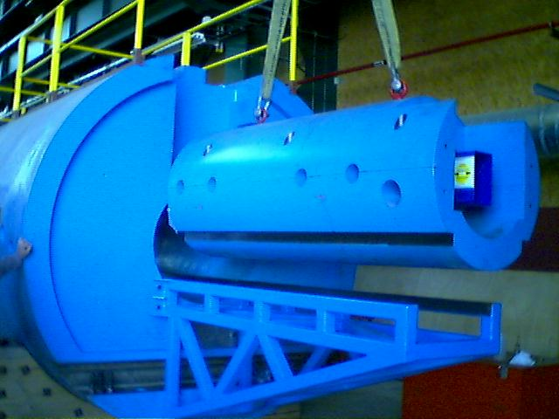
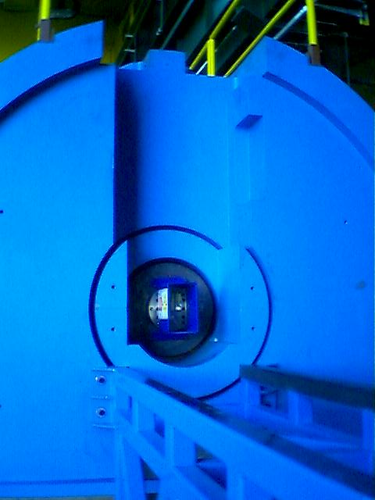
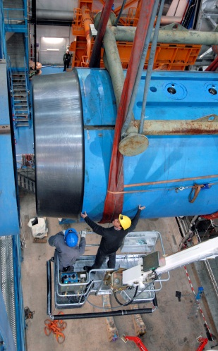
TAS - ATLAS
Location
: inside TX1S shielding
UX15 cavern – top view
UX15 cavern
TX1S
shielding
TX1S
Outer shielding
TAS
cradle
TAS
cradle
TX1S
shielding
TX1S – internal view
TAS and TX1S – installation sequence

Slide 9
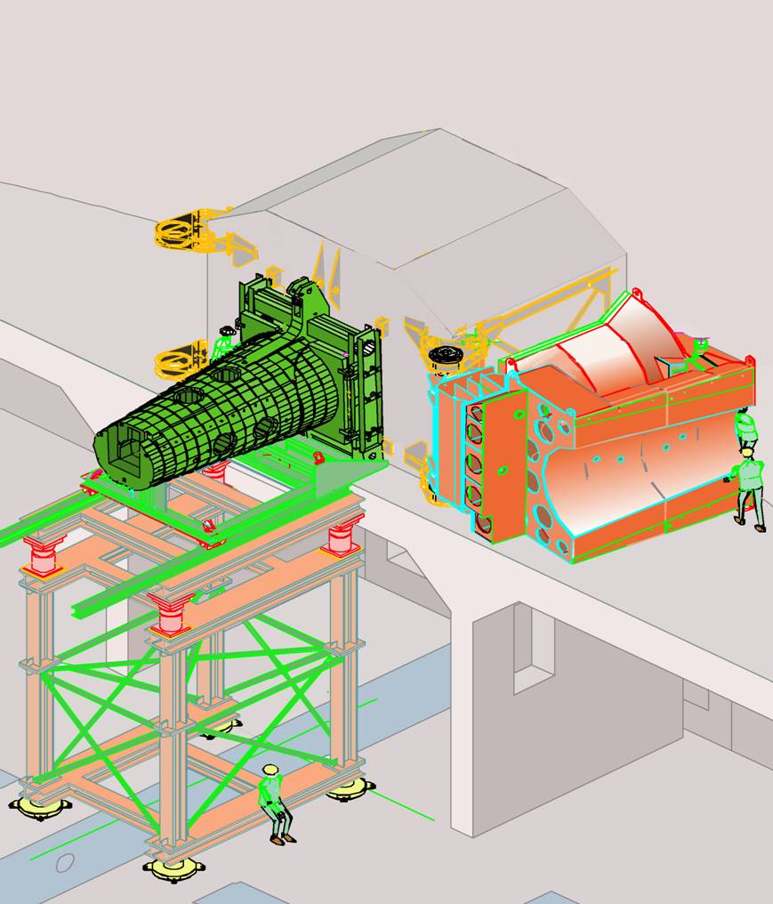
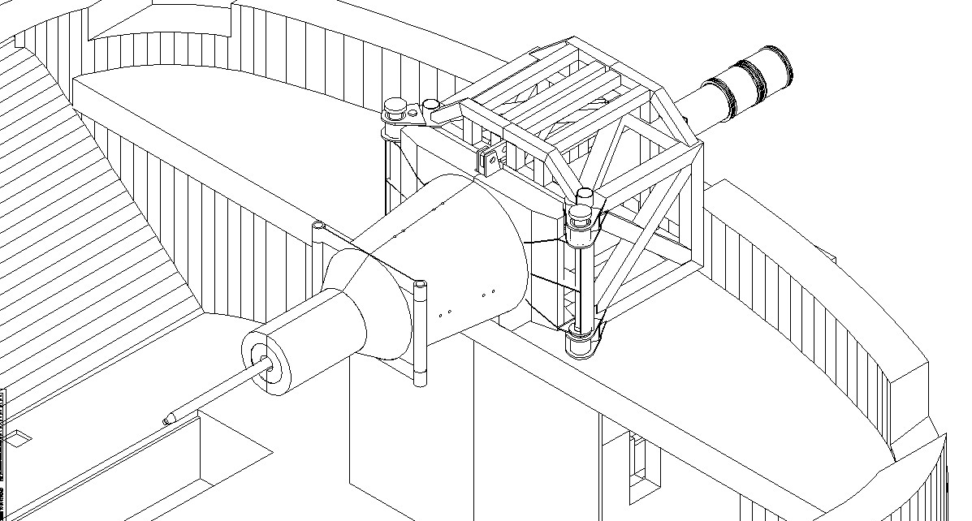
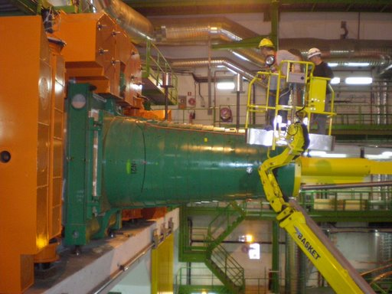
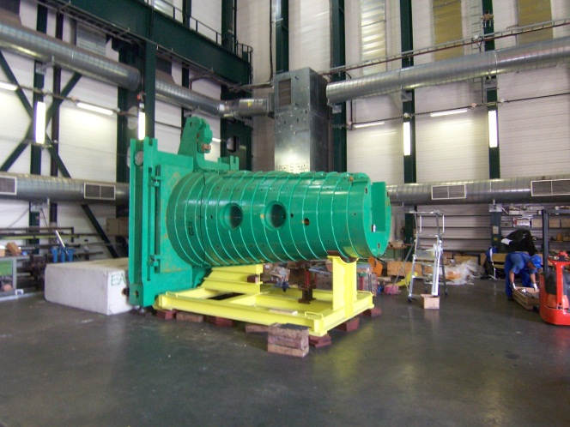
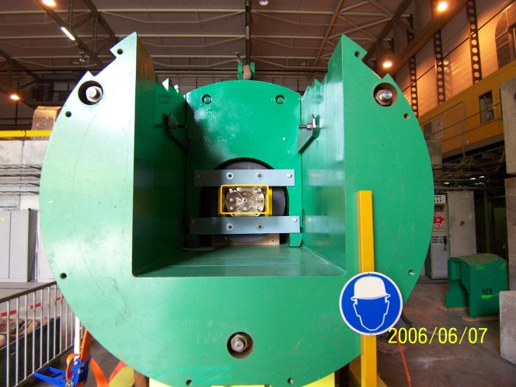
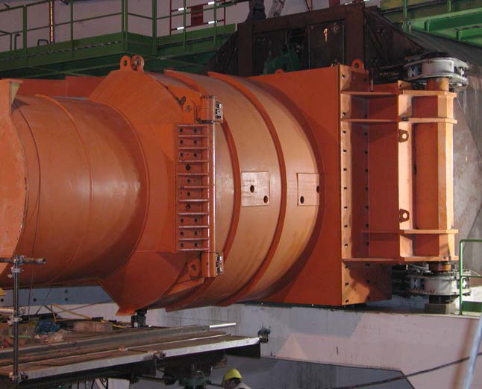
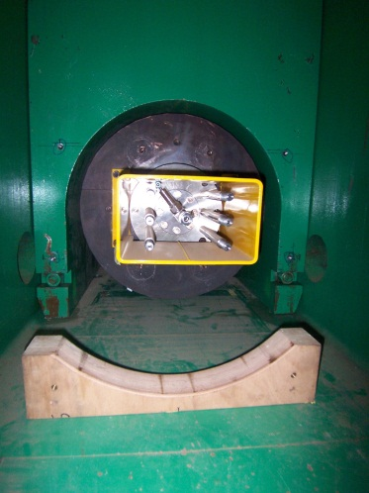
TAS – CMS
Location
: inside the Fixed Iron Nose
Rotating Shielding
Fixed Iron Nose
(FIN)
TAS
inside FIN
UX55 cavern – TAS surrounding
Rotating shielding closed
UX55 cavern – TAS surrounding
Rotating shielding open
TAS
Rotating shielding
FIN
TAS
FIN
FIN
TAS and FIN – installation sequences

Slide 10
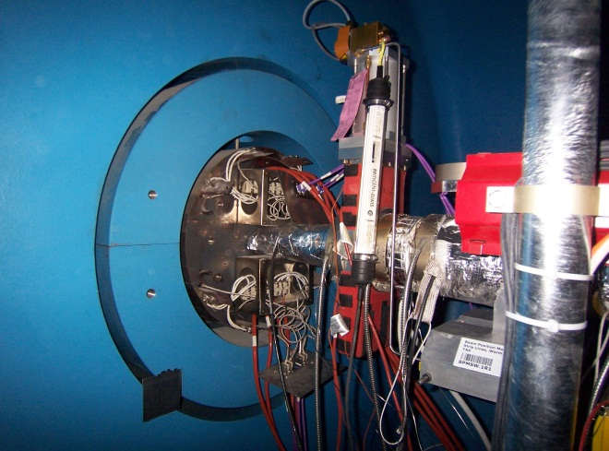
TAS – ATLAS & CMS
Technical issues for removal
RP issues (ALARA)
ATLAS TAS + cradle / CMS TAS + FIN
Weight of each assembly is 10 Tons
handling issues
Services removal (heating/cooling/survey)
TSX1 shielding - view from LSS1 side
Preliminary study by EN/MEF-EBE (F. Butin) (see edms:1254919)
Exit via LHC tunnel:
- might be considered in Pt1 but inner triplets to be dismantled first
- not considered for Pt5 (tunnel vs cavern scenari – ALARA consideration )
Exit via PX shaft (to be coordinated with ATLAS & CMS coordination team)

Slide 11
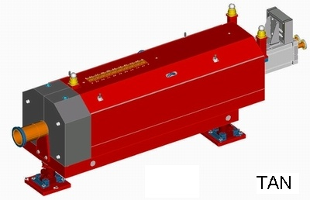
TAN (Target Absorbers Neutrals)
Purpose & technical specificities
Absorbers to protect the SC dipoles D2 and the outer triplet quads (prevent them from quenching)
Four around LHC (one on each side of IP1/5, @ 140m )
Steel and marble, internal beam tube ‘y-chamber’, 29 tons,
In situ vacuum bake-out (strip heaters/ internal thermocouples)

Slide 12
TAN – LSS1/5
Technical issues for removal
RP issues (ALARA)
Weight, dimension
handling issues
TAN study group (since July 2012)
- Monthly meeting to study the issues linked to the TANs removal and define
handling procedure for removal/displacement
- Participants: EN/HE, RP, EN/MEF
- Chairman: S. Evrard (EN/MEF-EBE)

Slide 13
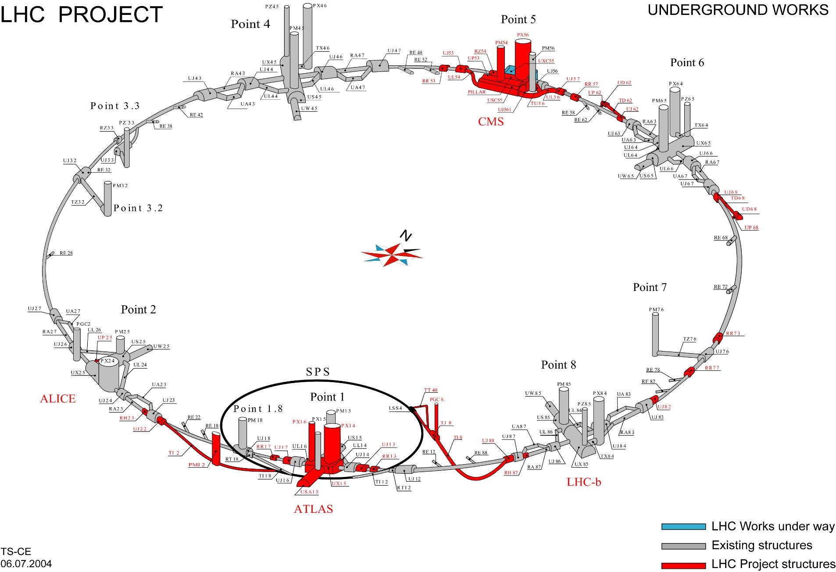
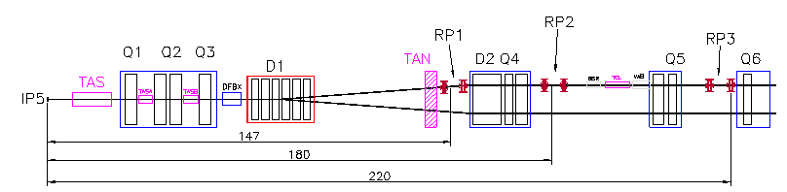
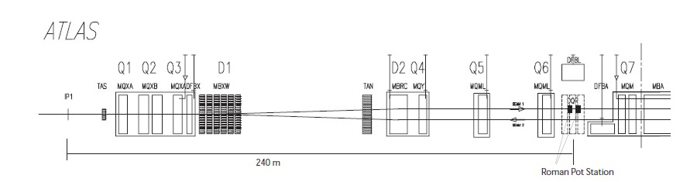

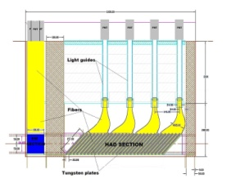
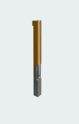
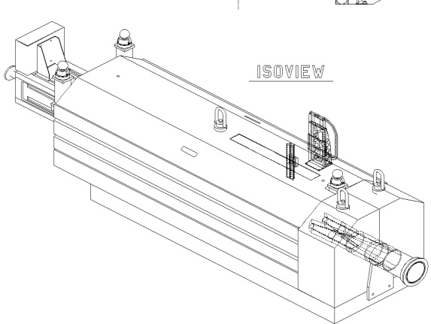

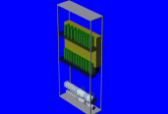
LHC forward detectors
LTEX
Point 4
Point 5
Point 6
Point 3.3
CMS
TOTEM Roman Pots around IP5
CMS ZDC, CMS FSC
BRAN, TOTEM
Point 3.2
Point 2
BRAN,
ALICE ZDC
LHCf, BRAN,
ATLAS ZDC, ALFA
Point 7
Detector
Secondary Vacuum
Bellow
Point 8
Thin window
ALICE
Point 1
Beam
Primary Vacuum
LHC-b
Vacuum Chamber
ATLAS
CMS ZDC
ATLAS Roman Pots (ALFA) around IP1
ATLAS ZDC
ECAL
BRAN
HCAL
BRAN
LHCf
Roman pots
TAN detectors
Point 1
TAN detectors
Point 5

Slide 14
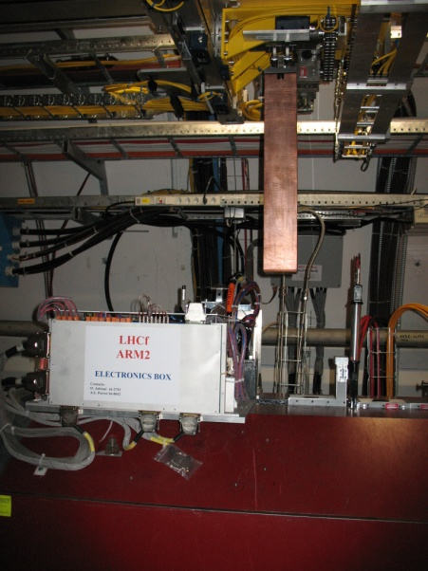
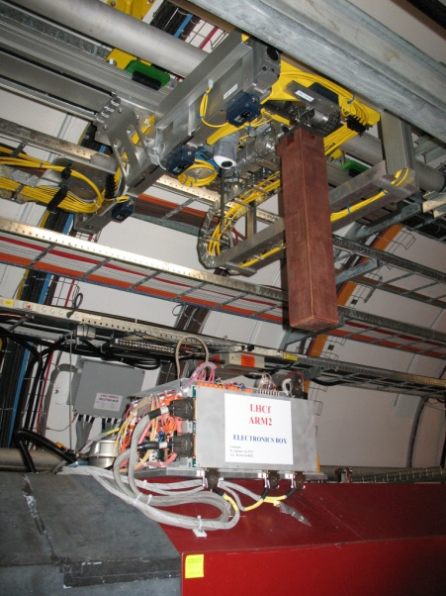
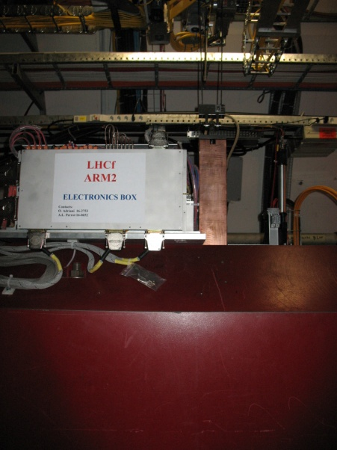
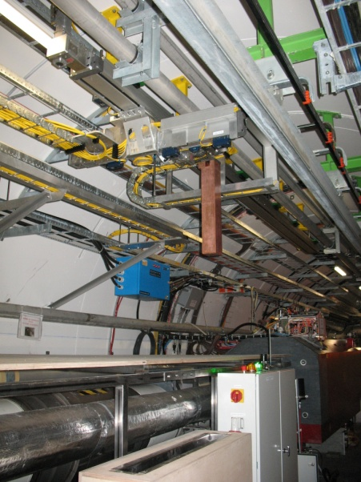
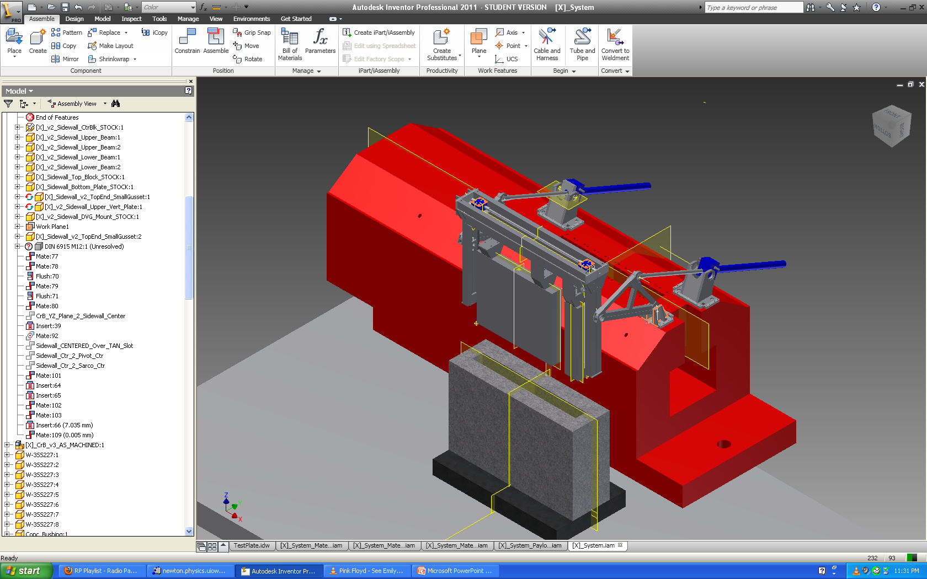
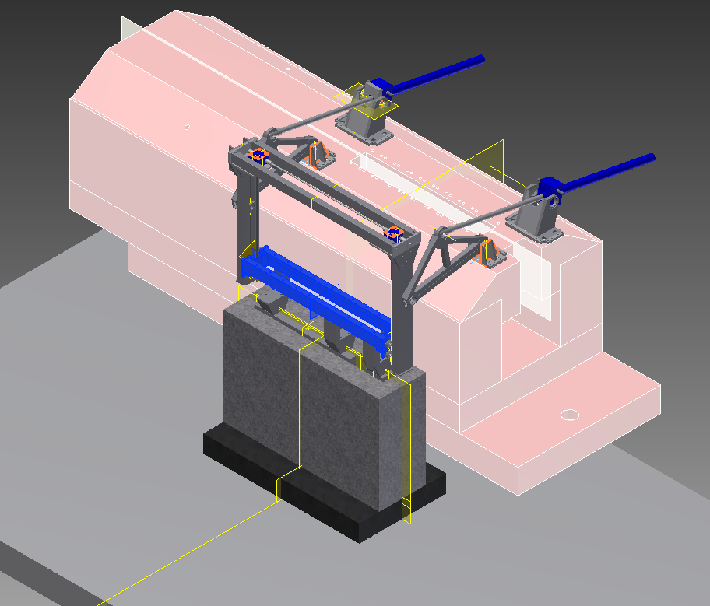
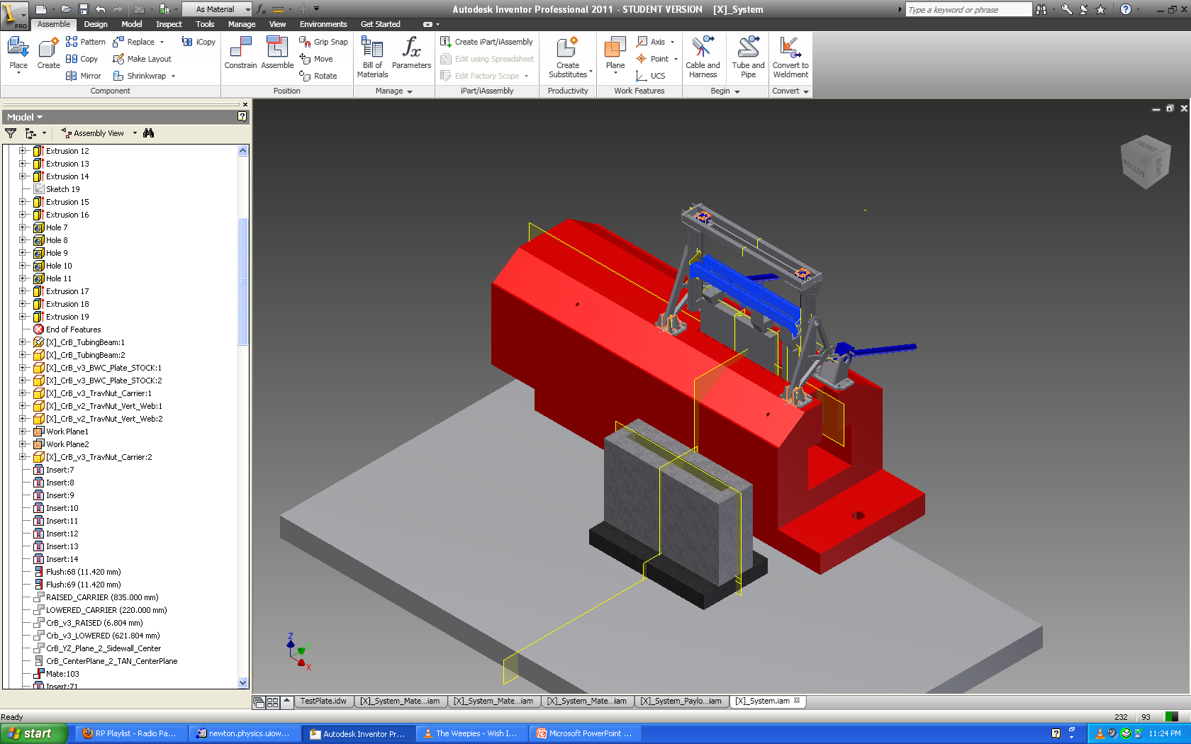
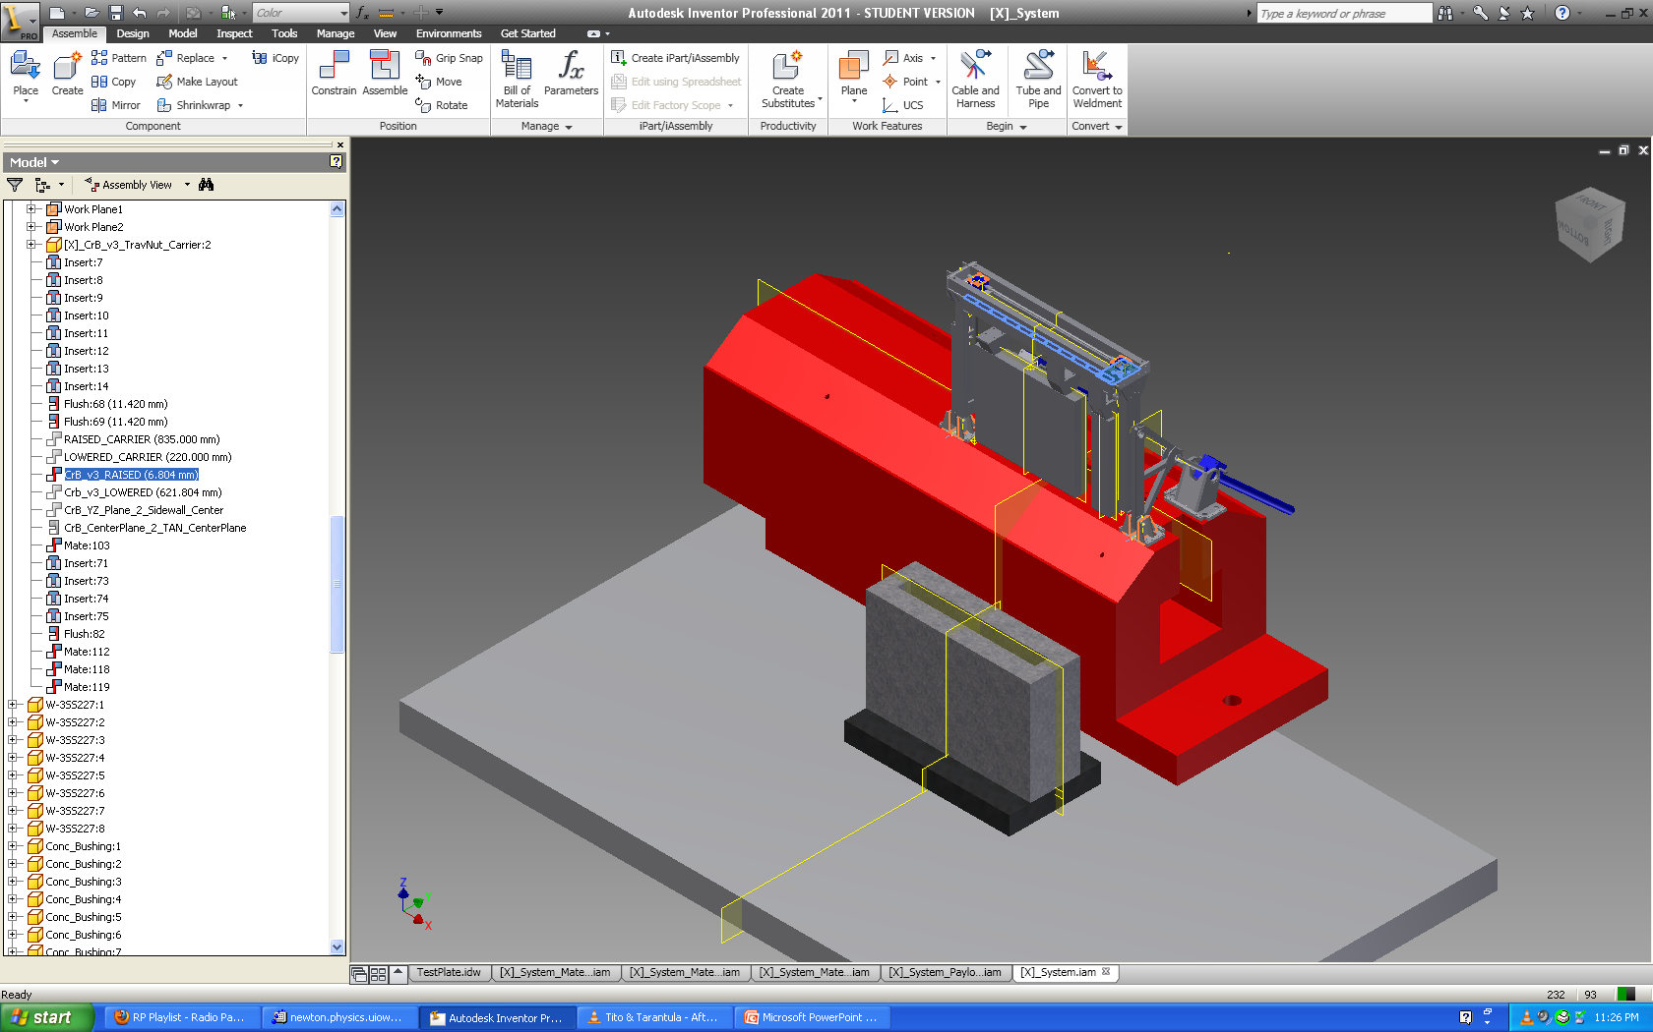
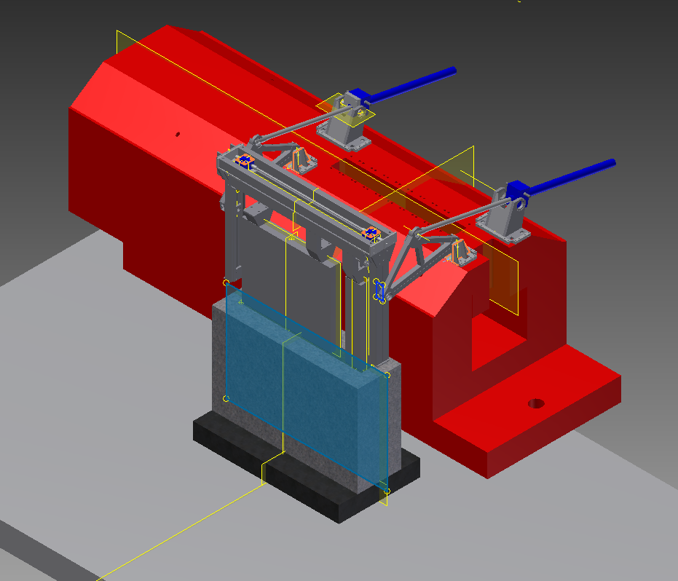
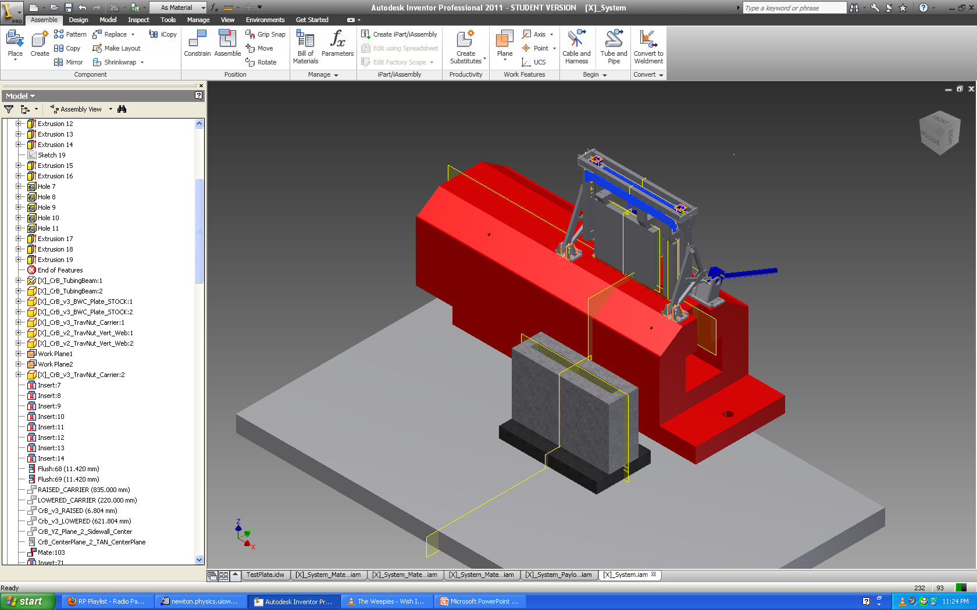
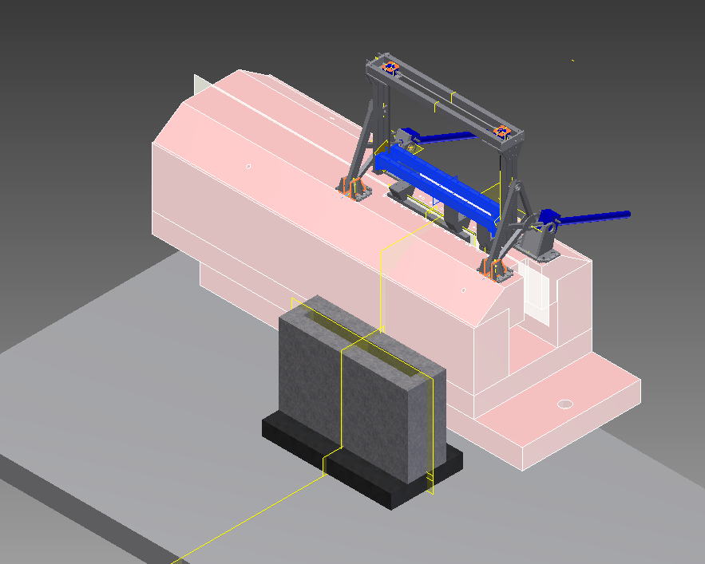
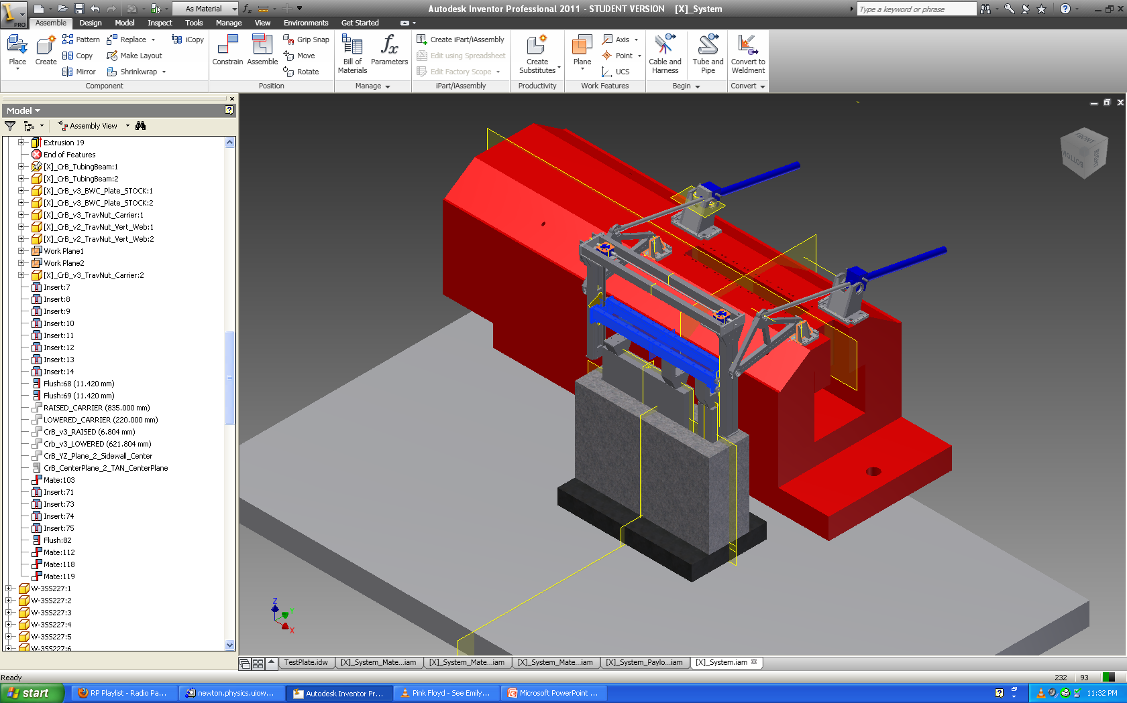
LHC forward detectors in TAN
LTEX
Removal procedure
Point 5 remote handling system
Under construction
Installation foreseen during LS1
Point 1 remote handling system
Installed in March 2009

Slide 15
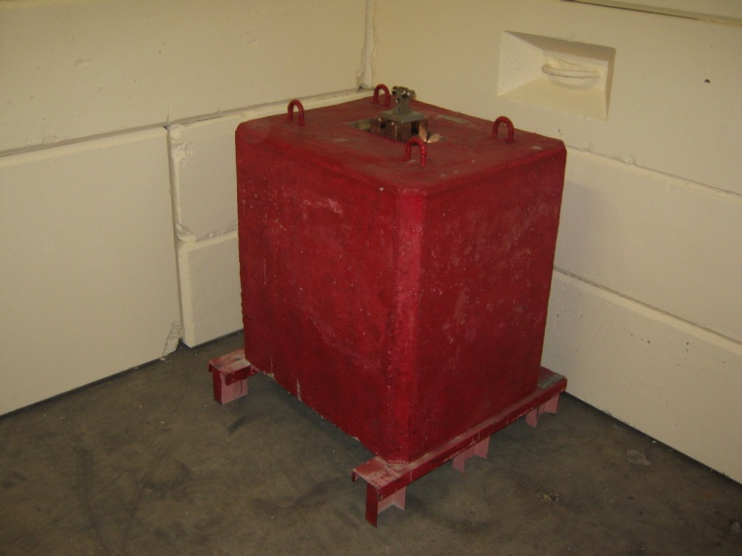
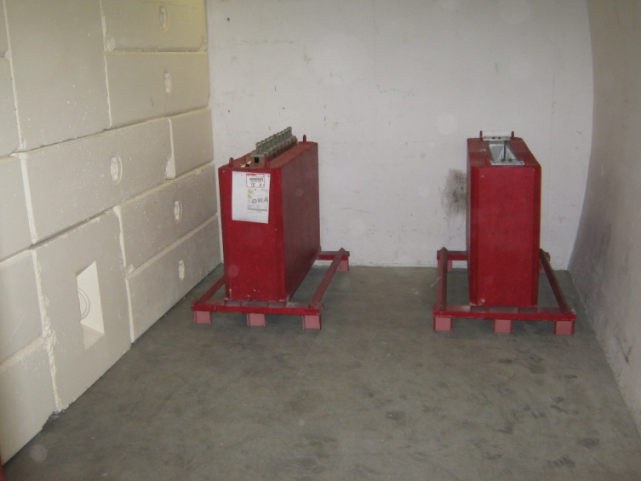
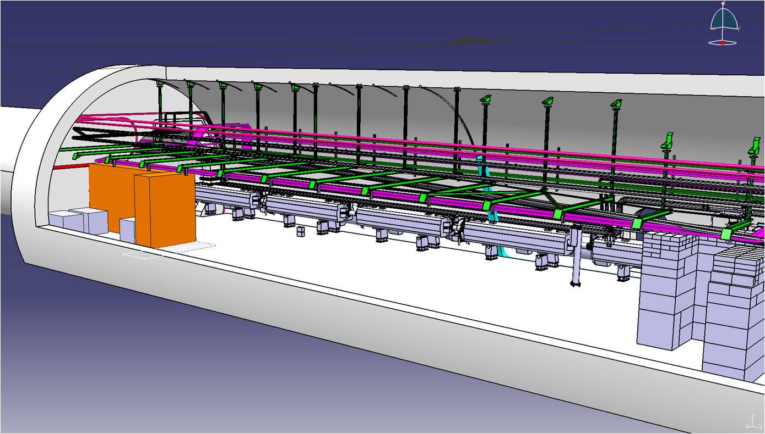
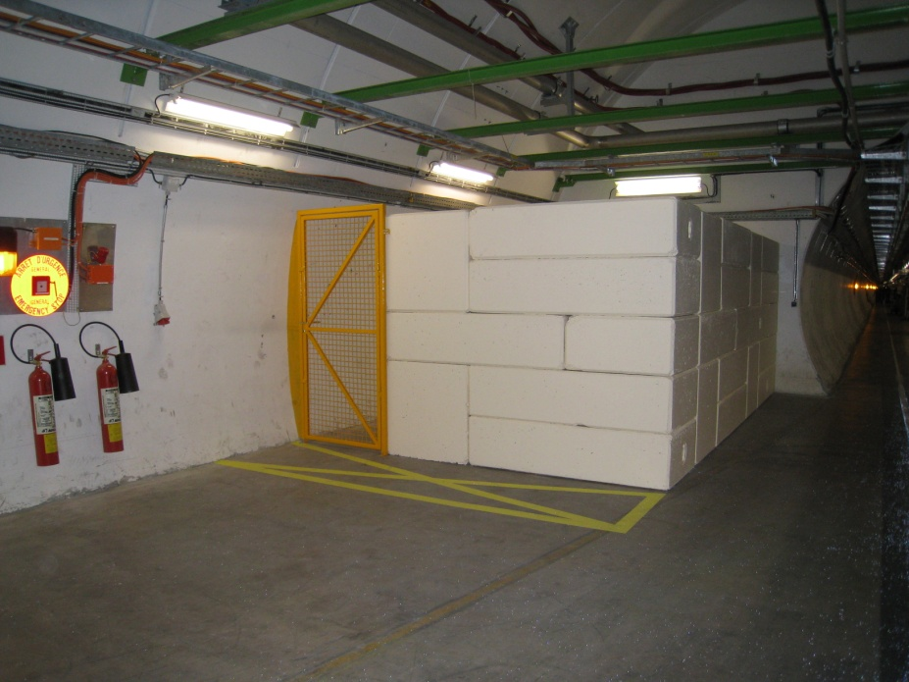
LHC forward detectors in TAN
LTEX
Underground storage
Dedicated sarcophaghi for forward detectors transport and storage
Storage bunkers in UJs around Pts1/5
If needed transport to surface via PMs

Slide 16
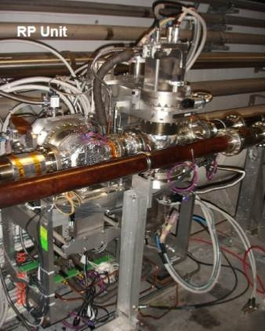
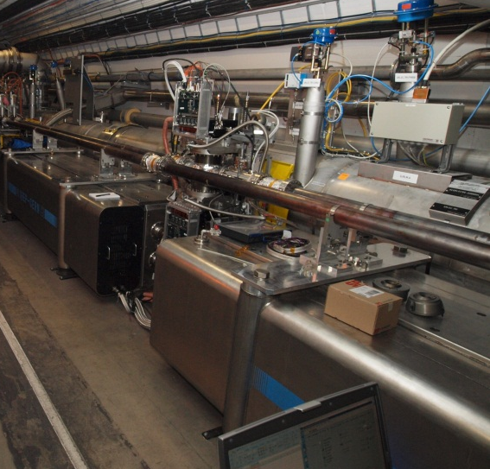
LHC forward detectors – TOTEM & ALFA
LTEX
Removal issues
Detectors in secondary vacuum
Pots in primary vacuum
break the vacuum to remove the pots
Associate local services to be removed
TOTEM roman pots
RP issues to be considered
Removal of TOTEM 147 m station during LS1
ALFA roman pots

Slide 17
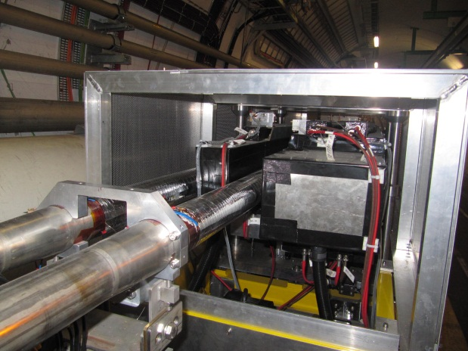
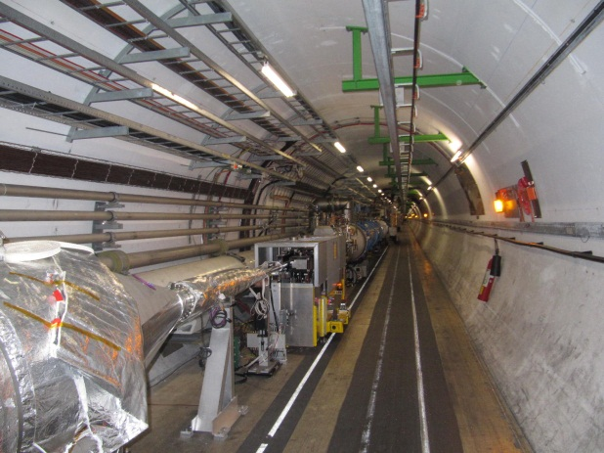
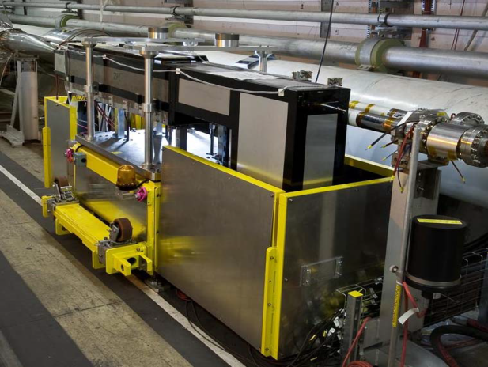
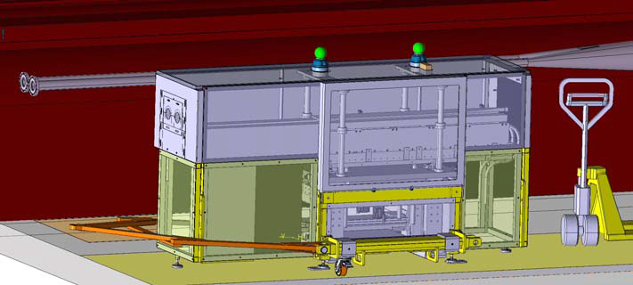
LHC forward detectors – ALICE ZDC
LTEX
Removal procedure
ZDC detectors installed on a movable platform
Designed to allow removal without breaking vacuum
ALICE ZDC platform & detectors
First full temporary removal during LS1
ALICE ZDC platform & detectors

Slide 18
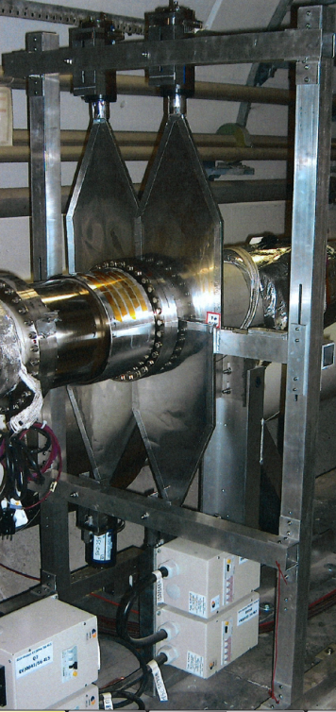
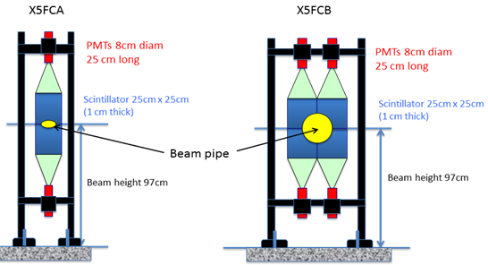
LHC forward detectors – CMS FSC
LTEX
Removal procedure
Scintillators located around the beam pipe
No special issues foreseen
CMS FSC station 3

Slide 19
Summary
TAS, TAN, Forward Detectors in LSS: location at the end of LS1 & technical specificities
Review the technical issues to remove TAS, TAN, FD
TAN removal: study group chaired by EN/MEF- EBE since July 2012
TAS removal: preliminary study by EN/MEF - EBE
Forward detectors removal: studies by LTEX working group chaired by EN/MEF- LE

Slide 20
Addendum

Slide 21
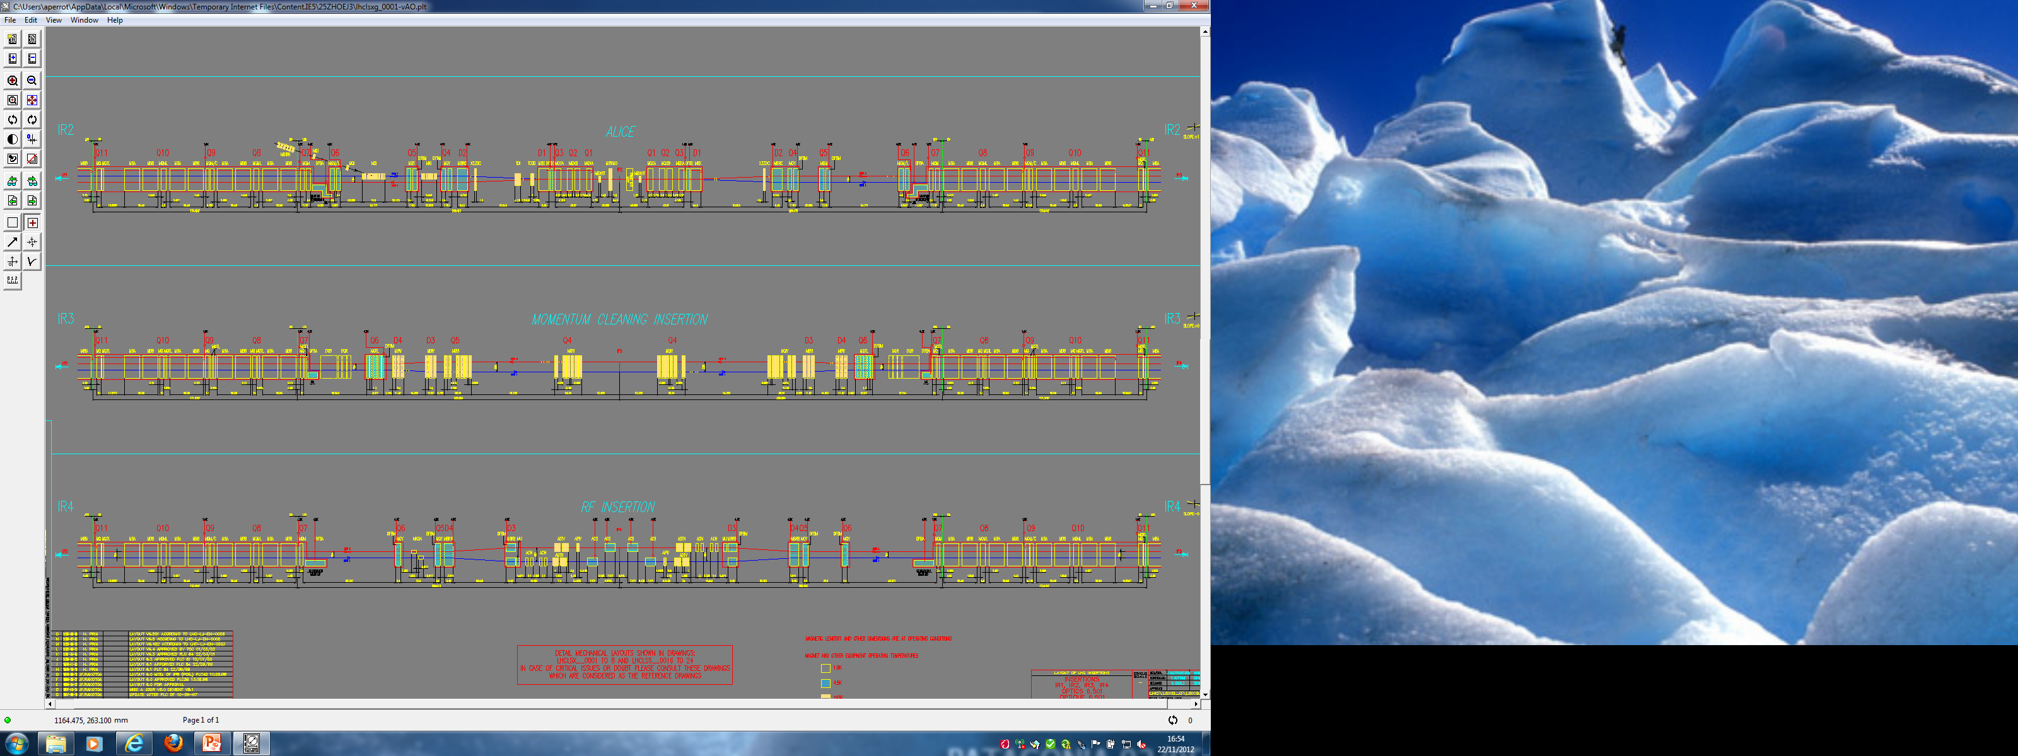
LSS layout at the end of LS1
LSS3

Slide 22
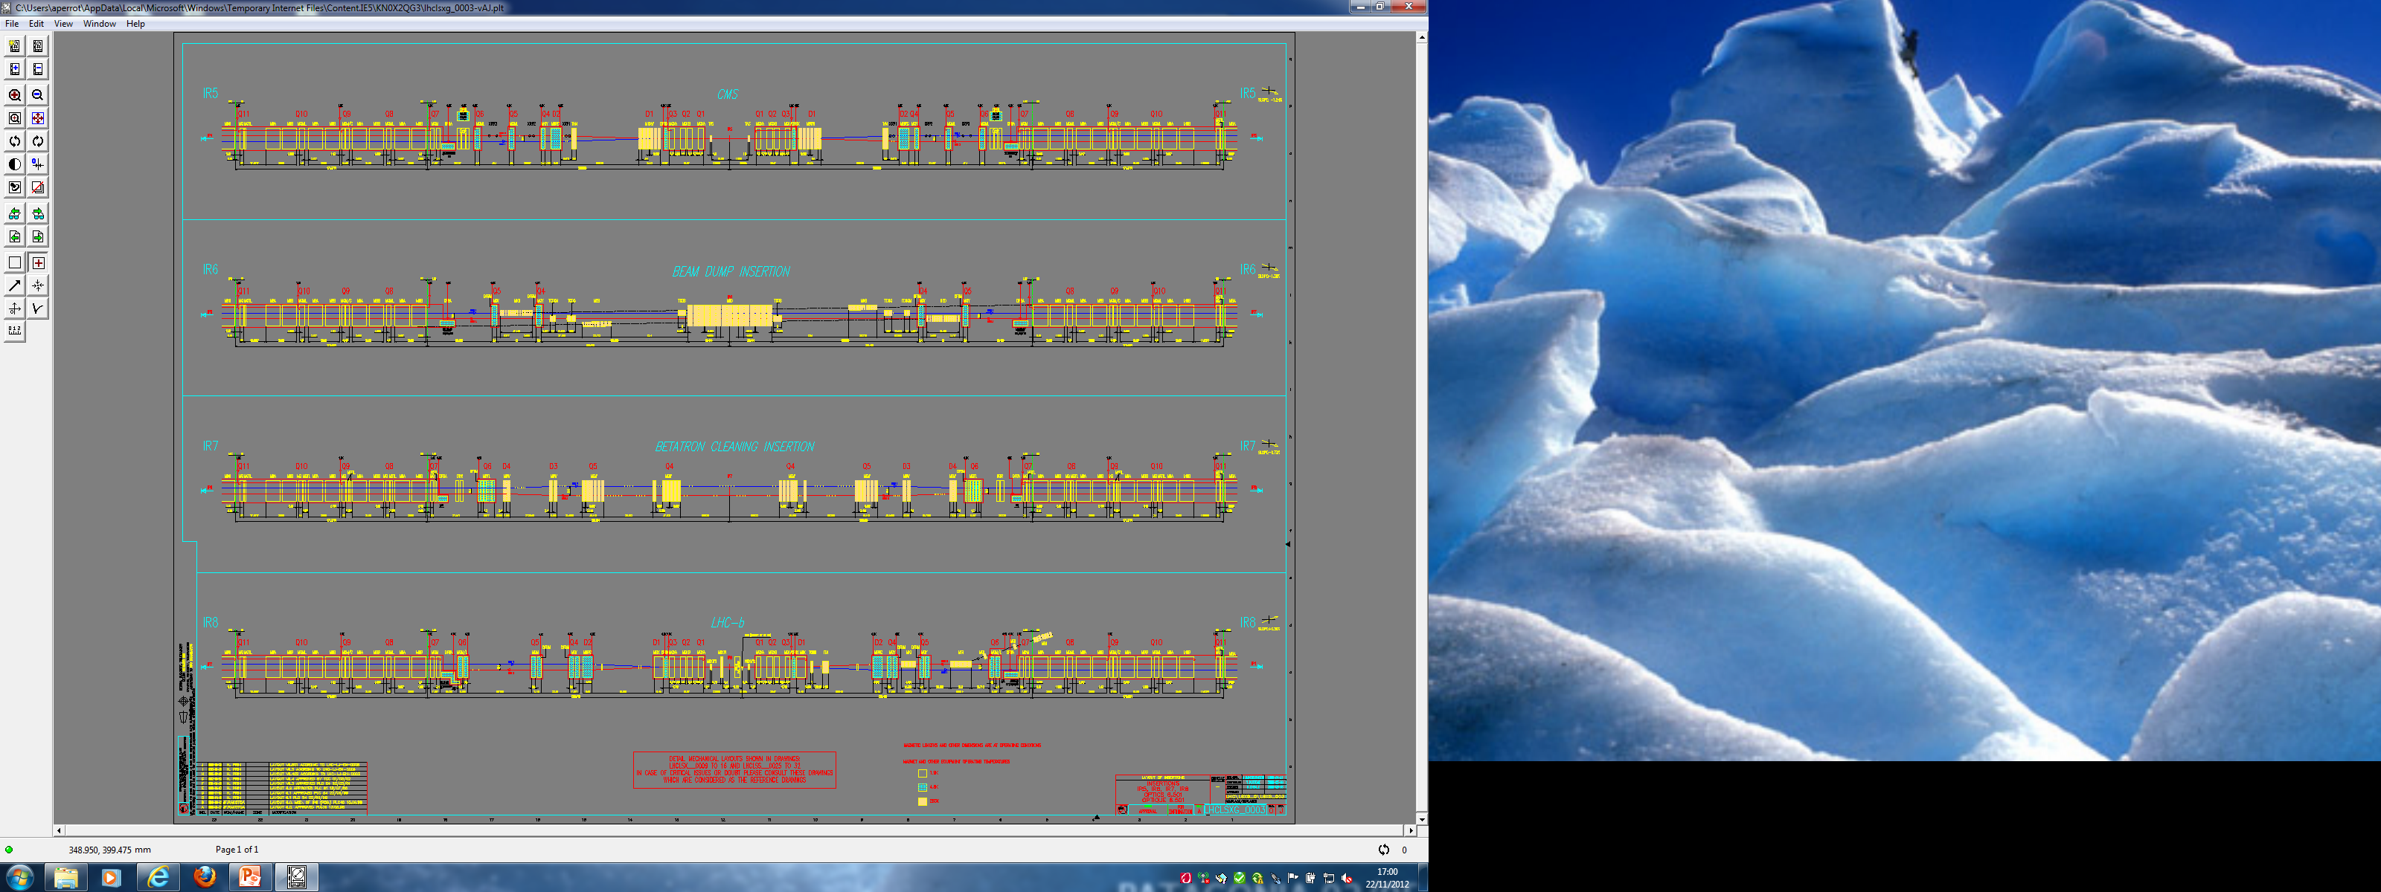
LSS layout at the end of LS1
LSS7

Slide 23
LSS layout at the end of LS1
LSS8

Slide 24

UJ14
Alimentation TAS
Clarinette à réaliser sur place
29/11/2012
jean-marc.bianco@cern.ch

