Slide 1
Forward Detectors after LS2 (TOTEM) 1st WP8 Workshop on Collider-Experiment Interface
J.Baechler for TOTEM 30 November 2012

Slide 2
Remarks
This presentation refers to the TOTEM physics program at high β*, special runs and p-A. The detectors necessary to perform this program are outlined.
Possible additional detectors in the region of +/- 200m from IP5, that are presently discussed in the framework of “detector upgrade studies” by TOTEM in collaboration with CMS (related to diffractive physics at low β* and high luminosities), are not addressed in this presentation.

Slide 3
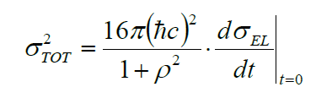
Main goals of TOTEM experiment
- Measurement of total cross section
Forward multiplicity
Diffractive physics (soft& hard diffraction, jets)
TOTEM detectors integrated in CMS (T1, T2)
TOTEM detectors integrated in LHC (RP)
Using luminosity from CMS
Luminosity independent
ρ parameter from compete fit
TOTEM physics program:
TOTEM (stand alone) & TOTEM+CMS

Slide 4
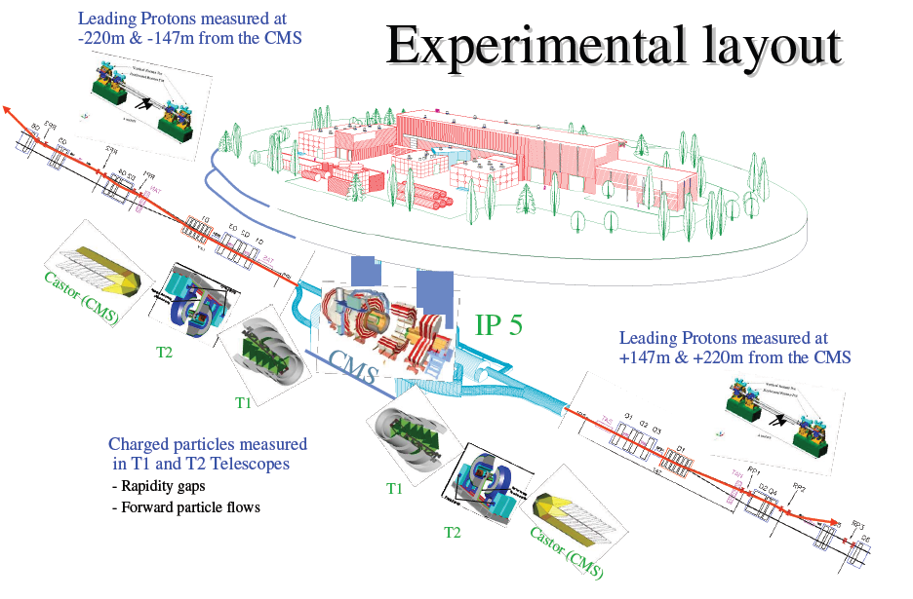

Slide 5
Present RP installation at IP5
TOTEM RP-147m (near-far)
TOTEM RP-220m (near-far)
Near 2 vertical RP top/bottom 1 horizontal RP
Far 2 vertical RP top/bottom 1 horizontal RP
Near 2 vertical RP top/bottom 1 horizontal RP
Far
2 vertical RP top/bottom
1 horizontal RP
outgoing
beam
Q6
~ 1.5 m
~ 5m
CMS ip5 ~ 220 m

Slide 6
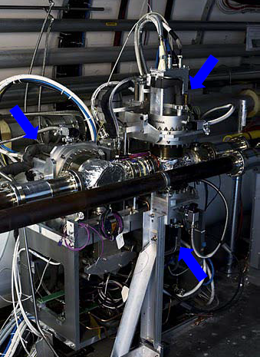
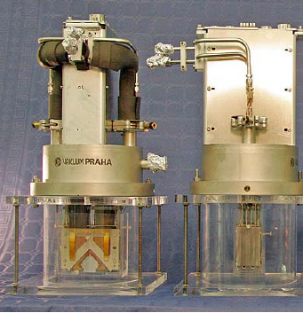
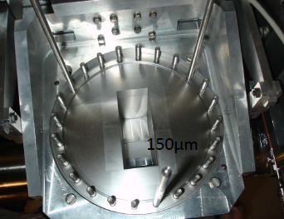
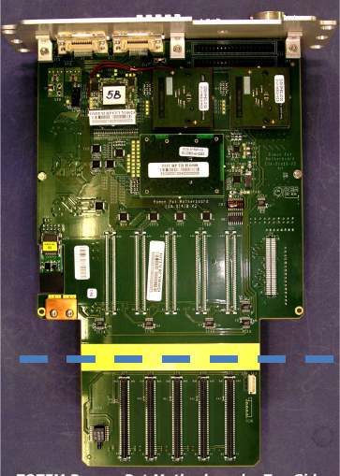
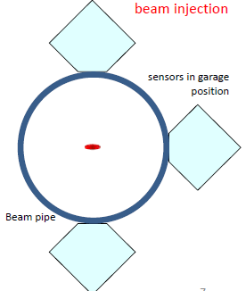
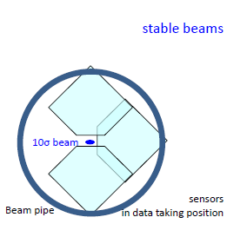
TOTEM Roman Pots installed at LHC
Roman Pot unit
with
motor system (step size: 5 µm)
Separation
of high LHC vacuum
from detector vacuum
Secondary vacuum ~ 20mbar Temp : -25 ⁰C
LHC beam-pipe
Roman Pot
parking position
Roman Pot data taking position
RP mother board: interface Si- detectors to outside world: Signal, Trigger,HV,LV
Hosts Radmon sensor and PT 100
RP detector package
RP mother board

Slide 7
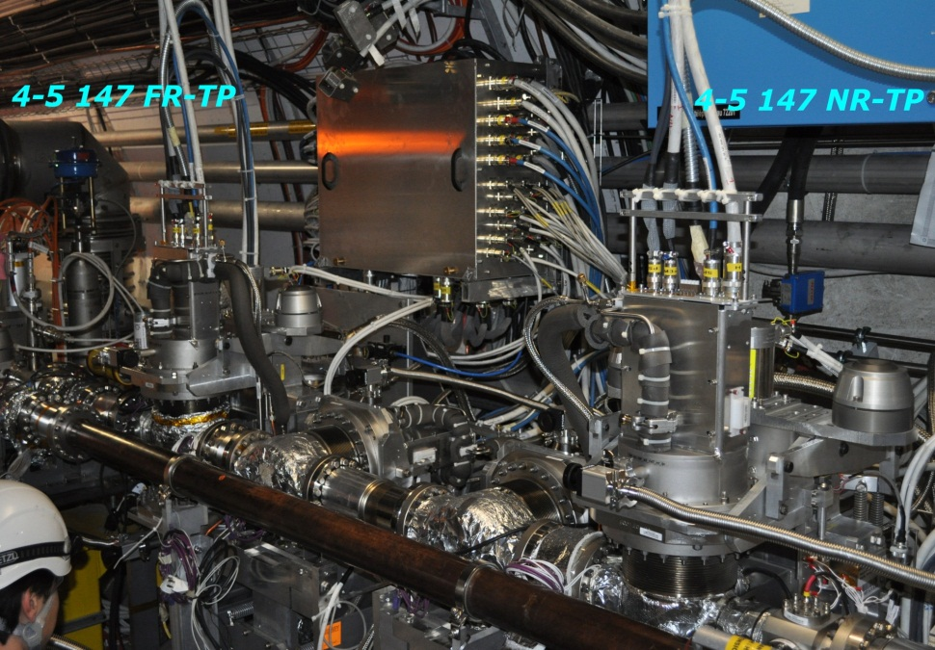
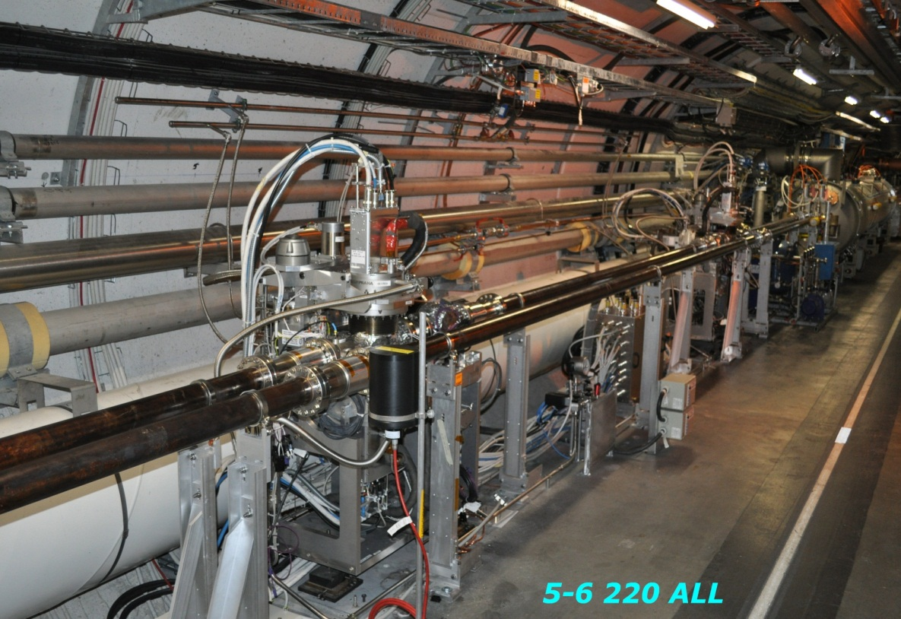
Roman Pot at 147m & 220m
patch panel
RP 220m
RP 147m

Slide 8
TOTEM
Research Board approved stand alone program of TOTEM at full LHC energy
During LS1 the detectors are prepared for the new phase of LHC after LS1 -> Roman Pots Removal of RP +/- 147m during LS1 & adaptation of detector packages to serve as spare detectors for RP +/-220m stations

Slide 9
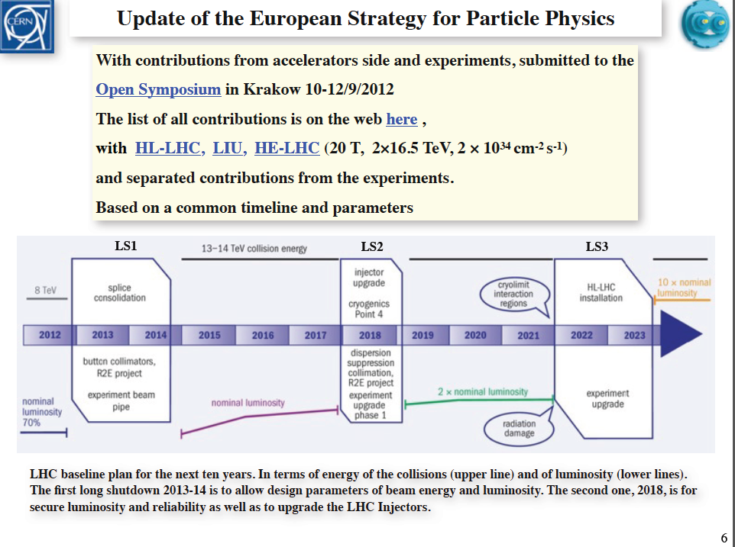
Water cooled cables
Water cooled cables

Slide 10
Summary
The RP detector systems at +/-220m will be used for the TOTEM stand alone physics program after LS1&LS2. (removal of RP147m during LS1)
The expected integrated radiation dose will allow RP operation after LS2 in possible special runs at high β*. (reserve by spare detector packages from RP147m)

Slide 11
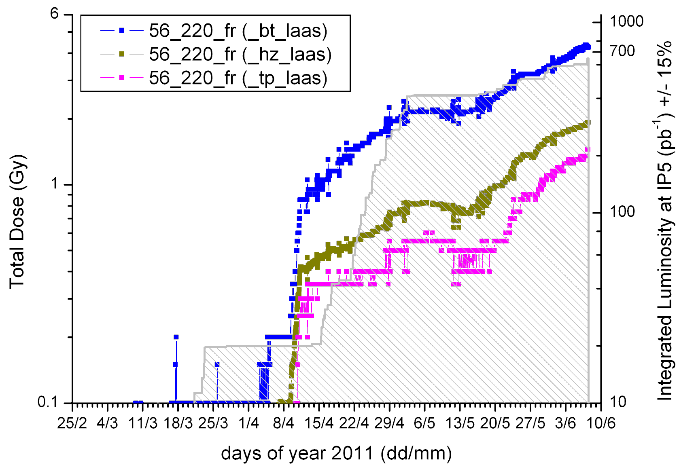
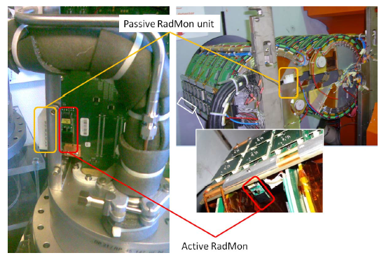
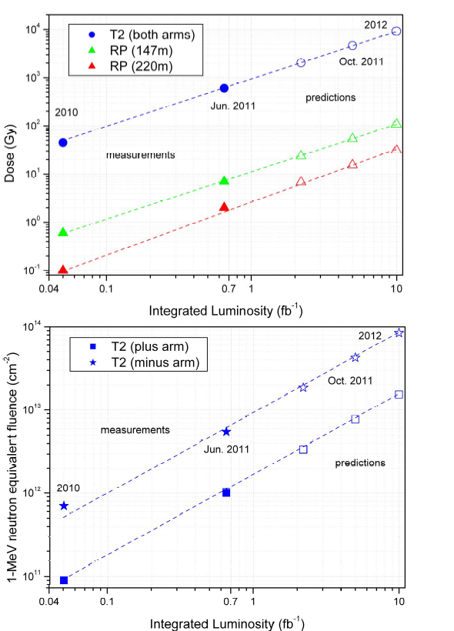
Radiation load on TOTEM detectors
Active and passive RadMon sensors mounted on RP – T1 – T2 detector
for TID and NIEL measurement
T2
RP

