Slide 1

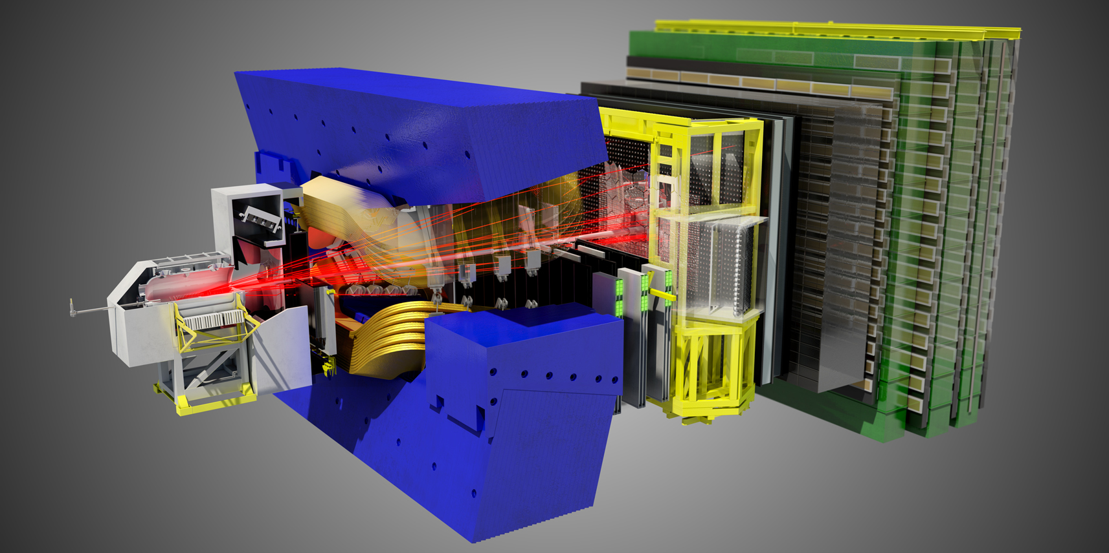
Layout change request from LHCb,
In view of the LHCb upgrade
On behalf of the LHCb collaboration

Slide 2
The importance of the LHCb upgrade:
Extrapolating the luminosity recorded so far, LHCb will collect ~ 7/fb by the end of 2017.
In order to reach ultimate theory precision in flavor variables more statistics has to be collected.
The current LHCb limitation is given by the read out capability (1 MHz) and LHCb can not profit of an increase in instantaneous luminosity.
Therefore, LHCb proposed an upgrade with
40 MHz readout
Full software trigger (better yields for charm and hadronic triggers),
Instantaneous L up to 2 *10³³ cm⁻²s⁻¹ collecting 50/fb, starting in 2019,
Bunch spacing of 25ns to limit the pile-up at the higher luminosity
→ Increase in yields: x10 in muonic channels x20 in hadronic channels

Slide 3


The steps towards the LHCb upgrade:
• March 2011, “Letter of Intent for the LHCb Upgrade” submitted to LHCC
→ Endorsement of physics case.
• June 2011 → LHCC endorses the LOI, green light for TDR preparation
• June 2012, Submission of “Framework TDR for the LHCb Upgrade”
• September 2012 → LHCC fully endorsed the FTDR
• October 2012, Presentation of
“Framework TDR” and
“Addendum to MoU for the Common Items of the LHCb Upgrade”
to RRB and to Funding Agencies
• Fall 2013, Submission of LHCb subsystems sub-system TDRs to LHCC
The installation of the LHCb upgrade is scheduled for 2018/19 and will be a one phase upgrade.
LHCb will profit of LS1 and any other longer technical stop or shut-down before LS2 to prepare for the upgrade installation.

Slide 4
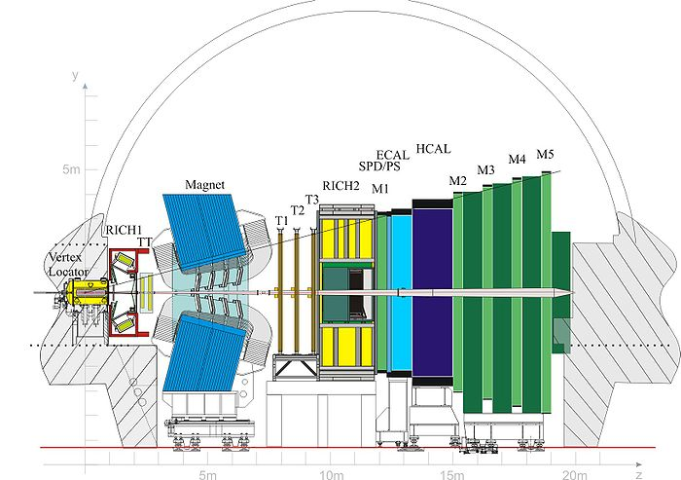
LHCb detector upgrade
Silicon Trackers
Si Strips
(replace all)
Outer Trackers Straw tubes
(replace R/O)
Calo PMTs
(Reduce PMTs gain+ replace R/O)
VELO
Si Strips
(replace all)
Muon MWPC
(almost compatible)
Or Scintillating Fibre Central Tracker
RICH HPDs
(replace HPDs
+ R/O)

Slide 5
What are the requirements
After Long Shut down 2
The LHCb upgrade is based on 25ns bunch crossing!
We will run at an instantaneous luminosity of L up to 2 *10³³ .
Collecting 50 fb ⁻¹ over up to ten years of data taking.
LHCb operational luminosity, leveling
  Separation leveling
  Squeeze (β*) leveling; preferred one.
From discussion with the HL-LHC group, no show-stoppers to operate LHCb at HL-LHC:
Optics compatible with the requirements for ATLAS&CMS (β*0.1m) and the LHCb upgrade (β*3.5m) have been developed.

Slide 6
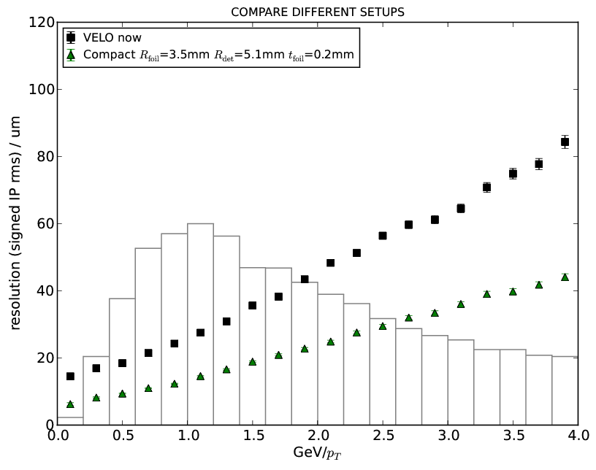
What are the requests to HL LHC
VELO, aperture
LHCb has requested to reduce the aperture of the VELO (Vertex Locator)
Moving the VELO closer to the beam line will clearly improve the IP resolution.
Even if it is only the RF foil that moves closer.
Si guard ring ~ 0.5 mm
Gap ~0.5 mm
RF foil thickness
~0.2-0.3 mm
Impact on machine aperture
Nominal beam axis
Aim: Si radius (active area) ~ 5.1 mm
Requires R_{min} of at most ~3.5 mm

Slide 7
What are the requests to HL LHC
VELO, aperture
When (re)designing the VELO detector, several aspects of the machine interface must be taken into account.
Most obvious ones:
RF effects:
  impedance (long. and transv.)
  heat dissipation
  pick-up
Aperture (in close VELO position):
  take into account range of β*, ε_{T} , α_{crossing}, bunch charges , etc.
Dynamic vacuum effects:
  ion bombardment
  electron multipacting
  synchrotron radiation

Slide 8
What are the requests to HL LHC
VELO, aperture
This request was presented to the LHC-Experiment Beampipe (LEB) working group
Proposal discussed at the LEB working group
  21st LEB meeting, 19 July 2012 https://indico.cern.ch/conferenceDisplay.py?confId=198975
  22nd LEB meeting, 10 Sep 2012 https://indico.cern.ch/conferenceDisplay.py?confId=204787
  23rd LEB meeting, 8 oct 2012 http://indico.cern.ch/conferenceDisplay.py?confId=209136
  24th LEB meeting, 26 oct 2012 http://indico.cern.ch/conferenceDisplay.py?confId=212405
Presented this also to the “Parameter and Layout Committee” (HL-LC) on 25 September 2012
Get LMC (LHC Machine Committee) approval
  Will be presented on 12 December

Slide 9

What are the requests to HL LHC
Beam Pipe
As with the VELO, the machine, as LHCb, have better knowledge of the beam position stability/reproducibility , which are much better than conservatively assumed up till 2010.
For the Trigger Tracker there is still a lack of sensitivity due to the present inner acceptance. A smaller beam pipe diameter and closer distance to the beam pipe is preferable.
The area between VELO and magnet might change considerable due to a new detector layout in this region.
A re-design of the first section of the LHCb beam pipe will be required.
Discussions with LEB are in full swing and this issue will be pursued further.
  At present we are discussing a reduction to a diameter to 40mm in the region of Trigger Tracker.
IP
VELO
UX85/1
TT

Slide 10
TAS, Target Secondaries Absorber
A dedicated meeting had been set up by Lucio Rossi and studies were presented by F. Cerrutti et al. of a TAS in front of the triplets of IP8 with LHCb running at a luminosity of L= 2 10³³ cm⁻² s⁻¹
As a conclusion form this meeting:
Given the data and the discussion it is clear that a TAS is not needed for a luminosity of 2 10³³ cm-2 s-1 in IP 8.
Variation of the safety factor depending on the kind of leveling is still under investigation.
Previous discussions with Markus Brugger for R2E indicated that new relocation (of equipment) already planned by R2E project for LS1 should be sufficient for the radiation level expected in Poin8 during the LHCb upgrade run.

Slide 11
What are the requests to HL LHC
Crossing angle at IP8
LHCb needs to run with both magnet polarities to reduce systematic uncertainties.
With 25 ns bunch spacing and the negative polarity of the LHCb spectrometer magnet, a vertical external crossing angle is mandatory.
Vertical external crossing angle
  External crossing angle decoupled from dipole polarity
  Absolute value of effective crossing angle independent of dipole polarity
Helps to reduce further systematic uncertainties.
At present the beam-screen in the inner triplet is horizontally.
An important parameter is the aperture at injection in point 8.
A measurement has been done during this week`s MD.
Results are important to decide on the orientation of the beam-screen to avoid the rotation of the crossing plane at flat top, before the squeeze.

Slide 12
LHCb is grateful for the help and fantastic support by BE, TE and EN
TE-VSC, with special thanks to Mark Gallilee, Giulia Lanza
BE-ABP, with special thanks to Bernhard Holzer, Massimo Giovannozzi, Benoit Salvant, S. Fartoukh, W. Herr
EN-STI, with special thanks to F. Cerutti, L. Esposito,
Machine coordinator/supervisor team, with special thanks to M. Lamont, J. Wenninger, G. Arduini, E. Holzer, J. Uythoven
… and not to forget the MD crew.

Slide 13
END

