Slide 1
Task2.2 HL-LHC Optics and Lattice Configurations
Bernhard Holzer
for the WP2, Task2.2 Team
B. Dalena, A. Bogomyagkov, R. Appleby, A. Fauss-Golfe, J. Payet, A. Chance’, K. Hock, M. Korostelev, R. deMaria, J. Resta, C. Milardi, L. Thompson, M. Thomas, A. Wolski

Slide 2
“ ... and do not show too many of this strange
zig zag plots “

Slide 3
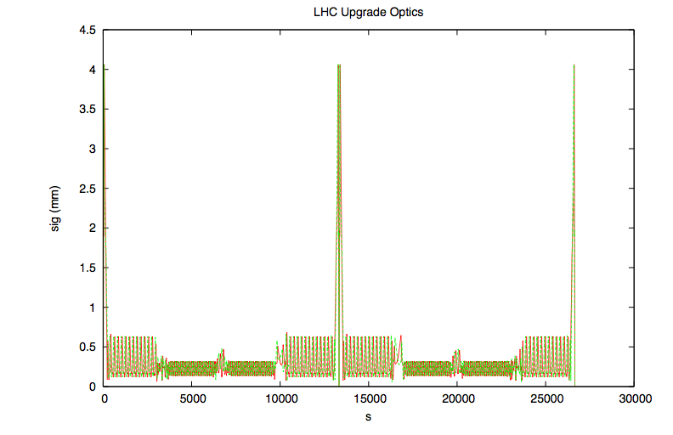
Luminosity & Beam Optics
The HL-LHC Lattice & Optics has to establish β* at IP1 & 5 to reach a
“virtual luminosity”
to small for the IR1 / 5
matching section
squeeze starts at neighboring
sectors (“ATS”) .
-> gentle premonition:
the lattice modifications used to optimise for smallest β*
might not be adequate for β = 500...1000m
IP8
IP1
IP2
Notes:
3

Slide 4
HL-LHC Parameter List
Parameter | nominal​ | 25ns​ | 50ns
N_{b} | 1.15E+11 | ​2.20E+11 | ​3.50E+11
n_{b} | ​2808 | ​2808 | ​1404
N_{tot} | 3.2E+14 | 6.2E+14 | 4.9E+14
beam current [A] | ​0.58 | 1.12 | 0.89
x-ing angle [mrad]​ | 300 | 590 | 590
beam separation [σ] | 9.9 | 12.5 | 11.4
β* [m] | 0.55 | ​0.15 | ​0.15
ε_{n} [μm]​ | 3.75 | ​2.50 | 3
ε_{L} [eVs]​ | 2.51 | ​2.51 | ​2.51
energy spread​ | ​1.20E-04 | ​1.20E-04 | ​1.20E-04
bunch length [m] | ​7.50E-02 | ​7.50E-02 | ​7.50E-02
IBS horizontal [h] | ​80 -> 106 | 18.5 | 17.2
IBS longitudinal [h] | 61 -> 60 | 20.4 | 16.1
Piwinski parameter | ​0.68 | 3.12 | 2.85
geom. Reduction factor 'R' | ​0.83 | ​0.305 | 0.331
beam-beam / IP without Crab Cavity | 3.10E-03 | ​3.28E-03 | 4.72E-03
beam-beam / IP with Crab cavity | 3.75E-03 | 1.08E-02 | 1.43E-02
Peak Luminosity without leveling [cm⁻² s⁻¹] | 1.0E+34 | 7.4E+34 | 8.5E+34
Virtual Luminosity: Lpeak/R [cm⁻² s⁻¹] | 1.2E+34 | 24E+34 | 26E+34
Events / crossing without leveling | ​19 -> 28 | 210 | 475
Levelled Luminosity [cm⁻² s⁻¹] | - | ​5E+34 | 2.50E+34
Events / crossing with leveling | *​19 -> 28 | 140 | 140
x-angle
β*
ε
L₀

Slide 5
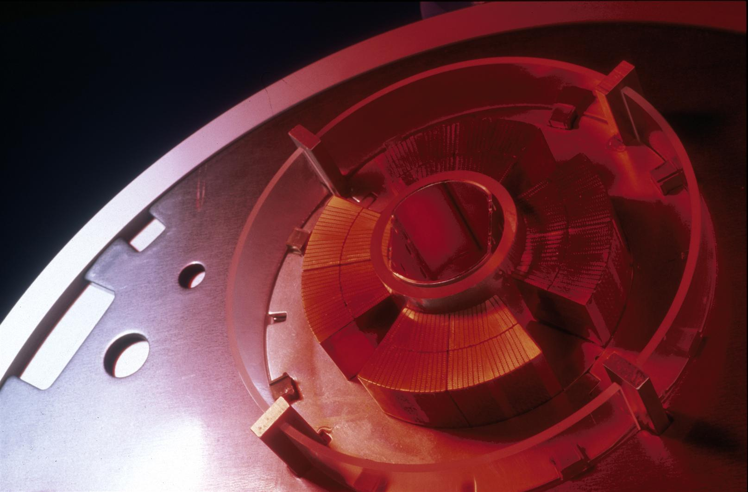
Lattice Modifications:
The Lattice has to be optimised to establish smallest β* values at IP1 & 5.
present design goal: β* = 15 cm
larger triplet apertures (and D1, Q4, TAS / TAN etc)
re-optimise the position of matching quadrupoles
find space for orbit correctors / spool piece correctors
find space for crab cavities
establish a crossing scenario without changing the crab orbit

Slide 6
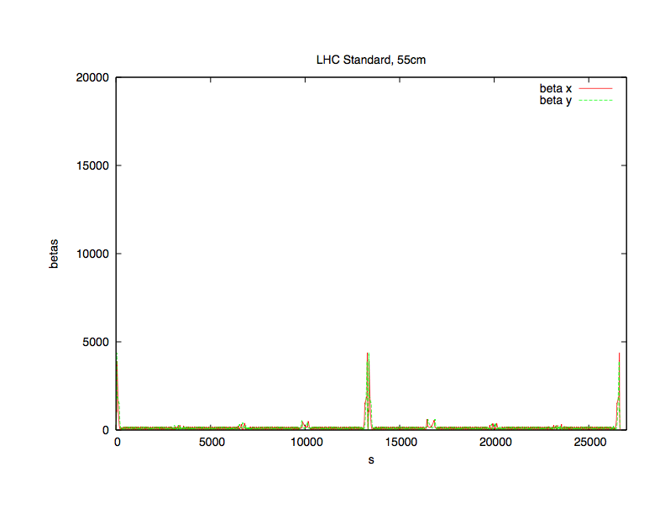
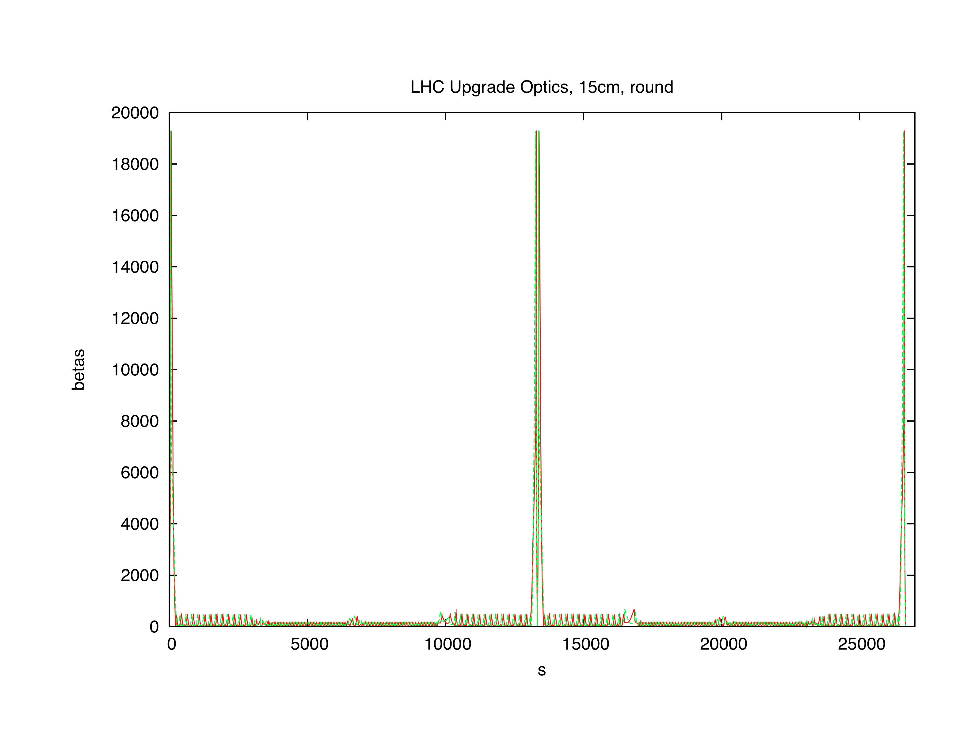
It is a long way to go:
LHC standard Optics, 55cm
HL-LHC Optics, 15cm
... my apologies for the zig-zags !

Slide 7

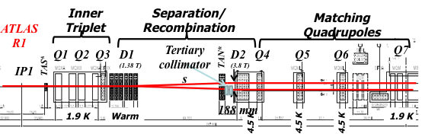
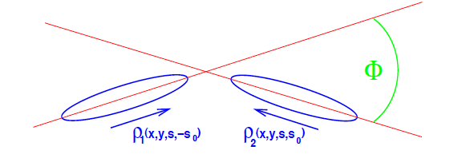
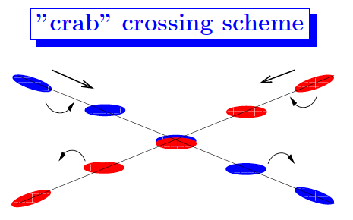

Luminosity, Loss Factor & Crab Cavities
* R
ideal luminosity formula
★★★★★★
loss factor due to crossing with an angle
(pure geometric effect ... but large)
R
* H
≈ 0.33

Slide 8
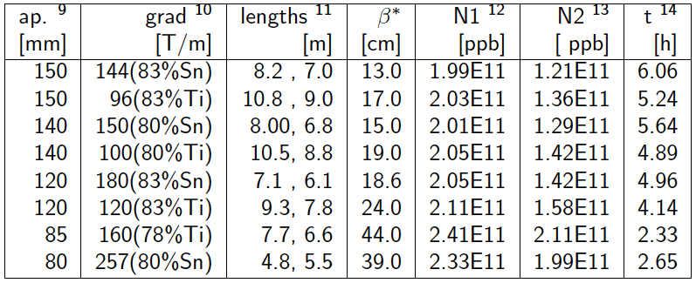
what we are talking about:
four baseline optics
based on assumptions on
aperture & magnet technique
and the latest version, based on 150mm aperture - 140T/m gradient ...
... being finalised at the moment
170

Slide 9
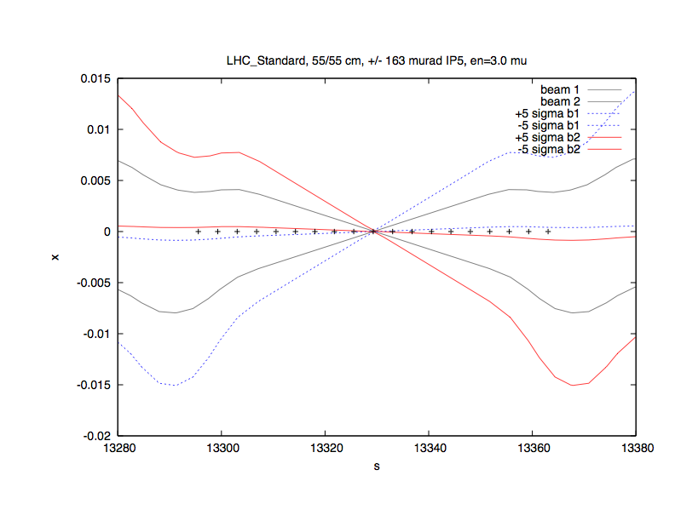
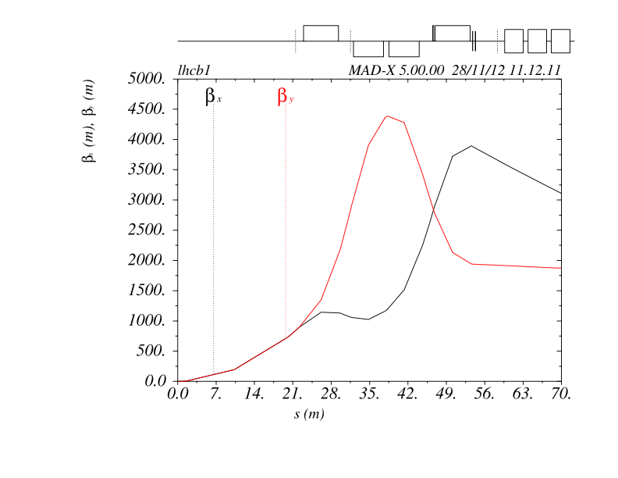
Beam Envelopes:
Standard LHC
Standard LHC, β*= 55cm, ε = 3.0
crossing angle = +/- 145 μrad
Q1 Q2 Q3 D1 ...
Lattice & Optics for LHC Standard

Slide 10
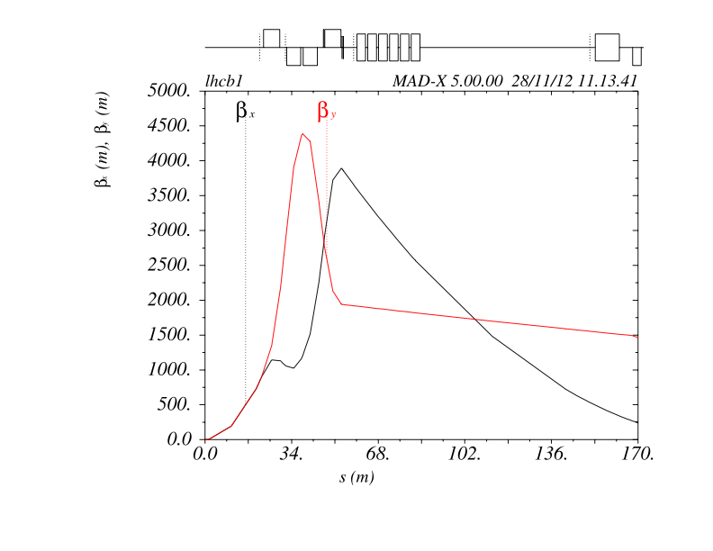
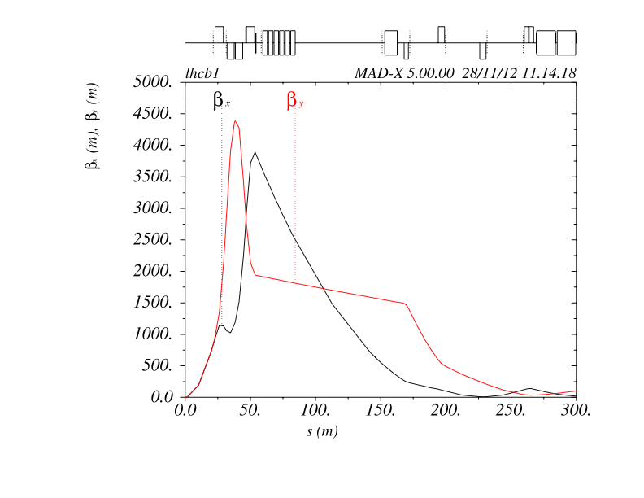
Standard LHC
Lattice:
Q1/2/3 D1 ... Q4
Q1/2/3 D1 ... D2 Q4 5 6 7

Slide 11
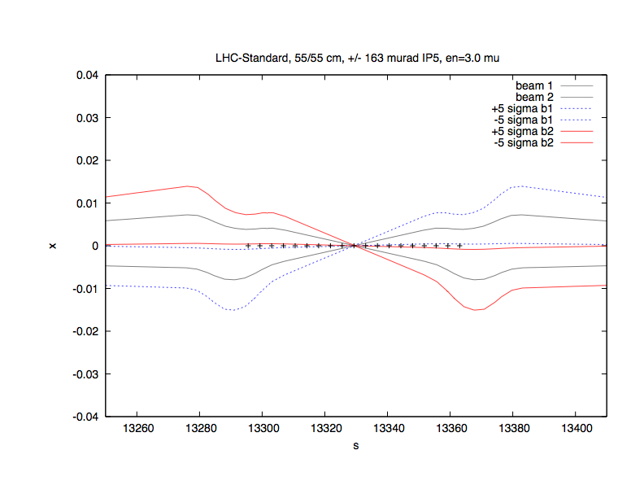
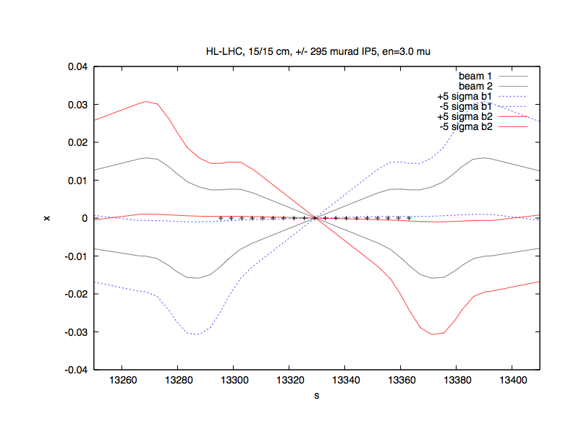
Beam Envelopes:
Upgrade Lattice: SLHC_V3.1b
150 T/m, 140mm
HL-LHC, β*= 15cm, ε = 3.0
crossing angle = +/- 295 μrad
Standard LHC, 55cm
HL-LHC, 15cm

Slide 12
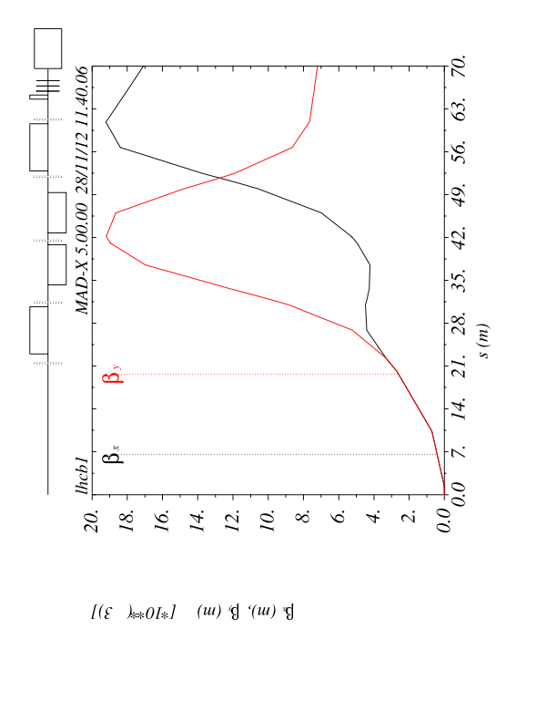
Upgrade Lattice: SLHC_V3.1b
150 T/m, 140mm
Lattice:
Q1 Q2 Q3 D1 ...
LHC Standard Lattice
SLHC Lattice V3.1b
longer triplet quadrupoles
D1 shifted away from IP
D1 sc and only 1 magnet

Slide 13
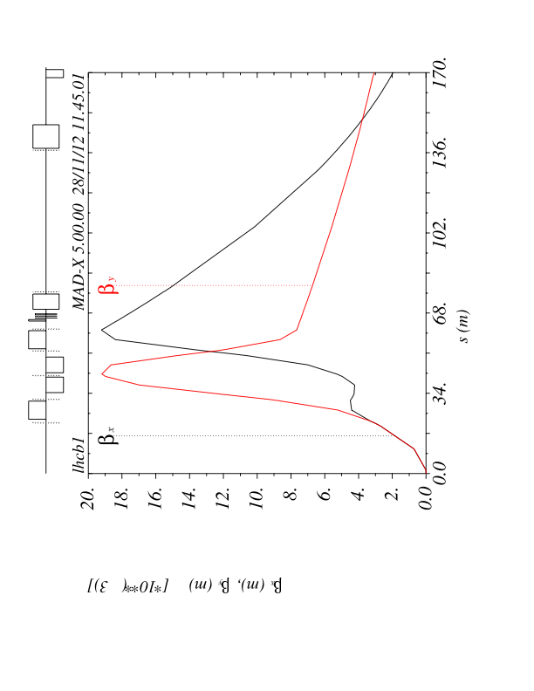
Upgrade Lattice: SLHC_V3.1b
150 T/m, 140mm
Lattice:
Q1/2/3 D1 ... D2 Q4
LHC Standard Lattice
SLHC Lattice V3.1b
longer triplet quadrupoles
D1 shifted away from IP
D1 sc and only 1 magnet
D2 shifted towards IP for
crab cavities Δs = -15m

Slide 14
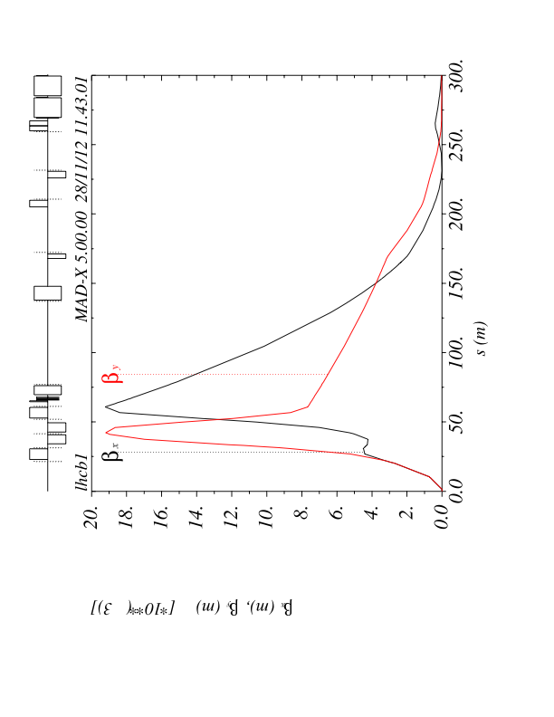
Upgrade Lattice: SLHC_V3.1b
150 T/m, 140mm
Lattice:
Q1/2/3 D1 ... D2 Q4 5 6 7
LHC Standard Lattice
HL-LHC Lattice V3.1b
longer triplet quadrupoles
D1 shifted away from IP
D1 sc and only 1 magnet
D2 shifted towards IP for
crab cavities Δs = -15m
Q5 shifted away from IP
Δs = +11m

Slide 15
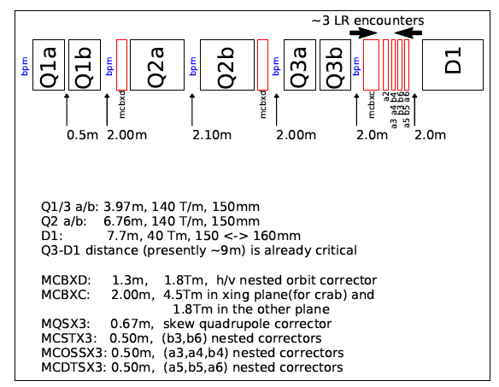
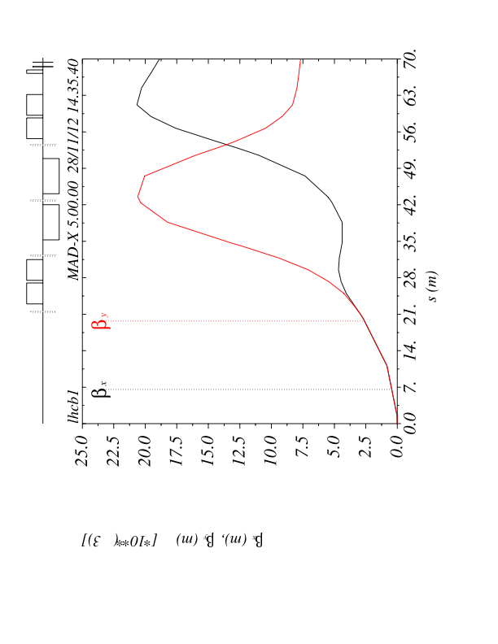
Upgrade Lattice: HL-LHC_V1.0
140 T/m, 150mm
Lattice:
Q1 Q2 Q3 D1 ...
LHC Standard Lattice
HL-LHC Lattice V1.0
even longer triplet quadrupoles
Q1 and Q3 split in two magnets

Slide 16
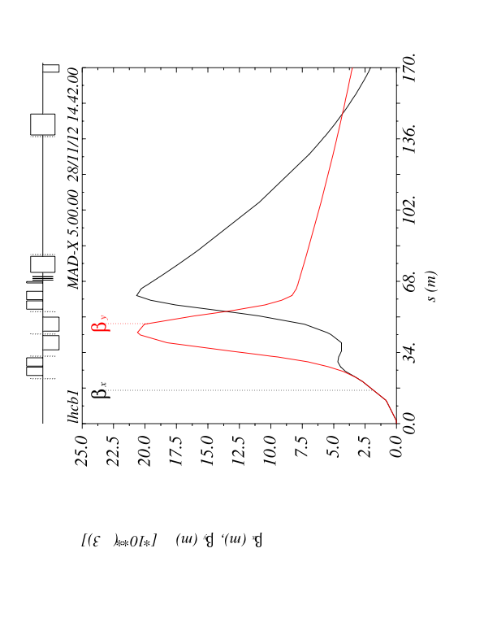
Upgrade Lattice: HL-LHC_V1.0
140 T/m, 150mm
Lattice:
Q1/2/3 D1 ... D2 Q4
LHC Standard Lattice
HL-LHC Lattice V1.0
longer triplet quadrupoles
Q1 and Q3 split in two magnets
D1 shifted away from IP
D1 sc and only 1 magnet
D2 shifted towards IP for
crab cavities Δs = -15m

Slide 17
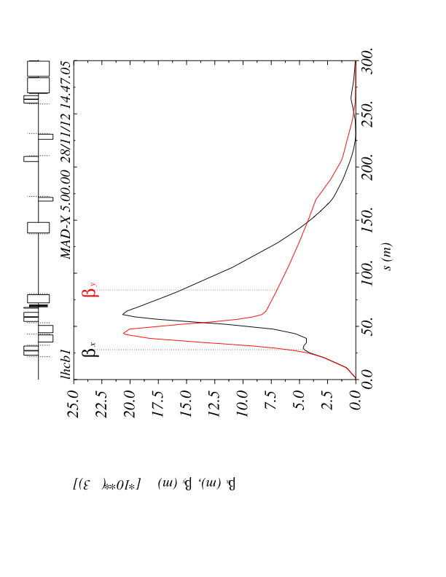
Upgrade Lattice: HL-LHC_V1.0
140 T/m, 150mm
Lattice:
Q1/2/3 D1 ... D2 Q4 5 6 7
LHC Standard Lattice
HL-LHC Lattice V1.0
longer triplet quadrupoles
Q1 and Q3 split in two magnets
D1 shifted away from IP
D1 sc and only 1 magnet
D2 shifted towards IP for
crab cavities Δs = -15m
Q5 shifted away from IP
Δs = +11m

Slide 18
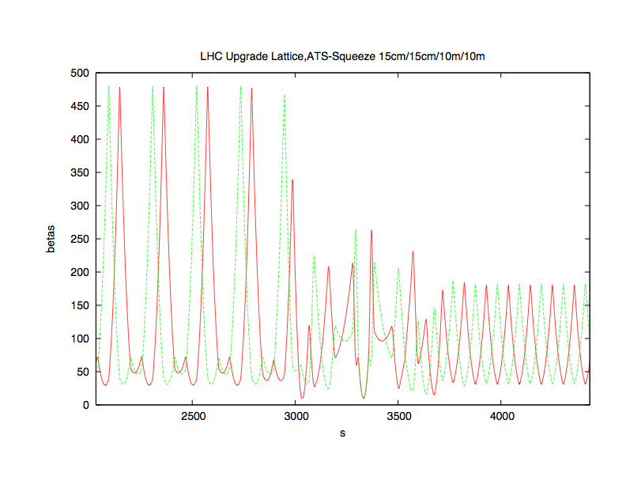
HL-LHC Optics in IR2 / IR8
the “ATS Squeece Optics
(15cm/15cm/10m/10m)
court. A. Bogomyagkov
IP1, ATS Optics
IP2
IP3, Standard FoDo Optics
Serious Optics changes in the matching section ...
But no Lattice Changes foreseen so far.
Ceterum Censeo: β-leveling will be difficult

Slide 19
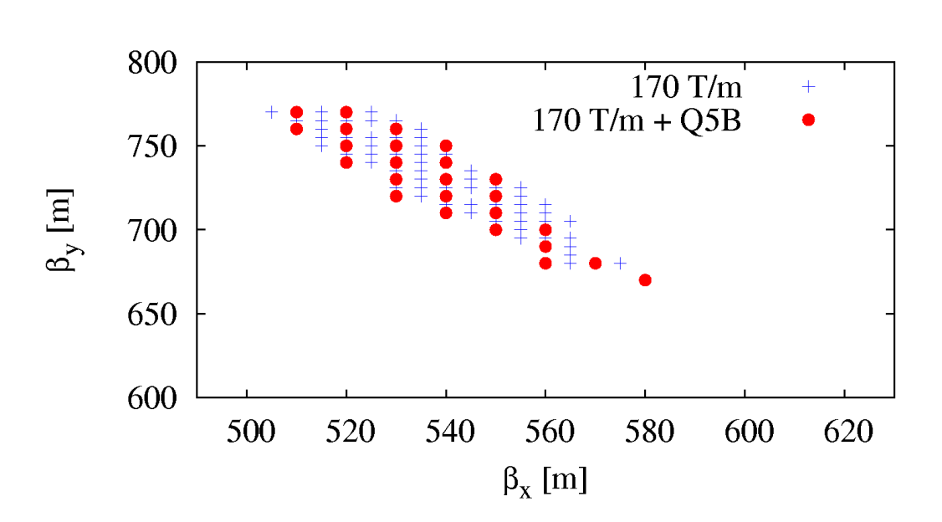
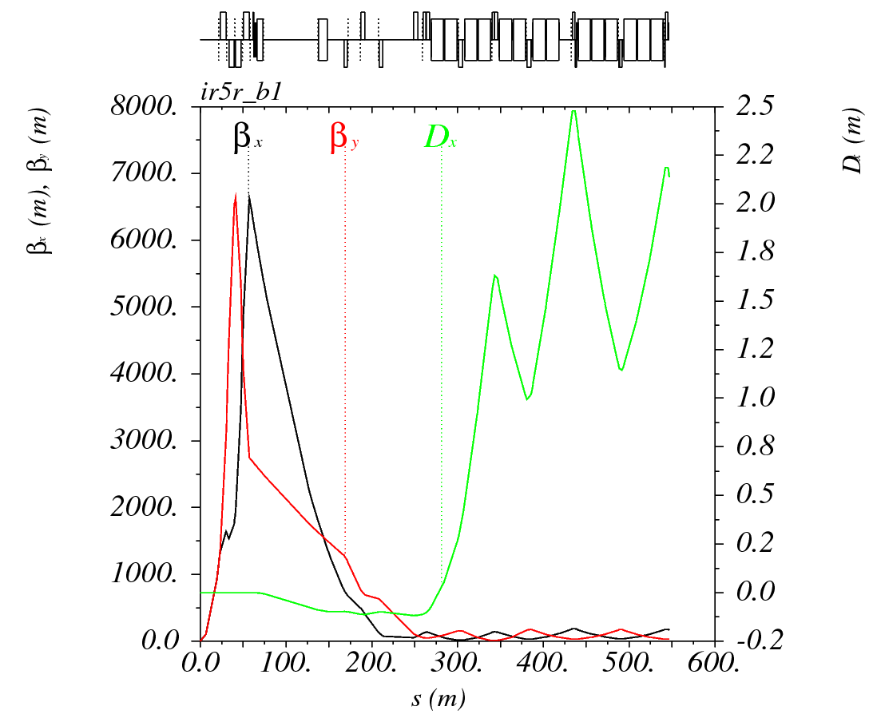
Lattice Optimisation for Crab Cavities
court. B. Dalena
Study of additional quadrupoles at Q5 / Q6 / Q7 ...
Q4 / Q5 / Q6 in triplet configuration & add. Q7
... allows for much larger βs at the Crab Cavities
add. Quad at Q5: no big change
CRAB side and beam | HL-LHC baseline [MV] | Best optimization [MV]
Horizontal L5 Beam 1 | 11.8 | 8.0
Horizontal R5 Beam 1 | 13.4 | 8.2
Horizontal L5 Beam 2 | 13.4 | 8.2
Horizontal R5 Beam 2 | 11.8 | 8.0

Slide 20
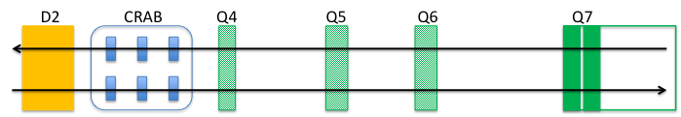
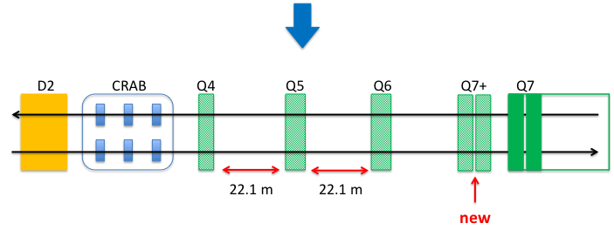
HL-LHC Lattice, Loss Factor & Crab Cavities
* F
F
LHC Standard Lattice
HL-LHC lattice, V1.0
Provide Space for Crab Installation
-> D2 shift
-> optimise lattice
Q4,5,6 in “triplet configuration”
-> optimise optics
HL-LHC lattice, Crab Optimised

Slide 21
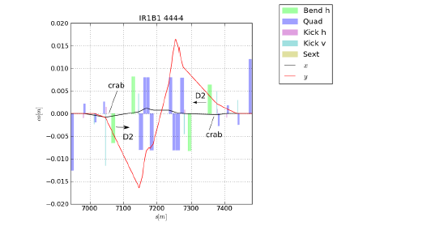
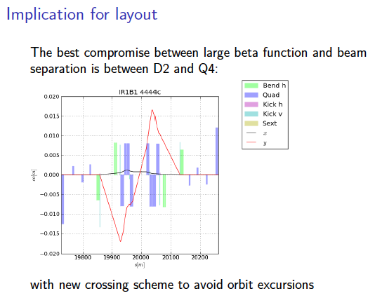
Lattice & Crab Cavities: Beam Orbit
court. R. DeMaria
Standard Bump for Crossing angle & beam separation closes at Q5 ... and leads to
(varying) orbit offsets at the crab cavity location.
-> bump closure by strong dipole magnet at D2.
-> Alternative: transverse cavity positioning feedback following the beam orbits

Slide 22
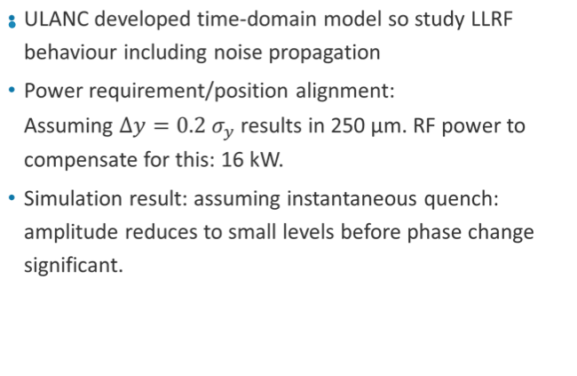
Lattice & Crab Cavities: Beam Orbit
A. Dexter/ E. Jensen Frascati Workshop 2012
strong orbit corrector needed in front of D2
for crossing angle bump & separation bump
first estimates:

Slide 23
Lattice Modifications: Summary
Magnet | LHC | SLHC V3.1b | HL-LHC V1.0
triplet layout | standard machine | 150T/m, 140mm | 140T/m, 150mm
MQXA | 22.2...26.2m
MQXB | 31.8...34.8m
MQXB | 38.3...41.3m
MQXA | 46.8...50.2m
MBXW D1 | 59...83m, 6 magnets
MBRC D2 | 152.1...157.9m
MQY Q4 | 167.7...169.6m
MQML Q5 | 194.0...196.5m
MQML Q6 | 225.9...228.4m
MQM Q7A | 259.6...261.7
MQM Q7B | 263.6...265.5

Slide 24
Lattice Modifications: Summary
Magnet | LHC | SLHC V3.1b | HL-LHC V1.0
triplet layout | standard machine | 150T/m, 140mm | 140T/m, 150mm
MQXA | 22.2...26.2m | MQXC 22.2...26.8m
MQXB | 31.8...34.8m | MQXD 33.6...37.5m
MQXB | 38.3...41.3m | MQXD 42.2...46.0m
MQXA | 46.8...50.2m | MQXC 52.5...56.7m
MBXW D1 | 59...83m, 6 magnets | MBXA 68.6...72.8m, 1 magnet
MBRC D2 | 152.1...157.9m | MBRD 137.1...142.9m
MQY Q4 | 167.7...169.6m | MQYY 167.7...169.6m
MQML Q5 | 194.0...196.5m | MQYL 205.0...207.5m
MQML Q6 | 225.9...228.4m | MQML 225.9...228.4m
MQM Q7A | 259.6...261.7 | MQM 259.6...261.7
MQM Q7B | 263.6...265.5 | MQM 263.6...265.5

Slide 25
Lattice Modifications: Summary
Magnet | LHC | SLHC V3.1b | HL-LHC V1.0
triplet layout | standard machine | 150T/m, 140mm | 140T/m, 150mm
MQXA | 22.2...26.2m | MQXC 22.2...26.8m | MQXC 1 22.2...25m MQXC 2 27.2...29.5m
MQXB | 31.8...34.8m | MQXD 33.6...37.5m | MQXD 34.7...38.7m
MQXB | 38.3...41.3m | MQXD 42.2...46.0m | MQXD 43.5...47.5m
MQXA | 46.8...50.2m | MQXC 52.5...56.7m | MQXC 1 54.1...56.7m MQXC 2 58.9...61.2m
MBXW D1 | 59...83m, 6 magnets | MBXA 68.6...72.8m, 1 magnet | MBXA 71.2...76.0m, 1 magnet
MBRC D2 | 152.1...157.9m | MBRD 137.5...142.9m | MBRD 137.5...142.9m
MQY Q4 | 167.7...169.6m | MQYY 167.7...169.6m | MQYY 167.7...169.6m
MQML Q5 | 194.0...196.5m | MQYL 205.0...207.5m | MQYL 205.0...207.5m
MQML Q6 | 225.9...228.4m | MQML 225.9...228.4m | MQML 225.9...228.4m
MQM Q7A | 259.6...261.7 | MQM 259.6...261.7 | MQM 259.6...261.7
MQM Q7B | 263.6...265.5 | MQM 263.6...265.5 | MQM 263.6...265.5

Slide 26
Lattice Modifications: Summary
Magnet | LHC | Crab Cavity Story
triplet layout | standard machine | 170T/m, 120mm
MQXA | 22.2...26.2m
MQXB | 31.8...34.8m
MQXB | 38.3...41.3m
MQXA | 46.8...50.2m
MBXW D1 | 59...83m, 6 magnets
MBRC D2 | 152.1...157.9m
MQY Q4 | 167.7...169.6m | MQYY ≈ 167.9
MQML Q5 | 194.0...196.5m | MQYL ≈ 193.4m
MQML Q6 | 225.9...228.4m | MQML ≈ 220.3m
 |  | MQML7 ≈ 248.9...253.7m
MQM Q7A | 259.6...261.7 | MQM ≈ 260
MQM Q7B | 263.6...265.5 | MQM ≈ 263.7
And finally B. Dalena et al:
additional Quadrupole to
support Q7
... crab cavitiy conditions

Slide 27
Reminder:
... all this is WORK IN PROGRESS
depending on the hardware available we will have to decide for one version
and do the fine tuning / hardware follow up

