Slide 1
Scheduling News
.
Magdalena Kowalska

Slide 2
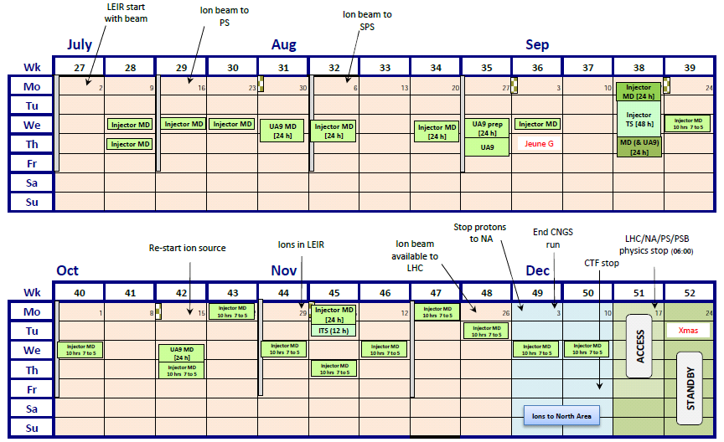
Injector schedule since last meeting
Confirmation of 2 week proton prolongation – until December 17th:
35 -> 37 weeks of physics (vs 29 weeks in 2011)

Slide 3
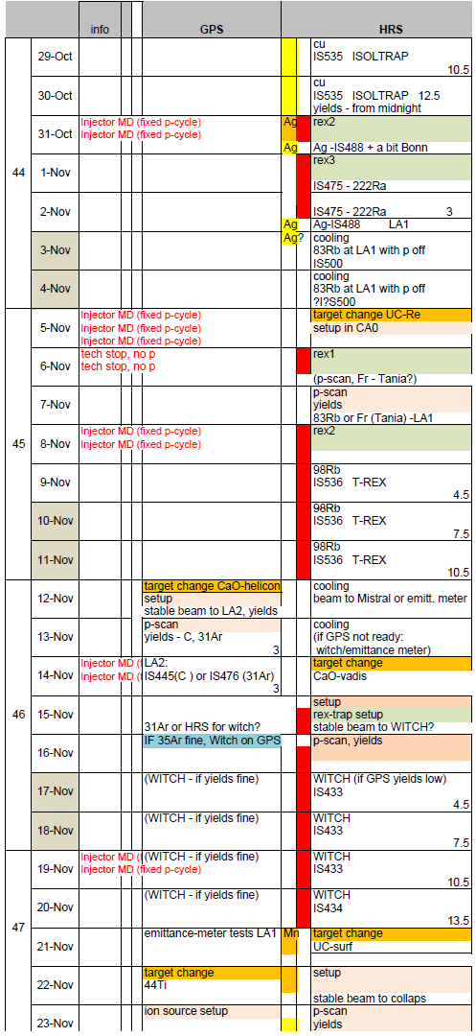
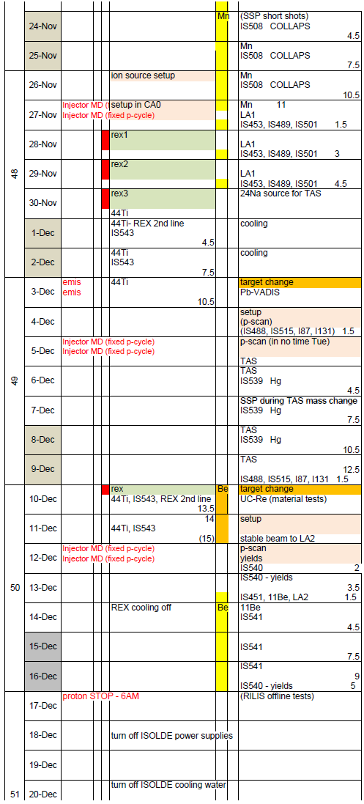
ISOLDE schedule since last meeting
Mid-October: GPS problem - extraction electrode stuck in the middle of target valve -> only light targets allowed
=> new ISOLDE schedule
v4.0, 26th Oct:
All GPS runs rescheduled (some shifts cut), partly in 2 additional weeks
Failed summer run (11Be) also rescheduled
CaO and offline 44Ti on GPS
=> No IS experiment cancelled (3 collection LOIs cancelled)
GPS
HRS

Slide 4
Schedule 2012
Shift balance: 1009 open shifts for IS experiments, 53 shifts for LOIs
Shift requests: 833 shifts for 71 IS exp vs 657.5 in 2010; 40 shifts for 14 LOIs
20 IS experiments with no beam requests
REX requests: 377.5 shifts (IS + LOIs)
Scheduled runs (since July – 2wk prolongation & GPS problem):
Scheduled | Oct 2012 | July 2012 | 2011
All shifts (IS+LOI+MD) | 565 | 579 | 491.5
Shifts for IS exp | 539 | 537 | 440
Shifts for LOIs | 26.5 | 36.5
# of IS exp | 51 | 53
# of LOIs | 10 | 13
REX runs & exp | 11 - 17 | 11 - 17 | 10? - 14
REX shifts (IS +LOI) | 221.5 | 220 | 190.5
Average shifts/day | 2.08 | 2.42 | 2.31

Slide 5
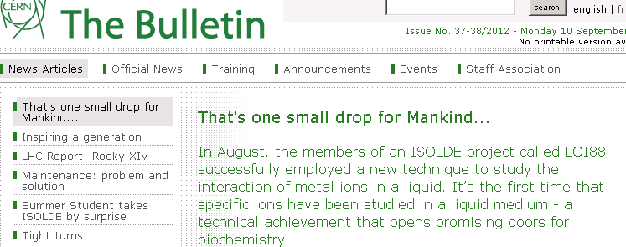
Physics runs since last meeting
Very successful LOI runs based on new experimental techniques:
  Jul: spin polarization with tilted foils behind REX - % beta-NMR signal on 8Li
  Aug: beta-NMR on liquids for biophysics – 1st liquid beta-NMR signal (31Mg in ionic liquid)
  Aug & Oct – CRIS shows expected detection efficiency and reaches 202Fr
Miniball runs: Po, Rn, Zn, K (instead of 30Na),

Slide 6
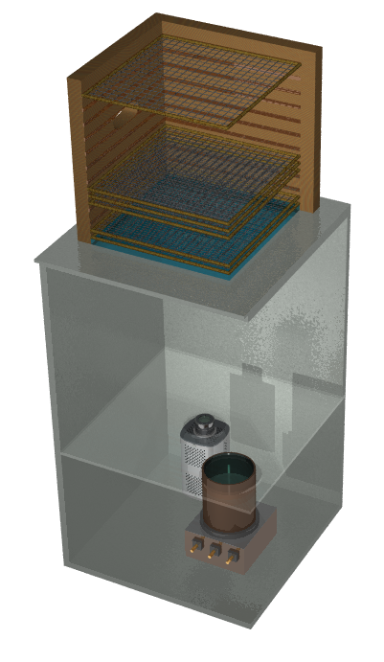
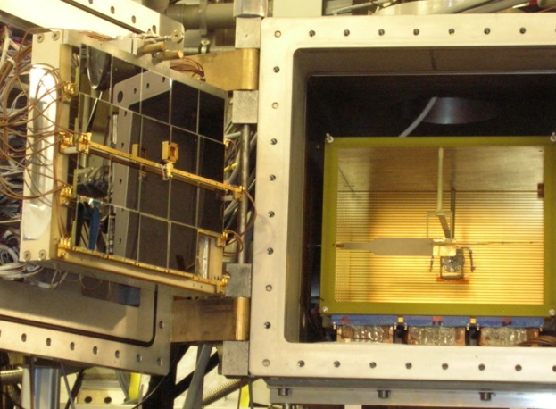
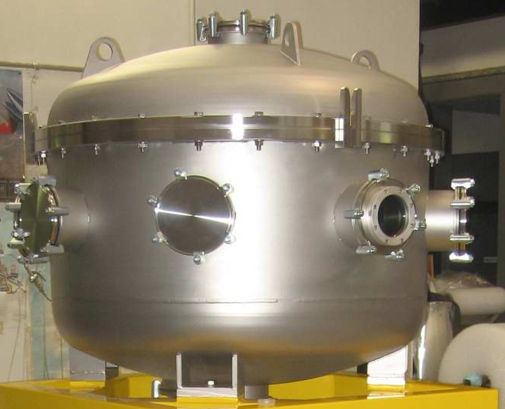
Physics runs since last meeting
TISD: LIST target, new n-converter geometry
Collections: Tb for cancer studies in PSI (Ulli) and Lausanne (MEDICIS), Cd and Ag for bio- and SSP
Successful experiments with new setups & by new groups:
  21Na and 31Mg with REX scattering chamber (Lund and Tokyo);
  6He with opt. time-proj. chamber (Warsaw);
  34Mg with fast tape-station (Bucharest)
  12 Be with MAYA;
In-source spectroscopy with decay detection (windmill) and MR-TOF (new method at ISOLTRAP): At and Au beams
Backup beam: Ba-> Cs – SAHA-Kolkata, Cu-> Rb – ISOLTRAP, 30Na-> 48K – Koeln
The only run with no beam – 11Be (rescheduled in December)
=> Many new setups and groups and mostly successful runs

Slide 7
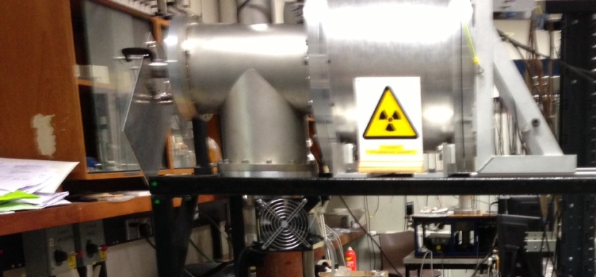

Upcoming
Runs coming before shutdown:
New method and groups - incomplete fusion with T-REX: Milano & Cracow
TISD: CaO-Helicon (on GPS) to produce C and possibly Ar beams
The only WITCH run this year
44Ti for astrophysics (GPS): 44Ti source from PSI, setup behind REX
Mn for COLLAPS (Manchester) and some SSP users
Hg for TAS (1st run since a few years) and priority collections
11Be which failed in the summer
:
Long shutdown 1:
Presently: first protons to ISOLDE at the end of June 2014
Access to ISOLDE: with permanent dosimeter, helmets and safety shoes; under discussion whether safety equipment will stay after LS1

