Slide 1
Financial Situation of the collaboration
Maria J. G. Borge

Slide 2
Income of the collaboration
Country | Amount per year (CHF) | Signed copy of MoU received
Belgium | 60.000 | ✔
CERN | 60.000 | ✔
Denmark | 60.000 | ✔
Finland | 60.000 | ✔
France | 60.000 | ✔
Germany | 60.000 | ✔
Greece
India | 40.000 | ✔
Ireland | 10.000
Italy | 60.000
Norway | 60.000
Romania | 30.000 | ✔
Spain | 60.000
Sweden | 60.000 | ✔
United Kingdom | 60.000 | ✔

Slide 3
Chapters of Expenditures
Income / year ≈ 740.000
Expediture Chapters:
  Solid state Physics
  Data Acquisition
  Rex-ISOLDE Operations
  Ion Source and Target Development
  Man Power:
    Experts
    Target & ion source
    RILIS operation
  Administration
  Engineering Assistance
  Consumables (Electronic Pool, Liquid Nitrogen…)
  HIE-ISOLDE ( since 2009)
  Infrastructure and support for the experiments
  Conferences & schools & Workshop

Slide 4
Expenditure 2011

Slide 5
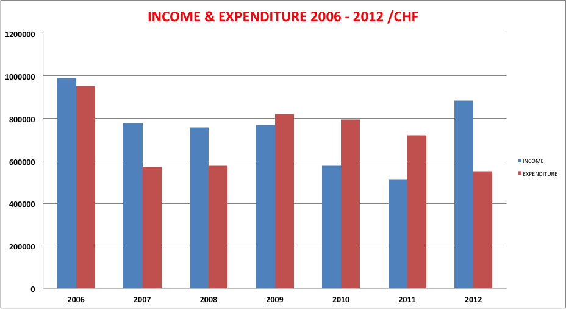
300.000 SCH transferred to the HIE-ISOLDE Project

Slide 6
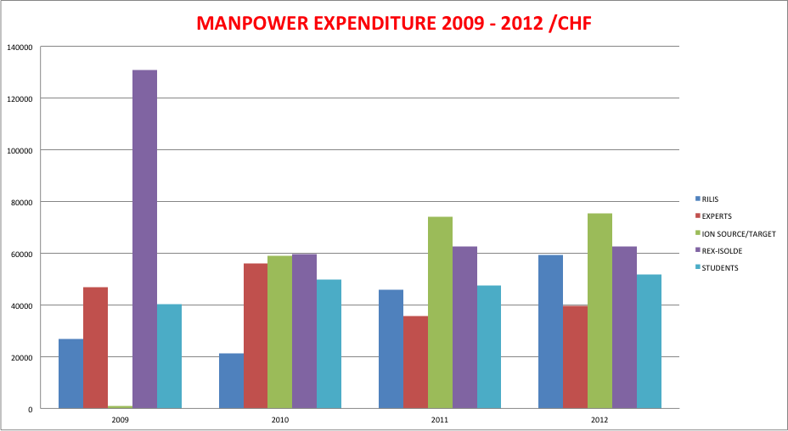
In year 2009 we were still paying Didier Voulot
Average 2009-2011 = 255.000 / (2012) 291.071

Slide 7
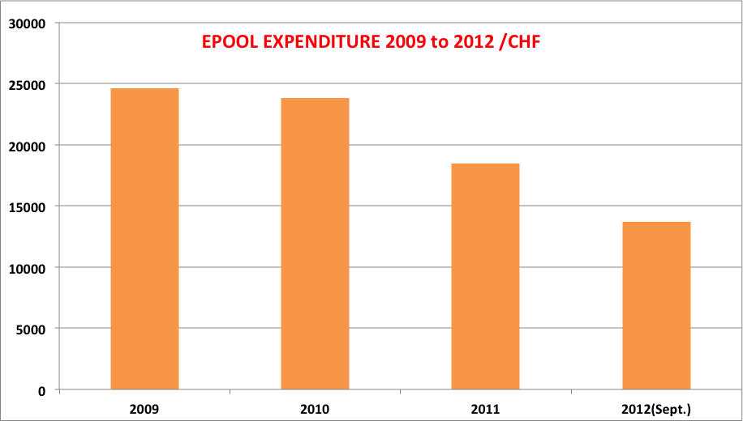
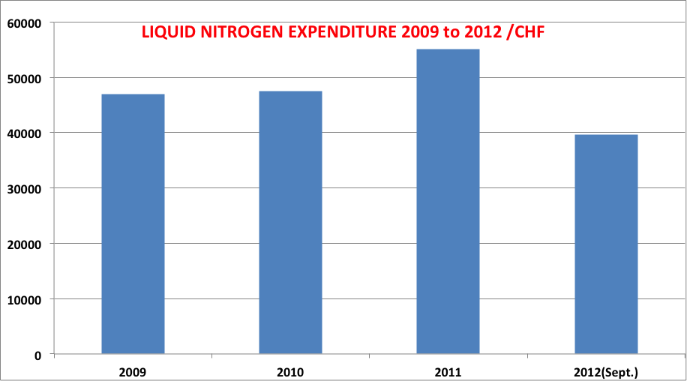
Consumables
200 Modules
Many non identified
Annual Cost around 18.000 CHF
For Free after 15 years
In the order of 46.000 CHF

Slide 8
Present status
Already spend: 442090
Compromised Manpower 73336
Administration 42000
Consumables 30000
Miscellaneous 20000
________
165336
Money in the account at 25 Oct 879974
Pending to be paid the HIE-ISOLDE Contribution
Can we transfer to the HIE-ISOLDE project 500.000 for this year?
Pending to pay 2012:
  Denmark
  Finland
  France
  India
  Spain

Slide 9
Budget for 2013
Man Power :
  Experts 35000
  Target & Ion sorce 8000 (A. Gottberg Jan-April)
  RILIS 3400 (Seliverstov Jan-Feb)
  Rex-Operation 83792 (Thibaud)
  Student support 25000
  ISOLDE Seminars 6000
        161192
Administration 35000
9-gap amplifier 50000
Consumables (10 % bat 115) 40000
Conferences & schools 10000
TOTAL 296.192
Income 740.000
Contribution to HIE-ISOLDE of 500.000?

Slide 10
Summary
Contrbution to HIE-ISOLDE of 500.000 2012 and 2013 possible
To be reconsidered for 2014

