Slide 1



Performant and Future Proof: MySQL, Memcache and Raspberry Pi
Martin Hellmich
( on behalf of the LCGDM team )
EMI INFSO-RI-261611

Slide 2
What we do today
Dmlite on a Raspberry Pi
Using memcached for speedup
HTTP load balancing

Slide 3

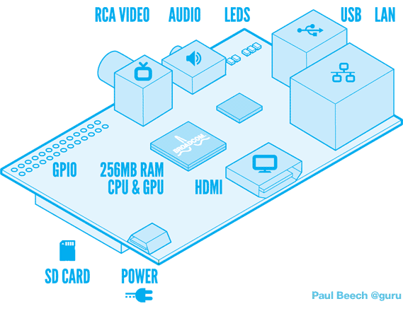
Raspberry Pi
700 MHz ARM11
256 MByte RAM
35US$

Slide 4
DPM on there?
Fedora 17 Raspberry Pi Remix
DPm on EPEL/Fedora
→ clean builds
Some rebuilds per koji necessary
Not the newest development versions

Slide 5



memcached
Distributed memory cache
Usage
  Add several cache servers to a head node
  Share cache between head nodes
  Take load off DB

Slide 6


Setup 1

Slide 7
Setup 2

Slide 8
Setup 3

Slide 9
Pen Load Balancer
Yum install pen
Debug start:
sudo pen -daf 80 headnode1.cern.ch \ headnode2.cern.ch

Slide 10
Setup 4

Slide 11
References
Fedora 17 Raspberry Pi Remix
http://zenit.senecac.on.ca/wiki/index.php/Raspberry_Pi_Fedora_Remix
Dmlite memcache plugin
https://svnweb.cern.ch/trac/lcgdm/wiki/Dpm/Dev/Dmlite/Plugins/Memcache
Memcached wiki
http://code.google.com/p/memcached/wiki/NewStart
Pen Load Balancer
http://siag.nu/pen/
http://blog.miketoscano.com/?p=7

