Slide 1
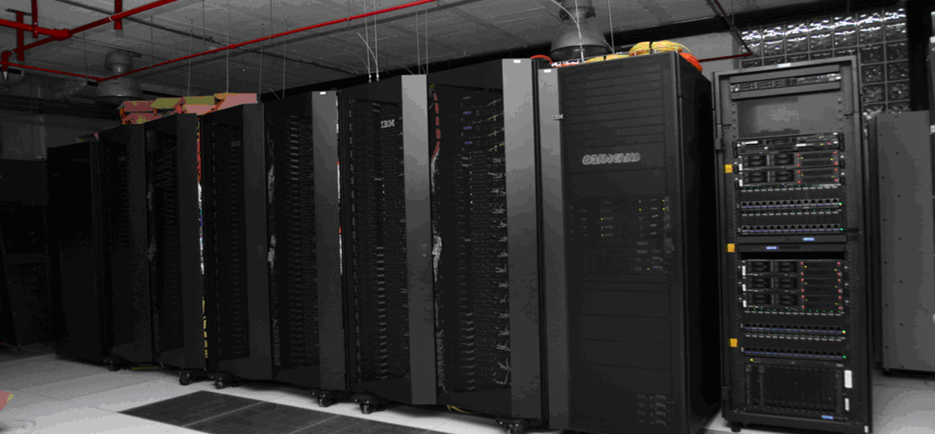
Direct exploitation of a top500 supercomputer in the analysis of CMS data
I. Cabrillo*, L. Cabellos*, J. Marco*, J. Fernández**, I. González**
*IFCA CSIC –Universidad de Cantabria & **Universidad de Oviedo SPAIN

Slide 2
THIS IS THE STORY OF A CHALLENGE…
A general purpose, powerful (Top500 list), supercomputer in production in the University of Cantabria (SPAIN)
A group of CMS researchers using Tier-2 CMS grid-based resources at IFCA center, but with peak demanding DATA processing needs to urgently prepare contributions to new papers (like Higgs WW, top cross section)
An strategy: EXPLOIT RESOURCES, MAXIMIZE IMPACT, MINIMIZE EFFORT
…AND A SOLUTION

Slide 3
The Scene & the Actors
IFCA, Institute of Physics of Cantabria, Universidad de Cantabria-CSIC
  Basic Research center in Santander, SPAIN
  HEP, Astrophysics, Statistical Physics & Computing
  IFCA Data Center: Tier-2 center for CMS + additional NGI & FEDCLOUD resources
    Several Clusters (>3600 cores)
    HPC data storage (>2 petabytes)
    10Gb backbone and dark fiber to NReN
  Management of the Spanish NGI (GRID expertise)
  Hosting the UC node of the Spanish Supercomputing Network (RES)
ALTAMIRA SUPERCOMPUTER
  A new supercomputer acquired by the University of Cantabria in 2012
  Designed with the support of IBM and BSC (Barcelona Supercomputing Center)
  Supported by a high level (but limited in number) technical team
CMS researchers at University of Oviedo and at IFCA
  With responsibilities in the top and Higgs into WW channels

Slide 4
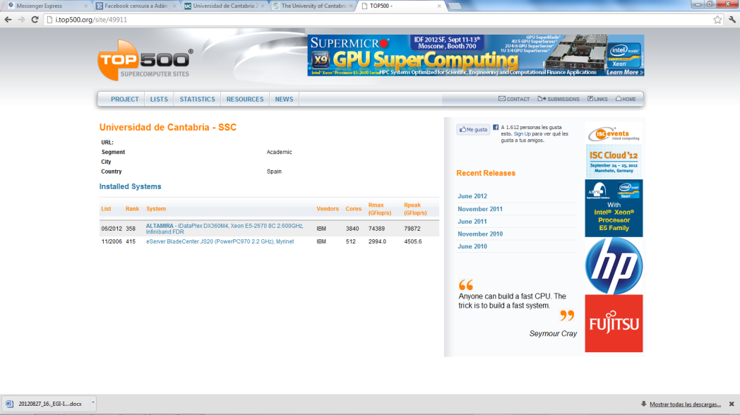

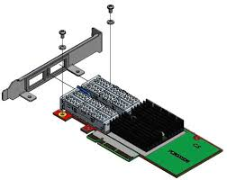
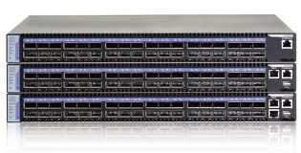
ALTAMIRA supercomputer
TOP 500 in June 2012
  #358
  #2 in Spain
  240 “nodes” (IBM idataplex dx360m4)
  ~4000 Intel cores: 330 Gflops/node
  Top Efficiency: #36 worldwide
Last generation FDR Infiniband (Mellanox)
  Latency between nodes <1 microsec.
  40 Gbps
Best solution for message passing in parallel jobs (in June 2012)
  Excellent performance reported by CERN expert in Lattice QCD (summer 2012)

Slide 5
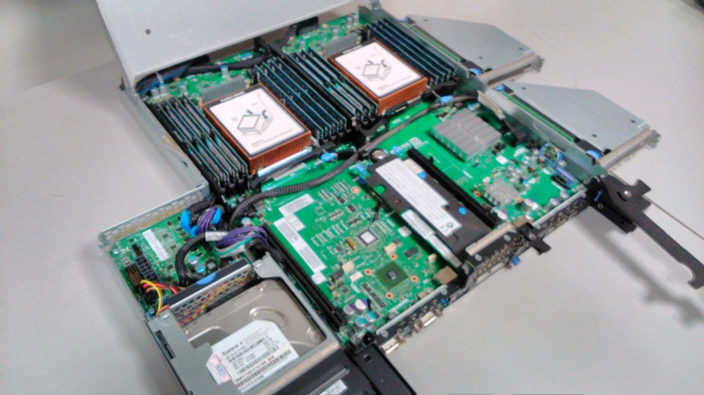
ALTAMIRA technical details
Hardware
  IBM idataplex cluster ,240 nodes dx360m4
    2x SandyBridge E5-2670 2.6GHz/1600 20MB
    64GB RAM, 16x4G DDR3-1600 DIMMs (4GB/core)
    500GB 7200 rpm SATA II local HDD
    332.8Gflop/node
  HPC Infiniband FDR10 (40 Gbps)
    FDR10 IB HCA Mellanox
    36 ports switches, leafs+ core layers
    FAT TREE non-blocking
    Advance Management
  Plus
    7 IBM dx360m3 GPUs TESLA
    11 IBM ps702 Power7
Open Software
  xCat (Management)
  Linux (Scientific Linux & Centos)
  SLURM (queue management)
  MPI (mvapich2, openmpi-x86_64)
  Compilers (gcc, INTEL)

Slide 6
INTEGRATING ACCESS AND RESOURCES
ALTAMIRA is managed as supercomputer
  “Local” accounts (user/gr + passw.)
  Queue system (SLURM)
  GPFS limited home & scratch space
  Network layer 2 over Infiniband
IFCA Clusters are managed “a la GRID”
  “Grid” access with local users access via LDAP to User Interface
  Storage Element via STORM, underlying GPFS over 10Gb Ethernet
INTEGRATION
  COMMON IDENTITY FOR LOCAL USERS (ldap based) (handle carefully user/grid)
  SHARE GPFS VOLUMES OVER BOTH SIDES (including common home)
    Over Ethernet for GRID resources, Over Infiniband for ALTAMIRA resources
  EXPLOIT SIMILARITY IN JDL (scripts need very minor modifications)
  Data Transfer Tools (vsftp, gridftp, xroot) + CMS software (via CVFMS)
EXPLOIT PERFORMANCE IN ALTAMIRA:
  LARGE NUMBER OF NODES + INFINIBAND, 40Gb to each node, FOR DATA PROCESSING
  RUN o(100) JOBS IN PARALLEL WITHOUT IMPACT ON DATA ACCESS

Slide 7
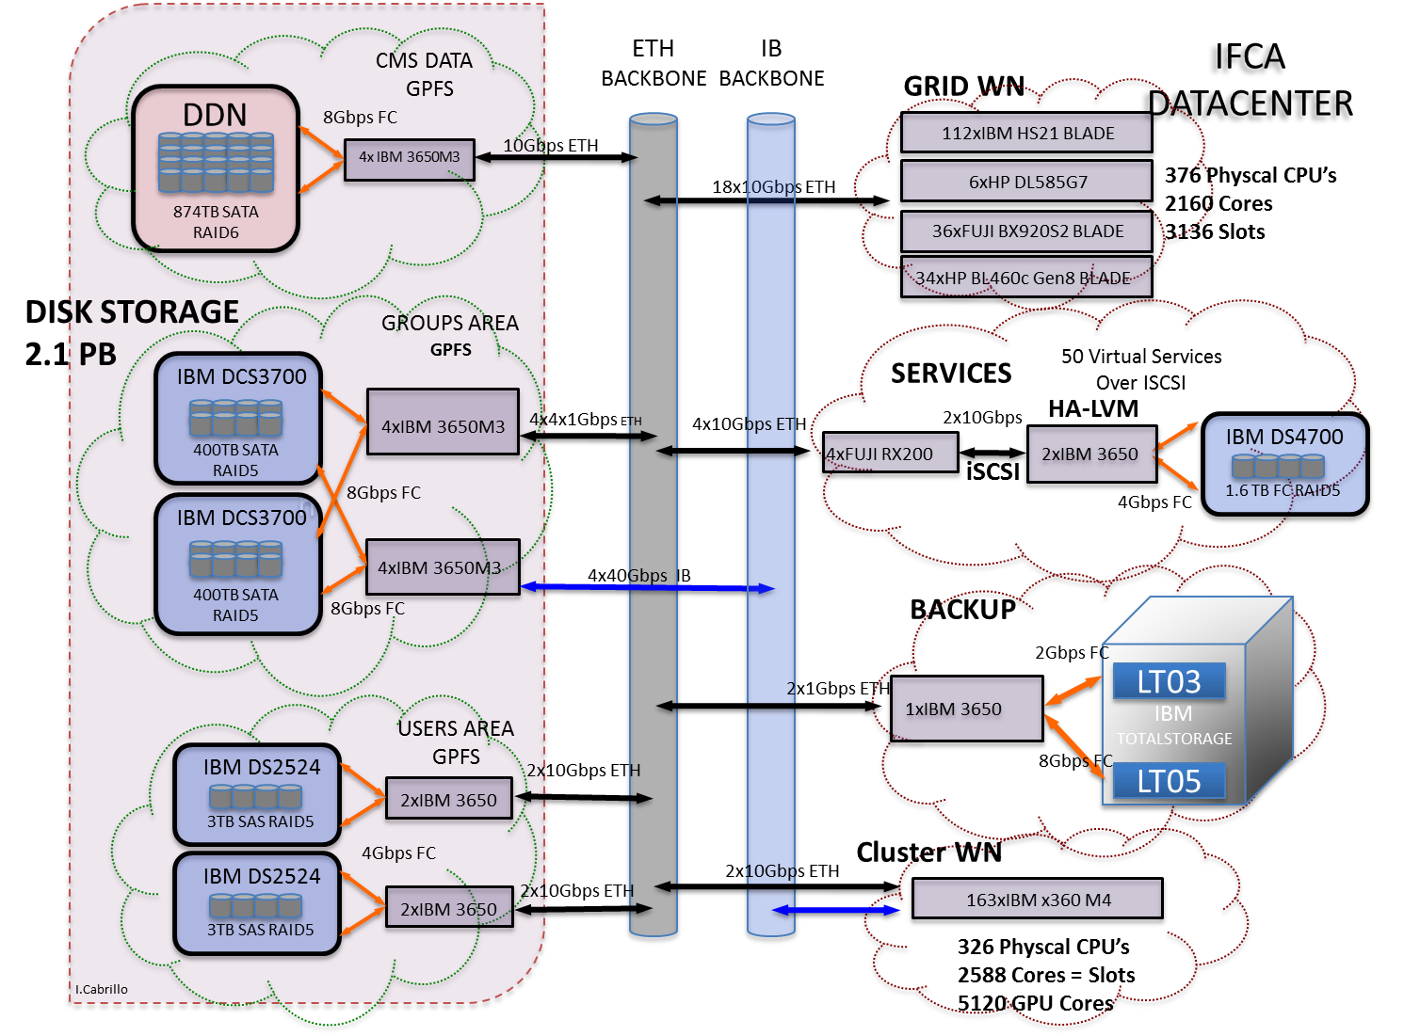
ALTAMIRA INTEGRATION: Hardware View
ALTAMIRA

Slide 8
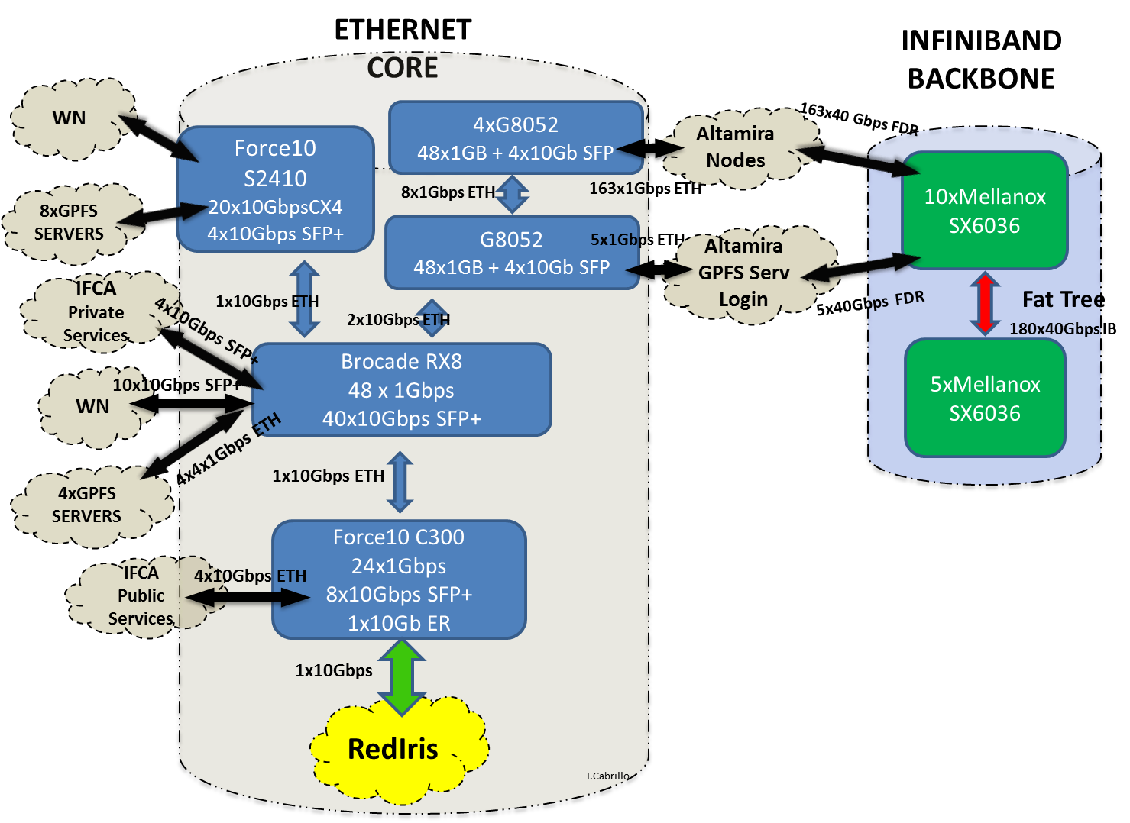
ALTAMIRA INTEGRATION: Network View

Slide 9
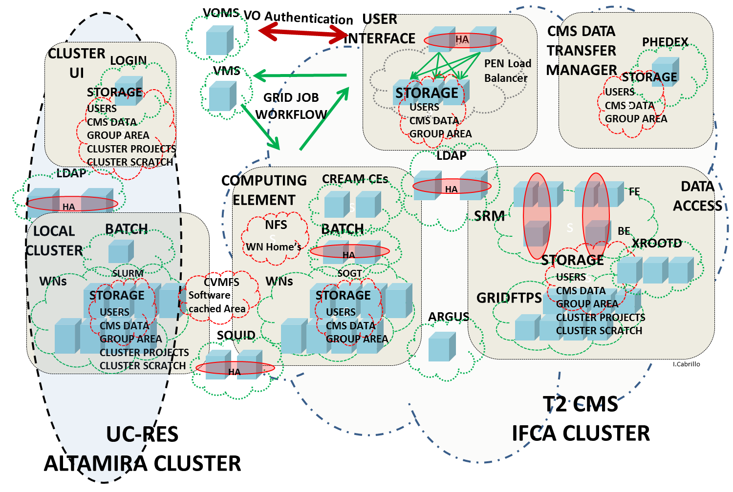
ALTAMIRA INTEGRATION: Global View

Slide 10
INTEGRATION: GPFS details
Connect all ALTAMIRA nodes to Ethernet IP network
  Cabling the nodes with 1Gb Ethernet connection to switches
  Deploy an optic 10Gbps + 10Gbps Trunk between IFCA Brocade Ethernet backbone and ALTAMIRA Ethernet switches.
Setup the new 4 ALTAMIRA GPFS storage servers
  Direct FC connection to DCS3700 storage cabin (1 Petabyte)
  4 Gb interfaces to access also IP storage network
  IB FDR interfaces to serve all ALTAMIRA nodes
  Create the 2 new ALTAMIRA file systems
Add all ALTAMIRA nodes to IFCA GPFS cluster
  At this point Altamira is able to access to different IFCA file systems
    cms data
    user home area
    other IFCA projects

Slide 11
INTEGRATION: GPFS details
Setting up the IB RDMA storage Network (GPFS > 3.4 is needed)
[root@node01 ~]# ibstat
CA 'mlx4_0'
CA type: MT4099
Number of ports: 1
Firmware version: 2.10.700
Hardware version: 0
Node GUID: 0x0002c9030030e820
System image GUID: 0x0002c9030030e823
Port 1:
State: Active
Physical state: LinkUp
Rate: 40 (FDR10)
Base lid: 95
LMC: 0
SM lid: 46
Capability mask: 0x02514868
Port GUID: 0x0002c9030030e821
Link layer: InfiniBand
[root@node01 ~]# ibstat
Infiniband device 'mlx4_0' port 1 status:
default gid: fe80:0000:0000:0000:0002:c903:0030:e821
base lid: 0x5f
sm lid: 0x2e
state: 4: ACTIVE
phys state: 5: LinkUp
rate: 40 Gb/sec (4X FDR10)
link_layer: InfiniBand
Keep an eye on the device name : mlx4_0

Slide 12
INTEGRATION: GPFS details
  Tell GPFS to active verbsRdma for altamira nodes
  Tell GPFS to active verbsPorts for altamira nodes
  Restart GPFS on Altamira nodes
#mmchconfig verbsRdma=enable –N “node1,node2,…,nodeN”
#mmchconfig verbsRdma=“mlx4_0” –N “node1,node2,…,nodeN”
Loading modules from /lib/modules/2.6.32-358.14.1.el6.x86_64/extra
Module Size Used by
mmfs26 1762439 0
mmfslinux 310536 1 mmfs26
tracedev 29456 2 mmfs26,mmfslinux
Wed Sep 25 13:11:26.505 2013: GPFS: 6027-310 mmfsd initializing. {Version: 3.5.0.10 Built: May 7 2013 17:30:30} ...
Wed Sep 25 13:11:28.437 2013: VERBS RDMA starting.
Wed Sep 25 13:11:28.438 2013: VERBS RDMA library libibverbs.so (version >= 1.1) loaded and initialized.
Wed Sep 25 13:11:28.811 2013: VERBS RDMA device mlx4_0 port 1 opened.
Wed Sep 25 13:11:28.812 2013: VERBS RDMA started.

Slide 13
INTEGRATION: GPFS details
  Testing GPFS connection over IB
  RDMA supports zero-copy networking by enabling the network adapter to transfer data directly to or from application memory, eliminating the need to copy data between application memory and the data buffers in the operating system
[root@node01 ~]# mmfsadm test verbs conn
NSD Client Connections:
destination status curr RW peak RW file RDs file WRs file RD KB file WR KB file recv file send file rcv KB file snd KB idx cookie
--------------- --------------- --------- --------- ---------- ---------- ----------- ----------- ---------- ---------- ----------- ----------- ---- ------
NSD Server Connections:
destination status curr rdma wait rdma rdma RDs rdma WRs rdma RDs KB rdma WRs KB rdma recv rdma send rdma rcv KB rdma snd KB idx cookie
--------------- --------------- --------- --------- ---------- ---------- ----------- ----------- ---------- ---------- ----------- ----------- ---- ------
<c0n148> IBV_QPS_RTS 0 0 936415 909909 35095190 33079486 0 0 0 0 1 229
<c0n195> IBV_QPS_RTS 0 0 0 9189003 238654045 313060231 0 0 0 0 6 251
<c0n198> IBV_QPS_RTS 0 0 0 78 44 3427 0 0 0 0 7 253
<c0n41> IBV_QPS_RTS 0 0 0 85 6825 3668 0 0 0 0 8 267
…………………………….

Slide 14
TESTING THE INTEGRATION PERFORMANCE
(No IB) Ethernet GPFS Server
IBM x3650 M3 8 Cores E5520 2.27GHZ, 16GB RAM
2 x 8Gbps FC SAN access
10 Gbps Ethernet
(No IB) Ethernet GPFS Client
HP 585GL 48 Cores AMD 6176 SE 2.30GHz, 225GB RAM
10 Gbps Ethernet
InfiniBand GPFS Client
IBM dx360 M4 16 cores E5 2670 2.60GHz, 64 GB RAM
IB FDR10 40 Gbps
Infiniband GPFS Server
IBM x3650 M3 4 Cores E5520 2.27GHZ, 16GB RAM
2 x 8Gbps FC SAN access
IB FDR10 40 Gbps
./gpfsperf “create/read/write” seq “fs” –n 32g –r 1m –fsync –th “n”
 | CREATE | READ | WRITE | READ 8TH | READ 16TH | READ 32TH
Eth Server | 1200MB/s | 920MB/s | 1200MB/s | 925MB/s | 930MB/s | 925MB/s
Eth Client | 460MB/s | 300MB/s | 455MB/s | 308MB/s | 315MB/s | 305MB/s
IB Server | 1700MB/s | 1500MB/s | 1850MB/s | 1170MB/s | 1420MB/s | 1370MB/s
IB Client | 1600MB/s | 2290MB/s | 1600MB/s | 1132MB/s | 1135MB/s | 1135MB/s

Slide 15
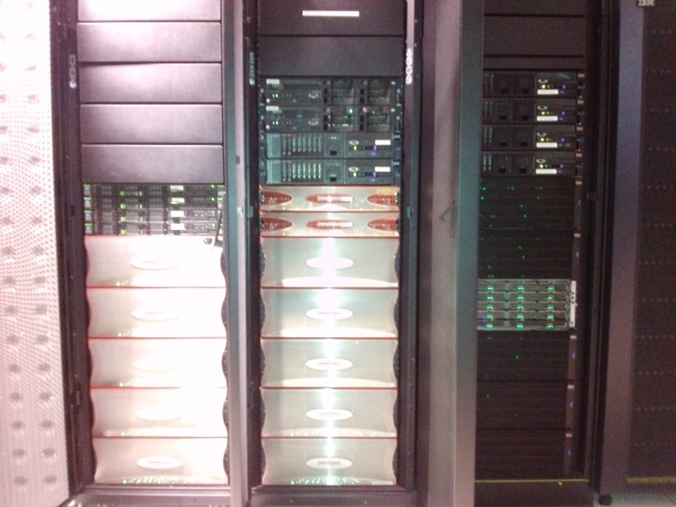
ALTAMIRA & VO DATA (CMS)
Now all VO Data is accessible from any ALTAMIRA node
Install cvmfs and assure all nodes can access IFCA squid servers
[root@node1 ~]# df -h
Filesystem Size Used Avail Use% Mounted on
/dev/sda4 428G 2.1G 404G 1% /
tmpfs 32G 0 32G 0% /dev/shm
/dev/sda2 248M 63M 173M 27% /boot
/dev/sda1 50M 252K 50M 1% /boot/efi
/dev/projects 262T 175T 88T 67% /gpfs/csic_projects
/dev/gpfs_cms 874T 582T 292T 67% /gpfs/gaes
/dev/gpfs_users 5.5T 2.0T 3.6T 36% /gpfs/csic_users
/dev/res_projects 88T 29T 59T 34% /gpfs/res_projects
/dev/res_scratch 88T 2.5T 85T 3% /gpfs/res_scratch

Slide 16
SATISFYING LOCAL USER ANALYSIS PEAK DEMANDS
ALTAMIRA jobs are limited to 72 hours, typically using 32-512 cores
Short jobs ( below 6 h ) are prioritized to optimize filling
Instantaneous “large & efficient” capacity using embarrassing parallel jobs: “wrap” multiple jobs, demand large number of cores!
CMS use case:
  Analysis jobs launched get access to the Tier-2 file system, including official CMS software and data
  Intensive data processing jobs: CMS EDM event selection and filtering (aka skimming), and ROOT Tree production
  Multiple batch submissions each wrapping ~ 150 jobs
  Carefully balance between total number of jobs, complexity of scripts and control, and saturation of data transfer capacity
Typical reduction of waiting time, compared to analysis in Tier-2:
an order of magnitude

Slide 17
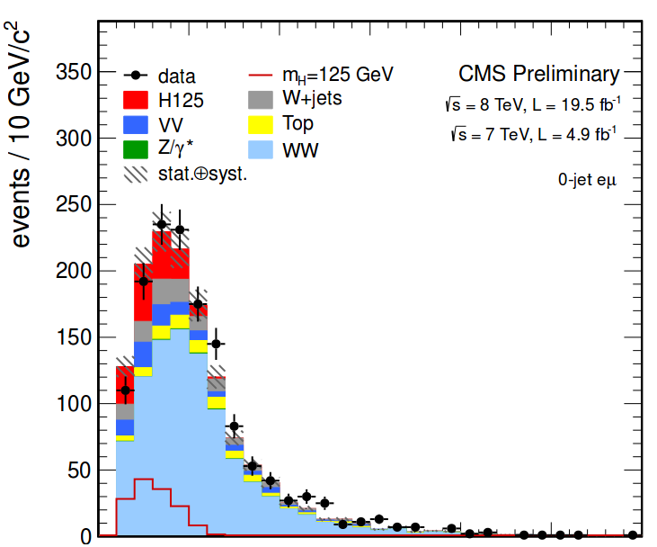
SATISFYING LOCAL USER PEAK DEMANDS
Real example (April 2013): Skimming and ROOT Tree production over 2012 data samples for a real SUSY search analysis
  257.000 CPU hours
  17 TB Data Input (3 loops)
    13TB at /gpfs/res_projects/csic/
    5TB at /gpfs/csic_projects/cms/
  2.5TB Data Output
    Moved to /gpfs/csic_projects/cms/
      Accessible to CMS Tier3
      Accessible to SRM
Estimated time for processing in Tier-2: two months
Finished in ALTAMIRA in less than one week
  High Data Throughput (R/W)
  No stageout fails (Sataured SRM)
  Multiple batch submissions (150 jobs)

Slide 18
CONCLUSIONS
ALTAMIRA supercomputer: an ideal system for LARGE DATA PROCESSING
INTEGRATION with TIER-2 RESOURCES: LDAP, GPFS
GPFS over INFINIBAND assures very good data transfer to any node
VO software (CMS) was installed with low managerial effort (through CVMFS).
CMS researchers were required to introduce only a very small modifications on their job submission scripts
Typical reduction of waiting time, compared to our Tier-2:
an order of magnitude faster!
(from months to weeks, or from weeks to days)
More than 500K hours used during 2013 in HWW, top and SUSY analysis (results already published in papers)
AND THE KEY ADVANTAGE:
Extra & efficient power available for analysis at peak periods

