Slide 1




WLCG Security:
A Trust Framework for Security Collaboration among Infrastructures
David Kelsey (STFC-RAL, UK)
CHEP2013, Amsterdam
17 Oct 2013

Slide 2
And many thanks to SCI members
K. Chadwick (FNAL)
R. Cowles (Univ of Indiana)
I. Gaines (FNAL)
D. Groep (Nikhef)
U. Kaila (CSC)
C. Kanellopoulos (GRNET)
J. Marsteller (PSC)
R. Niederberger (FZ-Juelich)
V. Ribaillier (IDRIS)
R. Wartel (CERN)
W. Weisz (University of Vienna)
J. Wolfrat (SURFsara)

Slide 3
Outline
What is Trust and why do we need it?
Early days of cooperation in security policy
Building a new Trust Framework
  Security for Collaborating Infrastructures (SCI)
The SCI document
Assessment versus SCI requirements
Future plans

Slide 4
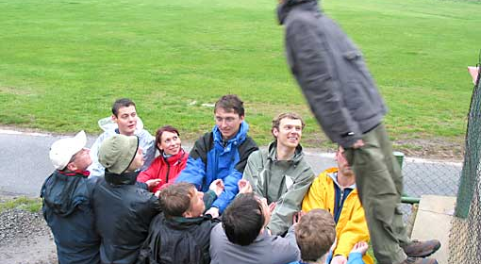
Trust?

Slide 5
A better definition of Trust
eXtreme Scale Identity Management for Scientific Collaborations XSIM (Bob Cowles)
  “Trust is a disposition willingly to accept the risk of reliance on a person, entity, or system to act in ways that benefit, protect, or respect one’s interests in a given domain.”
Based on Nickel & Vaesen, Sabine Roeser, Rafaela Hillerbrand, Martin Peterson & Per Sandin (eds.), Handbook of Risk Theory. Springer (2012)

Slide 6
Risk Management & Trust
Management of IT security
  Management of risk
  balanced with availability of services
Risk analysis
Security Plan
    to mitigate and manage the risks
Security Plan includes various “Controls”
  Technical
  Operational
  Management
Security Policy is part of Management Controls
Agreed policy framework – part of building trust

Slide 7
Early days of Grid Security Policy
Joint (WLCG/EGEE) Security Policy Group
We (EGEE, OSG, WLCG) agreed a common version of the Grid Acceptable Use Policy
EGI and WLCG in general continue to use the same Security Policies
BUT often not easy to agree on identical policy words
We need a better way of agreeing policy

Slide 8
And now to SCI …

Slide 9
Security for Collaborating Infrastructures (SCI)
A collaborative activity of information security officers from large-scale infrastructures
  EGI, OSG, PRACE, EUDAT, CHAIN, WLCG, XSEDE, …
Developed out of EGEE – started end of 2011
We are developing a Trust framework
  Enable interoperation (security teams)
  Manage cross-infrastructure security risks
  Develop policy standards
  Especially where not able to share identical security policies

Slide 10
SCI Document
V1 of the SCI document was submitted to ISGC 2013 proceedings
  Will (hopefully) be published soon
Latest public draft always at
http://www.eugridpma.org/sci/

Slide 11
SCI: areas addressed
Operational Security
Incident Response
Traceability
Participant Responsibilities
  Individual users
  Collections of users
  Resource providers, service operators
Legal issues and Management procedures
Protection and processing of Personal Data/Personally Identifiable Information

Slide 12
SCI example text:
Incident Response
Imperative that an infrastructure has an organised approach to addressing and managing events that threaten the security of resources, data and overall project integrity.
Each infrastructure must have:
[IR1] Security contact information for all service providers, resource providers and communities together with expected response times for critical situations.
[IR2] A formal Incident Response procedure, which must address roles and responsibilities, identification and assessment of … (text continues)
And continues …

Slide 13
SCI Assessment of maturity
To evaluate extent to which requirements are met, we recommend Infrastructures to assess the maturity of their implementations
According to following levels
  Level 0: Function/feature not implemented
  Level 1: Function/feature exists, is operationally implemented but not documented
  Level 2: … and comprehensively documented
  Level 3: … and reviewed by independent external body

Slide 14
A fictitious assessment

Slide 15
Future plans
Version of 1 document
  Now working on a background section and a glossary
Consult Infrastructure Management
  Feedback on SCI document
Perform self-assessments
Refine the SCI document
Others are welcome to join
  Contact me

Slide 16
Further info
Security for Collaborating Infrastructures
http://www.eugridpma.org/sci/
SCI meetings
https://indico.cern.ch/categoryDisplay.py?categId=68

Slide 17
Questions?

