Slide 1
An SQL-based approach to Physics Analysis
M. Limper

Slide 2
Intro
The challenge: stress a database engine by forcing it to do physics analysis:
  Store analysis data in relational database
  Complicated SQL queries
  Calls to external C++ libraries
  Let the database take care of parallelism

Slide 3
Analysis data in a relational database
Test with root-ntuples (D3PDs) produced for ATLAS top-physics group
  Sub-set of 7.2 million events (27 ntuples)
  ~4000 variables (“branches”) stored in event-tree
DB design uses different tables for different physics-objects
  Many columns per table

Slide 4
Physics Analysis in SQL
Make temporary tables using the WITH-AS statement:
WITH goodmuons AS (SELECT … FROM muon WHERE pt>25.)
JOIN statements on the RunNumber,EventNumber put information from the different selections together:
SELECT … FROM good_muons INNER JOIN good_bjets USING (RunNumber,EventNumber) WHERE goodmuons.N=2 AND goodbjets.N=2
Simple calculations were written in (PL/)SQL
Code from external C++ libraries was used for more complicated calculations

Slide 5
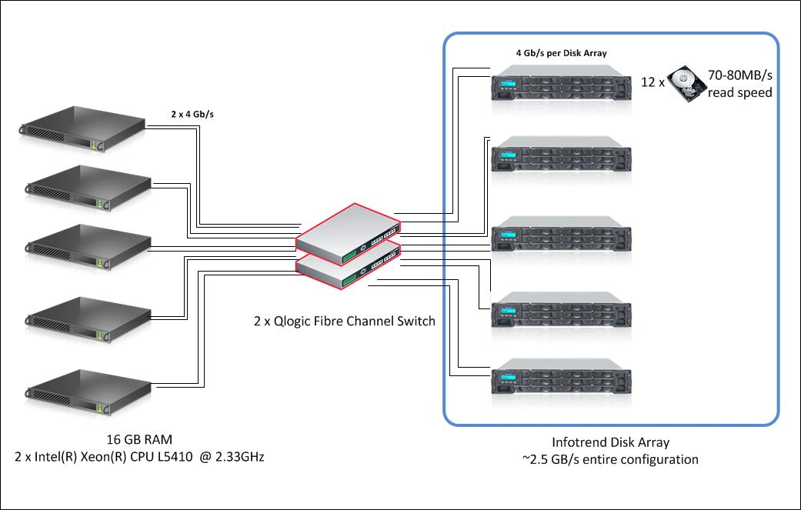
Test setup
5 nodes with 40 cores total
5 disk arrays each with 12 disks
max. I/O reads of ~2500 MB/s
Compare performance on Oracle RAC with 1-job-per-core ntuple-analysis

Slide 6
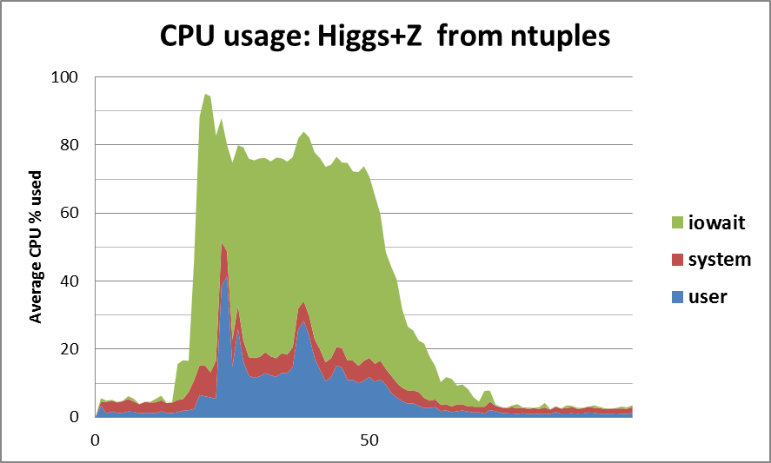
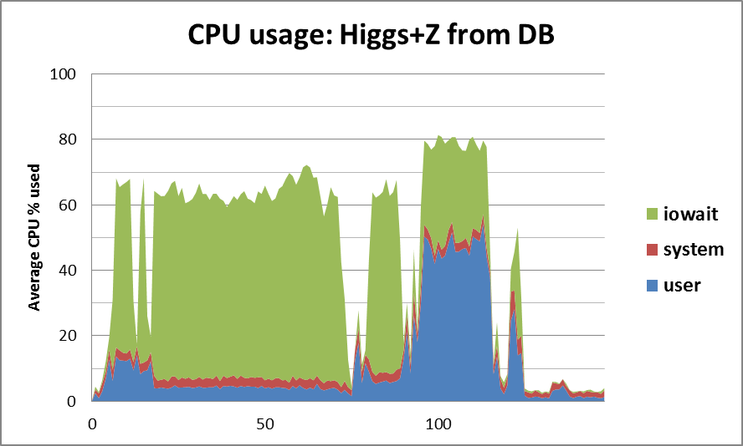
Benchmark 1.
  Simplified Higgs+Z: compare simple root-macro with SQL-query returning same results
In both cases limited by iowait !
I/O reads for root-ntuple analysis 10x less than for DB
40 root-jobs:
71 seconds
SQL parallel 40:
135 seconds

Slide 7
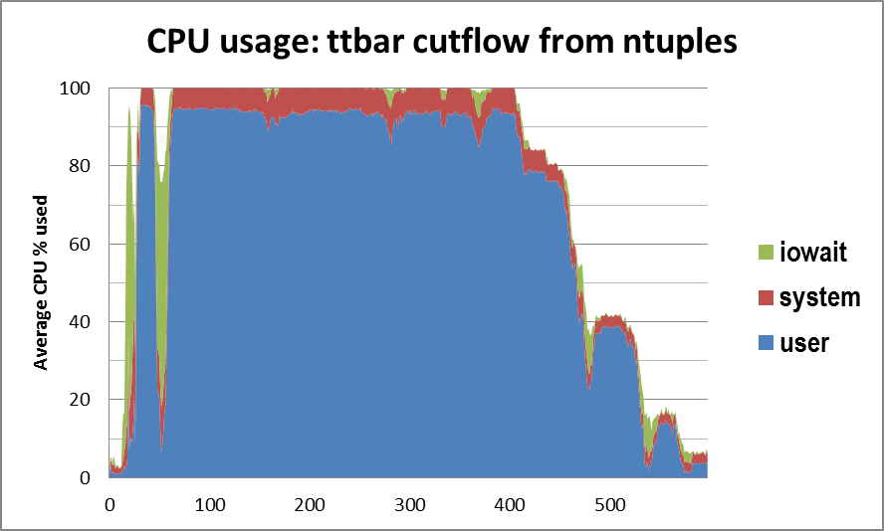
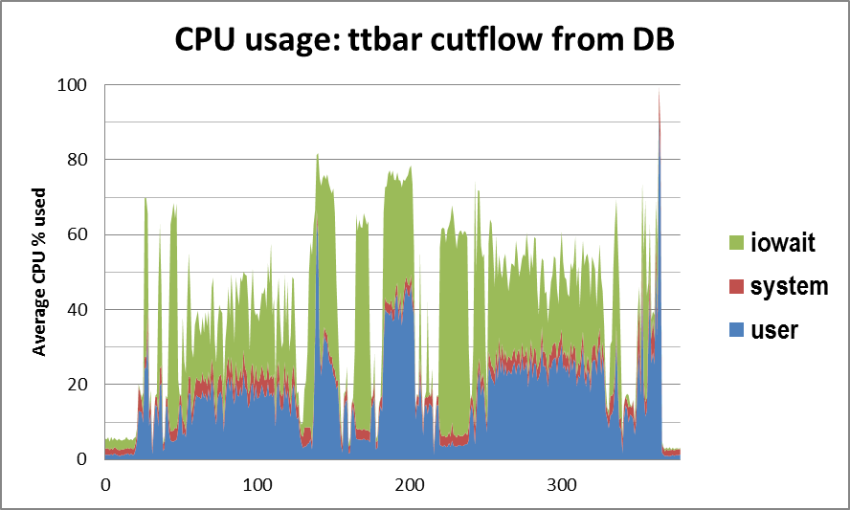
Benchmark 2.
Ttbar cutflow: compare existing ‘root-core’ packages with modified version that constructs SQL-query
40 root-jobs:
588 seconds
SQL parallel 40:
372 seconds

Slide 8
Conclusion
SQL-based physics analysis using data stored in a relational database could reproduce results from root-ntuple analysis’
  Database takes care of parallelism
  Row-based storage in combination with wide tables limits performance by the I/O read speed of the system

