Slide 1
Data processing in the wake of massive multicore processors
How our software infrastructure is evolving to meet changes in the large-scale computing environment
Jim Kowalkowski
Fermi National Accelerator Laboratory

Slide 2
Moving away from the simple commodity cluster
The computing environments that run our major event-processing framework software are changing. These frameworks have been evolving to accommodate this change. The changes need to go quite a bit further, to better handle coprocessors with alternative architectures.
Are we going far enough with our software framework and related infrastructure?
By the way: Heterogeneous computing is back
Notes:
My claim is that we are “Moving away from the simple commodity cluster.”
Some people might view this as exciting right now, but I would not be surprised to mostly hear sighs.
During this talk, I want to explore the question – “Are we going far enough …”
The last point is what I immediately thought of …

Slide 3
Overview
Reminders
  A few reminders concerning the changes
  Changes in computing architecture
Software
  Software development in this future context
  Software frameworks on modern architectures
Programming
  Aspects of programming many-core
  Already visible software issues
Putting it all together

Slide 4
A few reminders

Slide 5



The changes are real
Reminder
What specially am I talking about?
  The many-core processor, not the multicore processor.
  The accelerator or coprocessor
  The Nvidia GPGPU and the Intel Xeon Phi are the best examples out there
The computing challenge has been recognized nearly everywhere, as evident from the R&D groups that have popped up over the past couple of years.
From the frameworks perspective, the focus has been on multicore, which of course is an excellent start – but does it go far enough?
Concurrency Forum at http://concurrency.web.cern.ch/
Software Engineering, Parallelism & Multi-Core – Track 5
Event Processing, Simulation and Analysis – Track 2
Notes:
This is a reminder slide – The changes towards coprocessors is real.
Today I will talk more about the general principals that affect the software systems, not just because of multicore, but also because of many-core.
For the purpose of this talk, an accelerator and coprocessor are the same thing. The term coprocessor will be used in this talk
R&D groups that have popped up within CERN, FNAL, and LBNL, and elsewhere to at least partly address these concerns at the LHC experiments, as well other areas of High Energy Physics.
Concurrency forum has done an excellent job at keeping track of the various efforts out there and the projects that are being developed.
--------------------
Big ones are: Gaudi Hive, multicore CMSSW, Athena MP, Geant4 MP and the reengineering project to name the ones I am most familiar with.

Slide 6
The changes are fundamental
Reminder
The many-core computing change
  Large core counts is primary focus
  Slower cores with reduced memories, reduced operations, and much greater vector processing.
  The larger leadership class machines have been headed in this direction, but also include multiple high speed interconnects.
Even the simpler commodity-computing environment is changing.
  ARM based server announcements.
  PDAs replacing laptops and laptops have been replacing desktops.
  Integrated CPU-GPU systems.
Notes:
Many of the key concerns have been focused on large core counts, …
Our friends in accelerator modeling, LQCD, and Computational Cosmology have embraced this technology long ago. They have well-established relationships with the HPC community in the US. This adventure is largely just starting for our development team for HEP applications.

Slide 7
Changes in architecture

Slide 8
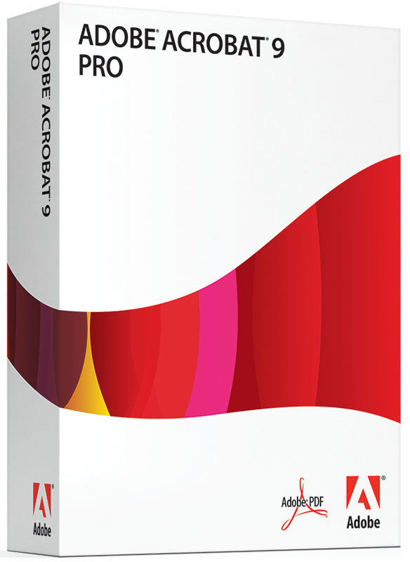


Mainstream Computing in HEP
Architecture
Heavyweight cores made life easy
  Endless memory
  High-level languages
  Single architecture
  Single OS (mostly)
Are we spoiled?
Must all good things come to an end?
Notes:
Let’s look at the current computing environment.
In my opinion, this era has been a golden age, culminating in multi-gigabyte user applications – look at adobe reader and MS office and Eclipse.
HEP was not immune to this – how many remember the earlier memory footprints of CMS and ATLAS?
The microprocessors we use are beautiful in design and function: instruction scheduling, guessing branches, sophisticated caching. Unfortunately the work done for the computational output has become too high given limited resources and even-increasing needs for processing - making the field ripe for alternative technology to squeeze in.
The underlying machinery that has made our lives so straightforward, hiding all complexity and making us ultra productive has also made us gluttons.
I this that developers are somewhat spoiled – it is amazingly easy to suck up all the resources that are available and the standard x86 helped.
For a long time, the doubling of available hardware resources every two years was great and made this easy.
I think the eventual breakdown of this mindset could be seen, but there was always faith in future technology.
An overall cost/benefit analysisof the work in this era would be interesting but very difficult.
--------
The focus on object-oriented C++ and abstraction layers did not help.
Feed a dog high quality beef and he will point is nose up at you when presented with a real bowl of doggy food.
Looks like there is at least a doubling of the size of things from D0/CDF days to CMS/ATLAS days.
Many people I knew who took part in design and code reviews during this period with training from the previous era of specialized processors and programming with limited abstractions and multiple platforms saw that things were not quite right.

Slide 9
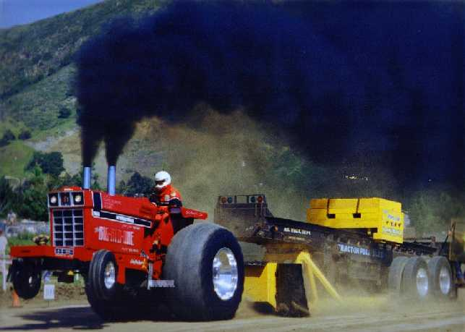
On the horizon
Architecture
Top 10 supercomputers –
  Where is money being spent?
  Who is driving change and innovation?
Looks like they are moving towards a more useful measures of effectiveness: cycles of computing accomplished for the energy used.
Note that the core counts are not all that exciting, as perhaps we expected a few years back.
Rank | Name | Total Cores | Processor | Mflops/Watt | Coprocessor
1 | Tianhe-2 (MilkyWay-2) | 3120000 | Intel Xeon E5-2692 12C 2.2GHz | 1901.54 | Intel Xeon Phi 31S1P
2 | Titan | 560640 | Opteron 6274 16C 2.200GHz | 2142.77 | NVIDIA K20x
3 | Sequoia | 1572864 | Power BQC 16C 1.600GHz | 2176.58 | None
4 | K computer | 705024 | SPARC64 VIIIfx 8C 2.000GHz | 830.18 | None
5 | Mira | 786432 | Power BQC 16C 1.600GHz | 2176.58 | None
6 | Stampede | 462462 | Xeon E5-2680 8C 2.700GHz | 1145.92 | Intel Xeon Phi SE10P
7 | JUQUEEN | 458752 | Power BQC 16C 1.600GHz | 2176.82 | None
8 | Vulcan | 393216 | Power BQC 16C 1.600GHz | 2177.13 | None
9 | SuperMUC | 147456 | Xeon E5-2680 8C 2.700GHz | 846.42 | None
10 | Tianhe-1A | 186368 | Xeon X5670 6C 2.930GHz | 635.15 | NVIDIA 2050
Notes:
What is on the horizon for us is out there in other areas of scientific computing – not far beyond our reach
Look at the top 10 supercomputers. The rank is from fastest to slowest based on the speed of the Linpack benchmark (in Tflops/Sec)
Many are mixed (standard CPU) environments with phi or GPGPU coprocessors.
I know that Mflops are not that exciting for us, but the important aspect is that the energy it takes to do our calculations is now relevant.
We were laughingly discussing horsepower as an interesting way to discuss power needed to complete a task.

Slide 10
An quick aside …
Architecture
Note that our old friend the heavyweight multicore cluster node has not changed much regarding core counts.
  Nothing greater than 16 cores per nodes on the top ten!
Note that high-speed networking is important on the top ten. This is now affordable, even at speeds of 40Gb/s.
  Does this mean anything for computing.
  At this speed, is it cheaper to move things around the network than to store and move files?
  Are there advantages to protocols outside TCP/IP over ethernet?
Notes:
I’m not sure all of us were so sure that the many-core machine was going to be so widely available, so soon.

Slide 11
Many-core: Available now
Architecture
Key features that impact software frameworks
  Lots of cores and support for many threads
  Low power given the computing resources
  Low memory per thread
Other key aspects
  NVIDIA K20: unusual synchronized thread operation
  Xeon Phi: Big 512 bit VPU registers
 | Phi | K20
Power | ~300W | ~235W
Cores | 60 | ~2500
Threads | 60*4=240 | 2048*13=26624
Memory / thread | 8GB/240=33MB | 32 regs + 24KB shared
Most interesting is how many-core affects event processing applications
Notes:
This is not a hardware talk, but there are key features worth mentioning –
Most important here are the things that do affect the software frameworks and event processing applications.
I am sticking to the concrete architectures that are available now. Here are the key features of the K20, Phi.
For the current K20, the key features that directly affect our ability to program them (inhibit or enable) to do useful work are still the low memory available per thread and the simultaneous compute capacity of >2500 cores.
The MIC Phi processors have a total of 240 threads available across the 60 cores. The memory is still very much limited to about 32MB/thread (based on 8GB total). There is also the VPU with 512 bit SIMD registers.
Can it be evaluated for K20now? Not straightforward. The threads cooperate and the programming view is somewhat abstracted from the hardware view. As an example, at full occupancy, assuming this can be done with the algorithm, 1024 threads (the maximum per block) can use 32 registers and share about 24KB of high-speed memory.
--------
Our system: Intel Xeon Phi 5110P (16)
K20 can do 1.2 Tflops

Slide 12
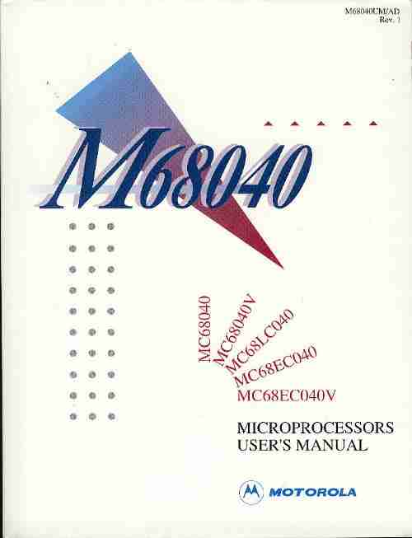
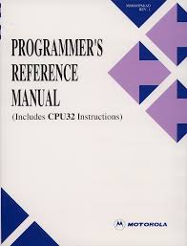
Past: Remembering days gone by
Architecture
Does anyone remember the era on the left?
What was unique about it?
Are the good times over or have they returned?
Does anyone remember running these things without an OS?
Notes:
Let’s step back for a moment to the era before the mainstream x86.
Does anyone look fondly at the manuals on the left?
I remember in these earlier days we needed to know nearly everything about the processor. In a way, it guts were laid open and to get anything done that was worthwhile required a good strong effort. This was especially true of us who worked in the embedded computing area.
How many of us wrote mini-operating systems or at standalone barebones programming environments for these processors?
Are we headed back there? We were not afraid then, should we be now?
Are we now too specialized now to care about such details? Is this sort of work still rewarding or even valued any more?
--------
Who wants to go back to eating spam after enjoying tenderloin?

Slide 13
Software development in this future context

Slide 14
Modern software on current cores
Applications
What has the large-core processors brought us?
Languages
  Java, Javascript, PHP very popular
  C++
    still an interesting choice
    what do many people outside of HEP say about it?
    How well do people know it?
Complexity
  Performance is difficult to quantify, even with the extremely advanced tools of today.
  Still difficult to estimate performance changes from measurements
  Many interacting parts contribute to this
Notes:
Before we get started with discussing software on many-core systems, I want to mention make one more point about current-era software with regards to development.
What has the processor of today brought us to regarding development?
Java came about. Javascript is everywhere. But we have mostly not moved in this direction.
C++ is still here and is strange one - trying to be broadly accommodating. What do people outside HEP say of it?
Some say it’s a thing of the past because it is too complex and requires too much thinking because of its strict typing.
Are they correct? If the language is used poorly than I guess yes, otherwise no.
With the complexity of the current heavyweight core, it can be difficult to quantify performance in a way that attributes work done to the various internal components. It is easy to measure many things, but not easy turning the collected data to valuable information that helps us predict how non-trivial changes affect code performance.
--------------
I think this illustrates the need to simplify in order to increase the performance.
As aside - How many have interviewed people for C++ positions recently? How well did it go? Do the candidates have the diverse skills that were available 10 years ago or so?

Slide 15
Living within the future context
Applications
What has our software infrastructure team been doing to accommodate these hardware changes?
A clash of thinking
  Have you worked with people that have been using complex parallel-capable machine for years?
  What about optimizing the computational kernel after locating it?
Still a mismatch for many-core
  Irregular problems and workloads
  Reduced flexibility changes programming patterns
  Slow progress in showing reasonably good value
Is more code design actually going to be necessary?
Notes:
Well, there is still a clash of thinking with other organizations: Our HPC acquaintances have experienced what we now face from almost the beginning with software – many special cases.
Have any of you heard “let’s find the kernel and optimize the hell out of it” from an expert? What about “we may need to turn the computational kernels from code that you somewhat understand into an incomprehensible blob that incorporates all the most primitive, architecture and platform-specific functions as possible for this to really work” ?
What to others say about the C++ choice? HPC still says the virtual function overheads and all that OO abstraction stuff make it useless where performance must be squeezed out and C is one of the ideal languages.
The architectures and integration are different on these processors. The compromises in programming flexibility for lower power and needs for greater computational load are leading to problems for us.
Why should this be the case? As you know, much of the pattern recognition, clustering, and decision codes we have are classified as irregular (meaning not on a regular grid). There architectures, with their segmented memories, large vector units have not traditionally been geared for these types of problems. This has made progress slow for showing reasonably good value.
The latest version of these processors show good signs of moving in our direction.
One thing to consider during this talk: More design will be needed.
-------
Our close friends in LQCD, accelerator modeling, and computation cosmology know the HPC people well (at least regarding HPC).

Slide 16
Why all the excitement?
Applications
Are massively parallel platforms really all that interesting?
Software frameworks are used to define our applications
  Organization and programming of these will be the my focus
Key changes to software requirements to watch for
  The Goldilocks effect: choosing just the right unit of work
  Extra steps likely needed: ordering and summarizing partial results
Notes:
NEED TO BE AT ABOUT 10 minutes HERE.
So in the end, why all the excitement?
to a large extent, the software frameworks are used to define our applications, so the organization and programming of these will be the my focus
I also believe they are one of the main elements of successful large-scale collaboration and code sharing.
Key things to watch for as the discussion here unfolds…
------------- not relevant for this section ---------------
Framework requirements for organization change
Units of work must be computationally big enough and similar enough, but not too big in size.
Global services are harmful.
Global variables and side effects are destructive.
The event representation is subject to fragmented access.
The summary are subject to unordered delivery making coordinated state transitions difficult.
Headed towards a more integrated approach?
The breakdown of separately developed workflow management, short-term storage, science code infrastructure has already begun.
Need at least anecdotal evidence here.
The important items are coordinated access to many resources, with locale as one of the important items for efficient computing as well as for data access.

Slide 17
Software frameworks on modern architectures

Slide 18
An essential organ:
The standard framework
Frameworks
Event Processing Framework: Software that coordinates the processing of collision events by pluggable reconstruction, filtering, and analysis modules. Events and modules are independent. Modules add data to and retrieve data from one event at a time.
Calibration
Timing
Message Logging
Services
HitFinding
Tracking
MuonTracking
ParticleID
Modules
Reader
Writer
Current Event Store
Data Model
Event
Loop
Data-flow
Control-flow
Notes:
I pulled this slide from a old talk. To a large extent the frameworks that are in operation still have this processing model. For C++ frameworks, this dates all the way back - before 2000 - although the facilities used and the capabilities of the current ones are far more advanced than the earlier ones. The implementations of scheduling and interactions amongst the components differs by experiment, but all of them largely fit this definition, with ROOT as the main I/O format for the readers and writers. The blue boxes represent the different flavors of “plugin”.
The impact on these frameworks and the various plugins will be large due to many-core processing, partly because it is where major APIs and protocols exist.
Any established rules for development will hinder or help progress towards better performance.
-------------
Explore parallel track-2 for discussions on how these frameworks are evolving (over the past two years) to accommodate multi-core.

Slide 19
Assumptions for this discussion
Frameworks
Event time and size estimates from CMS
  ~10-30 seconds for reconstruction
  1-20Hz processing rate for skim jobs
  1MB event size during reconstruction
  150KB size for AOD
Assuming that the processing times will be 10x bigger in next run
Bandwidth estimates based on these numbers and only on input data rates.
Notes:
CMS:
~10-30 sec reco time.
800M-1B events per month,
1-2MB reco event size,
1-20Hz for skim jobs,
AOD events are about 150KB,
reco time needs to be about 10x better to handle pile-up / lumi for next run.
What fraction is spent in CPU time reading and writing data (and compressing it)?
AOD = analysis object data

Slide 20
Let’s start from where we are now
Frameworks
Same old organization
  Serial processing of events
  One processor per core
New
  Rules for making thread-safe module code
  Removal of global variables
  Addressing global service issues
Memory
Event Processor
1
Event Processor
2
Event Processor
8-32
Core 1
Core 2
Core 8-32
I/O System
Disk
Network
3MB/s * 32 = 96MB/s (AOD)
100KB/s * 32 = 3.2MB/s (Reco)
Console
File Serving Infrastructure
Notes:
Now: One event processor per address space, per core, per node
(note – the Copy On Write framework additions provide value, but the organization shown still holds)
New:
Establishment of development rules - somewhat understand rules for making thread-safe code within a module.
Moving global variables out. Moving global services into a different form.
Other than this, the frameworks still have the familiar processing model.
See the bandwidth numbers.

Slide 21
Framework reorganization
Frameworks
Key principle: Work is assigned to tasks, and tasks are scheduled to run on cores.
  Intel Threading Building Blocks (TBB) operates like this and is commonly used
  Parallelism at the event, module, and algorithm level all available
  Framework schedules streams and modules, algorithms can generate more work
E
Event paths
Event
Service
Stream 1
ModA
ModB
Input
Output
Event
Service
Stream 2
ModA
ModB
Event
Service
Stream J
ModA
ModB
Event
Processor
Task 1
Task 2
Task M
Notes:
As everyone probably knows, many of the frameworks are being reorganized to deal with multi-core / multi-threading issues. Here is a simplified view of some of the organizational changes.
Many projects are similar to this, or permit the same degree of flexibility and parallelism.
There can be support for parallelism at all levels: multiple events using streams, modules that can run at the same time.
Algorithms within modules doing parallel tasks can internally generate more work.
Producer event path streams = provides serial modules for one event, but multiple events.
Analysis = parallel for all modules for an event.
Assume input and output are isolated systems, subject to the underlying available resources for reading and writing data.
Again, there are talks in track-2 that discuss the technical details of these changes.
------
Need a way to view parallelism and ours is not that different than the rest.
Most projects permit similar parallelism with different internal organization
I/O is still a special subsystem, even though
Our processing model (simplified). This model allows for an enormous amount of flexibility.
Streams permit multiple events to be processed, each executed within a task, modules operate within streams and can internally generate more parallel work (completed within more tasks).
For some of us: Utilizing the tried and true queuing system single producer / multiple consumer.

Slide 22
Near future framework
Frameworks
Focus on multi-core heavy-weight “serial cores”
Some goals
  Reduce memory use
  Maintain processing efficiency
  Reduce run latencies
  Allow multi-threaded algorithms
  Multiple active events
Memory
Event Processor
Core 1
Core 2
Core 8-32
I/O System
Disk
Network
3MB/s * 32 = 96MB/s (AOD)
100KB/s * 32 = 3.2MB/s (Reco)
Console
File Serving Infrastructure
Notes:
Most important is the focus on multicore and continued use of heavier weight “serial cores” for doing the bulk of the work.
The many-core machines have mainly been used for developing and testing specific algorithms.
The current workflow expressions of linear paths or desired end data products still holds.
Note that the estimated input bandwidth on the node remains the same.
(Certainly an important feature will be to permit multiple events to be actively processed at the same time within one application.
How many will be need to support at once? )

Slide 23
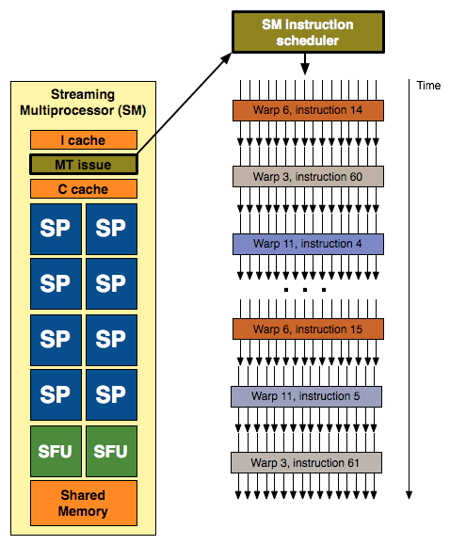
The many-core coprocessor
Frameworks
Small memories
Simple cores
Data transfer costs
Lock step operations
Specialized languages
Global Memory
Local Memory
Local Memory
Local Memory
Thread 1
Thread 2
Thread M
Core 1
Core 2
Core N
I/O System
PCIe
Network
 | Phi | K20
Cores | 60 | ~2500
Threads | 240 | ~26624
Memory / thread | ~33MB | 32 regs+24KB shared
Notes:
Now comes the many-core coprocessor into the mix. So let’s go into a bit more depth about its capabilities and organization
I do not think the huge counts on the K20 should diminish the capabilities of the Phi, they are not that straightforward to compare …
Key: this processor is currently a separate entity on the peripheral bus of a host machine (PCIe).
---------------
Relationships between cores and threads (or tasks) varies from processor to processor.
The memory system varies widely amongst processors.
The rules of execution vary widely.
The capabilities of the processors vary wildly.

Slide 24
Where are we heading?
Frameworks
10x compute capacity?
Low overhead scheduling and coordination essential
Is the bandwidth increase an issue?
Event Processor
Memory
Core 1
Core 2
Core 8-32
I/O System
Disk
Network
Coprocessor
1
Coprocessor
2
Coprocessor
3
Coprocessor
4
3GB/s (AOD)
102MB/s (Reco)
Console
File Serving Infrastructure
Notes:
So now let’s looks at a node with many-core processors.
Is it possible to think of 10x compute capacity? (many – more reasonable is perhaps 5x). Cost effective? (likely if the programming issues are diminished)
Goal: Solving the low-overhead scheduling needed for a node with many light-weight cores and some tightly coupled serial heavyweight cores.
Serial heavy-weight cores will do the coordination. They will aid in the computational codes and participate in the I/O.
The high performance cores will need to take on a majority of the computational work.
Big Core count remains the same (8-32)
Load balancing will become more relevant. With an 5-10x increase in computational capabilities, a problem with data bandwidth and data serialization is likely to crop up.
It will be easy to overload the processor that is easiest to program, which is likely going to be the coordination processor.
Data exchange and sharing within and between computational areas (GPU processor or Phi processor) is likely to increase, meaning that a portion of our coordination software may need to be present on the light-weight cores.
--------------
~570 Gflops with Linpack benchmark
Framework - one task per concurrent module, module generates additional tasks as necessary

Slide 25
Where are we heading?
Frameworks
  Now a distributed framework?
  Coordination of separate memories
  EDM and data sharing affected
  Load balancing difficulties
  Must not overload serial cores
Is this an intermediate step?
Event Processor
Memory
Core 1
Core 2
Core 8-32
I/O System
Disk
Network
Coprocessor
1
Coprocessor
2
Coprocessor
3
Coprocessor
4
3GB/s (AOD)
102MB/s (Reco)
Console
File Serving Infrastructure
Notes:
And what does this mean for our software framework?
Achieving a balanced load will be very difficult.
The tools and services that aid in debugging, diagnosing problems, and evaluating performance will be more important than ever. The framework will need to be able to collect data for these purposes, and help management the tools that are available through services.
However, I think this is still an intermediate solution … (go to next slide)

Slide 26
Is this still a coprocessor?
Frameworks
SICore = serial, integrated core
  ARM?
  PowerPC?
Shared memory
  Low overhead communications
  Single address space possible
  Usual coordinated access needed
A Hybrid Processor
SICore 1
SICore 2
SICore J
Global Memory
Local Memory
Local Memory
Local Memory
Thread 1
Thread 2
Thread M
Core 1
Core 2
Core N
I/O System?
PCI?
Network?
Notes:
Let’s keep going – is something like this still a coprocessor?
First note that is has all the the threads and cores we’ve been discussing, with the addition of the “SICore”.
SICore = serial integrated core. Probably not quite as wonderful as the full heavy weight X86 cores we have today, but still very capable for serial loads.
ARM and PowerPC are used in embedded contexts such as this – both might be candidates
I’m going to call this a hybrid node – one capable of mixed workloads with low coordination overhead possibilities
------
What should be said of the ARM64 and PowerPC (A2 or other version) processors? Both make good candidates for embedding close to the GPU cores to serve coordination roles and take processing load that are not suitable for GPU cores

Slide 27
Not that far away
Frameworks
What can we do this something like this?
Are files still useful?
Many options for event processor application
Is 20x - 40x increase plausible?
Event Processor
Global Memory
Integrated CPU
Coprocessor 1
Integrated CPU
Coprocessor 2
Integrated CPU Coprocessor 3
Integrated CPU
Coprocessor 4
I/O System
Disk
Network
3GB/s *4 = 12GB/s (AOD)
102MB/s *4 = 408MB/s (Reco)
Console
File Serving Infrastructure
Notes:
Let’s have a possible view of a node with hybrid processors …
What do we do with this? Maybe support one event processor image?
What are the implications for overall workflows, assuming bandwidths anywhere near those listed?
-------
This must include a densely packed co-processor / processor combo system, like what is in cray xc30

Slide 28
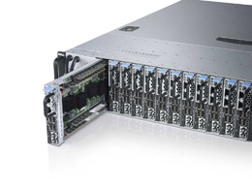
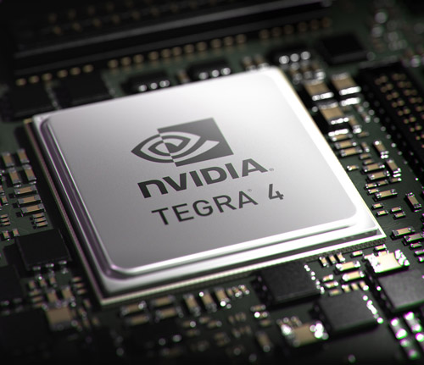
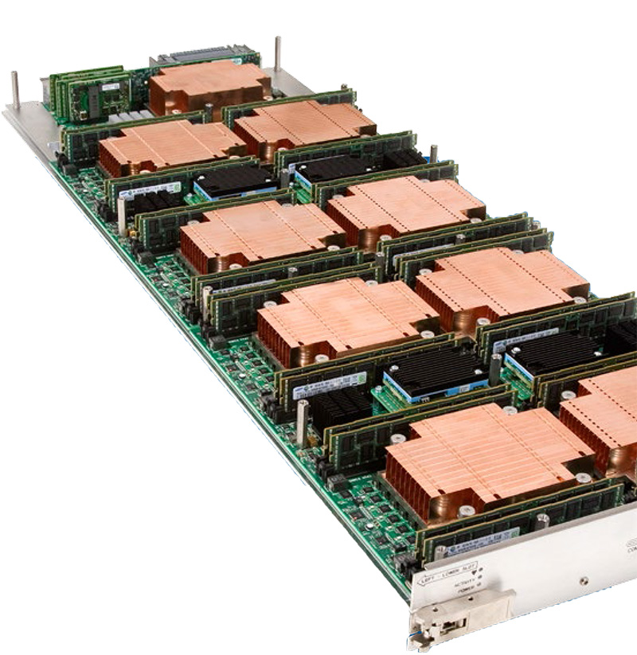
These things already exist
Frameworks
NVIDIA Tegra 4 (hand-helds)
  72 GPU Cores
  Quad-core ARM
Dell Copper
  4 quad-core ARMs per sled
  12 sleds per chassis
Cray XC30 blade
  High density
  multicore, GPGPU, MIC
  Pick and choose
  High-speed interconnect
Dell Copper
Cray XC30 Blade
NVIDIA Tegra
Notes:
Just to make this more concrete – here are some of the resources that can be available.
-----------
Where to these things go?
The portable computer is still important
Everyone knows that under the covers of the Macs we use is a reasonable GPU with CUDA 3.0 compute capability. It hardly seems possible to effectively share code and that will be able to utilize this resource – I mean here cooperatively with the multicore resources available on the machine already. I think this type of machine will certainly evolve, but will always be important for algorithm development and for modest size analyzes.
The system without files (mostly)
Moving data through systems with memory buffering may be an advantage. A 10GbE interface can sustain transfers nearly that rate. What would be different if this, or IB running at much higher rates, is readily available? Would we need to buffer data into disk files at all during intermediate stages of processing, or just at the end where it is rounded up for the final write. Yes, we would need a large parallel writing system to keep up, but now it becomes a specialized part of the infrastructure and not necessarily a piece that needs to be dealt with at the compute part, and additional hardware that must be operated and maintained.
Programming the many-core machines is getting better
The two many-core platforms that are readily available, MIC Phi

Slide 29
Programming many-core
Notes:
Now let’s talk a bit more about the programming aspects…

Slide 30
Programming aspects
Programming
Language extensions and special directives are needed
  Chose CUDA
  Will use the Intel tools: Cilk Plus, intrinsics, pragmas
Our development tools have evolved to incorporate many-core
  CUDA compilation is in our build suite.
  Integrated TBB into our tool chain
  Xeon Phi not far behind
Multiple architecture builds (again)
  Cross compiling necessary
  More than one algorithm implementation likely
  Complicates testing and validation
  Two or more kinds of compiled code available at run-time
  Moving to new externals requires more synchronization
Notes:
What is needed to programs these new machines …
Let’s face it, there will be special programming languages and features to use this hardware effectively.
I do not believe that OpenCL, (always catching up), or that OpenMP (not very rich abstractions) will be universal solutions to sharing code.
Regardless of the platform, we are still using compilers and tools that are specific for this sort of platform. Because of the specialized nature of these compute resources, it is likely that the special purpose CUDA language and the Intel-specific directives, intrinsics, and language extensions are here to stay. Sure, it is easy to look at the Intel MIC and conclude that because there is overlap and commonality of the basic instruction set, that this will surely make things easier. I am not so sure about this after looking through the vast number of assists that are available for utilizing the resources well.
These machine-specific programming features complicate every aspect of programming – from coding (perhaps three or more times with partial overlap!) to validation and testing. Each of these systems will embed the co-processor code into the host executable using cross-compilation tools. This will affect the development tool suites, release management, and moving to new compiler versions.
We currently have parts of the CUDA tool chain incorporated into our build system and are able to build mixed executables. We have just begun to do the same integration work for the Intel tool suite with the intent of using the Phi as a co-processor.
--------
We focused entirely on using CUDA – mainly because the language was already maturing when OpenCL arriving and there were no reports of catching up with regards to performance.
The algorithm work contains use-case algorithms that have been broken down into stages using a mixed processor environment and multiple programming techniques (TBB, CUDA host compiled code, hand code use of array and structures) within the control from the art framework. The early results of the algorithm work were discussed at a concurrency forum meeting.

Slide 31
More programming aspects
Programming
Programming the many-core machines is getting better
Dynamic parallelism and Hyper-Q
  Hyper-Q = many processing streams active at the same time
  Dynamic parallelism = GPU functions can start more GPU functions without returning control to host
  Allows for more than one independent activity on the GPU
Overlap of transfers and computation boosts performance
  Hides the transfer latencies present in the current series of processors
Notes:
I would like to say again that things are getting much better. On the bright side, I do recall that not many years back the many-core machines were barely approachable. The only game in town was the NVidia GPGPU and it was a challenge not only to code an algorithm to run, but to get any performance at all. The newer systems with compute capabilities 2.x make programming a bit smoother even though the constraints in using the cores and memory hierarchy are very similar.
The Hyper-Q and dynamic parallelism capabilities are relevant and important for framework and algorithmic development.
There is still plenty of work left in testing the limits and flexibility of the overlapped communications and computations to see how an event processing framework might take full advantage of them.
Both are necessary to keep the GPU busy without incurring communications and call overheads.
The dynamic parallelism feature will now permit elements of the software framework scheduling within the GPU.

Slide 32
Affected framework areas
Programming
Current HEP cluster defined as High Throughput (HTC), not High Performance (HPC)
  Increase in node capabilities will stress the I/O systems
A more distributed framework will affect the
  Scheduling of work (TBB will help, data dependencies more visible)
  Event data model (EDM delayed reading or loading is troublesome)
  Configuration (boundaries and constraints more important)
  Services (global will need to be eliminated)
Larger scale distributed reductions (sums and aggregations) will be necessary
Handling synchronization points such as runs and other event groupings become more complex
 | 1 core | 32 cores | 256 cores | 512 cores | >1024 cores
150KB @ 20Hz | 3MB/s | 96MB/s | 768MB/s | 1.5GB/s | 3GB/s
1MB @ .1Hz | 100KB/s | 3.2MB/s | 25MB/s | 51MB/s | 102MB/s
Summary of bandwidth guesses
Notes:
For the frameworks we support at Fermilab, what are some of the “affected framework areas” ?
HTC - Sure, over a large installation this is true, but with the resources available on one future node is this still true? Are the simple 1G network interfaces going to last?
The alternative-protocol high-performance networks might help here. For example making use of features like RDMA.
If there was to be light-weight, distributed coordination framework, what affects does it have on the subsystems? Big ones are (general conclusions and principles):
TBB – almost everyone likes this mode of working, the task model is efficient and hides or prevents a lot of multi-threading programming problems if it is used well (according to the rules)
Caching of data is bad
Services are troublesome because of their global nature
Dependency (data) is more important (simple control flow processing expressions are not enough
Delayed reading, or delayed loading is trouble
----------
1) EDM: can we afford serialization of arbitrary structs / objects? The host proc will not take the load. How often will I/O to disk be necessary when > 1024 does hit?
2) Configuration: not much consideration for things like # thread / modules doing parallel things, choosing the granularity of the tasks generated by modules.
MOVE TO LATER SLIDE? --- Things like RDMA are really very interesting.
NOT ADDRESSED YET: May need a semi-distributed EDM – at least one that works effectively for data structures written to by many at same time and can deal with parallel I/O – more than one event at a time, especially light-weight compression and serialization.
NOTE ADDRESED YET: Framework must handle reductions and not take time for scheduling.

Slide 33
Already visible software issues

Slide 34
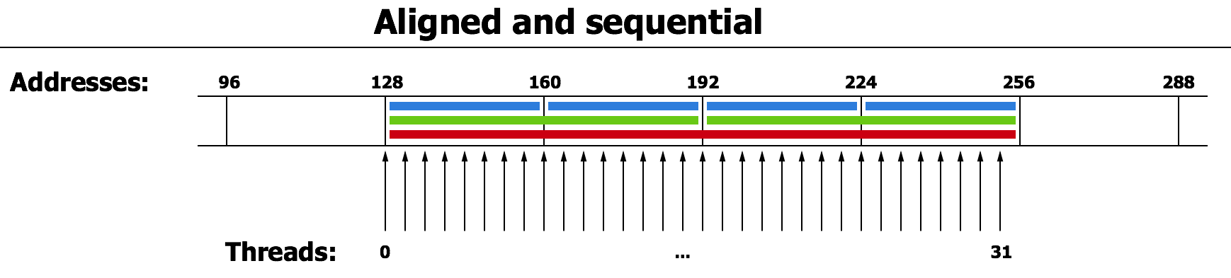
Issues that are already visible
Issues
Memory considerations
  Bank access patterns visible in code (must understand)
  Calculating values better than caching results
  Can quickly become the bottleneck and source of bad performance
  Small tweaks in access pattern can yield wildly difference results
Task model for parallelism has been good
  Common direction (layers easily cooperate)
  Can avoids locking
  Design decisions on data structures and algorithm decomposition become more critical than ever
Notes:
Where are the programming issues that are already visible?
Memory bank addressing issues and the visibility in code – but this is something relevant for boosting the performance of any of our modern processors.
It is sometimes better to do redundant calculations than cache results. (due to memory limitations)
Special tricks are needed in the GPU higher-speed memories to keep the GPU units busy to keep as many threads active as possible. This may just be an annoyance or not useful on other light-weight Phi processors.
Using the task model for parallelism is very nice. It is a good direction that everyone is going towards and it fits naturally with a higher-level interface for dividing work in a loop amongst.
It does not alleviate the need for thoughtful construction of data structures for the tasks to operate on and careful division of work into stages that are relevant for the processor type available.
It does alleviate the need for locking in user code when used well.
-------
Debugging is fairly primitive.

Slide 35
Issues that are already visible
Issues
Mixed execution locations needed
  For algorithm phases
  For modules
  Heterogeneity is back and will be a big issue
  Unclear how much visibility and control the framework will have here
Unclear how to keep a balanced load: many run-time parameters
New methods of collecting summary data and diagnostic information from algorithm phases will likely be needed
  Conditional logic troubles
  Deviations in work load problems
  Temporary storage of extra data issues
  Making it widely available concerns
What is good for the lighter weight processors has also been good for the heavier weight processors
Notes:
Bodies of user code (modules or algorithms) will need to be scheduled where they will run best – I do not see much progress in this area.
Back to tool chain specific code blocks and even different algorithm encodings with #defines or equivalent. Algorithms will need to be aware when the HPC cores are better than the serial cores.
Collecting additional information during algorithmic work is not straightforward. This includes data for validating the work done – it was easy in serial mode to just tack on extra variables within the global module area, or on the temporary data structure active during the module processing. One issue is adding conditional logic for certain circumstances. Another issue is associating the extra data and managing it. It would be a shame to have two version of code – one with diagnostics available and the with.
Keep in mind that some of this does not need to be visible in the framework or be part of the framework problem. It will however, affect the ability to place work on resources effectively.
What’s good for a group of high-performance processors is also good for the heavyweight processor in many circumstances. This is not necessarily true for the memory hierarchy that is directly visible in a GPU.
------
Be sure to categorize as maintenance, system-wide workflow, node-only, programmability, etc.
Resource limited processors force fine-grained parallel activities. The low overhead communications of new integration will make this easier.
Tasks are great, but efficiency using the available hardware given a problem will not be straightforward (configuration and load-balancing issues)
Services structures are going to be a problem.

Slide 36
Pulling it all together

Slide 37
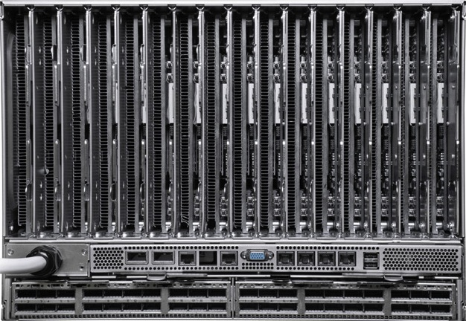
A possible overcome
One event processor per allocated resources
Framework configuration and functions for job now span specialized resources
Event Processor 1
HPC-HTC hybrid server
cluster
Event Processor 2
Event Processor N
Custer management
Source data push
Results
gather
Allocate,
Run,
Monitor,
Obtain results
Essential infrastructure services
EP-1
EP-2
EP-N
User Console
(Laptop)
Data queries, filtering,
file handling,
streaming services
Collection services,
file writing,
storage use rules
Big Data management: Commercial server cluster
Notes:
Now let’s pull everything together into on possible system outcome.
We will start with the cluster with densely packed, integrated core nodes.
Add the underlying hardware for handling “big data” using the latest commercial server cluster technology.
Incorporate essential infrastructure services into the data management for moving the right data into and out of storage
Now our user carries out the steps of developing a configuration and requesting a collection of coordinated resources to perform a physics task
Running the job involves placing the application components where they are best suited to run, using the more specialized hardware that is available.
Complexity of storage components and disk access is removed from the computational elements.
Data writing is delegated to nodes where file and storage system access is best.
Data selection is delegated to nodes designed for decision logic closely attached to the data catalogs and other indexing systems.
In this arrangement, we’ve done some of the things at the cluster level that we’ve traditionally done (with good results) at the event-processor application level.
-----------------
EDM that does not permit movement of data from one coprocessor to another, services that must be split between processors. No easy facility for coprocessor to coprocessor communications
The work we do with RTI DDS is relevant
Features of a system as a whole are relevant – MPI and other middleware systems take advantage of advanced features like RDMA. Can our EDM make use of such a thing?
Must mention the cry for Hadoop/Mapreduce or similar that can do large scale reductions? Probably do not want to go here.

Slide 38
Summary
A mixed computing environment is inevitable
  Heterogeneous within and among resource types
  Job specification / configuration split across resource types
Changes will affect our I/O subsystem
  Focus on simpler streaming methods
  Leave file and catalog handling to special-purpose nodes
  Newer network protocols and hardware may help
Changes in algorithm development strategy
  Began a while back
  Accommodate all types of many-core and multi-core
Notes:
A mixed computing environment is inevitable if we are going to make use of the “high performance” cores. Using these cores will be necessary to increase our “bang-for-the buck”.
It is not all that clear if the I/O subsystem and the event data representation and handling will be adequate for the node with this complexity and capacity. The I/O capacity of the simply configured processing node may be adequate. But the bandwidth for things after or even surrounding production may be something to worry about.
A change in strategy for algorithm development has already started and consideration for load balancing will need to be incorporated in the frameworks.
The expression of the work to be done may need to be expanded to aid in the scheduling of work on a 10x capable node. The cooperation of multiple events, multiple algorithms, and multiple nodes may need more convenient ways to express the problem being handled. All the asynchronous processing will cause a need for final “reduction” stages to properly order data, and provide the statistical summaries.
All these things mean the need for continued cooperation from the different development teams – especially outside HEP – who, in my observations, do not have the rich data structures or the advanced collaborative environments for sharing and development code.
------
May need two or more classes of machine to match type of work: selection and quick decision logic through one mechanism and heavy computation through another.
The bandwidth required to move data in and out of a many-core cluster may result in poor utilization or demand a mixed workload that reduces either the input or the output.
Keep in mind: 3 nodes operating at 3 GB/s can move 1TB in about 100 seconds.
This means keeping the cost of operating and maintaining systems that can handle to amount of work we will need to do into the future at a level that can be tolerated.

Slide 39
Conclusion
Movement in industry and research towards
  Increasing performance through specialization
  Keeping operational cost constant (or lower)
All of this means more independent parts within our software infrastructure
To keep up, we need continued and increased cooperation
  Between physics laboratories
  Between HPC communities
Notes:
More than ever we have a need for continued cooperation from the different development teams – especially outside HEP – who, in my observations, do not have the rich data structures or the advanced collaborative environments for sharing and development code.
I do not see how we can avoid the changes in computing platforms.
More specialized development will be needed.
Once again we must be good at many levels – my hope is that there is not only room for this in our highly specialized world, but also some rewards to be had.
------
First run = 50 minutes

