Slide 1
Big Data over a 100G Network at Fermilab
Gabriele Garzoglio
Grid and Cloud Services Department
Computing Sector, Fermilab
CHEP 2013 – Oct 15, 2013

Slide 2
Overview
Network R&D Program
Motivations and Overview
Network Infrastructure
Production and R&D
100G Network R&D Program
Results and Plans

Slide 3
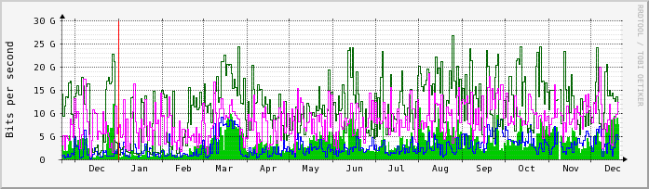
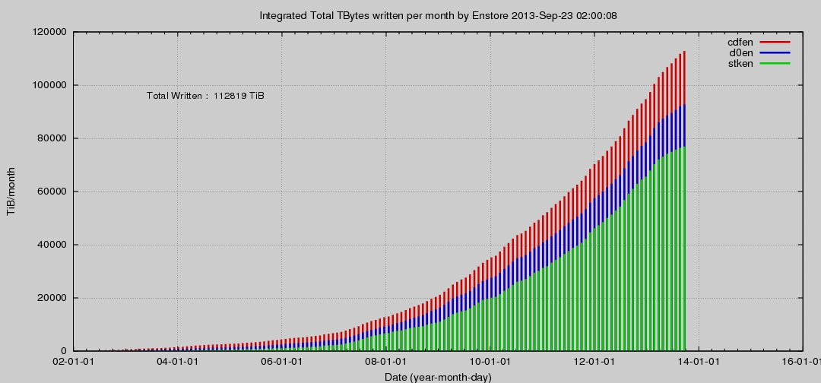
Fermilab Users and 100G
Using the network for decades in the process of scientific discovery for sustained, high speed, large and wide-scale distribution of and access to data
  High Energy Physics community
  Multi-disciplinary communities using grids (OSG, XSEDE)
Figures of merit
  113 Petabytes written to tape, today mostly coming from offsite
  170Gbps peak LAN traffic from archive to local processing farms
  LHC peak WAN usage in/out of Fermilab at 20-30 Gbps
30G
CMS WAN Traffic (1 of 2 Chnl) @Fermilab: Dec, 2012
2012
20 Gpbs
Compact Muon Solenoid (CMS) routinely peaks at 20-30 Gbps for WAN traffic in/out of Fermilab.
Written data: 113 PB
2 yrs
2008
113 PB of data ever written to the Enstore tape archive

Slide 4
Network R&D at Fermilab
Fermilab Network R&D Facility
Science Code
- E-Center
- OSG / LHC Dashboard
- CortexNet Data Selection
Tools & Services
Data
Management
Storage
Management
Network Management
- G-NetMon
- 100G High-Throughput Data
Application I/O
OS / Network Driver
- Multicore-Aware Data Transfers
- End-Site Control Plane System
Infrastructure / Network Layers 1-3
A collaborative process part of the national program on network involving multiple research organizations (ESNet, I2, LBL, UNL, ANL, NERSC, UFL, UCSD, …)
Builds on core competencies on Big Data inheriting from RunII and CMS expertise
A diverse program of work that spans all layers of computing for scientific discovery

Slide 5
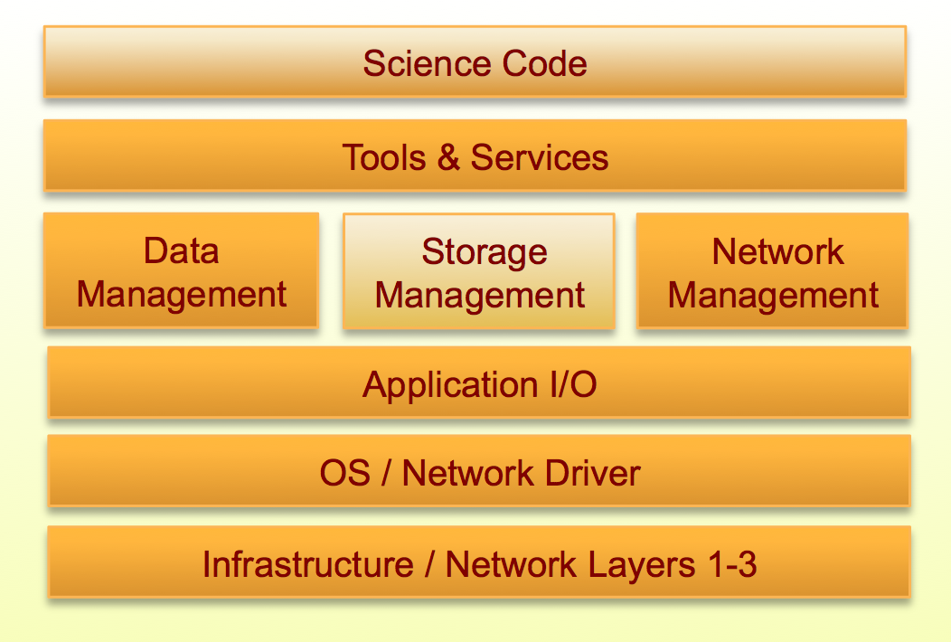
Pulling all R&D effort together from the top layers…
Providing tools & services to enable users / apps to optimize use of the network
  Collaborating with the OSG Network Area for the deployment of perfSONAR at 100 OSG facilities
  Aggregating and displaying data through E-Center and the OSG Dashboard for end-to-end hop-by-hop paths across network domains
Developing tools to monitor real-time 100G network traffic through multicore & manycore architectures
Proposed integration with Data Management through network-aware data source selection – CortexNET

Slide 6
Pulling all R&D effort together from the bottom layers…
Application-level R&D through the High Throughput Data Program
  R&D on 100G for production use by CMS & FNAL high-capacity high-throughput Storage facility
  Identifying gaps in data movement middleware for the applications used for scientific discovery – GridFTP, SRM, Globus Online, XRootD, Frontier / Squid, NFS v4
OS-level R&D to improve data transfer performance
  Optimizing network I/O for 40/100G environments
  Multicore-aware data transfer middleware (MDTM)
  Integrating local network infrastructure with WAN circuit technologies through policy-driven configuration (ESCPS)

Slide 7
Overview
Network R&D Program
Motivations and Overview
Network Infrastructure
Production and R&D
100G Network R&D Program
Results and Plans

Slide 8
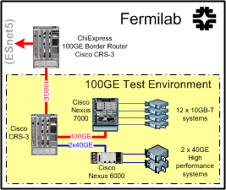
A dedicated R&D Network facility
- 100G R&D
- Production-like env for tech eval
- Testing of firmware upgrades
Nexus 7000 w/ 2-port 100GE module / 6-port 40GE module / 10GE copper module
12 nodes w/ 10GE Intel X540-AT2 (PCIe) / 8 cores / 16 GB RAM
* Diagram courtesy of Phil DeMar
Nexus 6000E for 40GE systems
    IPv6 tests / F5 load balancer / Infoblox DNS, Palo Alto firewall
2 nodes w/ 40GE Mellanox ConnectX®-2 (PCIe-3) / 8 cores w/ Nvidia M2070 GPU

Slide 9
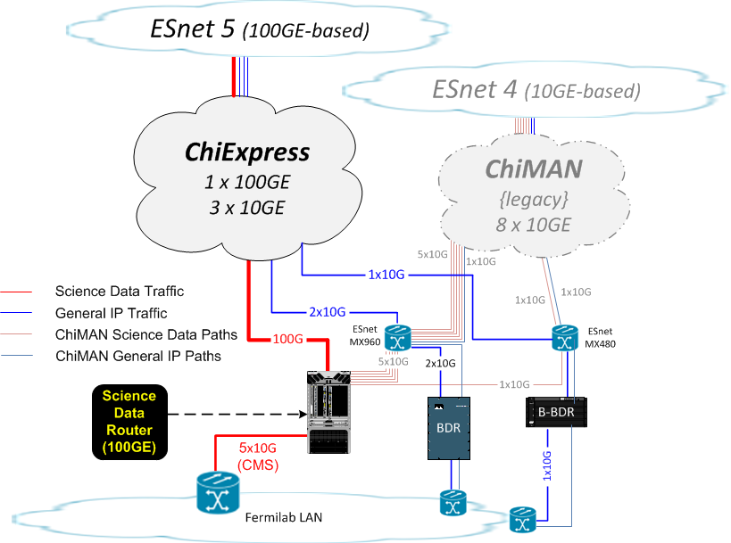
Fermilab WAN Capabilities:
In Transition from n x 10GE to 100GE
Legacy 10GE-based MAN being phased out:
  Eight 10GE channels
  Six used for science data
New 100GE-based MAN being phased in:
  One 100GE channel and three 10GE channels
  100GE channel is for science data movement
  10GE channels for general IP traffic and redundancy for science data
* Diagram courtesy of Phil Demar

Slide 10
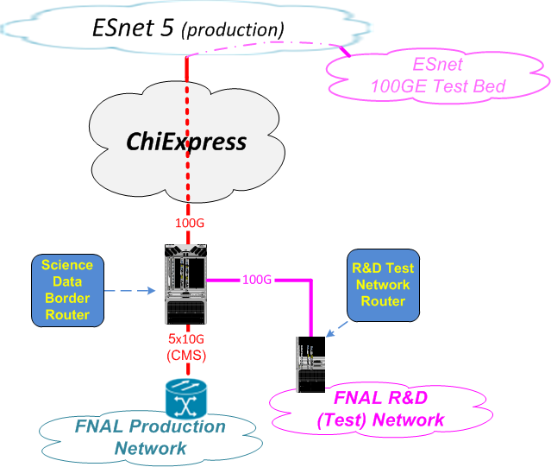
Using 100G Channel for R&D As Well
CMS needs 50G of data traffic from the 100G channel
Remaining ~50G for FNAL R&D network
  Potentially higher when CMS traffic levels are low
  LHC in shutdown until 2015
Planning WAN circuit into ESnet 100G testbed
  Potential for circuits to other R&D collaborations
* Diagram courtesy of Phil Demar

Slide 11
Overview
Network R&D Program
Motivations and Overview
Network Infrastructure
Production and R&D
100G Network R&D Program
Results and Plans

Slide 12
Goals of 100G Program at Fermilab
Experiment analysis systems include a deep stack of software layers and services.
Need to ensure these are functional and effective at the 100G scale end-to-end.
  Determine and tune the configuration of all layers to ensure full throughput in and across each layer/service.
  Measure and determine efficiency of the end-to-end solutions.
  Monitor, identify and mitigate error conditions.
Fermilab Network R&D Facility

Slide 13
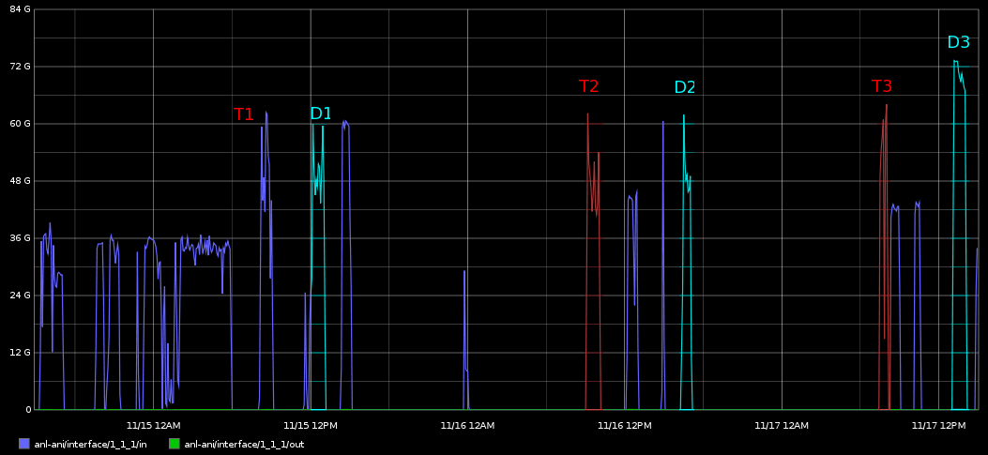
100G High Throughput Data Program
2011: Advanced Network Initiative (ANI) Long Island MAN (LIMAN) testbed.
  GO / GridFTP over 3x10GE.
2011-2012: Super Computing ’11
  Fast access to ~30TB of CMS data
  in 1h from NERSC to ANL using
  GridFTP.
  15 srv / 28 clnt – 4 gFTP / core;
  2 strms; TCP Win. 2MB
2012-2013: ESnet 100G testbed
  Tuning parameters of middleware for data movement: xrootd, GridFTP, SRM, Globus Online, Squid. Achieved ~97Gbps
    Rapid turn around on the testbed thank to custom boot images
  Commissioning Fermilab Network R&D facility: 12 nodes at 8.5 Gbps per 10G node
  Test NFS v4 over 100G using dCache (collab. w/ IBM research)
Fall 2013 / Winter 2014: 100G Endpoint at Fermilab
  Validate hardware link w/ data transfer apps with UFL and others. Talk to me if you want to participate in these activities.
  Demonstrate storage-to-storage 100G rates
70 Gbps (peak: 75)

Slide 14
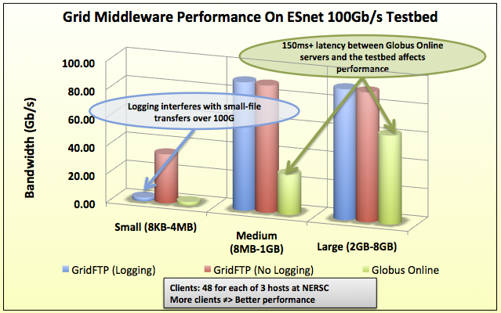
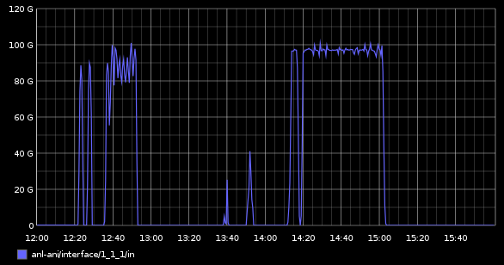
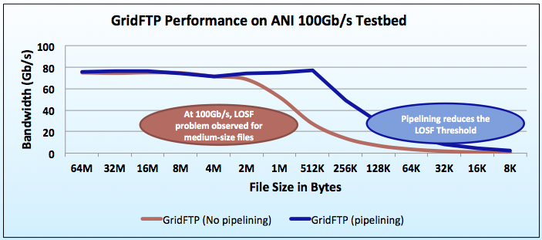
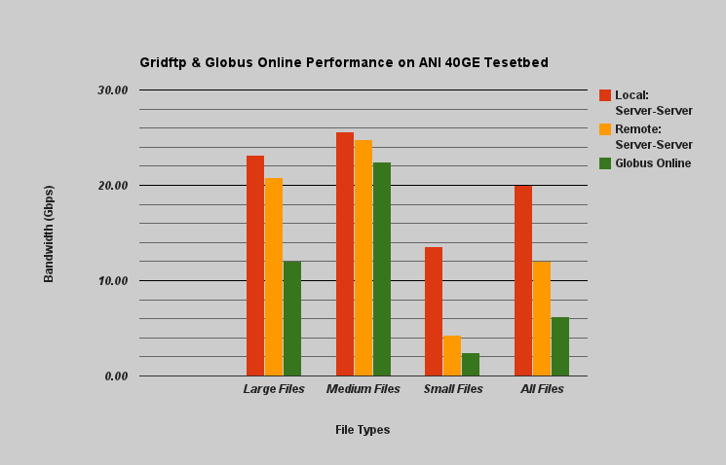
GridFTP / SRM / GlobusOnline Tests
Data Movement using GridFTP
  3rd party Srv to Srv trans.:
  Src at NERSC / Dest at ANL
  Dataset split into 3 size sets
Large files transfer performance ~ 92Gbps
GridFTP logging was through NFS on 1GE link: file transfers blocked on this.
Lot of Small Files (LOSF) transfer performance improved with pipelining
97 Gbps
Optimal performance: 97 Gbps w/ GridFTP
2 GB files – 3 nodes x 16 streams / node
Pipelining (“FTP cmd in-flight”) mitigates the negative effects of high-latency on transfer performance

Slide 15
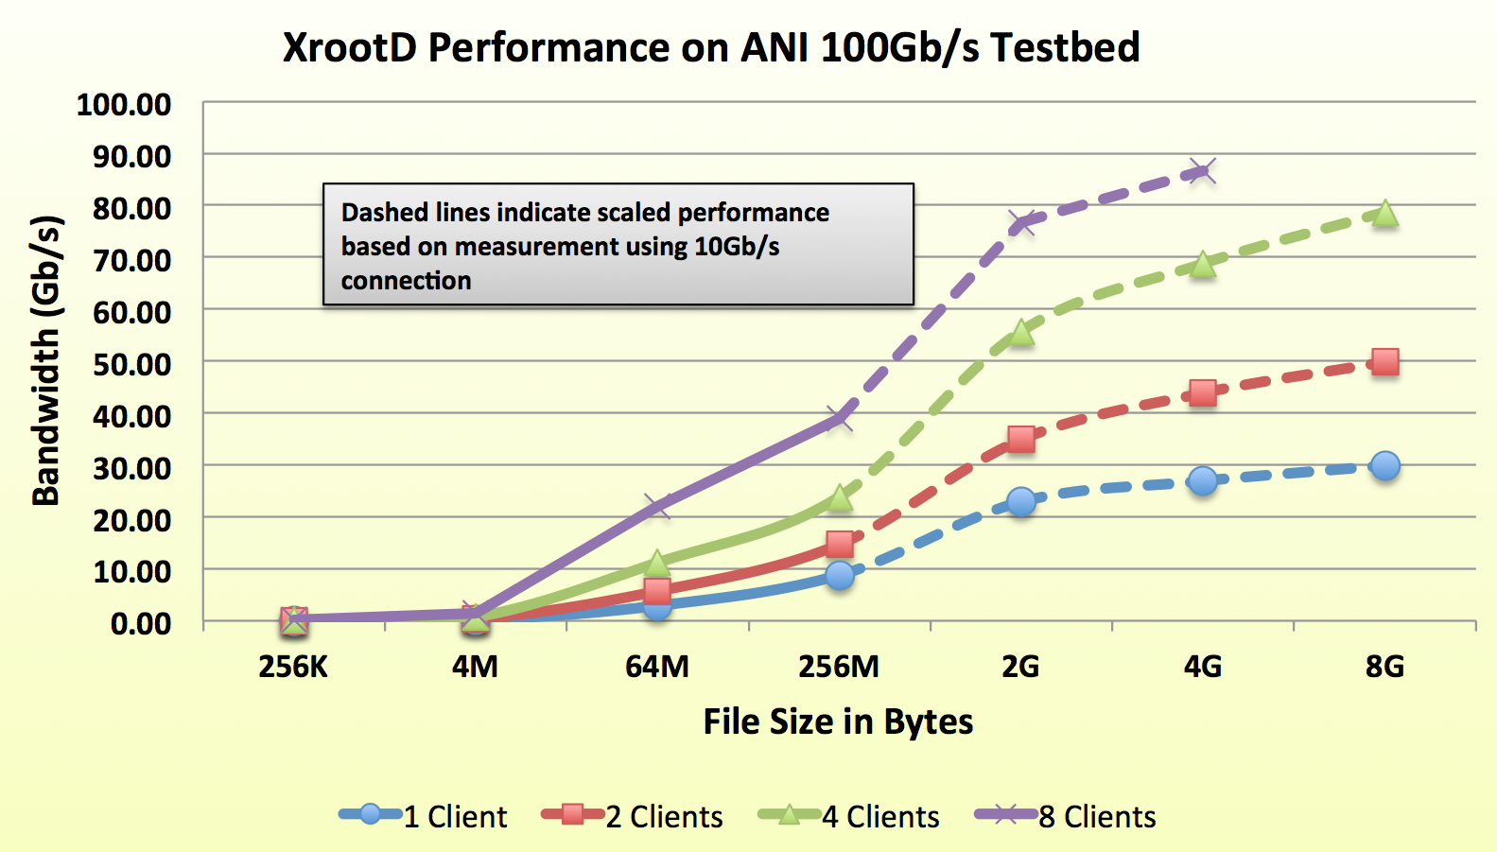
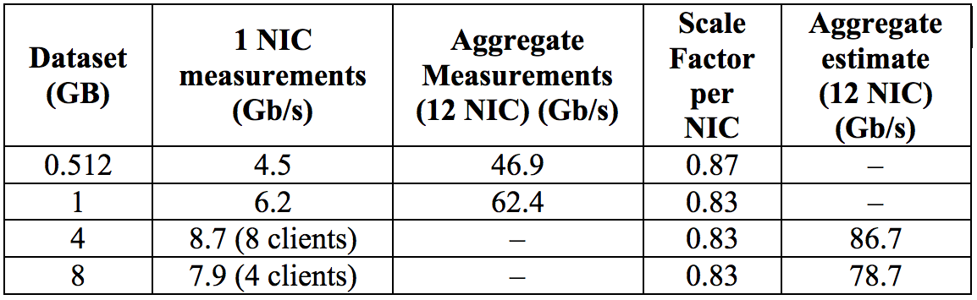
XRootD Tests
Data Movement over XRootD, testing LHC experiment (CMS / Atlas) analysis use cases.
  Clients at NERSC / Servers at ANL
  Using RAMDisk as storage area on the server side
Challenges
  Tests limited by the size of RAMDisk
  Little control over xrootd client / server tuning parameters
Calculation of the scaling factor between 1 NIC and an aggregated 12 NIC for datasets too large to fit on the RAM disk

Slide 16
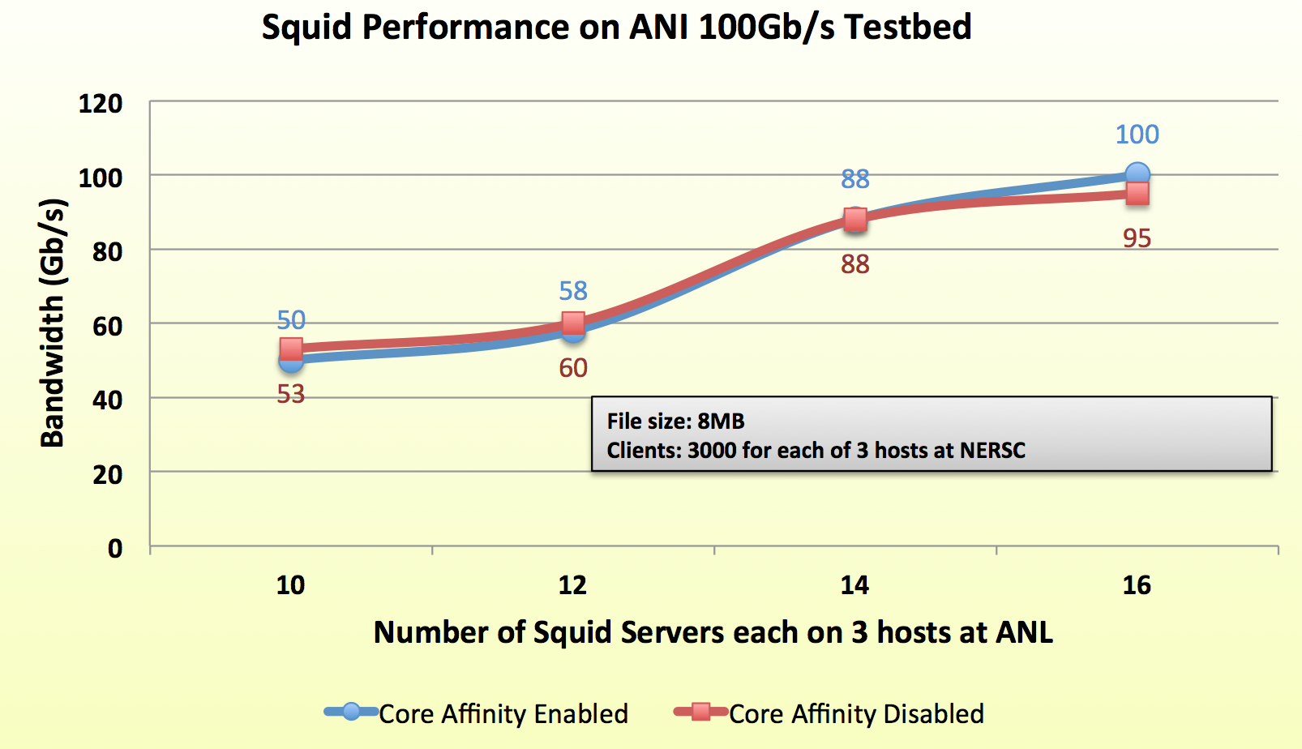
Squid / Frontier Tests
Data transfers
  Cache 8 MB file on Squid – This size mimics LHC use case for large calib. data
  Clients (wget) at NERSC / Servers at ANL
  Data always on RAM
Setup
  Using Squid2: single threaded
  Multiple squid processes per node (4 NIC per node)
  Testing core affinity on/off: pin Squid to core i.e. to L2 cache
  Testing all clnt nodes vs. all servers AND aggregate one node vs. only one server
Results
  Core-affinity improves performance by 21% in some tests
  Increasing the number of squid processes improves performance
  Best performance w/ 9000 clients: ~100 Gbps

Slide 17
Summary
The Network R&D at Fermilab spans all layers of the communication stack
Science discovery by HEP and Astrophysics drive the program of work
Fermilab is deploying a Network R&D facility with 100G capability
ESnet 100G Testbed has been fundamental for our middleware validation program
Fermilab will test the 100GE capability in the Fall 2013 – Winter 2014

