Slide 1



ECFS
A decentralized, distributed and fault-tolerant FUSE filesystem for the LHCb online farm
Session: Data Stores, Data Bases, and Storage Systems
tomasz.rybczynski@cern.ch*
enrico.bonaccorsi@cern.ch
niko.neufeld@cern.ch

Slide 2
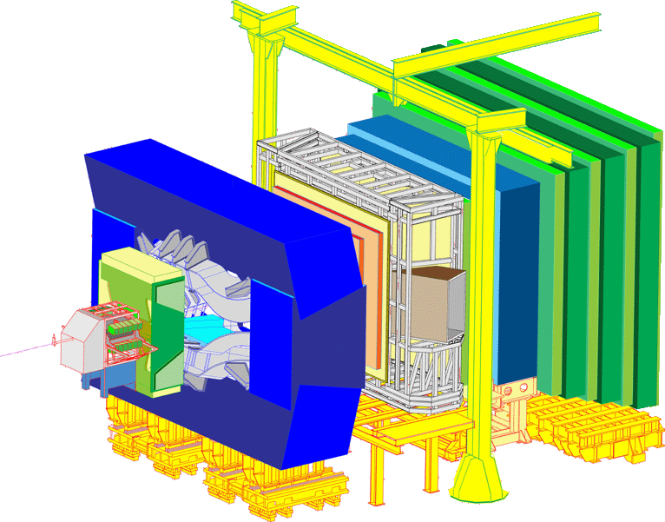

Introduction
Event Filter Farm
~2000 nodes

Slide 3
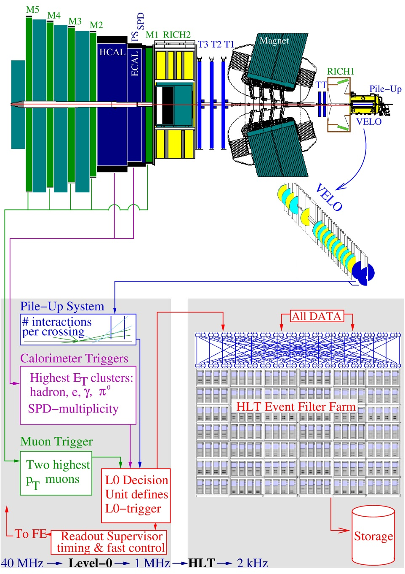
High Level Trigger

Slide 4
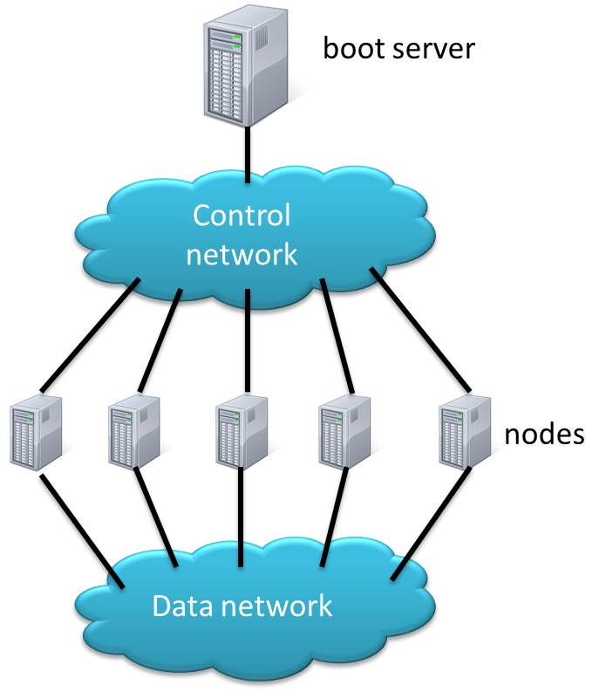

Event Filter Farm
20-25% of the time

Slide 5
Requirements
Fault tolerance – data redundancy
Single namespace
POSIX semantics
Write once read many
Sufficient performance

Slide 6
Searching for a solution
Linux RAID over HA cluster
GlusterFS
Tahoe-LAFS tahoe-lafs.org
…

Slide 7
Erasure Codes File System
ECFS - distributed, fault-tolerant file system
Project based on:
FUSE
NFS
Erasure Codes

Slide 8
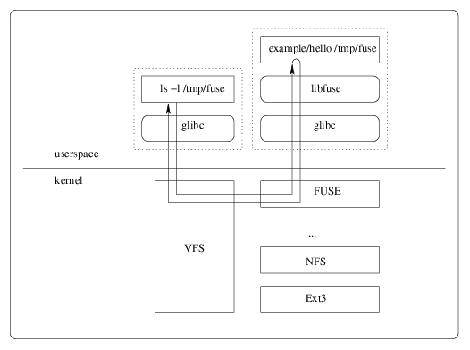
FUSE

Slide 9
NFS
/localdisk
NFS export
ECFS
/ECFS_mountdir
/misc/dir1
/misc/dir2
/misc/dir3
…
NFS mounts
via AutoFS

Slide 10
Erasure Codes
Coding parameters:
k = 6
n = 2
Successful decoding possible if the number of missing symbols is less or equal n
Original message of a size of k symbols
Code word with some symbols missing
Encoding
Decoding
Code word of a size of k + n symbols
Original message

Slide 11
File encoding
cp file_1 /ECFS_mountdir/
ECFS
coding buffer
file1
Encoding
blocks
/dir1/file1_block
/dir2/file1_block
/dir3/file1_block
/dir4/file1_block
/dir5/file1_block
/dir6/file1_block

Slide 12
File decoding
/dir1/file1_block
/dir2/file1_block
/dir3/file1_block
/dir4/file1_block
/dir5/file1_block
/dir6/file1_block
ECFS
blocks
coding buffer
cp /ECFS_mountdir/ ./file1
file1
Decoding

Slide 13
Parallel IO
file
ECFS
Coding
T 1
T 2
T 3
T 4
T 5
T 6
/dir1
/dir2
/dir3
/dir4
/dir5
/dir6

Slide 14
Fault detection
file
ECFS
Coding
T 1
T 2
T 3
T 4
T 5
T 6
/dir1
/dir2
/dir3
/dir4
/dir5
/dir6

Slide 15
Degraded write
file
ECFS
Coding
T 1
T 2
T 3
T 4
T 5
T 6
/dir1
/dir2
/dir3
/dir4
/dir5
/dir6

Slide 16
Write to a spare
file
ECFS
Coding
T 2
T 3
T 4
T 5
T 6
T 1
T 6
/dir1
/dir2
/dir3
/dir4
/dir5
/dir7
/dir6
/dir6

Slide 17
Test environment
hlt01
hlt02
hlt03
hlt04
hlt05
hlt06
hlt07
hlt08
hlt09
hlt10
8
8
8
8
8
8
8
8
8
8
ECFS
ECFS
ECFS
ECFS
ECFS
ECFS
ECFS
ECFS
ECFS
ECFS
Spare nodes
hlt11
hlt12
hlt13
hlt14
hlt15
hlt16
hlt17
hlt18
hlt19
hlt20
8
8
8
8
8
8
8
8
ECFS
ECFS
ECFS
ECFS
ECFS
ECFS
ECFS
ECFS
ECFS
ECFS
Each of the nodes:
Writes one file
Reads eight files

Slide 18
Performance
Average write: 188 MB/s ~10 MB/s per node
Average read: 119 MB/s ~7 MB/s per node

Slide 19
Conclusion
ECFS meets technical requirements of the project
Performance lower than expected
Much improvement has to be done

