Slide 1
Commissioning the CERN IT Agile Infrastructure with experiment workloads
Ramón Medrano Llamas
IT-SDC-OL
14.10.2013

Slide 2
Agenda
The Agile Infrastructure
Workload Management Systems
Dynamic provisioning
Conclusions

Slide 3
The Agile Infrastructure
Private IaaS cloud
OpenStack based
Federates Meyrin and Wigner
15,000 hypervisors by 2015
300,000 VMs by 2015
Configuration management tools
  Puppet, Foreman

Slide 4
Workload Management Systems
Pilot based systems
ATLAS: PanDA
CMS: glidein WMS
Both have an HTCondor backend
Using Nova and EC2 APIs

Slide 5
PanDA integration
Manual HTCondor cluster deployment
Long lived worker nodes
Condor for pilot submission
CVMFS + EOS
Same setup on HLT, Helix Nebula, Rackspace…

Slide 6
glidein integration
Dynamic cluster deployment (EC2)
Worker node automatically managed
Condor for batch orchestration
CVMFS + EOS

Slide 7
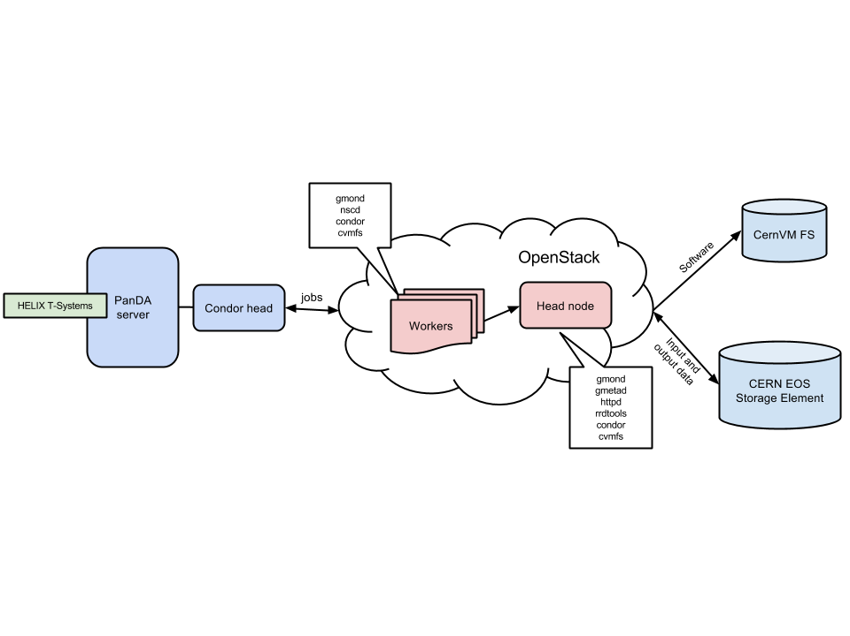
Deployment

Slide 8
Support from the AI Team
Got 1,600 cores from the OpenStack team
  Testing Essex, Folsom, Grizzly
Complete freedom to access resources ☺
Consultancy at any time
Rapid bug report-solution cycle

Slide 9
Testing strategy
Standard HammerCloud benchmark
Compared with other clouds, bare metal
690,000 ATLAS jobs
337,000 CMS jobs

Slide 10
Testing summary
ATLAS |  |  | CMS
Scheduler | PanDA |  | Scheduler | glideinWMS
Cluster management | Static |  | Cluster management | Dynamic
Cluster size | 770 cores |  | Cluster size | 200 cores
Jobs submitted | 694,698 |  | Jobs submitted | 337,080
Failure rate | 9.95% |  | Failure rate | 0.31%
Job type | Simulation |  | Job type | Simulation
Typical job duration | 31 min. |  | Typical job duration | 9 min.
Duration variance | 17.8 min. |  | Duration variance | 4.8 min.
Most common error | Failed to read LFC |  | Most common error | App. Error 8020

Slide 11
Performance testing: ATLAS, Ibex
Site | Wallclock (s) | CPU efficiency(%) | Failure rate (%)
OPENSTACK_CLOUD | 3,114 | 78.8 | 2.1
BNL_CLOUD | 1,505 | 80.2 | -
IAAS | 1,539 | 61.5 | -
CERN-PROD | 1,540 | 78.5 | -
BNL_CVMFS_1 | 1,660 | 67.5 | -
Tested Late 2012
Over commission of resources
  CPU efficiency not reliable in this context

Slide 12
Performance testing: ATLAS, Grizzly
Site | Wallclock (s) | CPU efficiency(%) | Failure rate (%)
OPENSTACK_CLOUD | 1,827 | 82.3 | 13.7
BNL_CLOUD | 1,960 | 69.9 | -
IAAS | 1,417 | 67.5 | -
CERN-PROD | 1,499 | 82.3 | -
BNL_CVMFS_1 | 1,611 | 72.6 | -
Tested Late 2013
Good improvement in performance
  And predictability

Slide 13
Performance testing: CMS, Ibex
Site | Wallclock (s) | CPU efficiency(%) | Failure rate (%)
T2_CH_CERN_AI | 616 | 91.1 | 0.0
T2_CH_CERN | 914 | 82.8 | -
T1_US_FNAL | 742 | 91.8 | -
T1_DE_KIT | 783 | 91.6
Tested Mid 2013
Reliability is incredible good

Slide 14
Performance testing: ATLAS wallclock

Slide 15
Reliability testing
Few failures
Infrastructure vs. WMS failure
  Need new monitoring techniques
  Difficult to measure with state of the art tools

Slide 16
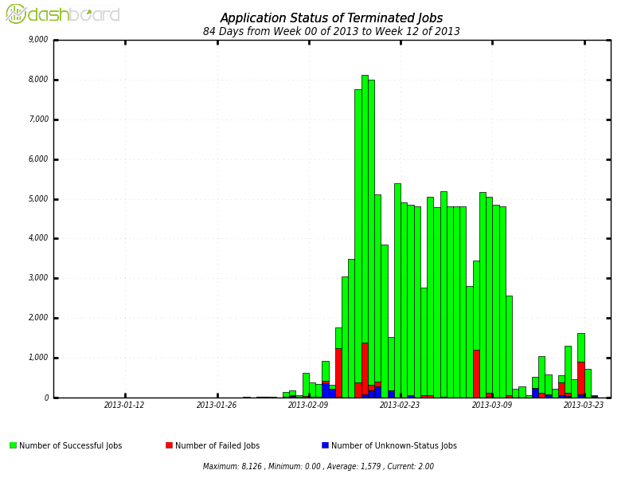
Reliability testing

Slide 17
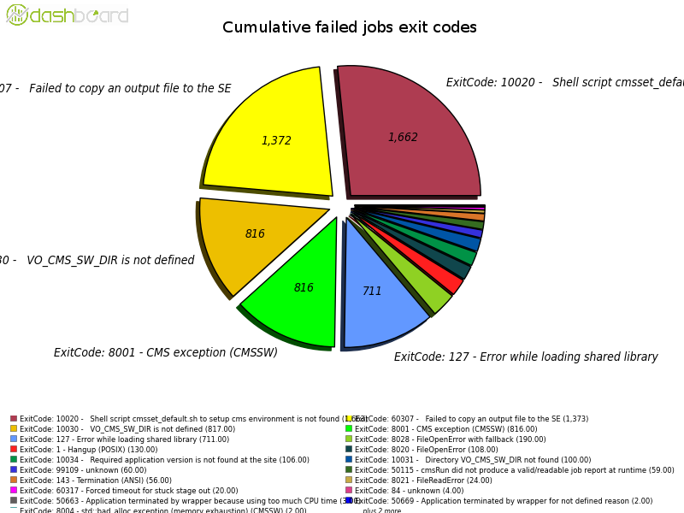
Reliability testing

Slide 18
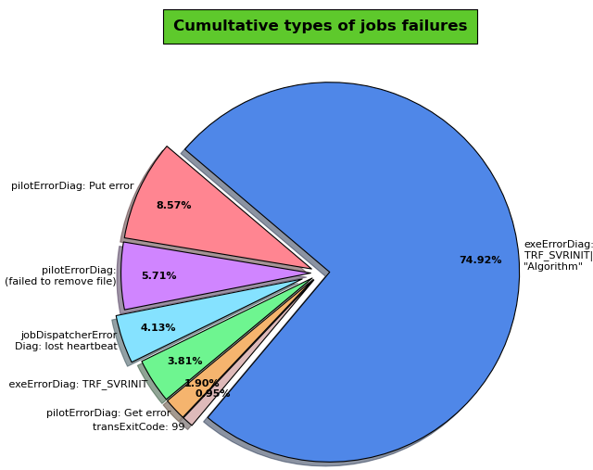
Reliability testing

Slide 19
Dynamic provisioning
gLidein scales clusters automatically,
  Slowness with non-batch requests
PanDA was still not ready for it
  Studying APF and Cloud Scheduler

Slide 20
Conclusions
Being able to successfully use the infrastructure
Scalability tests passed ☺

Slide 21
Future work
Unification of image lifetime
Federation of other OpenStack clouds
Accounting tools for clouds
Better understanding of failures

Slide 22

Questions?

