Slide 1





Application Performance Evaluation and Recommendations for the DYNES Instrument
Shawn McKee / Univ. of Michigan Presenting
CHEP 2013 in Amsterdam
Tuesday, October 15th 2013

Slide 2

Talk Overview
Introduction to virtual circuits and DYNES
Limitations of virtual circuits in practice
Exploration of solutions
Summary and Conclusion

Slide 3
Networking and Virtual Circuits
For users, networks are typically black boxes that try to transport bits between the source and destination in a “best effort” way.
Traffic is not differentiated; all flows are handled in the same way. Simple and powerful but problematic for some use-cases:
  Latency sensitive applications: remote control, video conferencing, real-time interaction
  Priority not able to be expressed between flows of varying importance
  Scheduling workloads over distributed resources is difficult
Research and Education (R&E) networks have experimented with the concept of Virtual Circuits (VC) for a number of years.
  This connection-oriented service emulates a physical point-to-point connection, using the underlying technology of packet-switched networks
  Virtual circuits can usually be configured to guarantee some properties of the connection like its bandwidth, loss characteristics and/or jitter in packet timing.
  This can be powerful in organizing resource use and in being able to support sensitive applications or deliver on deadline scheduling for workloads.
  Many R&E backbones have implemented VC technology
The problem: How can a user or application create and access a VC?
That was the basic question the DYNES project tried to address….

Slide 4
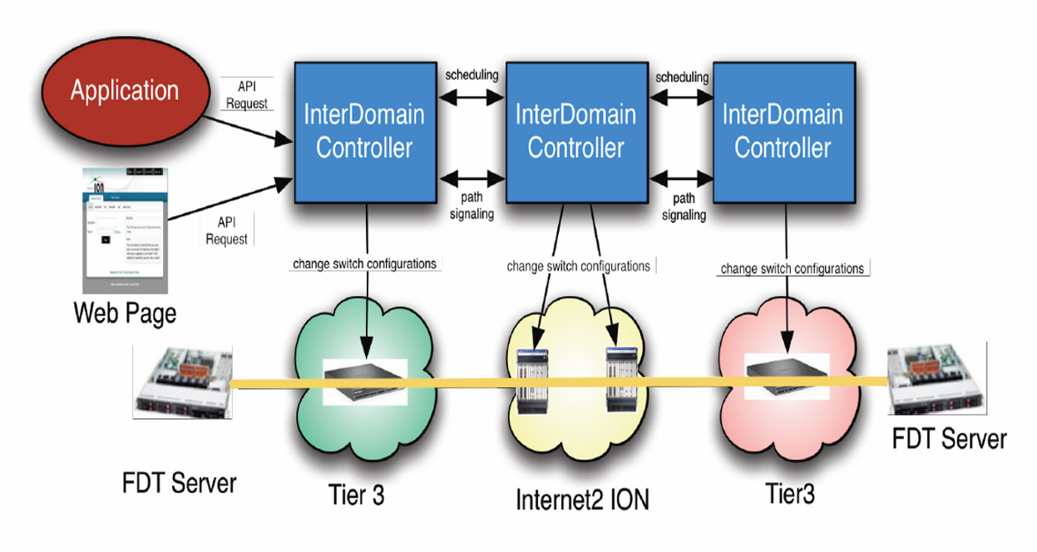
What is DYNES?
A distributed virtual cyber-instrument for the creation of virtual circuits on demand between DYNES sites. DYNES spans about 40 US universities and 11 Internet2 connectors and interoperates with ESnet, GEANT, APAN, USLHCNet, and many others.
Synergetic projects include OliMPS and ANSE.
Dynamic network circuit provisioning and scheduling

Slide 5
Uses For DYNES
For regional networks and campuses to support large, long-distance scientific data flows
In the LHC
In other leading programs in data intensive science (such as LIGO, Virtual Observatory, and other large scale sky surveys)
In the broader scientific community.
Broadening existing Grid computing systems by promoting the network to a reliable, high performance, actively managed component.
The DYNES team is partnering with the LHC and astrophysics communities, OSG, and Worldwide LHC Computing Grid (WLCG) to deliver these capabilities to the LHC experiment as well as others such as LIGO, VO and eVLBI programs

Slide 6
Limitations Using Virtual Circuits
As we brought up DYNES sites and began testing we noticed a very important practical limitation in using virtual circuits
  A virtual circuit of a specific size would be created
  An application would send data on the circuit
  The throughput achieved was significantly less than the reserved bandwidth, often less than 50%
What was wrong?

Slide 7
Exploring the Problem
DYNES extended the ability to create virtual circuits from the research and education network backbones out to end-sites, where scientists host their data and computing resources
Problem 1: The VCs created were intended to be end-to-end but practical implementation considerations often resulted in portions of the network path not protecting DYNES flows
  Reservations of X bandwidth are not typically guaranteed along every part of the path between DYNES sites
  One reason DYNES flows may not be able to utilize the bandwidth they have reserved is because they are traversing portions of the path that are congested, resulting in packet loss
Problem 2: The mismatch between the network interface card (NIC) bandwidth on the end-hosts and the amount of reserved bandwidth in the circuit cause micro-bursts of traffic to overrun what the VC can handle, resulting in packet loss or packet re-ordering. (More on this in the next slide)
Either problem causes TCP to deliver much less throughput than was reserved

Slide 8
DYNES Bandwidth Guarantees via OSCARS
OSCARS provides bandwidth guarantees, via QoS, for supported hardware.
OSCARS installs mechanisms on network devices that prioritizes VC traffic up to the bandwidth limit requested.
  This can be modeled into two basic classes of service:
    Expedited Traffic (traffic in the VC)
    Best Effort Traffic (all other traffic)
The QoS mechanism features another behavior that kicks in if the VC tries to use more bandwidth than was requested:
  Assume the application using the VC tries to push 2.5Gbps of traffic through a 2Gbps reservation. 2Gbps of the traffic will continue to be treated as expedited, but the remaining 0.5Gbps will be sent into a 3rd queue: less than best effort service.
This queue is treated on a lower priority than regular traffic on the interface. On a heavily loaded interface; there is the potential to disrupt the flow and have some packets arrive out of order.
Let’s demonstrate the problem

Slide 9
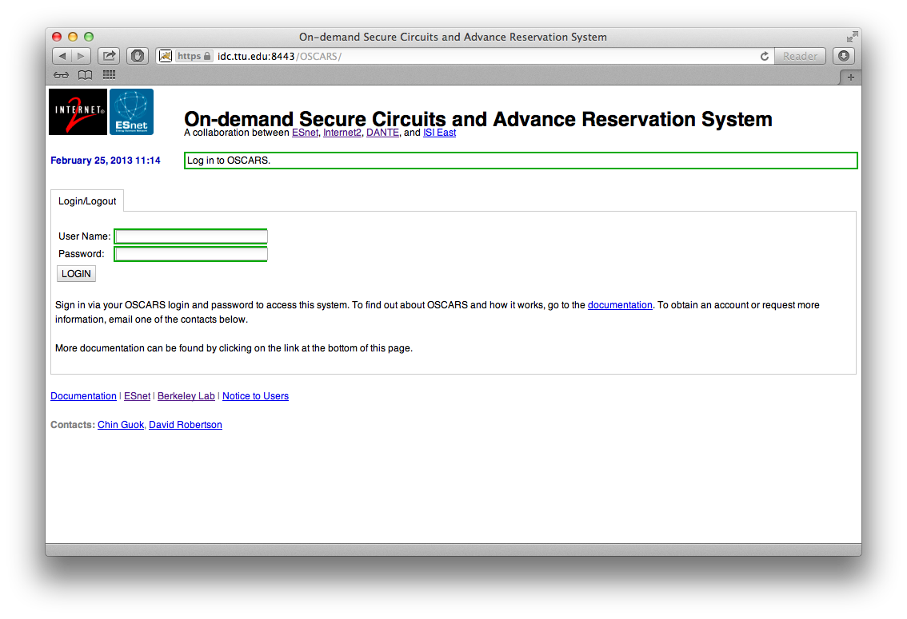
The DYNES OSCARS Circuit GUI

Slide 10
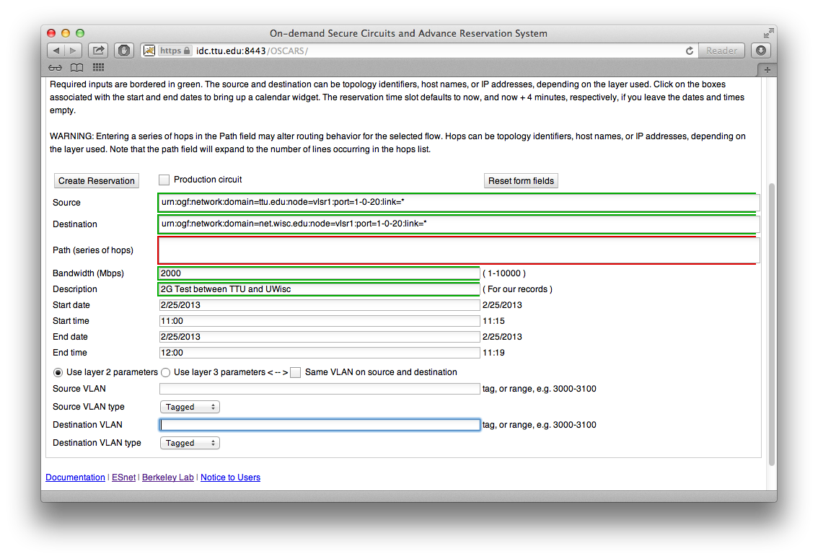
Setup Circuit Wisconsin to TTU

Slide 11
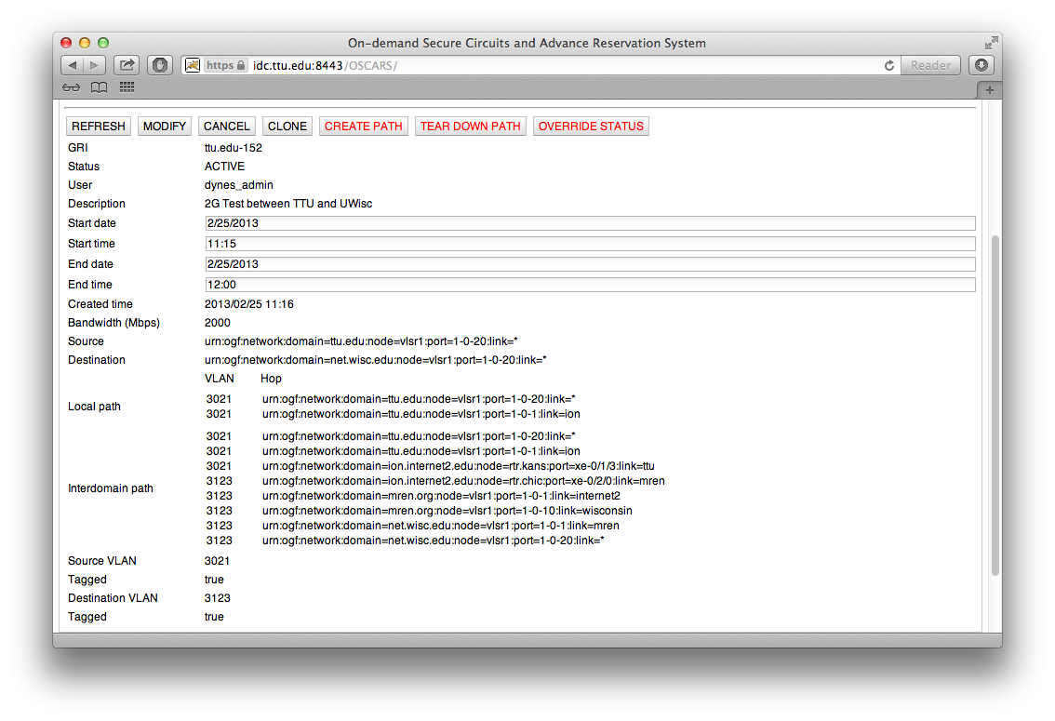
Circuit Details for Successful Setup

Slide 12
Adding Machines to Circuit via VLANs and Private Address Space
For what follows we setup a 1 Gbps VC (steps as above)
VLANs we care about are:
  Texas Tech University = 3021
  University of Wisconsin = 3123
We need to associate one of the server’s interfaces with the VLAN. We do the following at Texas Tech:
  sudo /sbin/vconfig add eth0 3021
  sudo /sbin/ifconfig eth0.3021 10.10.200.10/24 up
  sudo /sbin/ifconfig eth0.3021 txqueuelen 10000
Similarly at Wisconsin:
  sudo /sbin/vconfig add eth0 3123
  sudo /sbin/ifconfig eth0.3123 10.10.200.20/24 up
  sudo /sbin/ifconfig eth0.3123 txqueuelen 10000

Slide 13
Verifying the Circuit Data-Plane
We can do a simple test to check connectivity from Wisconsin
  ping -c 5 10.10.200.10
  PING 10.10.200.10 (10.10.200.10) 56(84) bytes of data.
  64 bytes from 10.10.200.10: icmp_seq=1 ttl=64 time=36.3 ms
  64 bytes from 10.10.200.10: icmp_seq=2 ttl=64 time=36.3 ms
  64 bytes from 10.10.200.10: icmp_seq=3 ttl=64 time=36.2 ms
  64 bytes from 10.10.200.10: icmp_seq=4 ttl=64 time=36.3 ms
  64 bytes from 10.10.200.10: icmp_seq=5 ttl=64 time=36.2 ms
  --- 10.10.200.10 ping statistics ---
  5 packets transmitted, 5 received, 0% packet loss, time 4005ms
  rtt min/avg/max/mdev = 36.296/36.313/36.352/0.209 ms
We see a latency that matches the distance, and we are able to see that the subnet definitions are correct.

Slide 14
Testing the Circuit
We initiate a test using the nuttcp [nuttcp] tool, from the Wisconsin end, sending to Texas Tech. The Texas Tech end is running a server:
[dynes@fdt-texastech ~]$ nuttcp -S -p 5679 -P 5678 --nofork
The Wisconsin end is running the client:
    [dynes@fdt-wisc ~]$ nuttcp -T 30 -i 1 -p 5679 -P 5678 10.10.200.10
    1.6875 MB / 1.00 sec = 14.1543 Mbps 9 retrans
    1.6875 MB / 1.00 sec = 14.1558 Mbps 3 retrans
    1.3750 MB / 1.00 sec = 11.5345 Mbps 0 retrans
    1.9375 MB / 1.00 sec = 16.2529 Mbps 0 retrans
    3.1250 MB / 1.00 sec = 26.2147 Mbps 0 retrans
    1.4375 MB / 1.00 sec = 12.0585 Mbps 21 retrans
    2.7500 MB / 1.00 sec = 23.0691 Mbps 0 retrans
    3.2500 MB / 1.00 sec = 27.2629 Mbps 8 retrans
    1.4375 MB / 1.00 sec = 12.0585 Mbps 0 retrans
    2.7500 MB / 1.00 sec = 23.0688 Mbps 0 retrans
    2.6250 MB / 1.00 sec = 22.0198 Mbps 37 retrans
    0.5625 MB / 1.00 sec = 4.7185 Mbps 0 retrans
    2.4375 MB / 1.00 sec = 20.4474 Mbps 0 retrans
    3.0000 MB / 1.00 sec = 25.1658 Mbps 20 retrans
    0.5000 MB / 1.00 sec = 4.1943 Mbps 0 retrans
    2.6250 MB / 1.00 sec = 22.0197 Mbps 0 retrans
    3.3750 MB / 1.00 sec = 28.3118 Mbps 13 retrans
    1.8125 MB / 1.00 sec = 15.2046 Mbps 0 retrans
    3.3125 MB / 1.00 sec = 27.7867 Mbps 0 retrans
    3.8125 MB / 1.00 sec = 31.9824 Mbps 0 retrans
    5.7500 MB / 1.00 sec = 48.2347 Mbps 0 retrans
    3.4375 MB / 1.00 sec = 28.8354 Mbps 14 retrans
    3.3125 MB / 1.00 sec = 27.7872 Mbps 0 retrans
    4.5625 MB / 1.00 sec = 38.2728 Mbps 23 retrans
    1.5625 MB / 1.00 sec = 13.1071 Mbps 0 retrans
    3.2500 MB / 1.00 sec = 27.2630 Mbps 0 retrans
    4.3125 MB / 1.00 sec = 36.1759 Mbps 23 retrans
    83.7159 MB / 30.45 sec = 23.0658 Mbps 0 %TX 0 %RX 171 retrans 36.69 msRTT
The performance does not look good considering that we had requested 1 Gbps speeds on the circuit.

Slide 15
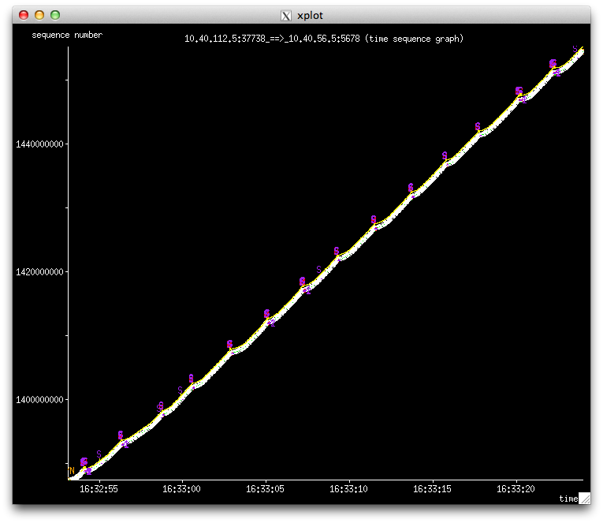
Examining the Details
We can use tcpdump to capture the packets for this test
We can then plot the results using tcptrace to examine the details
This graph plots sequence number over time, e.g. a linear graph indicates smooth sailing from a transmission perspective. The blips of activity are related to the trouble we saw with nuttcp; each indicates a stall in the process.

Slide 16
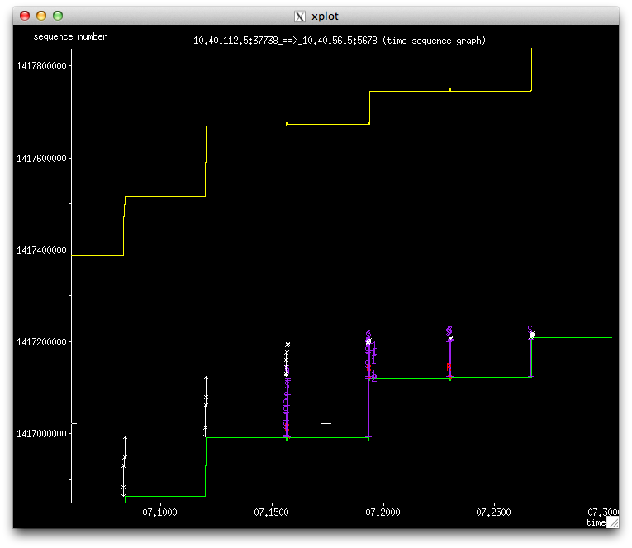
Zoom in on the Stalls
This indicates stalls or drops of data packets, which delays TCP. The sending end compensates by trying to recover with sending duplicate data into the network, which stalls things further. We end up in a continuous cycle, which reduces our throughput. We have surmised that this is being caused by a three factors:
NICs on sending hosts with much higher speeds than VC
Low buffering (128K) on some switches in the path
QoS provided by the switches in the path causing reordering

Slide 17
Exploring Solutions
What can we do to improve the situation?
We initially tried tuning the network stack to match the bandwidth-delay product.
  No significant improvement
Some of our applications (e.g., FDT, nuttcp) support “pacing” the application send rate
  Some minor improvement but issue seems to be lack of control over how the hardware actually ends up sending packets
We then looked into tc which is part of the iptables package in many Linux distributions

Slide 18
Using ‘tc’
tc is used to show and manipulate traffic control settings within the Linux operating system.
  Essentially, we create queues on the host interface (similar to network device QoS) to categorize traffic.
  With queuing we determine the way in which data is sent; it is important to realize that we can only shape data that we transmit.
While tc has many capabilities, for our use-case we plan to use a simple Hierarchical Token Bucket (HTB) queue and configure traffic rates that are slightly below the requested circuit capacity

Slide 19
Trying TC
With this in mind, we institute a tc rule that will limit our throughput to 900Mbps (under our reservation of 1 Gbps). Note that this is done on the Wisconsin side:
sudo /usr/sbin/tc qdisc del dev eth0.3123 root
sudo /usr/sbin/tc qdisc add dev eth0.3123 handle 1: root htb
sudo /usr/sbin/tc class add dev eth0.3123 parent 1: classid 1:1 htb rate 112.5mbps
sudo /usr/sbin/tc filter add dev eth0.3123 parent 1: protocol ip prio 16 u32 match ip src 10.10.200.20/32 flowid 1:1
Note shaping rate is specified as Mbytes/sec but shown in the TC rule as mbps (=MB/sec)
After adding this rule, we run the client again, and see the following performance (next slide)

Slide 20
TC Test Results
[dynes@fdt-wisc ~]$ nuttcp -T 30 -i 1 -p 5679 -P 5678 10.10.200.10
2.1875 MB / 1.00 sec = 18.3486 Mbps 0 retrans
8.3125 MB / 1.00 sec = 69.7281 Mbps 1 retrans
28.3125 MB / 1.00 sec = 237.5170 Mbps 0 retrans
99.1875 MB / 1.00 sec = 832.0559 Mbps 0 retrans
108.5000 MB / 1.00 sec = 910.1831 Mbps 0 retrans
108.4375 MB / 1.00 sec = 909.6078 Mbps 0 retrans
108.4375 MB / 1.00 sec = 909.6706 Mbps 0 retrans
108.4375 MB / 1.00 sec = 909.6215 Mbps 0 retrans
108.3125 MB / 1.00 sec = 908.5747 Mbps 0 retrans
108.3750 MB / 1.00 sec = 909.1354 Mbps 0 retrans
108.3750 MB / 1.00 sec = 909.1363 Mbps 0 retrans
108.2500 MB / 1.00 sec = 908.0605 Mbps 0 retrans
108.3750 MB / 1.00 sec = 909.1218 Mbps 0 retrans
108.3125 MB / 1.00 sec = 908.5911 Mbps 0 retrans
108.3125 MB / 1.00 sec = 908.5902 Mbps 0 retrans
108.4375 MB / 1.00 sec = 909.6133 Mbps 0 retrans
108.5000 MB / 1.00 sec = 910.1731 Mbps 0 retrans
108.4375 MB / 1.00 sec = 909.6533 Mbps 0 retrans
108.3750 MB / 1.00 sec = 909.1199 Mbps 0 retrans
108.4375 MB / 1.00 sec = 909.6388 Mbps 0 retrans
108.3750 MB / 1.00 sec = 909.1154 Mbps 0 retrans
108.4375 MB / 1.00 sec = 909.6406 Mbps 0 retrans
108.3750 MB / 1.00 sec = 909.1154 Mbps 0 retrans
108.3125 MB / 1.00 sec = 908.5911 Mbps 0 retrans
108.4375 MB / 1.00 sec = 909.6388 Mbps 0 retrans
108.5000 MB / 1.00 sec = 910.1640 Mbps 0 retrans
108.3125 MB / 1.00 sec = 908.5593 Mbps 0 retrans
108.5000 MB / 1.00 sec = 910.1967 Mbps 0 retrans
108.4375 MB / 1.00 sec = 909.6397 Mbps 0 retrans
108.3125 MB / 1.00 sec = 908.5911 Mbps 0 retrans
2965.6678 MB / 30.12 sec = 825.9052 Mbps 3 %TX 8 %RX 1 retrans 36.73 msRTT
Very close to the 900 Mbps shaped request. This works much better. Retry with 1000 Mbps TC config next

Slide 21
Next TC Test at 1 Gbps
dynes@fdt-wisc ~]$ nuttcp -T 30 -i 1 -p 5679 -P 5678 10.10.200.10
2.8750 MB / 1.00 sec = 24.1153 Mbps 0 retrans
6.8125 MB / 1.00 sec = 57.1492 Mbps 3 retrans
15.1250 MB / 1.00 sec = 126.8811 Mbps 8 retrans
17.1875 MB / 1.00 sec = 144.1652 Mbps 0 retrans
19.0625 MB / 1.00 sec = 159.9147 Mbps 0 retrans
22.5000 MB / 1.00 sec = 188.7422 Mbps 0 retrans
29.4375 MB / 1.00 sec = 246.9406 Mbps 0 retrans
31.9375 MB / 1.00 sec = 267.9114 Mbps 6 retrans
15.8125 MB / 1.00 sec = 132.6459 Mbps 0 retrans
21.5625 MB / 1.00 sec = 180.8795 Mbps 0 retrans
24.6875 MB / 1.00 sec = 207.0925 Mbps 0 retrans
30.2500 MB / 1.00 sec = 253.7435 Mbps 0 retrans
39.7500 MB / 1.00 sec = 333.4735 Mbps 0 retrans
44.0000 MB / 1.00 sec = 369.1102 Mbps 7 retrans
21.6875 MB / 1.00 sec = 181.9228 Mbps 0 retrans
29.3750 MB / 1.00 sec = 246.4070 Mbps 0 retrans
32.1250 MB / 1.00 sec = 269.4830 Mbps 0 retrans
37.8750 MB / 1.00 sec = 317.7239 Mbps 0 retrans
46.9375 MB / 1.00 sec = 393.7466 Mbps 0 retrans
57.3750 MB / 1.00 sec = 481.2993 Mbps 0 retrans
31.8750 MB / 1.00 sec = 267.3751 Mbps 4 retrans
33.9375 MB / 1.00 sec = 284.6907 Mbps 0 retrans
36.8750 MB / 1.00 sec = 309.3503 Mbps 0 retrans
41.1250 MB / 1.00 sec = 344.9805 Mbps 0 retrans
48.9375 MB / 1.00 sec = 410.5187 Mbps 0 retrans
18.3750 MB / 1.00 sec = 154.1303 Mbps 9 retrans
27.8125 MB / 1.00 sec = 233.2900 Mbps 0 retrans
30.0000 MB / 1.00 sec = 251.6952 Mbps 0 retrans
35.6875 MB / 1.00 sec = 299.3684 Mbps 0 retrans
44.0625 MB / 1.00 sec = 369.6230 Mbps 0 retrans
906.7649 MB / 30.28 sec = 251.2284 Mbps 0 %TX 3 %RX 37 retrans 36.71 msRTT
We see a problem again!

Slide 22
TC Summary and RoCE
Using tc to shape application traffic destined for a DYNES virtual circuit can significantly improve the efficiency of using that circuit.
  tc is available already on most Linux distributions
We have also begun to explore using RDMA or Converged Ethernet (RoCE) as another option which shows great promise for “clean” network paths.
  RoCE has been demonstrated to achieve 99% of the underlying circuit bandwidth BUT it requires a lossless path to work well.

Slide 23
Conclusion
Virtual circuits are an interesting option to help manage our infrastructure and support sensitive or high-priority tasks
Using virtual circuits efficiently requires that we appropriately modify how we use the network.
Using ‘tc’, available in most linux distros as part of iptables, allows us to shape our network traffic to efficiently use bandwidth made available via virtual circuits
Additional options like RDMA over Converged Ethernet (RoCE) also show promise in being able to efficiently use bandwidth provided by virtual circuits

Slide 24
Useful Links
The DYNES web-page at Internet2:
http://www.internet2.edu/ion/dynes.html
We have a DYNES user guide at:
http://www.internet2.edu/ion/docs/20130108-DYNESGuide.pdf
Subscribe to the DYNES user mailing list at https://lists.internet2.edu/sympa/subscribe/dynes-users
Email questions to dynes-questions@internet2.edu
Packet pacing http://fasterdata.es.net/host-tuning/packet-pacing/
Using ‘tc’ whitepaper http://fasterdata.es.net/assets/fasterdata/Using-tc-with-OSCARS-curcuits.pdf

Slide 25
Questions or Comments?

Slide 26
Additional Slides

Slide 27
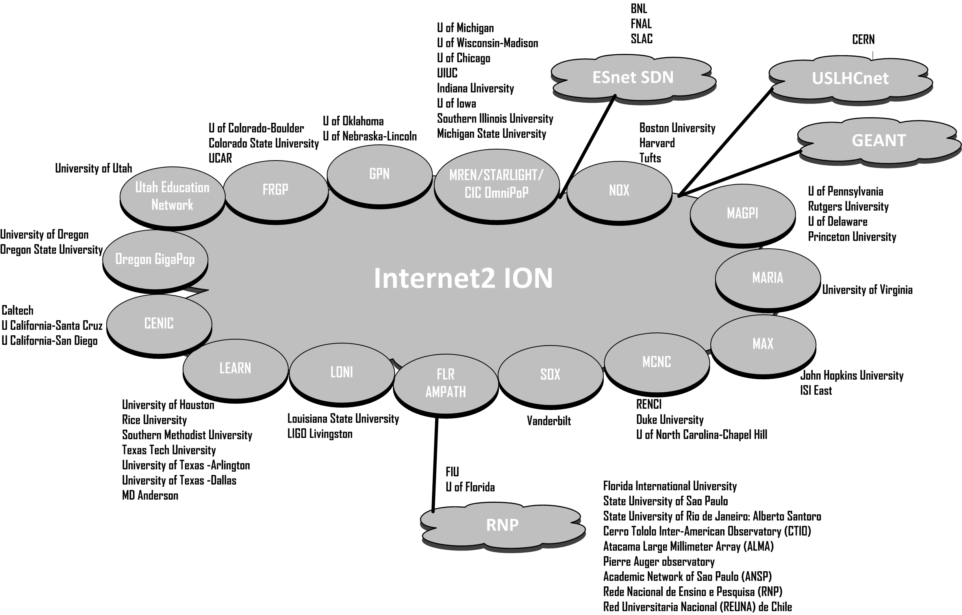
DYNES Deployment Diagram

Slide 28
DYNES Status
The DYNES project (an NSF MRI 3 year grant) was completed on July 31.
Last set of sites were installed in Spring 2013
We have deployed all of the DYNES planned footprint and upgraded a subset of sites with Openflow capable switches
We are continuing to work on some remaining issues with the reliability and speed of VC creation between DYNES sites

