Slide 1
Self service for software development tools
Michal Husejko, behalf of colleagues in CERN IT/PES
Notes:
Good afternoon … My name is Michal HUSEJKO, I’m working in CERN IT department.
We had a small change, original author of this presentation, had left CERN early summer. The project on Self service for software development tools has therefore been delayed, but I will give a short report on behalf of my colleagues.

Slide 2
Self service for software development tools
&
Scalable HPC at CERN
Michal Husejko, behalf of colleagues in CERN IT/PES
Notes:
I will also use the opportunity to share some findings from another project related to this track, namely Scalable HPC at CERN.

Slide 3
Agenda
Self service portal for software development tools
Scalable HPC at CERN
Next steps

Slide 4
Services for (computing) projects
A place to store code and configuration files under revision control
A place to document development and to provide instructions for users
A place to track bugs and plan new features
  Other services such as build and testing frameworks, but this is outside the scope of this talk
Notes:
Typically When you start a software project you need a place to store source code under revision control.
You want to document your development and store documentation for your users.
You need ways to track problems and plan new features.
There are other services which you normally need (continuous integration, build infrastructure, etc.) which we do not cover in that presentation.
Slide transition:
For open source project it is common to put your projects on github. We are refereeing to existing services at CERN.

Slide 5
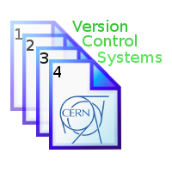
Version Control Services at CERN
SVN: Still the main version control system. 2100 repositories, over 50000 commits per month (SVN Statistics)
GIT: Available as a service since spring, about 700 repositories
Notes:
CVS has been stopped recently. Projects migrated to SVN or Git (officially).
Main version control is Subversion (SVN), complemented by a Git service for those who wishes distributed version control system. This new service is growing rapidly.
For Q&A: There are no plans to stop Subversion.

Slide 6
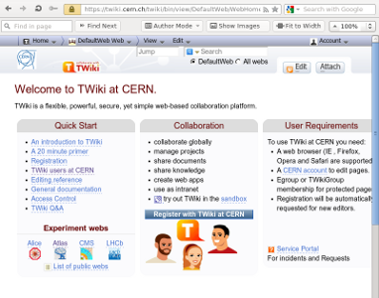
Collaborative Web documentation
Typically, TWiki for web documentation
  In use at CERN since 2003, ~10000 users
  Documentation divided into project “Webs” and “Topics”
  Currently running TWiki 5.1
  Many plugins and active user community
Could also be on Drupal or another web site for the project
  A link provides flexibility
Notes:
Twiki is used at CERN since 2003. Widely used by LHC experiments and IT projects.
Twiki is a application you probably know, but there are also other web tools in use at CERN like Drupal.

Slide 7
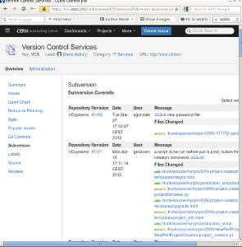
JIRA issue tracking service
Central JIRA instance
  CERN : SSO, eGroups, Service-now link
  Plugins : Git, SVN, Agile, Issue Collector, Gantt charts
  165 projects and ~2000 users of central instance, growing (10 projects/week)
  More users in the other JIRA instances, that have been migrated to the central Issue Tracking infrastructure
  Savannah migration to JIRA on-going (e.g. ROOT migrated)
Notes:
As you know an issue tracking system is to track bugs, plan new features, and releases.
At CERN we have our central issue tracking service based on JIRA. This service was started up in 2012, and it is integrated with CERN central infrastructure (authorization [egroups] and authentication[SSO])
Growing rapidly, now with 165 projects.
Experiment users from LCG Savannah are migrating to JIRA.

Slide 8
The case for automation
Creation of a project on a self-service basis is easy for the user and avoids a repetitive task for support teams.
Administrators of projects would benefit if they can set e.g. authorization rules for multiple tools at the same time
Certain settings of a Git or SVN projects are beyond the scope of a project administrator, if an intervention requires access to server infrastructure
JIRA project administrators have restricted rights to change their configuration. Providing more freedom would be desirable.
Notes:
For all of these services, certain tasks can be done by project administrators, such as: authorizing users by egroups, etc.
However, new projects in the service and changes to certain settings require to server infrastructure. Examples are links between JIRA and Git or Subversion projects.
To ease the task of project administrators we propose to automate task that currently has to be done by support team/personnel.

Slide 9
Example: Git service
AFS
Gitolite
  Permissions, integrated with e-groups
  World or Cern visibility option
Gitweb
  Browser access
Infrastructure
  Puppet
  DNS LB
  Apache LB
  HTTP
  AFS (FS agnostic)
DNS
Load balancer
8443
8443
8443
DNS
443
443
443
Git.cern.ch
https
Notes:
Just to show you an example of service architecture, here is schema of the Git service setup. Data storage is currently on AFS, there is a cluster of servers behind the DNS load balancer and alias. The server infrastructure is managed with Puppet.
Permissions are manage with open source toolkit called Gitolite, which is written in Perl, and integrated with egroups.
Browser access is served by Gitweb which is another open source popular Git web interface.
Allowing public internet access, bypassing egroup permissions, currently requires system privileges (triggering Service Request).

Slide 10
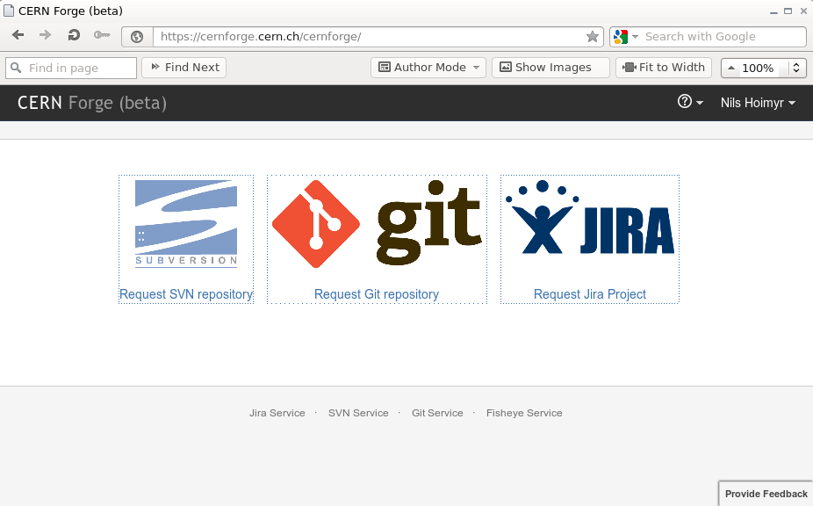
CERN Forge admin portal
Django Web interface, with backend DB for service metadata
Use REST API to JIRA and other services for administrative actions
Notes:
To enable project administrators to setup and configure new (software) projects, we are working on a portal, CERNFORGE.
It is implemented with Django Web interface and a database backend for service metadata.
Use REST (HTML PUT, GET, DELETE …) API to JIRA and other services for administrative actions.
The first prototype version that is already available only allows for project creation.

Slide 11
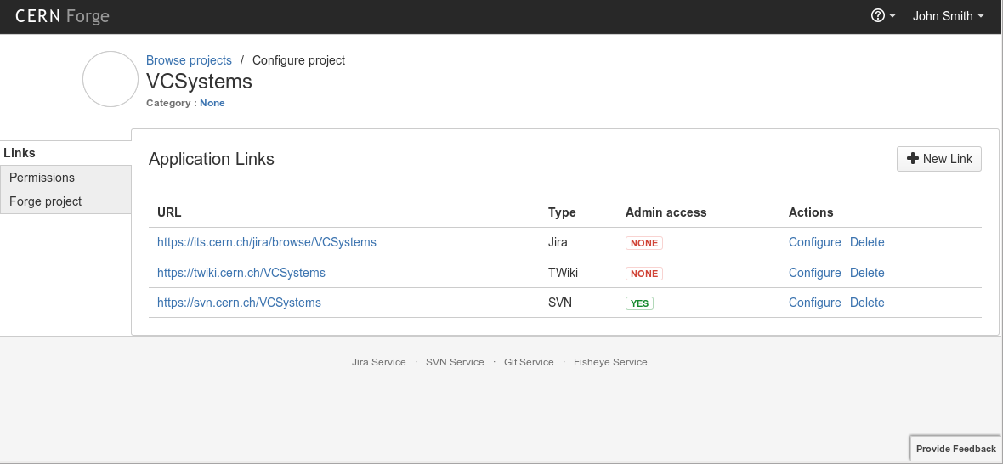
CERN Forge admin portal - 2
In the future, users will be able to configure links between VCS and Issue tracking, as well as other settings (public/private etc)
Notes:
This is an example of CERNFORGE prototype.
In the future, users will be able to:
configure links between Git, Subversion, and Issue tracking,
Setup links to project webpages (Twiki)
… as well as other settings.

Slide 12
More in the next chapter!
Stay tuned for updates on http://cernforge.cern.ch
Over to another challenge where we are working towards on demand flexibility:
Scalable High Performance Computing
Notes:
Stay tuned for updates on CERNFORGE
Over to another challenge where we are working towards on demand flexibility.
This is area of my project.

Slide 13
Scalable HPC (1/2)
Some 95% of our applications are served well with bread-and-butter machines
We (CERN IT) have invested heavily in AI including layered approach to responsibilities, virtualization, private cloud.
There are certain applications, traditionally called HPC applications, which have different requirements
Even though these applications sail under common HPC name, they are different and have different requirements
These applications need detailed requirements analysis
Notes:
Some 95% of our applications are served perfectly well with standard bred-and-butter machines (dual CPU, 3...4 GB/core, a bit of disk space, GigE or at best 10GE), as most of these applications are single-threaded
In order to operate these machines more efficiently, we have invested into AI, including layered approach of responsibilities, virtualisation, private cloud
A small fraction of applications (engineering, theory, accelerator) have requirements that are not well served by these bred-and-butter machines, due to core count, memory size/latency/bandwidth, interprocess communication, ... traditionally called HPC. Different architectures required
Even if all that is sailing under the label HPC, the requirements (and hence the optimal technical solutions) can be very different
Every effort must be made to serve these requirements as much as possible by the same layered approach. In order to understand to what extent this is possible, detailed understanding of the requirements is needed.

Slide 14
Scalable HPC (2/2)
We contacted our user community and started to gather continuously user requirements
We have started detailed system analysis of our HPC applications to gain knowledge of their behavior.
In this talk I would like to present the progress and the next steps
At a later stage, we will look how the HPC requirements can fit into the IT infrastructure
Notes:
In order to understand the requirements of HPC applications, we have reached to our user community to gather user test cases.
With this in hand, we have prepared system analysis environment, based on available hardware and standard Linux performance monitoring tools . With the main goal to better understand requirements of user applications.
In this talk I would like to introduce some of the hpc applications, which are present at CERN, I would like to present the progress on understanding the requirements imposed by this application. And present next steps which we will take to go towards deciding how this will fit into our IT infrastructure.

Slide 15
CERN HPC applications
Engineering applications:
  Used at CERN in different departments to model and design parts of the LHC machine.
  Tools used for: structural analysis, fluid dynamics, electromagnetics, and recently multiphysics
  Major commercial tools: Ansys, Fluent, HFSS, Comsol, CST
    but also open source: OpenFOAM (fluid dynamics)
Physics simulation applications
  HEP community developed simulation applications for theory and accelerator physics
Notes:
Based on our interaction with user community, we have distilled two different groups of HPC applications: Engineering applications (general purpose HPC applications, targeting different markets) and Physics simulation applications (purpose build HPC applications developed at CERN, with some with help of external institutes).
Engineering applications
… blah blah ...
Physics simulation
… blah blah …
BACKUP:
Transition: While working closely with our users, we have understood that in principle, we have two type of HPC applications present at CERN.

Slide 16
One of many eng. cases …
Ansys Mechanical
  LINAC4 beam dump system, single cycle simulation
Time to obtain a single cycle solution:
  8 cores -> 63 hours to finish simulation
  64 cores -> 17 hours to finish simulation
User interested in 50 cycles: would need 130 days on 8 cores, or 31 days on 64 cores
It is impossible to obtain simulation results for this case in a reasonable time on a standard user engineering workstation
Notes:
So, we took the user test case and we simulated it on our test setup.
It took 63 hours to simulate the user case on 8 cores, and 17 hours on 64 cores.
And This was just one cycle. User will need to simulate 50 cycles to get meaningful results of beam deposition in dump system.
50 cycles will take around 31 days on 64 core system, … and 130 days on 8 core system.
… and we don’t want engineers to start buying expensive 128 GB of RAM workstations to keep them under the desk.

Slide 17
Challenges
Why do we care ?
Challenges
  Problem size and its complexity are challenging our users’ workstations
  This can be extrapolated to other Engineering HPC applications
How to solve the problem ?
  Can we use current infrastructure ?
  … or do we need something completely new ?
  … and if something new, how this could fit into our IT infrastructure
  We are running a Data Center and not a Super Computing Center
Notes:
Everyday we are facing users asking us how to speed up their engineering application.
Problem size and its complexity are challenging user computer workstations in terms of computing power, memory size, and file I/O. The way the users are working: design, simulation, correction, simulation, re-design, simulation, before they actually get final results.
Definitely it is a problem.
Can we use current infrastructure to provide a platform for these demanding applications, if current infrastructure is.
So, let’s have a look at what is happening behind the scene to see if our Data Center optimized hardware can also suit HPC type of jobs
This is happening due to increasing problem size and increasing number of details being simulated. Also more and more users are interested in Multiphisics simulations.

Slide 18
Current infrastructure
CERN lxbatch – Optimized for HEP data processing
  Definitely not designed with MPI applications in mind
Example lxbatch node:
  Network: mostly Ethernet 1 Gb/s, rarely 10 Gb/s (very limited number with low latency)
  8-48 cores, 3-4 GB RAM per core
  Local disk, AFS or EOS/CASTOR HEP storage
Can current lxbatch service provide “good-enough” HPC capability?
  How interconnect affects performance (MPI based distributed computing)
  How much RAM per core
  Type of temporary storage
  Can we utilize multicore CPUs to decrease time to solution (increase jobs/week) ?
Notes:
We know what we have – CERN Lxbatch
To understand the requirements of our HPC applications we decided to perform detailed analysis of system level performance

Slide 19
Multi-core scalability
We know that some of our tools have a good scalability (example Ansys Fluent)
How about other, heavily used at CERN (example Ansys Mechanical)?
One of many test cases: LINAC4 beam dump system, single cycle simulation – results:
  Scales well beyond single multi-core box.
  Greatly improved number of jobs/week, or simulation cycles/week
Conclusion
  Multi-core distrbuted platforms needed
  to finish simulation in reasonable
  time
Notes:
To better understand how many cores these applications can utilize, we have started multi-core scalability measurements.
So, we took previously presented user case (beam dump system), and we run it on distributed node (two nodes, 64 cores).

Slide 20
Interconnect latency impact
Ansys Fluent – Commercial CFD application
Speedup beyond single node can be diminished because of high latency interconnect.
  The graph shows good scalability for 10 Gb low latency beyond single box, and dips in performance when switched to 1 Gb MPI
Conclusion:
  Currently 99 % of nodes in CERN batch system are equipped with 1 Gb/s NIC
  Low latency interconnect solution needed.
Notes:
We took case from CERN group which performs CFD simulations.
This tool is reportd as able to scale very well on multiple of nodes ( linearly up to 10-15’000 nodes).
We measured impact of interconnect latency on number of jobs per week.
Going from low latency to high latency interconnect diminishes speedup achieved with multi node setup.

Slide 21
Memory requirements
In-core/out-core simulations (avoiding costly file I/O)
  In-core = most of temporary data is stored in the RAM (still can write to disk during simulation)
  Out-of-core = uses files on file system to store temporary data.
  Preferable mode is in-core to avoid costly disk I/O accesses, but this requires increased RAM memory and its bandwidth
Ansys Mechanical (and some other engineering applications) has limited scalability
  Depends heavily on solver and user problem
  Limits possibility of problem splitting among multiple nodes
All commercial engineering application use some licensing scheme, which can put skew on choice of a platform
Notes:
To avoid costly file I/O we need to have enough RAM to store all temporary data in it.
Some tools have scalability limitations – there is a boundary where required amount of RAM for optimal run can be spread over.
All the commercial tools have some license scheme which put another constraint on scalability.
In order to profit from these days CPU power, the temporary data used during the simulation n
Ansys HPC licensing
320 euro @ core (research)
700 euro @ core (associate)

Slide 22
Impact of HDD IOPS on performance
Temporary storage ?
Test case: Ansys Mechanical, BE CLIC test system
Disk I/O impact on speedup. Two configurations compared.
  Using SSD (better IOPS) instead of HDD increases
  jobs/week almost by 100 %
Conclusion:
  We need to investigate more cases
  to see if this is a marginal case
  or something more common
Notes:
There could be some cases (we observed at least one). That even though you have big enough memory, the system is still performing a lot of file I/O operations.
In that case using SSD, instead of HDD, can lead to better results.
We have run the test case on HDD, and in the log files we have observed that simulation process spends hell a lot of the time in IOWAIT, so most of the cores were stalled waiting for disk access.
Based on that we decided to mount SSD drivers, to perform comparison. And as expected we observed immediately improvement.
We still have to investigate if this is marginal case, or it is more common.

Slide 23
Analysis done so far for engineering applications
Conclusions
  More RAM needed for in-core mode, this seems to solve potential problem of disk I/O access times.
  Multicore machines needed to decrease time to solution
  Low latency interconnect needed for scalability beyond single node, which by itself is needed to decrease simulation times even further.
Next steps:
  Perform scalability analysis on many-node clusters
  Compare low latency 10 Gb/s Ethernet with Infiniband Cluster for all CERN HPC Engineering applications

Slide 24
Last but not least
If low latency interconnect then … Ethernet or Infiniband ?
Notes:
You can always argue the multi-node multicore scalability of engineering application is limited by the way the problem is described by the user –garbage in, garbage out. Some are utilizing multi-cores better some are worst at it.
To perform the comparison between different low latency interconnect technologies, we decided to use application for Lattice QCD simulations.
Why Infiniband and Ethernet:
Infiniband as the COTS solution which is able to deliver best low latency/high bandwidth.
Ethernet because we have standardized on it in our data center.

Slide 25
Lattice QCD
Lattice QCD:
  Highly parallelized MPI application
Main objective is to investigate:
  Impact of interconnection network on system level performance (comparison of 10 Gb Ethernet iWARP and Infiniband QDR)
  Scalability of clusters with different interconnect
  Is Ethernet (iWARP) “good enough” for MPI heavy applications ?

Slide 26
IB QDR vs. iWARP 10 Gb/s
Two clusters, same compute nodes, same BIOS settings.
  Dual Socket, Xeon SandyBridge E5-2630L, 12 cores total per compute node
  64 GB RAM @ 1333 MT/s per compute node
Different Interconnect networks
  Qlogic (Intel) Infiniband QDR (40 Gb/s)
    12 compute nodes + 1 frontend node (max. 128 cores)
  NetEffect (Intel) iWARP Ethernet (10 Gb/s) + HP 10Gb low latency switch
    16 compute nodes + 1 frontend node (max. 192 cores)

Slide 27
IB QDR .vs iWARP 10 Gb/s (1/3)

Slide 28
IB QDR .vs iWARP 10 Gb/s (2/3)
Less is better

Slide 29
IB QDR .vs iWARP 10 Gb/s (3/3)
Less is better

Slide 30
Conclusions and outlooks
Activity started to better understand requirements of CERN HPC applications
Performed first steps to measure performance of CERN HPC applications on Ethernet (iWARP) based cluster – results are encouraging
Next steps are:
  Refine our approach and our scripts to work at higher scale (next target is 40-60 nodes) and with real-time monitoring
  Compare results between Sandy Bridge 2 socket system with SB 4 socket system – both iWARP
  Gain more knowledge about impact of Ethernet interconnect network and tuning parameters on MPI jobs
  Investigate impact of virtualization (KVM, Hyper-V) on latency and bandwidth for low latency iWARP NIC.

Slide 31
Q&A

