Slide 1
US LHC Tier-1
WAN Data Movement
Security Architectures
Phil DeMar (FNAL); Scott Bradley (BNL)
demar@fnal.gov; bradley@bnl.gov
CHEP 2013
October 17, 2013

Slide 2
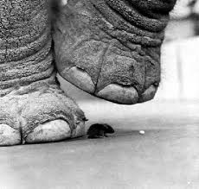
The Challenges with High Impact Data Movement
Network Bandwidth:
  General R&E networks may not provide enough
Site Perimeter Security Obstacles:
  Firewall performance isn’t keeping up
Intermingling Bulk Data Traffic
  with Interactive Applications:
  Don’t want this to be your users
    audio/video apps
Optimal performance may require use of alternate network paths
  Means using non-default routing mechanisms

Slide 3
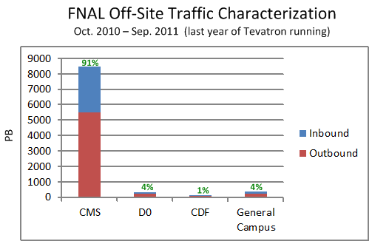
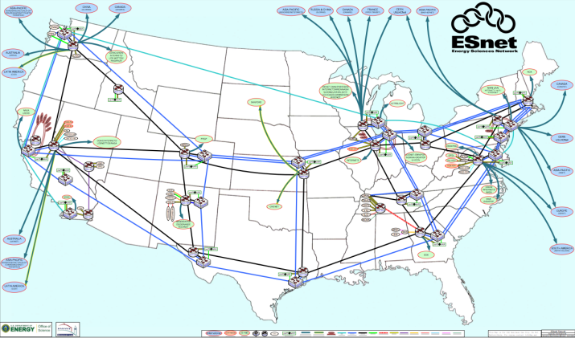
Long Term Trend Toward Isolating Wide-Area Science Data Movement
At Tier-1 Centers, LHC WAN data dwarfs everything else:
  (Final year of Tevatron operations)
Hybrid R&E Networks to service high impact science data:
  Isolated network paths
  Potentially with B/W guarantees
Data circuit technologies enable virtual pt-to-pt connections
  More secure “private” network paths
Discipline-specific networks appear
ESnet4 circa 2009

Slide 4
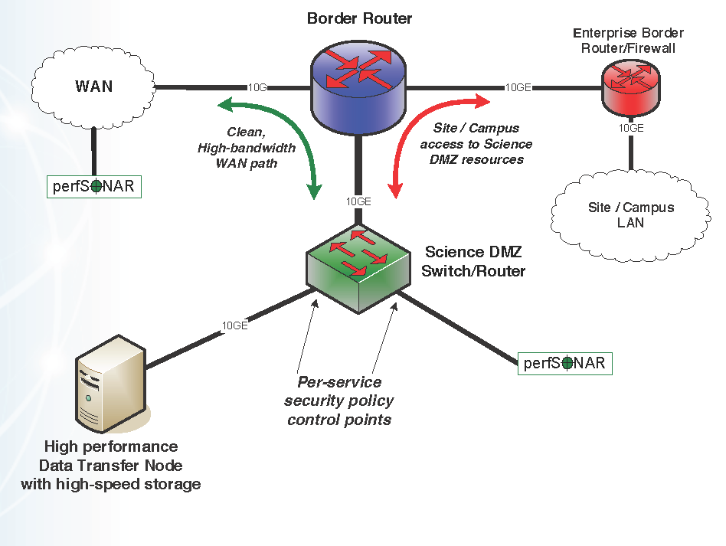
ESnet-Developed Model for a Prototype Site Science DMZ
General idea: separate science data from general campus network infrastructure
Components:
  Data Transfer Node (DTN):
    Optimized for WAN transfers
  Bypass routing around
  site firewalls
  Network measurement
  infrastructure
    PerfSONAR
An architecture, not implementation
ESnet prototype
Science DMZ figure

Slide 5
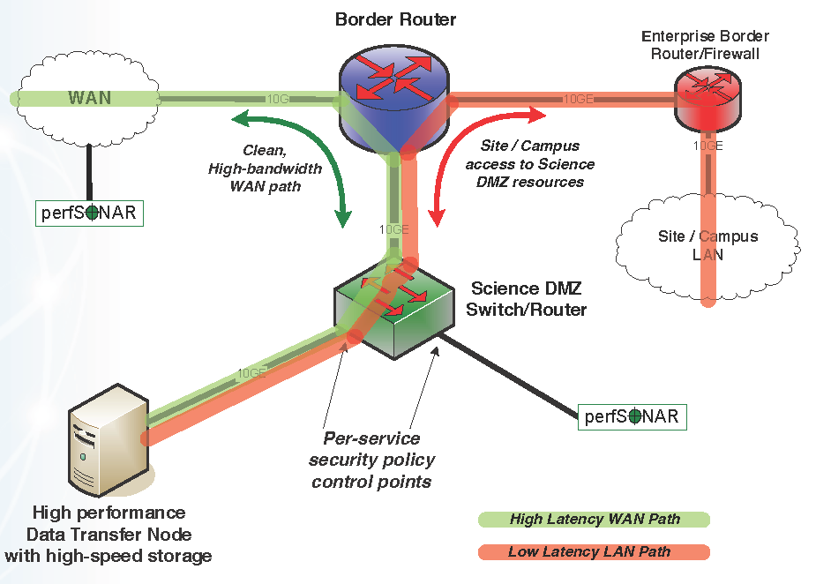
Prototype Science DMZ Data Paths
Custom WAN path(s) for science DMZ systems:
  Appropriate bandwidth provisioning is primary goal
  Optimizing latency isn’t a goal
Specific security policies
  & tools for science data
  traffic
Science DMZ resides
outside of site perimeter
ESnet figure on
Science DMZ data paths

Slide 6
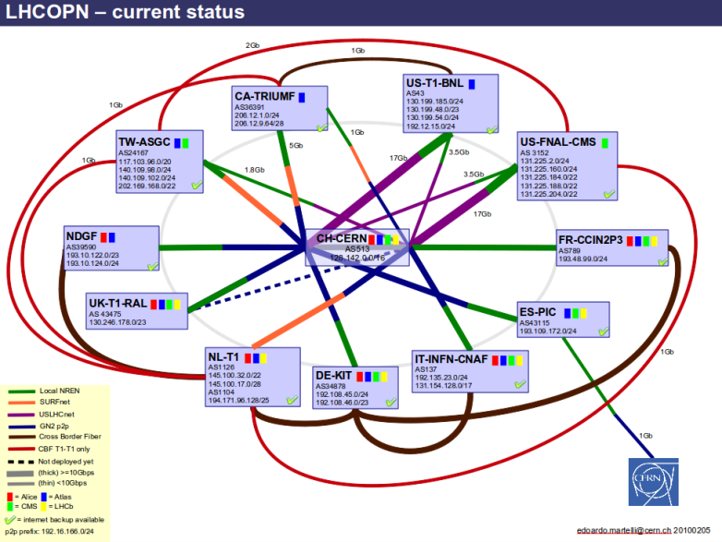
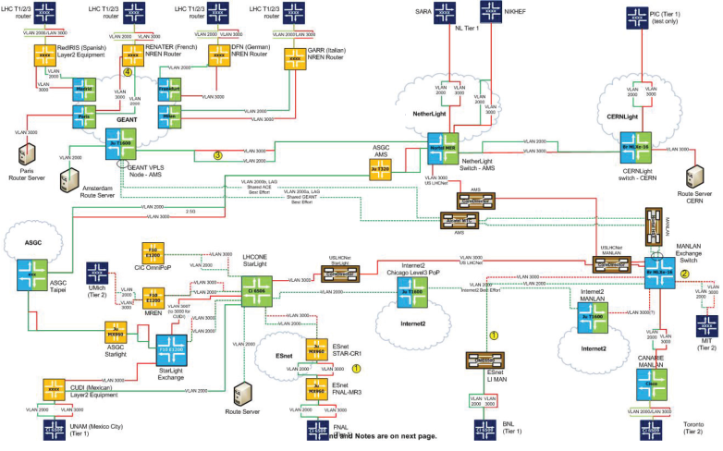
Diverse Set of LHC WAN Paths
LHC Optical Private Network
(LHCOPN) for T0 <-> T1 data
  Tightly-controlled access
  Dedicated bandwidth
LHC Open Network Exchange
(LHCONE) for T1/T2 <-> T1/T2
  Loosely-controlled access
  Mix of routed & end-to-end traffic
End-to-end circuits:
  Sometimes over private links
  Sometimes over R&E networks
Routed IP path over general R&E network infrastructure
  When no other paths are available
Controlled-access traffic
reduces security risks
LHCOPN
LHCONE

Slide 7
Policy-Based Routing (PBR)
PBR = forwarding of specific packets based on administrative decision or policy:
  In contrast to following normal (dynamic…) routing tables
  Manually configured on routers
Cisco implementation is Route-Map command:
  Up to 5-tuple mapping (src/dest IP, src/dest port, protocol)
  Basic components are “mapping” & “action taken if matched”
Similar capabilities available from other vendors
  Generic name = ACL-based forwarding

Slide 8
IPSLA & Object Tracking
PBR is a form of static routing:
  Potential for black-holing traffic is path is down
IPSLA and Object Tracking can be used to avoid black-holing
  IPSLA continuously checks to make sure path is up:
    ICMP ping to remote end of path
    Also used for SNMP monitoring of status for end-to-end circuits
  Object Tracking maintains status of path as an object
    If IPSLA fails, object (path) is marked as down
  Route-maps (PBR) configured with tracking object identifier
    If object is down, PBR forwarding is not implemented

Slide 9
FNAL Implementation

Slide 10
Site Perimeter Basics at FNAL
FNAL does not have a site firewall
  OK, we have one but science data systems aren’t behind it
  Firewalls aren’t a factor for our science data movement
Site security based on wide spectrum of controls
  Strong authentication mandated
  Onus on sysadmins to secure their systems
  Intense vulnerability scanning
  Perimeter controls (ACLs), IPS, web proxy, etc
By default, science data must pass thru perimeter controls
  Bypass exception:
  “Known traffic from well-managed systems at trusted sites”
    Exception based on risk analysis and acceptable residual risk

Slide 11
FNAL’s PBR Implementation
Forwards science traffic to alternate network paths
2-tuple, based on src/dest netblocks
  CMS Tier1 is always one netblock
  Remote T0/T1/T2 netblock is always the other
All FNAL PBR is internal:
  No PBR forwarding into WAN
Perimeter security control mechanism for bypass traffic:
  Only PBR-validated traffic can use the bypass route

Slide 12
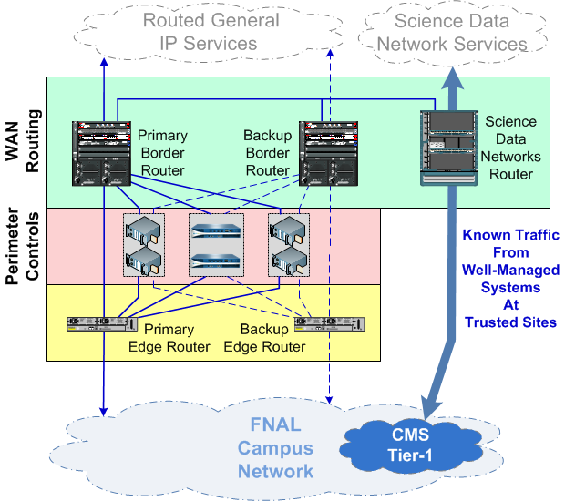
FNAL Network Perimeter versus the Science DMZ Model
CMS Tier-1 integrated into campus network:
  No special DTN nodes
  Tier-1 dCache servers are equivalent to DTNs
Separate border router for bypass traffic:
  Consistent with bypass traffic security policy
Non-bypass traffic to/from Tier-1 passes through normal perimeter security controls

Slide 13
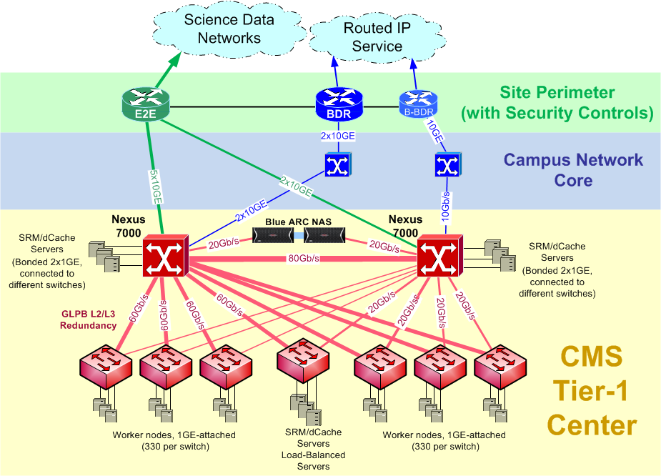
US-CMS Tier-1 – Alternate WAN Paths
US-CMS Tier-1:
  ~1600 systems
  Distributed across
  4 computer rooms
  dCache servers
  distributed as well
Primary & secondary
Tier-1 LAN switches
  Connections to
  campus core
  Also to bypass perimeter router (E2E) for WAN science data
    Higher bandwidth connection for science data movement

Slide 14
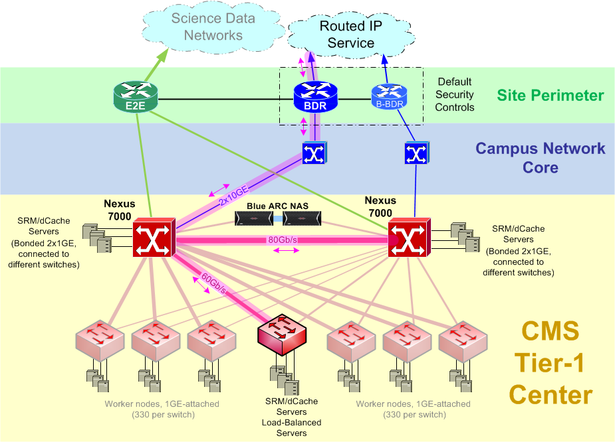
By Default, Tier-1 Traffic Follows
General IP (Routed) Path
Tier-1 WAN traffic forwarded through primary Tier-1 switch
  Path symmetry more important than traffic load balancing
  Layer -2 traffic within LAN distributed across links via VPC
Unless bypass routed, traffic will pass through campus core & border router
  This includes perimeter security controls

Slide 15
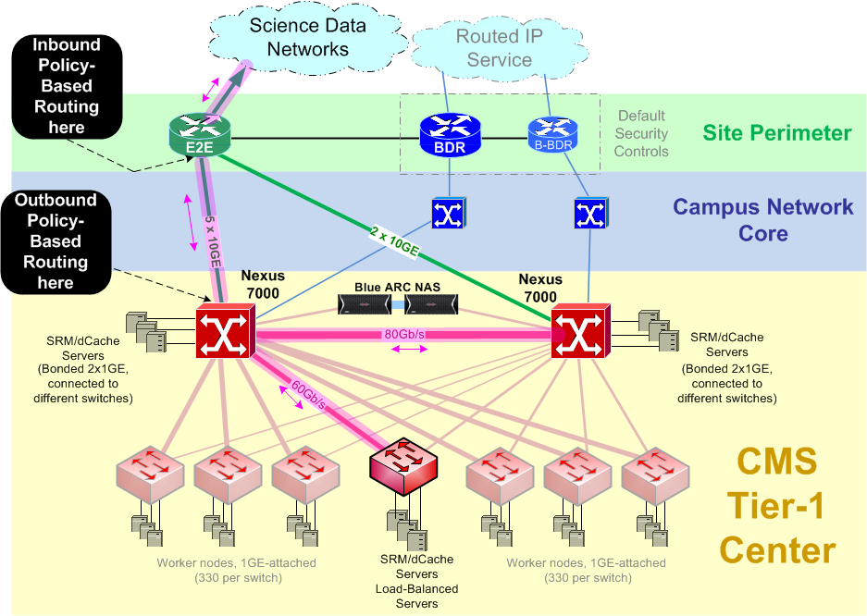
Alternate Network Paths via PBR
PBR steers select traffic to/from bypass router
  Based on src/dst address blocks
  Our Tier-1 netblock is always one of the tuples
    Remote Tier-0, Tier-1, or Tier-2 is the other
PBR is manually configured:
  A bit of a pain, but scalable to level of CMS collaboration
  Dealing with address changes at remote sites also an issue

Slide 16
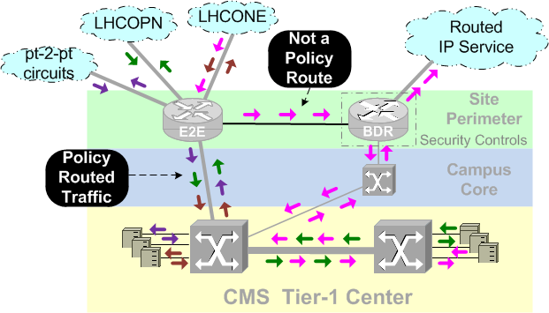
Non-PBR Traffic on Bypass Connections
Incoming traffic not in PBR tables forwarded to border router:
  Still gets into the Tier1
  But passes through security controls
  Also creates WAN path asymmetry
    May cause firewall problem on remote end
We monitor flow data between bypass and border router for this type of traffic
  Will add to PBR tables if its valid CMS traffic
  But this is still a manual process

Slide 17
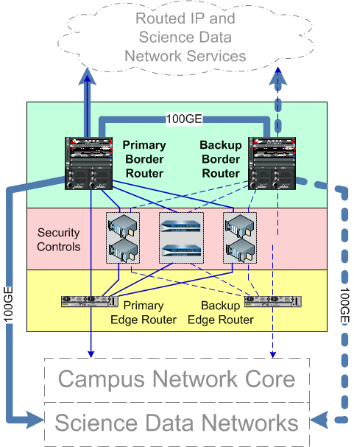
FNAL Future Directions – Perimeter Architecture
Costs of 100GE will necessitate consolidating bypass router functions into border & backup border routers:
  Consistent with general technology trend to consolidate network hardware & virtualize network functions

Slide 18
BNL Implementation

Slide 19
BNL Science DMZ
100gb/sec WAN Connectivity:
  Provides native 100gb/sec. interfaces
  Will interface to Testing and Production 100g waves
  Supports multiple 10gb/sec. and 40gb/sec. connections
  Initially 2 attachment ports at 100gb/sec.
  Dedicated CIDR block for IP addressing
  Will have limited Etherchannel to BNL campus
  Dedicated routing platform – Juniper MX2010

Slide 20
BNL Science DMZ cont
Current Status
  First 100g wave in testing phase
  Will participate in TA100 testing with CERN
  Currently evaluating an Arista 7508E switch for aggregation, others to follow
    High port density and types are key requirements

Slide 21
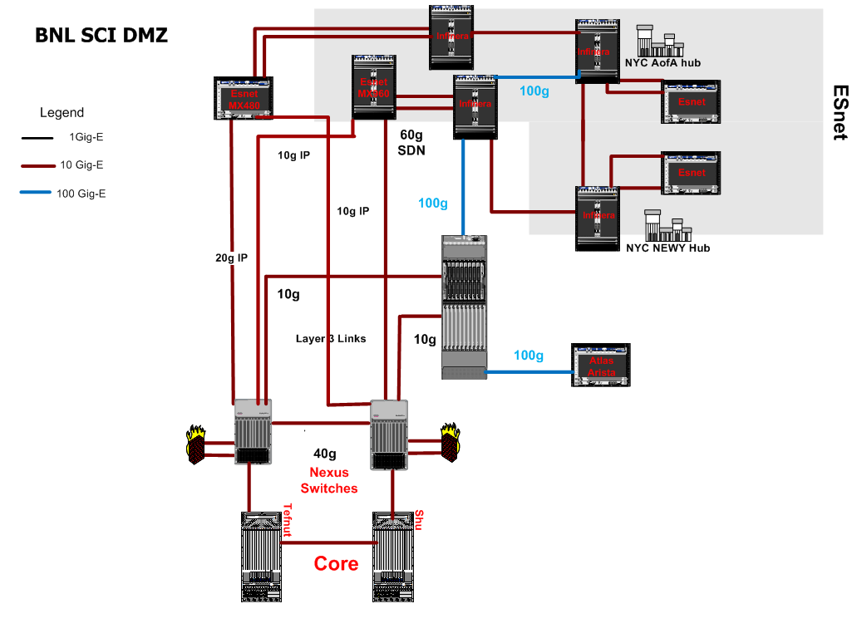
BNL Science DMZ Topology
Dedicated SCI DMZ
Router
Aggregation Switch

Slide 22
General Future Directions - OpenFlow
PBR has worked very well to isolate & control our science data traffic, but:
  Manual configuration is a pain
  Adds complexity to site routing & troubleshooting
  Keeping up with address changes/additions is difficult
OpenFlow - emerging standard for flow-based forwarding:
  PBR is essentially flow-based forwarding, too
  We’re investigating OpenFlow to replace current PBR
    Long term vision - end-to-end forwarding based on OpenFlow
    Short term goal - replace PBR within the US-CMS Tier-1

Slide 23
Summary
Separating science data movement from general network traffic has worked well at US-LHC Tier-1s
  Enabled us to meet needs of both LHC stakeholders & general users, but not at each other’s expense
  Science DMZ architectures based around PBR for LHC traffic:
    Avoids performance issues with overloading perimeter security tools
Our implementations work well for us because:
  We are dealing with established traffic characteristics
  Our stakeholders are well-organized & long-lived
  May not translate well to other disciplines
Looking toward OpenFlow as a more standard approach to separate out our science data movement

Slide 24
Questions
?

