Slide 1
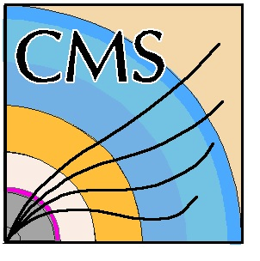

The new CMS DAQ system for LHC operation after 2014 (DAQ2)
CHEP2013: Computing in High Energy Physics 2013
14-18 Oct 2013
Amsterdam
Andre Holzner, University California at San Diego
On behalf of the CMS collaboration

Slide 2
Overview
DAQ2 Motivation
Requirements
Layout / Data path
Frontend Readout Link
Event builder core
Performance considerations
Infiniband
File based filter farm and storage
DAQ2 test setup and results
Summary/Outlook

Slide 3
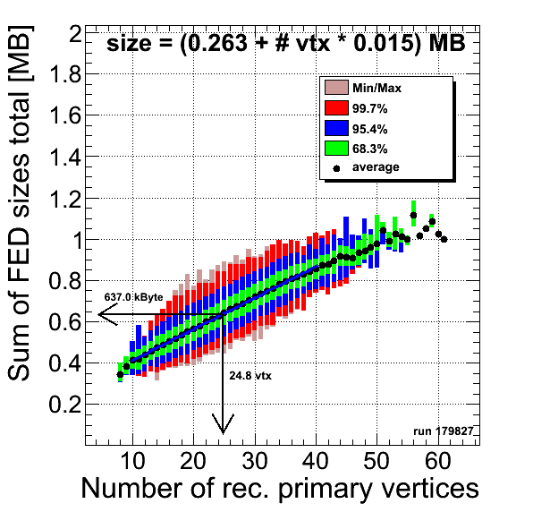
DAQ2 motivation
Aging equipment:
  Run1 DAQ uses some technologies which are disappearing
    PCI-X cards, Myrinet
    Almost all equipment reached the end of the 5 year lifecycle
CMS detector upgrades
  Some subsystems move to new front-end
  drivers
  Some subsystems will add more channels
LHC performance
  Expect higher instantaneous luminosity after LS1
  → higher number of interactions per bunch
  crossing (‘pileup’)
  → larger event size, higher data rate
Physics
  Higher centre-of-mass energy and more pileup imply:
    either raise trigger thresholds, or
    more intelligent decisions at Higher Level Trigger
    → requires more CPU power
Notes:
Buying equipment to just replace the old hardware (with the same interfaces) may even be more expensive than buying state of the art equipment

Slide 4
DAQ2 requirements
Requirement | DAQ1 | DAQ2
Readout rate | 100 kHz
Front end drivers (FEDs) | 640: 1 ~ 2 kByte | 640: 1 ~ 2 kByte ~50: 2 ~ 8 kByte
Total readout bandwidth | 100 GByte/s | 200 GByte/s
Interface to FEDs¹⁾ | SLink64 | Slink64/Slink Express
Coupling Event builder software/HLT software²⁾ | no requirement | decoupled
Lossless event building | ✅
HLT capacity | extendable
High availabilty/ fault tolerance³⁾ | ✅
Cloud facility for offline processing⁴⁾ | originally not required | ✅
Subdetector local runs | ✅
See talks of 1) P. Žejdl 2) R. Mommsen 3) H.Sakulin 4) J.A.Coarasa

Slide 5
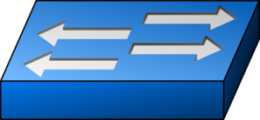
DAQ2 data path
FED
~640 (legacy) + 50 (μTCA) Front End Drivers
custom
hardware
Slink64/
SlinkExpress
~576 Front End Readout Optical Links (FEROLs)
FEROL
Eth 10 GBit/s
10 GBit/s Ethernet → 40 GBit/s Ethernet switches,
8/12/16 →1 concentration
Eth 40 GBit/s
RU
72 Readout Unit PCs (superfragment assembly)
IB 56 GBit/s
Infiniband switch (full 72 x 48 connectivity,
2.7 TBit/s)
commercial
hardware
IB 56 GBit/s
BU
48 Builder units (full event assembly)
Eth 40 GBit/s
Ethernet switches 40 GBit/s → 10 GBit/s (→ 1 GBit/s),
1 →M distribution
FU
Filter units (~ 13’000 cores)
storage

Slide 6
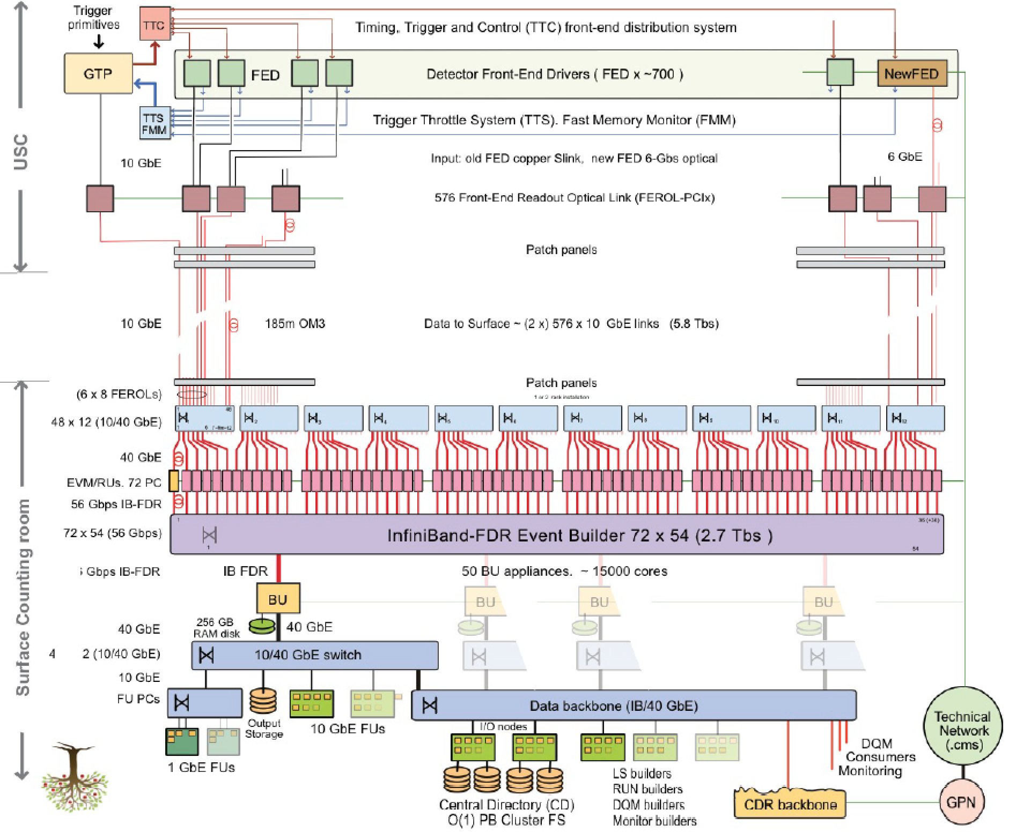
DAQ2 layout
underground
surface

Slide 7
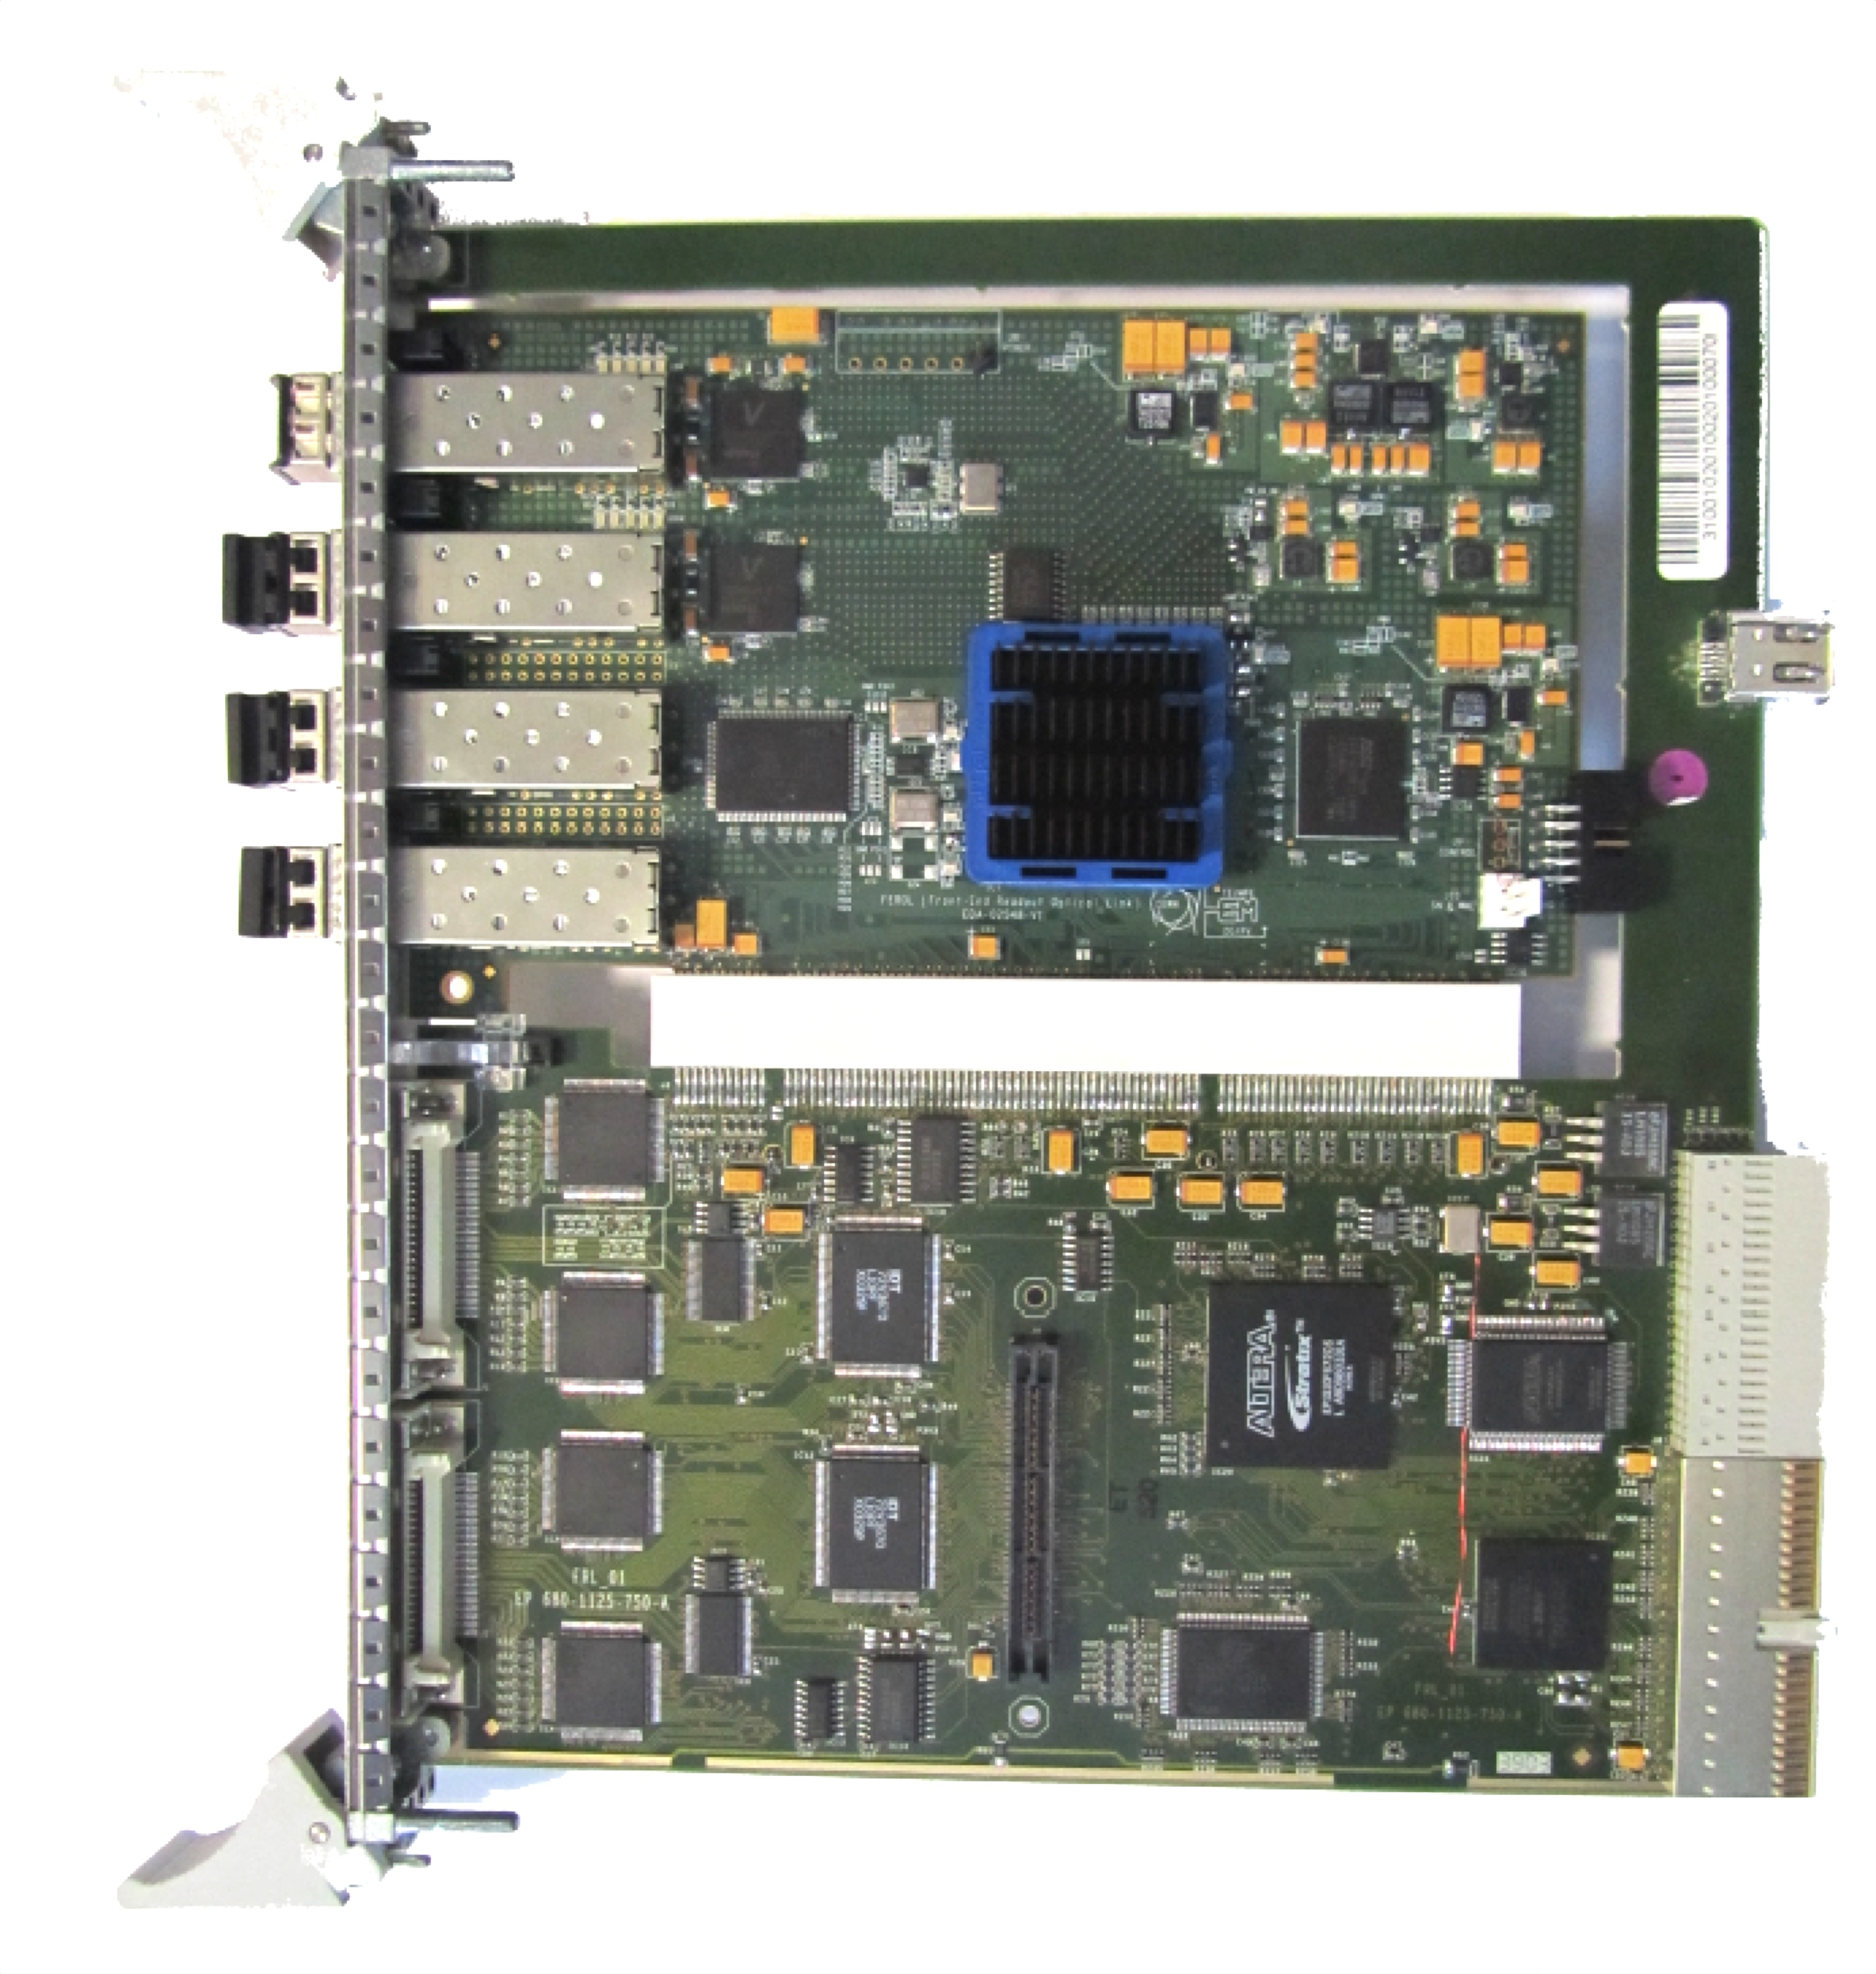
FrontEnd Readout Link (FEROL)
Replace Myrinet card
(upper half) by a new
custom card
PCI-X interface to legacy
slink receiver card
(lower half)
10 GBit/s Ethernet output to
central event builder
  Restricted TCP/IP protocol engine inside the FPGA
Additional optical links (inputs) for future μTCA based Front End Drivers (6-10 GBit/s; custom, simple point to point protocol)
Allows to use industry standard 10 GBit/s transceivers, cables and switches/routers
  Only commercially available hardware further downstream
10 GBit/s Ethernet
Slink Express
from μTCA
FEDs
Slink64
from FEDs
see P. Žejdl’s talk
for more details

Slide 8
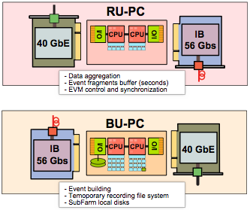
Event Builder Core
Two stage event building:
  72 Readout units (RU) aggregate
  8-16 fragments (4 kByte average) into superfragments
    Larger buffers compared to FEROLs
  48 Builder Units (BU) build the entire event from superfragments
InifiniBand (or 40 Gbit/s Ethernet) as interconnect
Works in a 15 x 15 system, need to scale
to 72 x 48
Fault tolerance:
  FEROLs can be routed to different RU
  (adding a second switching layer improves
  flexibility)
  Builder Units can be excluded from running

Slide 9
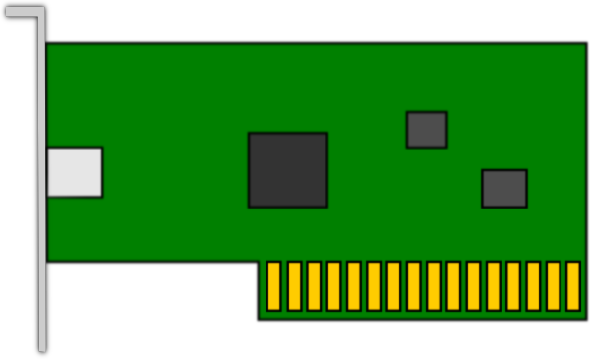
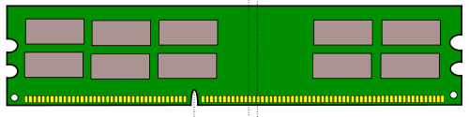
Performance considerations
Number of DAQ2 elements
is an order of magnitude
smaller than for DAQ1
Consequently, bandwidth
per PC is an order of
magnitude higher
CPU frequency did not increase since DAQ1 but number of cores
did
Need to pay attention to
performance tuning
  TCP socket buffers
  Interrupt affinities
  Non-uniform memory access
 | DAQ1 | DAQ2
# readout units (RU) | 640 | 48
RU max. bandwidth | 3 Gbit/s | 40 Gbit/s
# builder units (BU) | >1000 | 72
BU max. bandwidth | 2 Gbit/s | 56 Gbit/s
PCIe
Memory Bus
CPU0
QPI
CPU1

Slide 10
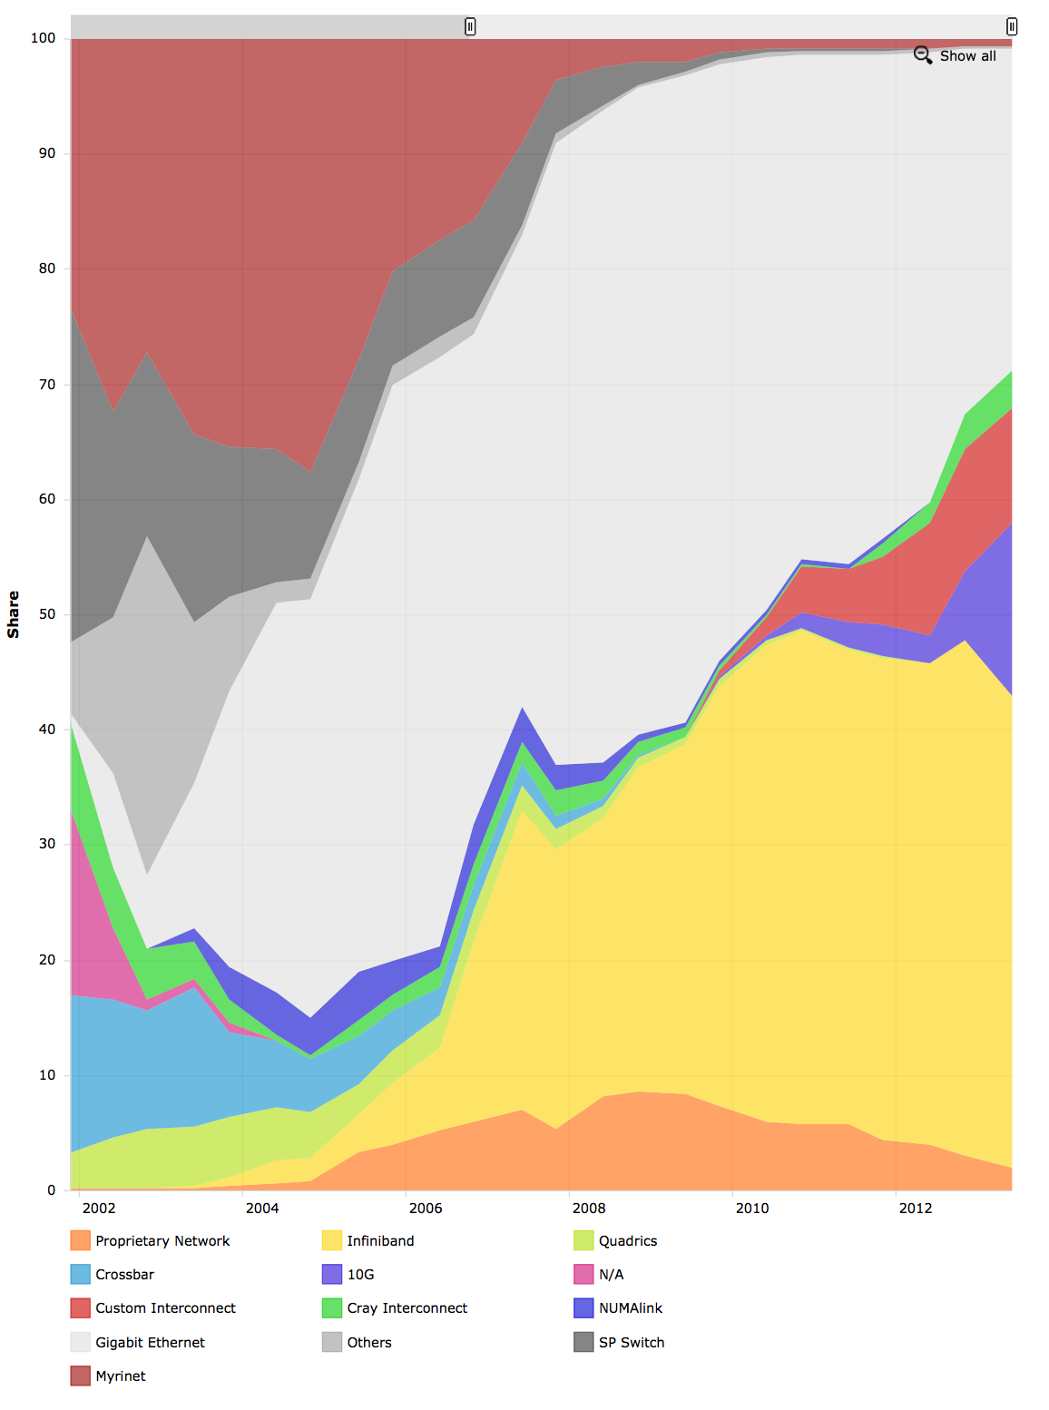
Infiniband
DAQ1 TDR (2002)
Advantages:
  Designed as a High Performance Computing interconnect over short distances (within datacenters)
  Protocol is implemented in the network card silicon → low CPU load
  56 GBit/s per link (copper or optical)
  Native support for Remote Direct Memory Access (RDMA)
  No copying of bulk data between user space and kernel (‘true zero-copy’)
  affordable
Disadvantages:
  Less widely known, API significantly differs from BSD sockets for TCP/IP
  Fewer vendors than Ethernet
  Niche market
Myrinet
1 Gbit/s
Ethernet
10 Gbit/s
Ethernet
Infiniband
2013
Top500.org share by Interconnect family

Slide 11
File based filter farm and Storage
BU
In DAQ1, high level trigger process was
running inside a DAQ application
→ introduces dependencies between
online (DAQ) and offline (event
selection) software which have
different release cycles, compilers,
state machines etc.
Decoupling these needs a common,
simple interface
  files (no special common code required to
  write and read them)
Builder unit stores events in files in a RAM disk
  Builder Unit acts as a NFS server, exports event files to Filter Unit PCs
  Baseline: 2 Gbyte/s bandwidth
  ‘Local’ within a rack
Filter units write out selected events (~ 1 in 100) back to a global (CMS DAQ wide) filesystem (e.g. Lustre) for transfer to Tier0 computing centre
FU
FU
FU
FU
FU
FU
FU
see R. Mommsen’s talk
for more details

Slide 12
DAQ2 test setup
FRL/FEROL
FEROL
emulator
A
x8
A
B
x8
R310
R310
x8
C6220
x16
R310
R310
C6220
R310
R310
C6220
10 Gbit
Copper
10 Gbit
Fiber
10 Gbit
Fiber
40 Gbit
Cupper
x8
10 Gbit
Fiber
x8
x8
FED Builder
x2
x2
x8
1U 40 Gbit/s
Ethernet switch
1U 10/40 Gbit/s
Ethernet switch
x8
x2
40 Gbit
Copper
x2
40 Gbit
Copper
x2
x3
RU
R720
x2
C6220
x3
B
x13
RU/BU Emulators
C
B
C6220
C6220
Copper
Copper
x2
x3
x13
Copper
10 Gbit
Fiber
RU Builder
1U Infiniband
FDR switch
Copper
x3
x8
BU
R720
Copper
R720
C’
B
x8
10 Gbit
Fiber
C6220
FEROL/RU/BU/FU
Emulators
C6220
40 Gbit
Copper
x8
C6220
x3
1U 40 Gbit/s
Ethernet switch
4
4
10 Gbit
fiber
B
x3
X8
B
A | X3450 @ 2.67GHz
B/C/C’ | Dual E5-2670 @ 2.60GHz
D | Dual X5650 @ 2.67GHz
C6220
RG45
1-10 GBit/s router
RG45
x2
FU
D
x16
C6100
C6100
C6100

Slide 13
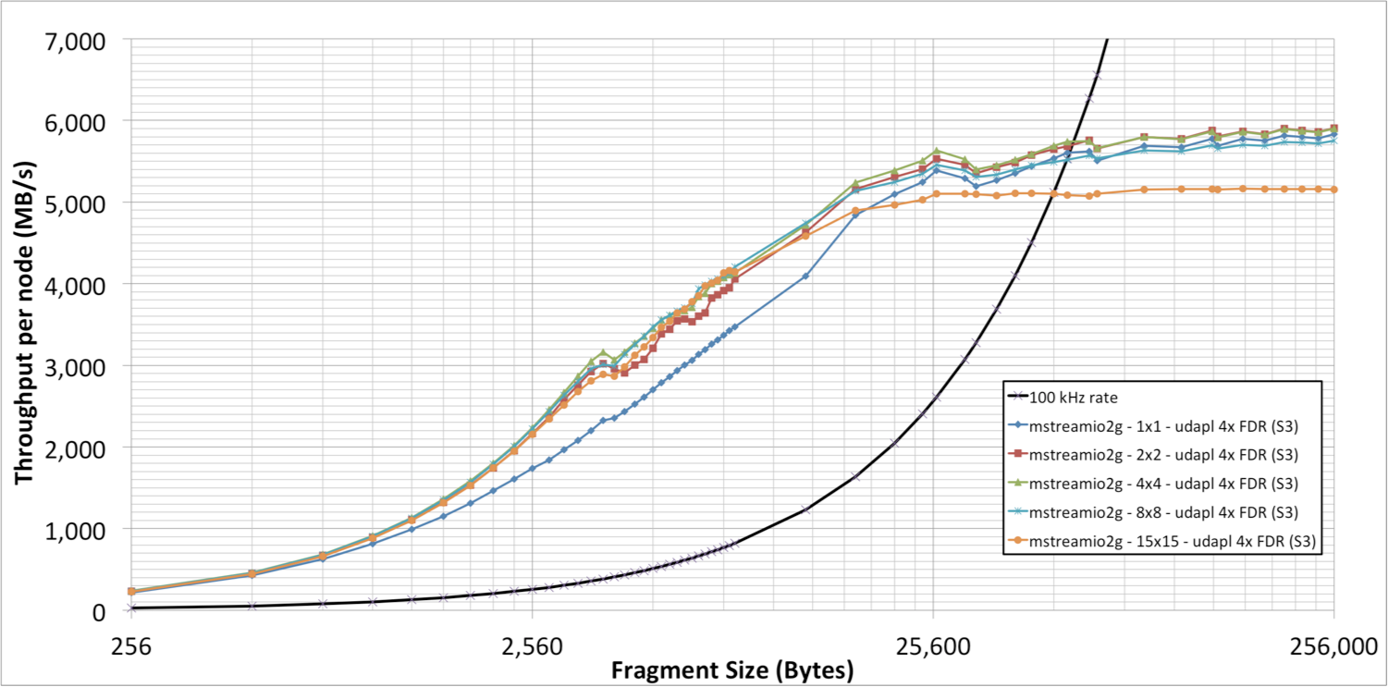
InfiniBand Measurements
FED
working range
FEROL
15 RU
RU
RU
RU
RU
15 BU
BU
BU
BU
BU
FU

Slide 14
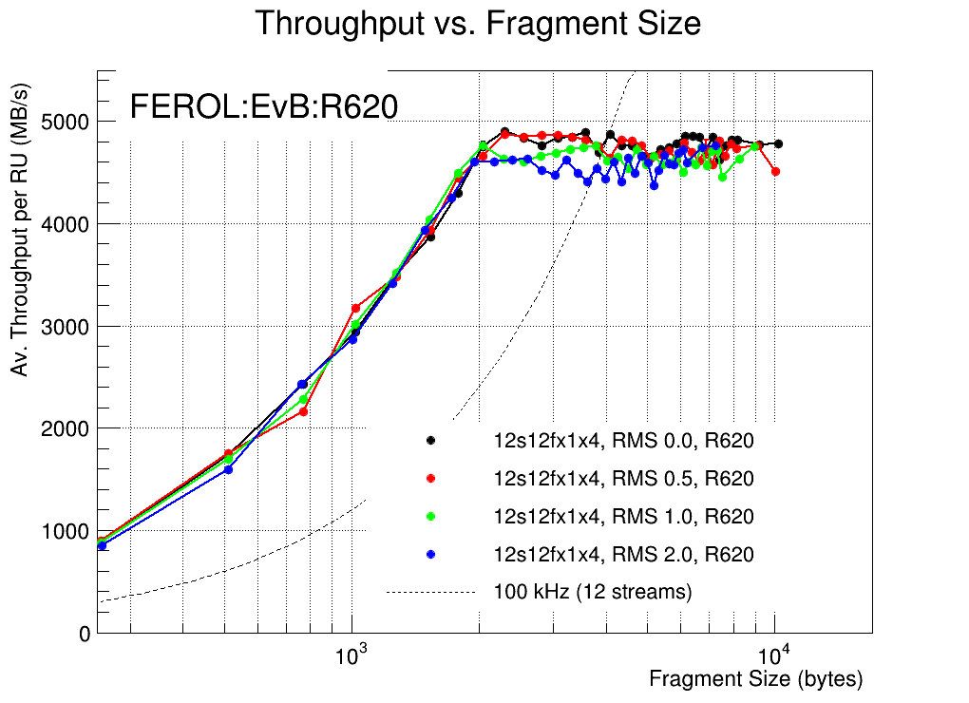
Test setup results
12 FEROLs
100 kHz
FEROL
FEROL
FEROL
working range
1 RU
RU
4 BU
BU
BU
BU
BU
FU

Slide 15
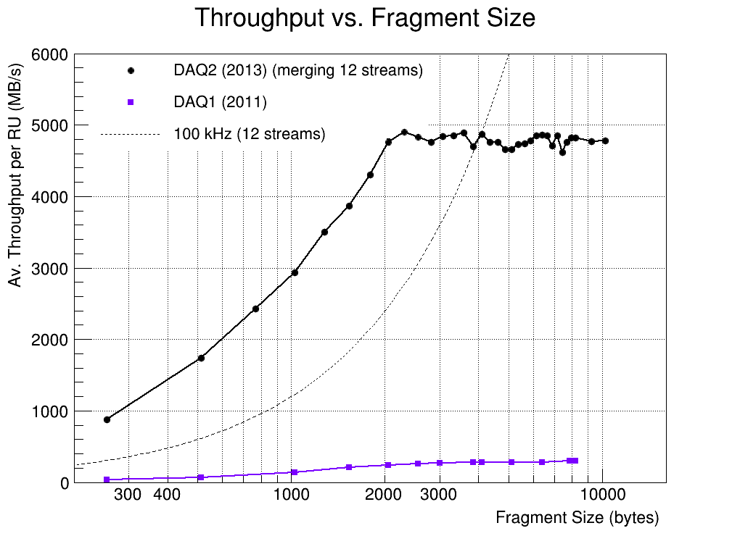
Test setup: DAQ1 vs. DAQ2
Comparison of throughput per Readout Unit

Slide 16
Summary / Outlook
CMS has designed a central data acquisition system for post-LS1 data taking
  replacing outdated standards by modern technology
  ~ twice the event building capacity than DAQ system for Run1
  accomodating a large dynamic range of up to 8 kByte fragments, flexible configuration
Increase in networking bandwidth was faster than increase in event sizes
  Number of event builder PCs reduced by a factor ~10
    Each PC handles a factor ~10 more bandwidth
    Requires performance related fine-tuning
Performed various performance tests with a small scale demonstrator
First installation activities for DAQ2 have started already
  Full deployment foreseen for mid 2014
Looking forward to recording physics data after the Long Shutdown 1 !

