Slide 1

Preview of a Novel Architecture for Large Scale Storage
Andreas Petzold, Christoph-Erdmann Pfeiler, Jos van Wezel
Steinbuch Centre for Computing

Slide 2
Storage Management Systems at GridKa
dCache for ATLAS, CMS, LHCb
  6 PB disk-only
  3 PB tape-buffers
  287 pools on 58 servers
  Agnostic to underlying storage technology
Scalla xrootd for ALICE
  2.7 PB disk-only/tape buffer
  15 servers
  Agnostic to underlying storage technology
SRM
Storage Management System
Linux
File System
Storage Controller
Disks

Slide 3
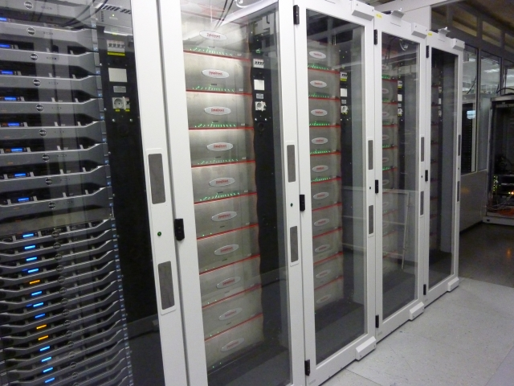
Current GridKa Disk Storage Technologies
9 x DDN S2AA9900
  150 enclosures
  9000 disks
  796 LUNs
  SAN Brocade DCX
1 x DDN SFA10K
  10 enclosures
  600 disks
1 x DDN SFA12K
  5 enclosures
  360 disks

Slide 4
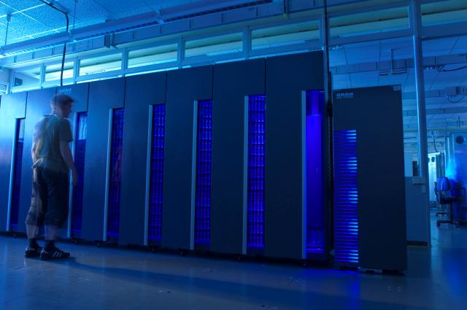
Current GridKa Tape Storage Technologies
2 Oracle/Sun/STK SL8500
  2 x 10088 slots
  22 LTO5, 16 LTO4
1 IBM TS3500
  5800 slots
  24 LTO4
1 GRAU XL
  5376 slots
  16 LTO3, 8 LTO4

Slide 5
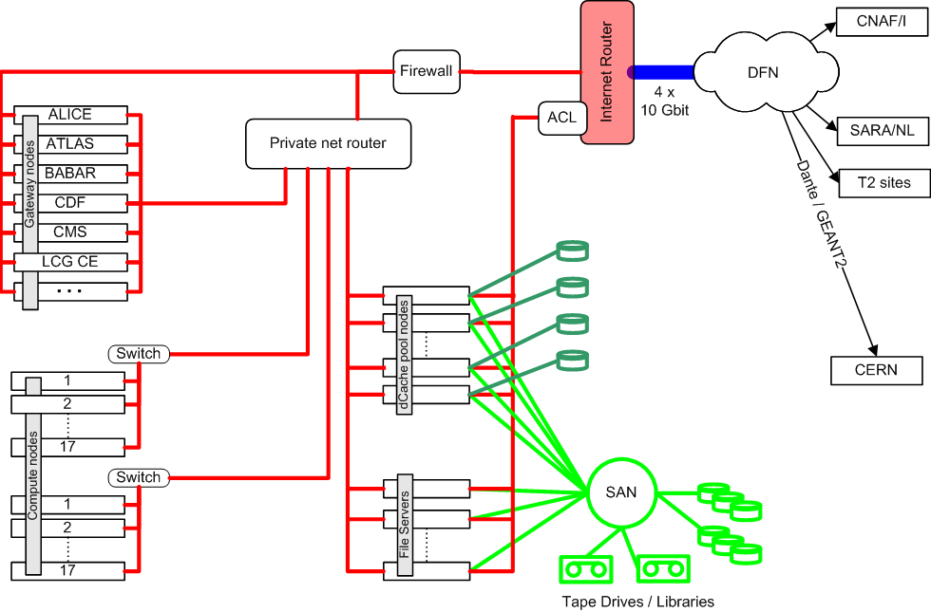
GridKa Storage Overview
gateway nodes
Compute nodes
storage nodes

Slide 6
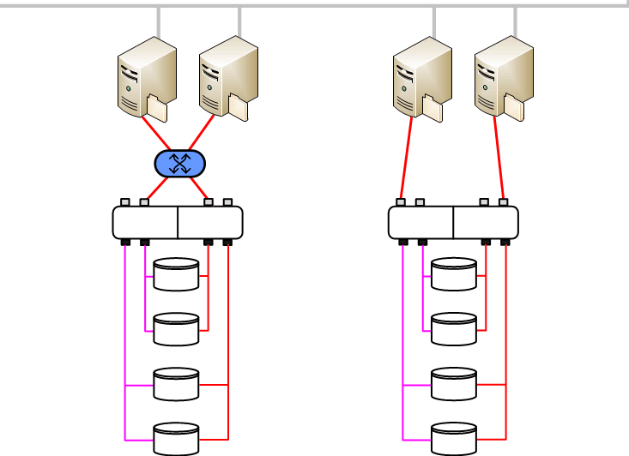

GridKa Storage Units
Servers
  connect directly to storage
  or via SAN but not explicitly needed
Cluster Filesystem (GPFS)
  connects several servers
  filesystem visible on all nodes
  predictable IO throughput
  nice storage virtualisation layer
Currently evaluating alternative filesystems
  XFS, ZFS, BTRFS, EXT4
10G Ethernet
Fibre Channel

Slide 7
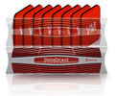
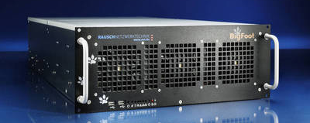
Novel Storage Solutions for GridKa
Expect large resource increase in 2015
  Chance to look at new solutions during LHC LS1
  Simplification in operations and deployment required
Solution 1: DataDirectNetworks SFA12K-E
  Server VMs run embedded in storage controller
Solution 2: Rausch Netzwerktechnik BigFoot
  More conventional setup; server directly connected to local disks

Slide 8
Shortening Long IO Paths
Traditional storage at GridKa
application
begin {
do_io
} end
Worker node
NIC
Switch Router
NIC
Server
HBA
SAN Switch
HBA
Storage Controller
SAS/FC fabric
disk
disk
potentially redundant components
Previewed storage at GridKa
application
begin {
do_io
} end
Worker node
NIC
Switch Router
NIC
Server
SAS/FC fabric
disk
disk
BigFoot
application
begin {
do_io
} end
Worker node
NIC
Switch Router
NIC
Storage Controller
SAS/FC fabric
disk
DDN SFA12K-E
disk
DDN SFA12K
application
begin {
do_io
} end
Worker node
NIC
Switch Router
NIC
Server
IB
HCA
IB
HCA
Storage Controller
SAS/FC fabric
disk
disk
network

Slide 9
DDN SFA E Architecture
Worker node
Worker node
Worker node
10 GE NIC dedicated to VM
NIC
IO
bridge
IO
bridge
IO
bridge
IO
bridge
IO
bridge
IO
bridge
IO
bridge
IO
bridge
8 VMs per SFA pair
VM1
xrootd
VM2
VM3
VM4
VM1
VM2
VM3
VM4
DDN VM driver
dma access to storage
sfablkdriver
sfablkdriver
Cache
Cache
SFA OS
SFA OS
SAS Switch
SAS Switch
SSD
SSD
SSD
SSD

Slide 10
BigFoot Architecture
Worker node
Worker node
Worker node
10 GE NIC
NIC
OS
SAS HBA/RAID Controller
Cache
SSD
SSD

Slide 11
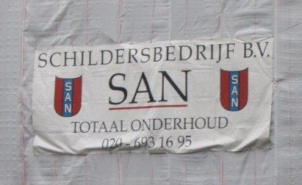
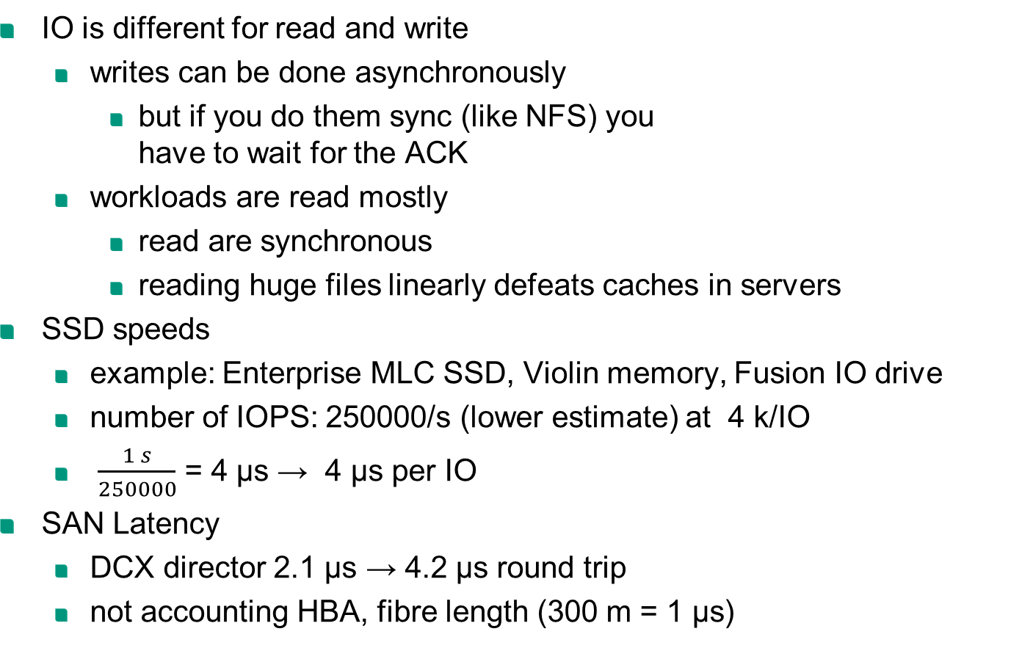
Thoughts on Effect of SAN and Long Distance Latency
IO is different for read and write
  writes can be done asynchronously
    but if you do them sync (like NFS) you
    have to wait for the ACK
  workloads are read mostly
    read are synchronous
    reading huge files linearly defeats caches in servers
SSD speeds
  example: Enterprise MLC SSD, Violin memory, Fusion IO drive
  number of IOPS: 250000/s (lower estimate) at 4 k/IO
  $\frac{1 s}{250000}$ = 4 μs → 4 μs per IO
SAN Latency
  DCX director 2.1 μs → 4.2 μs round trip
  not accounting HBA, fibre length (300 m = 1 μs)

Slide 12
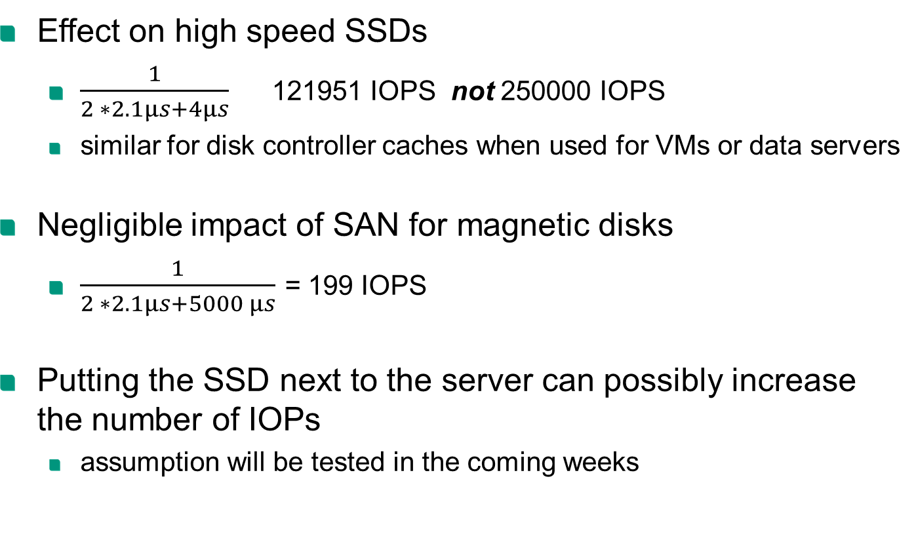
Thoughts on Effect of SAN and Long Distance Latency
Effect on high speed SSDs
  $\frac{1}{2 ∗2.1μs+4μs}=$ 121951 IOPS not 250000 IOPS
  similar for disk controller caches when used for VMs or data servers
Negligible impact of SAN for magnetic disks
  $\frac{1}{2 ∗2.1μs+5000 μs}$ = 199 IOPS
Putting the SSD next to the server can possibly increase the number of IOPs
  assumption will be tested in the coming weeks

Slide 13
Expected Benefits
Reduced Latency
  HBA and SAN: 2.1 μs (e.g. Brocade DCX, blade to blade)
  storage controller
  Improved IO rates
Reduced power
  Server and controller HBA, SAN Switch
  ~300-400W = ~600Euro/server/year
Reduced investment
  500-600 €/HBA, 400-600 €/switch port =1800-2400 €
Improved MTBF
  Less components
Notes:
17cent pro kWh

Slide 14
Possible Drawbacks
Loss in flexibility
  w/o SAN storage building blocks are larger
  Limited server access to storage blocks
  Storage systems are only connected via LAN
VMs inside storage controller (DDN SFA12K-E)
  Competition for resources
  Limited number of VMs limits “server/TB” ratio
  Loss of redundancy
Simple server attached storage (BigFoot)
  Limited by simple hardware controller
  HW admin doesn’t scale to 100s of boxes
  No redundancy

Slide 15
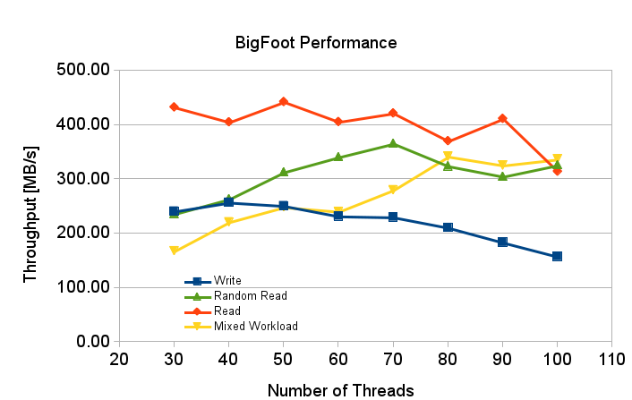
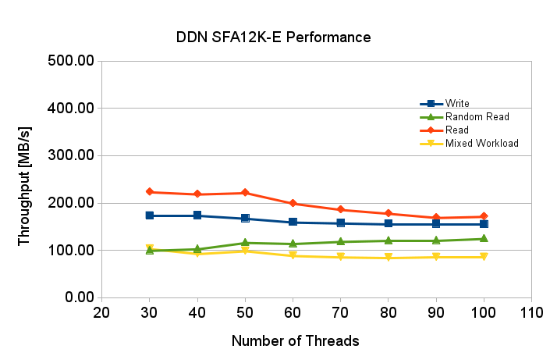
Glimpse at Performance
Preliminary performance evaluation
  IOZONE testing 30-100 parallel threads on XFS filesystem
  Xrootd data server in VM, performance similar to IOZONE
  Out-of-the-box settings, no tuning
  Performance below expectations, reasons still to be understood
  ZFS tested on BigFoot
IOZONE

Slide 16
Conclusions
Storage extension at GridKa requires expensive upgrade of GridKa disk SAN – or novel storage solution
Tight integration of server and storage looks promising
Many possible benefits – further evaluation required
  Less components
  Less power consumption
  Less complexity
Performance needs to be understood together with vendors
More tests with other vendors in near future

Slide 17
