Slide 1



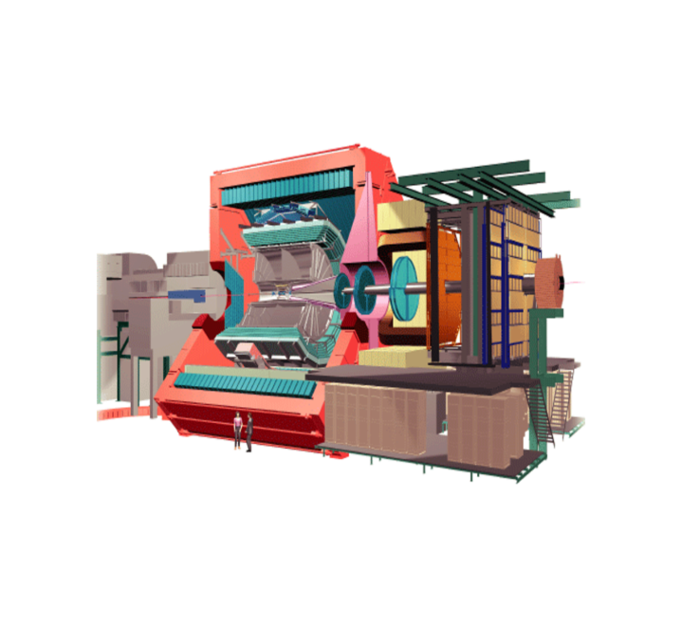
















EXTERNAL ACCESS TO ALICE CONTROLS CONDITIONS DATA
¹CHOCHULA, Peter, ¹AUGUSTINUS, Andre, ²JADLOVSKÝ, Ján, ²JADLOVSKÁ, Anna, ²SARNOVSKÝ, Ján,
²JAJČIŠIN, Štefan, ²ČOPÍK, Matej, ²JADLOVSKÁ, Slávka, ²PAPCUN, Peter, ²BIELEK, Radoslav, ²ČERKALA, Jakub, ²KOPČÍK, Michal
ABSTRACT - ALICE Controls data produced by commercial SCADA system WINCCOA is stored in ORACLE database on the private experiment network. The SCADA system allows for basic access and processing of the historical data. More advanced analysis requires tools like ROOT and needs therefore a separate access method to the archives. The present scenario expects that detector experts create simple WINCCOA scripts, which retrieves and stores data in a form usable for further studies. This relatively simple procedure generates a lot of administrative overhead - users have to request the data, experts needed to run the script, the results have to be exported outside of the experiment network. The new mechanism profits from database replica, which is running on the CERN campus network. Access to this database is not restricted and there is no risk of generating a heavy load affecting the operation of the experiment. The developed tools presented in this paper allow for access to this data. The users can use web-based tools to generate the requests, consisting of the data identifiers and period of time of interest. The administrators maintain full control over the data - an authorization and authentication mechanism helps to assign privileges to selected users and restrict access to certain groups of data. Advanced caching mechanism allows the user to profit from the presence of already processed data sets. This feature significantly reduces the time required for debugging as the retrieval of raw data can last tens of minutes. A highly configurable client allows for information retrieval bypassing the interactive interface. This method is for example used by ALICE Offline to extract operational conditions after a run is completed. Last but not least, the software can be easily adopted to any underlying database structure and is therefore not limited to WINCCOA.
ALICE DCS COMPONENTS ALICE DCS CONTEXT ALICE CONDITIONS DATABASE IN DCS
External Services and Systems
Alice Systems
OFFLINE
OFFLINE
Conditions
Database
GAS
HV
COOLING
FEE
LHC
Electricity
ECS
TRIGGER
Conditions
Database
AMANDA 3
ALICE on-detector electronics
LV
Magnets
Ventilation
DAQ
HLT
Detector devices
FEE
Safety
Cooling
Detector Control System
External sub-systems
Magnets
Gas
SCADA
Archival
Database
300 000 values/s
read by software
Access Control
Detector Control System
LHC
Safety
Configuration
Database
SCADA
Archival
Database
AMANDA 3
Infrastructure
1000 ins/s
Offline
(GRID)
Operator
UIs
B-field
Devices
DCS data processing farm
Space Frame
Devices
Up to 6 GB
Devices
DCS data storage
(ORACLE, fileservers)
Beam Pipe
Devices
Configuration
Database
Environment
Data Consumers
Radiation
Devices
DETECTORS and
DETECTOR-like
systems
Devices
30 000 values/s
Injected into PVSS
1000 values/s
Written to ORACLE after smoothing in PVSS
>200 values/s
Sent to consumers
FMD
T00
V00
PMD
MTR
MCH
ZDC
ACO
Devices
SPD
SDD
SSD
TPC
TRD
TOF
HMP
PHS
Devices
AD0
TRI
LHC
AMANDA 3 SOLUTION
AMANDA 3 OVERVIEW
The developed software suite represents a new generation of components replacing the original “Alice MANager for Dcs Archives”, known as AMANDA. It aims to improve data availability for more users. The original (AMANDA 2) version successfully served its purpose - the conditions data exchange between the DCS and ALICE offline during the LHC RUN1. However, it was designed as a simple server/client tool without any ambition for wider use by interactive clients. The main design goal of the presented AMANDA 3 package is to provide a mechanism allowing for concurrent access to DCS archives using multiple clients. It extends the original data exchange functionality by advanced download possibilities, user management, security and logging. The main feature of the new system is the server’s decentralized architecture. Specific tasks are scattered across multiple computers, which allows for load balancing and system jam prevention. The web client removes the dependency on the operating system, but dedicated clients are available as well.
AMANDA 3 WEBSERVER CLIENT LIFECYCLE
Log in
Authenticate user
Show particular window
Get available aliases and ranges
Select data for download
Check if data not downloaded
Show current download
Start data download
Data are transferred from database
Download data from server
Use browser data downloader
Get user role
Can cancel download
Download progress is shown
ORACLE DATABASE MODULE – DOWNLOAD SYSTEM
SOLUTION PARTS:
WEBSERVER MODULE – GATEWAY
separates ALICE databases from AMANDA clients
shares a computer with the ASP.NET webserver
all requests are checked for validity to prevent external access to databases except for clients
informs clients about AMANDA 3 operational glitches
ORACLE DATABASE MODULE – THE SOURCE
the only module with direct access to the DCS Archive database
ORACLE procedures are used to ensure efficient data transfers
downloaded data is sent directly to webserver service module
separate & independent threads are used to process individual requests, i.e.
multiple users can download data at once
the module handles management of concurrent downloads, computes
transfer statistics and estimate sizes of database data
AMANDA 3
SERVER
CORE MODULE
DESKTOP CLIENT
WIN7 CLIENT
WEBCLIENT
LOGS MODULE
AUTH MODULE
ORACLE MODULE
WEB MODULE
WEB BROWSER
WEB CLIENT MODULE
client running on Web browser removes the host operating system dependency
previously downloaded data is temporarily cached on server, and can be shared by several users
caching significantly improves system performance in the interactive mode (users often tend to repeat the request with only slightly modified search criteria)
user can log off, once the download has been launched
downloads can be cancelled by users/admins
data throughput per user can be controlled (number of sessions can be restricted)
INTERNET USER
ASP .NET
WEBSERVER
WEBSERVER
MODULE
ORACLE
DATABASE MODULE
AMANDA
OFFLINE
AUTHENTIFICATION MODULE – WHO?
integrated into the existing security and
account system
each user is assigned an unique login
and role that grant them specific rights
INTERNET USER
DESKTOP
CLIENT
Desktop client and library for AMANDA data transfer to be available as well.
CORE MODULE
AUTH MODULE
USERS
DATABASE
LOCAL USER
GLOBAL
LOGGER
MODULE
GLOBAL
LOGS
GLOBAL LOGGING MODULE - LOGS
all service modules support 3 types of logging :
  log files stored on local computer
  request processing logging
  global logging
the module is designed for global logging
of information with higher-level (administrator) significance
AMANDA 3
DATA TRANSFER MANAGEMENT
administrators use the web client for data transfer control and overall system management
monitoring of AMANDA 3 is achieved by independent service modules
the flexible architecture of the webpage-based manager allows for further extensions
Firewall
Internet
Internal network
CORE SERVICE MODULE – COORDINATOR
handles and monitors requests from other services
acknowledges every significant step of request processing
the relevance of the module increases if separate computers or multiple services of the same type are involved
WCF AND WINDOWS SERVICE – INTERCONNECTION
Windows Communication Foundation ensures fast and reliable communication between all internal modules
REFERENCES
P. Chochula, A. Augustinus, L. Jirden, S. Kapusta, P. Rosinsky: “Handling large amounts of data in ALICE”, Proc. of ICALEPCS’07, Knoxville, USA, 2007.
A. Augustinus, P. Chochula et al., “Computing architecture of the ALICE Detector Control System” Proc. of ICALEPCS’11, Grenoble, France, 2011
S. Kapusta et al.: “Data Flow in ALICE Detector Control System”, 11th Vienna Conference on Instrumentation – VCI 2007, Vienna, Austria, 2007
CONCLUSION AND PERSPECTIVES
A software suite has been developed which facilitates the transfer of large data blocks from the ALICE offline conditions database. Future steps of the application design include:
  finalization of the AMANDA 3 release version, performance tests with real data
  enhancement of the windows service mode with auto-restart and power event ability
  integration of multiple services of the same type, including backup services
  development of a web and desktop client (in cooperation with future users)
¹CERN – European Organization for Nuclear Research, Geneva, Switzerland,
²Department of Cybernetics and Artificial Intelligence, Faculty of Electrical Engineering and Informatics, Technical University of Košice, Letná 9, 042 00, Košice, Slovak Republic.
ALICE CERN: http://aliceinfo.cern.ch/
TU-FEEI-KKUI: http://web.tuke.sk/kkui/
CMCT&II: http://kyb.fei.tuke.sk/laben/
POSTER BY
CMCT&II

