Slide 1
ROOT I/O in JavaScript
Reading ROOT files in a browser
B. Bellenot, CERN, PH-SFT
B. Linev, GSI, CS-EE

Slide 2
JavaScript
One very nice feature of JavaScript is the possibility to dynamically (at runtime) create classes
Allowed to implement dynamic streamers (automatically generated from the streamer info)
Allows to potentially read any object from a ROOT file, as soon as we can read the streamer info of its class

Slide 3
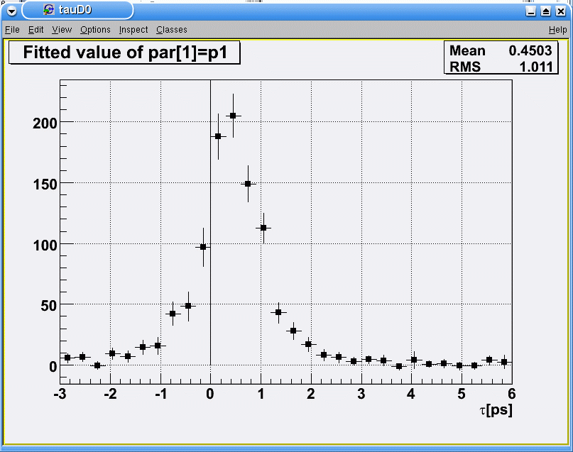
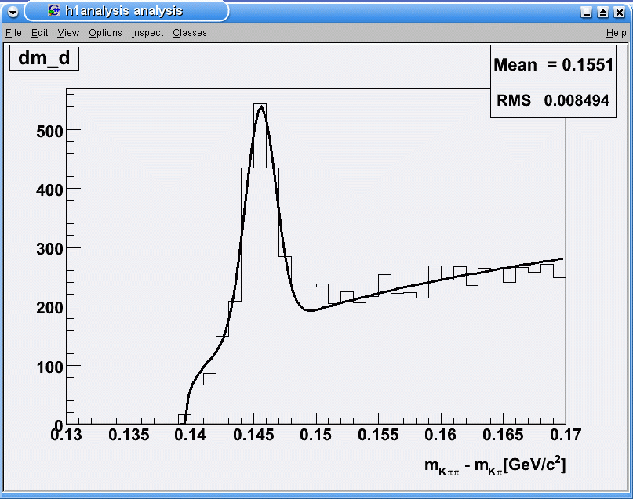
Reading the file
Using HTTP byte range (available in HTTP/1.1) to download only a single compressed object when the user wants to read it
Minimizes data transfer and memory usage
Compressed (zipped) objects are in binary format
WEB SERVER
User’s selection request
ROOT Files
Client
Compressed object

Slide 4
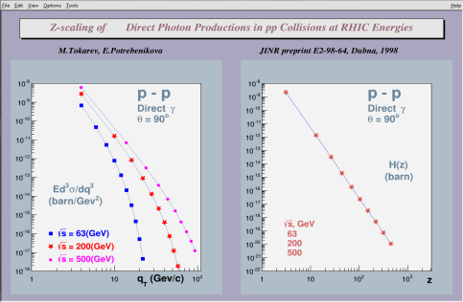
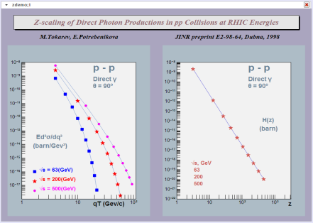
Displaying objects
JavaScript rendering in a web browser: Same font, same color, same layout! Only minor differences…
Original rendering (with ROOT)

Slide 5
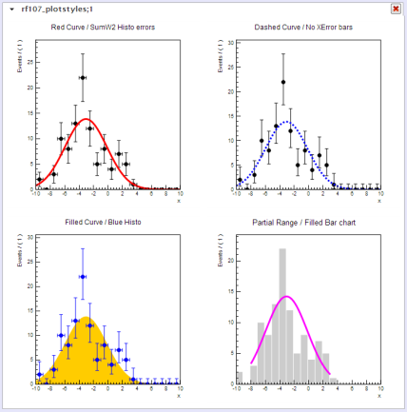
Displaying objects (cont.)
Example of roofit plot styles

Slide 6
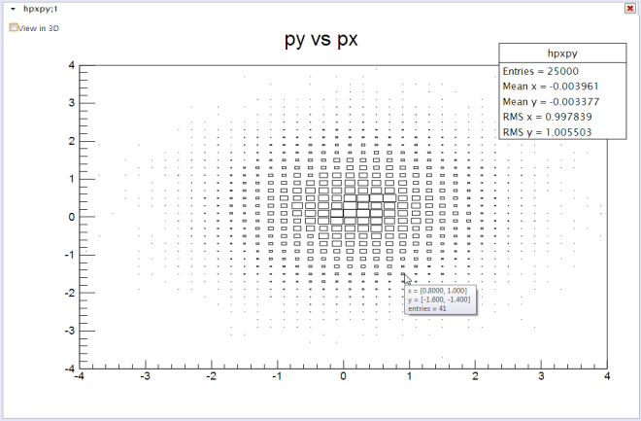
Displaying objects (cont.)
2D histogram (TH2), drawn with the BOX option (default)

Slide 7
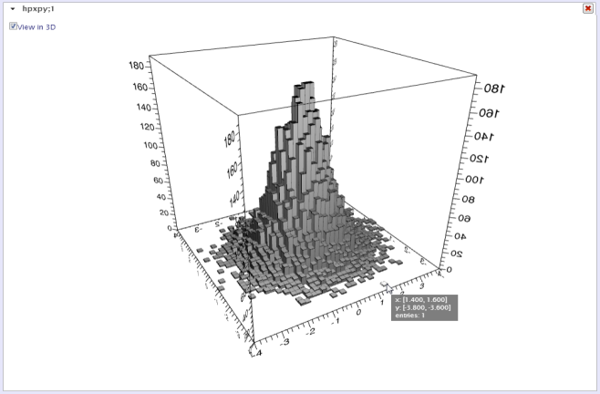
Displaying objects (cont.)
Same histogram, displayed with 3D option (“LEGO”), using WebGL (when available)

Slide 8
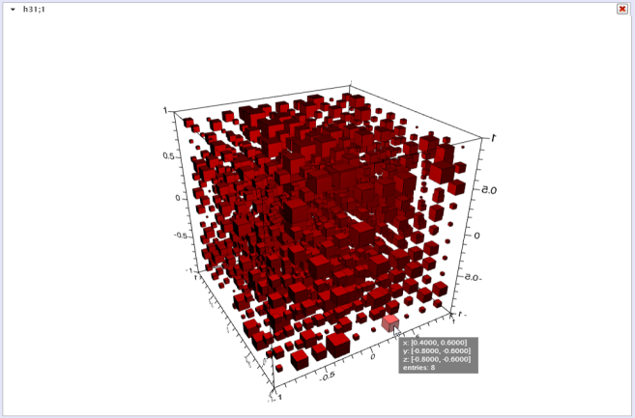
Displaying objects (cont.)
3D Histogram (TH3), using WebGL (when available)

Slide 9
How to use it?
Simply copy the ROOT file(s) anywhere on the web
Create a simple html page next to the files
  Only two lines have to be added in the <head>
  And a few lines in the <body>. Here is a complete example:
<!DOCTYPE html>
<html>
<head>
<title>Read a ROOT file in Javascript (Demonstration)</title>
<meta http-equiv="Content-type" content="text/html; charset=utf-8" />
<link rel="stylesheet" type="text/css" href=“http://root.cern.ch/js/style/JSRootInterface.css"/>
<script type="text/javascript" src="http://root.cern.ch/js/scripts/JSRootInterface.js"></script>
</head>
<body onload="BuildSimpleGUI()">
<div id="simpleGUI" files=“file_1.root;file_2.root;file_n.root;"></div>
</body>
</html>

Slide 10
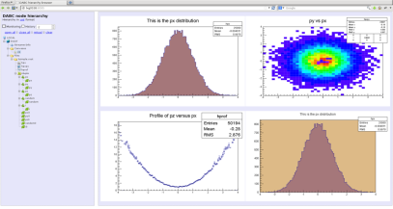
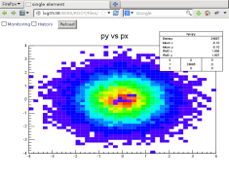
Monitoring of a running ROOT application
ROOT session
* You are welcome to visit our Web site *
* http://root.cern.ch *
* *
*******************************************
ROOT 5.34/09 (v5-34-09@v5-34-09, Jun 26 2013, 17:10:36 on linuxx8664gcc)
CINT/ROOT C/C++ Interpreter version 5.18.00, July
Type ? for help. Commands must be C++ statements.
Enclose multiple statements between { }.
root [0] DabcRoot::StartHttpServer(8095);
root [1] .x $ROOTSYS/tutorials/hsimple.C
hsimple : Real Time = 0.14 seconds Cpu Time = 0.14 seconds
(class TFile*)0x7fbe1c26ed70
root [2]
http

Slide 11
Monitoring of a running ROOT application
  Single command to start http server: DabcRoot::StartHttpServer(8095);
  Scans gROOT for existing objects
  Builds objects hierarchy in the browser
  Stream and zip objects only when requested
  JSRootIO graphics for objects display
  Live update of objects content
  NO ANY changes in analysis code
  Similar approach for: DAQ, slow control, online/offline analysis
  More information on http://dabc.gsi.de

Slide 12
Conclusion
The source code is available in git: http://root.cern.ch/git/rootjs.git
Not a replacement of ROOT:
  No tree analysis
  No fitting
Feel free to try and to send feedback & requests

