Slide 1


Data Archiving and Data Stewardship
Pirjo-Leena Forsström, Heikki Helin, Kimmo Koivunen, Juha Lehtonen, Kuisma Lehtonen
CHEP 2013

Slide 2
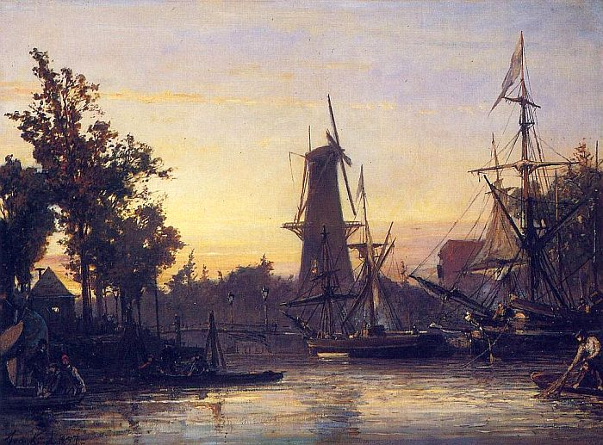
Index
Background and motivation
What is preservation?
For whom and what?
How is it done?
Pilots
In conclusion
Source: wikipedia PD
Image resources

Slide 3
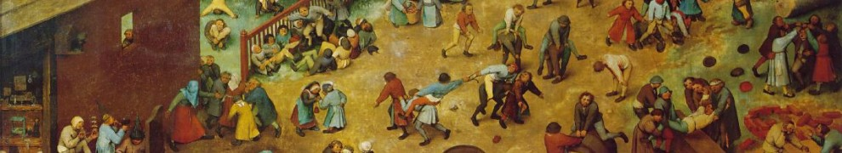
Digitalization of research and cultural processes
Typical:
  Growing volume of data and sources
  Complexity of data processing
  data is dynamic
  High demand of data
  Complicated interaction between users and data
Most important challenges:
  Managing and processing exponentially growing datasets
  Significant acceleration in analysis cycle
  Combining data sources
Source: wikipedia PD
Image resources

Slide 4
Long-term preservation of research and cultural heritage data
Preservation of digital information is the core of research and cultural organization's activity.
At this time, there has been no controlled and functional way of handling digital information in the long term.
Long-term preservation of digital data means the reliable preservation of digital information for several decades or even hundreds of years.
Equipment, software, and file formats will become outdated, but despite this the information must be preserved in understandable form.

Slide 5
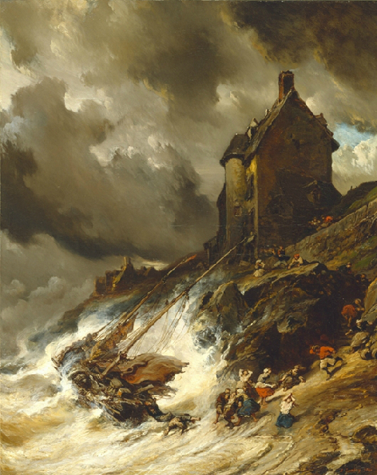
Digital processes break easily
Short-period funding
Software lifecycle: code, interfaces, formats…
Dependent on expert knowledge
Thin documentation and metadata
Source: : wikipedia PD Image resources

Slide 6
Future Aim:
Research and cultural data routinely deposited in well-documented form, regularly and easily consulted and analyzed, and openly accesible while suitably protected and reliably preserved.
Needs PERSISTENCE
Coherent organizational framework?
  Ownership
  Curation
Flexible technical architecture:
  Standard open protocols and interfaces
  Flexible user access, analysis and visualization of data
  Address issues of autenthication, authorization, security
  Supports workflows

Slide 7
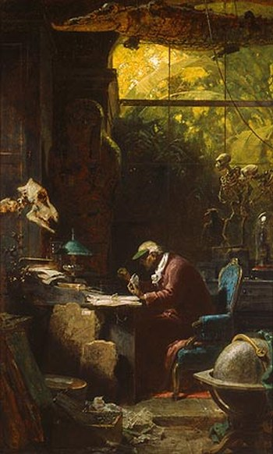
Persistence
Holy grail of preservation & information management more generally
What does persistence mean?
How long it persists?
What persists?
What is “guaranteed” to be accessible?
Source: : wikipedia PD Image resources

Slide 8
Digital Curation
Curation : The activity of, managing and promoting the use of data from its point of creation, to ensure it is fit for contemporary purpose, and available for discovery and re-use. For dynamic datasets this may mean continuous enrichment or updating to keep it fit for purpose.
Archiving : A curation activity which ensures that data is properly selected, stored, can be accessed and that its logical and physical integrity is maintained over time, including security and authenticity.
Preservation : An activity within archiving in which specific items of data are maintained over time so that they can still be accessed and understood through changes in technology.
Digital curation : looking after and somehow "adding value" to digital data, ensuring its current and future usefulness. This probably implies creating some new data from the existing, in order to make the latter more useful and "fit for purpose".

Slide 9
Data Collections
Research Collections: Authors individual investigators and investigator teams. Maintained to serve immediate group participants during the project lifetime. May not conform to any data standards.
Resource Collections : Authored by a community of investigators (specific domain of science or engineering) with community-level standards. Lifetime from mid- to long term.
Reference Collections : Authored by and serve large segments of science and engineering community. Using well-established and comprehensive standards.

Slide 10
Preservation methods
Preserving the original look-and-feel
  Emulation
    Development of emulators to new platforms etc.
    Active testing and technology watch
Preserving the content
  Migration
    Format development watch (format libraries)
    Development of transformation processes, testing, implementation, monitoring
    Preparation for recoveries
Preserving the bits
  Integrity
    File validation and monitoring
    Management of copies
    Both objects and metadata

Slide 11
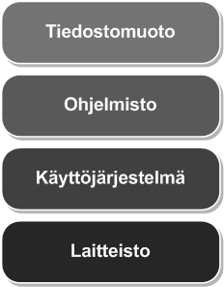




Migration
FORMAT
Migration
FORMAT
Application
Application
Operating system
Operating system
Hardware
Hardware
Migration enables the utilization of digital objects in new ICT environment
Special care needed to preserve information content: planning, testing and validation with care

Slide 12
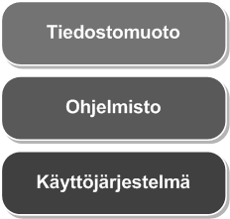

Emulation
FORMAT
FORMAT
Application
Application
Operating system
Operating system
Emulator
Hardware
Hardware
Emulation enables the use of old solution on new hardware environment
Emulation has to solve how the information can be used in context of new data production (copy-paste)

Slide 13
Preservation solution has to manage
Authencity
Integrity
Technology change
Risk management
Preservation metadata management
Scalability of the solution

Slide 14
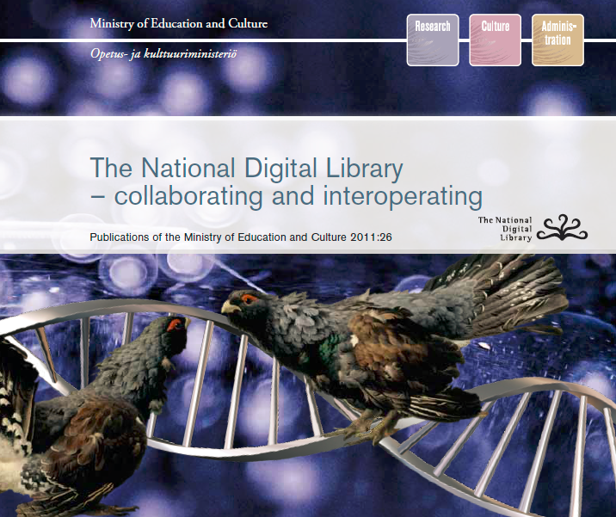

Slide 15
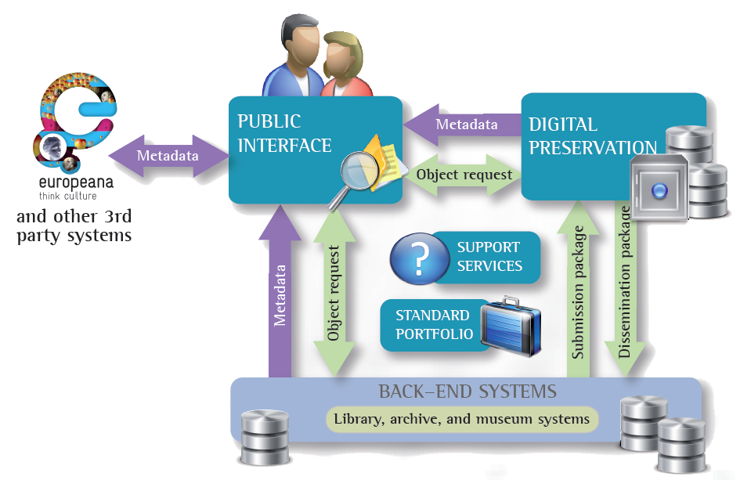
National Digital Library

Slide 16

Ministry of Education: national collaboration and roadmap for research Data
National Information Infrastructure services for research
TTA provides 2012-2013
  Storage solution IDA
  Metadata catalogue KATA
Long Term Preservation 2015 –
  Pilots starting 2014

Slide 17
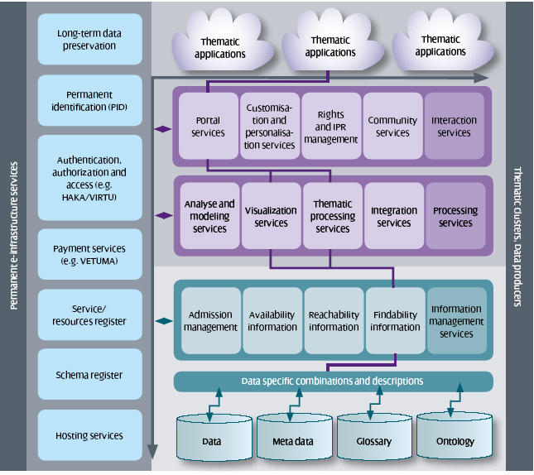
Research Information infrastructure
Embeddedness
Transparency
Reach of scope
Links with conventions of practice.
Embodiment of standards
Build on an open platform: Infrastructure does not grow de novo; it wrestles with the “inertia of the installed base” and inherits strengths and limitations from that base.

Slide 18
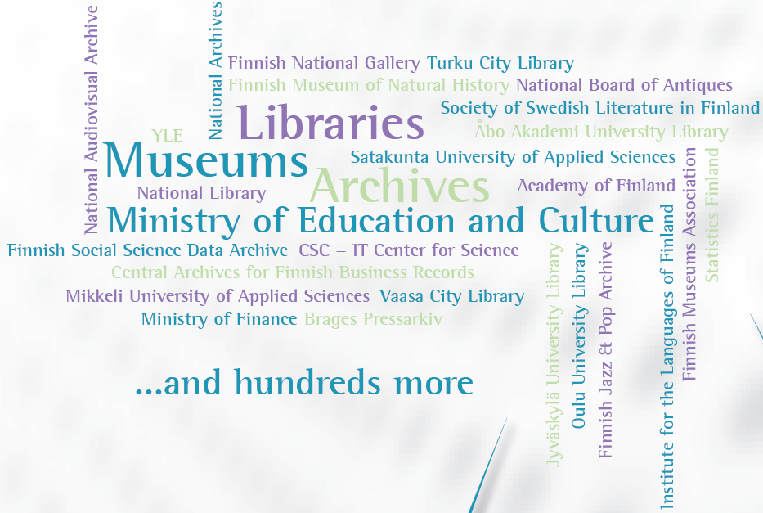
Who? Research organizations
Museums, Archives, Libraries

Slide 19
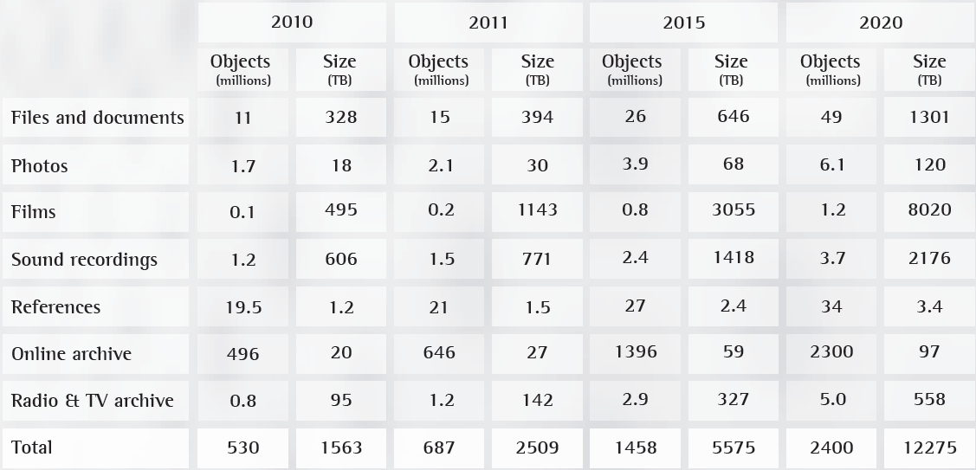
What? - Data Volumes

Slide 20
Research Data volumes, first quess
31pt
11,5pt

Slide 21
Digital Preservation Services (1/3)
Digital preservation system will be built according to Open Archival Information System (OAIS) reference model
Preparation and ingest services
  Metadata specification
  Preservation plan preparation
  Submission information package (SIP) packaging service
  SIP ingest and validation
  Processing of acceptable file formats (for transfer) to recommended file formats

Slide 22
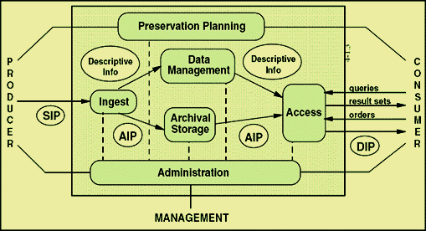
Digital Preservation Solution
the ISO OAIS Reference Model for an OAIS. This reference model is defined by recommendation CCSDS 650.0-B-1 of the Consultative Committee for Space Data Systems;^{[1]} this text is identical to ISO 14721:2003.
Source: Long-Term Preservation of Digital Documents. 2006. doi:10.1007/978-3-540-33640-2. ISBN 978-3-540-33639-6.
Public Domain.

Slide 23
Digital Preservation Services (2/3)
Preservation services
  Archival information package (AIP) from SIP
  Development and monitoring of preservation methods and environment
  Preservation actions: integrity monitoring, refreshment, replication, migration
  Geographical distribution
    E.g. Espoo and Kajaani – 550 km distance between
    http://goo.gl/maps/J5XkX
Digital information search functions
  Dissemination information package (DIP)

Slide 24
Digital Preservation Services (3/3)
Digital information management services
  Metadata updates
  Digital object updates
  Removal of digital objects
  Preservation plan updates
Advisory and support services
  Usage support of the services and the digital preservation system
  Administrative support
  Training and information services

Slide 25


Roadmap
1st site: Ingest and bit level preservation service starts december 2013
  3 copies in 3 different media
2nd site 2016
  Geographical distribution
  Risk minimization, different process etc
  Less copies?
Dark Archive
  No internet
  Minimization of human error
Dark Archive
2nd site
1st site

Slide 26
Single digital object preservation
Reseach communitites, archives, libaries, museums
Content: understanding, significance
Preseravtion service
metadata
Preservation planning
format
Long Term Use
Apllication of preservation method
Management of copies
storage media
Storage hardware

Slide 27
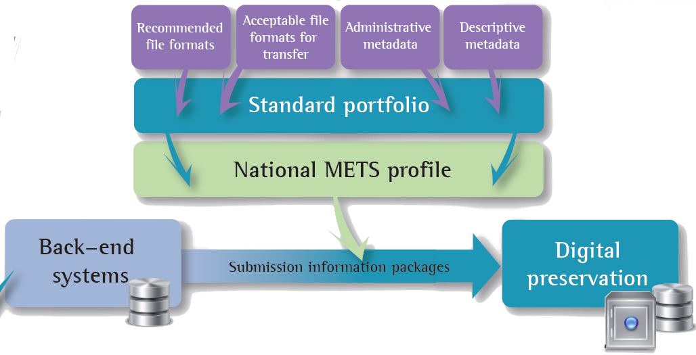
How? - Nationally Unified Structure

Slide 28
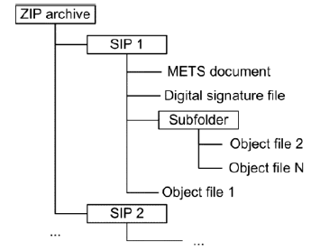
Digital Preservation Solution
Specifications defined for preparing and creating unified Submission Information Packages (SIPs) with a redifed METS schema
A closed set of acceptable file formats
From the acceptable file formats, some are recommended formats, some acceptable for transfer

Slide 29
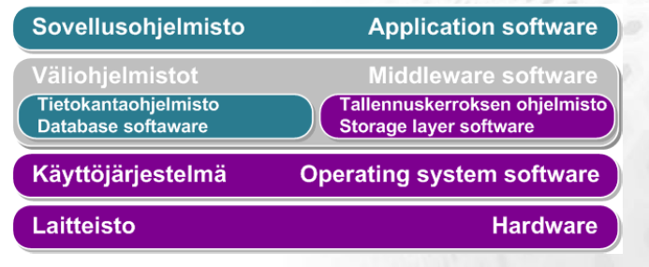
Technical architecture
Consists of several layers
These layers are described in
    Application architecture
    Infrastructure architecture

Slide 30
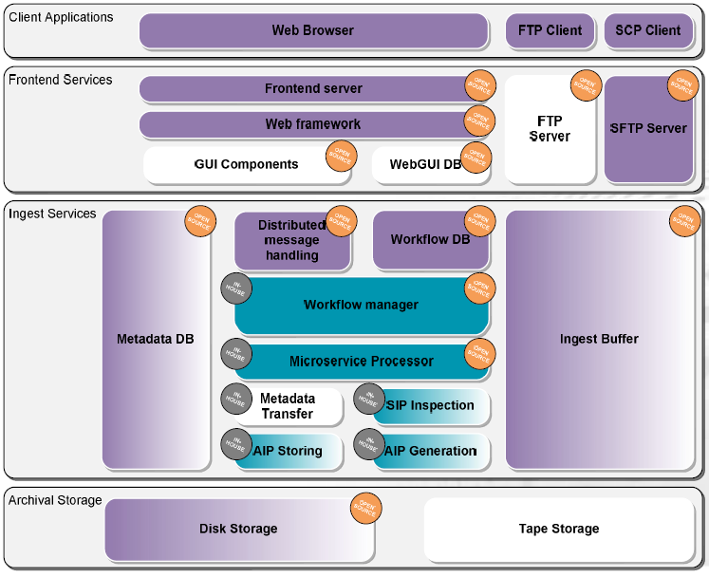
Ingest

Slide 31
Ingest
We utilize 24 different Open Source components
  Format checks: 11 components (JHOVE1, JHOVE2, FITS, Epubcheck, Apache ODF Toolkit, Officetron, FLAC, Pngcheck, warc-tools, Ms Office binary File Format Validator, MP3val)
Missing parts done in-house
LOT of integration work (technology watch, testing, report handling etc.)

Slide 32
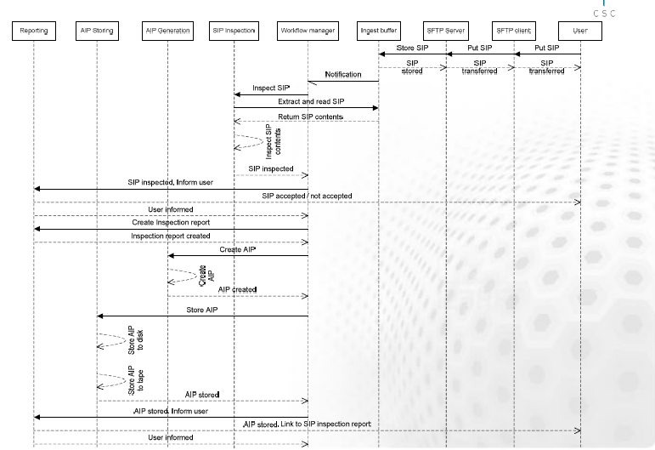
Ingest messages

Slide 33
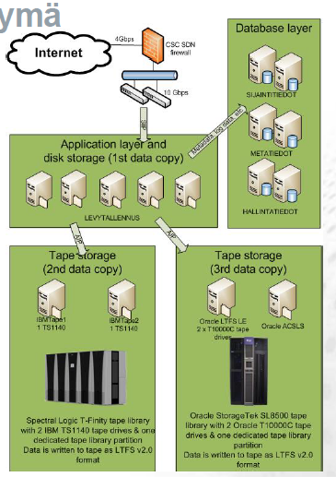
Hardware infrastructure
Separate database layer
3 copies on 3 different media
Distributed storage group of storage nodes, linked together via tcp/ip & storage software running on operating system
=> no enterprise storage solution

Slide 34
In practise
Finnish common digital preservation system:
Highlights the ownership and roles
Needs actions starting from policy level and similarly from operational level
draws practices of partner organizations closer to each other
reduces the costs and fragmented nature of the ICT systems
intensifies cooperation
However:
Common specification (profile) will be most likely updated several times in the future.
  requires a lot of discussion and collaboration.

Slide 35
Actions on many levels
Goal: the extensive use of publicly funded data in research
Discovery
Availability
Usability
Data life cycle
The required activities
Coordination
Role division
Attitude
Collaboration
Interoperability
Resources
Political will
and data policy
Legislation
renewal
Development
of practices
The data
infrastructure building
blocks
Political alignment
Common goals
Principles and the division of
responsibilities
Resource planning
Coordination enhancements
Clear rules
Removing the ambiguity
Easing the availability and
usage of research data
Data inventaries
Terms of use
Rules for financing and research prin-
ciples
The strenghtening of skills
Interoperable systems
Common services
Thematic applications
Long term preservation
Investments
Ministries,
government,
state council
Ministries,
Data protection
commissioner,
the parliament
Ministries,sponsors,
Data producing and governing
organizations, univer-
sities, research institu-
tions, researchers
The ministry of
culture and education,
research organizations,
Infrastructure actors
Main actors

Slide 36
Workload distribution
Preservation of cultural heritage
Preservation of scientific data

Slide 37
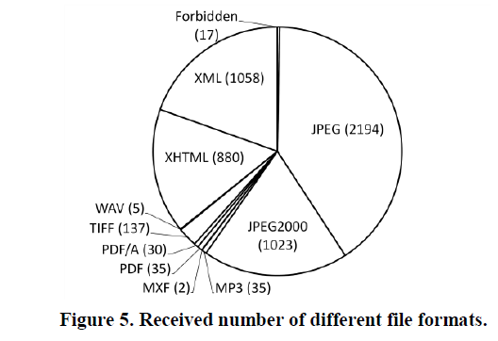
Pilots
To understand the preparedness of partner organization
Ten pilots in total, three libraries, five archives, two museums
Source: On preparedness of memory Organizations for Ingesting Data. J.Lehtonen, H.Helin, K.Koivunen, K.Lehtonen, iPRES2013.

Slide 38
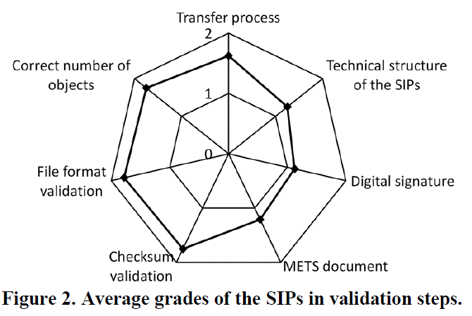
Overall packaging results
A grade was given fot each SIP in each validation step
0. The part is missing or does not follow the specifications
1. The part includes sever errors or a large number of minor mistakes
2. The part is flawless or includes only a few minor mistakes
Source: On preparedness of memory Organizations for Ingesting Data. J.Lehtonen, H.Helin, K.Koivunen, K.Lehtonen, iPRES2013.

Slide 39
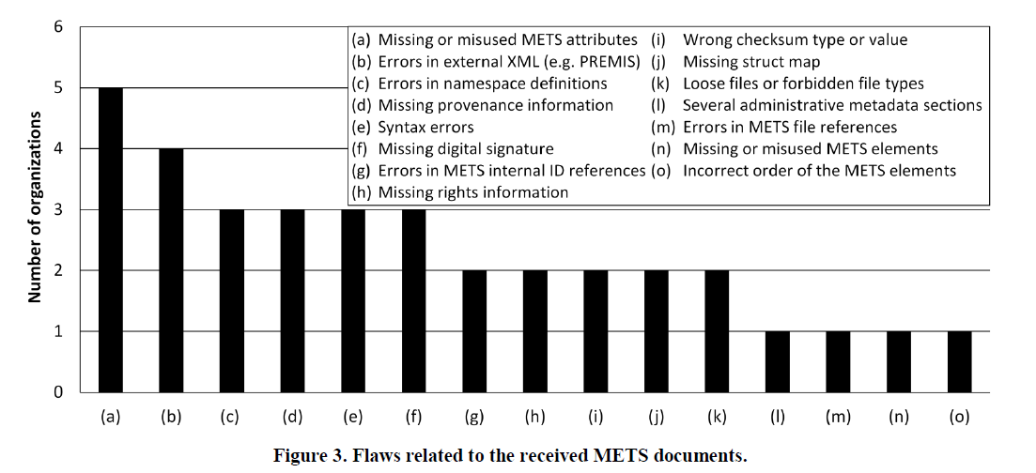
Metadata results
Source: On preparedness of memory Organizations for Ingesting Data. J.Lehtonen, H.Helin, K.Koivunen, K.Lehtonen, iPRES2013.

Slide 40
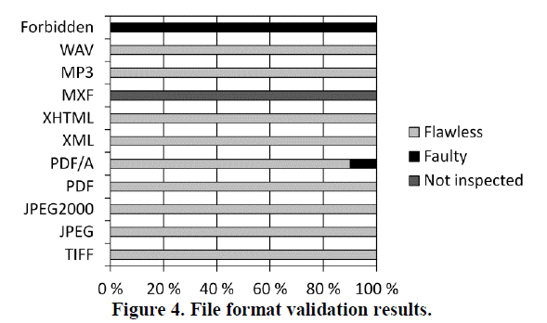
File format results
Source: On preparedness of memory Organizations for Ingesting Data. J.Lehtonen, H.Helin, K.Koivunen, K.Lehtonen, iPRES2013.

Slide 41
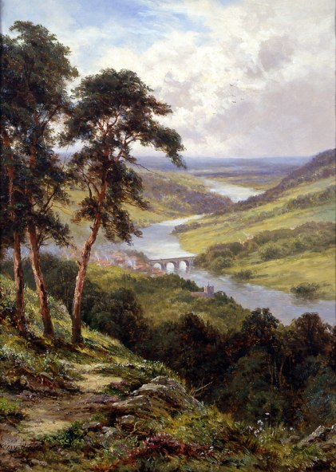
Never the same again
"πάντα χωρεῖ καὶ οὐδὲν μένει" καὶ "δὶς ἐς τὸν αὐτὸν ποταμὸν οὐκ ἂν ἐμβαίης"
Panta chōrei kai ouden menei kai dis es ton auton potamon ouk an embaies
"Everything changes and nothing remains still ... and ... you cannot step twice into the same stream"^{[37}
Heraclitos
Preservation is an open end problem
Automatize as much as possible
Save time: thorough ingest process
Remember the learning curve
Accept lifecycles: not everything has to be stored for ever
Source: wikipedia PD
Image resources

Slide 42
Conclusions
If you want your digital data to survive, start today!
Equally important:
  Ingest
  Ownership/stewardship
  Preservation planning
  Preservation solution
Clear definition of roles and organization
Collaboration!
Exit-strategy
Source: wikipedia PD
Image resources

Slide 43
Thank you!
http://www.kdk.fi/ http://www.tdata.fi
Pirjo-leena.forsstrom@csc.fi

