Slide 1


Precision Physics with leptons: g-2, LFV and EDMs
IoP2013, High Energy and Astro Particle Physics, University of Liverpool, 9th April 2013
Thomas Teubner
`A very incomplete experimental overview from a theorist’
[Sorry no time to cover tau physics, eDMs]
Thanks to M. Lancaster, L. Roberts, D. Glenzinski, Y. Kuno, T. Mibe,
N. Saito, D. Stoeckinger, D. Nomura for slides and help with the talk

Slide 2
Introduction/Motivation: g-2, LFV, EDMs
Why in one talk?
Low energy, precision, intensity, single-number experiments
Realistic chance to `see’ physics beyond the SM
in turn constrain/distinguish between models
Complementary to high energy searches at the LHC:
- un-coloured sector so far not strongly constrained
- leptons ideal for low energy precision studies
We know already:
ν masses (small) and mixing: point towards some high-scale (GUT) physics,
so LFV in neutral sector established, but no Charged LFV seen so far
No direct signals for BSM from LHC so far:
some models like CMSSM are in trouble/excluded already when trying
to accommodate LHC exclusion limits and to solve muon g-2

Slide 3
Introduction: Lepton Dipole Moments
Flavour Conserving:
Interaction with E and B fields:
g-2:
EDM: is CP-violating and very small within the SM
(from quark CKM in 4-loop diagrams , larger from Maj. ν's)
Flavour Violating:
Also and `conversion’, all procs. have similar diagrams
EDM or CLFV measurement ≠ 0
would be a clear signal for NP

Slide 4
Status of the muon g-2: SM prediction
QED: Kinoshita et al. 2012: 5-loop completed (12672 diagrams) ✓
EW: 2-loop ✓
Hadronic: the limiting factor of the SM prediction
L-by-L: - so far use of model calculations, form-factor data will help improving
- in the future: lattice QCD predictions (first results encouraging)
- several groups: USQCD, UKQCD, ETMC, … much increased effort
Vacuum Polarisation: use of e+e- had. cross section data; big improvements foreseen

Slide 5
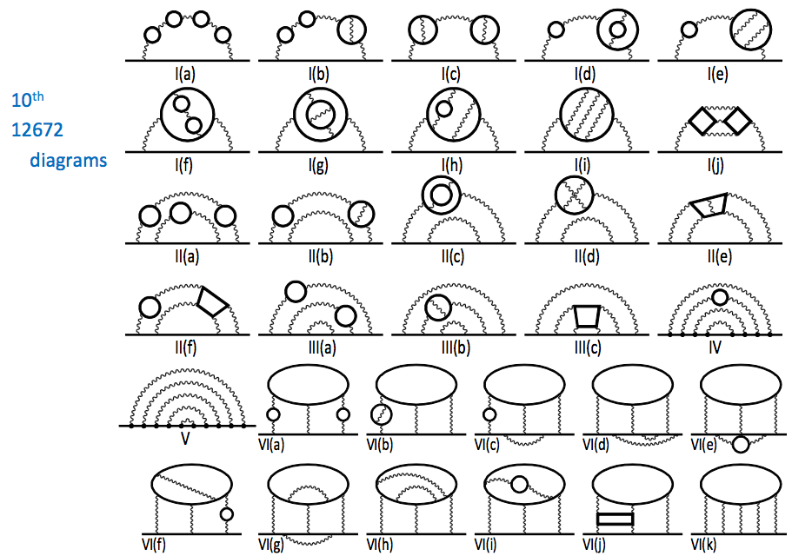
Kinoshita et al: g-2 in QED at 5-loop order
T. Aoyama, M. Hayakawa,
T. Kinoshita, M. Nio (PRL, 2012)

Slide 6
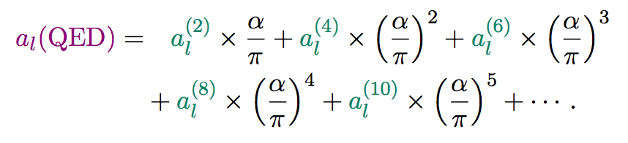
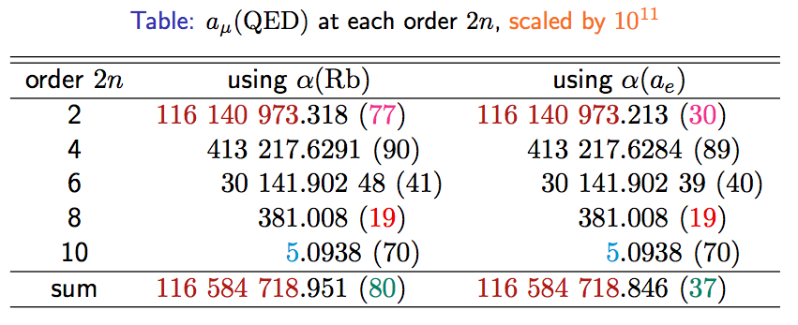
Kinoshita et al: g-2 in QED at 5-loop order
A triumph of perturbative QFT and computing
[From M. Hayakawa (tau2012)]
NEW!

Slide 7
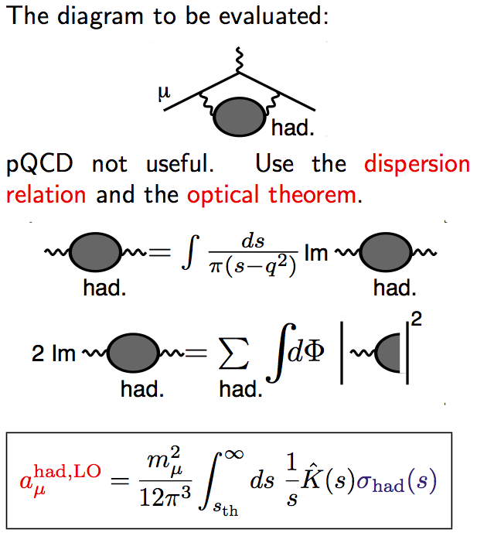
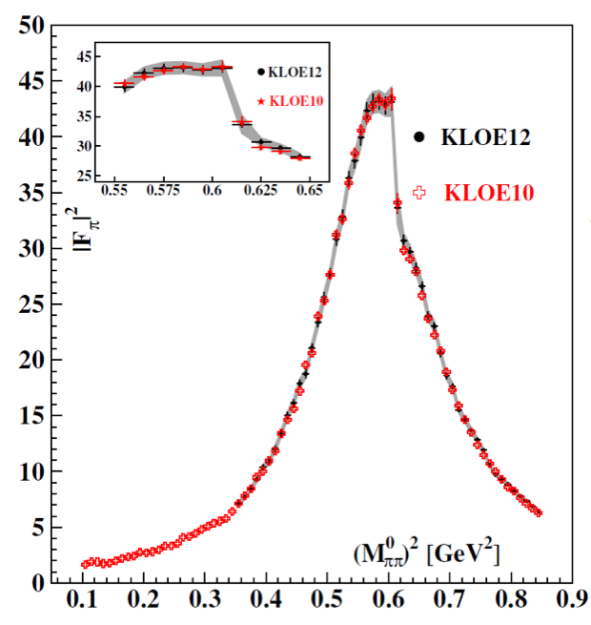
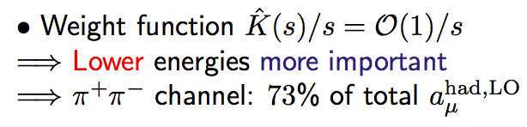
Status of the muon g-2 SM prediction: hadronic VP
Use of data compilation for hadr. VP:
Data from many exps. for many final states
from many experiments;
- traditional `scan’ (tunable e+e- beams)
- `Radiative Return’ at meson factories, eg

Slide 8
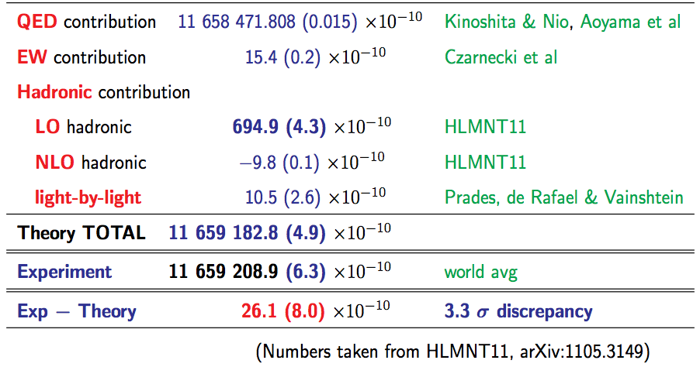
Status of the muon g-2 SM prediction
Several groups have produced hadronic compilations over the years.
Here: Hagiwara+Liao+Martin+Nomura+T

Slide 9
Status of the g-2 SM prediction: ?!
Recent history plot:
Data combination can be non-trivial:
More hadronic cross section data from:
KLOE, BaBar, Belle(II), CMD-3, SND, BESIII
Radiative corrections/Monte Carlos
Improved model predictions for l-by-l
Lattice QCD
SM prediction consolidated,
though `the devil is in the detail’;
- EXP+TH will have to work hard to match
planned exp. improvements (see below):

Slide 10
g-2 and BSM physics
Many physics models probed by g-2
Large change wrt SM prediction
Extended technicolor (muon mass generated radiatively)
SUSY (natural, gauge-mediated, …), RS, large ED, dark γ
Z’, W’, Little Higgs, Universal ED, 2HDM
SM prediction changed little

Slide 11
g-2 and BSM physics: SUSY?
SUSY could easily explain g-2:
Main 1-loop contributions:
Simplest case:
- Needs μ>0, `light’ SUSY-scale Λ and/or large tan β to explain 260 x 10⁻¹¹
- This is already `excluded’ by LHC searches in the simplest SUSY scenarios
(like CMSSM); causes large χ² in simultaneous SUSY-fits with LHC data and g-2
- However note: SUSY does not have to be minimal (w.r.t. Higgs),
could have large mass splittings (with lighter sleptons), or
corrections (to g-2 and Higgs mass) different from simple models,
or not be there at all
- g-2 constrains params, distinguishes between NP models `degenerate’ for LHC

Slide 12
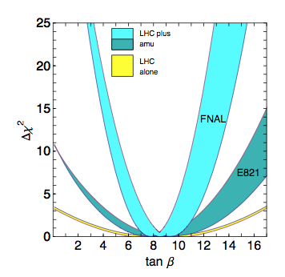
g-2 constrains SUSY
LHC with (100 fb⁻¹) can determine
tan(β) to 50%, with g-2 to 10%
g-2 complements LHC data selecting
in the vast SUSY (param/model) space
Guidice, Paradisi, Strumia JHEP 1210, 186

Slide 13
SUSY in CLFV and dipole moments
Contributions to CLFV and DMs related to elements of slepton mixing matrix:
Large contributions to g-2 ➔ large LFV, but:
bound from MEG on μ -> eγ rules out most of the parameter
space of certain SUSY models:

Slide 14
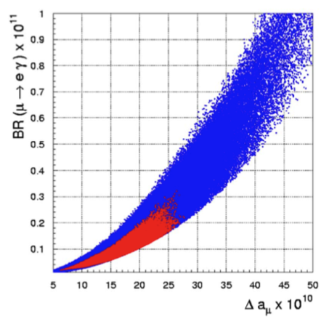
SUSY in CLFV and dipole moments
[From Tsutomu Mibe]
Large g-2 → Large cLFV
G. Isidori, F. Mescia, P. Paradisi, and D. Temes, PRD 75 (2007) 115019
Excluded by MEG
MEG limit now even:
g-2 (BNL E821)
deviation from SM (g-2)

Slide 15
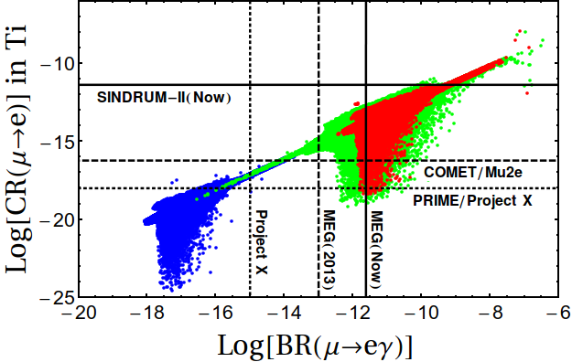
SUSY in CLFV: conversion vs μ->eγ
Expected limits from current and future CLFV experiments (conversion vs μ->eγ)
[from Calibi et al, arXiv:1207.7227]
tan β = 10
red: PMNS in mSUGRA
green: NUHM
blue: `CKM’
(small mixing)

Slide 16
g-2 and low scale NP: probing `dark photons’
200x10⁻¹¹ contribution to a_{μ}
Dark photon A’ of mass 20
…200 MeV from extra U(1)
Contributions to g-2 via
mixing with photon not
(yet) excluded
APEX and HPS @ JLAB,
MAMI and MESA in Mainz

Slide 17

Experiments at the high precision/intensity frontier
PSI
ILL
CERN
nEDM
Staged programme over next 15 years
MEG
Mu3e
EDM ?
nEDM
NA62
J-PARC
FNAL
COMET
(g-2)
KOTO
PRISM ?
(g-2)
EDM
Mu2e
ORKA ?
Project-X ?
Osaka
SNS
MuSIC
nEDM
Muon Experiments
Kaon Experiments
Neutron EDM

Slide 18
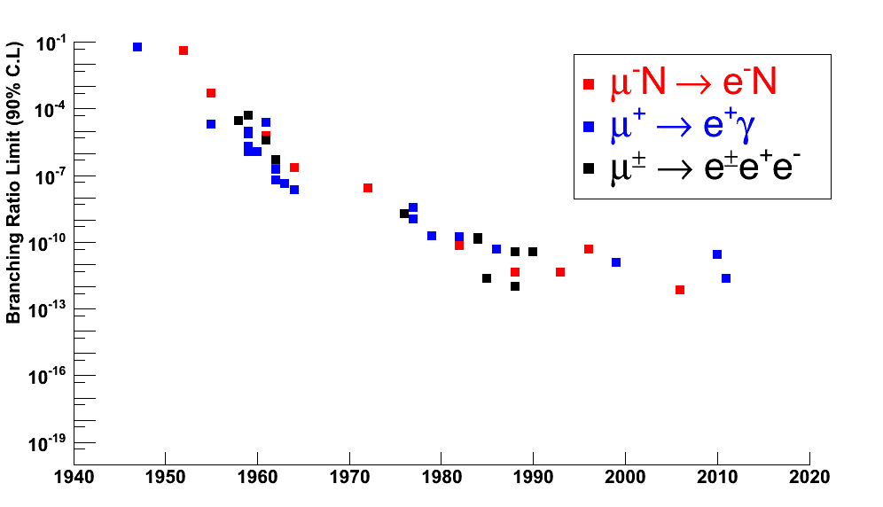
CLFV: Limits in different processes
Muon to electron conversion experiments aiming for single event sensitivity of 2x10⁻¹⁷
Pontecorvo (Dec 1947)
Liverpool 1959.
COMET/Mu2e

Slide 19
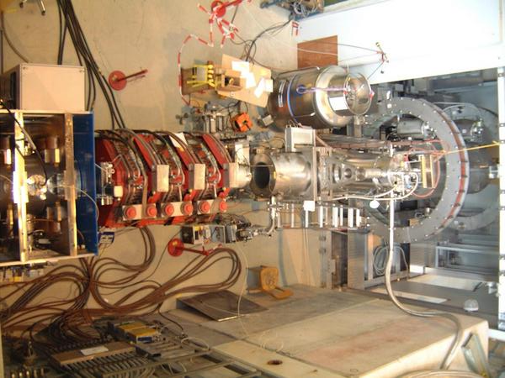
CLFV: Experimental Technique. MEG limits
Proton Beam
Muonic Atoms Formed
and Decay
π
μ
μ
Production Target
Stopping Target
aka THE TARGET
Detector
MEG at PSI: 10⁸ `stopped’ μ+/sec
Limit with 2011 data: Br(μ->eγ) < 5.7 x 10⁻¹³
(90% CL Excl.)
`Eliminates’ SUSY models, fitting g-2 and CLFV
With naïve power counting:
Doubled statistics expected his summer
Upgrade aiming at 6 x 10⁻¹⁴

Slide 20


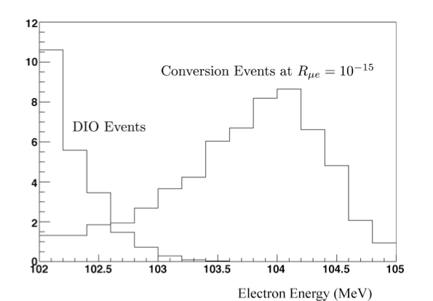
CLFV: Conversion vs decay processes
Suffer, at the highest
rates, from accidental
backgrounds that scale
as muon rate²
vs
μ⁻
e⁻
`Conversion’ process can occur due to
- `dipole like’ diagrams (like decays)
- four fermion operators,
- leptoquark or Z’ exchanges…
Signals in reach in many models!
Sindrum-II (PSI) 2004:
Conversion has a simple one particle
signature: E_{e} <~ m_{μ} , easy to separate
from `normal’ Decay In Orbit
Arguably best route to highest
sensitivity at high muon rates
N
Conversion @ 10⁻¹⁵

Slide 21
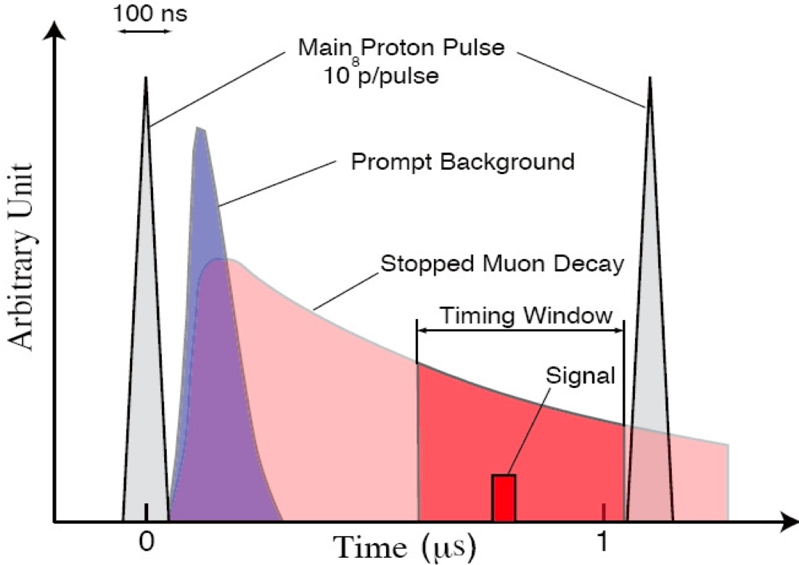

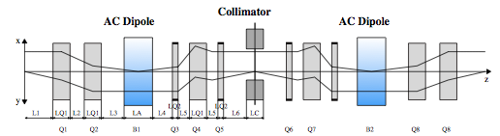
CLFV: the route to SES of 10⁻¹⁷: Pulsed proton beam
[Comet: 10¹¹ muons/sec, up from 10⁸ at MEG.]
Requirement (mue2/COMET) that < 10⁻⁹ of primary pulse
# protons
time
AC dipole/collimator system kicks
out the out-of-time particles
AC dipole @ FNAL

Slide 22
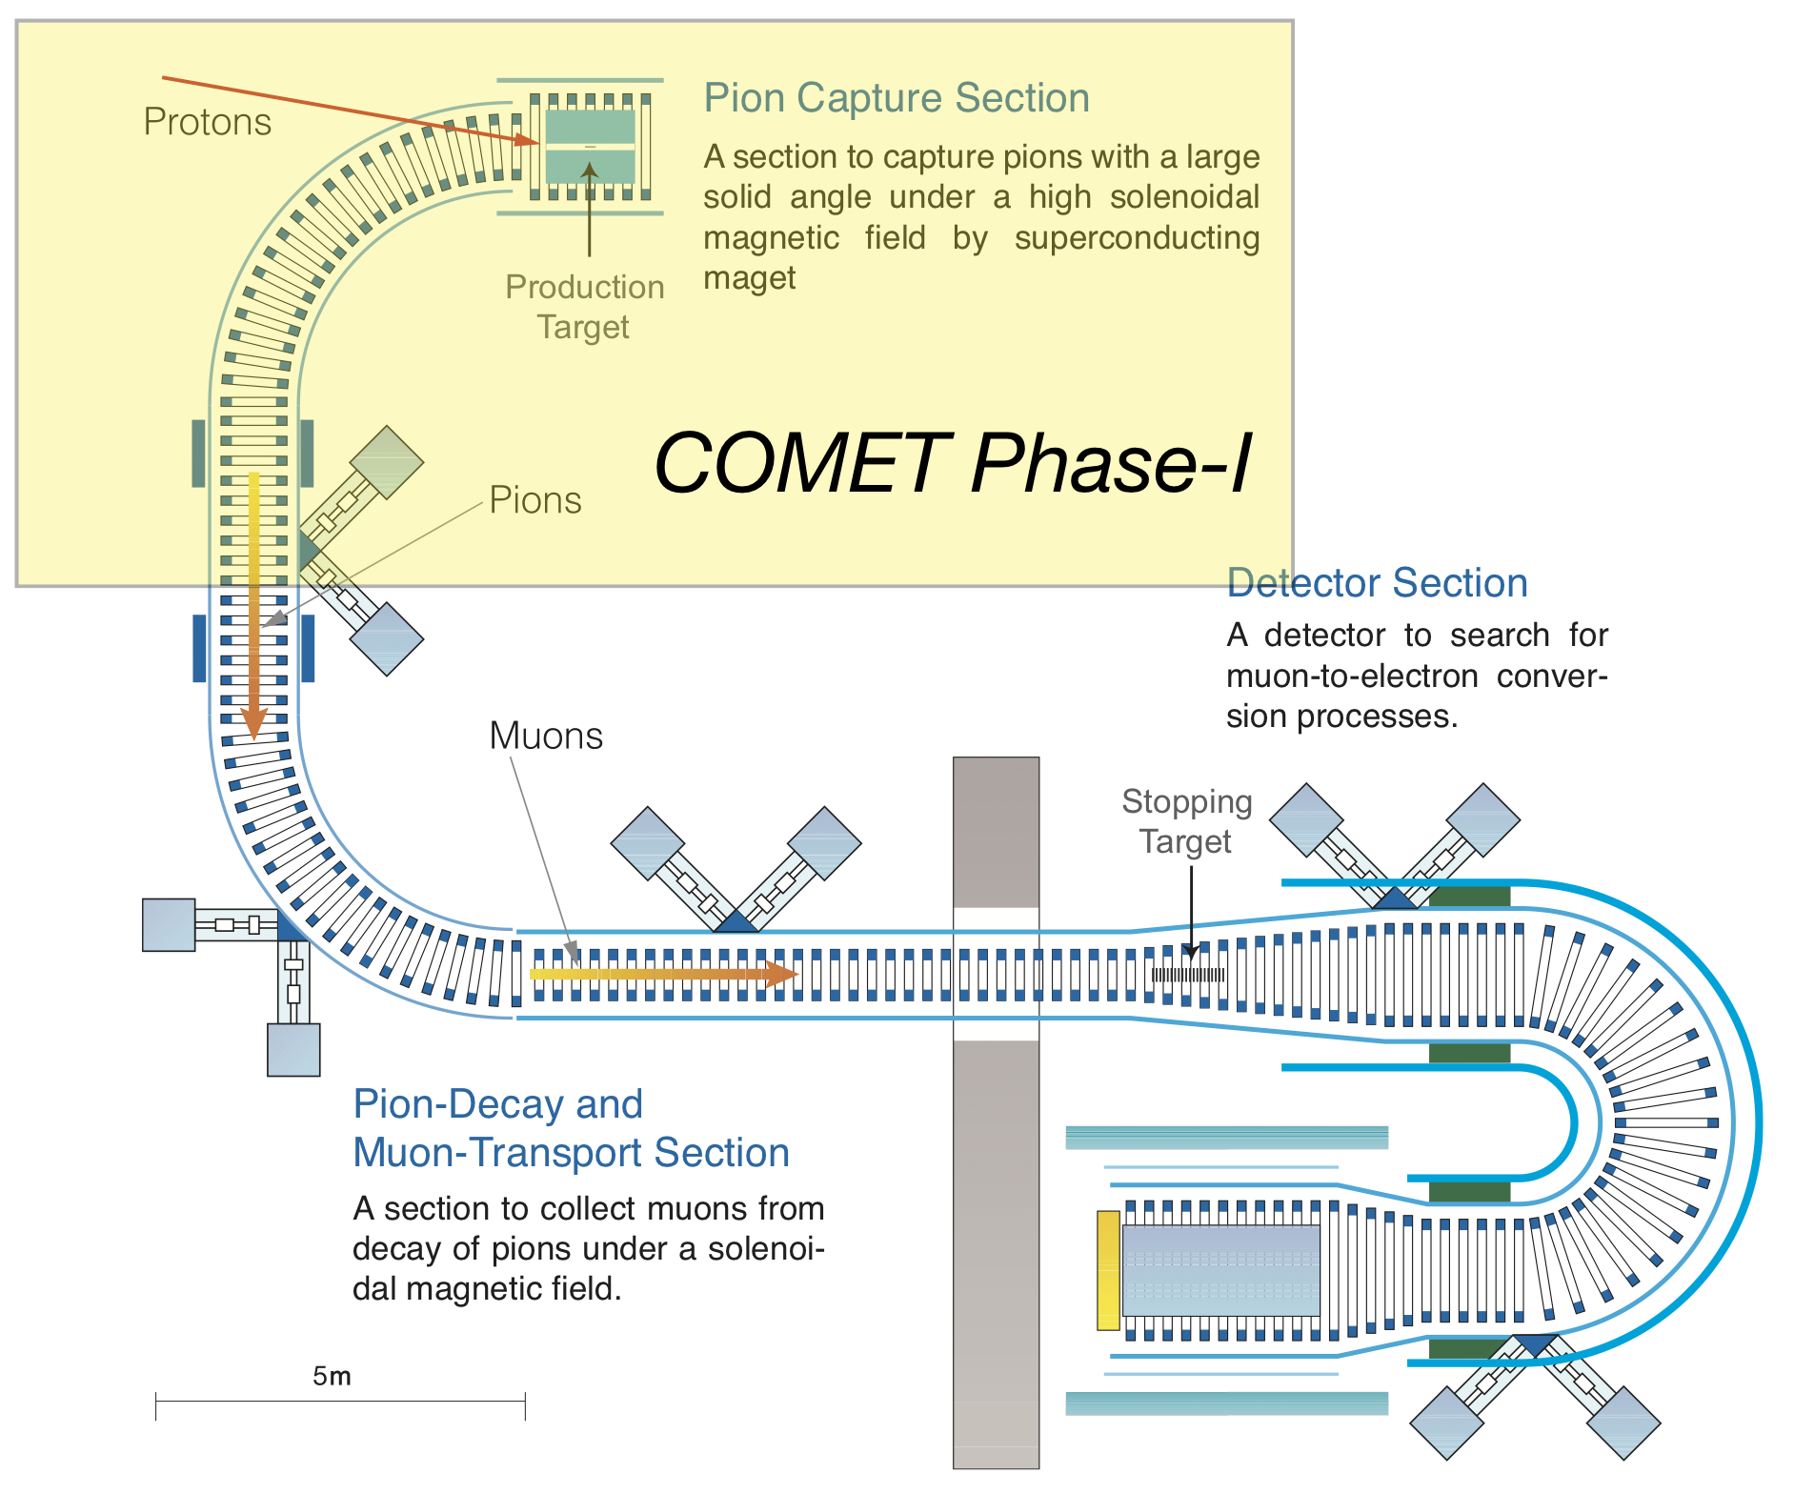
CLFV: COMET @ JPARC
COMET to be built in two phases
- Phase-I : now – 2016
- Phase-II : 2017 – 2020
Current Mu2e/COMET sensitivity estimates of
BR < 10⁻¹⁶ extrapolate current background knowledge over 4 orders of magnitude…
COMET Phase-I Aims:
1. Demonstrate that beam extinction >=10⁻⁹ can be achieved
2. Measure in-situ backgrounds: neutrons, anti-p, nuclear capture products and so refine/optimise the simulation.
3. Test final/prototype detectors
4. Measure conversion process with sensitivity x100 that of SINDRUM-II ie go below 10⁻¹⁴ :
physics-wise comparable to the MEG (2013) limit.

Slide 23
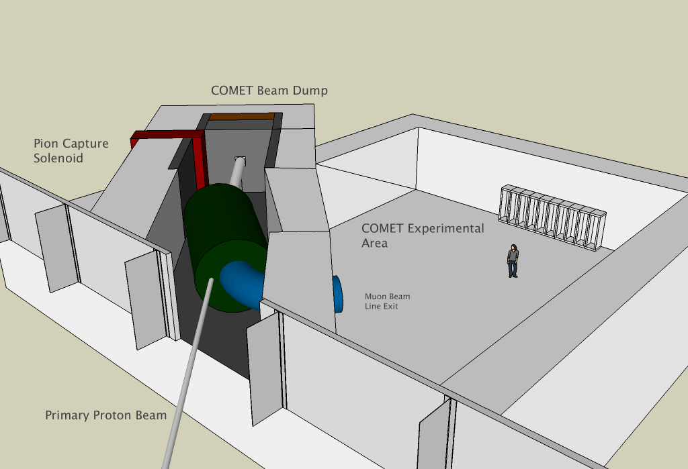
CLFV: COMET construction has begun
7x7 crystal ECAL prototype
UK Groups (Imperial, Manchester, Oxford, UCL, RAL)
- production target
- trigger / DAQ
- offline simulation and framework
- late arriving particle tagger

Slide 24
CLFV: Mu2e @ FNAL
Proton beam
Same physics reach as COMET Phase-II
Consists of 3 superconducting solenoid systems
DOE CD1 approval granted in 2012

Slide 25
Mu2e and g-2 @ FNAL: Proton Beam Delivery
Many components shared
between g-2 and Mu2e

Slide 26
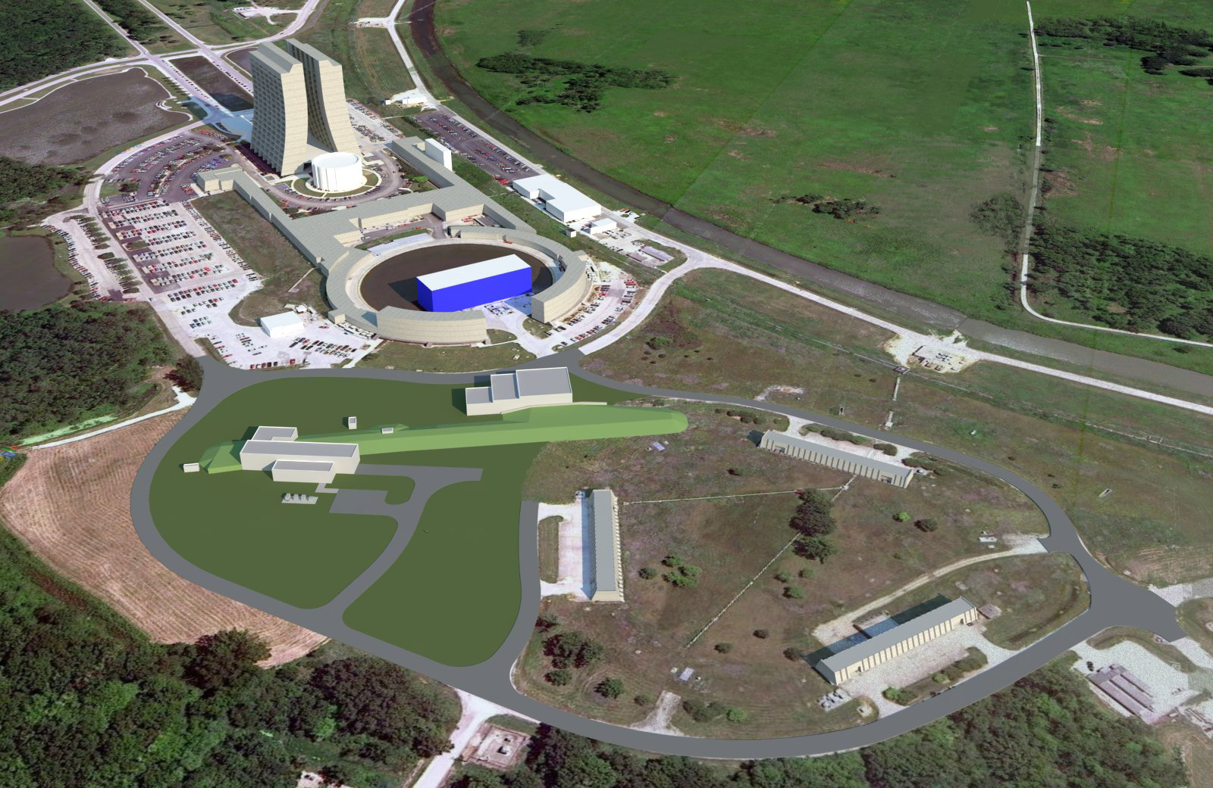
Mu2e and g-2 @ FNAL: Muon Campus
Construction of the g-2 building has begun
g-2 building
Mu2e building

Slide 27
CLFV: Timelines and expected sensitivities
[Scientific case for Mu3e accepted by PSI. First tests of prototype sensors at DESY.]
[Budget for COMET Phase-I beam line approved.]

Slide 28
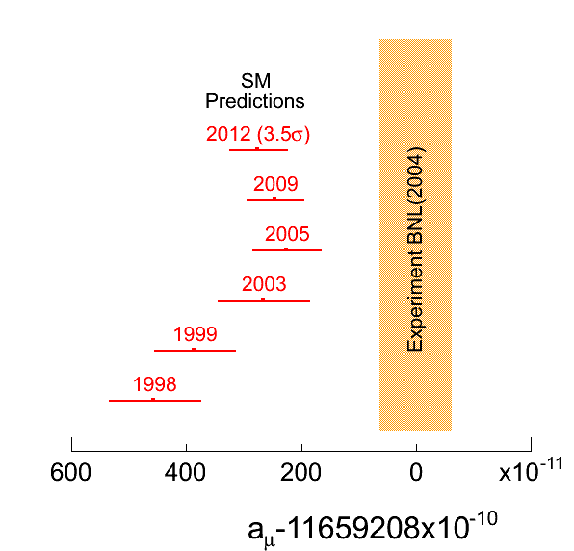
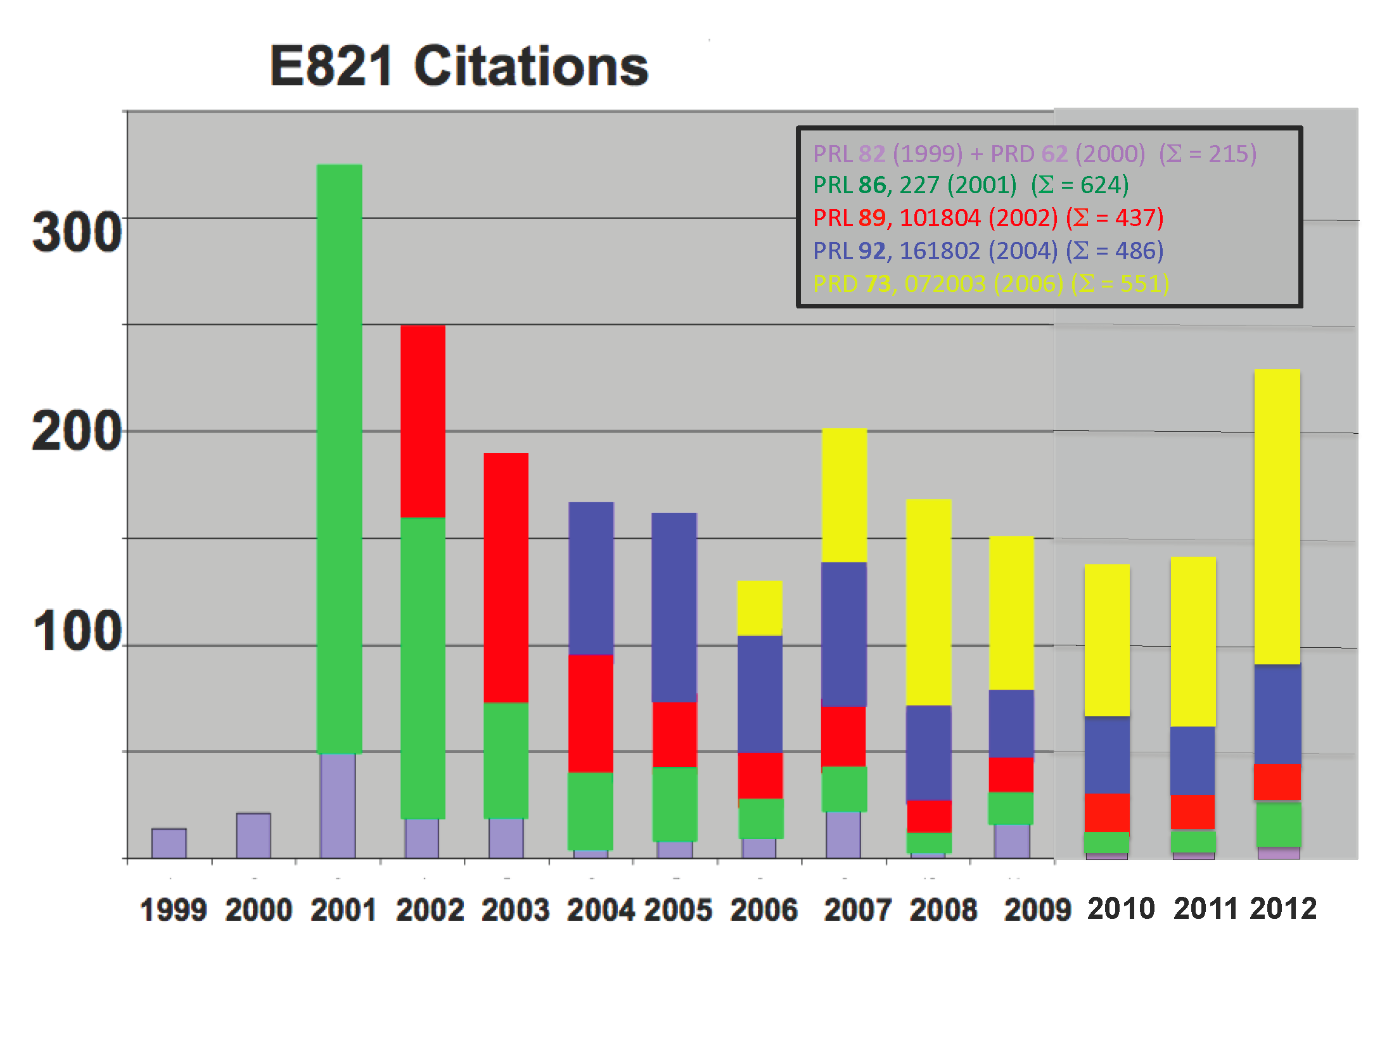
g-2: the story has just begun…
BNL measurement differs from SM prediction by about 280 x 10⁻¹¹ (~ 3.5 σ)
2nd most cited paper(s) in experimental
particle physics
Have to firmly establish discrepancy and find/constrain NP models

Slide 29
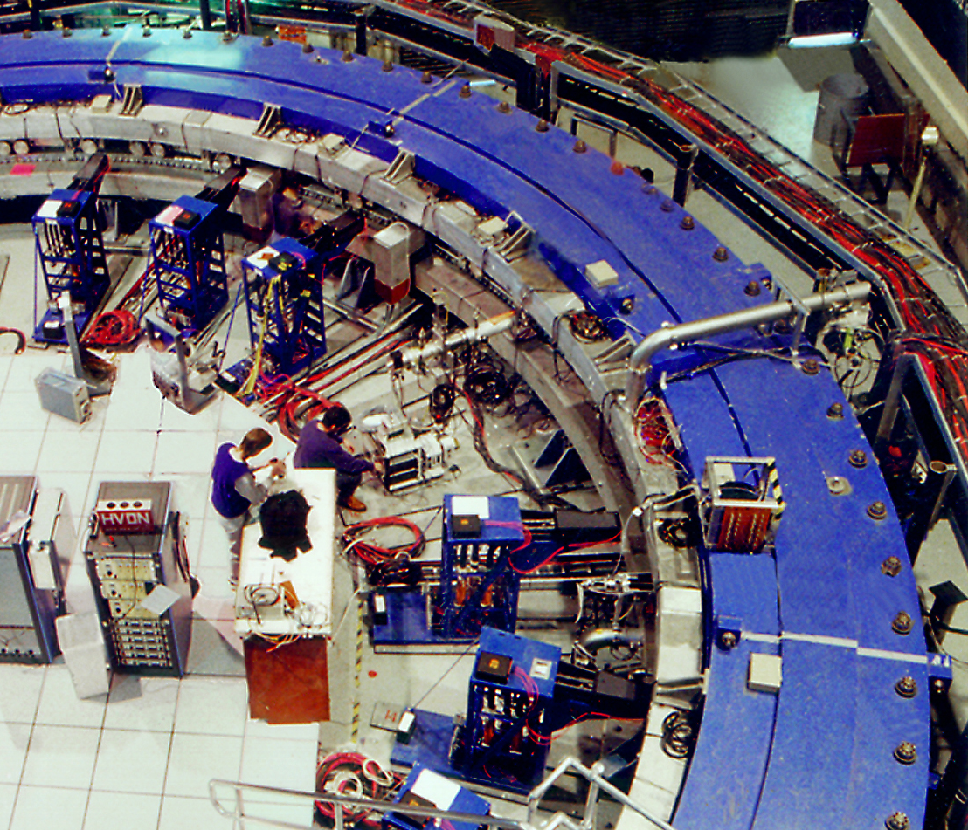
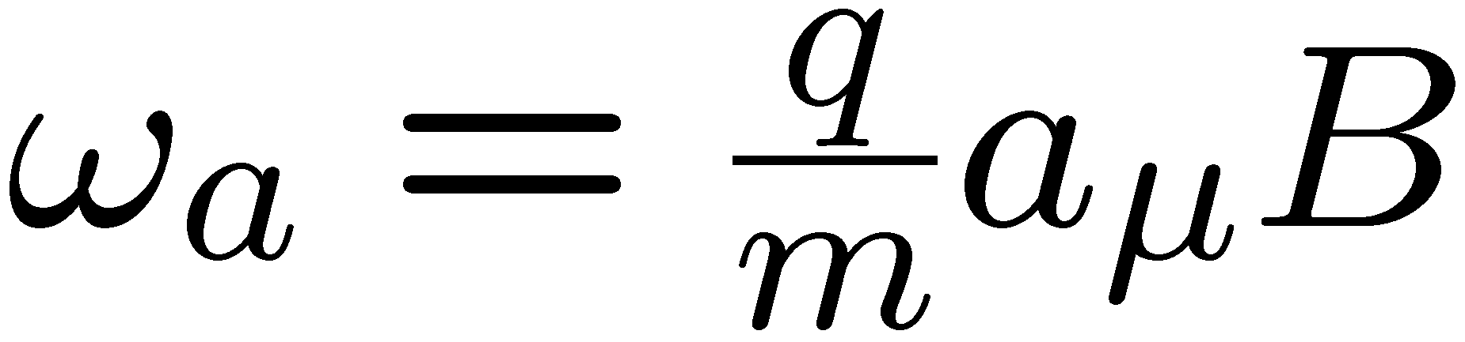
g-2 @ FNAL: aiming for 0.14 ppm precision
Use established technique (& apparatus)
Increase # of muons by factor of 21 to reduce statistical error by over 4
3. Reduce systematics by
factor of 3
e
Momentum
Spin
BNL uncertainty (10⁻¹¹)
Proposed FNAL uncertainty (10⁻¹¹)
SM uncertainty (10⁻¹¹) now
SM uncertainty (10⁻¹¹) 2017

Slide 30
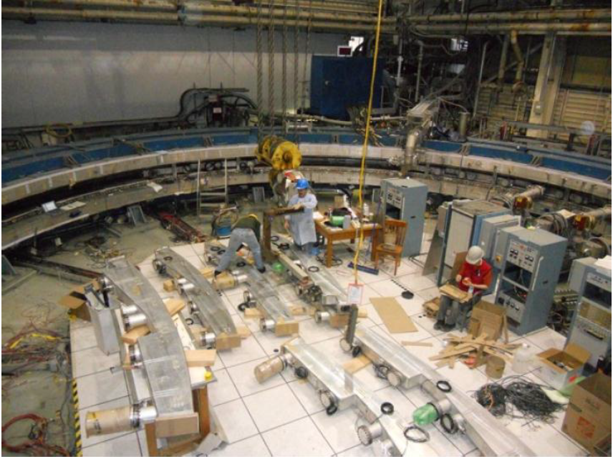
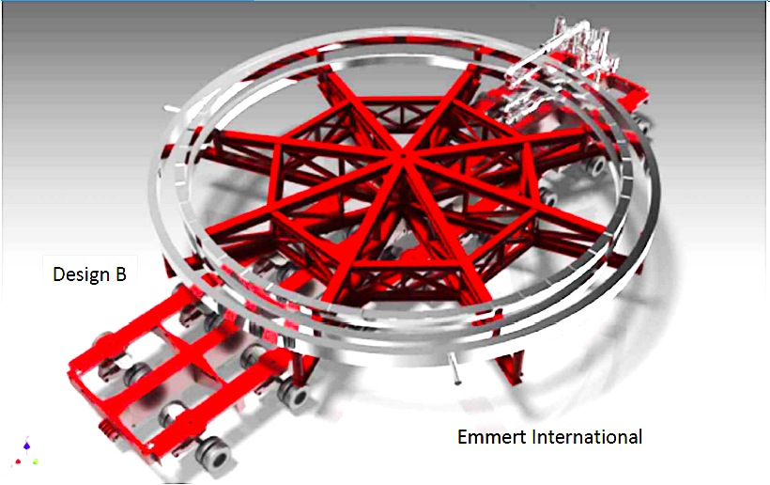
g-2 @ FNAL: work has begun
BNL Ring May 2012
Must be shipped in one piece

Slide 31
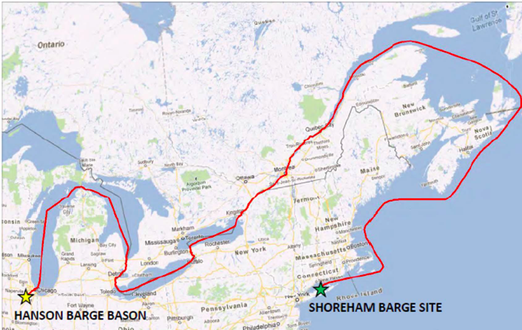
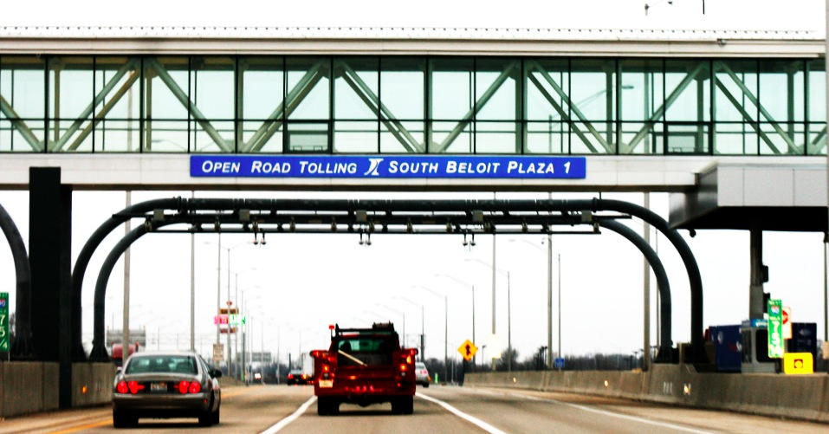
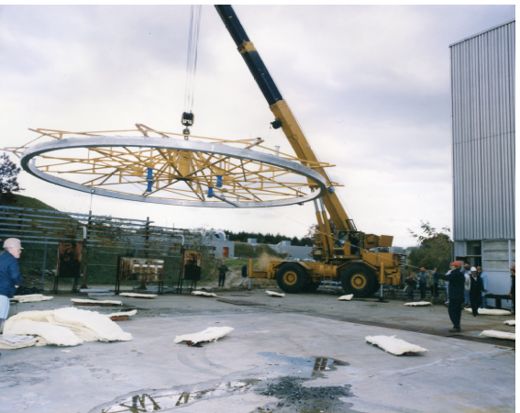
g-2 @ FNAL: planned transport of the ring
4 week journey of the ring from BNL to FNAL to begin June 2013
CDR being finalised now
Expect DOE CD1 in summer
15.24 m ≈ 30 cm to spare

Slide 32
g-2 @ FNAL: UK contributions
Proposed contributions from 5 institutes in 5 areas:
- Construction of straw trackers (Liverpool)
- Squid Magnetometer (Oxford)
- DAQ (UCL/Oxford)
- Injection system (STFC RAL TD/STFC Cockcroft)
- Physics optimisation (hadronic SM contribution)
First beam in muon storage ring @ FNAL in 2016.
$40M

Slide 33
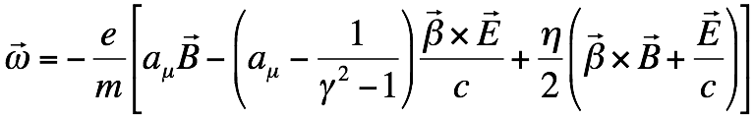











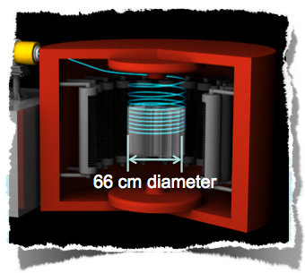
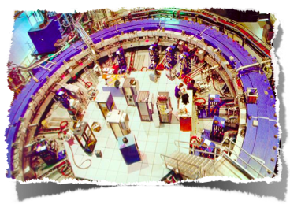


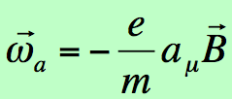
g-2: BNL/FNAL AND J-PARC
[From Naohito Saito]
Complementary!
BNL/Fermilab Approach
J-PARC Approach
14m diameter
22

Slide 34
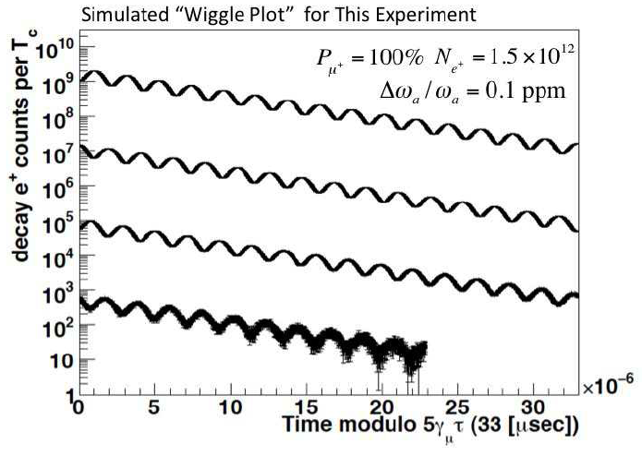
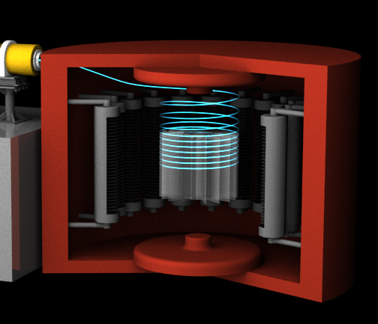
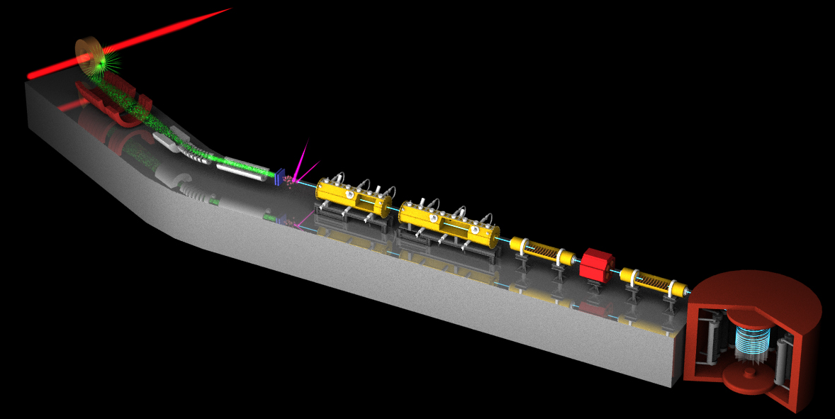
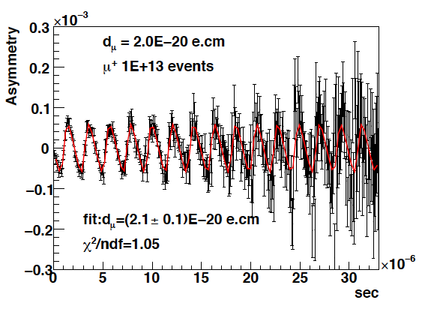
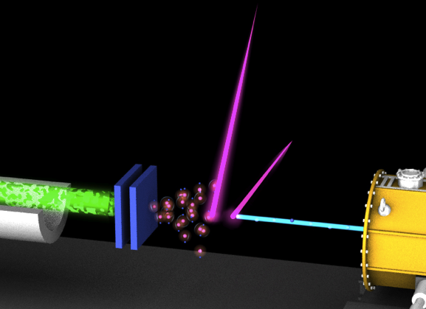
[Slide from Naohito Saito]
3 GeV proton beam
( 333 uA)
g-2
Graphite target
(20 mm)
Silicon Tracker
Surface muon beam
(28 MeV/c, 4x10⁸/s)
66 cm diameter
Muonium Production
(300 K ~ 25 meV⇒2.3 keV/c)
Super Precision Magnetic Field
(3T, ~1ppm local precision)
Resonant Laser Ionization of Muonium (~10⁶ μ⁺/s)
Muon LINAC
(300 MeV/c)
EDM
New Muon g-2/EDM Experiment at
J-PARC with Ultra-Cold Muon Beam

Slide 35
g-2: BNL/FNAL vs J-PARC
 | BNL-E821 | Fermilab | J-PARC
Muon momentum | 3.09 GeV/c |  | 0.3 GeV/c
gamma | 29.3 |  | 3
Storage field | B=1.45 T |  | 3.0 T
Focusing field | Electric quad |  | Very weak magnetic
# of detected μ+ decays | 5.0E9 | 1.8E11 | 1.5E12
# of detected μ- decays | 3.6E9 | - | -
Precision (stat) | 0.46 ppm | 0.1 ppm | 0.1 ppm
[From Tsutomu Mibe]

Slide 36
Conclusions
Low energy precision experiments with leptons strongly test the SM and already exclude/constrain many BSM scenarios
g-2, CLFV and EDMs often complementary to direct searches;
rich experimental programme involving many facilities
Muon g-2 discrepancy consolidated at > 3 σ , but no signs for SUSY at the LHC so far
Big improvements in sensitivity for future projects, eg
g-2 and Mu2e @ FNAL, g-2 and COMET @ J-PARC
Groups from UK hope to contribute significantly to this!
Stay tuned Thank you.

Slide 37
Spares

Slide 38
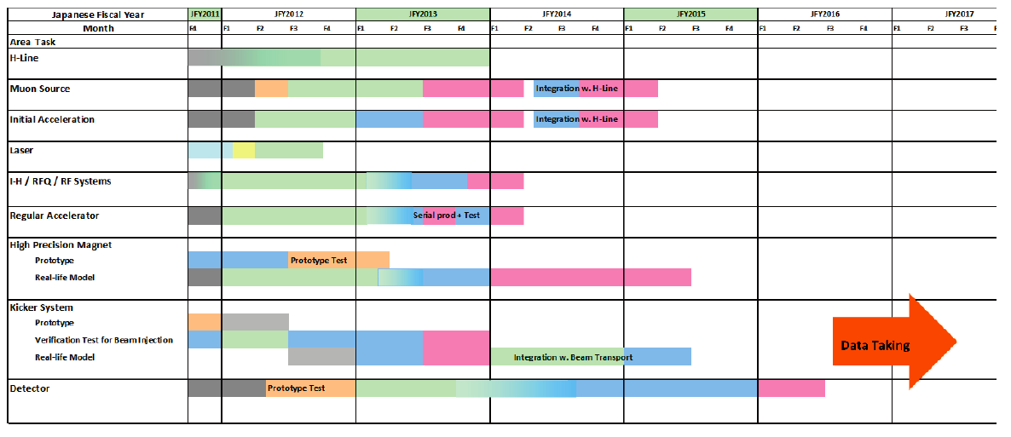
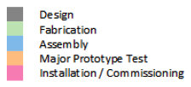
g-2 @ J-PARC: schedule
[From Naohito Saito]
Need to be competitive with Fermilab g-2 which starts in 2016.
Originally…
JFY2012
JFY2013
JFY2014
JFY2015
JFY2016
JFY2017
H-Line
Muon Source
Initial Acc
Laser
RFQ / IH
Hi-β LINAC
Hi Precision Magnet
Kicker System
Detector

Slide 39
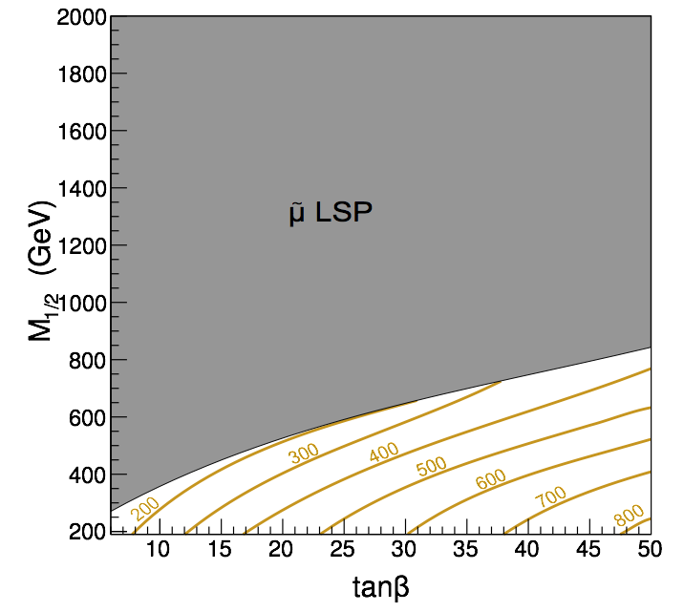
g-2 and SUSY
LHC/Dark Matter data rule out much of light squarks / gluino param.-space,
but light sleptons (best limits from LEP) still not excluded
“Looking to (SUSY) models with a different connection between the coloured and uncoloured sector, not only seems timely now, but mandatory.”
John Ellis et al, arxiv:1207.7315
Feng et al., arxiv:1112.3021
SUSY contribution to g-2 determined by
smuon, sneutrino, chargino and neutralino
masses
Smuon masses contributing 280x10⁻¹¹ to a_{μ}

Slide 40
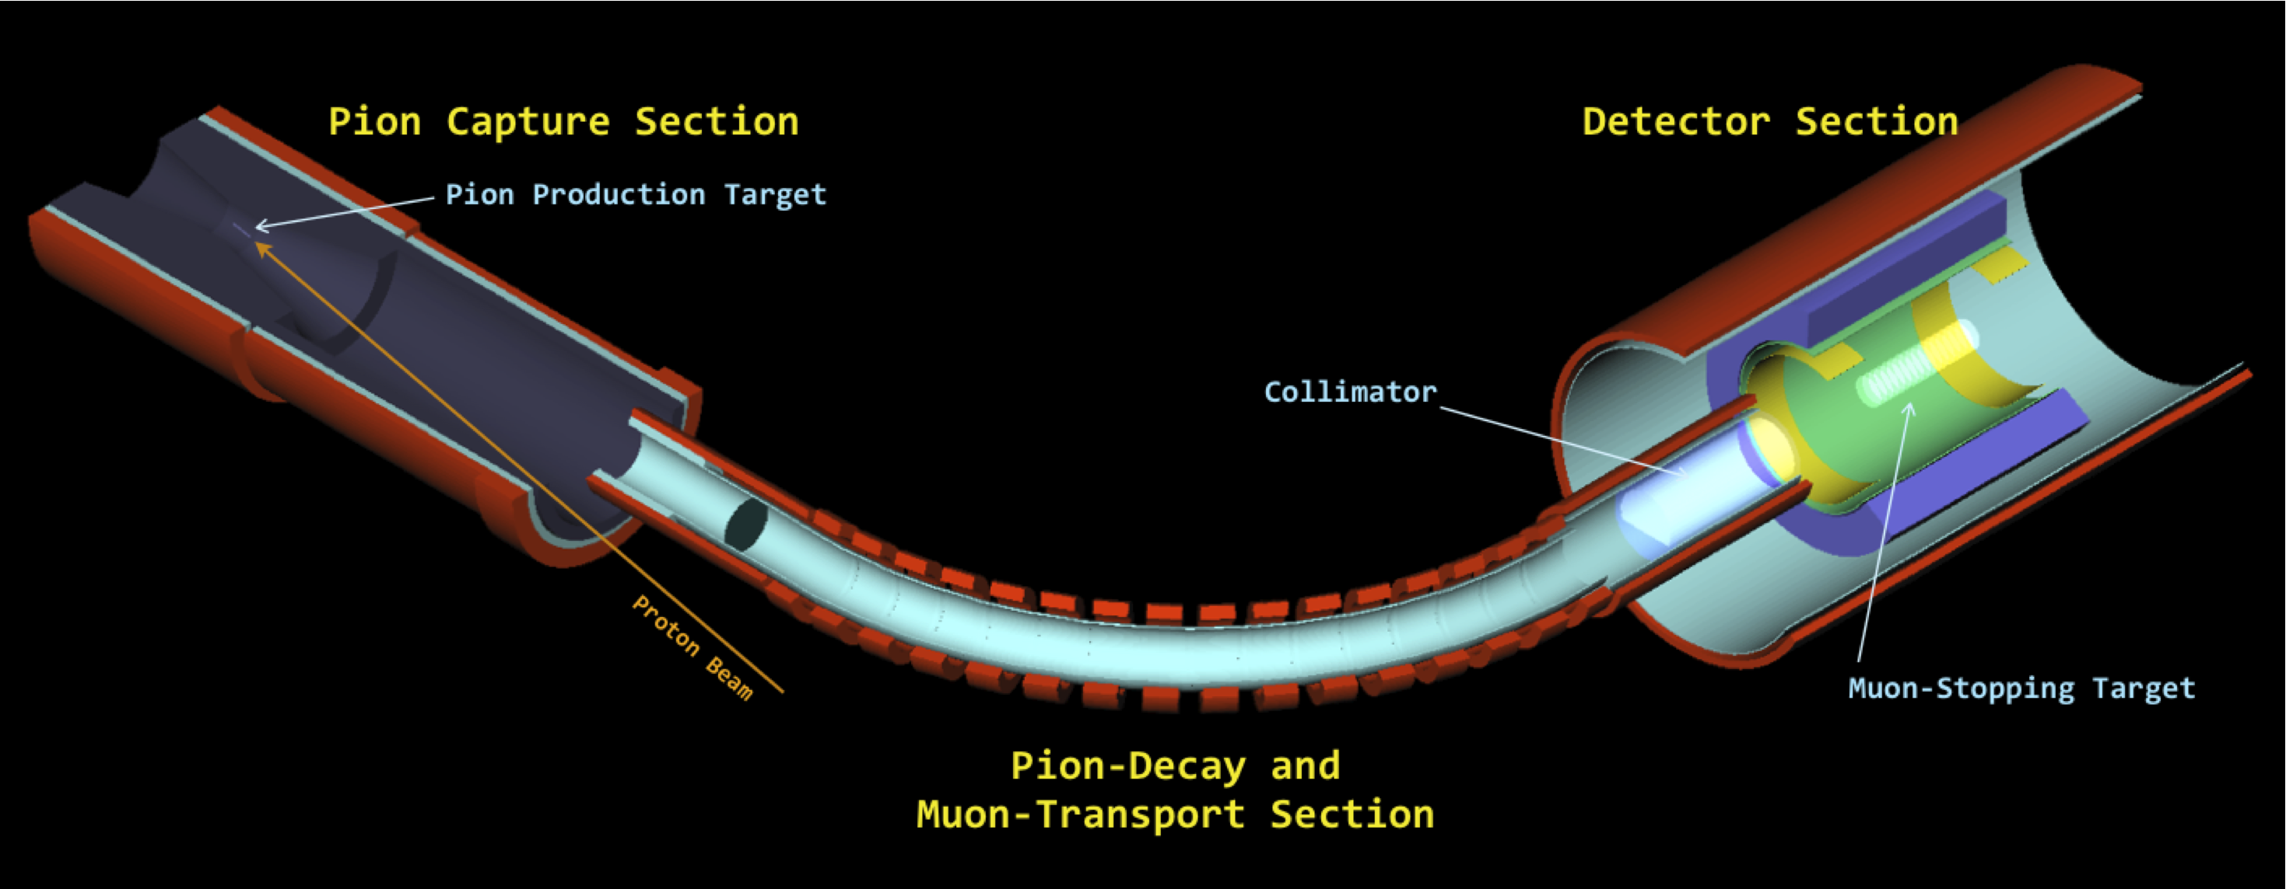
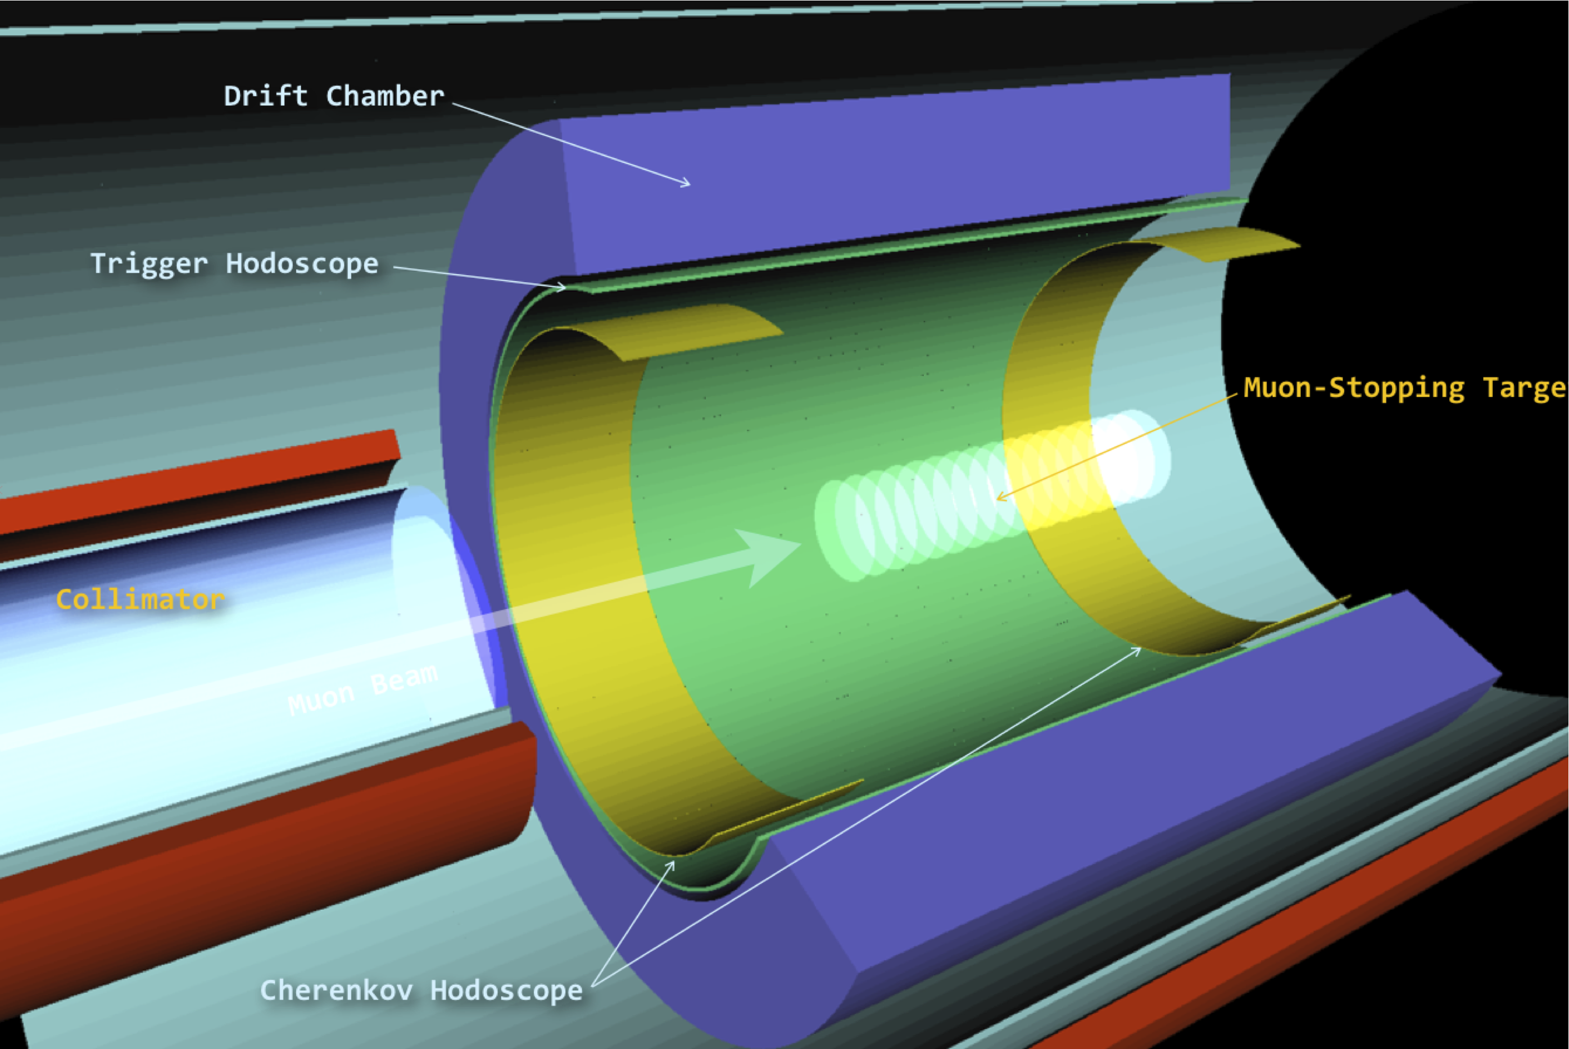
CLFV: COMET Phase-I
Cylindrical detector
has higher acceptance but poorer
resolution compared to transverse/phase-II
detector

Slide 41
Mu2e: Schedule

Slide 42
g-2 @ FNAL: UK Contributions
Construction / design of straw trackers with FNAL
Straw trackers:
- understand and correct for pileup effects in calorimeter
- monitor beam trajectory / losses
- measure muon electric dipole moment
Hodoscope

Slide 43
g-2 @ FNAL: UK Contributions
Squid Magnetometer
- to improve magnetic field monitoring
Prototype developed for
cryoEDM experiment
Pickup-loops and SQUID inside
superfluid ³He
Test at LSBB

Slide 44
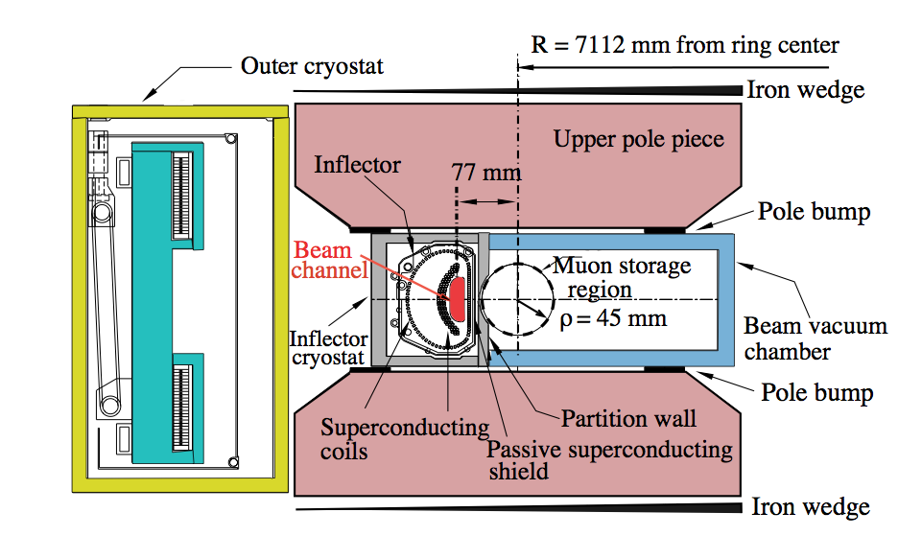
g-2 UK Contributions
Modeling of injection/kicker system (software)
Design of new inflector magnet
- reduce muon loss on injection
Non-ferromagnetic, static with no flux leakage into storage ring
Null storage ring field

Slide 45
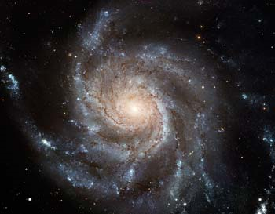
eEDM (e.cm)
[From Ed Hinds’ talk @ Liverpool 2013]
Theoretical estimates of eEDM
10⁻²²
selectron
γ
10⁻²⁴
Multi Higgs
MSSM
e
e
10⁻²⁶
The interesting
region of sensitivity
Left -Right
10⁻²⁸
other
SUSY
10⁻³⁰
10⁻³²
10⁻³⁴
Insufficient CP
to make universe
10⁻³⁶
of matter
Standard Model
45

Slide 46
A clever solution
For more details, see E. A. H. Physica Scripta T70, 34 (1997)
amplification
(Sandars)
E
ηd_{e} σ
Interaction energy
electric field
-d_{e} ηE•σ
F P
Polarization factor
Structure-dependent relativistic factor ∝ Z³
atom or molecule containing electron
[From Ed Hinds’ talk @ Liverpool 2013]
46

Slide 47
Current status of EDMs
d e.cm
d(muon) < 1.9×10⁻¹⁹
10⁻²⁰
neutron:
10⁻²²
d(proton) < 5×10⁻²⁴
10⁻²⁴
MSSM
electron:
d(neutron) < 3×10⁻²⁶
10⁻²⁶
Multi
Higgs
d(electron) < 1×10⁻²⁷
YbF
10⁻²⁸
Left-Right
10⁻²⁹
1960
1970
1980
1990
2000
2010
2020
2030
[From Ed Hinds’ talk @ Liverpool 2013]
47

