Slide 1


First Results from Cherwell, a CMOS sensor for Particle Physics
By James Mylroie-Smith
https://heplnm061.pp.rl.ac.uk/display/arachnid/Home

Slide 2
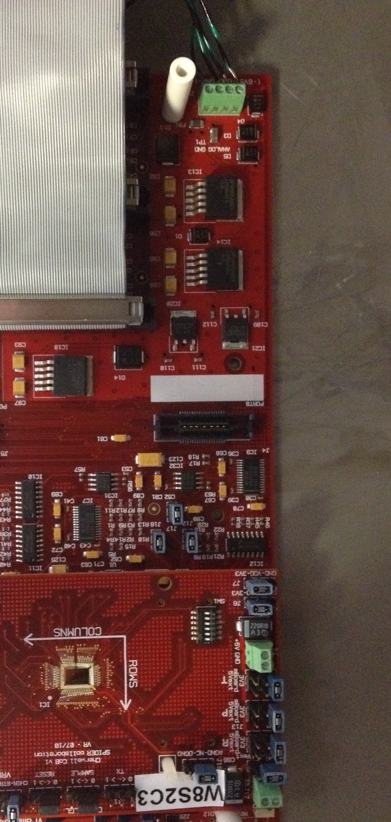
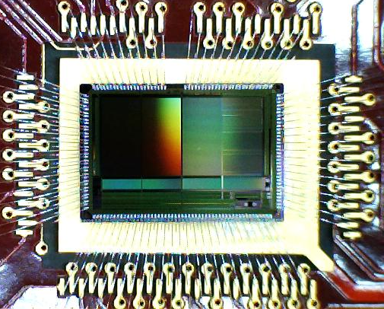
Outline
CMOS sensors
CHERWELL
4T MAPS
Deep P-Well
First Results
Future Plans
Summary

Slide 3
INMAPS CMOS in Particle Physics
Past
Present
Future
TPAC
Digital Calorimeter using INMAPS CMOS technology
Linear Colider?
FORTIS
4T CMOS sensor for tracking and vertexing
CHERWELL
Alice?
Calorimetry
+ ...... ?
Tracking

Slide 4
CHERWELL
DECAL 25
DECAL 50
Ref Pixel
STRIXEL
5mm
Cherwell
Digital Calorimetry (DECAL)
“4T” pixels with triggered global shutter and in-pixel CDS
25um pixel pitch 2x2 pixel summing at column base
50um pixel pitch
Vertex/Tracking
Standard “4T” pixels
Reference pixel array 12 bit ramp ADC implemented at column base
“Strixel” array 12 bit ramp ADC embedded in pixel array
SUM
ADC
ADC
ADC
5mm

Slide 5
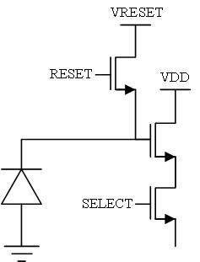
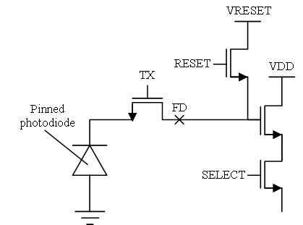
4T Technology
3T CMOS
  readout and charge collection node are the same
  No correlated double sampling(CDS)
4T CMOS
  3 additional elements
  Readout and charge collection at different points
Benefits
  Low noise from capacitance of the floating diffusion
  Low noise and in pixel CDS
  High gain
3T
4T

Slide 6
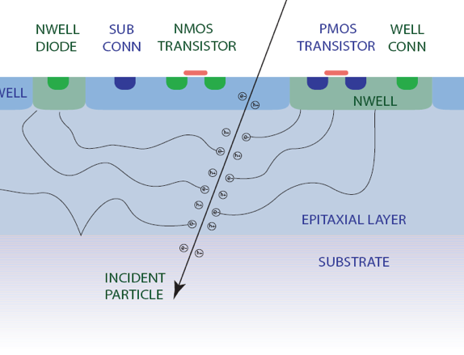
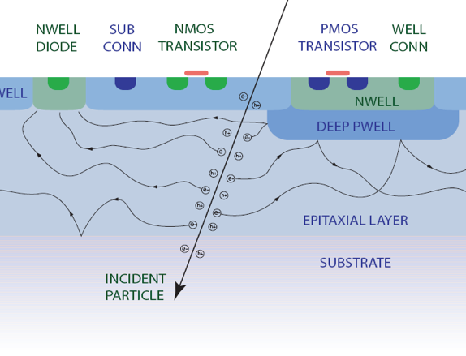
Deep P Well Implants
PMOS Transistors require an n-well
PMOS n-well competes with n-well diode
reducing the charge collection
To improve charge collection efficiency a deep p-well is implanted
Reflects charge back into the epitaxial layer
STANDARD CMOS
INMAPS

Slide 7
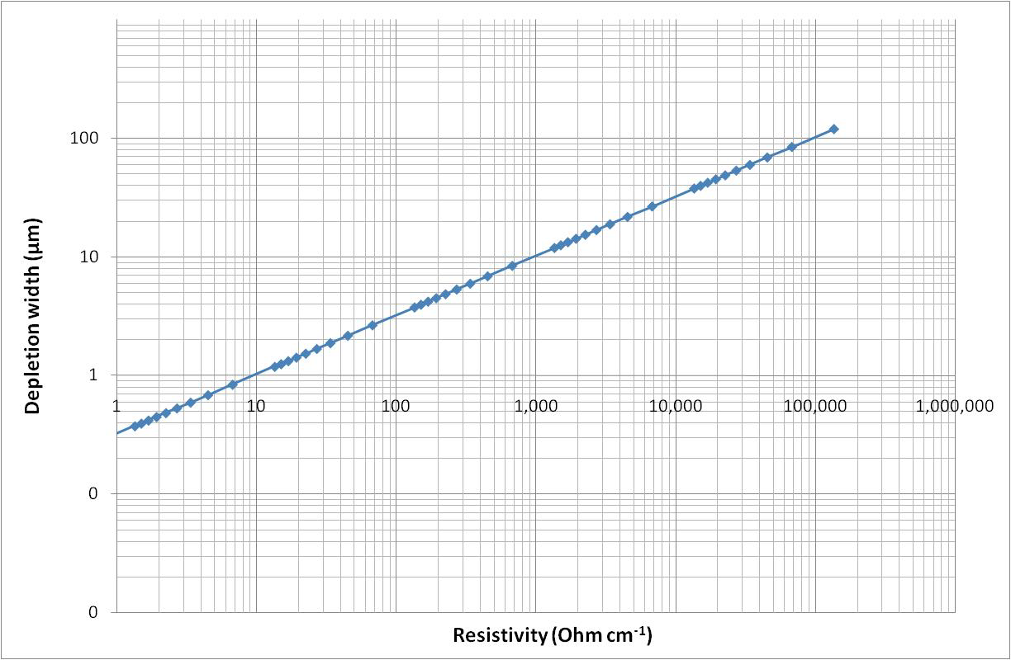
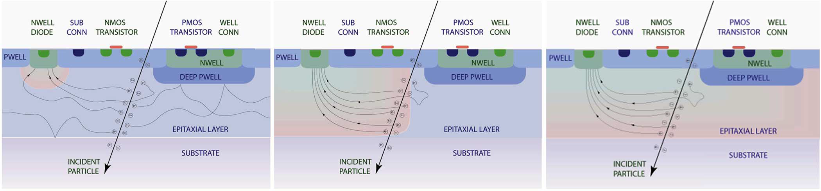
High Resistivity
High resistivity
1-10kΩcm
We have sensors using standard and high resistivity epitaxial layers
Benefits of high resistivity:
  Faster charge collection
  Reduced charge spread
  Increased radiation hardness
Typical resistivity
10-100Ωcm

Slide 8
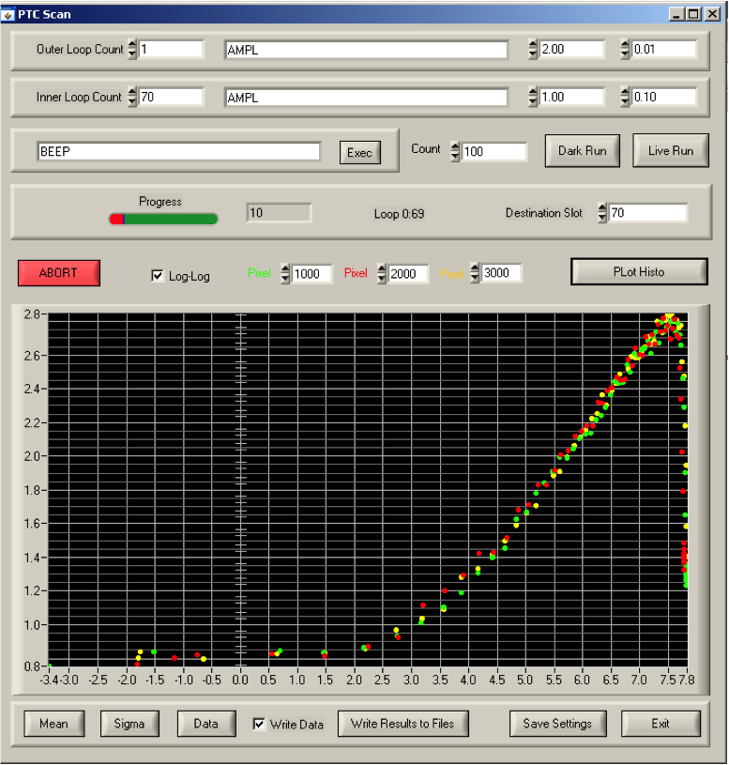
Photon Transfer Curve
PTC used to characterise CMOS censors
Extract:
  Gain
  Noise
  Well Capacity
PTC scan controlled by computer
IR LED uses programmable generator to give uniform illumination
Sensor read back to computer and data complied into PTC and results plotted

Slide 9
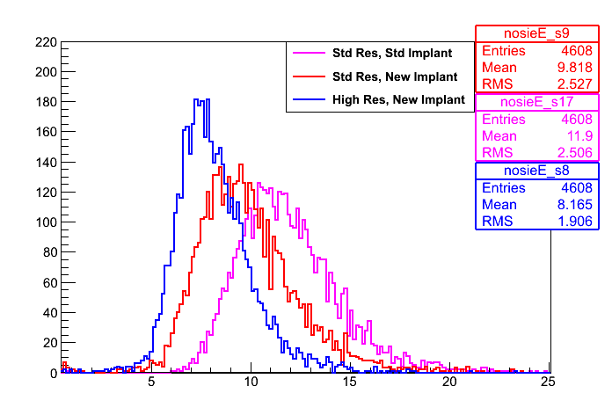
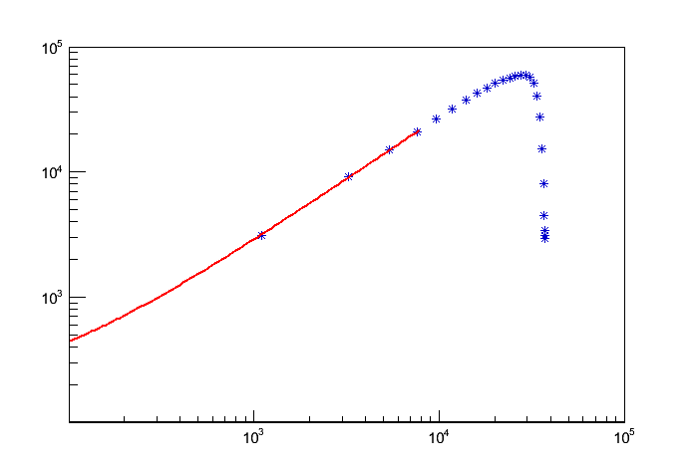
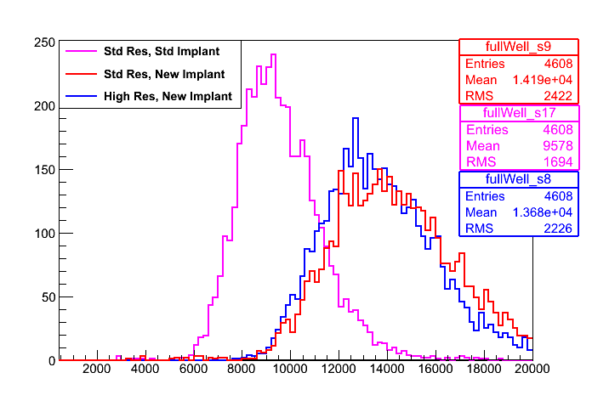
Lab Tests
PTC scans performed for the three different types of sensor
Increase the intensity of illumination and plot the signal vs noise
Comparison made for the reference pixels
Noise (e⁻)
Example PTC scan
Log(Noise²)
Log(Signal)
Full Well (e⁻)

Slide 10
Test beam setup
Performed at CERN in November
120 GeV pions
Stack of 6 sensors
    Two of each type (most of the running)
    Four of std. res. std. implant type and one of each low Vt implant
Placed on x-y stage controlled remotely for alignment
Triple coincidence trigger(2 top, 1 bottom)
Beam
EUDET
Scintillators
Cherwell Stack
Scintillators

Slide 11
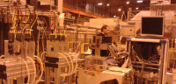
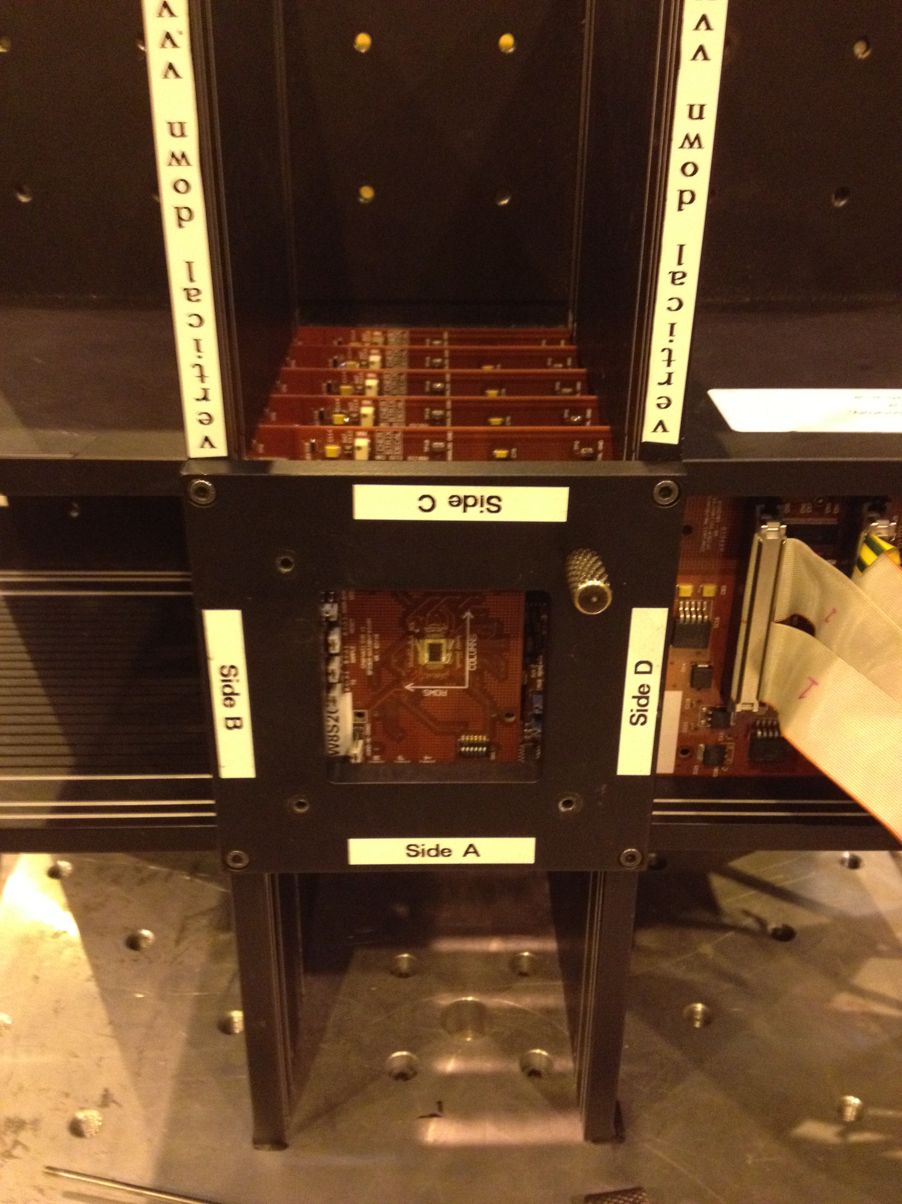
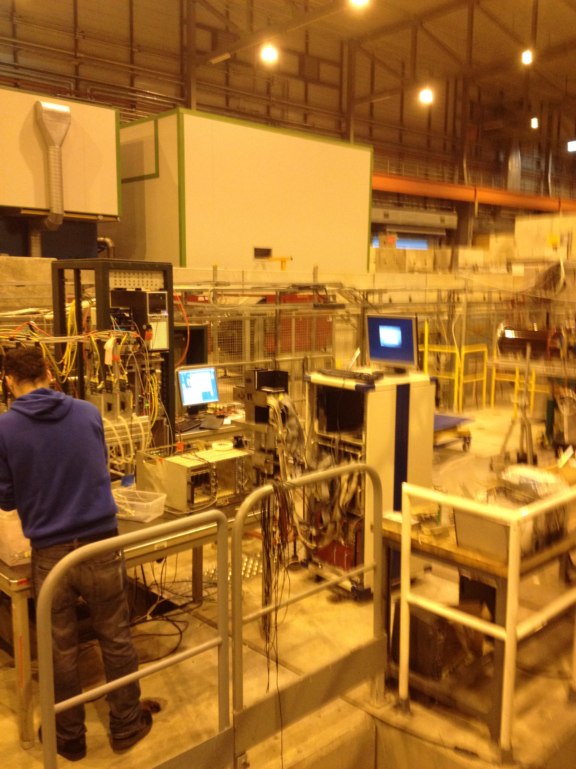
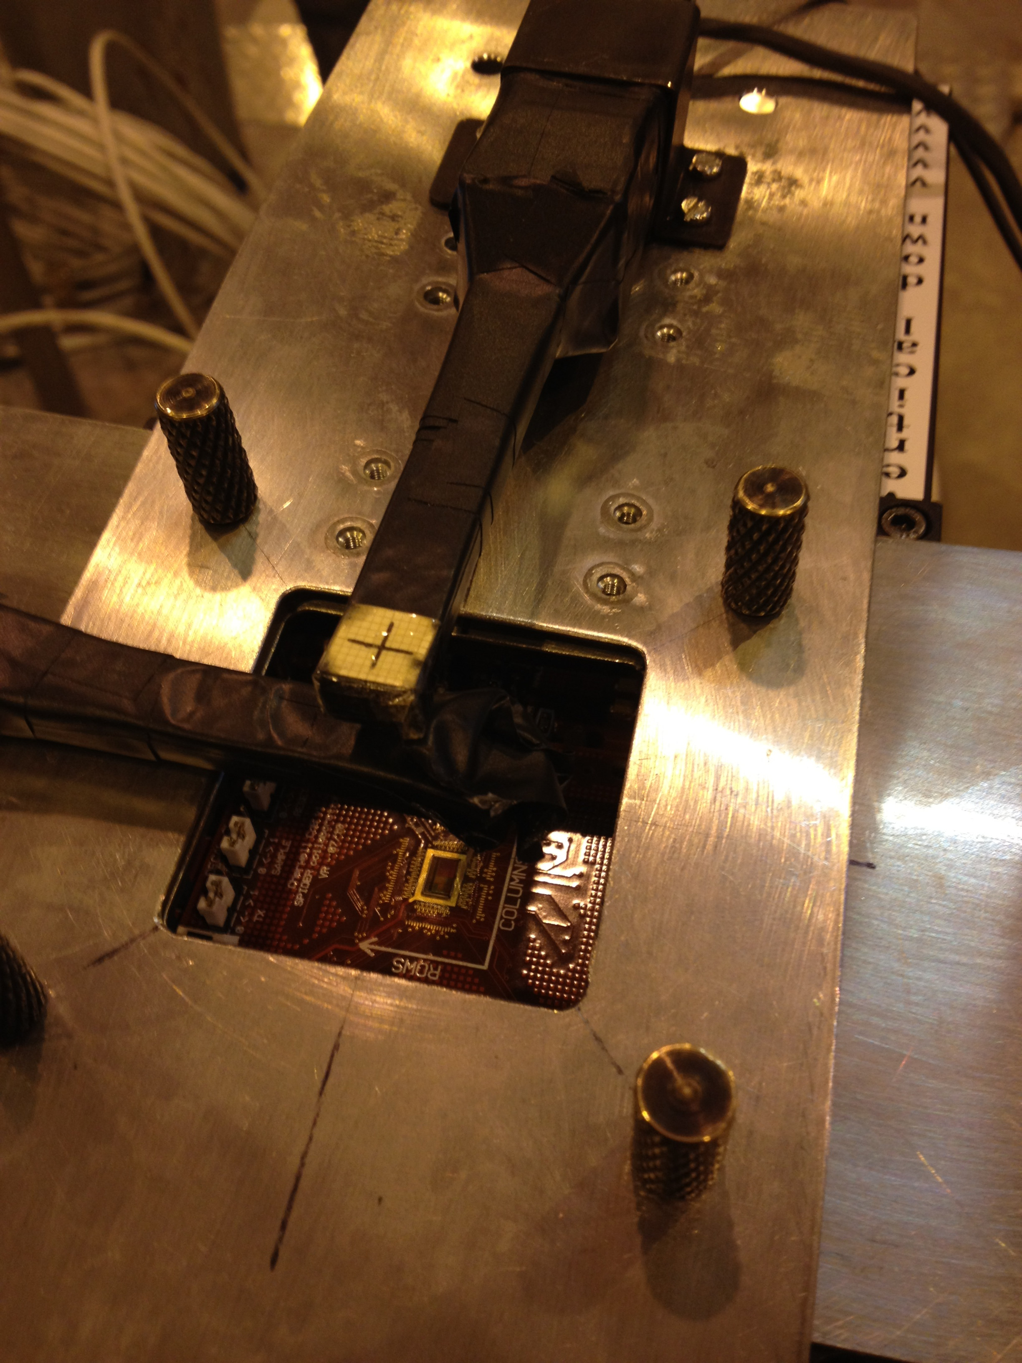
Pictures…
EUDET
Cherwell Stack

Slide 12
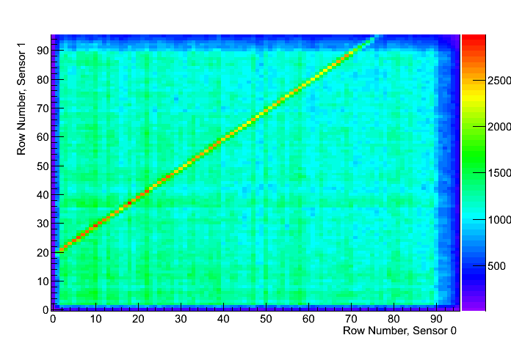
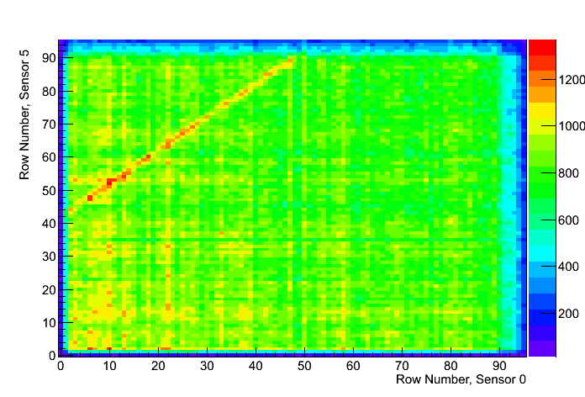
Correlation Plots
Correlation plots show that we see particle crossing
the entire detector and are used to align the sensors
First two sensors
First and last sensor

Slide 13
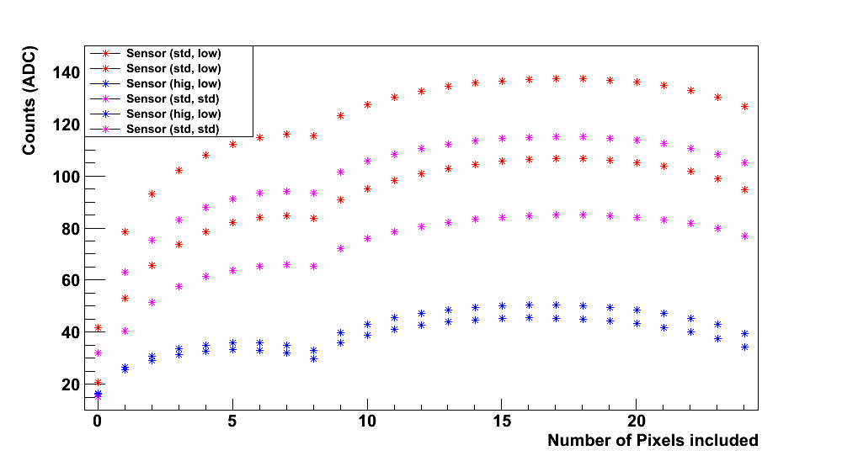
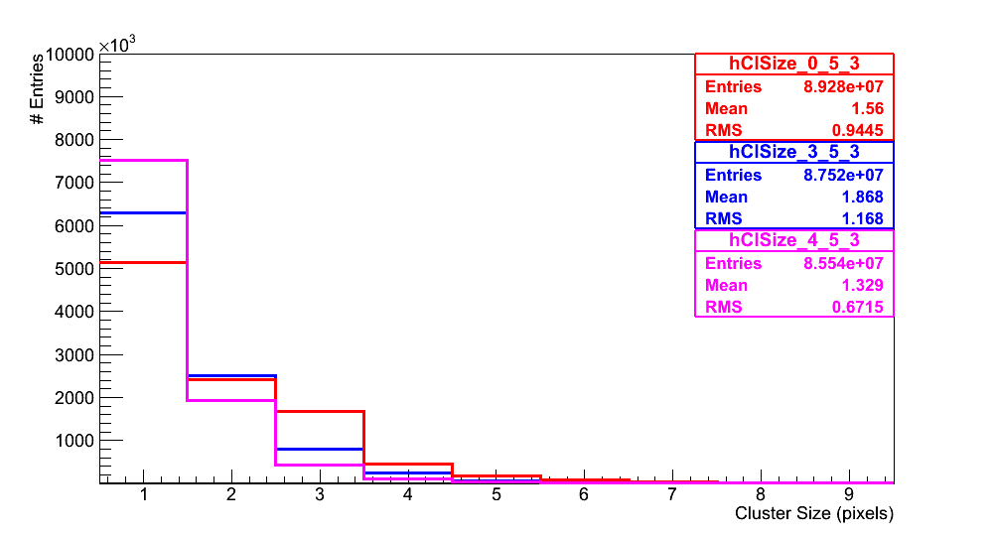
Cluster analysis
Seagull plot showing where charge is added to a hit
Shows that charge is spread between more clusters in standard resistivity sensors
Looking at the size of clusters (lower plot) charge is also more often in larger clusters

Slide 14
Future Plans
Cherwell 2 has been designed for possible use in ALICE
Chip is now being fabricated (paid for by CERN)
    One of three designs for the ALICE upgrade
    Due back in 2 months
Plans to test DECAL at DESY test beam in June

Slide 15
Summary
Cherwell sensor is performing well
A range of tests have been performed to compare different sensor types. And understand their performance.
Test beam results are being understood.

