Slide 1
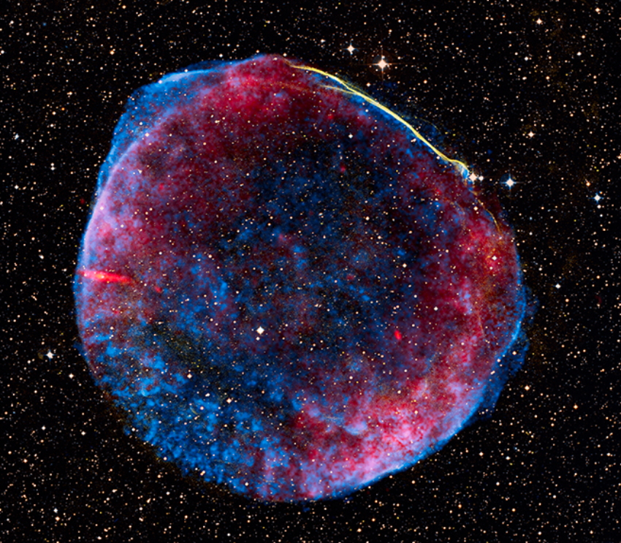
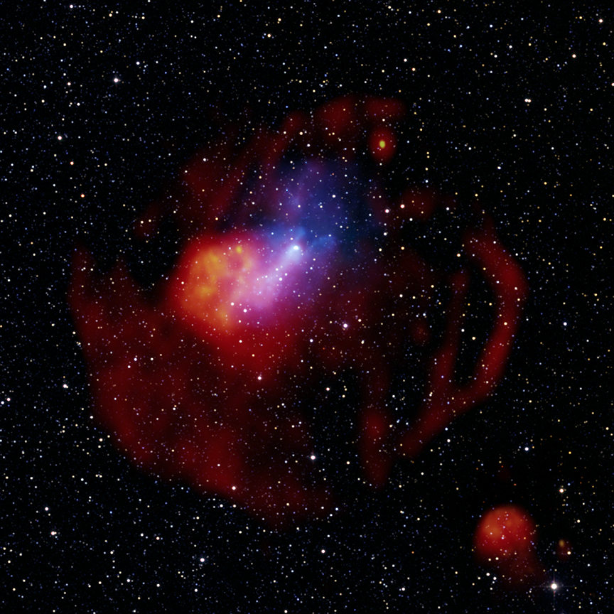
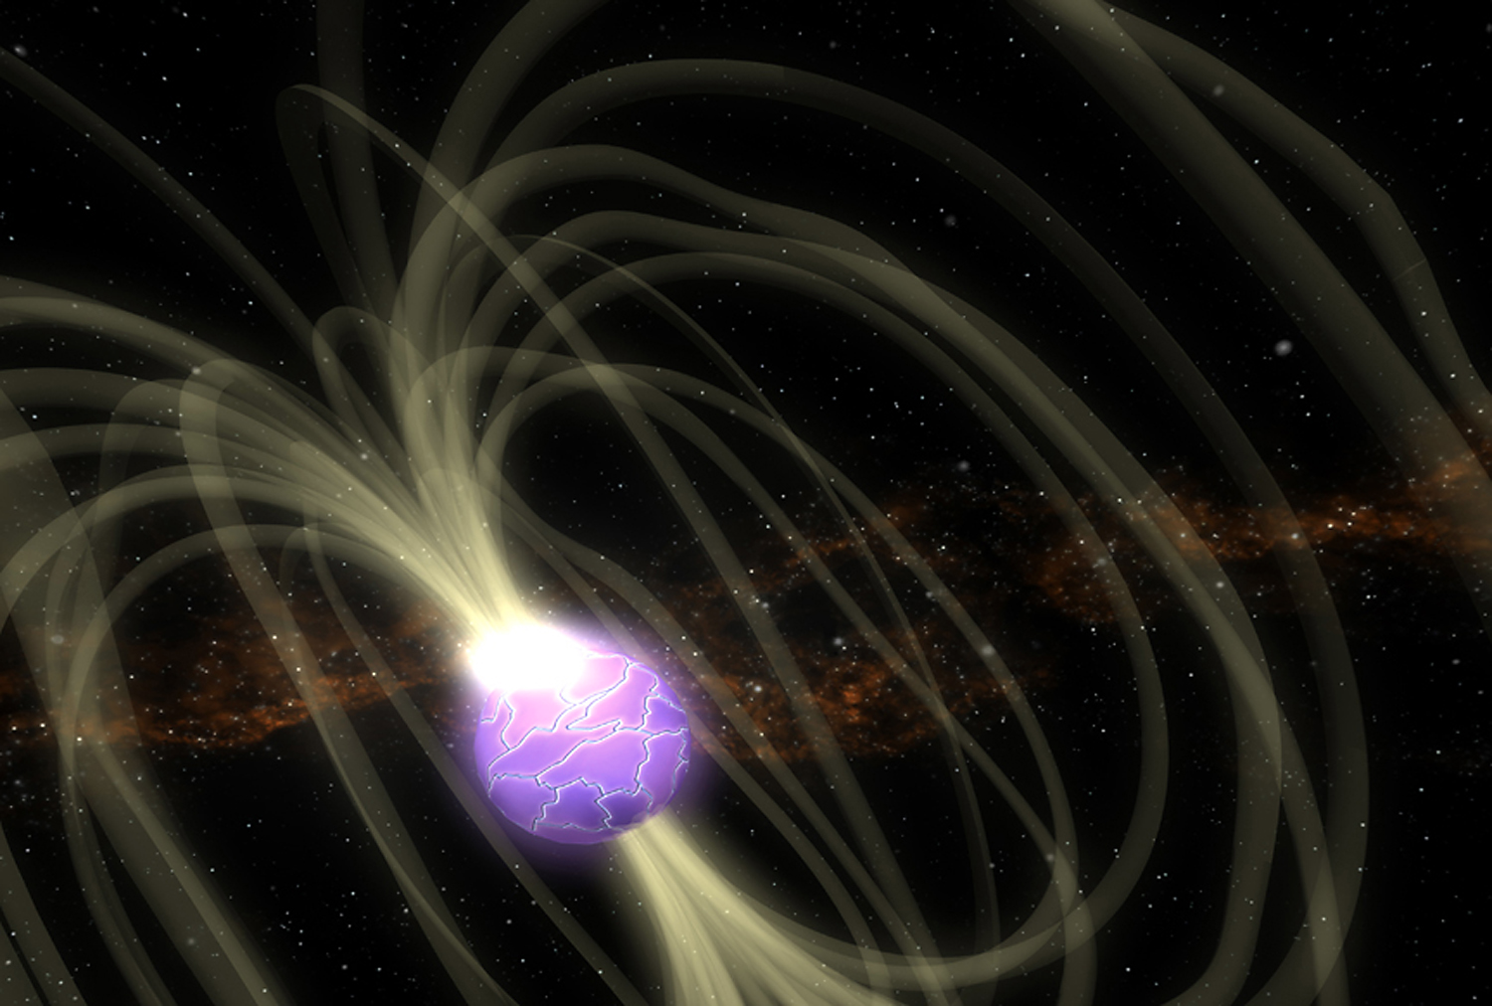
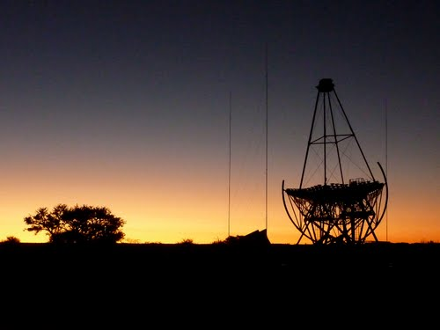
Extreme Galactic Particle Accelerators
The case of HESS J1640-465
Stefan Ohm (Univ. of Leicester), Peter Eger, for the H.E.S.S. Collaboration
Joint HEPP & APP meeting
Liverpool: 08-10/04/2013

Slide 2
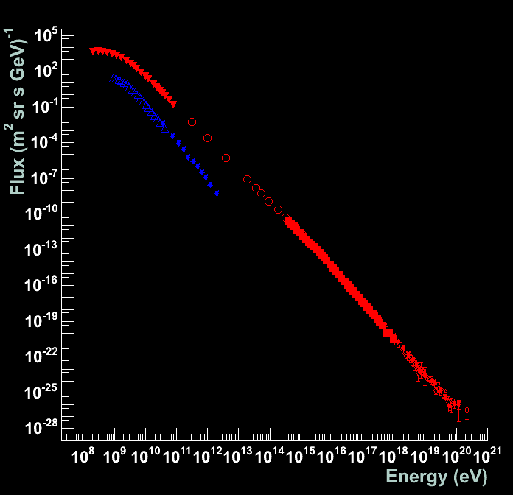
High-energy particles in space
Why are they important?
  energy density of is comparable to star light, CMB, and interstellar B-fields
  impact on star-formation process (chemistry in dense molecular clouds)
  source of ionisation in the Galaxy
  form significant contribution to the pressure in many astrophysical sources (e.g. SNRs, AGN)
Properties of cosmic rays
  spectrum follows a power law in energy
  >10 decades in energy, >30 decades in flux
  produced by acceleration of particles
  SNR shells likely acceleration site of CRs up to the “knee” (∼3 x 10¹⁵ eV!)
How can we find the accelerators?
    → Neutral messenger particles (photons and neutrinos)
Galactic
Electrons
Protons
+Nuclei
UHECRs
Notes:
of course particles are charged, get deflected in instellar magnetic fields and have hence lost directional information about their place of origin
→ need neutral messenger particles, i.e. photons or neutrinos

Slide 3
Non-Thermal Radiation
Tracers for ultra-relativistic electrons and hadrons
Energy
Flux (νF_{ν})
Stars
π⁰ decay
Dust
Synchrotron Emission
Synchrotron Emission
Optical, UV, Soft X-ray – Heavily absorbed
Optical, UV, Soft X-ray – Heavily absorbed
Inverse Compton
Scattering
Radio Infra-red X-rays γ-rays
Energy
adapted from W. Hofmann

Slide 4
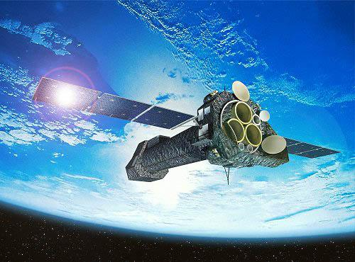
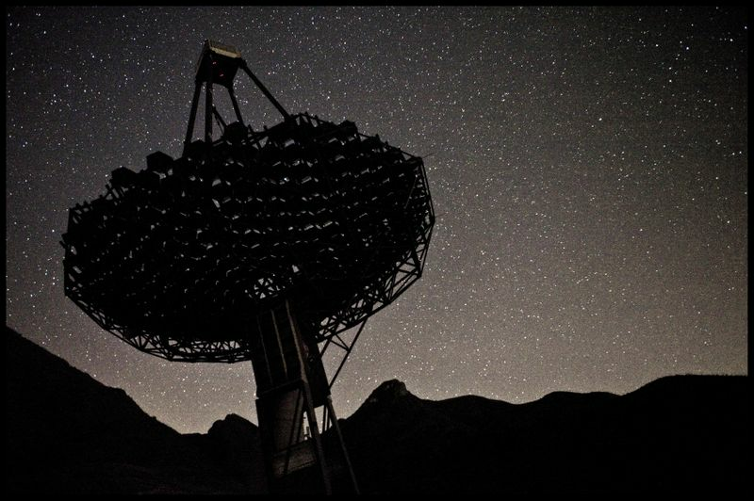
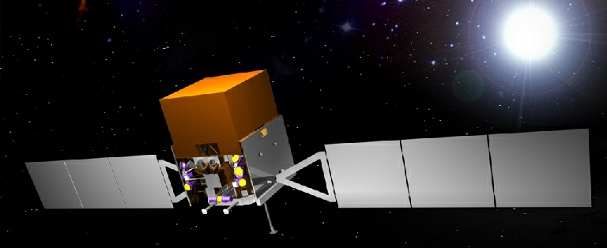
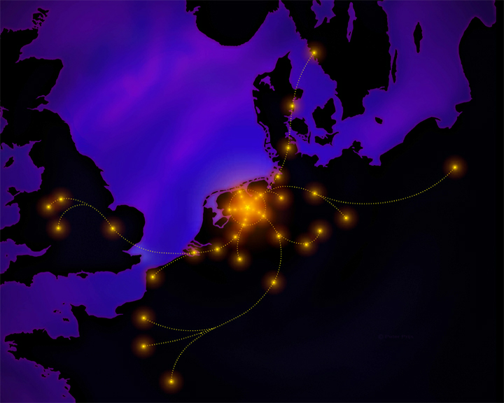
Non-Thermal ‘Windows’
Cherenkov Telescopes
Tracers for ultra-relativistic electrons and hadrons
  Non-thermal windows
    radio
    hard X-rays
    γ rays
Satellites
Energy
Flux (νF_{ν})
Stars
π⁰ decay
Dust
Synchrotron Emission
Synchrotron Emission
LOFAR
Optical, UV, Soft X-ray – Heavily absorbed
Optical, UV, Soft X-ray – Heavily absorbed
Inverse Compton
Scattering
Radio Infra-red X-rays γ-rays
Energy
adapted from W. Hofmann

Slide 5
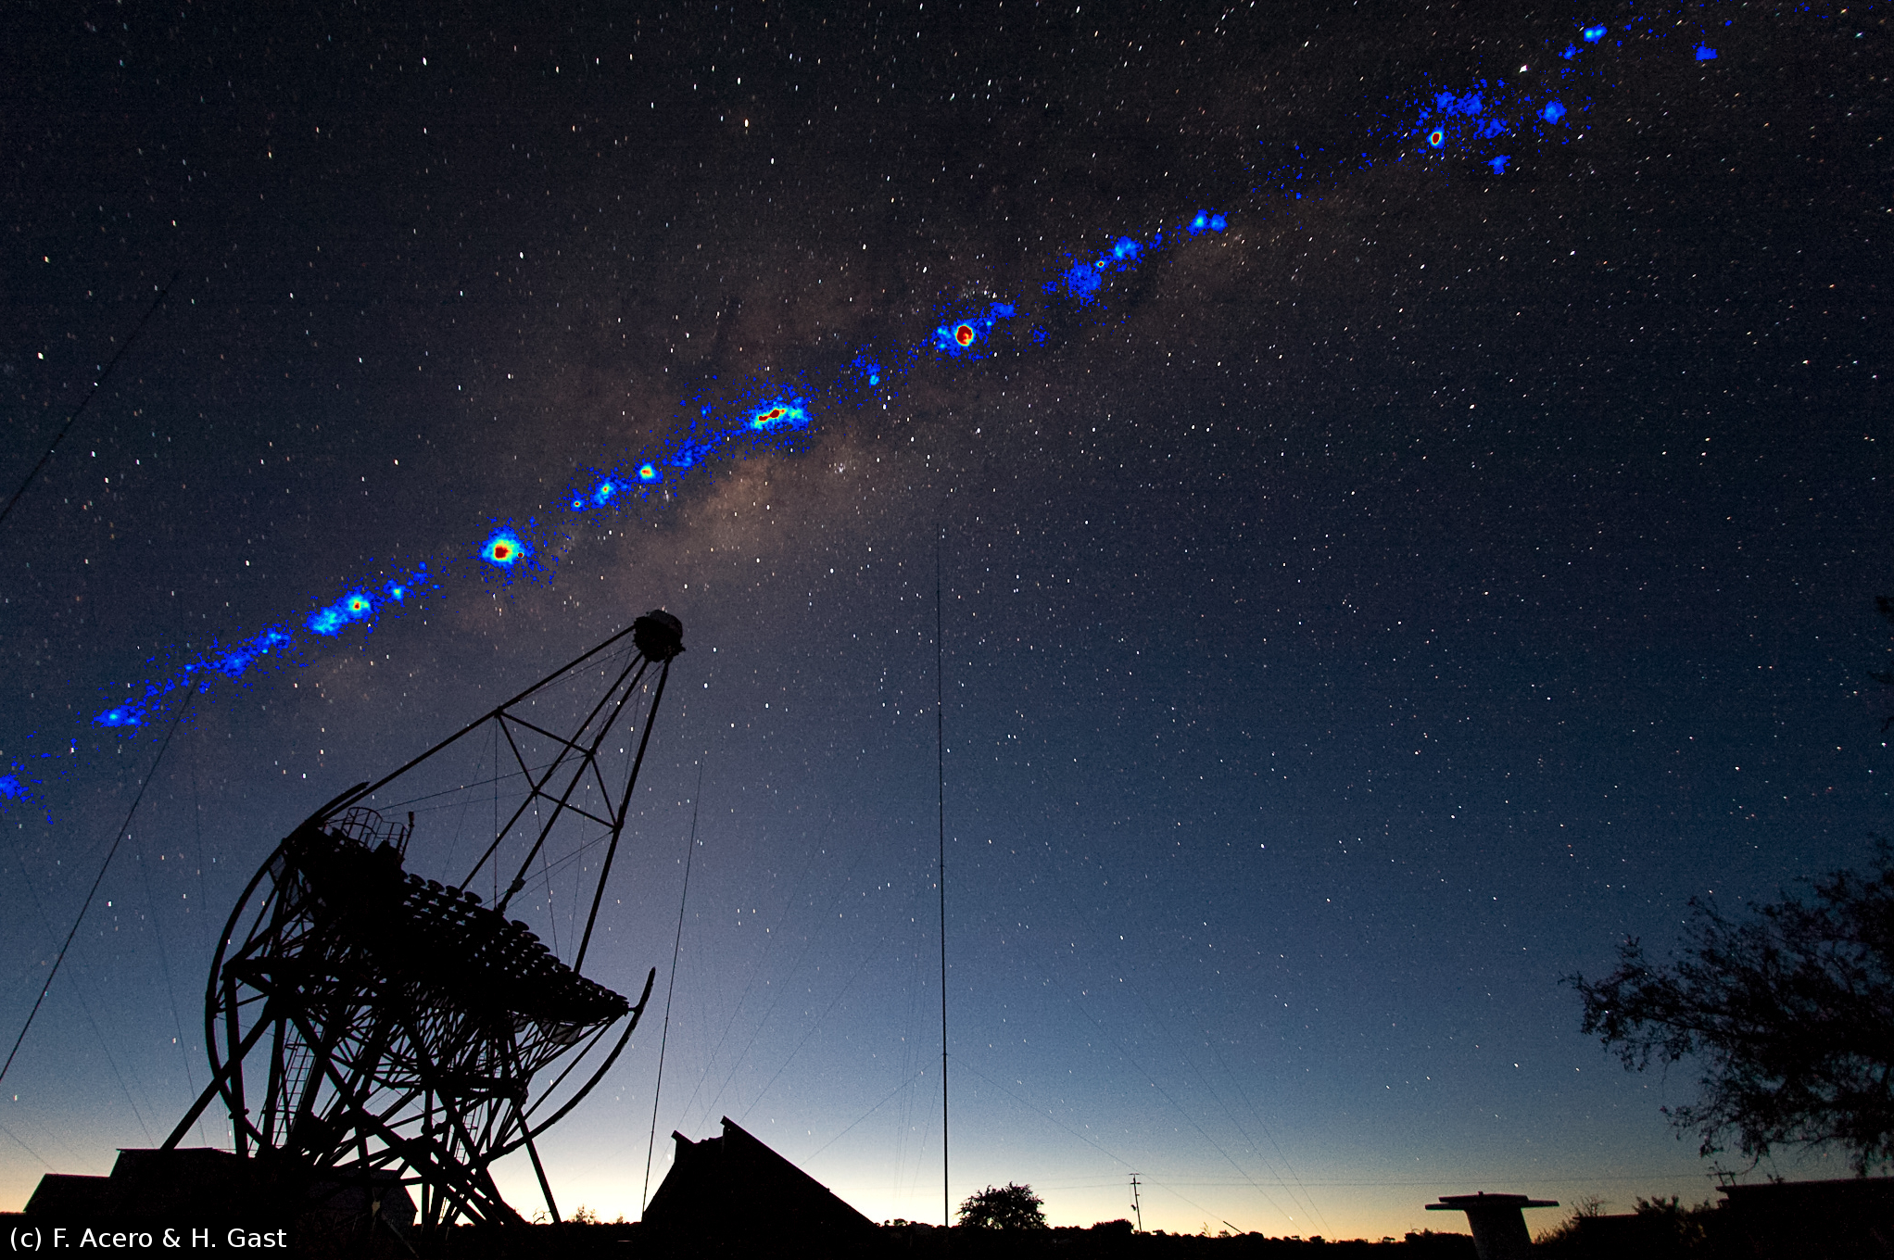

The H.E.S.S. telescope array
Key Parameters
  5 imaging atmospheric Cherenkov telescopes located in Namibia
  Energy range: ∼100 GeV - ∼50 TeV
  Angular resolution: ∼0.1º
  Energy Resolution: ∼15%
  Field-of-View: 5º
Success of H.E.S.S.
  Stereoscopic approach (γ/hadron separation, sensitivity, energy resolution, ...)
  Southern hemisphere location (see inner Galaxy)
Galactic VHE γ-ray sources
  cluster tightly along the Galactic plane
  Trace molecular gas and regions of massive star formation
  Many sources coincident with objects at late evolutionary stages:
    → Pulsar Wind Nebulae (1/4)
    → Shell-type SNRs or SNR – MC interaction regions (1/5)
    → γ-ray binaries, stellar cluster
HESS J1640-465

Slide 6
The H.E.S.S. telescope array
Key Parameters
  5 imaging atmospheric Cherenkov telescopes located in Namibia
  Energy range: ∼100 GeV - ∼50 TeV
  Angular resolution: ∼0.1º
  Energy Resolution: ∼15%
  Field-of-View: 5º
Success of H.E.S.S.
  Stereoscopic approach (γ/hadron separation, sensitivity, energy resolution, ...)
  Southern hemisphere location (see inner Galaxy)
Galactic VHE γ-ray sources
  cluster tightly along the Galactic plane
  Trace molecular gas and regions of massive star formation
  Many sources coincident with objects at late evolutionary stages:
    → Pulsar Wind Nebulae (1/4)
    → Shell-type SNRs or SNR – MC interaction regions (1/5)
    → γ-ray binaries, stellar cluster
HESS J1640-465
see Richards plenary talk for more
info on Cherenkov telescopes and
the next generation CTA

Slide 7
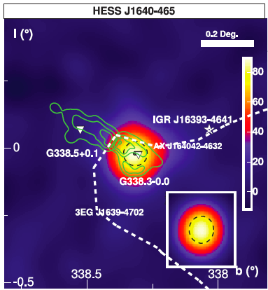
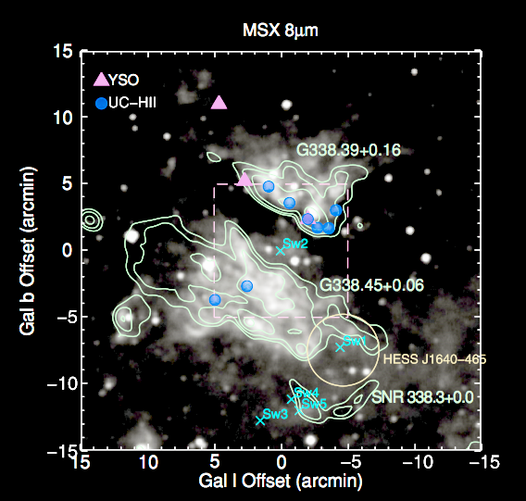
HESS J1640-465
HESS source
  discovered in Galactic Plane Scan (2005)
  rather compact, strong γ-ray emitter
  coincident with SNR G338.3-0.0
Environment
  in a very complex region (e.g. HII region and stellar cluster nearby)
  not much known about the SNR (incomplete shell, 8’ size, no spectral measurement)
  HI and X-ray absorption measurements suggest large distance of ∼10 kpc

Slide 8
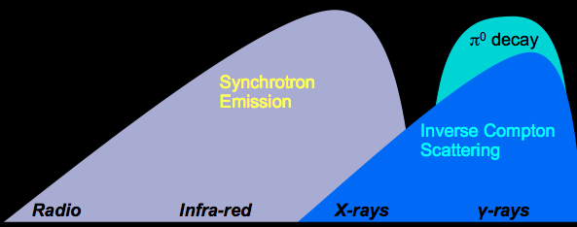
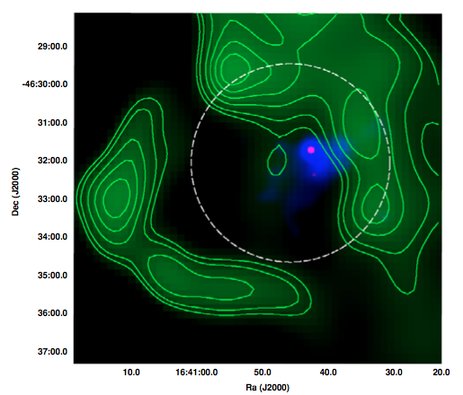
Association / X-rays
X-ray window
Swift (Landi et al. 2006)
  found point-like source
Radio (843 MHz)
X-rays
XMM (Funk et al. 2007)
  nothing spectacular in the low energy map
  2 keV – 10 keV maps shows significantly extended source
Chandra (Lemiere et al. 2009)
  detect point-like object (PSR) and confirm extended PWN candidate
  also other characteristics point towards PWN origin
  → suggests central source is of non-thermal nature (PSR) and powers synchrotron nebula

Slide 9
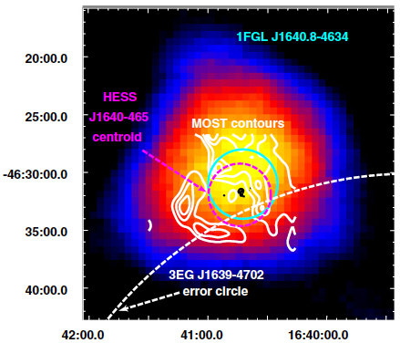
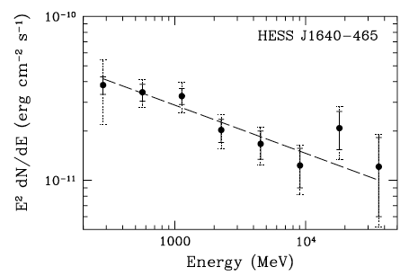
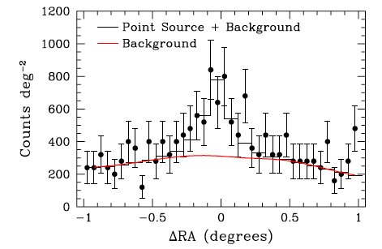
Association / GeV γ-rays
GeV γ-ray window
Slane et al. (2010)
  15 months of data acquired with Fermi satellite
  position consistent with HESS
  no extension detected
  reconstructed spectrum between 200 MeV – 50 GeV
  connects with TeV spectrum
  → Also interpreted in PWN scenario

Slide 10
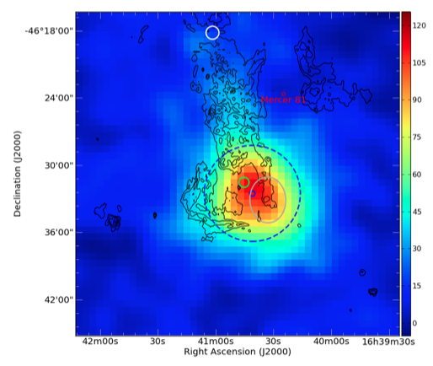
HESS J1640-465 today
TeV γ-ray window
Data & Analysis
  much more data (14 → 83 hr)
  improved analysis techniques
  γ-ray excess: 330 → 1850
Position & Extension
  significantly extended emission: σGauss = 4.3’ ± 0.3’
  extended towards HII region
  suggestive of asymmetry along northern SNR shell (2σ effect)
  within HESS extension PWN and northern SNR shell
HESS γ-ray excess + 610 MHz radio contours
other HESS source
Preliminary
PWN (XMM)
Fermi
HESS position/extension

Slide 11
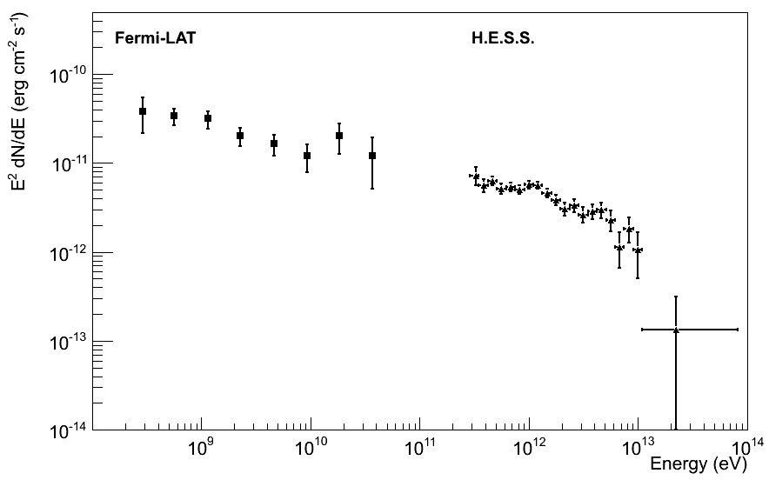
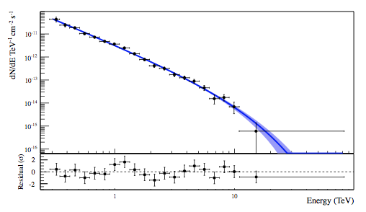
HESS J1640-465 today
GeV + TeV
Spectrum
  nicely connects with Fermi spectrum at lower energies
  fit of exponential cut-off power law gives to TeV:
    Γ = 2.15 ± 0.1
    E_{c} = (7.3 ± 2.0) TeV
  pure power law cannot be ruled out (1% probability)
  spectral points up to 10 TeV
Preliminary
HESS γ-ray excess + 610 MHz radio contours
1 GeV
1 TeV
What is the source of the TeV γ-ray emission?
  SNR or PWN?
  investigate spectral and morphological characteristics

Slide 12
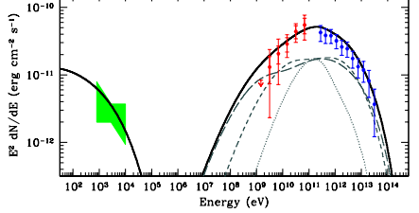
What is the source of γ-rays?
X-rays + GeV + TeV
Pulsar Wind Nebula
  quite common source of very-high-energy γ-rays
  spatial coincidence of GeV and TeV source with PWN candidate in X-rays
What you would expect:
  Inverse Compton + synchrotron emission
  peak between Fermi and HESS range
  very hard Fermi spectrum
SED of HESS J1825-134

Slide 13
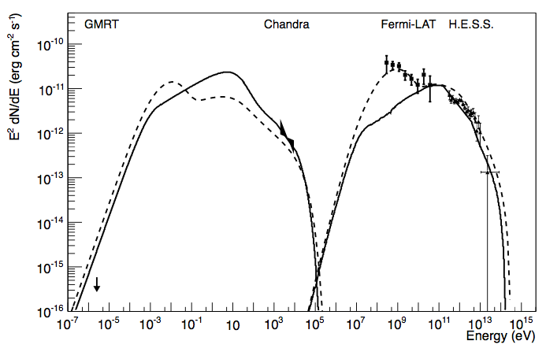
PWN scenario
full SED
Pros
  quite common source of very-high-energy γ-rays
  spatial coincidence of GeV and TeV source with PWN candidate in X-rays, but...
Cons
  smooth γ-ray spectrum (not seen in any other PWN)
  TeV source more extended than SNR (not seen in any other PWN)
  no radio emission seen from PWN, upper limit factor ∼5 below models
  → GeV very hard to explain as from PWN
  → fine-tuning required to match GeV and TeV
Slane
Lemiere
Preliminary
Spectrum looks like other prominent GeV and TeV-detected SNRs

Slide 14
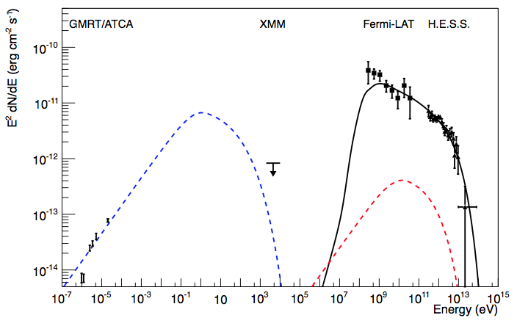
SNR scenario
full SED
Pro SNR
  New radio measurements (Castelletti et al., 2011) show non-thermal radio emission from shell
  Re-analysis of XMM data didn’t show non-thermal X-ray emission from shell
  Fermi-LAT position and HESS extension compatible with protons interacting with gaseous material that produce γ-rays
  Simple model can explain the SED without any fine-tuning:
  B = 25μG, E_{c,e} = 10 TeV,
  Γ_{e} = 2.0, e/p ratio of 1/100
  → Inverse Compton emission orders of magnitude below measurements
  E_{c,p} = 50 TeV, Γ_{p} = 2.2,
  n_{H} = 150 cm⁻³
  W_{p} = 2.5 x 10⁵⁰ erg
Preliminary

Slide 15
HESS J1640-465 an extreme accelerator
Implications
  Product of energy in protons and target density of 4 x 10⁵² erg cm⁻³ is required to explain observed luminosity
  need high densities to reduce energy in relativistic protons (could be up to 350 cm⁻³)
  such dense gas has not been found yet
Preliminary

Slide 16
HESS J1640-465 an extreme accelerator
Implications
  Product of energy in protons and target density of 4 x 10⁵² erg cm⁻³ is required to explain observed luminosity
  need high densities to reduce energy in relativistic protons (could be up to 350 cm⁻³)
  such dense gas has not been found yet
Why is that extreme?
  Canonical SN has E_{kin} = 10⁵¹ erg, and E_{kin} → E_{CR} = 10%
  these particles interact and produce γ-rays.
  for density of ∼100 cm⁻³ and canonical 10% in CRs:
  → E_{SN} could be ∼4 x 10⁵¹ erg
  → Acceleration efficiency could be up to 40%
  Extreme implies
  very efficient accelerator and/or very energetic supernova
  potentially higher, as only part of SN shell interacts with dense material
  brightest SN in TeV γ-rays (factor 10), as bright as other SNe in GeV γ-rays

Slide 17
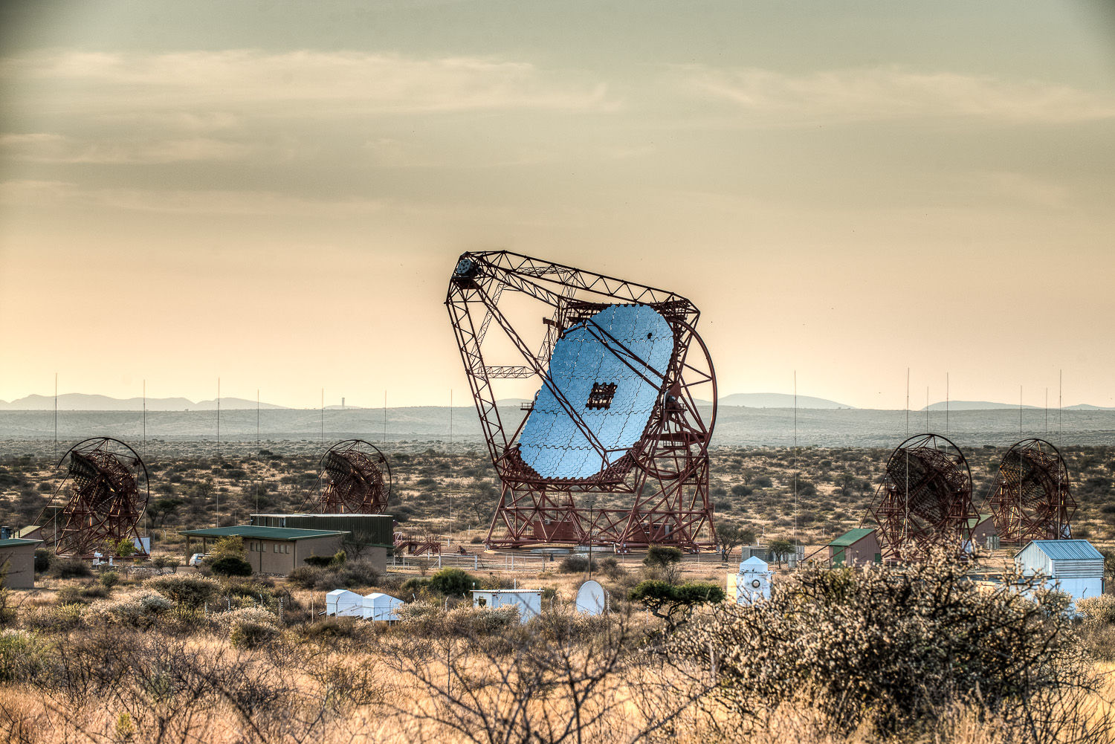
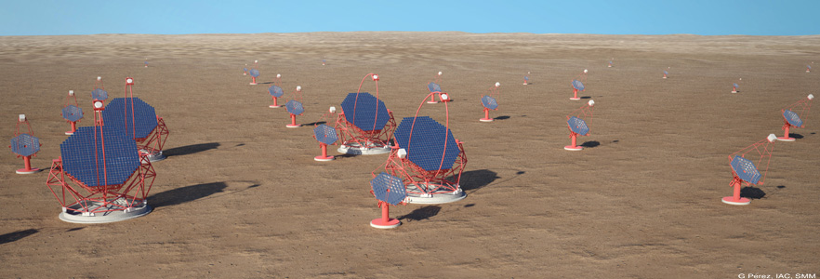
The future
HESS J1640-465
  Need better PSF and sensitivity to disentangle PWN from SNR shell and maybe even resolve the shell
  Need spectral coverage to detect photons of 100 TeV energies (→Pevatrons)
How to do that?
  HESS 2 (600 m² telescope) will deliver some of that
  CTA will be the next big thing → see Richard’s talk after the coffee break!
H.E.S.S. 2 (2012)
CTA (2016 – 2020)

