Slide 1
Protons in High Density Neutron Matter
Misak Sargsian
Florida International University, Miami
The Modern Physics of Compact Stars and Relativistic Gravity
18-21, 2013 Yerevan

Slide 2
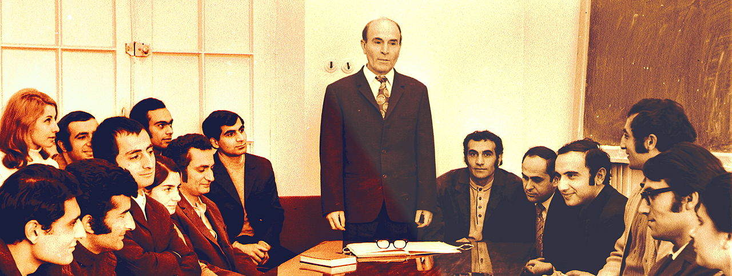
Sahakyan Constellation

Slide 3
Two New Properties of High Momentum
Component of Momentum Distributions
in Asymmetric Nuclei
MS,arXiv:1210.3280
Phys. Rev. C
Protons are more Energetic in
Neutron Rich High Density Nuclear Matter
M. McGauley, MS
arXiv:1102.3973
-Universal Property of Asymmetric
Two Component Fermi Systems

Slide 4
Nuclear Forces at Short Distances
- Theory:
QCD – hadron transition
Relativistic Bound State Problem
- Phenomenology
High Energy Nuclear Processes
- Experimentation
JLab, BNL, FAIR, JPARC

Slide 5
- Dominance of pn short range correlations
as compared to pp and nn SRCS
2006-2008s
Dominance of NN Tensor as compared
to the NN Central Forces at <= 1fm
- Two New Properties of High Momentum
Component
- Energetic Protons in Neutron Rich Nuclei
EMC-SRC - correlation
Implications
Neutrino-Nuclei Interactions: NuTeV anomaly
Protons in the Neutron Stars

Slide 6
Short-Range NN Correlations in Nuclei
-- Dominance of NN Correlations in the nuclear wave function
(Lippmann-Schwinger Equation)

Slide 7
-- The same is true for relativistic equations as:
Bethe-Salpeter or Weinberg Light Cone Equations
-- From
follows
Frankfurt, Strikman Phys. Rep, 1988
Day,Frankfurt, Strikman, MS, Phys. Rev. C 1993
- Experimental observations
Egiyan et al, 2002,2006
Fomin et al, 2011
- Isospin composition ?

Slide 8
p+A → pp (90⁰ cm)+ n + X at BNL
proton
proton
proton
Carbon
neutron
BNL Experiment

Slide 9
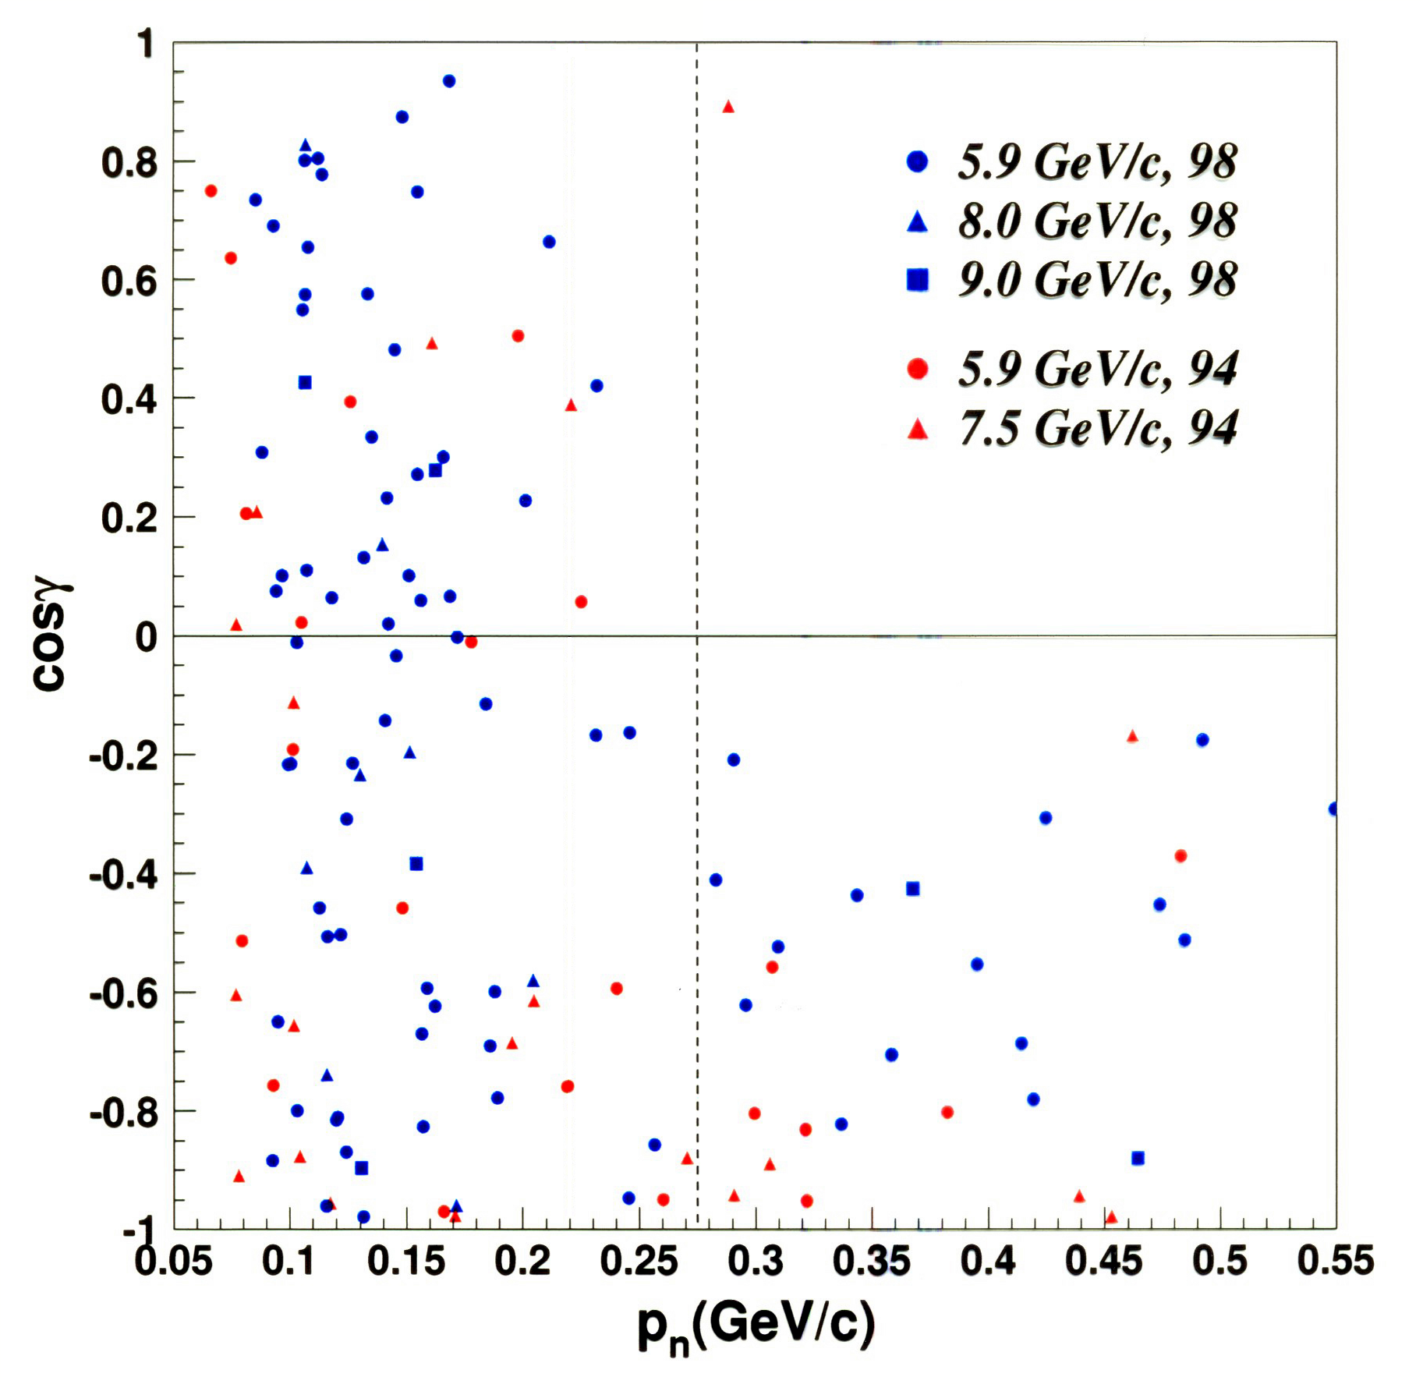
A. Tang et al, PRL 2003

Slide 10




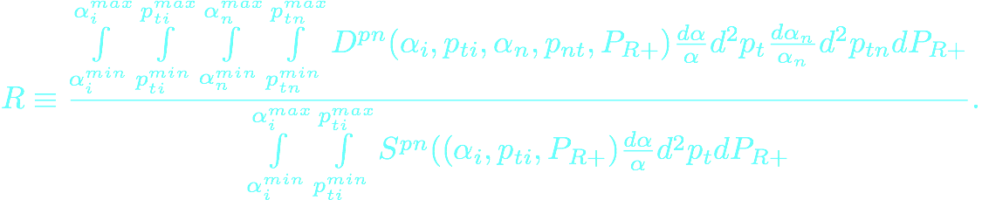
Brookhaven Experiment
A. Tang et al, PRL 2003
Theoretical Analysis
Piasetzky, MS, Frankfurt,
Strikman, Watson PRL 2007
relative probability of finding pn SRC in the “pX” configuration that contains a proton with

Slide 11


Expected: (Wigner counting)
pn = 2/3, pp = 1/3
92% of the time two-nucleon correlations are proton and neutron
at most 4% of the time proton-proton or neutron-neutron

Slide 12
p+A → pp (90⁰ cm)+ n + X at BNL
proton
Carbon
neutron rate 92%
calculated upper limit of proton rate 4%

Slide 13


Jeferson Lab Experiment
electron
R. Shneor et al. PRL 07
electron
proton
Carbon
neutron/proton
e + A → e’ + p (> GeV)+ n/p (300-600MeV) + X

Slide 14
R.Shneor, et al PRL , 2007

Slide 15
Combined Analysis
R.Subdei, et al Science , 2008
pn
pn
pp

Slide 16
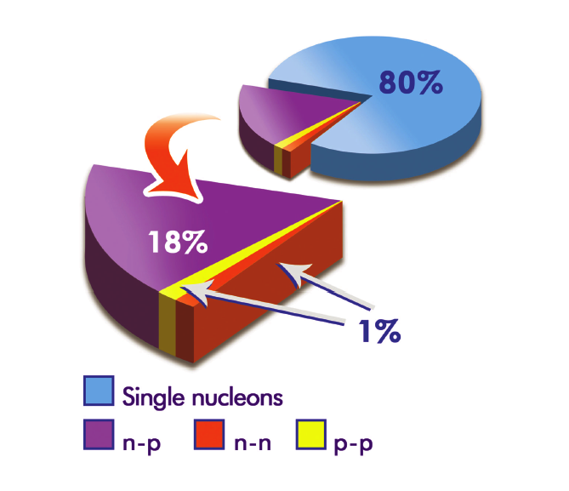
Combined Analysis
R.Subdei, et al Science , 2008

Slide 17

BNL data on A(p,2pn)X
Piasetzky, MS, Frankfurt,
Strikman, Watson PRL 2007
JLAB data A(e,e’pn)X
R. Shneor et al. PRL 07
short range correlations in the range of 250-600 MeV/c are pn SRCs

Slide 18
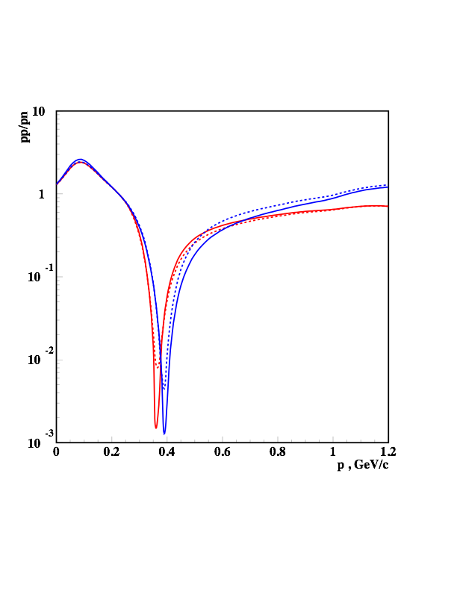
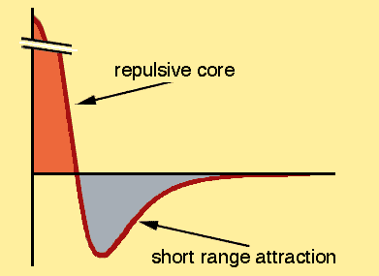
Explanation lies in the dominance of the tensor part in the NN
interaction
Isospin 1 states
M.S, Abrahamyan, Frankfurt,Strikman PRC,2005
Isospin 0 states

Slide 19
Explanation lies in the dominance of the tensor part in the NN
interaction
Isospin 1 states
Sciavilla, Wiringa, Pieper, Carlson PRL,2007
Isospin 0 states

Slide 20
New Properties of High Momentum Component
-- Dominance of NN Correlations in the nuclear wave function

Slide 21
-- From
follows
(1)
-- Dominance of pn Correlations
(neglecting pp and nn SRCs)
(2)

Slide 22
- Define momentum distribution of proton & neutron
(3)
- Now define
- and observe that in the limit of no pp and nn SRCs
- Neglecting CM motion of SRCs

Slide 23
First Property: Approximate Scaling Relation
-if contributions by pp and nn SRCs are neglected and
the pn SRC is assumed at rest

Slide 24
Realistic 3He Wave Function: Faddeev Equation
MS,arXiv:1210.3280

Slide 25
Realistic 3He Wave Function: Correlated Gaussian Basis
T.Neff & W. Horiuchi
April 2013

Slide 26
Be9 Variational Monte Carlo Calculation:
Robert Wiringa
http://www.phy.anl.gov/theory/research/momenta/
Tanks to S. Pastore

Slide 27
Be10 Variational Monte Carlo Calculation:
Robert Wiringa

Slide 28
Second Property:
Using Definition:
Approximations:
One Obtains

Slide 29
Second Property: Fractional Dependence of
High Momentum Component
with
In the limit
Momentum distributions of p & n are inverse
proportional to their fractions

Slide 30
Observations: High Momentum Fractions
A Pp(%) Pn(%)
12 20 20
27 23 22
56 27 23
197 31 20

Slide 31
Observations: High Momentum Fractions
Checking for He3
Energetic Neutron
(Neff & Horiuchi)
Energetic Neutron

Slide 32
VMC Estimates: Robert Wiringa

Slide 33
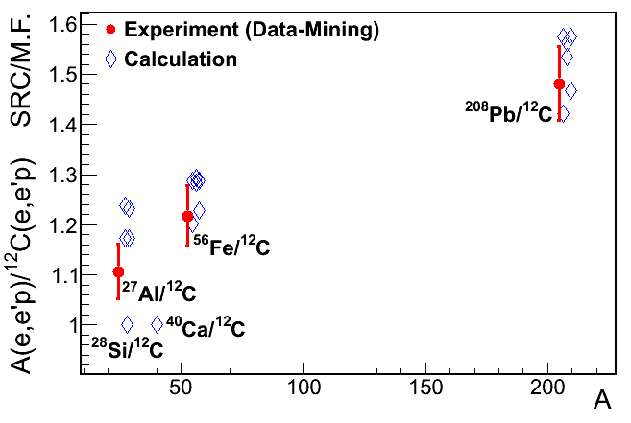
Implications: Protons are more energetic in neutron
rich matter
- Can be checked in A(e,e’p) Reactions
(Or Hen & Eli Piasetzky preliminary)

Slide 34
Implications: Energetic Protons in neutron rich Nuclei
Implications: Protons are more modified in neutron
rich nuclei
u-quarks are more modified then
d-quarks in Large A Nuclei
- Flavor Dependence of EMC effect
- Different explanation of NuTev Anomaly
- Can be checked in neutrino-nuclei or
in pvDIS processes

Slide 35
Nuclear Medium Modifications of Hadrons (EMC Effect)
JLAB 2009: Silly et al PRL09

Slide 36
EMC-SRC Correlations
EMC
EMC
SRC

Slide 37
EMC-SRC Correlations
-Weinstein et al PRL 2011,
arxiv 2012

Slide 38
Energetic Protons in Large A Nuclei
- EMC Effect
Color Screening Model: Frankfrut Strikman 1987

Slide 39
- EMC Effect

Slide 40
- EMC Effect (preliminary)

Slide 41
- NuTev Experiment : Measuring Weinberg Angle

Slide 42
- NuTev Experiment : Measuring Weinberg Angle

Slide 43
- NuTev Anomaly
NuTeV Experiment: Zeller et al PRL 2002
- Standard model:

Slide 44
Anomaly's explanation: Bentz,Cloet,Londergan,Thomas, PRL09, 2011

Slide 45
Anomaly's explanation: Bentz,Cloet,Londergan,Thomas, PRL09, 2011

Slide 46
Anomaly's explanation: Our explanation

Slide 47
- EMC Effect in A(e,e’)X scattering
Color Screening Model: Frankfrut Strikman 1987

Slide 48
- EMC Effect

Slide 49
Anomaly's explanation: Our explanation
Preliminary

Slide 50
Implications: For Nuclear Matter

Slide 51
Implications: For Nuclear Matter
Our Goal

Slide 52
,
,
(1)
Parametric Form
(2)
For
we analyze data for symmetric nuclei
and for other A’s use the relation
where
(3)
Neglecting contributions due to pp and nn SRCs one obtains boundary conditions
M. McGauley, MS Feb. 2011
arxiv 1102.3973

Slide 53
Implications: For Nuclear Matter

Slide 54
Implications: For Nuclear Matter
- 6 data points
- 2 boundary conditions due
to the neglecting pp/nn
SRCs
-2 more boundary conditions
due to
-1 more positivness of f(y)

Slide 55
Extrapolation to infinite and superdense nuclear matter
with
C.Ciofi degli Atti, E. Pace, G.Salme, PRC 1991

Slide 56
Asymmetric and superdense nuclear matter:

Slide 57
Implications: For Nuclear Matter

Slide 59
Some Possible Implication of our Results
Cooling of Neutron Star:
Protons in the Neutron Star Cores:

Slide 60
Isospin Locking and Large Masses of Neutron Stars

Slide 61
Limitation of the Model
- pp/nn Correlations are neglected
- pn SRC is at Rest
Identical Effects on
proton and neutron
distributions?
- 3N SRCS
- non-nucleonic component of SRCs

Slide 62
Is the Observed Effect Universal for Two Component Asymmetric Fermi Systems?
- Start with Two Component Asymmetric Degenerate Fermi Gas
- Asymmetric:
- Switch on the short-range interaction between two-component
- While interaction between each components is weak
- Spectrum of the small component gas will strongly deform
Cold Atoms
Finite T Nuclear Gas
A. Rios, A. Polls and W. H. Dickhoff,
Depletion of Nuclear Fermi Gas
Phys. Rev. C 79, 064308 (2009).
Trapped 2 component gas
diffusion

Slide 63
Is the Observed Effect Universal to Two Component Asymetric Fermi Systems?
n
p

Slide 64
Is the Observed Effect Universal to Two Component Asymetric Fermi Systems?
A.Rios, A. Polls and W. H. Dickhoff,
PRC 79, 064308 (2009).
Private Communication

Slide 65
Is the Observed Effect Universal to Two Component Asymetric Fermi Systems?
A.Rios, A. Polls and W. H. Dickhoff,
PRC 79, 064308 (2009).

Slide 66
Conclusions and Outlook
- We observe two new properties of high momentum
distribution of proton and neutron in nuclei
Predicting more energetic/virtual protons in neutron
reach matter
May have strong implication for protons in
neutron stars

