Slide 1
MAGNETOSONIC WAVES IN THE CRUST OF A NEUTRON STAR
D. M. Sedrakian, A. S. Harutyunyan, and M. V. Hayrapetyan
The equations of magnetohydrodynamics are used to show that the energy released at the inner surface of the crust of a neutron star generates magnetosonic wave beams that propagate to the star’s surface. These equations can be linearized under the conditions of matter in the crust of neutron stars and for frequencies 10^7≤ ω≤10^11Hz. The solution has a form of the standing wave beam with a constant radius. The outer base of this beam on the star’s surface is a source of radio emission. Electrical currents are excited in this source and it becomes an antenna that emits radio waves into the circumstellar space. The intensity of the radio emission decreases at higher frequencies, so that the spectrum of pulsars is bounded above (ω ≤ 10^11Hz ).

Slide 2
Asymmetric release of energy at the boundary of the superfluid core of a neutron star
Sedrakian D. M.; Sedrakian, A. D. Sov. Phys. - JETP, Vol. 73, No. 2, p. 193 – 197, 1991
Sedrakian, D. M.; Hayrapetyan, M. V. Astrophysics, Volume 55, Issue 3, pp.377-386, 2012
Vortex structure of the superfluid core of a neutron star is consederd, taking into account the residual (RP), generated poloidal (GP) and toroidal (TP) magnetic fields. The motion of the vortex structure to the boundary of the core and the crust during the spin-down of a star leads to the formation of two local “magnetic caps”, where the magnetic field increases with time and reaches the value of second critical field. It is shown that the intensity of energy output in the “magnetic caps” due to the collapse of the magnetic field is of the order of the pulsars‘ radioluminosity.

Slide 3
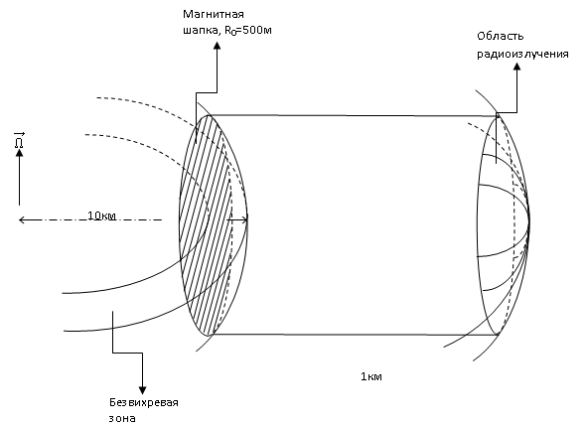
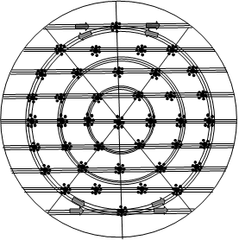
Asymmetric release of energy at the boundary of the superfluid core of a neutron star

Slide 4
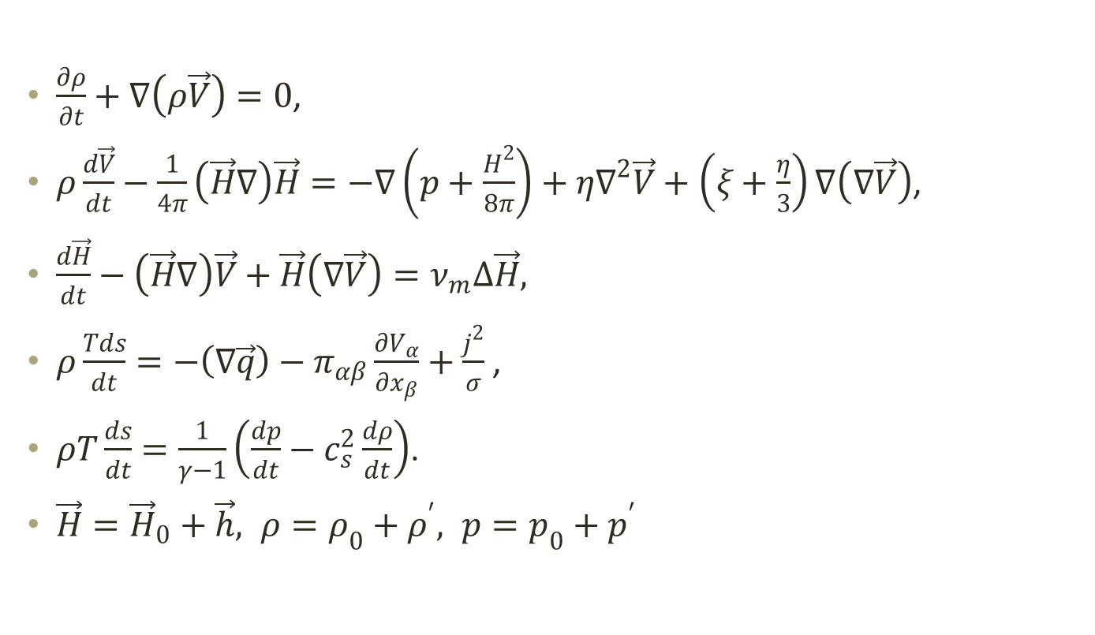
MHD Equations
$\frac{∂ρ}{∂t}+∇\left(ρ\vec{V}\right)=0$,
$ρ\frac{d\vec{V}}{dt}−\frac{1}{4π}\left(\vec{H}∇\right)\vec{H}=−∇\left(p+\frac{H^{2}}{8π}\right)+η∇^{2}\vec{V}+\left(ξ+\frac{η}{3}\right)∇\left(∇\vec{V}\right)$,
$\frac{d\vec{H}}{dt}−\left(\vec{H}∇\right)\vec{V}+\vec{H}\left(∇\vec{V}\right)=ν_{m}∆\vec{H},$
$ρ\frac{Tds}{dt}=−\left(∇\vec{q}\right)−π_{αβ}\frac{∂V_{α}}{∂x_{β}}+\frac{j^{2}}{σ}$ ,
$ρT\frac{ds}{dt}=\frac{1}{γ−1}\left(\frac{dp}{dt}−c_{s}^{2}\frac{dρ}{dt}\right)$.
$\vec{H}={\vec{H}}_{0}+\vec{h}, ρ=ρ_{0}+ρ^{′}, p=p_{0}+p^{′}$

Slide 5
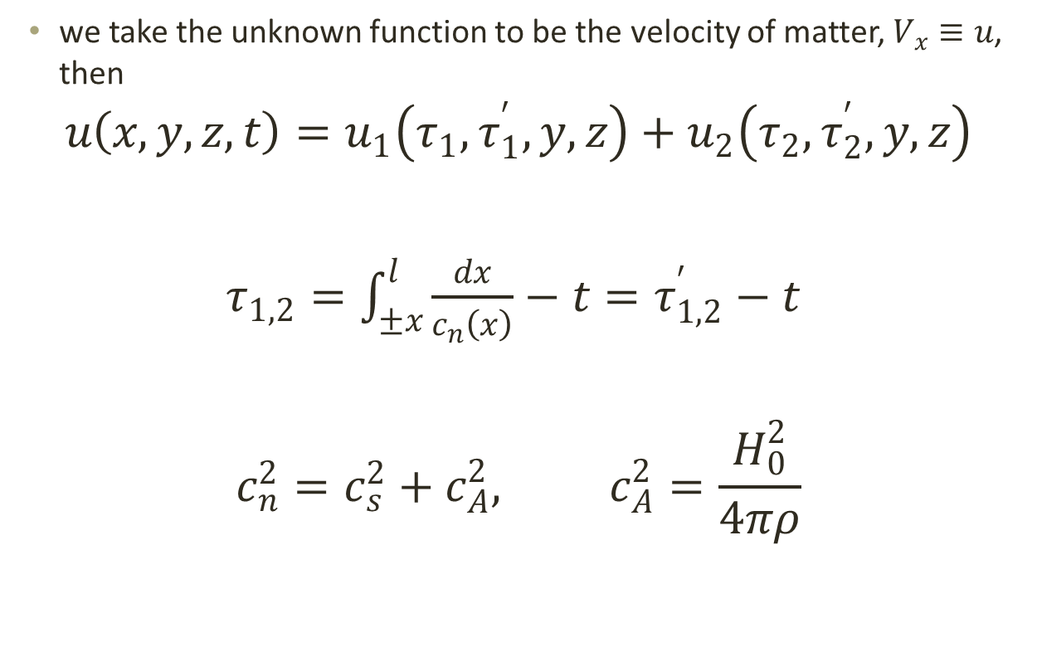
A wave beam in the crust of a neutron star
we take the unknown function to be the velocity of matter, $V_{x}≡u$, then
$$u\left(x,y,z,t\right)=u_{1}\left(τ_{1},τ_{1}^{′},y,z\right)+u_{2}\left(τ_{2},τ_{2}^{′},y,z\right)$$
$τ_{1,2}=\int_{±x}^{l}{\frac{dx}{c_{n}\left(x\right)}}−t=τ_{1,2}^{′}−t$
$$c_{n}^{2}=c_{s}^{2}+c_{A}^{2}, c_{A}^{2}=\frac{H_{0}^{2}}{4πρ}$$

Slide 6
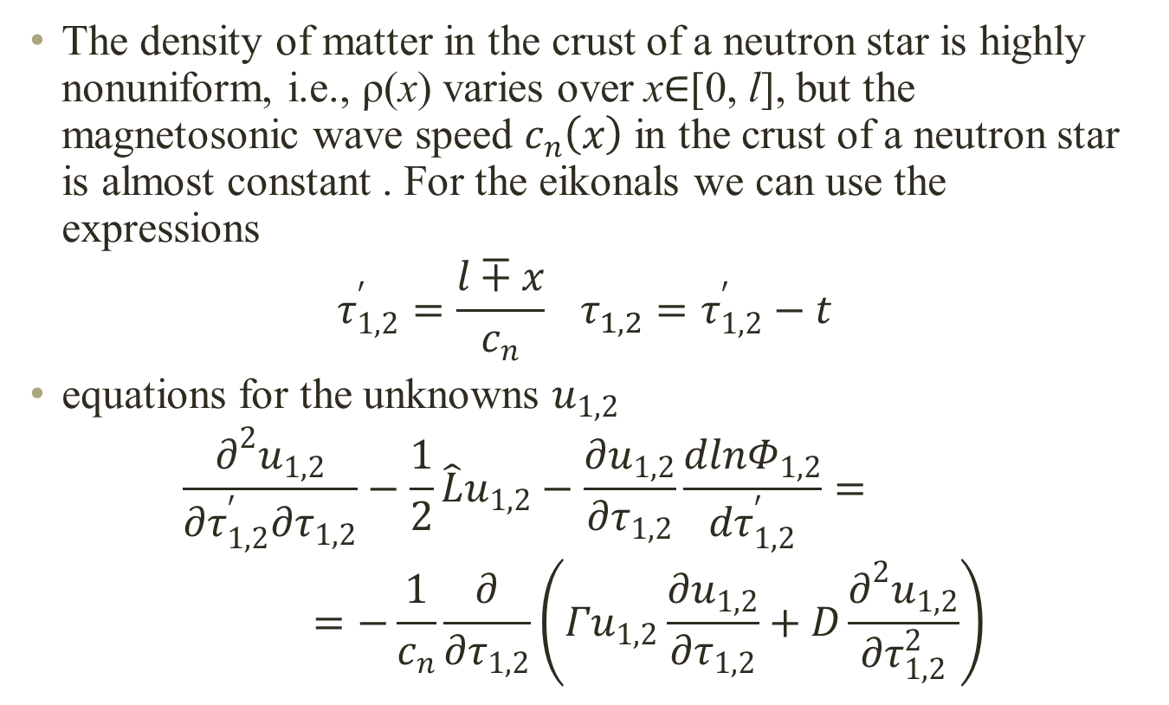
A wave beam in the crust of a neutron star
The density of matter in the crust of a neutron star is highly nonuniform, i.e., ρ(x) varies over x∈[0, l], but the magnetosonic wave speed $c_{n}\left(x\right)$ in the crust of a neutron star is almost constant . For the eikonals we can use the expressions
$$τ_{1,2}^{′}=\frac{l∓x}{c_{n}} τ_{1,2}^{}=τ_{1,2}^{′}−t$$
equations for the unknowns $u_{1,2}$
$$\frac{∂^{2}u_{1,2}}{∂τ_{1,2}^{′}∂τ_{1,2}}−\frac{1}{2}\hat{L}u_{1,2}−\frac{∂u_{1,2}}{∂τ_{1,2}}\frac{dlnΦ_{1,2}}{dτ_{1,2}^{′}}==−\frac{1}{c_{n}}\frac{∂}{∂τ_{1,2}}\left(Γu_{1,2}\frac{∂u_{1,2}}{∂τ_{1,2}}+D\frac{∂^{2}u_{1,2}}{∂τ_{1,2}^{2}}\right)$$

Slide 7
A wave beam in the crust of a neutron star

Slide 8
A wave beam in the crust of a neutron star
The perturbations in the unknown physical quantities are related to by the following equations

Slide 9
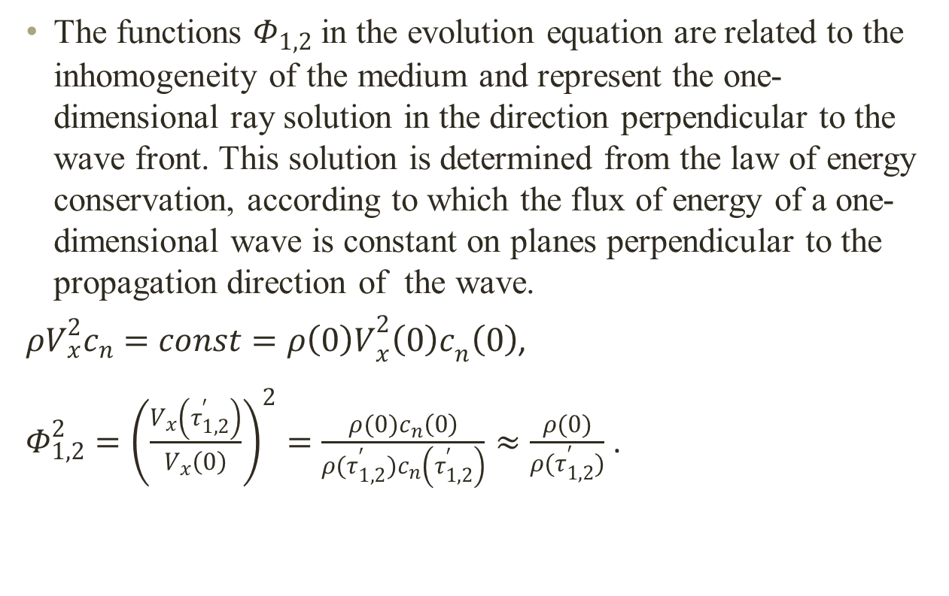
A wave beam in the crust of a neutron star
The functions $Φ_{1,2}$ in the evolution equation are related to the inhomogeneity of the medium and represent the one-dimensional ray solution in the direction perpendicular to the wave front. This solution is determined from the law of energy conservation, according to which the flux of energy of a one-dimensional wave is constant on planes perpendicular to the propagation direction of the wave.
$ρV_{x}^{2}c_{n}=const=ρ{\left(0\right)V}_{x}^{2}{\left(0\right)c}_{n}\left(0\right)$,
$Φ_{1,2}^{2}={\left(\frac{V_{x}\left(τ_{1,2}^{′}\right)}{V_{x}\left(0\right)}\right)}^{2}=\frac{ρ(0)c_{n}\left(0\right)}{ρ(τ_{1,2}^{′})c_{n}\left(τ_{1,2}^{′}\right)}≈\frac{ρ(0)}{ρ(τ_{1,2}^{′})}$ .

Slide 10
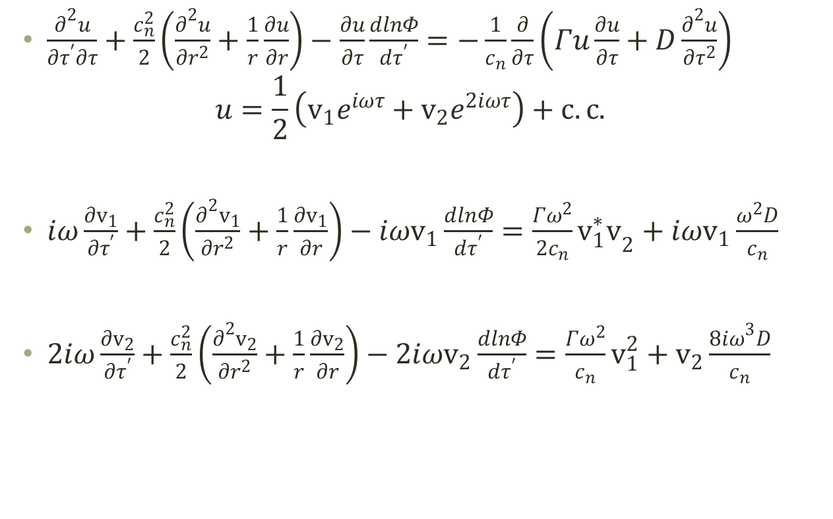
A wave beam in the crust of a neutron star
$\frac{∂^{2}u}{∂τ^{′}∂τ}+\frac{c_{n}^{2}}{2}\left(\frac{∂^{2}u}{∂r^{2}}+\frac{1}{r}\frac{∂u}{∂r}\right)−\frac{∂u}{∂τ}\frac{dlnΦ}{dτ^{′}}=−\frac{1}{c_{n}}\frac{∂}{∂τ}\left(Γu\frac{∂u}{∂τ}+D\frac{∂^{2}u}{∂τ^{2}}\right)$
$$u=\frac{1}{2}\left(v_{1}e^{iωτ}+v_{2}e^{2iωτ}\right)+c.c.$$
$iω\frac{∂v_{1}}{∂τ^{′}}+\frac{c_{n}^{2}}{2}\left(\frac{∂^{2}v_{1}}{∂r^{2}}+\frac{1}{r}\frac{∂v_{1}}{∂r}\right)−{iωv}_{1}\frac{dlnΦ}{dτ^{′}}=\frac{Γω^{2}}{2c_{n}}{v_{1}^{∗}v}_{2}+{iωv}_{1}\frac{ω^{2}D}{c_{n}}$
$2iω\frac{∂v_{2}}{∂τ^{′}}+\frac{c_{n}^{2}}{2}\left(\frac{∂^{2}v_{2}}{∂r^{2}}+\frac{1}{r}\frac{∂v_{2}}{∂r}\right)−{2iωv}_{2}\frac{dlnΦ}{dτ^{′}}=\frac{Γω^{2}}{c_{n}}v_{1}^{2}+v_{2}\frac{{8iω}^{3}D}{c_{n}}$

Slide 11
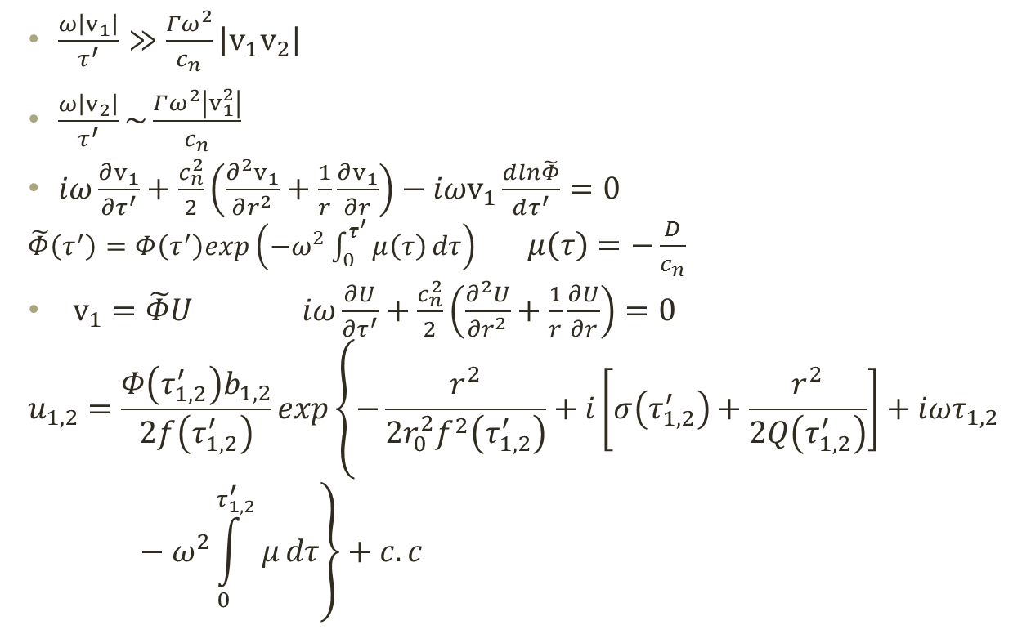


A wave beam in the crust of a neutron star
$$\left|v_{2}\right|≪\frac{c_{n}}{τ^{′}Γω}$$
$\left|\frac{v_{2}}{v_{1}}\right|\sim \frac{Γωτ^{′}}{c_{n}}\left|v_{1}\right|$
=

Slide 12
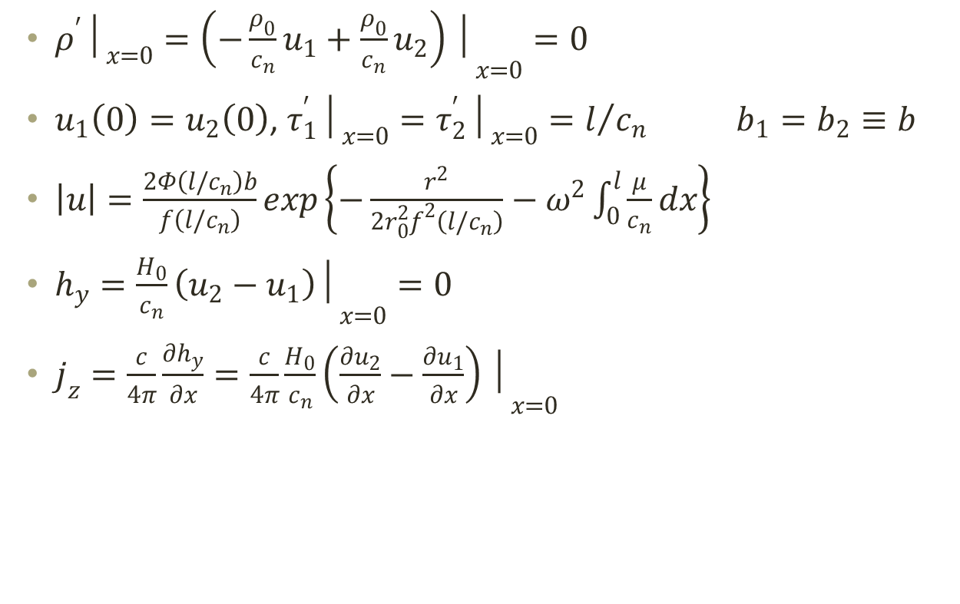
A wave beam in the crust of a neutron star
${ρ^{′}│}_{x=0}={\left(−\frac{ρ_{0}}{c_{n}}u_{1}+\frac{ρ_{0}}{c_{n}}u_{2}\right)│}_{x=0}=0$
$u_{1}\left(0\right)=u_{2}\left(0\right)$, ${τ_{1}^{′}│}_{x=0}={τ_{2}^{′}│}_{x=0}=l/{c_{n}}$ $b_{1}=b_{2}≡b$
$\left|u\right|=\frac{2Φ\left(l/c_{n}\right)b}{f\left(l/c_{n}\right)}exp\left\{−\frac{r^{2}}{2r_{0}^{2}f^{2}\left(l/c_{n}\right)}−ω^{2}\int_{0}^{l}{\frac{μ}{c_{n}}dx}\right\}$
$h_{y}={\frac{H_{0}}{c_{n}}\left(u_{2}−u_{1}\right)│}_{x=0}=0$
$j_{z}=\frac{c}{4π}\frac{∂h_{y}}{∂x}=\frac{c}{4π}{\frac{H_{0}}{c_{n}}\left(\frac{∂u_{2}}{∂x}−\frac{∂u_{1}}{∂x}\right)│}_{x=0}$

Slide 13
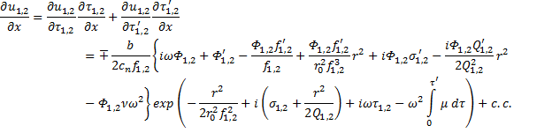
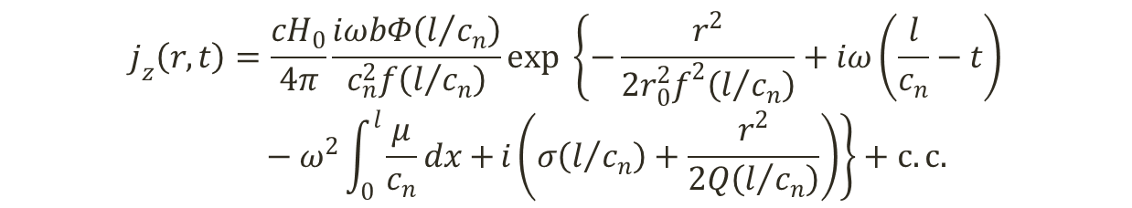
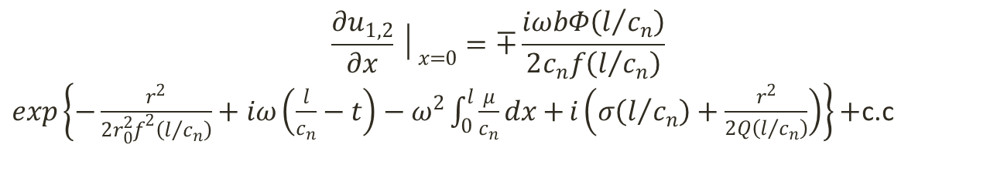
A wave beam in the crust of a neutron star
$$\frac{∂u_{1,2}}{∂x}│_{x=0}=∓\frac{iωbΦ\left(l/{c_{n}}\right)}{2c_{n}f\left(l/{c_{n}}\right)}$$
$exp\left\{−\frac{r^{2}}{2r_{0}^{2}f^{2}\left(l/{c_{n}}\right)}+iω\left(\frac{l}{c_{n}}−t\right)−ω^{2}\int_{0}^{l}{\frac{μ}{c_{n}}dx+}i\left(σ\left(l/{c_{n}}\right)+\frac{r^{2}}{2Q\left(l/{c_{n}}\right)}\right)\right\}+$c.c
$$j_{z}\left(r,t\right)=\frac{cH_{0}}{4π}\frac{iωbΦ\left(l/{c_{n}}\right)}{c_{n}^{2}f\left(l/{c_{n}}\right)}exp \left\{−\frac{r^{2}}{2r_{0}^{2}f^{2}\left(l/{c_{n}}\right)}+iω\left(\frac{l}{c_{n}}−t\right)−ω^{2}\int_{0}^{l}{\frac{μ}{c_{n}}dx+}i\left(σ\left(l/{c_{n}}\right)+\frac{r^{2}}{2Q\left(l/{c_{n}}\right)}\right)\right\}+c.c.$$
The coefficient before exponent is the main term of the exact solution

Slide 14
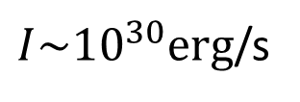
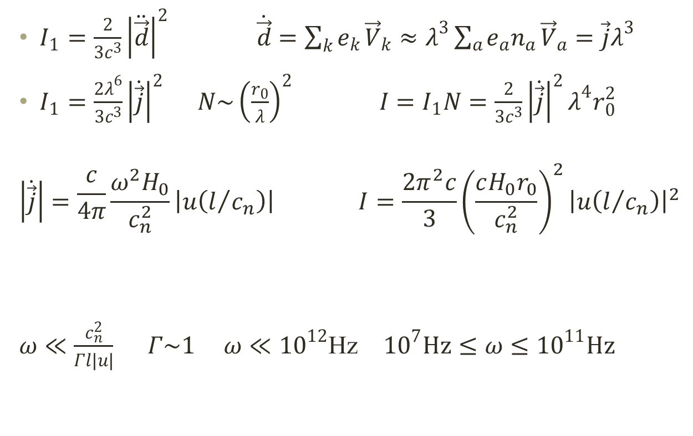
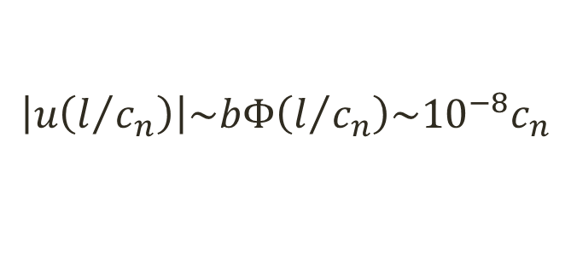
Estimating b from observations of the radioemission from pulsars
$I_{1}=\frac{2}{3c^{3}}{\left|\ddot{\vec{d}}\right|}^{2} \dot{\vec{d}}=\sum_{k}{e_{k}}{\vec{V}}_{k}≈λ^{3}\sum_{a}{e_{a}n_{a}}{\vec{V}}_{a}=\vec{j}λ^{3}$
$I_{1}=\frac{2λ^{6}}{3c^{3}}{\left|\dot{\vec{j}}\right|}^{2}$ $N\sim {\left(\frac{r_{0}}{λ}\right)}^{2}$ ${I=I}_{1}N=\frac{2}{3c^{3}}{\left|\dot{\vec{j}}\right|}^{2}λ^{4}r_{0}^{2}$
$$\left|\dot{\vec{j}}\right|=\frac{c}{4π}\frac{ω^{2}H_{0}}{c_{n}^{2}}\left|u\left(l/{c_{n}}\right)\right| I=\frac{2π^{2}c}{3}{\left(\frac{cH_{0}r_{0}}{c_{n}^{2}}\right)}^{2}{\left|u\left(l/{c_{n}}\right)\right|}^{2}$$
$ω≪\frac{c_{n}^{2}}{Γl\left|u\right|}$ $Γ\sim 1$ $ω≪{10}^{12}$Hz ${10}^{7}Hz≤ω≤{10}^{11}Hz$
$$\left|u\left(l/{c_{n}}\right)\right|\sim bΦ\left(l/{c_{n}}\right)\sim {10}^{−8}c_{n}$$
$I\sim {10}^{30}erg$/s

