Slide 1
Resonance searches at future colliders
Snowmass BSM
UC Irvine
David Adams
BNL
January 15, 2013

Slide 2
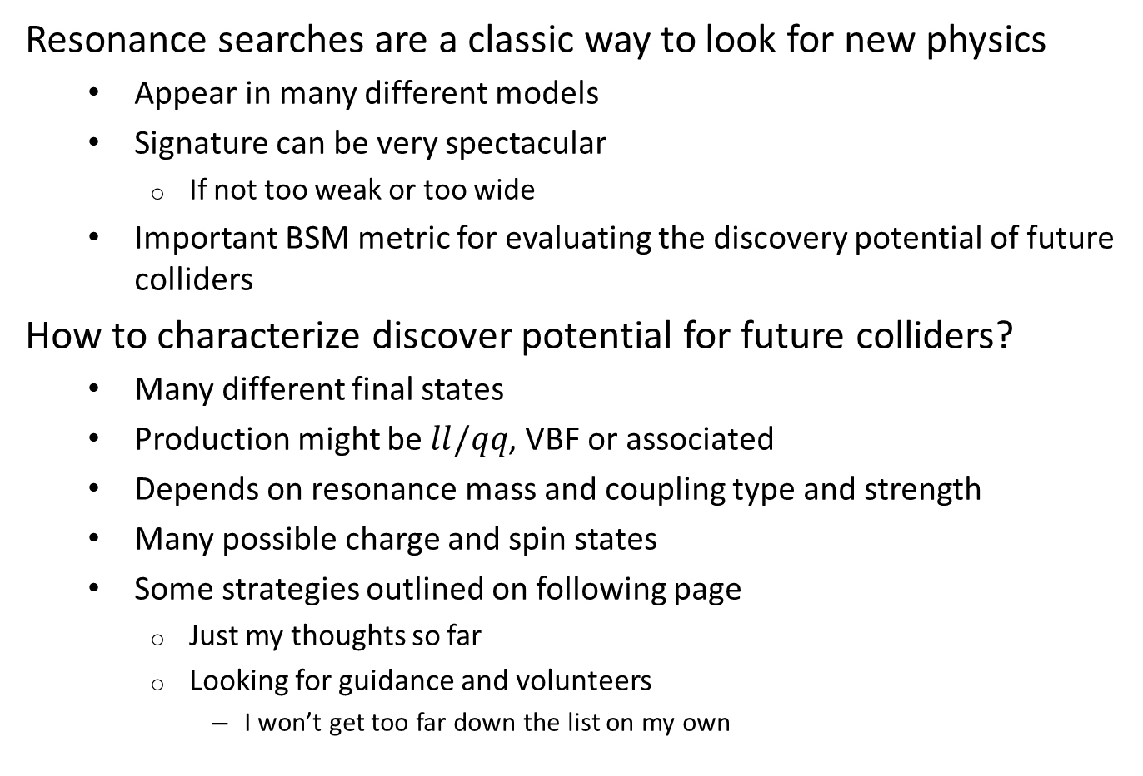
Introduction
Resonance searches are a classic way to look for new physics
  Appear in many different models
  Signature can be very spectacular
    If not too weak or too wide
  Important BSM metric for evaluating the discovery potential of future colliders
How to characterize discover potential for future colliders?
  Many different final states
  Production might be $ll/qq$, VBF or associated
  Depends on resonance mass and coupling type and strength
  Many possible charge and spin states
  Some strategies outlined on following page
    Just my thoughts so far
    Looking for guidance and volunteers
      I won’t get too far down the list on my own

Slide 3
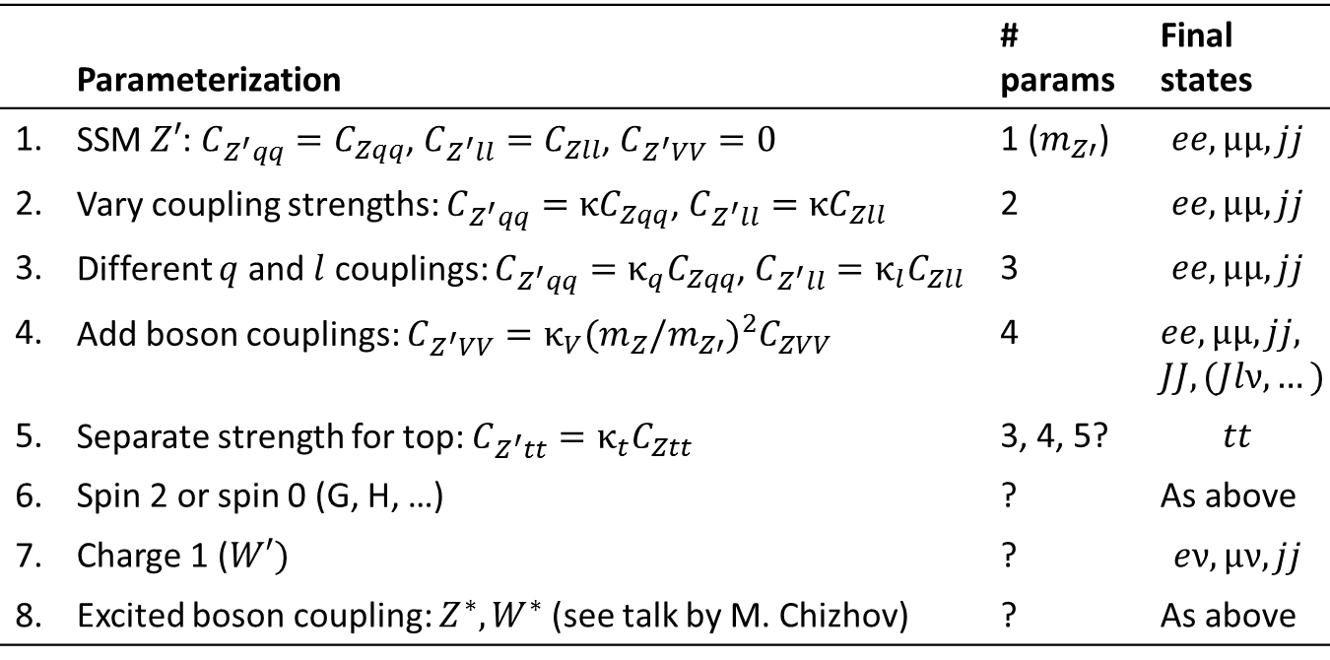
Parameterizing resonance searches
 | Parameterization | # params | Final states
1. | SSM $Z′$: $C_{Z^{′}qq}=C_{Zqq}$, $C_{Z^{′}ll}=C_{Zll}$, $C_{Z^{′}VV}=0$ | 1 ($m_{Z′}$) | $$ee, μμ, jj$$
2. | Vary coupling strengths: $C_{Z^{′}qq}={κC}_{Zqq}$, $C_{Z^{′}ll}={κC}_{Zll}$ | 2 | $$ee, μμ, jj$$
3. | Different $q$ and $l$ couplings: $C_{Z^{′}qq}={κ_{q}C}_{Zqq}$, $C_{Z^{′}ll}=κ_{l}C_{Zll}$ | 3 | $$ee, μμ, jj$$
4. | Add boson couplings: $C_{Z^{′}VV}={κ_{V}{(m_{Z}/m_{Z′})}_{}^{2}C}_{ZVV}$ | 4 | $ee, μμ, jj,$ $JJ, (Jlν, …)$
5. | Separate strength for top: $C_{Z^{′}tt}=κ_{t}C_{Ztt}$ | 3, 4, 5? | $$tt$$
6. | Spin 2 or spin 0 (G, H, …) | ? | As above
7. | Charge 1 ($W′)$ | ? | $$eν, μν, jj$$
8. | Excited boson coupling: $Z^{∗}, W^{∗}$ (see talk by M. Chizhov) | ? | As above
Which (if any) of the above would we like to study?

Slide 4
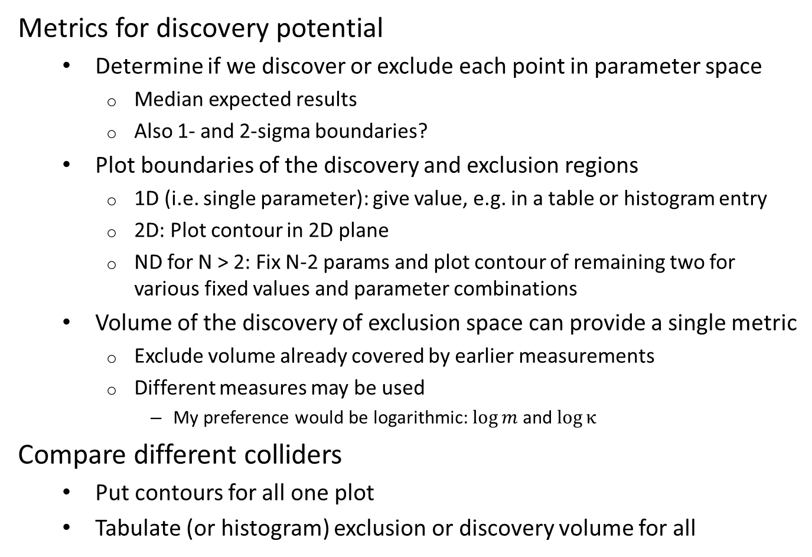
Presenting results
Metrics for discovery potential
  Determine if we discover or exclude each point in parameter space
    Median expected results
    Also 1- and 2-sigma boundaries?
  Plot boundaries of the discovery and exclusion regions
    1D (i.e. single parameter): give value, e.g. in a table or histogram entry
    2D: Plot contour in 2D plane
    ND for N > 2: Fix N-2 params and plot contour of remaining two for various fixed values and parameter combinations
  Volume of the discovery of exclusion space can provide a single metric
    Exclude volume already covered by earlier measurements
    Different measures may be used
      My preference would be logarithmic: $\log{m}$ and $\log{κ}$
Compare different colliders
  Put contours for all one plot
  Tabulate (or histogram) exclusion or discovery volume for all

Slide 5
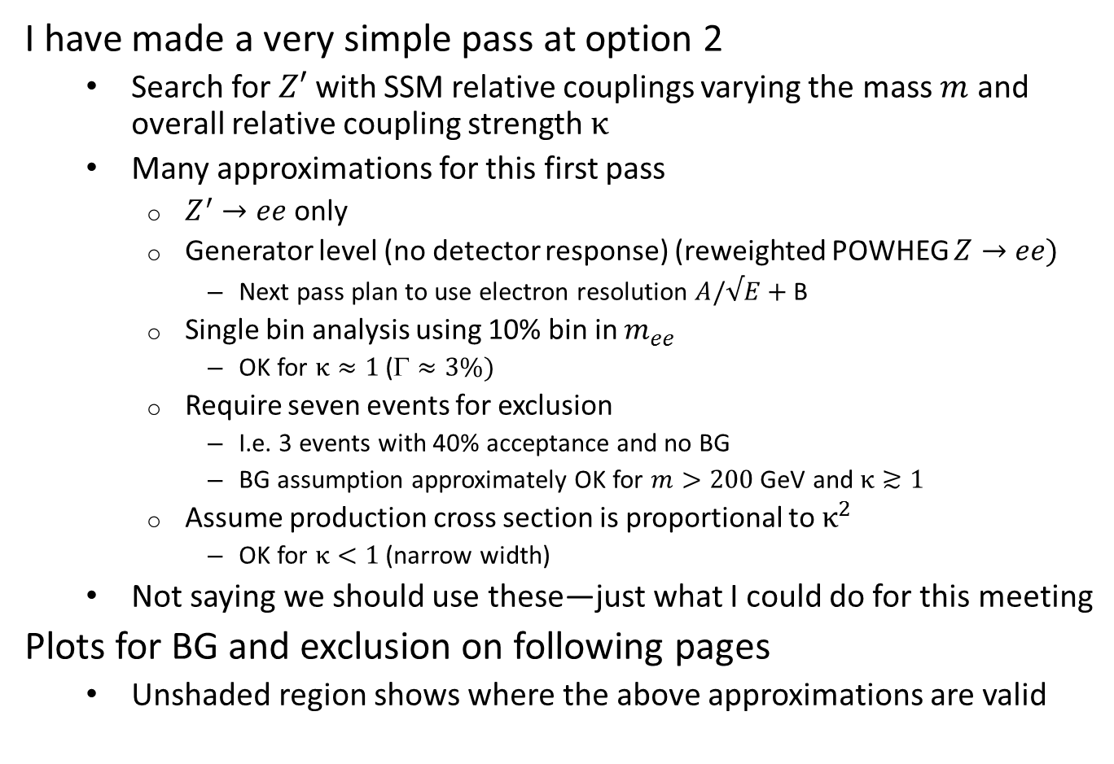
Current result
I have made a very simple pass at option 2
  Search for $Z′$ with SSM relative couplings varying the mass $m$ and overall relative coupling strength $κ$
  Many approximations for this first pass
    $Z^{′}→ee$ only
    Generator level (no detector response) (reweighted POWHEG $Z→ee)$
      Next pass plan to use electron resolution $A/√E+$ B
    Single bin analysis using 10% bin in $m_{ee}$
      OK for $κ≈1$ ($≈3\%)$
    Require seven events for exclusion
      I.e. 3 events with 40% acceptance and no BG
      BG assumption approximately OK for $m>200$ GeV and $κ≳1$
    Assume production cross section is proportional to $κ^{2}$
      OK for $κ<1$ (narrow width)
  Not saying we should use these—just what I could do for this meeting
Plots for BG and exclusion on following pages
  Unshaded region shows where the above approximations are valid

Slide 6
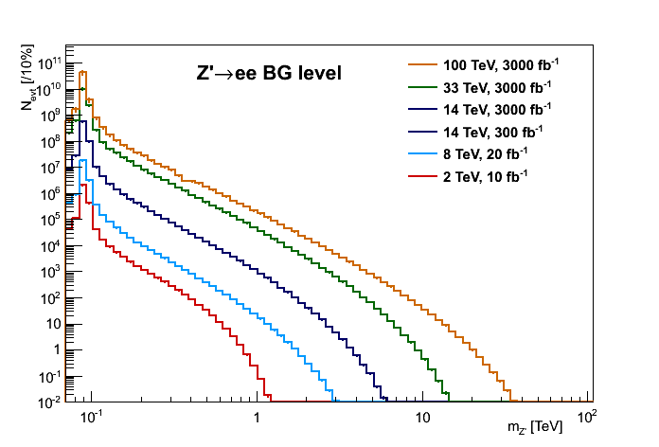

BG for $Z′→ee$ search
DY only

Slide 7
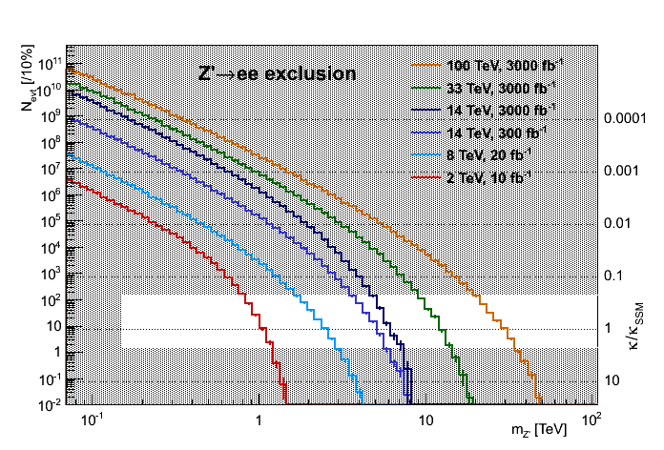

Exclusion contours for $Z′→ee$ search
Future collider options (pp only)
Starting point for options

Slide 8
Conclusions
Want to compare discovery potential for future collider options
  Resonance search is an important BSM process to include
Metrics proposed for comparing options
  Exclusion or discovery contours in a reduced parameter space
  Volume of the exclusion/discovery the new collider adds to existing knowledge (300 fb⁻¹ LHC)
Some parameterization options have been presented
  Which do we want to pursue?

