Slide 1

CMS E&O Activities
Marzena Lapka
on behalf of the CMS Communications Group

Slide 2
CMS E&O Activities
CMS Visits
ZOOOM: CMS visualised in 3D
Youngsters @CMS
CMS Public Data
Graphical uses of CMS public data format
CMS Google Earth videos

Slide 3
1. Visits to CMS - Number of visits
  Increase in visits to CMS, P5
  2011: 3 000
  2012: 10 384
  2013 : ~15-20 000 (estimation)

Slide 4
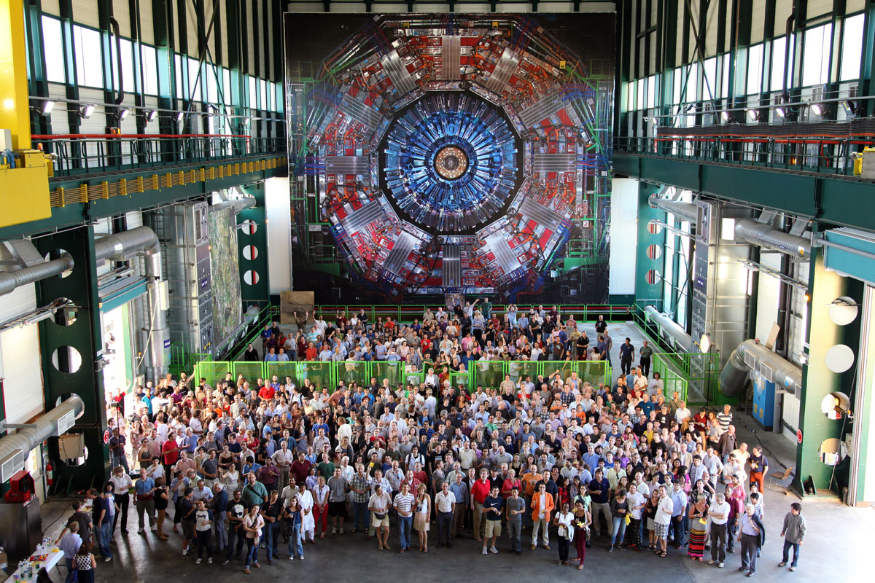
1. Visits to CMS - New objects
  CMS real
  size poster (surface hall)

Slide 5
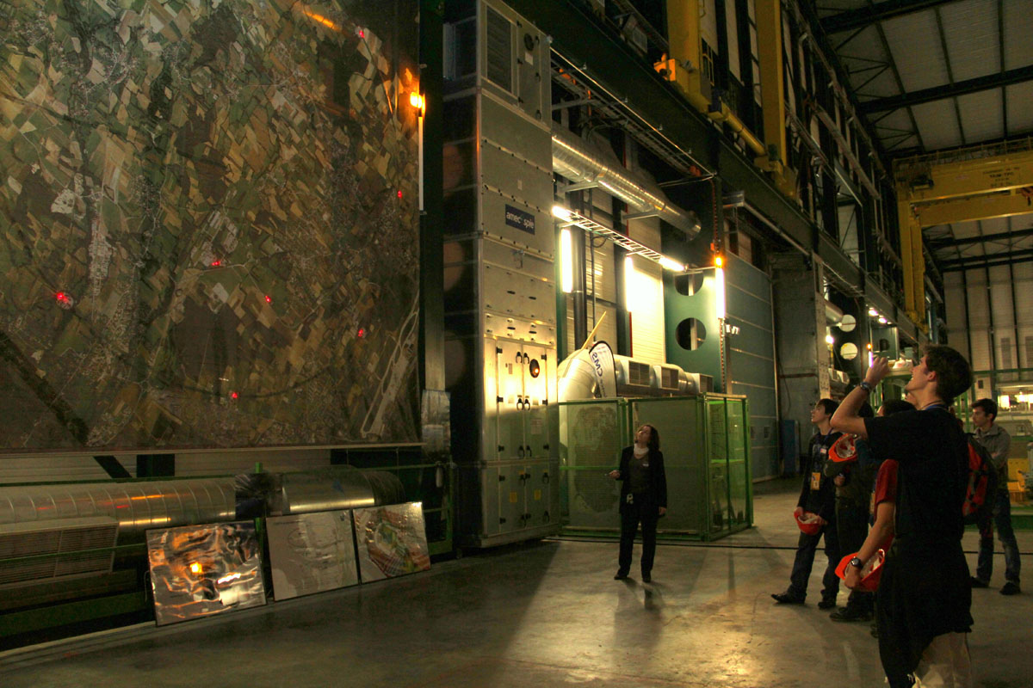
1. Visits to CMS - New objects
  LHC animated poster (surface hall)

Slide 6
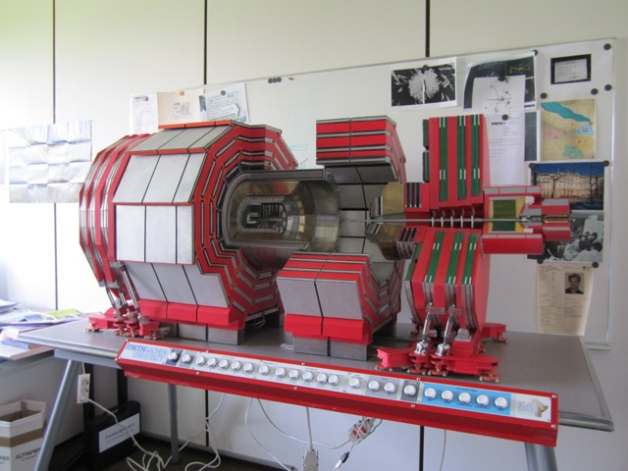
1. Visits to CMS – New objects
  1:20 CMS model
  Cost: 20 500 chf
Arrived this week!
  Provider:http://www.architectes.org/portfolios/maurice-frey-et-valerie-gobyn-architectes

Slide 7
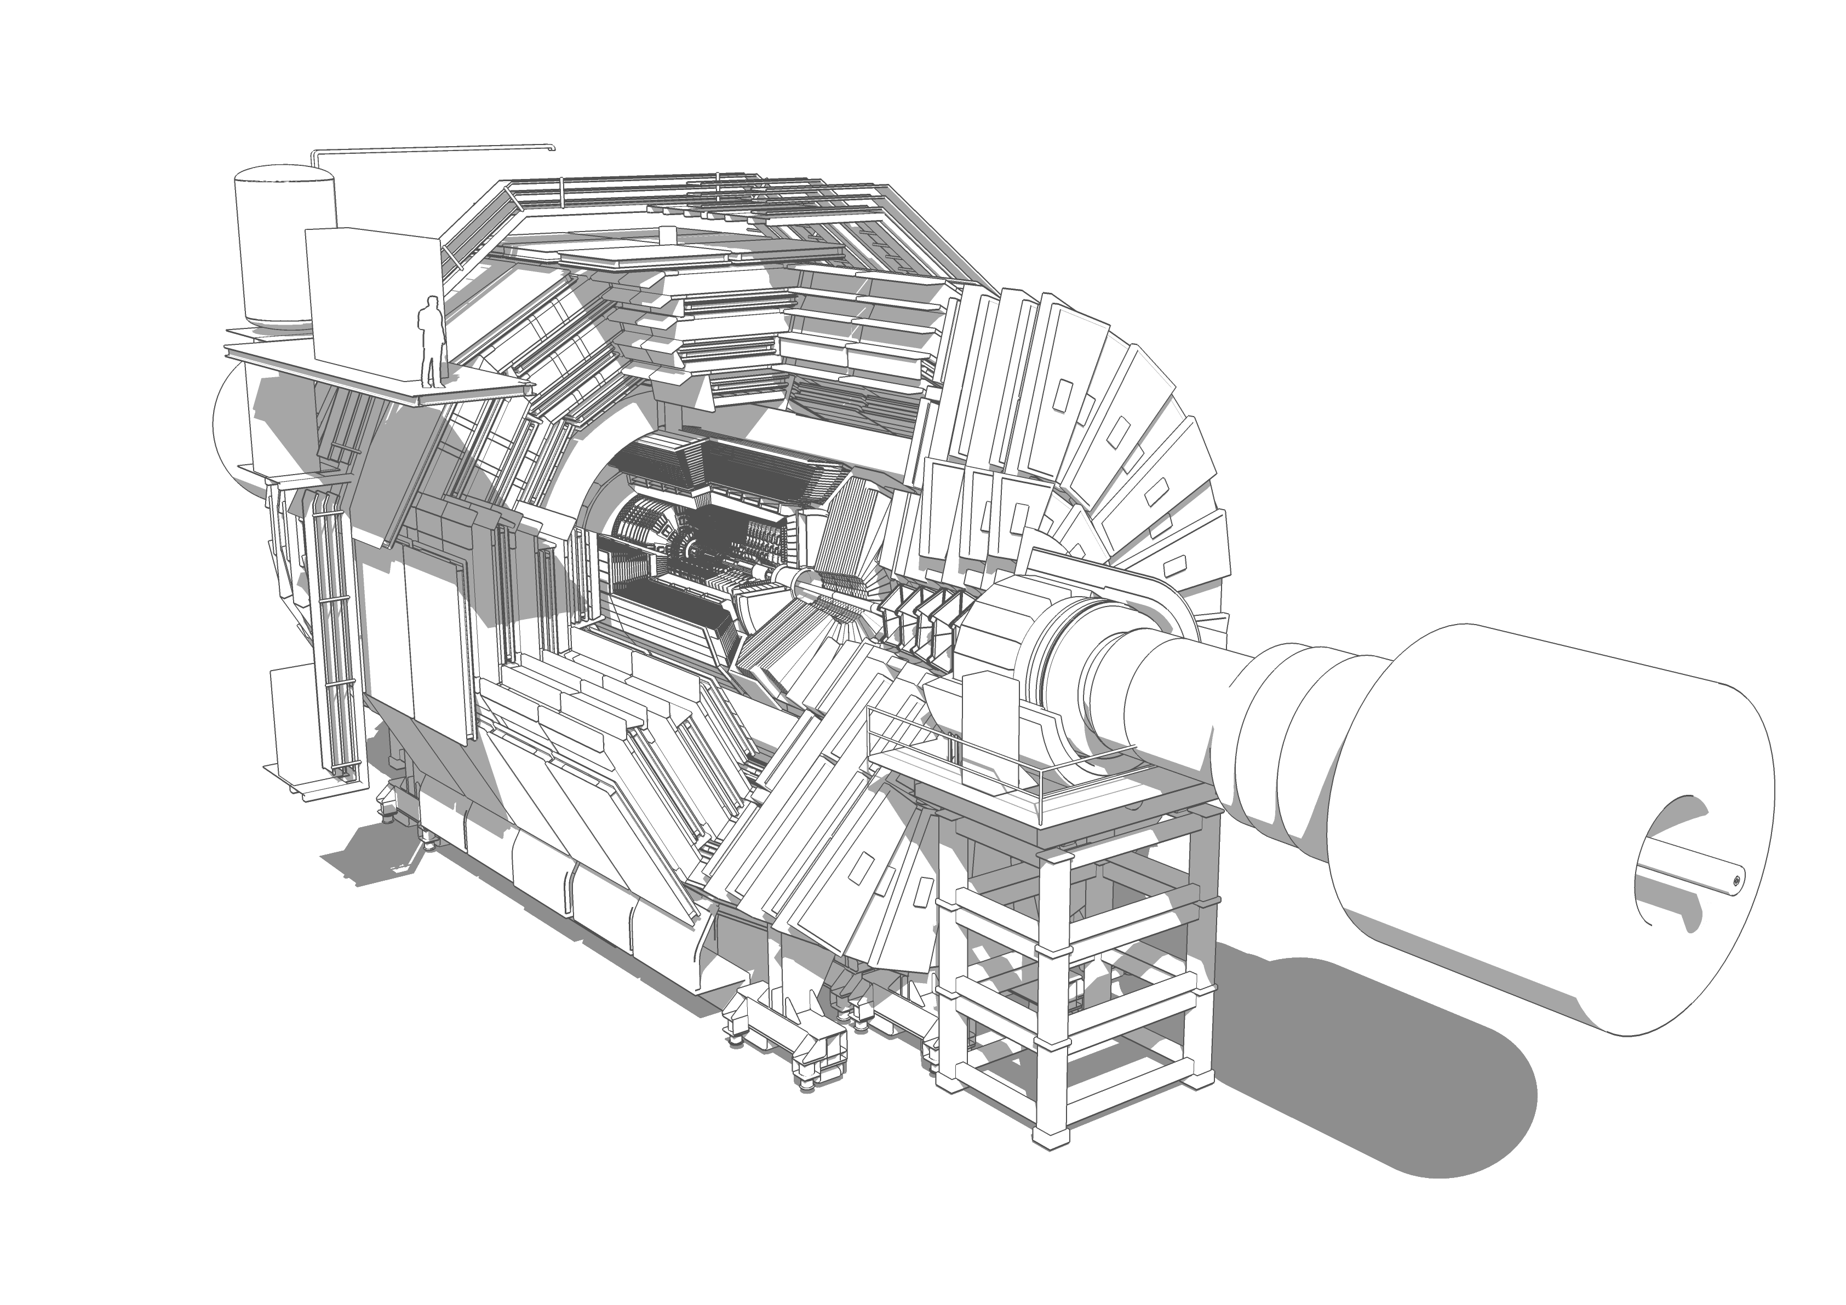
2. ZOOOM: CMS visualised in 3D
A series of ten CMS detector zooming-in SketchUp drawings.
To be used for:
Posters (exhibited @P5)
Formal documentation (papers, Technical Design Reports, etc.)
By Tai Sakuma
News article: http://cms.web.cern.ch/news/zooom-cms-visualised-3d

Slide 8
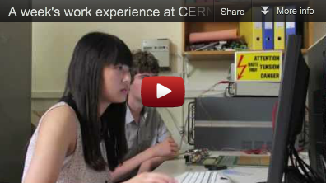
3. From CMS News: youngsters @CMS
2 articles:
An inspiring summer: from the diary of a CERN internhttp://cms.web.cern.ch/news/inspiring-summer-diary-cern-intern
A memorable week with CMShttp://cms.web.cern.ch/news/memorable-week-cms
Video on CMS YouTube: http://cern.ch/go/6NWg
Triggered interest from young people → emails asking how they could come for a short internship to CERN.

Slide 9
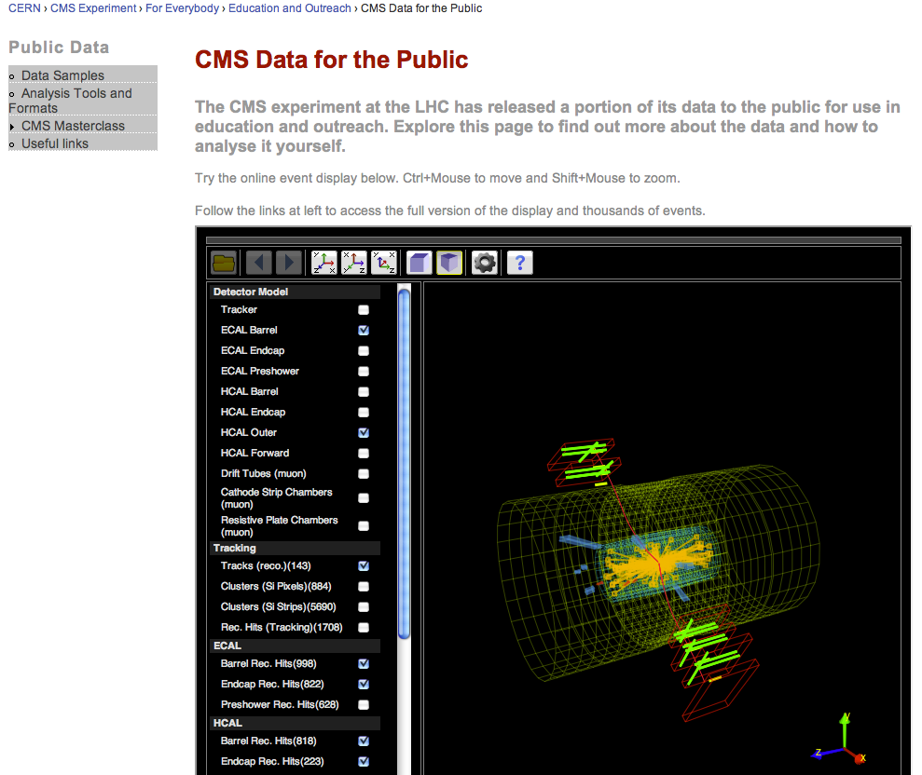
4. CMS Public Data
http://cms.web.cern.ch/content/cms-public-data
Higgs candidate data available soon! Watch this space…
Tutorial for CMS Collaboration

Slide 10
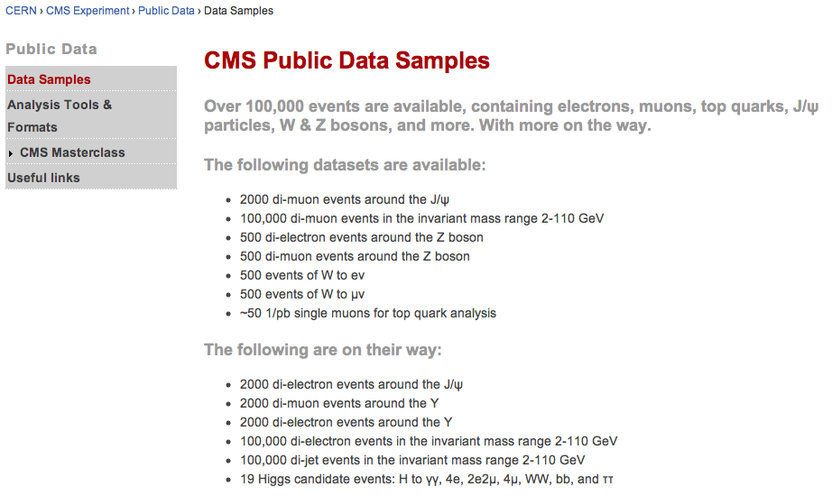
4. CMS Public Data
Used for Masterclass
measurements

Slide 11
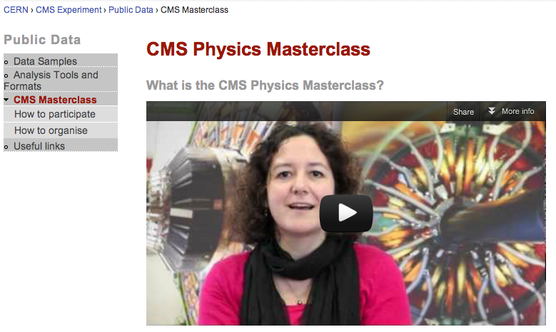
4. CMS Public Data
http://cms.web.cern.ch/content/cms-data-public
Tutorial for CMS Collaboration
Dave’s talk available in IPPOG database!

Slide 12
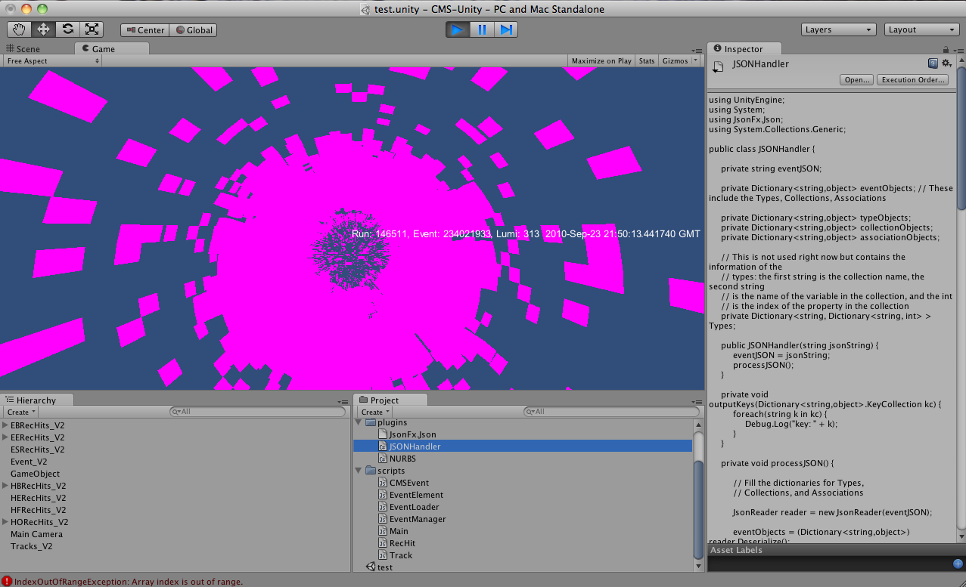
5. Graphical uses of CMS public data format
Public data format read (but not quite rendered, yet)
into Unity game engine (used to create CAMELIA)

Slide 13
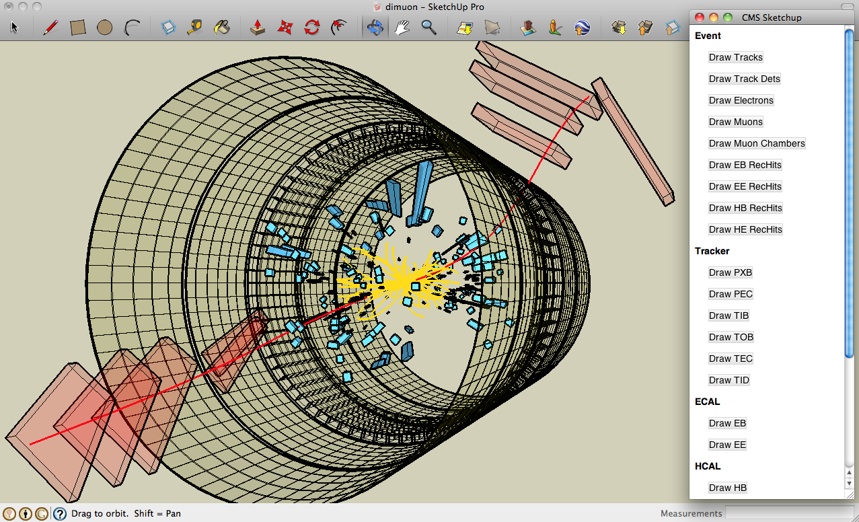
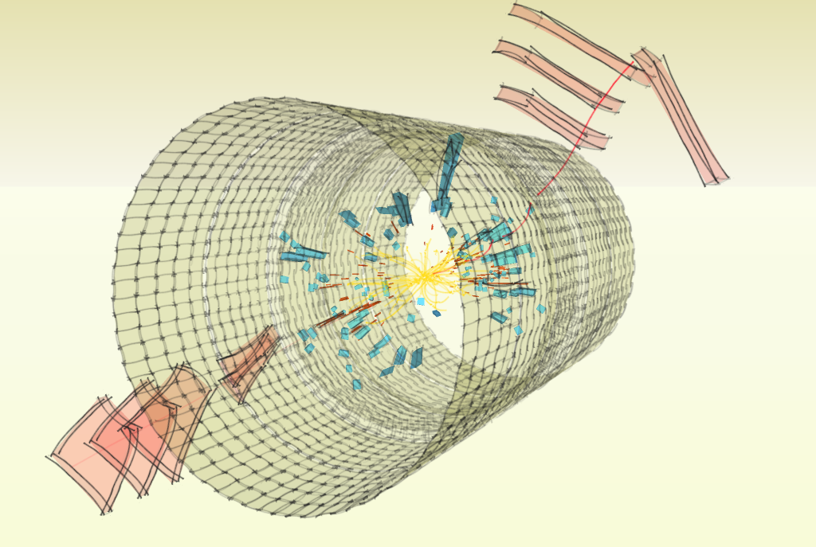
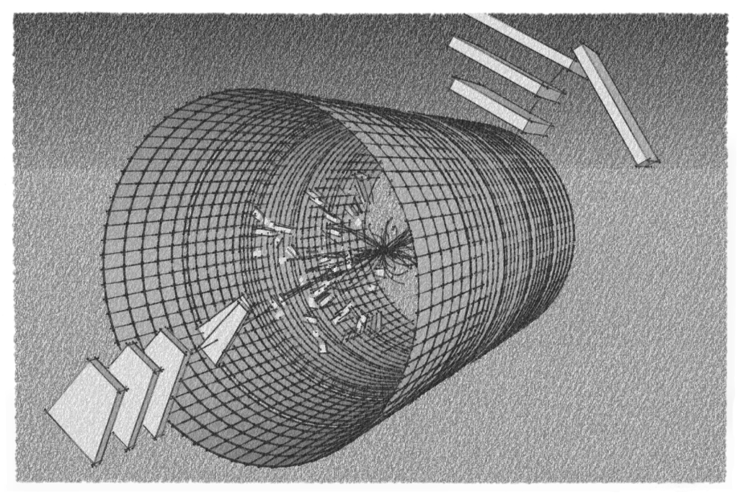
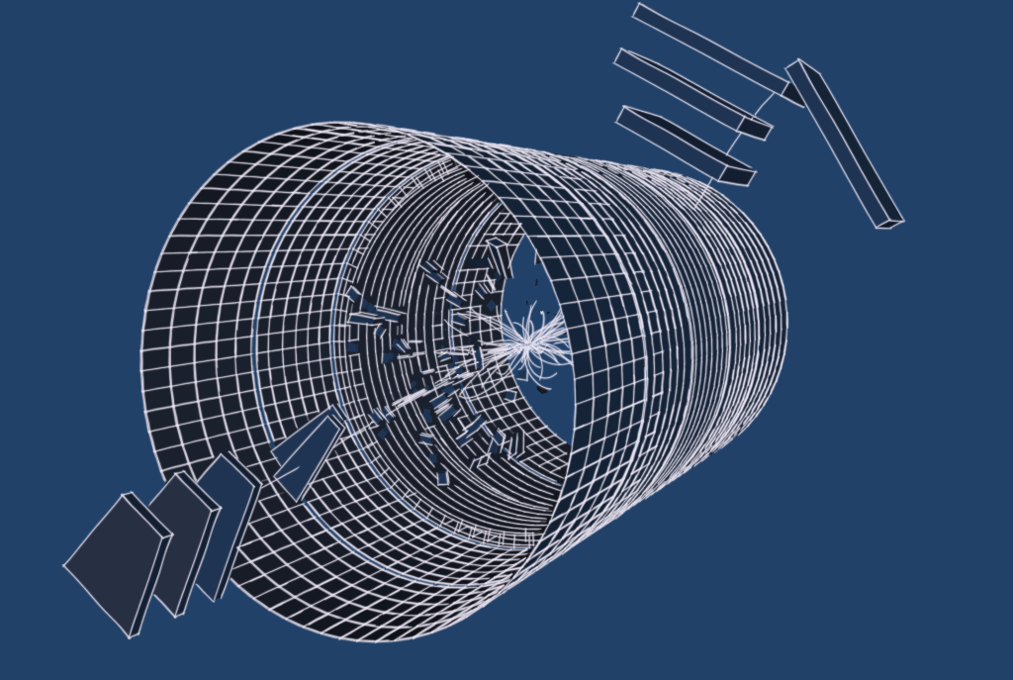
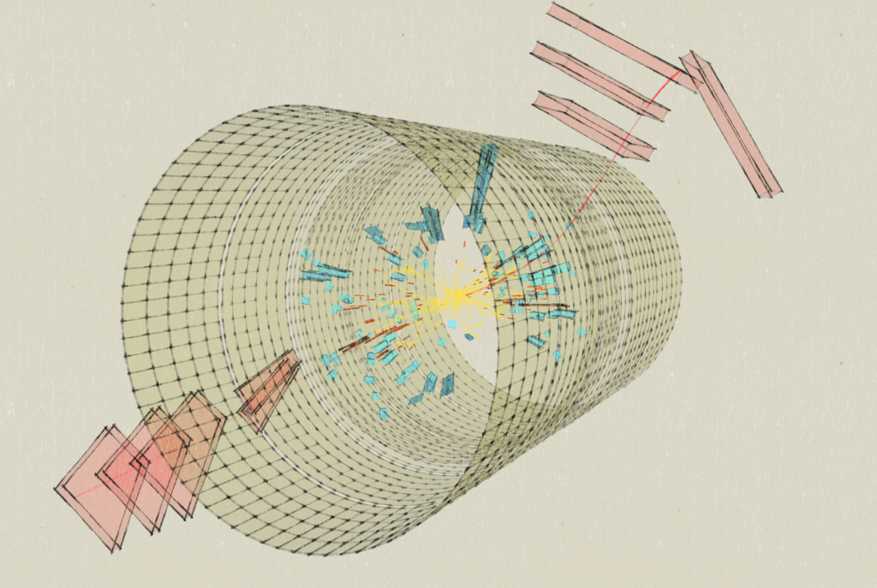
5. Graphical uses of CMS public data format
Public data format read and rendered into SketchUp (http://www.sketchup.com/ ):
detector geometry and event z information
Export to 3D models
Export to 2D images (including high res)
Animations
Various styles available e.g.
Ongoing collaboration with CERN media lab to
allow for CMS events in CAMELIA (and/or
CAMELIA-like applications)
Future applications: games, animations, etc.

Slide 14
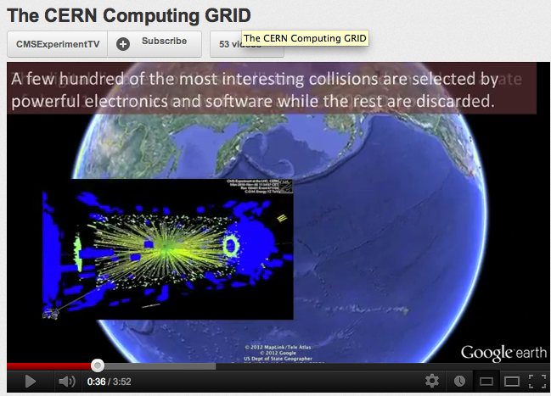

6. CMS Google Earth videos
For websites, exhibitions, etc.

Slide 15
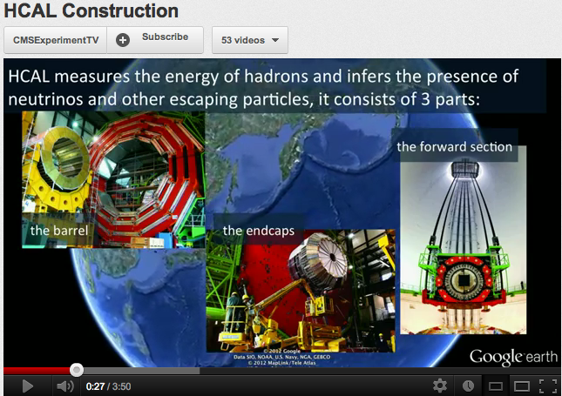
6. CMS Google Earth videos
For websites, exhibitions, etc.

Slide 16
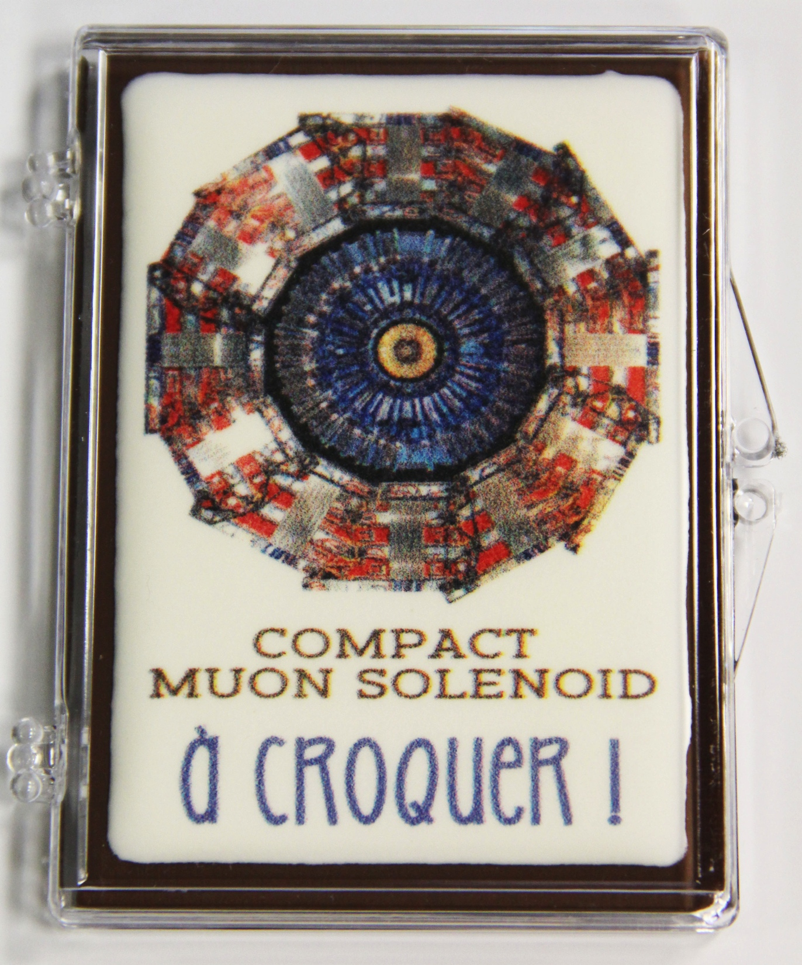
Thank you!
Any questions?

