Slide 1

Introduction, November 30th 2012
Dave Barney, Michael Kobel: IPPOG Co-chairs

Slide 2
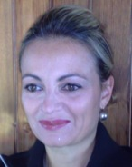
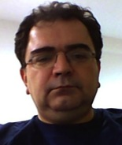
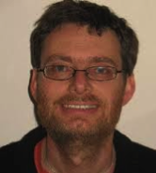
IPPOG Expansion
In 2012 we have invited TOTEM, Romania, Ireland, Israel, India
  TOTEM: Beatrice Bressan
  Romania: Gabriel Stoicea
  Ireland: Jonivar Skullerud
  Both Israel and India seeking appropriate member

Slide 3
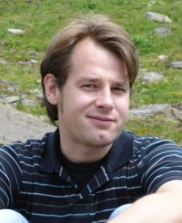
IPPOG Membership
Welcome to Sascha Caron, who
replaces Vanessa Mexner as IPPOG
Member for the Netherlands

Slide 4
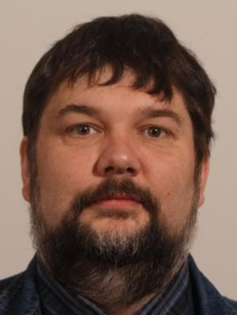
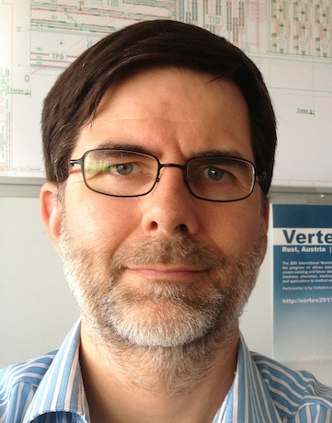
Welcome to our Guests
We also welcome Zoltan Szillasi
who is representing Hungary today
and Wolfgang Adam, representing
Austria in place of Laurenz (who joins
us via VIDYO)

Slide 5
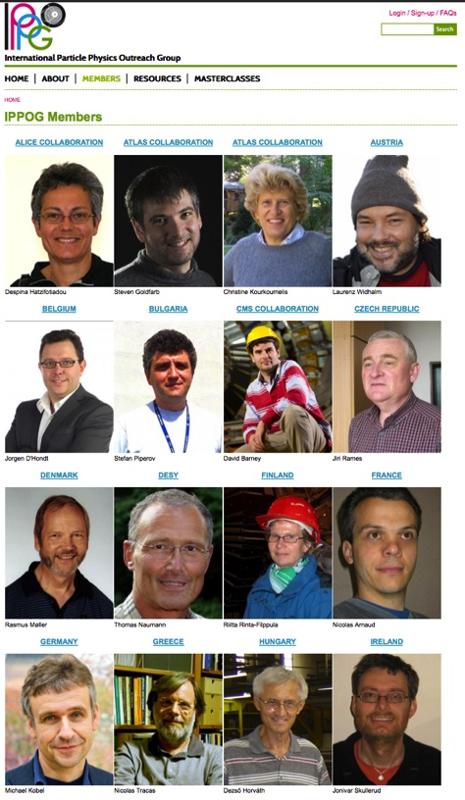
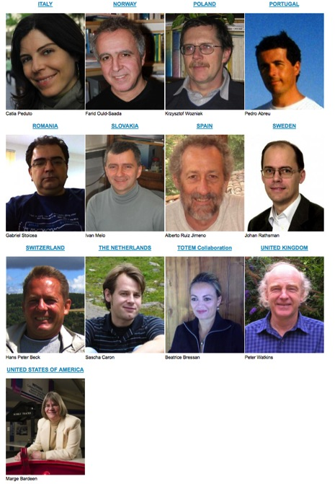
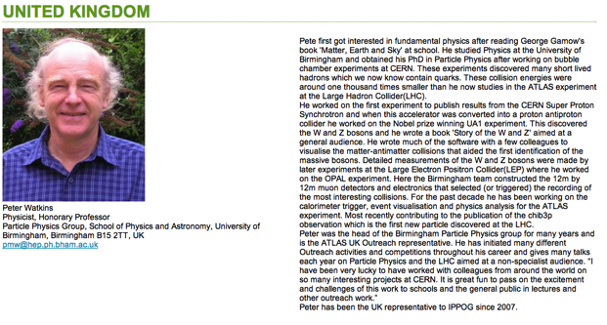
IPPOG Members Pages
New IPPOG Website includes
members page with profiles

Slide 6
Aims of this Meeting
IPPOG Activities
  Next steps with the Masterclasses
  Status of the working groups
    Higgs explanation
    IPPOG@conferences
  New national/international E&O activities
Election of new co-chairs

Slide 7
Dinner Tonight
At the Auberge Communale de Cessy at 7:30pm
Map at http://cern.ch/go/W67n
Bus leaves from CERN entrance B at 7pm; returns to CERN at 10:15pm

