Slide 1
Higgs Working Group Hans Peter Beck Bern University
Explaining the Higgs mechanism
or better – understand the Higgs mechanism
before disseminating oddities and flaws to the public

Slide 2
Priors
Discussion launched in Innsbruck
With the Higgs discovery imminent (Innsbruck was in April 2012), IPPOG members will need to be able to talk about the Higgs discovery, its purpose, what it is, how it works, etc. in many ways.
We were even thinking of producing animations and texts to explain the Higgs to the world.

Slide 3
Participants
Most active in the discussions were
Pete Watkins, Michael Kobel, Farid Ould Saada, Ivan Melo, Thomas Naumann, Nick Tracas, HPB, …
with some help from theorists – external to IPPOG
Robert Harlander, Dominik Stockinger, Frank Close
about 160 e-mails exchanged since Innsbruck!
Some informal meetings at CERN
over coffee tables, during lunch, …

Slide 4
How we did get started?
By asking a few questions to kick-off to some quite useful discussions
what is a 'particle' anyhow ?
what is the origin of mass?
what does it mean when physicists say that a particle is structureless ?
How can a structureless particle have mass at all ?
What is the Higgs mechanism?
for heavy bosons / and the massless photon
for fermions ?
How best to explain spontaneous symmetry breaking ?
What is the Higgs field and what is the Higgs particle ?

Slide 5
…and criticism from few
No names here…
Our discussions are too complex, do not lead to a useful description and/or animation that would be understandable by non-physicists. I.e. we are outside the scope of IPPOG
My answer in the next slide

Slide 6
Why such a complex discussion ?
If we physicists in IPPOG do not understand in depth what they are talking about among themselves, how should we be enabled to do outreach?
We realized that there are many subtle details in the concept and understanding of the Higgs mechanism that some/many of us never even were thinking about.
Still, these are VERY relevant in understanding the full picture.

Slide 7
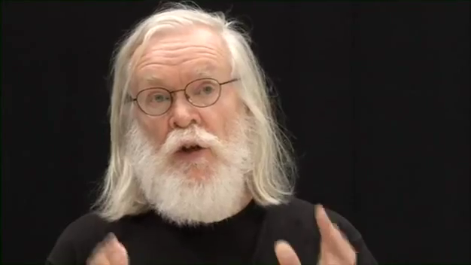
A video that triggered quite some discussions

Slide 8
One particular comment was
specially misleading t.o.h.o. is the sentence "The Higgs Boson has the Job of giving mass to all elementary particles". No, the Higgs field does! Likewise, the Higgs field is not "made out of ... Higgs Bosons" like snow is made out of snowflakes. At least not out of the "LHC's" Higgs Bosons we (probably) have found recently. That one is an *excitation* of the field. In the picture of the snow, it's rather like an avalanche, i.e. an excitation of the whole snow field. It is *not* responsible for giving mass to anything. (in david miller's party picture it's even more clear: a *clustering* of party guests is the Higgs Boson, i.e. an excitation of the party, the single party guests are not the Higgs Bosons we have been looking for at LHC) All particles have mass, even if there are zero Higgs Bosons excited in the whole universe. Exciting Higgs Bosons just makes us "see" the Higgs field, because a featureless homogenious field with quantum numbers of the vacuum cannot be seen directly.

Slide 9
What have we learned from all that?
We can’t be too religious about metaphors
The Higgs mechanism is complex and has a lot of deep going subtleties
Every metaphor being used (snow field, air, dinner party, molasses, …) has its own advantages and is often (i.e. always!?) flawed when trying to extract more from it than the presenter wanted to say/explain at first.

Slide 10
What should IPPOG do?
If we in IPPOG understand better the
Higgs mechanism
Mass generation of bosons and fermions
The role of the Higgs field before and after EWSB and where the Higgs boson comes into the game
Then we will be able to cope with any metaphor we encounter and that we are confronted with – in public!
We will talk with much more ease about the Higgs mechanism, its subtleties (if/when needed)
and also be able to explain the limits of given metaphors

Slide 11
What we don’t need to do
There is a lot of material on the Higgs already out there
Videos, Animations, Images, Metaphors, text
some good, some bad, some better, some worse
We should not reinvent the wheel!
But profit from what is already there
Only once we see a specific need for more material we should start thinking how to animate

Slide 12
A few examples
Is the Higgs field made out of virtual Higgses?
This caused a lot of debate
A quantum field is the stuff (medium) which permeats all space and this holds for the Higgs field, electron field, electromagnetic (photon) field and other fields. This field can be disturbed in a nice, regular manner and not so nice, irregular manner. The result of the regular manner is a wave with well defined frequency that propagates through the medium. The corresponding particle is the wave with the smallest possible intensity, the quantum of the field.
(Ivan)

Slide 13
A few examples
Is the Higgs field a new Ether?
In a way yes!
But this type of ether is Lorentz-invariant
it has nothing to do with being a medium for electromagnetic waves; i.e. not a carrier for light!
However, this Ether is there to allow particles to have mass
It fills space throughout the universe

Slide 14
An interesting web-site
http://profmattstrassler.com/articles-and-posts/particle-physics-basics/the-known-apparently-elementary-particles/the-known-particles-if-the-higgs-field-were-zero/

Slide 15
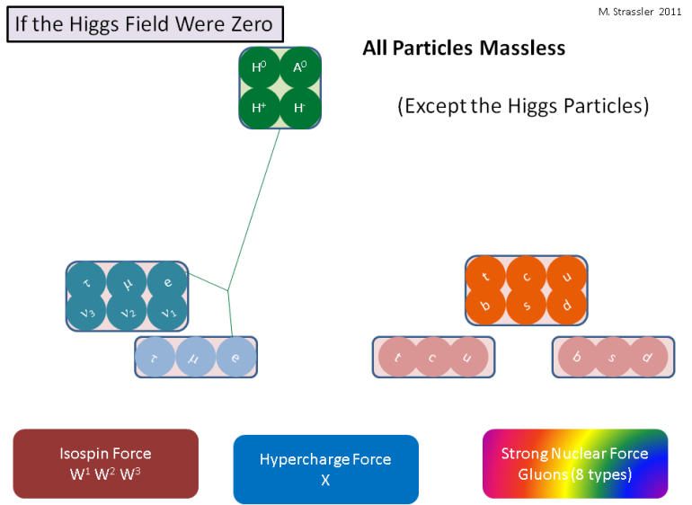

Slide 16
Next steps
HPB started a summary document, which is distributed among the core participants to this WG.
It will summarize the what we have learned during our discussions – which will for sure be battleground for more discussions.
Don’t worry – it is helpful for us in the end, and will make us better conveyors of the Higgs mechanism
It’s a compendium of Higgs metaphors being used and discusses their good points, what and how it can be used and how far it can be taken; i.e. where weaknesses start
It still needs more filling in of text
It’s use will be for us in IPPOG, and it will allow us to be better in discussions, question and answer with public or any audience

Slide 17
Conclusion
I had a lot of fun discussing the Higgs in much more detail than I usually would have in my daily life as a physicist
And I strongly believe this is true for all participating
We learned a lot, we improved our understanding
I don’t think we have concluded everywhere
…which means we will continue!
Don’t be shy participating, even if you have been silent up to now

