Slide 1

Introduction, November 30th 2012
Dave Barney, Michael Kobel: IPPOG Co-chairs

Slide 2
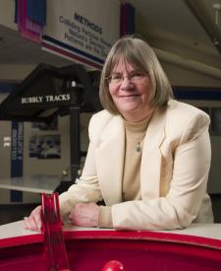
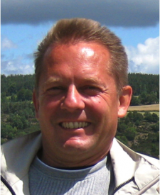
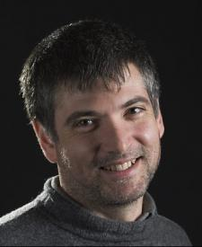
IPPOG Co-chair election
Three candidates
  Marge Bardeen
  Hans Peter Beck
  Steven Goldfarb

Slide 3
Election Procedure
Term of office is 3 years, starting January 1st 2013
Only IPPOG Members can vote
Each Member votes for 1st and 2nd place
  2 points for 1st place, 1 point for 2nd place
Candidates with highest numbers of points are elected

